Slide 1
Optimization of Two-dimensional Path Optimization Algorithm Based on Dijkstra Ant Colony Optimization Algorithm
Heng Guo, Qingquan Liu, Zhihui Dang.
2024 2nd International Conference on Signal Processing and Intelligent Computing(SPIC)
Presenter: Pei-Chian Lee
Date: Nov. 19, 2024

Slide 2
Abstract
To address the limitations of the traditional Dijkstra
algorithm in two-dimensional path optimization problems, this
article uses ant colony algorithm to optimize the Dijkstra
algorithm, solving the limitations of the Dijkstra algorithm that
requires path optimization in finite node graphs and is difficult
to traverse the best path that matches actual situations. Generate
initial path through Dijkstra algorithm and allocate pheromones
to the initial path through ant colony algorithm for iterative
calculation, ultimately converging to the optimal path. Through
MATLAB software simulation, the optimized Dijkstra-ant
algorithm was compared with the original algorithm, optimized
algorithm resulted in a better path.
Notes:
3a

Slide 3
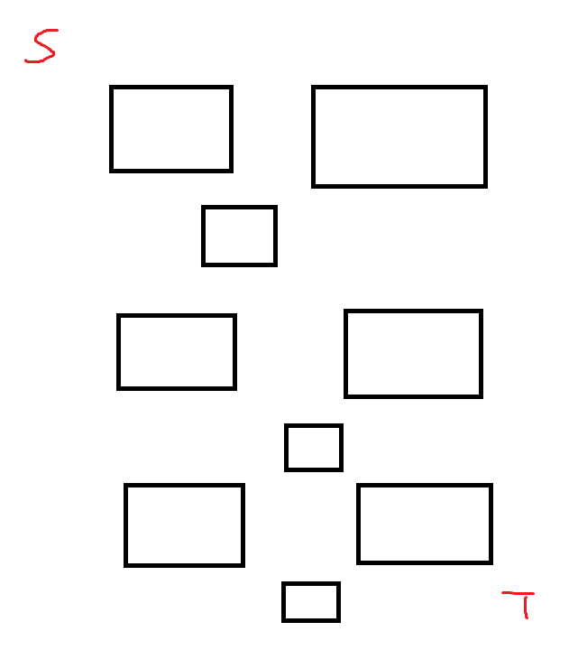
the difficulty of Dijkstra algorithm
Notes:
3b

Slide 4
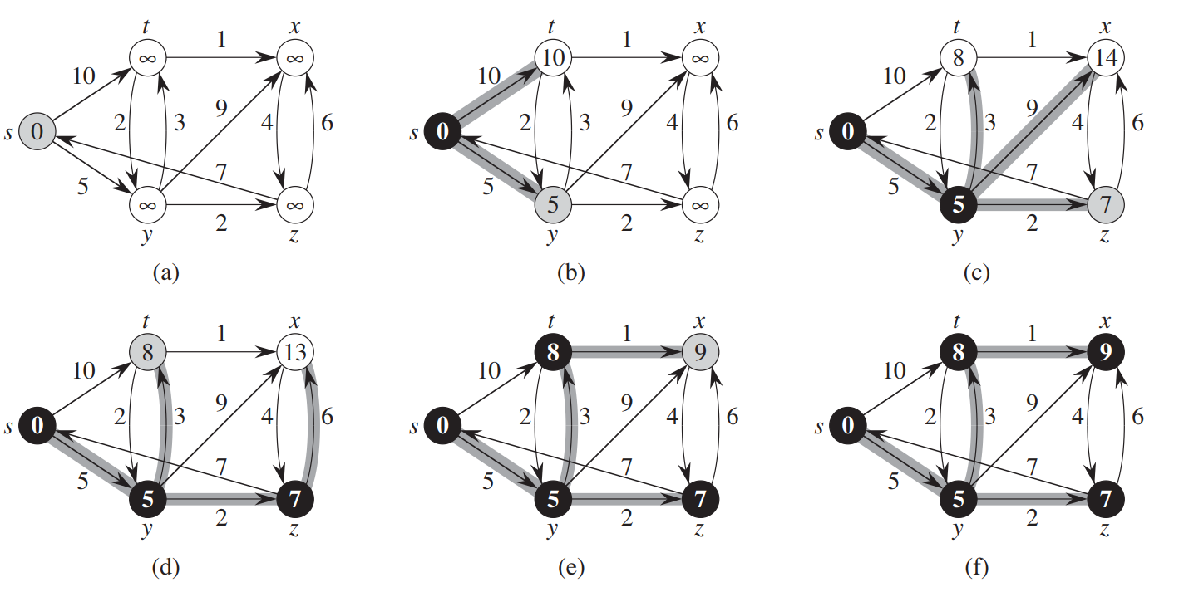
Dijkstra algorithm
Notes:
3b

Slide 5
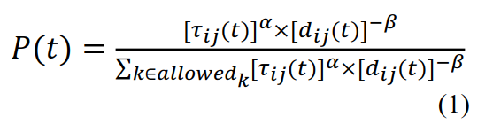
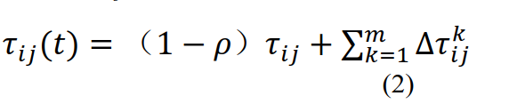
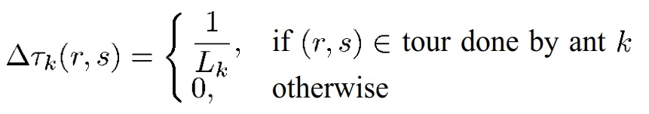
Ant colony algorithm

Slide 6
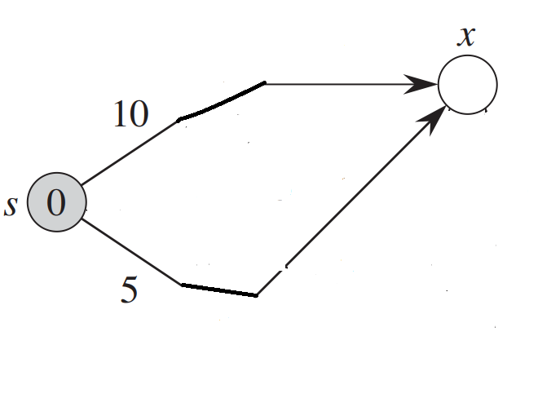


Ant colony algorithm
m = 3
𝜌 = 0.1
𝛼 = 1
𝛽 = 1
T = 500
$${\text{τ}}_{up}\left(2\right)=\left(1−0.1\right)∗1+1∗\frac{1}{11}=0.99…$$
$${\text{τ}}_{down}\left(2\right)=\left(1−0.1\right)∗1+2∗\frac{1}{14}=1.04…$$
$P_{up}(1)$ = $\frac{1^{1}\text{×}{10}^{−1}}{1^{1}\text{×}{10}^{−1}+1^{1}\text{×}5^{−1}}=\frac{1}{\begin{aligned}3 \\ \end{aligned}}$
$P_{down}(1)$ = $\frac{1^{1}\text{×}{10}^{−1}}{1^{1}\text{×}{10}^{−1}+1^{1}\text{×}5^{−1}}=\frac{2}{\begin{aligned}3 \\ \end{aligned}}$

Slide 7
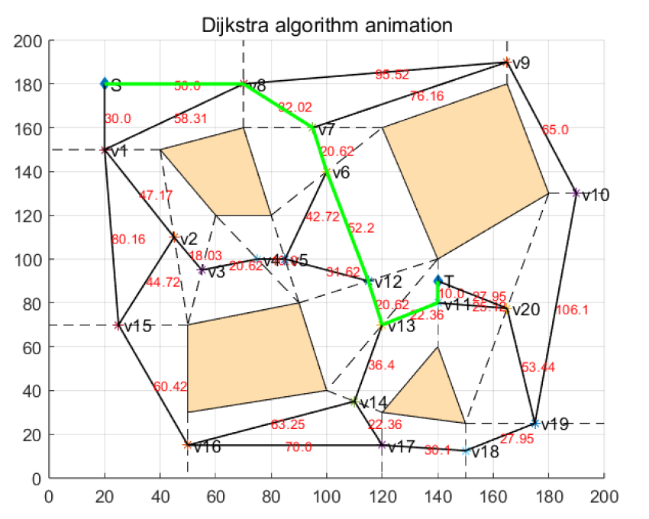
Exisiting Integer Hull Algorithm
Step1: Generate Dijkstra initial path.

Slide 8
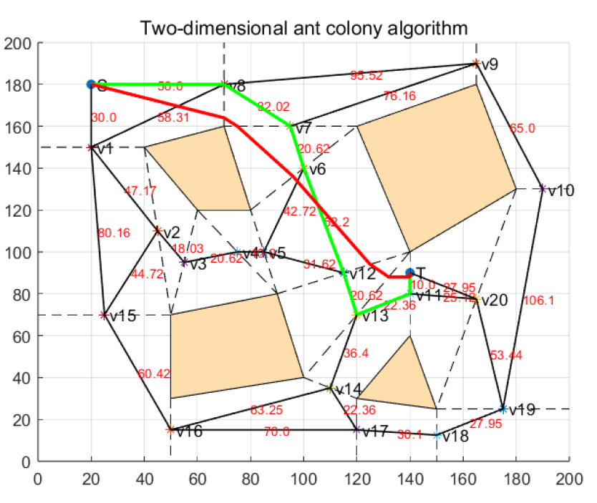
Algorithm Optimization Process
Step2: Use ant colony algorithm.
m = 20
𝜌 = 0.1
𝛼 = 1
𝛽 = 0.5
T = 500

Slide 9
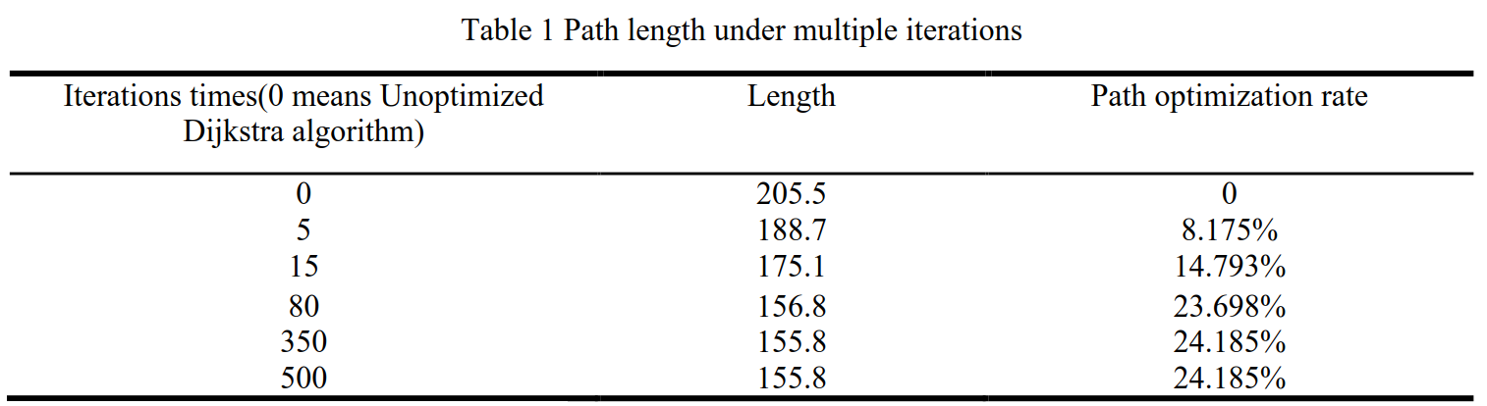
Result

Slide 10
Conclusions
Using ant colony algorithm to optimize Dijkstra
algorithm to solve two-dimensional path optimization
problems has a significant improvement compared to
traditional algorithms, and can converge to a better target path
at lower iterations.

