Slide 1
Fast computation of a longest increasing subsequence and application
Maxime Crochemore, Ely Porat
Information and computation 208.9 (2010): 1054-1059.
Presenter: Shih-Hong Lee
Date: Dec. 19, 2024

Slide 2
Abstract
We consider the complexity of computing a longest increasing subsequence (LIS) parameterised by the length of the output. Namely, we show that the maximal length k of an increasing subsequence of a permutation of the set of integers {1, 2,..., n} can be computed in time O(n log log k) in the RAM model, improving the previous 30-year bound of O(n log k). The algorithm also improves on the previous O(n log log n) bound. The optimality of the new bound is an open question. Reducing the computation of a longest common subsequence (LCS) between two strings to an LIS computation leads to a simple O(r log log k)-time algorithm for two sequences having r pairs of matching symbols and an LCS of length k.

Slide 3
Longest Increasing Subsequence
Given a sequence A = <1,5,3,7,6>
LIS of A = <1,3,6>, <1,5,7>, <1,5,6>

Slide 4
LIS with O(nlogn) solution
Given a sequence A = <4,6,2,8,1,3,12,9,5,7,11,10>
4 | 4
6 | 4,6
2 | 2,4,6
8 | 2,6,8
1 | 1,2,6,8
3 | 1,3,6,8
12 | 1,3,8,12
9 | 1,3,8,9,12
5 | 1,3,5,8,9
7 | 1,3,5,7,9
11 | 1,3,5,7,11
10 | 1,3,5,7,10,11

Slide 5
LIS with O(nloglogn) solution(1/2)
Given a sequence A = <12,8,9,1,11,6,7,2,10,4,5,3>
The sequence must be a permutation
Use van Emde Boas trees to implement the operations Insert, Delete, prev, and succ, each operation takes O(loglogn)

Slide 6
Given a sequence A = <12,8,9,1,11,6,7,2,10,4,5,3>
LIS of A length = 4, ans = <1,2,4,5>, <1,6,7,10>
initial
12 | 12
8 | 8,12
9 | 8,9
1 | 1,8,9
11 | 1,9,11
6 | 1,6,9,11
7 | 1,6,7,11
2 | 1,2,6,7
10 | 1,2,7,10
4 | 1,2,4,7,10
5 | 1,2,4,5,10
3 | 1,2,3,4,5
End | 1,2,3,4,5
Notes:
答案可以透過 traceback的方式

Slide 7

Main algorithm
Given a sequence S = <12, 8, 9, 1, 11, 6, 7, 2, 10, 4, 5, 3>, and m = 4
C₁ = <12, 8, 9, 1> $C_{1}^{s}$ = <1, 8, 9, 12>
C₂ = <11, 6, 7, 2> $C_{2}^{s}$ = <2, 6, 7, 11>
C₃ = <10, 4, 5, 3> $C_{3}^{s}$ = <3, 4, 5, 10>
Key of C₁ = (d, b, c, a)

Slide 8
C₁ = <12, 8, 9, 1>
Key(C₁) = (d, b, c, a)
start
12 | d
8 | b, d
9 | b, c
1 | a, b, c
End | a,c

Slide 9
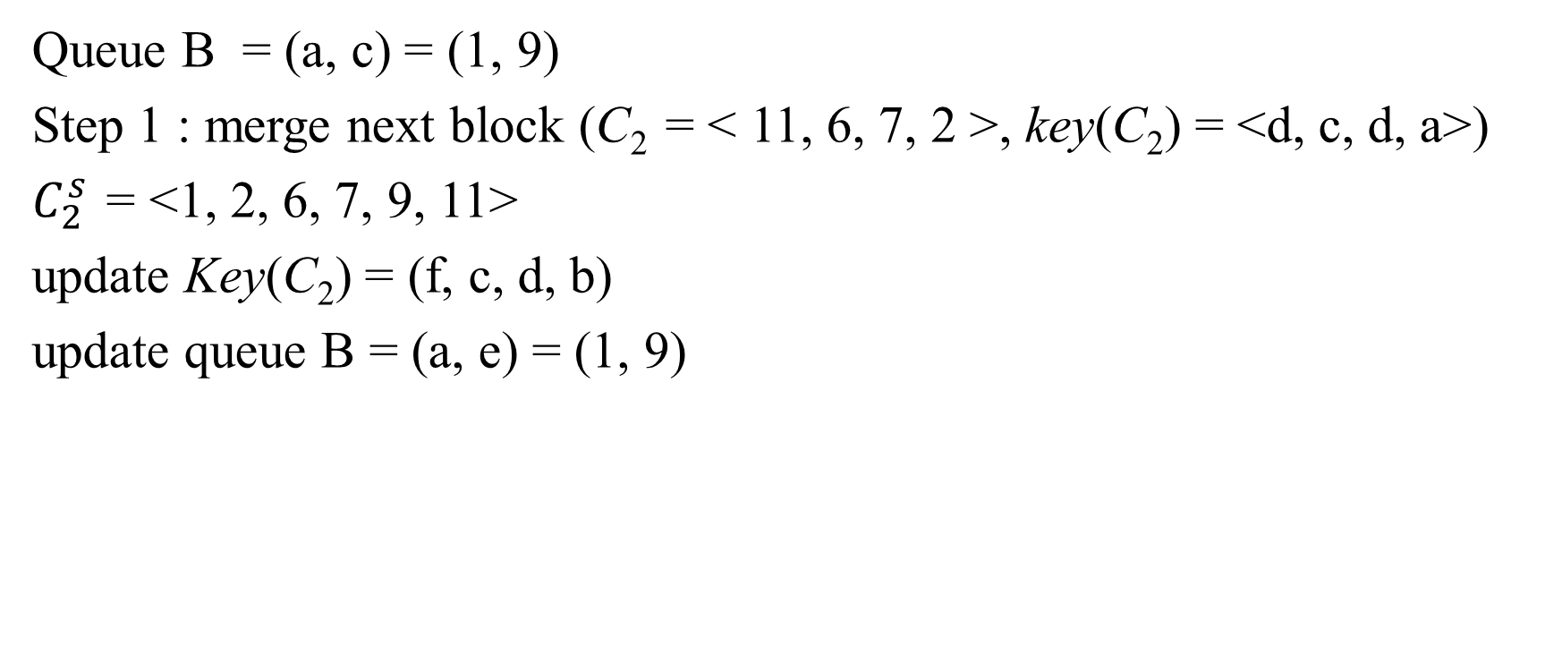
Queue B = (a, c) = (1, 9)
Step 1 : merge next block (C₂ = < 11, 6, 7, 2 >, key(C₂) = <d, c, d, a>)
$C_{2}^{s}$ = <1, 2, 6, 7, 9, 11>
update Key(C₂) = (f, c, d, b)
update queue B = (a, e) = (1, 9)
start | a, e
11 | a, e, f
6 | a, c, e, f
7 | a, c, d, f
2 | a, b, c, d
end | a, b, d

Slide 10

Queue B = (a, b, d) = (1, 2, 7)
Step 1 : merge next block (C₃ = < 10, 4, 5, 3 >, key(C₂) = <d, b, c, a>)
$C_{3}^{s}$ = <1, 2, 3, 4, 5, 7, 10>
update Key(C₃) = (g, d, e, c)
update queue B = (a, b, f) = (1, 2, 7)
Length of LIS(S) = 4 ending with 5
start | a, b, f
10 | a, b, f, g
4 | a, b, d, f, g
5 | a, b, d, e, g
3 | a, b, c, d, e
end | a, b, c, e

Slide 11
Time Complexity (1/2)
Radix sort : O(n)
Insert, delete, update with van Emde Boas trees : O(log log m)

Slide 12

Time Complexity (2/2)
while (Queue B >=m_{i}) {
i++;
m_{i} = m_{i-1}^{log mi-1}
LIS_{m}(S)
}
m < k^{log k}
log log m < 2 log log k
Time complexity : O(nloglogk)

Slide 13

Computing a longest common subsequence
Given two strings x = ababa and y = aabba
p(x[1]) = (5, 2, 1)
p(x[2]) = (4, 3)
S(x, y) = p(x[1]) p(x[2]) ··· p(x[n])
S(ababa, aabba) = (5, 2, 1, 4, 3, 5, 2, 1, 4, 3, 5, 2, 1)
why decreasing?
e.g. x = ab y = abb S(x,y) = 123 LIS(S(x,y)) = 123(abb) wrong
Not a permutation -> change to permutation

Slide 14
Computing a longest common subsequence
x = ababa y = aabba
S(ababa, aabba) = (5, 2, 1, 4, 3, 5, 2, 1, 4, 3, 5, 2, 1)
Pairs: (5, 3), (2, 3), (1, 3), (4, 2), (3, 2), (5, 2),
(2, 2), (1, 2), (4, 1), (3, 1), (5, 1), (2, 1), (1, 1)
Rename: (13, 6, 3, 10, 8, 12, 5, 2, 9, 7, 11, 4, 1)

Slide 15
Time Complexity
O(mnloglogk)

Slide 16
Thanks

