Slide 1
Association rule mining to detect factors which contribute to heart disease in males and females
Jesmin Nahar, Tasadduq Imam, Kevin S. Tickle, Yi-Ping Phoebe Chen.
Expert Systems with Applications
Vol. 40, 2013, 1086-1093
Presenter: Wan-Ni Ou
Date: Nov. 26, 2024
Notes:
a Faculty of Arts, Business, Informatics and Education, Central Queensland University, Queensland, Australia bDepartment of Computer Science and Computer Engineering, La Trobe University, Melbourne, Victoria 3086, Australia

Slide 2
Abstract(1/2)
This paper investigates the sick and healthy factors which contribute to heart disease for males and females. Association rule mining, a computational intelligence approach, is used to identify these factors and the UCI Cleveland dataset, a biological database, is considered along with the three rule generation algorithms – Apriori, Predictive Apriori and Tertius. Analyzing the information available on sick and healthy individuals and taking confidence as an indicator, females are seen to have less chance of coronary heart disease then males. Also, the attributes indicating healthy and sick conditions were identified. It is seen that factors such as chest pain being asymptomatic and the presence of exercise-induced angina indicate the likely existence of heart disease for both men and women.

Slide 3
Abstract(2/2)
However, resting ECG being either normal or hyper and slope being flat are potential high risk factors for women only. For men, on the other hand, only a single rule expressing resting ECG being hyper was shown to be a significant factor. This means, for women, resting ECG status is a key distinct factor for heart disease prediction. Comparing the healthy status of men and women, slope being up, number of coloured vessels being zero, and oldpeak being less than or equal to 0.56 indicate a healthy status for both genders.

Slide 4
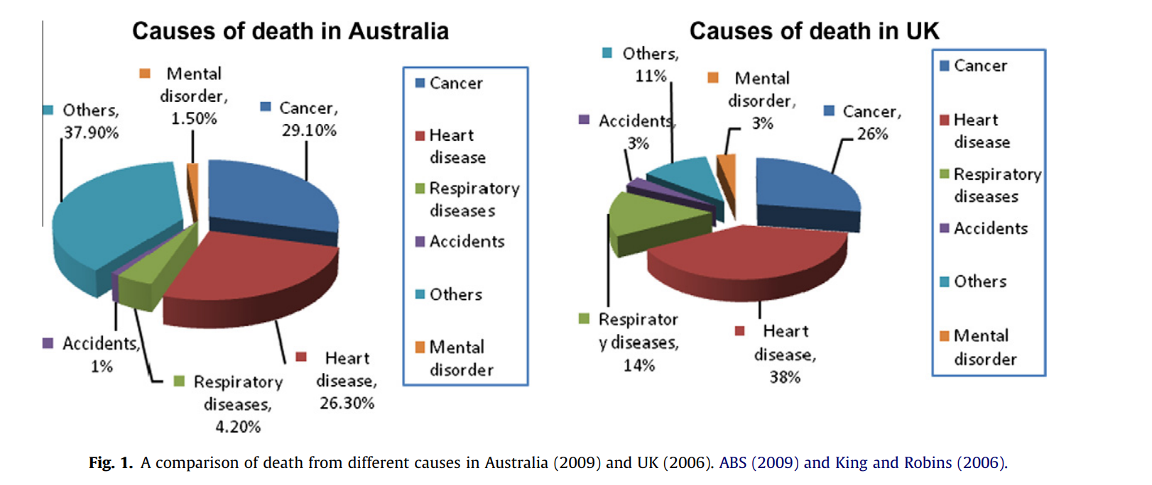
Contai

Slide 5
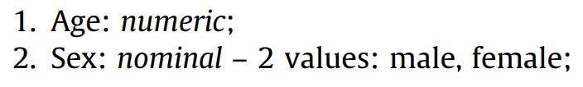
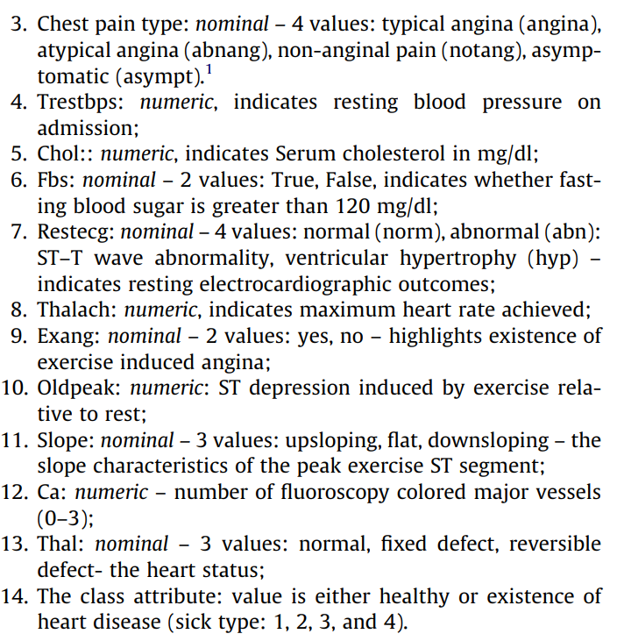
Data set
UCI heart disease dataset
Features: 14
Algorithms
Apriori
Predictive Apriori
Tertius

Slide 6
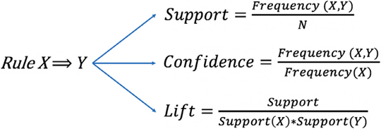
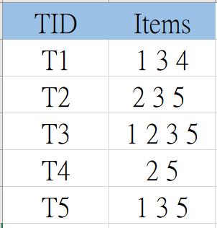
Association rule
support( {3, 5} ) = 3/5 = 60%
confidence({3, 5} ⭢ {2} ) = 2/3 = 66%

Slide 7
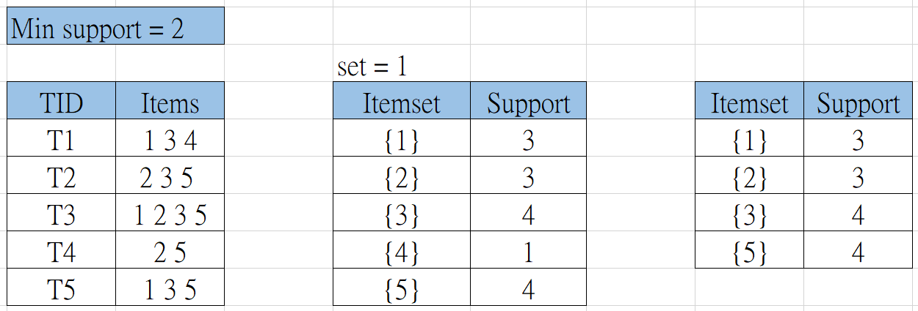
Apriori Algorithm(1/4)
Contai

Slide 8
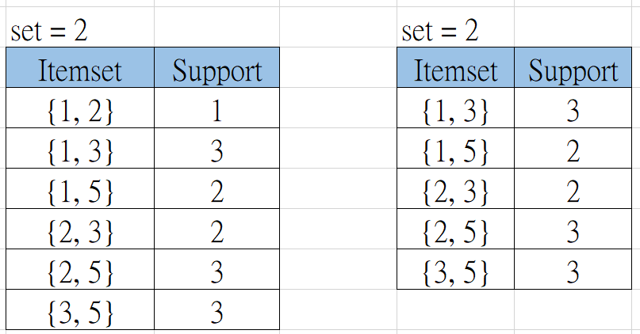
Apriori Algorithm(2/4)
Contai

Slide 9
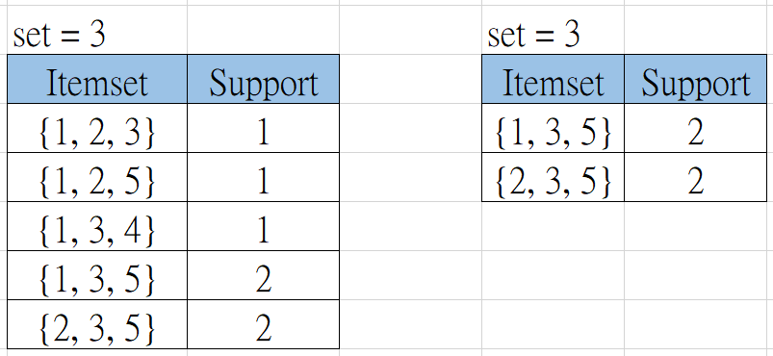
Apriori Algorithm(3/4)
Contai

Slide 10
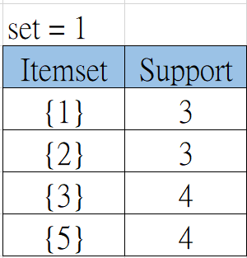
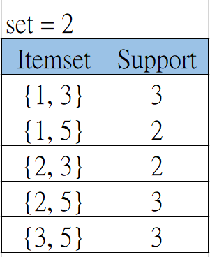
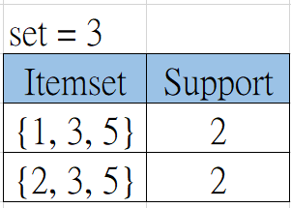
Apriori Algorithm(4/4)
Confidence( {3, 5} ⭢ {1}) = support({1, 3, 5}) / support({3, 5}) = 2/3 = 66%
Notes:
接下來會講

Slide 11
Predictive Apriori
Not only considers confidence but also support while ranking the rules.
without relying on fixed support or confidence thresholds.
dynamically adjusts the minimum support threshold.
Rule 1: {1} ⭢ {3}
Rule 2: {5} ⭢ {2}
Rule 1: supp = 3, conf = 3/3
Rule 2: supp = 4, conf = 4/4
Rank: Rule 2 > Rule 1
4

Slide 12
Tertius
Unexpectedness
e.g. {age > 60} ⭢ {blood pressure = high} // 不稀有
{having an apple everyday} ⭢ {blood pressure = low} // 稀有
Fraction of expected counter-instances
e.g. {age < 40} ⭢ {heart disease probability = low}
反例：age < 30, but has heart disease.

Slide 13
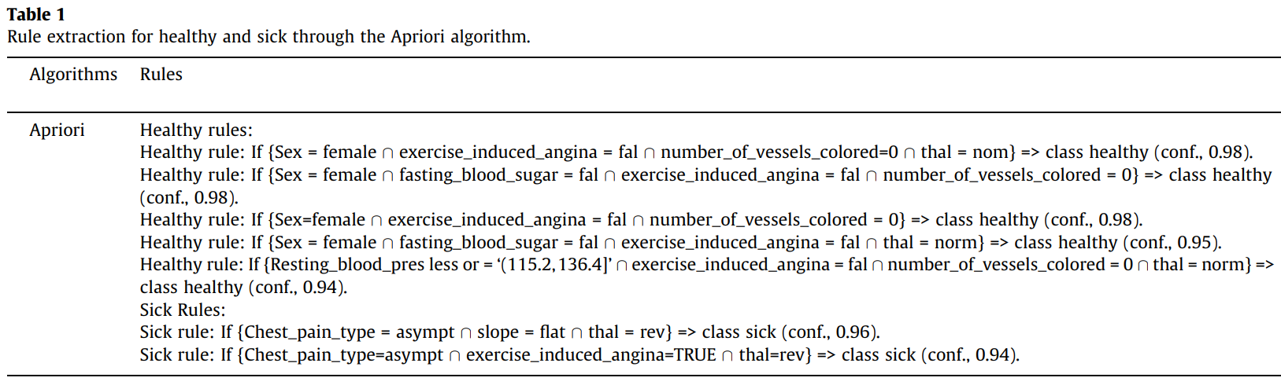
Results(1/5)
Contai

Slide 14
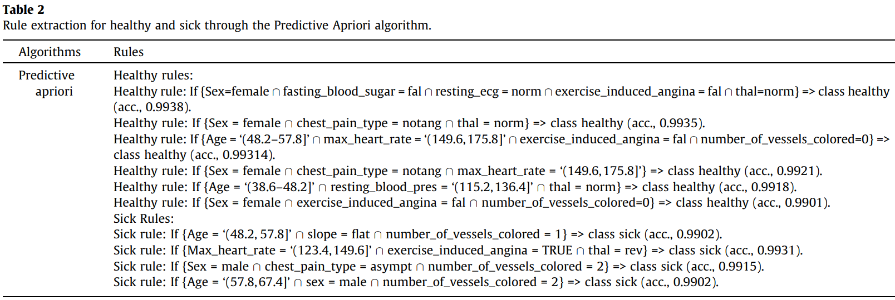
Results(2/5)
Contai

Slide 15
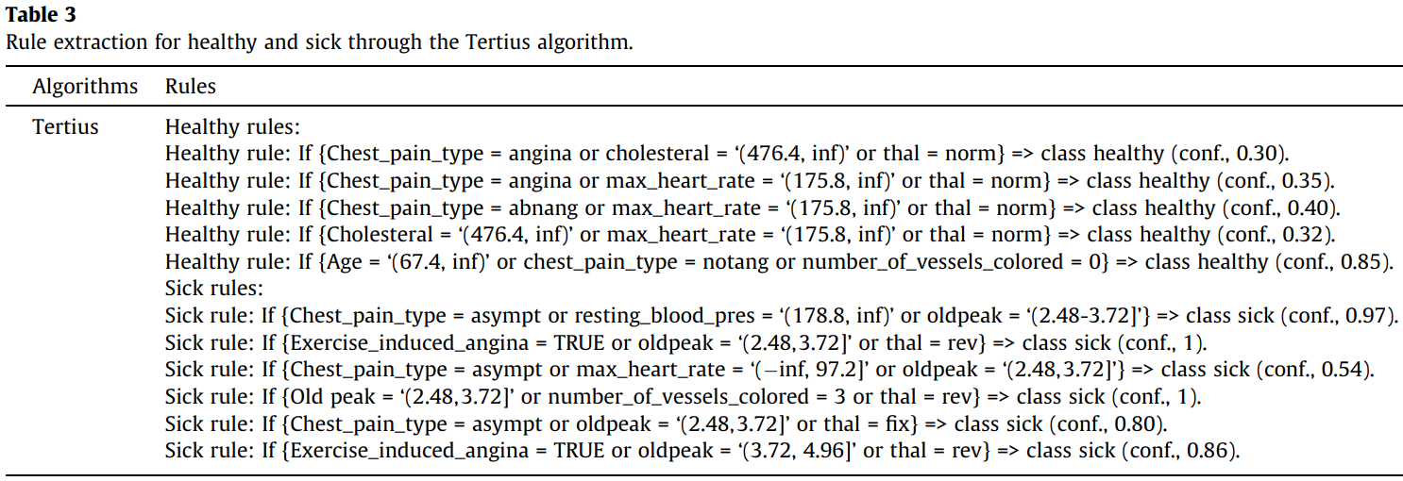
Results(3/5)
Contai

Slide 16
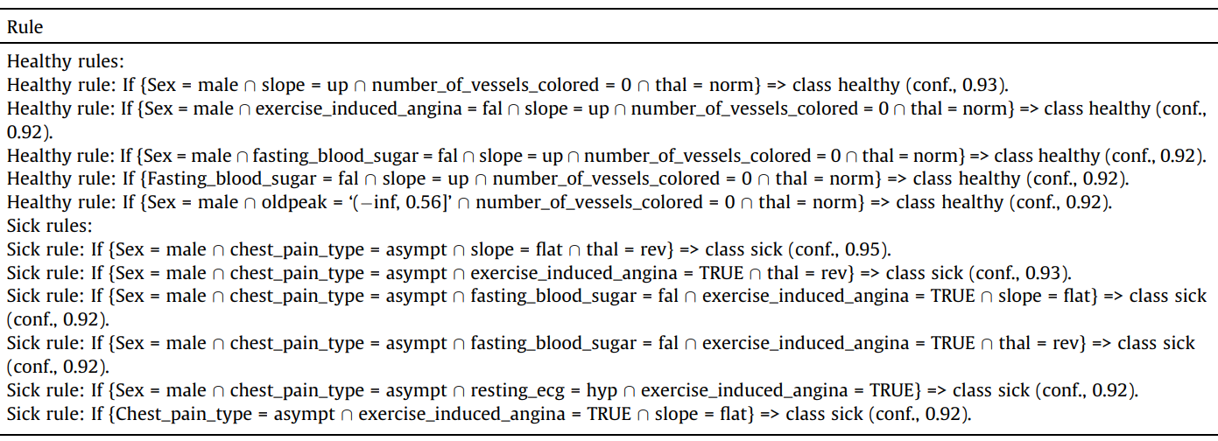
Results(4/5)
Contai

Slide 17
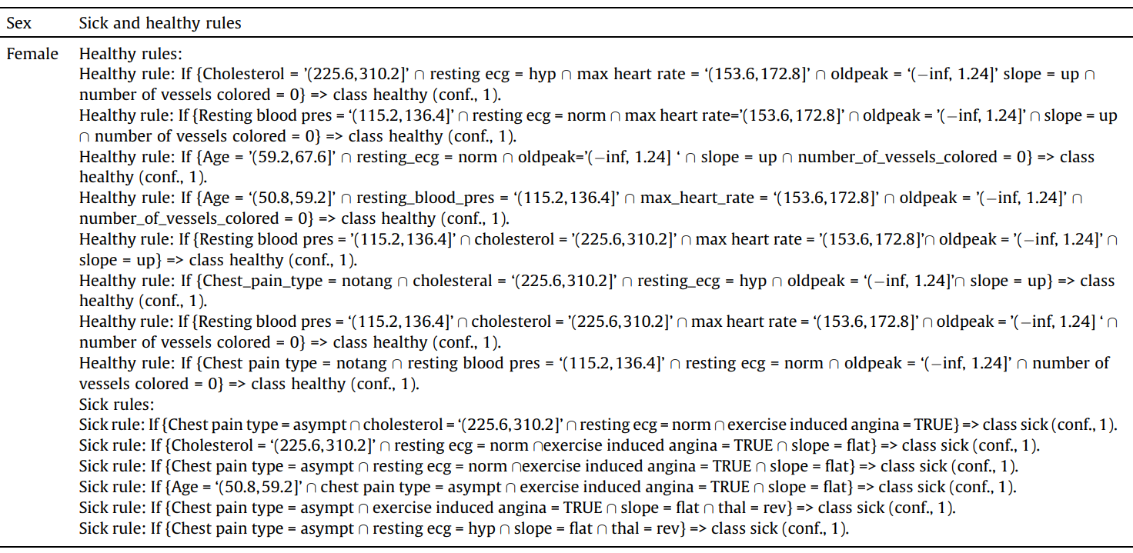
Results(5/5)
Contai

Slide 18
Conclusion
presented a rule extraction experiment on heart disease data using three rule mining algorithms.
significant risk factors for heart disease were found for both men and women.
Men: Resting ECG = hyper.
Women: (Resting ECG = normal or hyper) and ST slope = flat
coronary heart disease risk: Men > Women

Slide 19
Thanks

