Slide 1
What factors impact injury severity of vehicle to electric bike crashes in China?
Quan Yuan , Haiquan Yang , Jing Huang , Shengjie Kou , Yibing Li and Athanasios Theofilatos
Sage Journal Advances in Mechanical Engineering 2017, Vol. 9(8) 1–10
Presenter: Tse-Ying Huang
Date: Nov. 26, 2024
1

Slide 2
Abstract
In place of pedestrians and bikes, crashes involving electric bikes have become a large portion of crashes in China in these years. Crash data from Beijing, China, from the year 2009 to 2015 are used to identify how the factors impact injury severity of vehicle to electric bike crashes. A total of 150 crash samples are collected in order to investigate the influence of human, vehicle, road, and environment characteristics on injury severity. For that reason, a binary logistic model is established to analyze the significance of main contributing factors of crashes. This article describes the sample data, which includes time of incident, road users’ age and gender, crash patterns, and characteristics of road and environment. The results of descriptive statistics reveal that older riders and younger drivers are more likely to be involved in fatal crashes; the crashes have much higher frequency in motor vehicle roads, in suburban area, and in roads with higher speed limitation. The logistic regression model shows that older riders (age . 25) and electric bike turning increased the injury severity. On the contrary, the off-peak hour and the older driver (age . 25) of vehicle reduced the likelihood of fatal crash. These findings are hopeful to react on related research for accident prevention and injury reduction.
2

Slide 3
Introduction 1/2
Overview of E-Bike Usage in China
Increase in E-Bike Popularity: E-bikes have become increasingly popular in China, with estimates suggesting over 120 million e-bikes in use by 2010, reflecting their advantages in cost, energy efficiency, and convenience.
Regulatory Classification: In China, e-bikes are classified as non-motorized vehicles, allowing them to operate on bike lanes without requiring licenses or insurance.
Safety Concerns for Vulnerable Road Users (VRUs)
Challenges for VRUs: The safety of vulnerable road users, including e-bike riders, is expected to face significant challenges due to the rising number of crashes involving these vehicles.
Notes:
1.2e的使用者，在中國騎電動自行車不需要駕照且不用戴安全帽，但在2020年時已規定要戴安全帽，故此此篇論文沒考慮到安全措施所帶來的影響。

Slide 4
Introduction 2/2
Research Significance
Need for Study: The paper emphasizes the necessity for research focused on e-bike-related crashes, given their increasing prevalence and associated injuries.
Previous Research Insights: Various studies have highlighted factors contributing to crash severity among cyclists and e-bike users, indicating that demographics such as age and gender play a crucial role in fatality risks.
Objectives of the Current Study
Data Collection: The study aims to analyze 150 serious crash cases involving passenger vehicles and e-bikes in Beijing from 2009 to 2015.
Analysis Goals: It seeks to identify contributing factors related to human behavior, vehicle characteristics, road conditions, and environmental influences that affect injury severity in these crashes.
Notes:
在近幾年ebike出車禍率有大幅增加，且在瑞士也有人在研究相關的內容。data collection的部分會那麼少有可能是因為沒有人員傷亡時就不會記錄在案

Slide 5
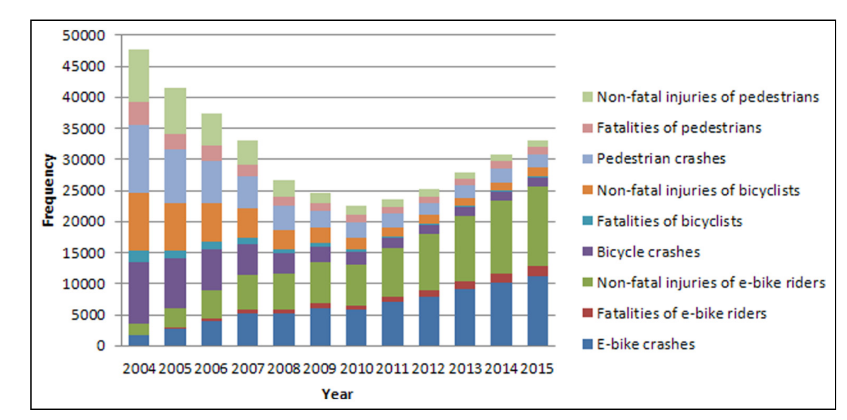

Slide 6
Methodolgy
Statistical Techniques
Descriptive Statistics: Initial analysis includes descriptive statistics to summarize the crash data, providing insights into the characteristics of the involved parties and incidents.
Binary Logistic Regression Model: A binary logistic model is established to analyze the relationship between various independent variables (such as driver, vehicle, road user, and environmental factors) and the dependent variable, which is the injury severity of e-bike riders.
This model categorizes injury severity into two groups:
Non-fatal injuries (coded as 0)
Fatalities (coded as 1)
OR(Odds Ratio勝算比)
=(40×10)÷(30×10)=1.3
 | Night | Morning
Fatalities | 40 | 30
Non-fatal injuries | 10 | 10
Notes:
你賭晚上會出車禍贏的機率，而非晚上出車禍的機率

Slide 7
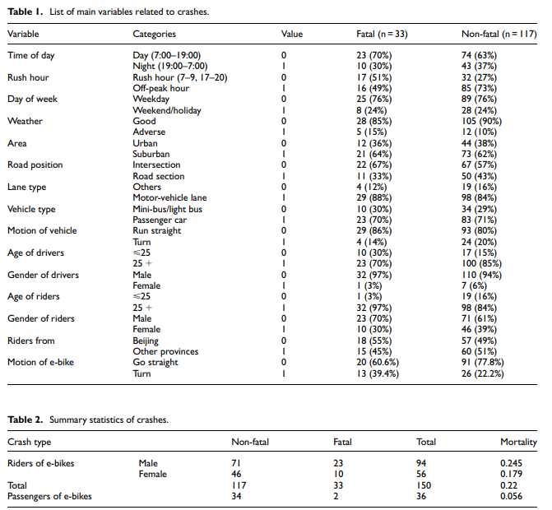
Result
Fatal Crash Cases:22% of all incidents.
Male Riders: representing 63% of the total.
Mortality Rates: The mortality rate for e-bike riders is noted to be 0.22, while for passengers, it is considerably lower at 0.056
Notes:
死亡case占22%

Slide 8
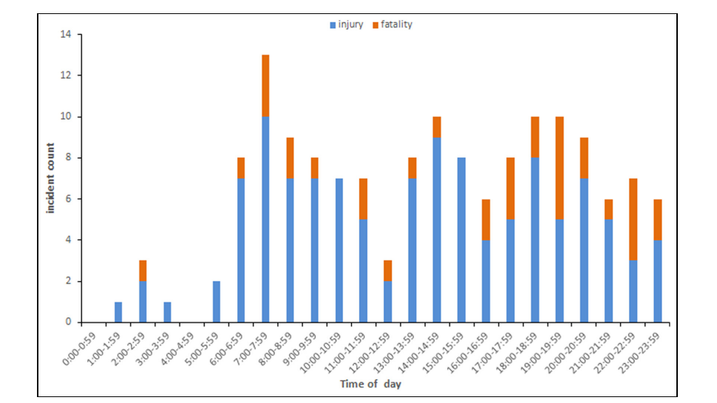
Result
Peak Hours:7:00 and 7:59 and 14:00 to 14:59 and 18:00 to 19:59
Notes:
夜間騎車的致死率高於白天

Slide 9
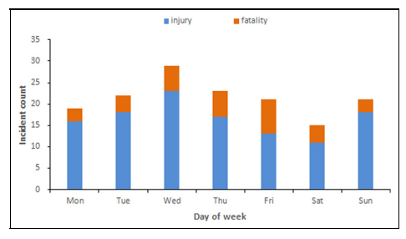
Result
Notes:
星期三發生最多，星期六最少

Slide 10
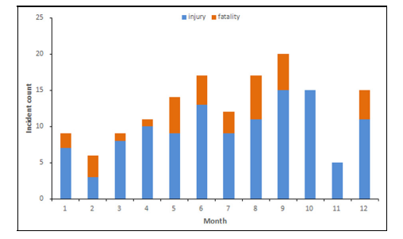
Result
Notes:
相比在寒冷環境，溫暖的環境比較讓人想騎車，且月分和致死率沒有相對的關係。

Slide 11

Result
Types of Vehicles Involved
Passenger Cars: 70%
Minibuses and Light Buses: 26%
Others: 4%
Notes:
可以發現巴士佔了一定的比例，因為有些時候巴士的駕駛者都不守規矩，且司機們都缺乏安全駕駛的意識。

Slide 12
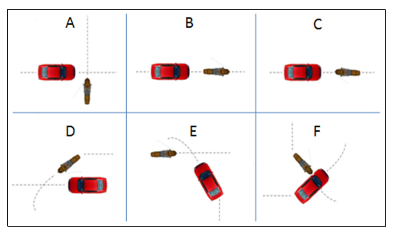
Impact Scenarios
Scenario A: 67 cases (about 45%).
Scenario D: 35 cases (about 23%).
Scenario F: only 4 cases.
Vehicle Direction and Crash Frequency
Straight Travel: The majority of crashes (122 cases, 81%) involve vehicles traveling straight on the road.
Turning Vehicles: Only 19% of crashes
Driver Gender
Male:95%
Female:5%
Age Statistics: The ages of the drivers ranged from 18 to 69 years, with a mean age of 36.8 years and a median age of 35 years. In fatal crash cases, the mean age decreased to 32.1 years, with a median of 31 years, indicating that younger drivers are disproportionately involved in fatal incidents
Result
Notes:
直行車輛發生意外的比例高於轉彎車輛。且開車的人，有95%是男性，5%是女性。

Slide 13
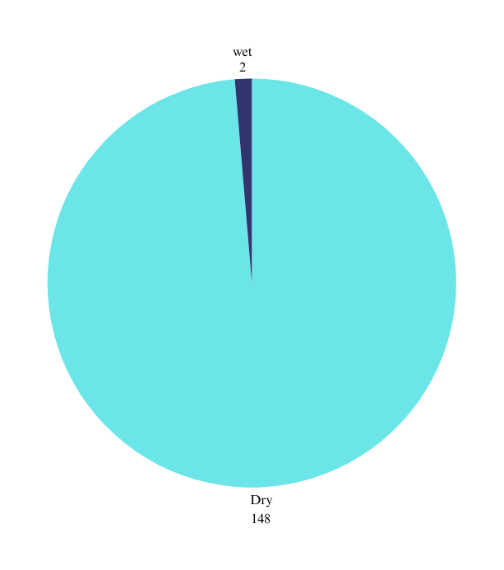
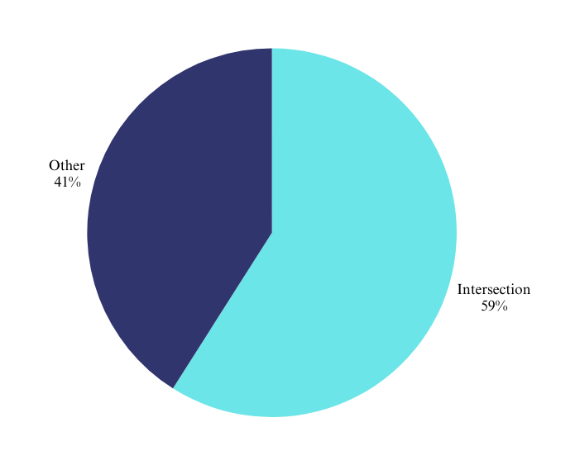
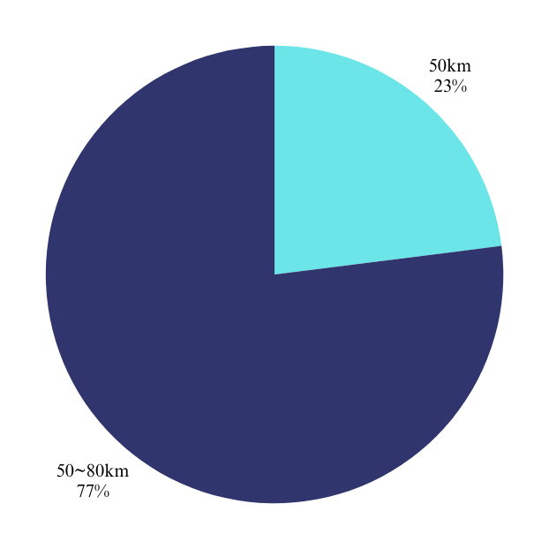
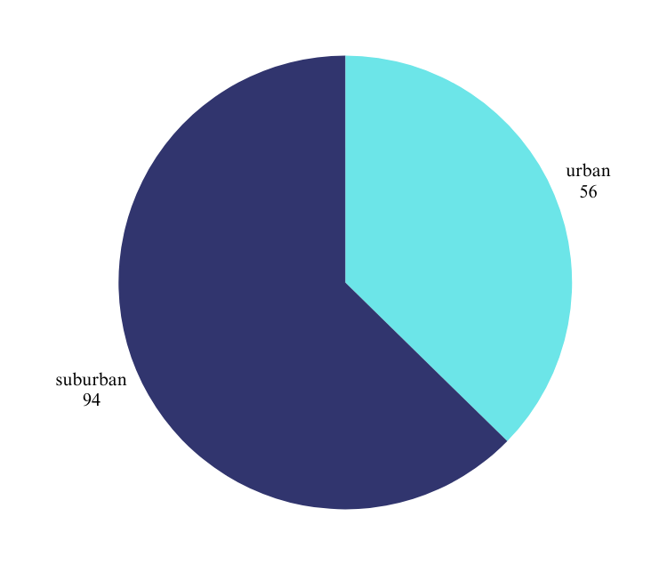
Place and Environement
Result
Notes:
限速50km

Slide 14
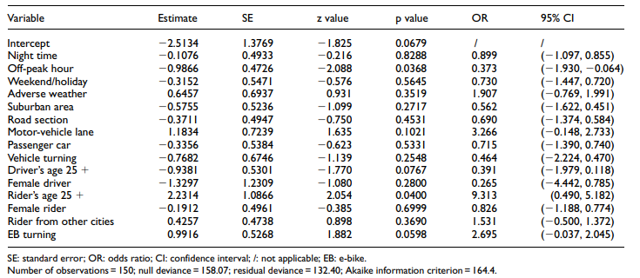
Result
EB turning :2.695 fold
Rider's age 25+:9.313 fold
Off-peak hour decrease the severity
Notes:
騎乘者年齡的影響：
年齡超過 25 歲的騎士發生電動自行車致命撞車事故的可能性大幅增加 9.313 倍。這顯示年紀較大的騎乘者可能因為各種因素而有較大風險，例如身體脆弱或對電動自行車騎乘動態經驗較少。
電動自行車在轉彎時，嚴重受傷的可能性增加 2.695 倍。這顯示轉彎時發生車禍的風險較高，可能是因為能見度降低或對交通互動判斷錯誤。

Slide 15
Conclusion
Key Findings
Crash Timing: Rush hour (7:00–7:59 AM). Mortality rates :night>morning
Vehicle Dynamics: Crashes involving vehicles traveling straight are associated with higher frequencies and severities.
Driver age: Younger riders are more prone to fatal crashes.
Crash Locations: The most crash-prone areas include suburban regions, intersections, and motor-vehicle lanes.
TheHigher speed limits correlate with increased crash frequency.

Slide 16
Conclusion
Logistic Regression Insights
The logistic regression model indicates that older riders (age 25 and above) and e-bike turning maneuvers significantly increase injury severity. Conversely, crashes during off-peak hours and involving older drivers reduce the likelihood of fatalities.
Recommendations for Safety Improvements
Infrastructure Enhancements: To enhance safety, it is recommended to improve road designs by separating vulnerable road users (VRUs) from motor vehicles, such as by adding guardrails between motorways and bicycle lanes.
Education and Management: There is a pressing need for effective management strategies and educational programs for e-bike riders. This includes promoting helmet use, adherence to traffic rules, training on safe driving behaviors, and raising safety awareness.
Notes:
建議機動車道和VRUs人群中多一道護欄，增加安全性。

