Slide 1
Predicting stock and stock price index movement using Trend Deterministic Data Preparation and machine learning techniques
Patel, J., Shah, S., Thakkar, P., & Kotecha, K. (2015).
Expert systems with applications, 42(1), 259-268.
Presenter : Jing-Xiang Yang
Date : Nov 26, 2024

Slide 2
ABSTRACT
This paper addresses problem of predicting direction of movement of stock and stock price index for Indian stock markets. The study compares four prediction models, Artificial Neural Network (ANN), Support Vector Machine (SVM), random forest and naive-Bayes with two approaches for input to these models. The first approach for input data involves computation of ten technical parameters using stock trading data (open, high, low & close prices) while the second approach focuses on representing these technical parameters as trend deterministic data. Accuracy of each of the prediction models for each of the two input approaches is evaluated. Evaluation is carried out on 10 years of historical data from 2003 to 2012 of two stocks namely Reliance Industries and Infosys Ltd. and two stock price indices CNX Nifty and S&P Bombay Stock Exchange (BSE) Sensex. The experimental results suggest that for the first approach of input data where ten technical parameters are represented as continuous values, random forest outperforms other three prediction models on overall performance. Experimental results also show that the performance of all the prediction models improve when these technical parameters are represented as trend deterministic data.

Slide 3
Contribution
Proposes Trend Deterministic Data Preparation Layer
Convert continuous technical indicator values into discrete trend signals.

Slide 4
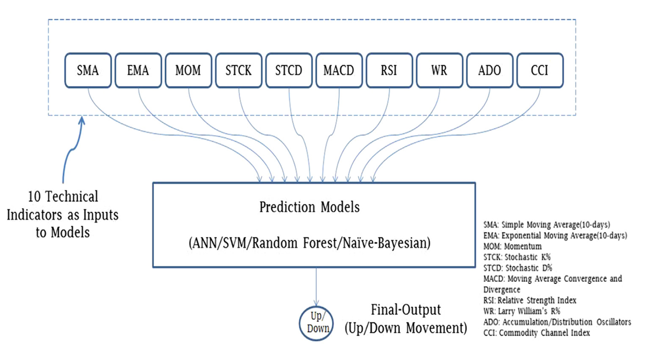
Baseline

Slide 5
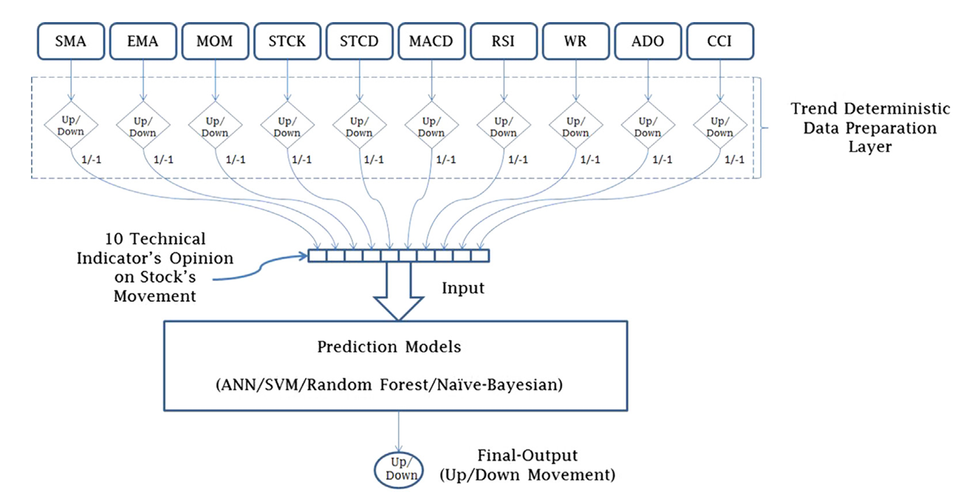
Trend Deterministic Data Preparation Layer

Slide 6
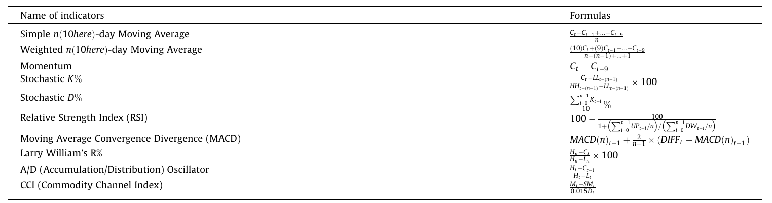
Technical Indicator

Slide 7
Trend Deterministic Data Preparation Layer
Close Price > SMA
+1
+1
Today SMA
Close Price < SMA
-1
RSI < 30
-1
RSI > 70
Today RSI
MACD_{t} > MACD_{t-1}
+1
RSI_{t} > RSI_{t-1}
+1
Today MACD
RSI_{t} < RSI_{t-1}
MACD_{t} < MACD_{t-1}
-1
-1
Notes:
RSI=[上升平均數÷(上升平均數+下跌平均數)]×100

Slide 8
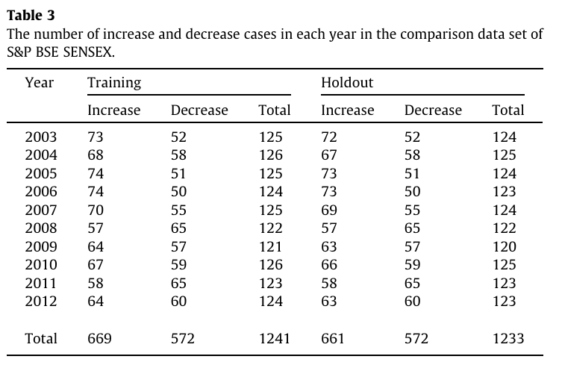
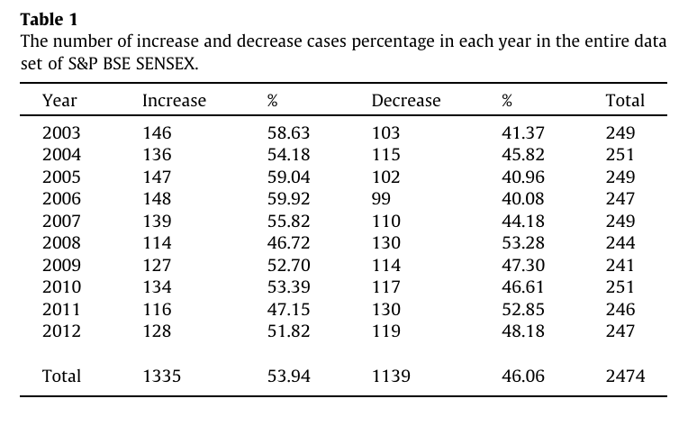
Data Set
CNXNifty (2003~2012)
S&P BSESensex (2003~2012)
RelianceIndustries (2003~2012)
Infosys (2003~2012)

Slide 9
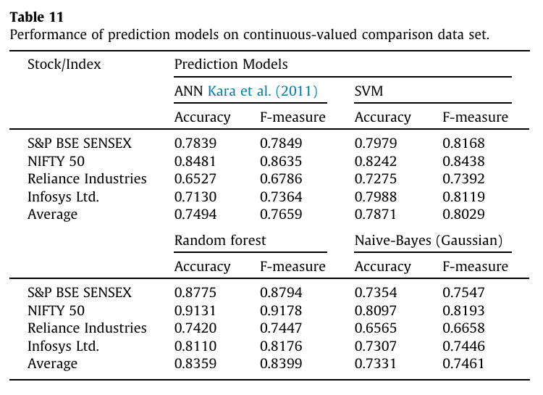
Experiment
Baseline

Slide 10
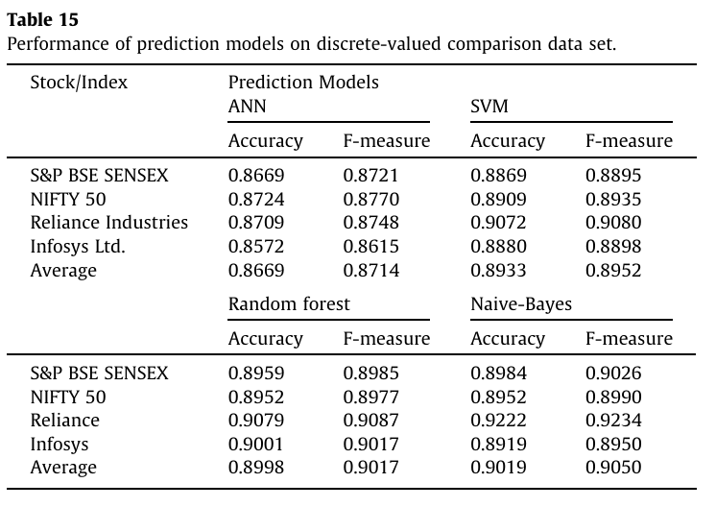
Experiment
Proposed
Notes:
結論 : 透過將冷冰冰德技術分析數值，轉換成更高層次的趨勢訊息，可以更好的幫助傳統機器學習進行股票趨勢的判斷 (因為傳統機器學習是直接根據輸入資料 maybe 做統計上的分析來得出解果)
如果套用到深度學習不確定會不會變得更準 (因為其實將 raw 的技術指標數據送到深層網路，網路神經元的權重 somhow 就已經歸納出淺在地股票走向的趨勢了)

Slide 11
Thanks

