Slide 1
The Generalized Definitions of the Two‑Dimensional Largest Common Substructure Problems
Huang‑Ting Chan, Hsuan‑Tsung Chiu, Chang‑Biau Yang, Yung‑Hsing Peng
Algorithmica, Vol. 82, pp. 2039-2062, 2020
Presenter : Yu-Ju Liao
Date : Feb. 23, 2021

Slide 2
Abstract
The similarity of two one-dimensional sequences is usually measured by the longest common subsequence (LCS) algorithms. However, these algorithms cannot be directly extended to solve the two or higher dimensional data. Thus, for the two-dimensional data, computing the similarity with an LCS-like approach remains worthy of investigation. In this paper, we utilize a systematic way to give the generalized definition of the two-dimensional largest common substructure (TLCS) problem by referring to the traditional LCS concept. With various matching rules, eight possible versions of TLCS problems may be defined. However, only four of them are shown to be valid. We prove that all of these four TLCS problems are NP-hard and APX-hard. To accomplish the proofs, two of the TLCS problems are reduced from the 3-satisfiability problem, and the other two are reduced from the 3-dimensional matching problem.

Slide 3
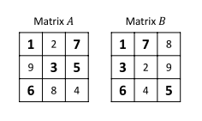
TLCS

Slide 4
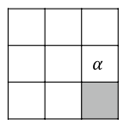
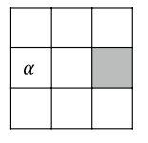
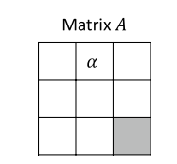
Side
Corner

Slide 5
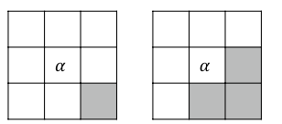
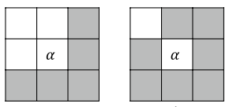
Corner
Matrix B
And (N)
Or (O)
(L) (E)
Less than less than or Equal to
(L) (E)

Slide 6
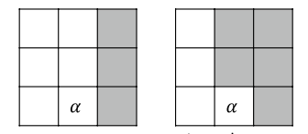
Side
Matrix A
Matrix B
(L) (E)

Slide 7
P(corner, operator, side)
P(LNL): P(Less than, aNd, Less than)
P(LNE): P(Less than, aNd, less than or Equal to)
P(ENL): P(less than or Equal to, aNd, Less than)
P(ENE): P(less than or Equal to, aNd, less than or Equal to)
P(LOL): P(Less than, Or, Less than)
P(LOE): P(Less than, Or, less than or Equal to)
P(EOL): P(less than or Equal to, Or, Less than)
P(EOE): P(less than or Equal to, Or, less than or Equal to)

Slide 8
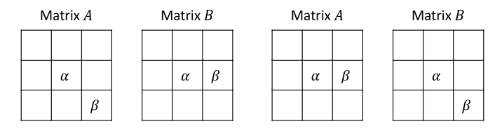
Symmetric __P(ENL), P(ENE), P(LOL) , P(LOE)
P(ENL): P(less than or Equal to, aNd, Less than)

Slide 9
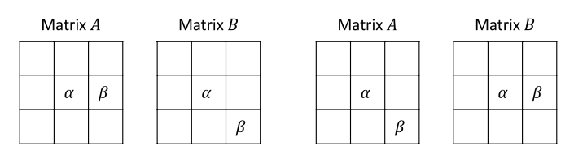
Not Symmetric __P(LNL), P(LNE), P(EOL) and P(EOE)
P(LNE): P(Less than, aNd, less than or Equal to)

Slide 10
P(corner, operator, side)
P(ENL): P(less than or Equal to, aNd, Less than)
P(ENE): P(less than or Equal to, aNd, less than or Equal to)
P(LOL): P(Less than, Or, Less than)
P(LOE): P(Less than, Or, less than or Equal to)

Slide 11
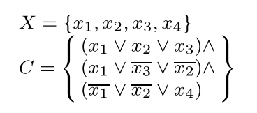
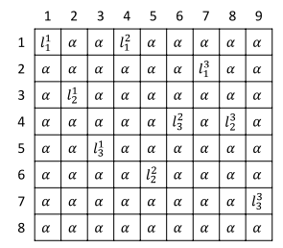
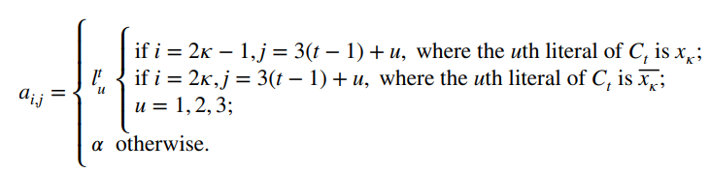


NP‑Hardness of P(ENL) and P(ENE)
3SAT:
1
2
3
1
2
3
$$x_{1}$$
x₁
$$\overline{x_{1}}$$
x₂
P(ENL):
x₃
x₄
Matrix A

Slide 12
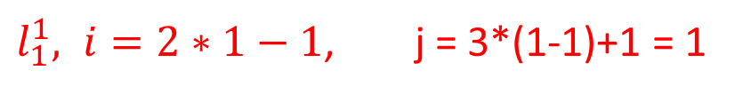


NP‑Hardness of P(ENL) and P(ENE)
1
2
3
1
2
3
$$x_{1}$$
x₁
$$\overline{x_{1}}$$
x₂
x₃
x₄
$l_{1}^{1}, i=2∗1−1$, j = 3*(1-1)+1 = 1
Matrix A

Slide 13
NP‑Hardness of P(ENL) and P(ENE)
1
2
3
1
2
3
$$x_{1}$$
x₁
$$\overline{x_{1}}$$
x₂
x₃
x₄
Matrix A

Slide 14
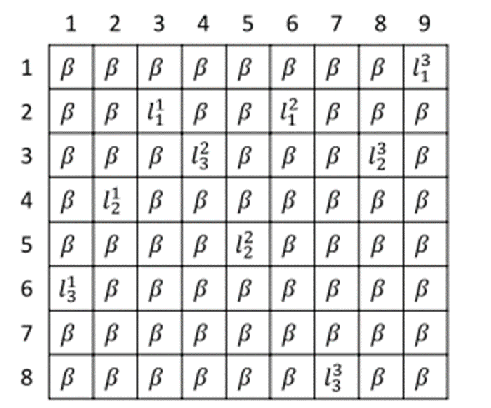
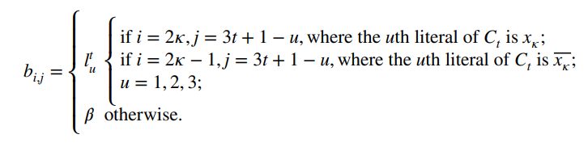
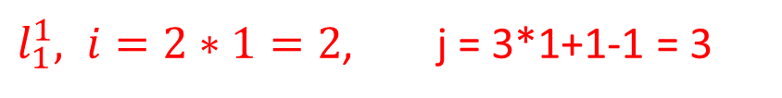


NP‑Hardness of P(ENL) and P(ENE)
1
2
3
3
2
1
$$\overline{x_{1}}$$
x₁
$$x_{1}$$
x₂
x₃
x₄
$l_{1}^{1}, i=2∗1=2$, j = 3*1+1-1 = 3
Matrix B

Slide 15
NP‑Hardness of P(ENL) and P(ENE)
1
2
3
3
2
1
$$\overline{x_{1}}$$
x₁
$$x_{1}$$
x₂
x₃
x₄
Matrix B

Slide 16
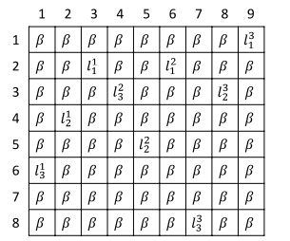




NP‑Hardness of P(ENL) and P(ENE)
$$x_{1}$$
$$\overline{x_{1}}$$
$$x_{1}$$
$$\overline{x_{1}}$$
Matrix A
Matrix B

Slide 17
NP‑Hardness of P(ENL) and P(ENE)
1
2
3
3
2
1
Matrix A
Matrix B

Slide 18
NP‑Hardness of P(ENL) and P(ENE)
Matrix A
Matrix B

Slide 19

APX‑Hardness of P(ENL) and P(ENE)_MAX 3SAT-3
X={x1,x2,x3,x4}
C=(x1 ∨ x2 ∨ x3)∧
(x1 ∨ $\overline{x3}$ ∨ $\overline{x2}$)∧
($\overline{\text{x}\text{1}}$ ∨ $\overline{x2}$ ∨ x4)
{x1, $\overline{x2}, \overline{x3}$, x4}, number of satisfied clauses is 3
Notes:
Maximum 3-satisifiability bounded by 3
（每個最多三個變數，每個變數最多出現三次）
最多符合的

Slide 20
3DM
X = {x1, x2, x3}
Y = {y1, y2, y3}
Z = {z1, z2, z3}
k=3
(M ⊆ X × Y × Z )
=>M = {(x1, y1, z1), (x1, y3, z3), (x2, y3, z2), (x3, y2, z4), (x1, y2, z2)}
M’={(x1,y1,z1),(x2,y3,z2),(x3,y2,z4)}
Notes:
Maximum 3-dimensional matching bounded by 3

Slide 21
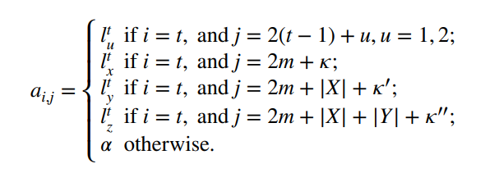
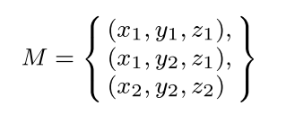
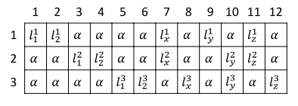
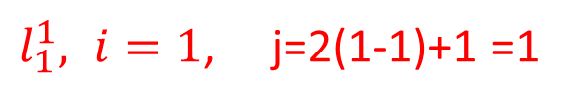
NP‑Hardness of P(LOL) and P(LOE)
P(LOL) :
$l_{1}^{1}, i=1$, j=2(1-1)+1 =1
3DM:
x₁
x₂
y₁
y₂
z₁
z₂
1
2
3
Matrix A

Slide 22
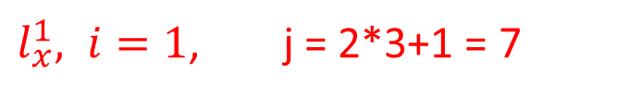
NP‑Hardness of P(LOL) and P(LOE)
P(LOL) :
$l_{x}^{1}, i=1$, j = 2*3+1 = 7
3DM:
x₁
x₂
y₁
y₂
z₁
z₂
1
2
3
Matrix A

Slide 23
NP‑Hardness of P(LOL) and P(LOE)
P(LOL) :
3DM:
x₁
x₂
y₁
y₂
z₁
z₂
1
2
3
Matrix A

Slide 24
NP‑Hardness of P(LOL) and P(LOE)
P(LOL) :
3DM:
x₁
x₂
y₁
y₂
z₁
z₂
1
2
3
Matrix A

Slide 25
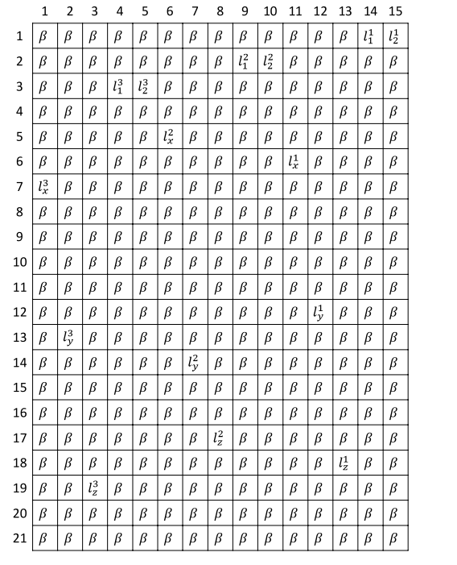
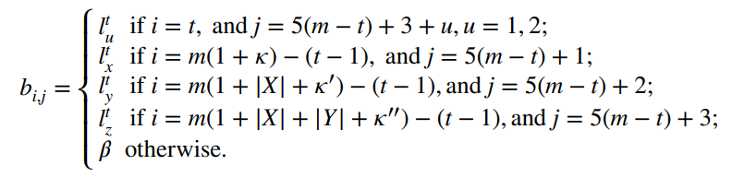
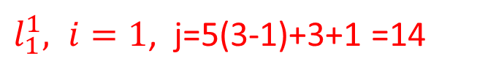
NP‑Hardness of P(LOL) and P(LOE)
3DM:
P(LOL) :
$l_{1}^{1}, i=1$, j=5(3-1)+3+1 =14
Matrix B

Slide 26
NP‑Hardness of P(LOL) and P(LOE)
3
2
1
3DM:
x₁
x₂
P(LOL) :
y₁
y₂
z₁
z₂
Matrix B

Slide 27
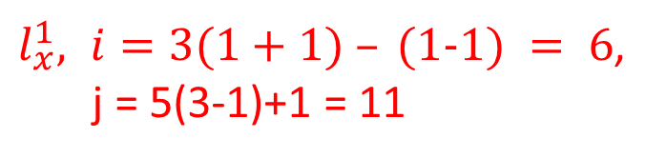
NP‑Hardness of P(LOL) and P(LOE)
x
y
z
x
y
z
x
y
z
3DM:
x₁
x₂
P(LOL) :
y₁
y₂
z₁
$l_{x}^{1}, i=3(1+1) – (1−1) = 6$,
j = 5(3-1)+1 = 11
z₂
Matrix B
Notes:
(1,1) I = 3(1+1) – (1-1) = 6 j = 5(3-1)+1 = 11
(2,1) I = 3(1+1) – (2-1) = 5 j = 5(3-2)+1 = 6
(3,1) I = 3(1+2) – (3-1) = 7 j = 5(3-3)+1 =1

Slide 28

NP‑Hardness of P(LOL) and P(LOE)
x
y
z
x₁
3
2
1
$l_{x}^{1}, i=3(1+1) – (1−1) = 6$,
j = 5(3-1)+1 = 11
3
x₂
2
1
Matrix B
Notes:
(1,1) I = 3(1+1) – (1-1) = 6 j = 5(3-1)+1 = 11
(2,1) I = 3(1+1) – (2-1) = 5 j = 5(3-2)+1 = 6
(3,1) I = 3(1+2) – (3-1) = 7 j = 5(3-3)+1 =1

Slide 29
NP‑Hardness of P(LOL) and P(LOE)
x
y
z
x₁
3
2
1
3
x₂
2
1
Matrix B

Slide 30
NP‑Hardness of P(LOL) and P(LOE)
x
y
z
x₁
3
2
1
3
x₂
2
1
Matrix B

Slide 31
NP‑Hardness of P(LOL) and P(LOE)
x₁
x₂
y₁
y₂
z₁
z₂
Matrix B

Slide 32
NP‑Hardness of P(LOL) and P(LOE)
Matrix A
Matrix B

Slide 33
NP‑Hardness of P(LOL) and P(LOE)
x
y
z
3
X₁
2
x₁
1
3
1
x₂
2
2
1
3
Matrix A
Matrix B

Slide 34
NP‑Hardness of P(LOL) and P(LOE)
x₁
x₂
y₁
y₂
Matrix A
2m ≤ |CU_{LOL}| ≤ 3m
=> 2*3 ≤ 8 ≤ 3*3
|CU_{LOL}| = 2m + k
=> 8= 2*3 + k
z₁
z₂
Matrix B

Slide 35
APX‑Hardness of P(LOL) and P(LOE)_MAX 3DM- 3
X = {x1, x2,x3}
Y = {y1, y2, y3}
Z = {z1, z2, z3}
(M ⊆ X × Y × Z )
=>M = {(x1, y1, z1), (x1, y3, z3), (x2, y3, z2), (x3, y2, z4), (x1, y2, z2)}
M’={(x1,y1,z1),(x2,y3,z2),(x3,y2,z4)}
Notes:
Maximum 3-dimensional matching bounded by 3
(沒有重複的變數)

Slide 36
x₁
x₂
y₁
y₂
z₁
z₂
1
2
3

Slide 37
x₁
x₂
y₁
y₂
z₁
z₂

Slide 39
Logical operator
less than (L)
less than or equal to (E)

Slide 40
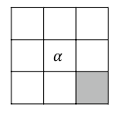
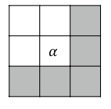
Logical operator
Matrix B
And (N)
Or (O)
Matrix A

Slide 41
symmetric
P(LNL): P(Less than, aNd, Less than)
P(LNE): P(Less than, aNd, less than or Equal to)
P(ENL): P(less than or Equal to, aNd, Less than)
P(ENE): P(less than or Equal to, aNd, less than or Equal to)
P(LOL): P(Less than, Or, Less than)
P(LOE): P(Less than, Or, less than or Equal to)
P(EOL): P(less than or Equal to, Or, Less than)
P(EOE): P(less than or Equal to, Or, less than or Equal to)

Slide 42

Not Symmetric __P(LNL), P(LNE), P(EOL) and P(EOE)
1
2
3
3
2
1
$$\overline{x_{1}}$$
x₁
$$x_{1}$$
x₂
$$\overline{x_{1}}$$
x₃
x₄

