Slide 1
An Improved Algorithm for The Longest Common Subsequence Problem
Sayyed Rasoul Mousavi, Farzaneh Tabataba
(Isfahan University of Technology, Iran)
Computers & Operations Research, 2012
Volume 39, Issue 3, pp512-520
Presenter: Tsung-Lin Lu
Date: Feb 23, 2021

Slide 2
Abstract
The Longest Common Subsequence problem seeks a longest subsequence of every member of a given set of strings. It has applications, among others, in data compression, FPGA circuit minimization, and bioinformatics. The problem is NP-hard for more than two input strings, and the existing exact solutions are impractical for large input sizes. Therefore, several approximation and (meta) heuristic algorithms have been proposed which aim at finding good, but not necessarily optimal, solutions to the problem. In this paper, we propose a new algorithm based on the constructive beam search method. We have devised a novel heuristic, inspired by the probability theory, intended for domains where the input strings are assumed to be independent. Special data structures and dynamic programming methods are developed to reduce the time complexity of the algorithm. The proposed algorithm is compared with the state-of-the-art over several standard benchmarks including random and real biological sequences. Extensive experimental results show that the proposed algorithm outperforms the state-of-the-art by giving higher quality solutions with less computation time for most of the experimental cases.

Slide 3
Introduction
Beam Search algorithm (BS)^{[1]}
Two types
Low-time
High-quality
Two different greedy functions for evaluation
Upper bounds for pruning
Improved Beam Search algorithm (IBS)
Probability-based heuristic function for evaluation
A list ĸ-best for pruning
[1] Blum C, Blesa MJ, Iba ́n ̃ez ML. COR 2009;36(12): 3178–86.

Slide 4
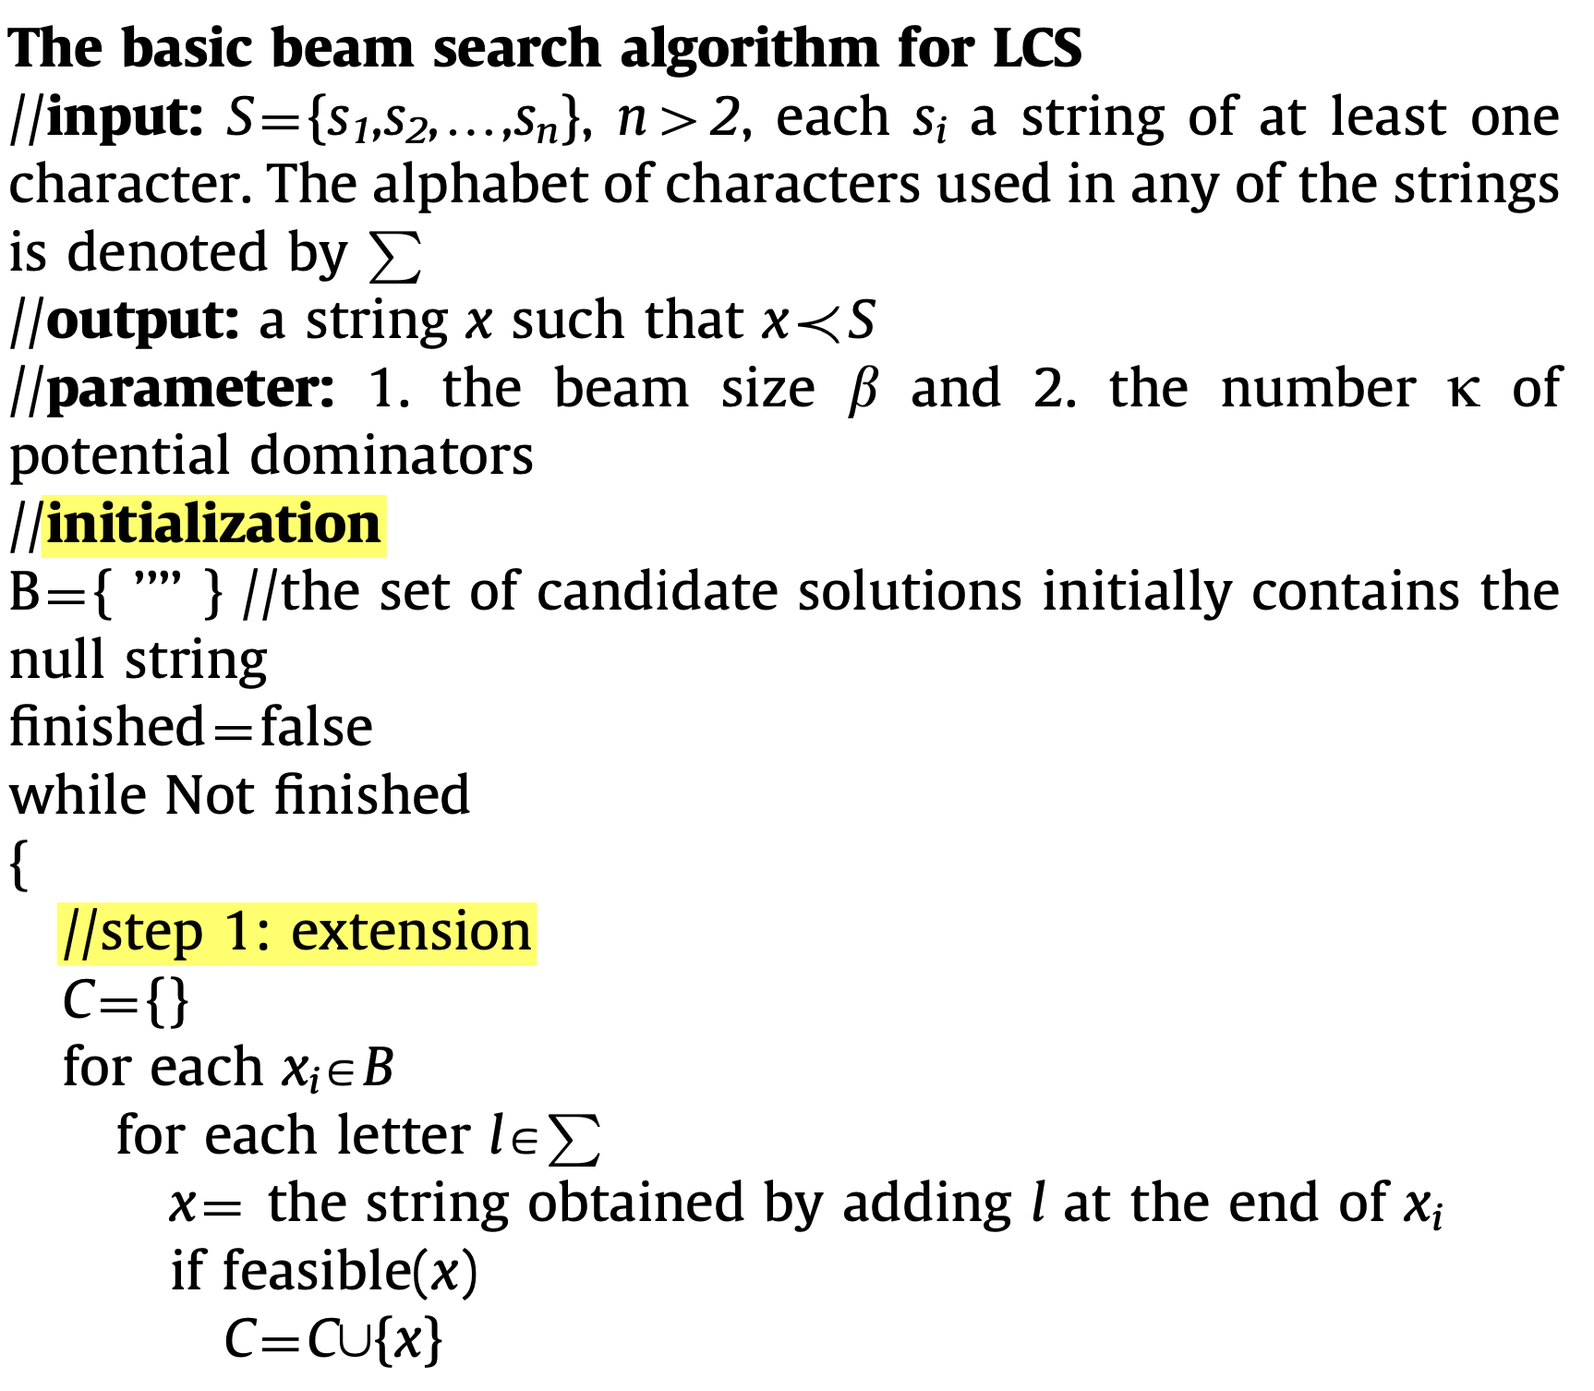
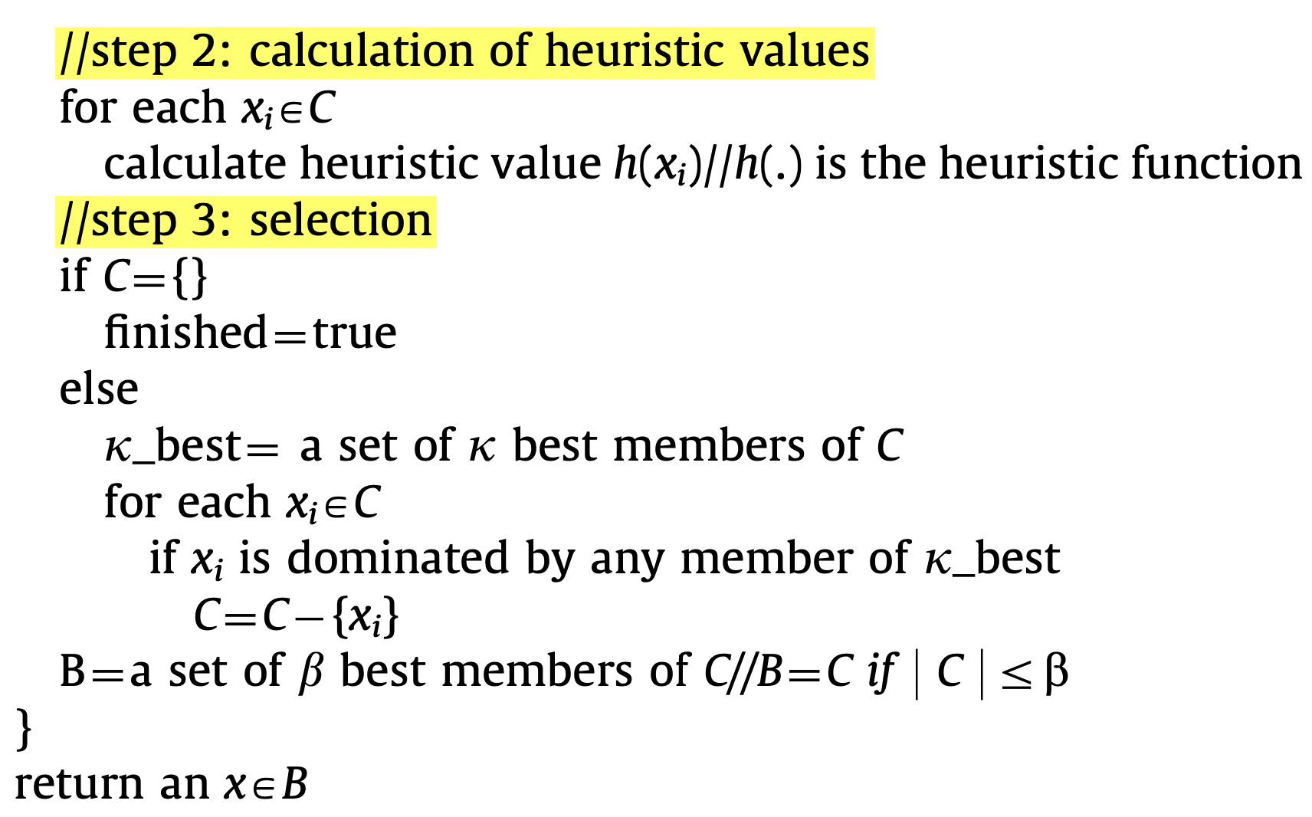
Algorithm

Slide 5
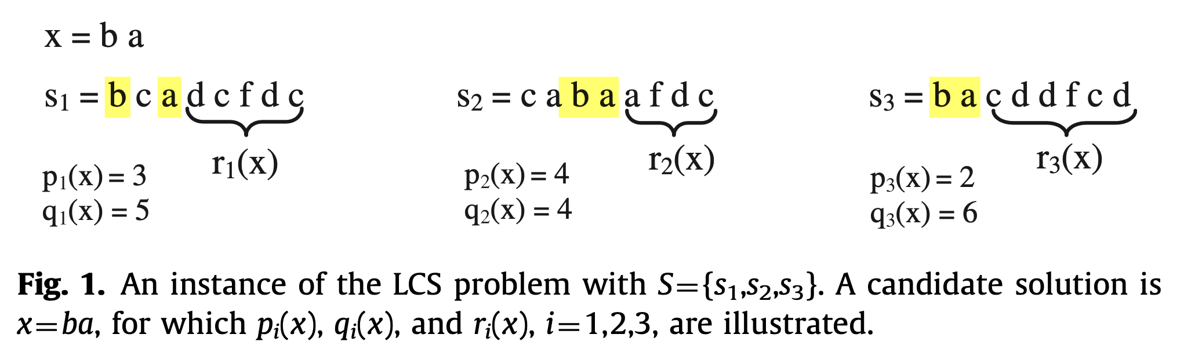
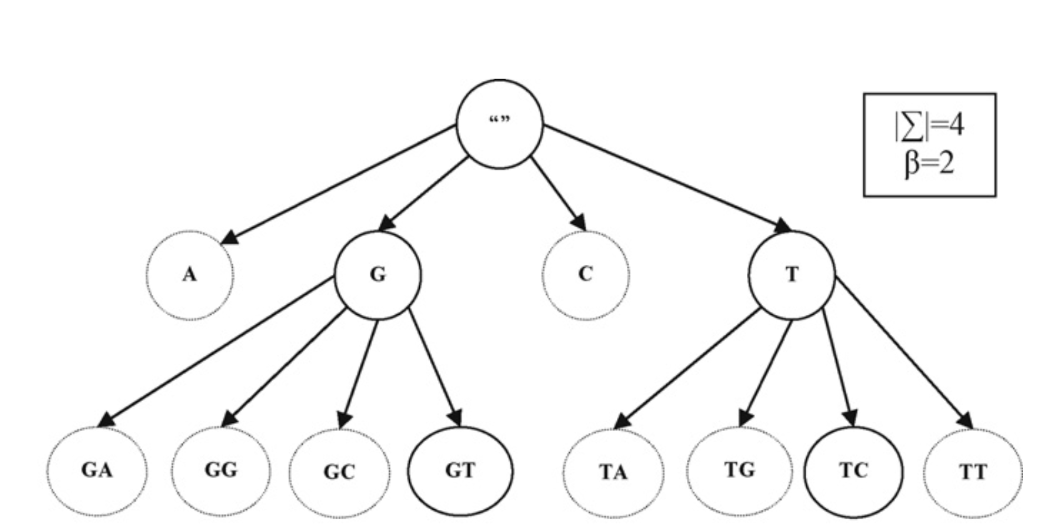
Definition
ß: beam size
∑: alphabet set
x: candidate
p(x): the cost of the optimal map of x to s
q_{i}(x): mi-pi(x)
r(x): the string deleting the first p_{i}(x) charcters from si

Slide 6
Step1: Extension
Each candidate solution xi in B is extended by appending at its end a character drawn from ^{P}.
Only the feasible ones, determined using the function feasible(.), are kept in the set C.

Slide 7
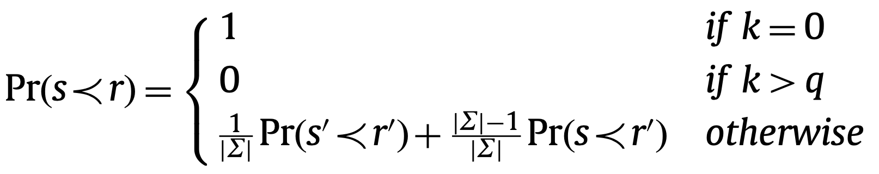
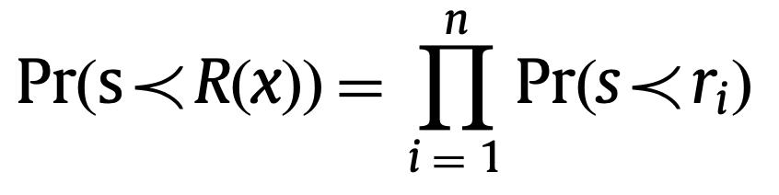
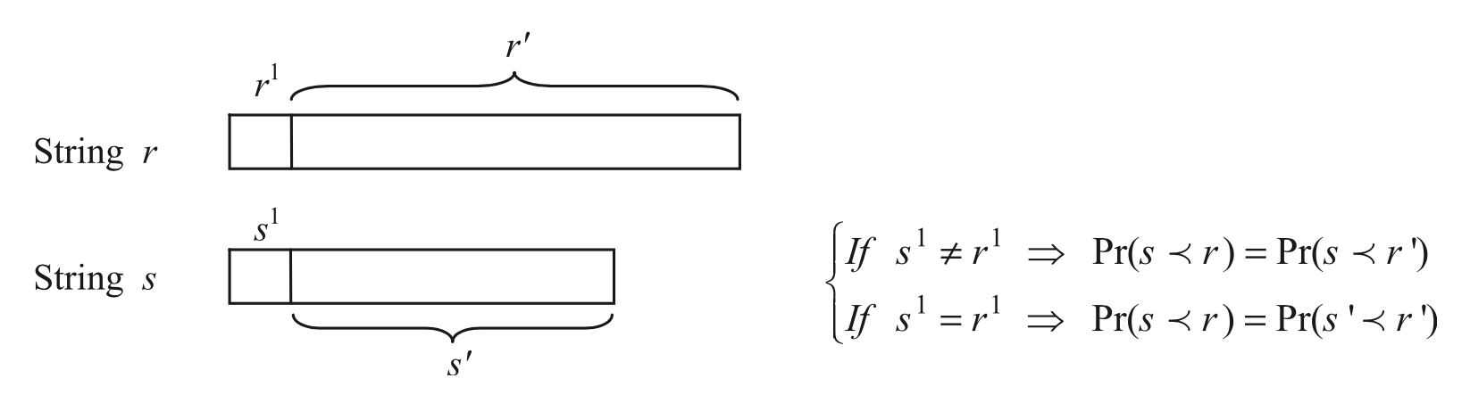
Step2: Calculation of heuristic values
Assumption: The strings in S are “independent”.
Case2
Case1
Case (i): s¹≠r¹, s≺r ↔︎ s≺r'
Case (ii): s¹=r¹, s≺r ↔︎ s'≺r', implies s≺r
k = |s|, q = |ri|

Slide 8
Step2: Calculation of heuristic values
Assumption: The strings in S are “independent”.
Case2
Case1
Case (i): s¹≠r¹, s≺r ↔︎ s≺r'
Case (ii): s¹=r¹, s≺r ↔︎ s'≺r', implies s≺r
k = |s|, q = |ri|

Slide 9
Step2: Calculation of heuristic values
Assumption: The strings in S are “independent”.
Case2
Case1
Case (i): s¹≠r¹, s≺r ↔︎ s≺r'
Case (ii): s¹=r¹, s≺r ↔︎ s'≺r', implies s≺r
k = |s|, q = |ri|

Slide 10
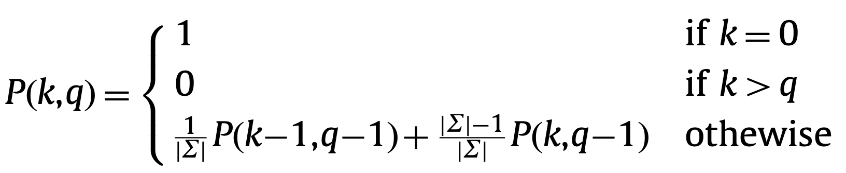
Step2: Calculation of heuristic values
Assumption: The strings in S are “independent”.
Case2
Case1
Case (i): s¹≠r¹, s≺r ↔︎ s≺r'
Case (ii): s¹=r¹, s≺r ↔︎ s'≺r', implies s≺r
k = |s|, q = |ri|

Slide 11
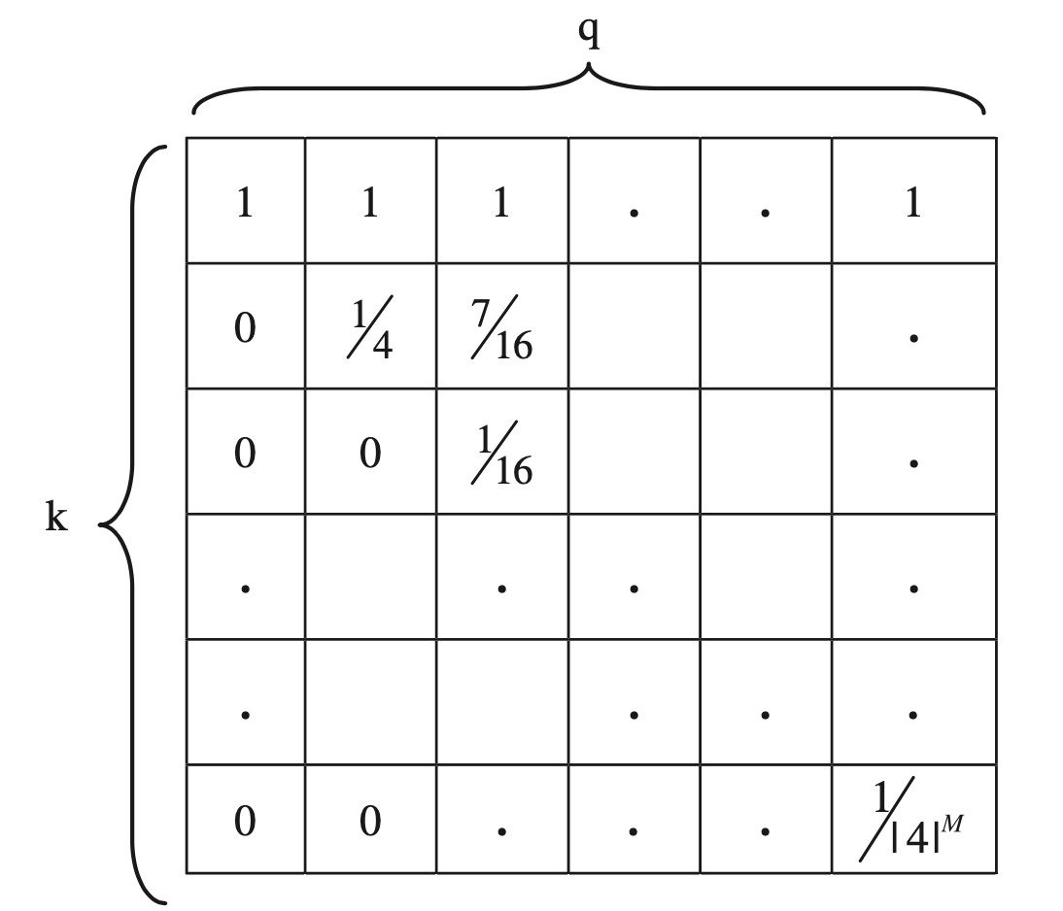
Step2: Calculation of heuristic values
Case2
Case1
1 | 1 | 1
0 | 1/4 | 7/16
0 | 0 | 1/16
*1/4
*3/4
k = |s|, q = |ri|

Slide 12
Step2: Calculation of heuristic values
Case2
Case1
1 | 1 | 1
0 | 1/4 | 7/16
0 | 0 | 1/16
*1/4
*3/4
k = |s|, q = |ri|

Slide 13
Step2: Calculation of heuristic values
Case2
Case1
1 | 1 | 1
0 | 1/4 | 7/16
0 | 0 | 1/16
*1/4
*3/4
k = |s|, q = |ri|

Slide 14
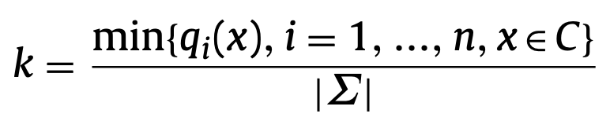
Step3: Selection
a list ĸ-best is constructed which consists of the k best candidate solutions.
Each candidate solution in C is then checked for being dominated by any member of ĸ-best and removed if so.
A candidate solution xj is dominated by another candidate solution xĸ if pi(xj) ≥ pi(xĸ), i = 1, 2, …, n.
ĸ-best: Avoiding the extra comparisons
Heuristic table: Avoiding calculation of upper bounds

Slide 15
Time complexity
O(m² + nm |∑| + L*(ß lgß + ĸß |∑|) )
1 | m² | heuristic table
2 | nm |∑| | Step1. Extension
3 | ß lgß | Step2. Calculation
4 | ĸß |∑| | Step3. Selection
m: the length of input strings
n: the number of input strings
L*: the length of the LCS
ß: beam size
∑: alphabet set

Slide 16
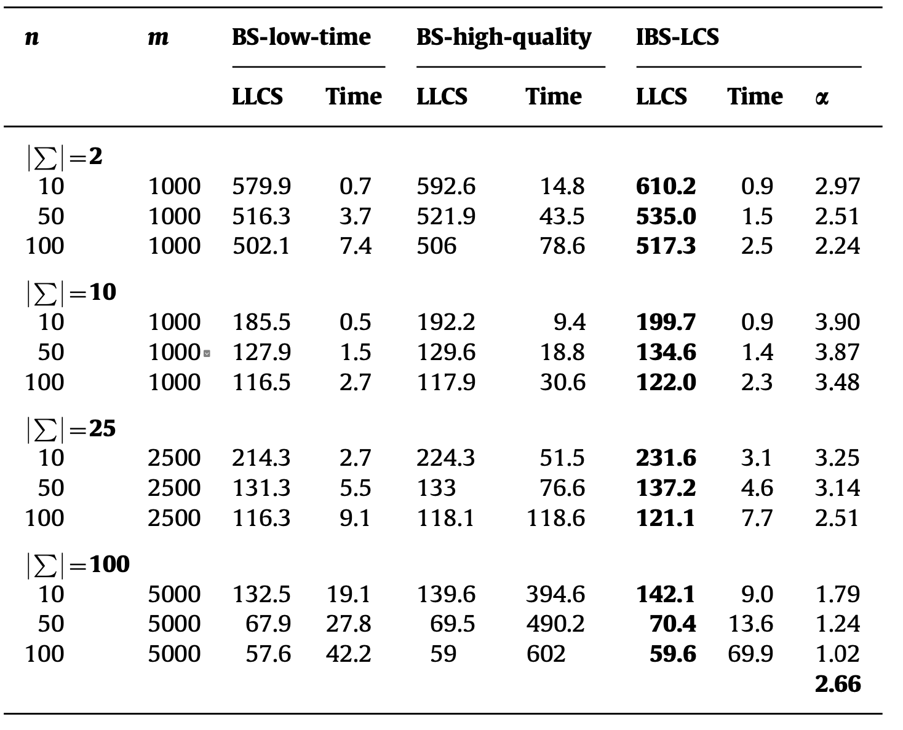
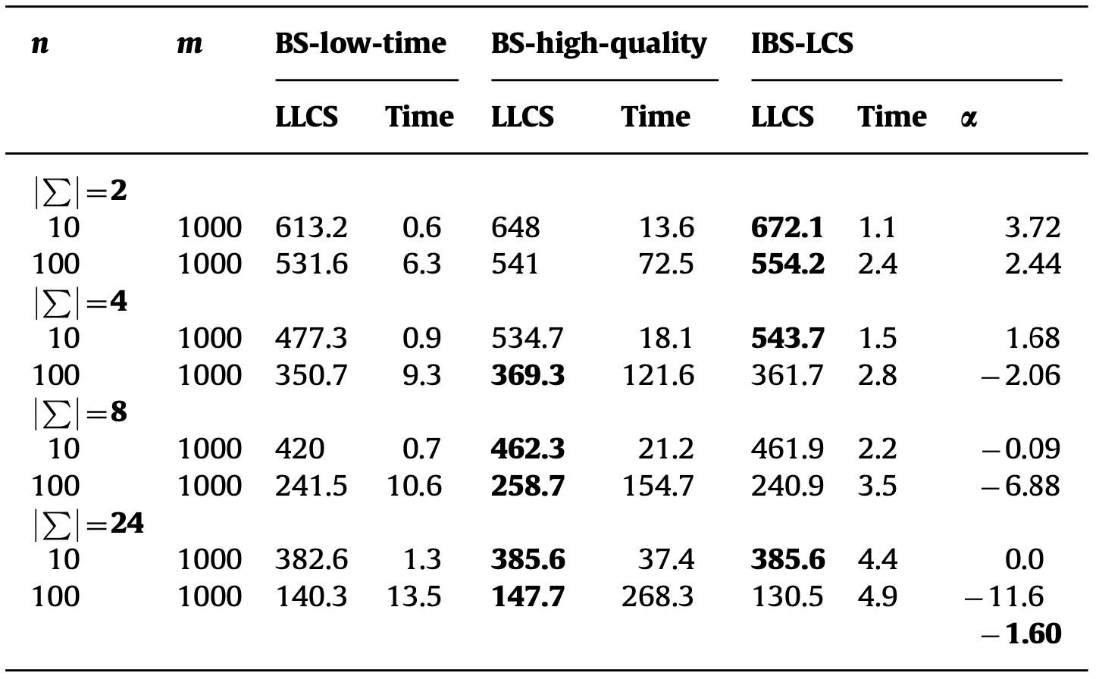
Result.1 BS-LCS v.s. IBS-LCS
ß=200, ĸ=7
BB benchmark, where the sequences are highly related
ES benchmark

Slide 17
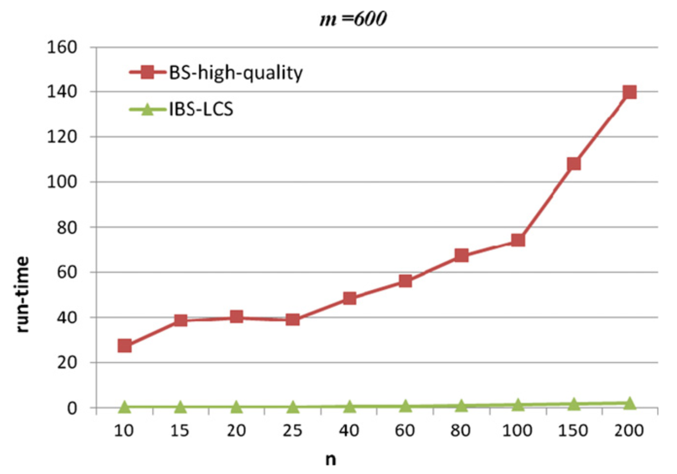
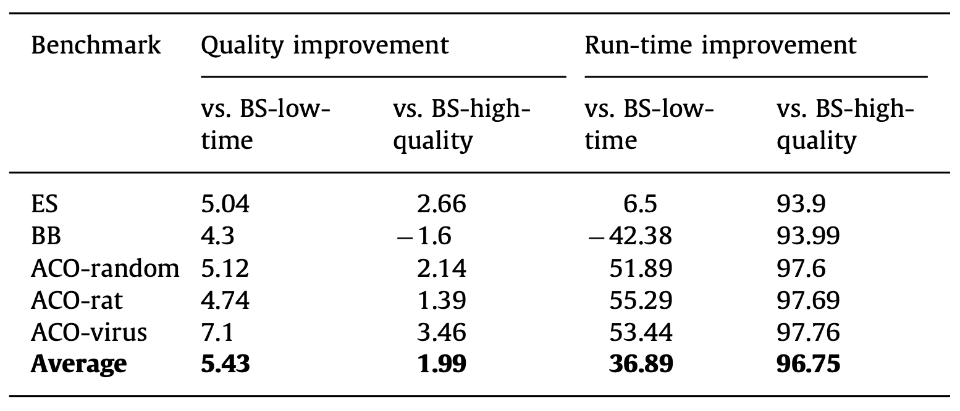
Result.2 BS-LCS v.s. IBS-LCS
Worst
Solution quality usually decreases, while the run-time of BS grows rapidly, by increasing n or |∑|.
IBS-LCS should better suit larger alphabets.

Slide 18
Conclusion
This heuristic function has been inspired by the probability theory.
Assuming the input strings are independent.
Real datasets showed that the assumption is reasonable.
Relax the independence assumption.
Generalize the heuristic formula to the case where the input strings are highly related.

Slide 19
Thank you for listening

Slide 20
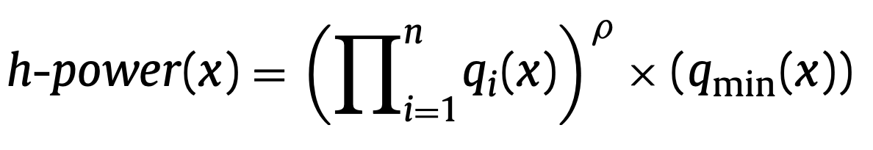
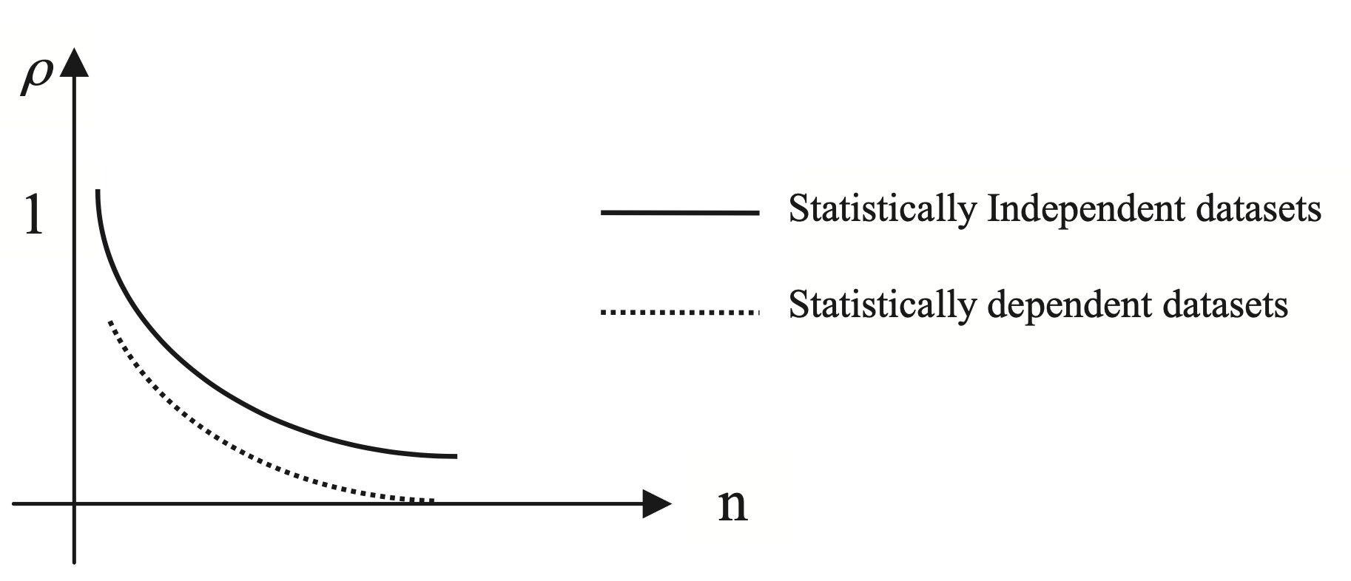
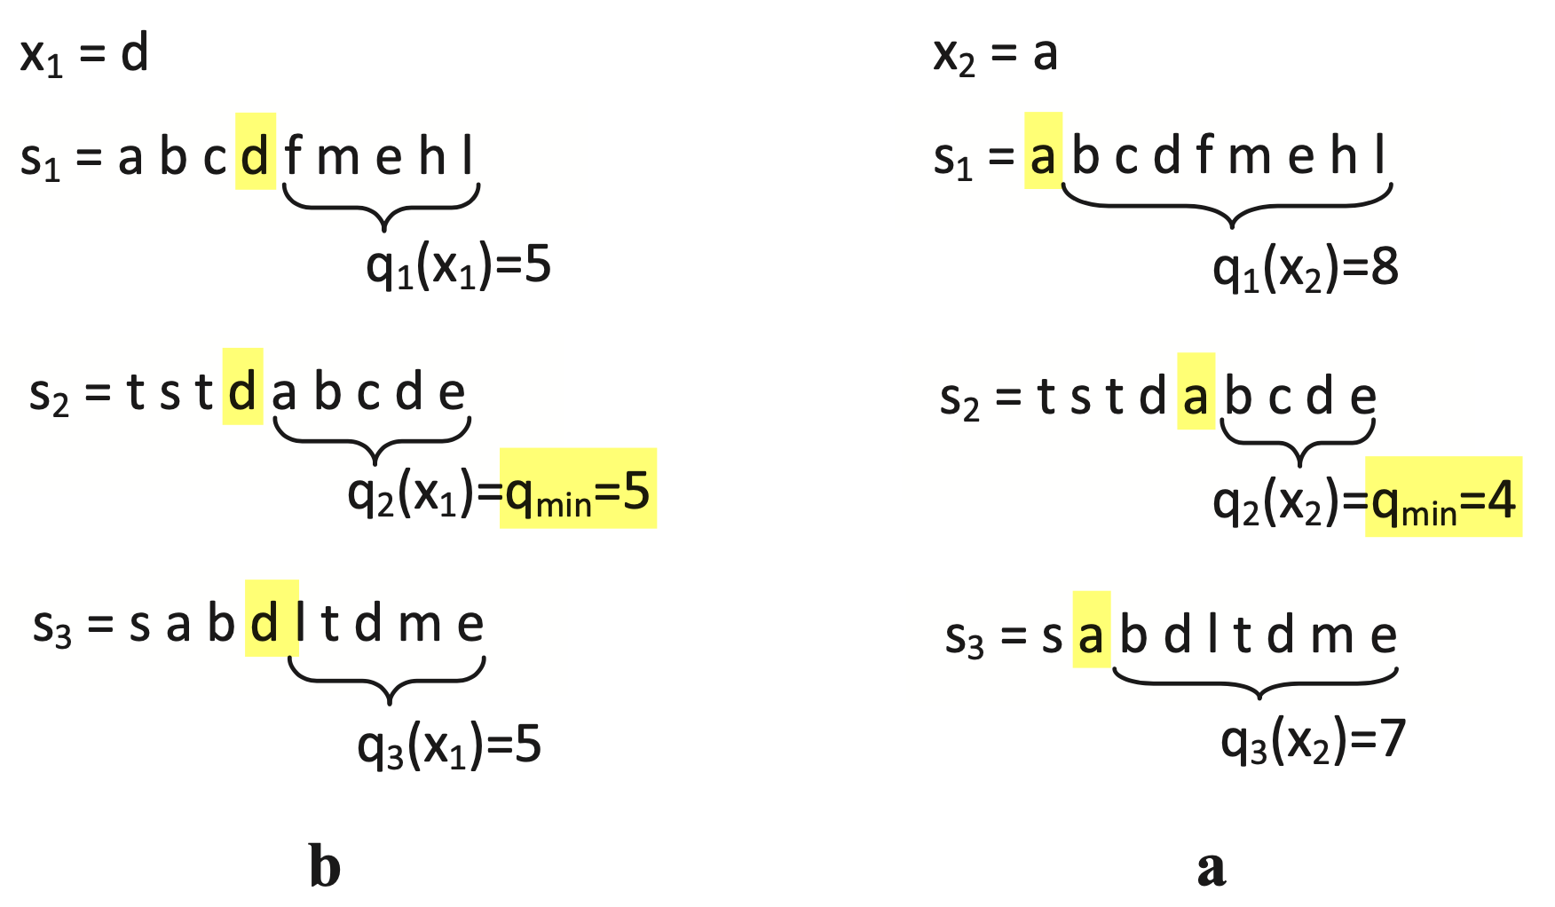
H-power(.)
All the values q_{i}(x), i=1,...,n, should be considered and not only qmin(x).
ƿ(n)=a×exp(−b×n)+c
de abde

Slide 21
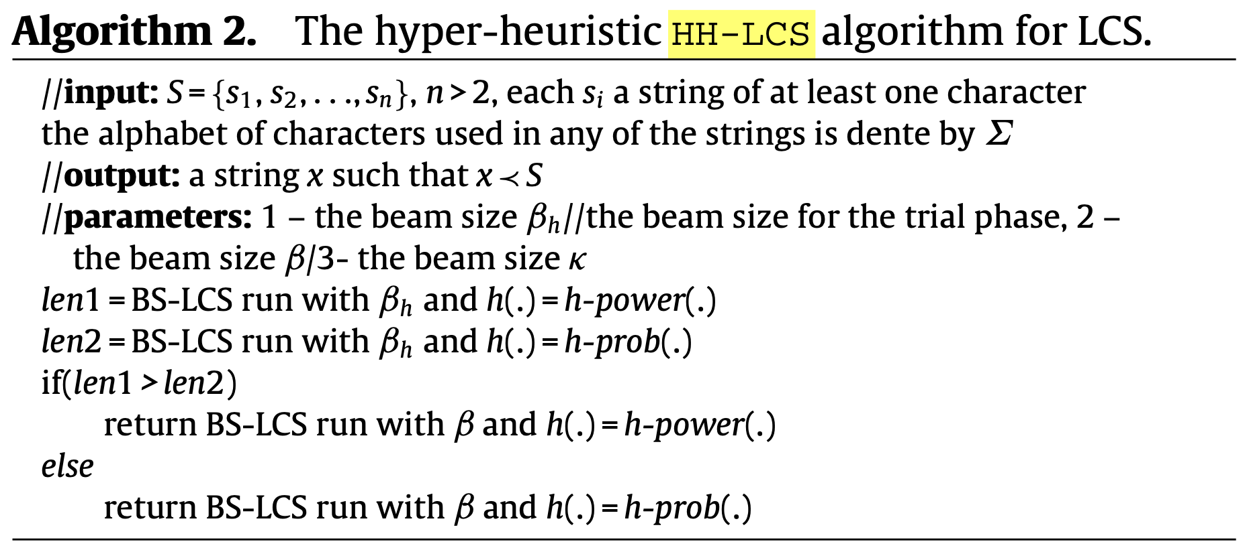
Algorithm

Slide 22
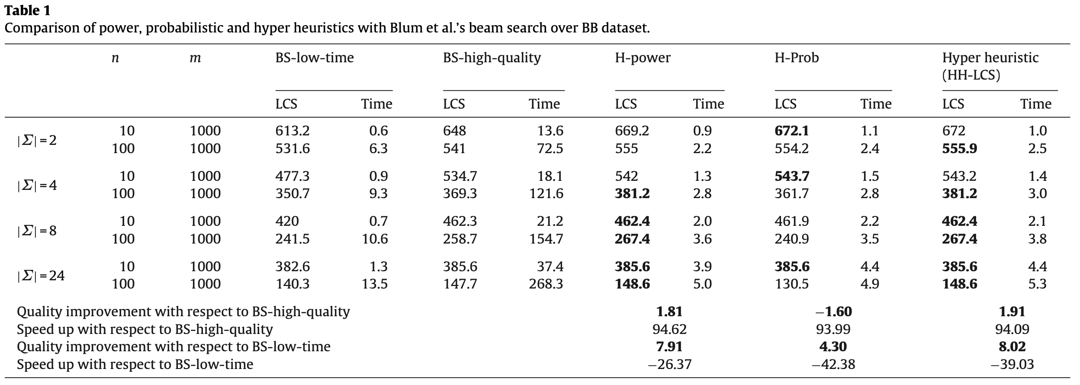
Result BS-LCS v.s. HH-LCS

