Slide 1
MUMmer4: A fast and versatile genome alignment system
Guillaume MarcËais, Arthur L. Delcher, Adam M. Phillippy, Rachel Coston, Steven L. Salzberg, Aleksey Zimin
PLoS Computational Biology,
26 January 2018
(open access)
Presenter: Yuan-Hsiu Tsai
Date: Feb. 23, 2021

Slide 2
Abstract(1/2)
The MUMmer system and the genome sequence aligner nucmer included within it are among the most widely used alignment packages in genomics. Since the last major release of MUMmer version 3 in 2004, it has been applied to many types of problems including aligning whole genome sequences, aligning reads to a reference genome, and comparing different assemblies of the same genome. Despite its broad utility, MUMmer3 has limitations that can make it difficult to use for large genomes and for the very large sequence data sets that are common today. In this paper we describe MUMmer4, a substantially improved version of MUMmer that addresses genome size constraints by changing the 32-bit suffix tree data structure at the core of MUMmer to a 48-bit suffix array, and that offers improved speed through parallel processing of input query sequences.

Slide 3
Abstract(2/2)
With a theoretical limit on the input size of 141Tbp, MUMmer4 can now work with input sequences of any biologically realistic length. We show that as a result of these enhancements, the nucmer program in MUMmer4 is easily able to handle alignments of large genomes; we illustrate this with an alignment of the human and chimpanzee genomes, which allows us to compute that the two species are 98% identical across 96% of their length. With the enhancements described here, MUMmer4 can also be used to efficiently align reads to reference genomes, although it is less sensitive and accurate than the dedicated read aligners. The nucmer aligner in MUMmer4 can now be called from scripting languages such as Perl, Python and Ruby. These improvements make MUMer4 one the most versatile genome alignment packages available.

Slide 4
Introduction - MUMmer
Data structure
Suffix tree and suffix array
Goal
Computing global sequence alignment

Slide 5
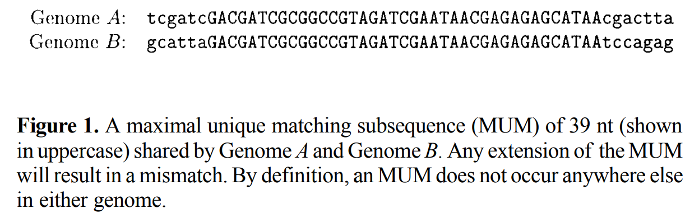
Introduction - MUMmer
What we need to find ?
Maximal Unique Matches (MUMs)
Maximal Exact Matches (MEMs)

Slide 6
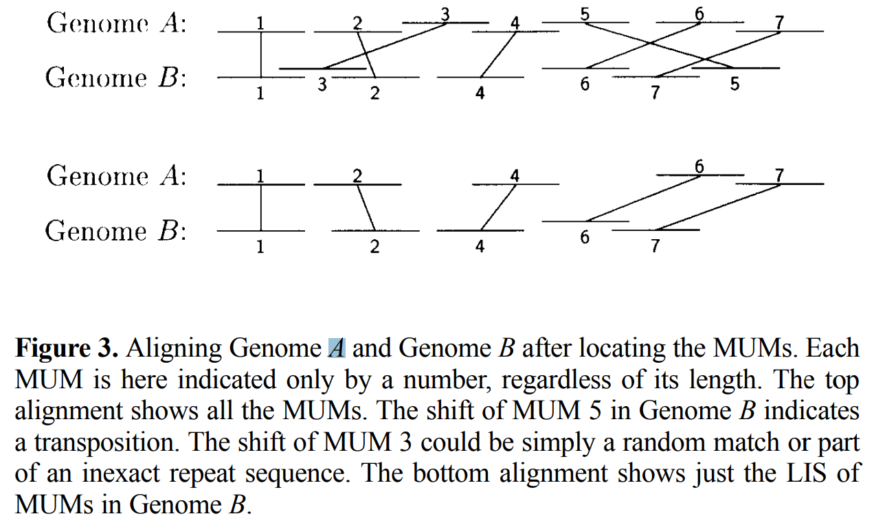
Introduction - MUMmer
How to do ?

Slide 7
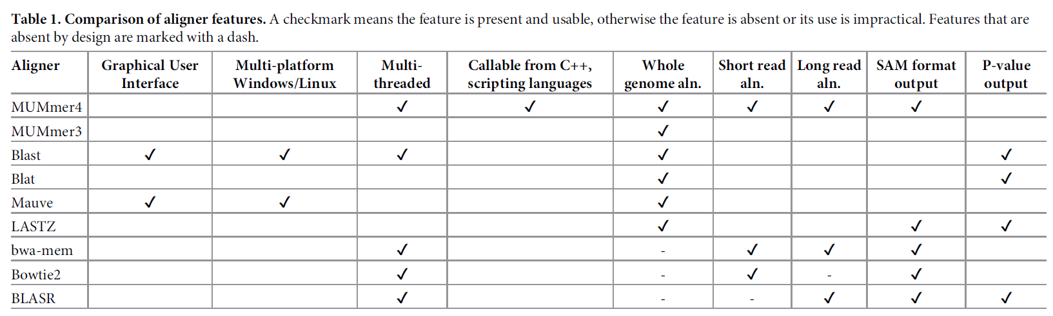
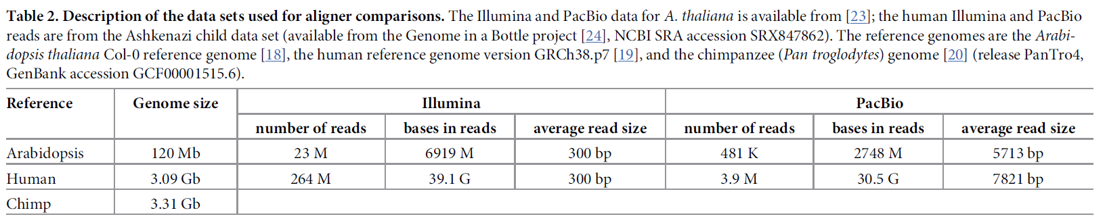
Experiment

Slide 8
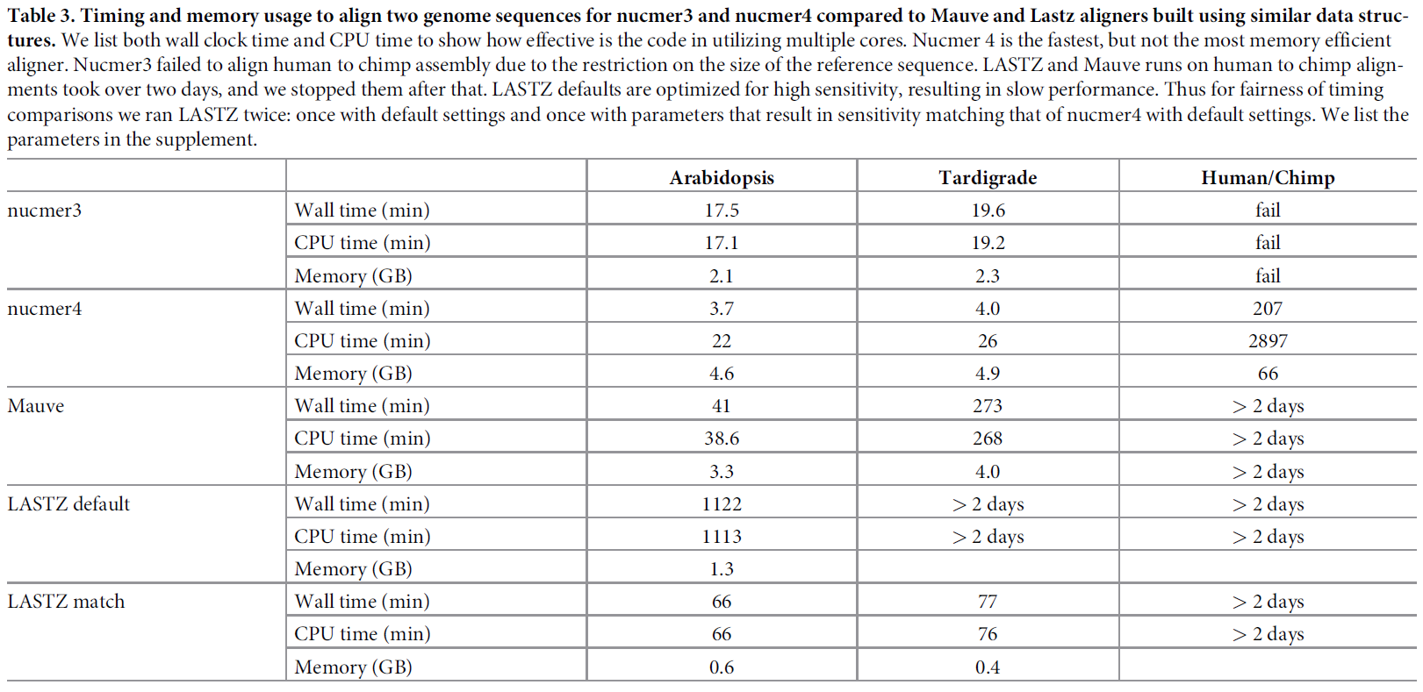
Experiment – similar data structure

Slide 9
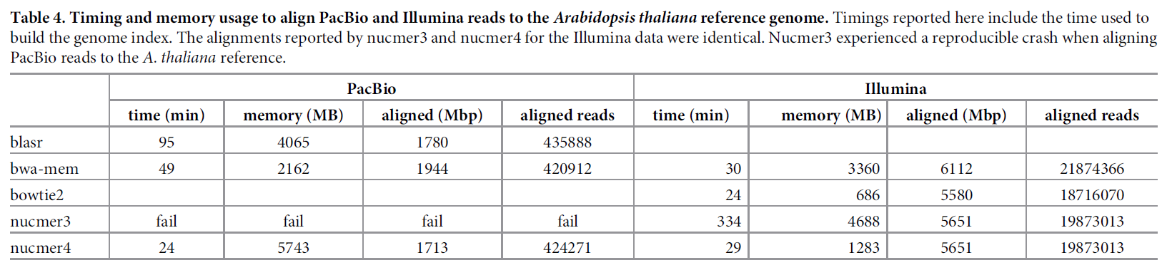
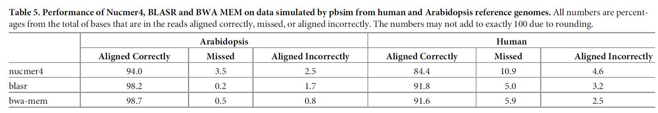
Experiment – many to one

Slide 10
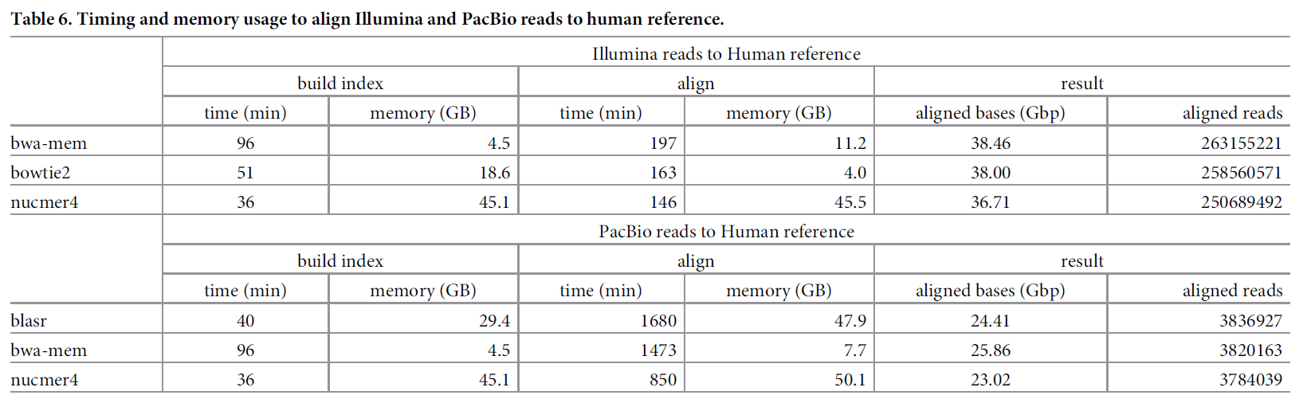
Experiment – many to one

Slide 11
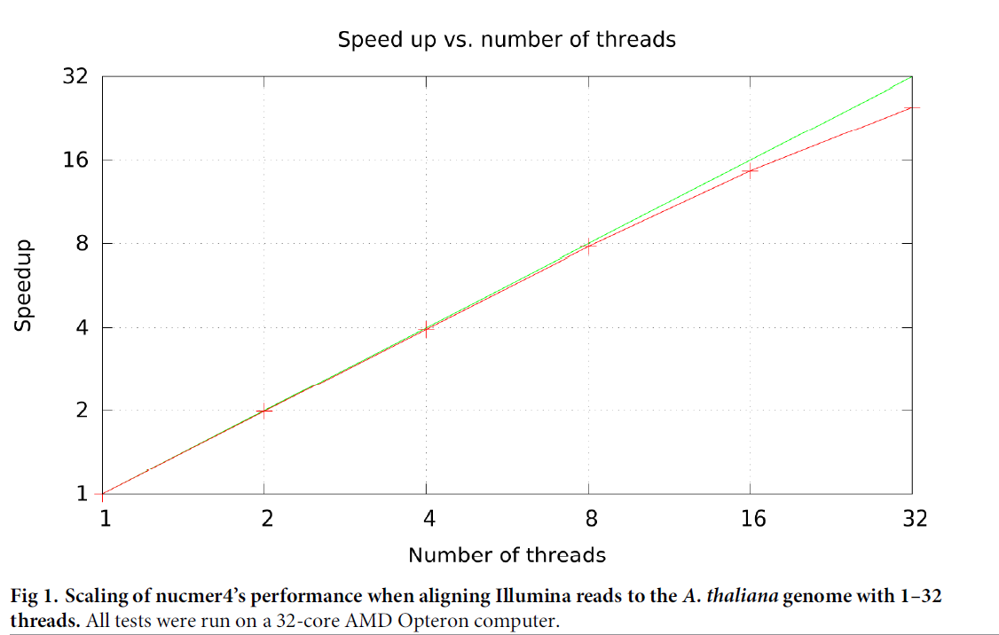
Experiment – multiple thread

