Slide 1
Connecting face hitting sets in planar graphs
Pascal Schweitzer , Patrick Schweitzer
Information Processing Letters , pp. 11–15, 2010
Presenter: Hsin-Fang Wu
Date: Jan. 04, 2011

Slide 2
A b s t r a c t
We show that any face hitting set of size n of a connected planar graph with a minimum degree of at least 3 is contained in a connected subgraph of size 5n −6. Furthermore we show that this bound is tight by providing a lower bound in the form of a family of graphs. This improves the previously known upper and lower bound of 11n−18 and 3n respectively by Grigoriev and Sitters. Our proof is valid for simple graphs with loops and generalizes to graphs embedded in surfaces of arbitrary genus.

Slide 3
Hitting Set
Definition
  Given a set A = {a1,…,an}, a collection B1,B2,…, Bm
  of subsets of A, and a number k. There exists a Hitting Set H ⊆ A of size k, such that H ∪ Bi≠∅,1 ≤ i ≤ m.
  E.g. A={3,5,7,8,15,16,18,20}, B1={3,5,7}, B2={5,15},
  B3={16,18} ,k=2
  => H={5,16} is a hitting set.

Slide 4
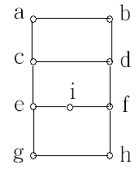
Face Hitting Set
  Two prominent hitting sets of planar graphs are the face hitting set
  一個平面圖的點集若meets每個face即稱為face hitting set.
  E.g. Face hitting set={ a,i }

Slide 5
Cycle Hitting Set (Feedback Vertex Set)
  Each feedback vertex set contains at least one vertex of any cycle in the graph. The feedback vertex set problem is an NP-complete problem in computational complexity theory. It was among the first problems shown to be NP-complete.
  E.g. Cycle hitting set={ a, i , c}

Slide 6
Feedback Vertex Set Size
  Since every face of a planar graph is a cycle, every feedback vertex set is also a face hitting set.
  Every face hitting set is contained in a feedback vertex set whose size is at most twice as large as the size of the face hitting set.
  A set of vertices is connected, if the subgraph induced by the vertex set is connected. This definition led to two new types of hitting sets of connected planar graphs: The connected feedback vertex sets and the connected face hitting sets. In fact, these two definitions coincide.

Slide 7
Goal (1/2)
  Grigoriev and Sitters show that any face hitting set S of a connected planar graph with a minimum degree of at least 3 is contained in a connected subgraph of size at most 11|S| − 18. They thereby show that the size of the smallest face hitting set of such a graph is at most 11 times smaller than the size of the smallest connected face hitting set.
  We show that every face hitting set S of a connected planar graph G with a minimum degree of at least 3 is contained in a connected subgraph of G of size at most 5|S| − 6.

Slide 8
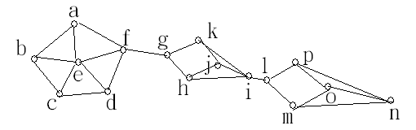
Goal (2/2)
  Our proof is furthermore valid for graphs with loops and generalizes to arbitrary genus, showing that in any graph embedded in a surface of genus g every face hitting set S is contained in a connected subgraph of size of at most 5|S| − 6+4g
  S={e, j, o},|S|=3
  Then we just need 5*3-6=9 vertices to contain S.
  V(G’)={e, f, g, k, j, i, l, p, o}, size 9.

Slide 9
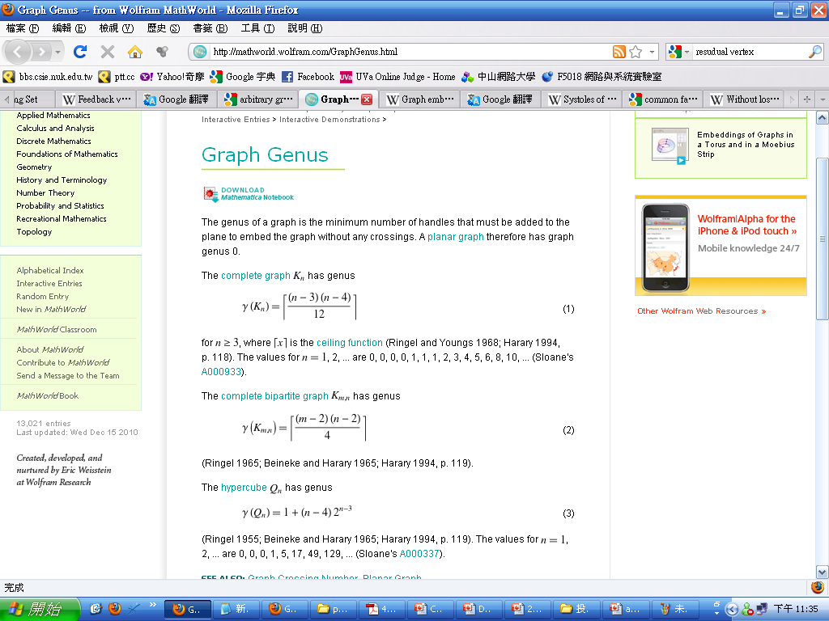
Genus
  Genus :The genus of a graph is the minimum number of handles that must be added to the plane to embed the graph without any crossings. A planar graph therefore has graph genus 0.
  The complete graph has genus :
  The complete bipartite graph has genus:

Slide 10
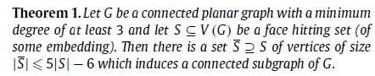
Proof
Definition 1. For a graph G and a nonempty subset of its vertices S ⊆ V (G) we define N(S) to be the vertices of V (G) \ S which are neighbors of S. We further define R(S) = V (G) \ (S ∪ N(S)) to be the residual vertices with respect to S.
Hence any nonempty set S partitions the vertices into the disjoint sets S, its neighbors N(S), and the residual vertices R(S).

Slide 11
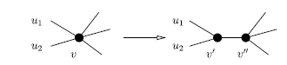
Degree reduction of vertices outside of S (1/2)
Suppose G is a connected planar graph and S a face hitting set . Consider a vertex v ∈ N(S) ∪ R(S) of degree deg(v) > 3. We replace v by two adjacent vertices v’ and v’’ obtaining a new graph G’ . We partition the edges that were incident with v into edges incident with v’ and edges incident with v’’ while maintaining planarity: We let u1 and u2 be the neighbors of v’; all other former neighbors of v become neighbors of v’’.

Slide 12
Degree reduction of vertices outside of S (2/2)
In the new graph G’ the vertices in S still form a face hitting set and the connection cost of S is not smaller than in the original graph G, since by contracting the edge between v’ and v’’ any connected subgraph of G maps to a connected subgraph of G of at most equal size. For the degrees of the new vertices we have deg(v’) = 3 and deg(v’’) = deg(v) −1.
We thus assume from now on that every vertex not contained in S has degree 3.

Slide 13
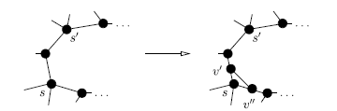
Removal of multiple vertices from S that are incident with the same face (1/2)
We manipulate the graph so that it only contains one vertex of S on every walk around the boundary of a face. Suppose there is a walk around a face f that meets two vertices s and s’ of S. (the starting vertex and the ending vertex are not counted as two occurrences.) Let e1 and e2 be two consecutive edges of the walk around the face f which are both incident with s. Since s has a degree of at least 3, the edges e1 and e2 are distinct. We subdivide the edges e1 and e2 by introducing the vertices v and v and connect the newly added vertices by a new edge. Preserving planarity, this new edge divides the face into two faces.

Slide 14
Removal of multiple vertices from S that are incident with the same face (2/2)
One face contains at least s and the other face contains at least s’. As in the previous reduction, the connection cost of S in the new graph is not smaller than in the original graph: any connected subgraph in the new graph maps to a connected subgraph in the original graph whose size is not larger, when we identify the vertices s, v’ and v’’ . With this process, we inductively decrease the number of incidences with vertices from S when walking around the boundary of a face. Note that by introducing new faces in this way, the set S remains a face hitting set, and that the newly added vertices have degree 3.
Due to the two reductions we now assume w.l.o.g. that all vertices in the original graph G not contained in S have degree 3 and every walk around a face meets exactly one vertex from S.

Slide 15
The graph G − S has exactly one connected component
The graph G − S is not empty. Recall that vertices from S are not adjacent. Thus, to show connectivity of G − S, it suffices to show that any two neighbors of a vertex s ∈ S are connected by a path in G − S. The vertex s and its two consecutive neighbors lie on a common face. The boundary of this face defines two walks between the two neighbors of s, one via s and one that avoids s. Since vertices in S do not lie on a common face, the latter walk does not contain any vertex from S, and thus only contains vertices from G − S.

Slide 16
Bound on the number of residual vertices (1/3)
We now show that |R(S)| ≤ max{2|S| − 4, 0}
The graph G’ is connected and 3-regular. It contains |V (G’)| = |R(S)| vertices, since the vertices in N(S) are exactly the vertices of degree 2 in G − S. (Here we use the observation that vertices in N(S) are only adjacent to one vertex of S and rely on the absence of multi-edges in G.) Note that since R(S) ≠ {} and since G − S is connected, every cycle of G − S must contain a vertex of degree larger than 2, which means it contains a vertex from R(S). Therefore faces do not vanish when vertices of degree two are replaced.

Slide 17
Bound on the number of residual vertices (2/3)
The number of faces of G’ is |S|, On the one hand a face f of G − S consists of merged faces of G and since S is a face hitting set at least one vertex from S was contained in f prior to deletion. Hence |F (G−S)| ≤ |S|. On the other hand, consider a vertex s ∈ S. Removal of s and its incident edges merges all faces that are incident with s. Since vertices from S do not lie on a common face in G, all vertices different from s that lie on a common face with s are vertices of G − S. In G − S these vertices thus bound a face f which contained s prior to its deletion. The face f is composed exclusively of faces incident with s, and thus did not contain a vertex from S \ {s} prior to deletion. We conclude that at most one vertex from S has been deleted within every face of G − S. Hence |F (G − S)| ≥ |S |.

Slide 18
Bound on the number of residual vertices (3/3)
Combining the two results shows that the deleted vertices from S and the faces of G − S are in one-to-one correspondence.
Since G’ is a 3-regular multi-graph, it holds that 2|E(G’)| = 3|V (G’)|. Substituting this into Euler’s formula |V (G’)| − |E(G’)| + |F (G’)| =2 we obtain
|V (G’)| = 2|F (G’)| − 4, which leads to |R(S)| = 2|S| − 4 according to the equalities above.

Slide 19
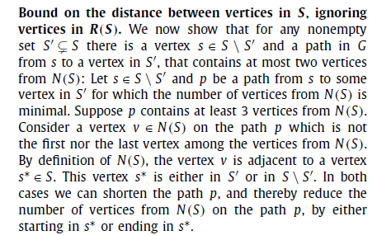
Bound on the distance between vertices in S, ignoring vertices in R(S)

Slide 20
Conclusion of proof of Theorem 1
Finally we conclude the theorem by the following counting argument: We successively connect all vertices from S by using at most 2 additional vertices from N(S) for each vertex, except for the first one, and an arbitrary number of vertices from R(S). Together we get at most |S|+2(|S|−1)+|R(S)| ≤ |S|+2(|S|−1)+max{2|S|− 4, 0} = max{5|S| − 6, 1} vertices. Since |S| ≥2 for any face hitting set S of a simple planar graph with minimum degree at least 3, this simplifies to 5|S| − 6.

Slide 21
Proof (1/4)
Theorem 2. For n ∈ {2, 3, . . .} there exists an embedded connected planar graph Gn of minimum degree 3 whose smallest face hitting set has size n and whose smallest connected face hitting set has size 5n −6.
Proof. To construct Gn with n ∈ {2, 3, . . .} we start with a tree T on n − 1 vertices of maximum degree 3. We replace every vertex by the wheel W8, with 8 spokes and 9 vertices. Suppose the center nodes of the wheels, are s1, . . . , sn−1. For every edge (u, v) ∈ E(T), we subdivide an outer edge of the wheels that correspond to u and v. These newly created vertices are then connected. The choice of the wheel’s outer edge to be subdivided is done in such a way that no two adjacent outer edges are subdivided. We call the set of vertices introduced by these subdivisions R.

Slide 22
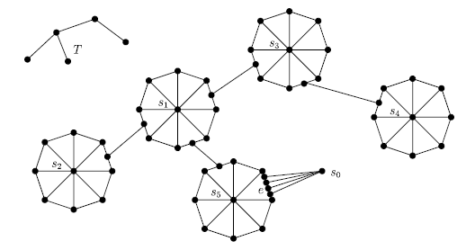
Proof (2/4)
Finally, we pick another non-adjacent outer edge e in a wheel corresponding to a leaf in T. We replace e by a path of length 5 with an additional vertex s0 adjacent to all inner vertices of the path.

Slide 23
Proof (3/4)
The unique smallest face hitting set in the graph is the set s0, . . . , sn−1: It contains exactly the vertices of degree larger than 3, and every face is incident with only one vertex from the set. Therefore any smaller set covers less faces.
Every connected face hitting set contains all vertices from R. There are 2(n − 2) such vertices, since every edge of T contributes two vertices of R. Furthermore every connected face hitting set contains for every vertex in R a connection vertex on the outer edges of the wheel in which it is contained. Since vertices of R within one wheel are at a distance of at least 3, these connection vertices are distinct. The connected face hitting set thus contains at least |R| = 2(n −2) connection vertices.

Slide 24
Proof (4/4)
Finally, every minimal connected face hitting set in the graph contains the hubs of every wheel: Suppose there is a minimal connected face hitting set that does not contain hub si . Consider the wheel corresponding to si. In this wheel, the minimal connected face hitting set contains more than one outer vertex in addition to the vertices from R and their connection vertices. Replacing these additional vertices with si reduces the number of vertices in the connected face hitting and yields a contradiction. A similar argument can be used to see that s0 together with two additional connection vertices is contained in every minimal connected face hitting set.

Slide 25
Conclusion of proof of Theorem 2
Together this shows that at least 2(n − 2) + 2(n − 2) + n − 1 + 3 = 5n − 6 vertices are in every connected face hitting set of Gn. (That there is indeed a connected face hitting set of size 5n −6 follows of course from Theorem1.)

Slide 26
Thanks for your listening !!

