Slide 1
An algorithm for solving the longest increasing circular subsequence problem Sebastian Deorowicz Information Processing Letters, Vol. 109, pp. 630-634, 2009.
Presenter: Hong-Yu Chen
Date: Jan. 18, 2011

Slide 2
Abstract

Slide 3
The longest increasing circular subsequence (LICS)
LICS is a longest subsequence of any rotation of a given sequence.
This paper is based on
a cover representation of the sequence
two observations
Notes:
先講動機
1.
2. There are applications where the data items have a small amount of noise.

Slide 4
Robinson-Schensted-Knuth Algorithm for LIS
Input
3
5
2
7
4
8
1
6
1
3
3
2
2
2
2
1
1
L
2
5
5
5
4
4
4
4
3
7
7
7
7
6
4
8
8
8
LIS: 3578
time complexity: O(nlogn)
n numbers are inserted and each insertion takes O(logn) time for binary search.

Slide 5





Definitions
otherwise,
LICS
Notes:
先講動機
1.
2. There are applications where the data items have a small amount of noise.

Slide 6




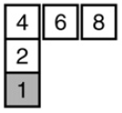
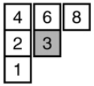
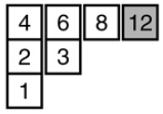
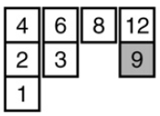
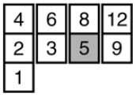
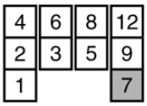
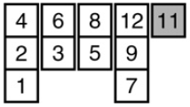
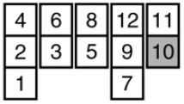
Greedy cover
S = 4, 6, 2, 8, 1, 3, 12, 9, 5, 7, 11, 10
Notes:
先講動機
1.
2. There are applications where the data items have a small amount of noise.

Slide 7
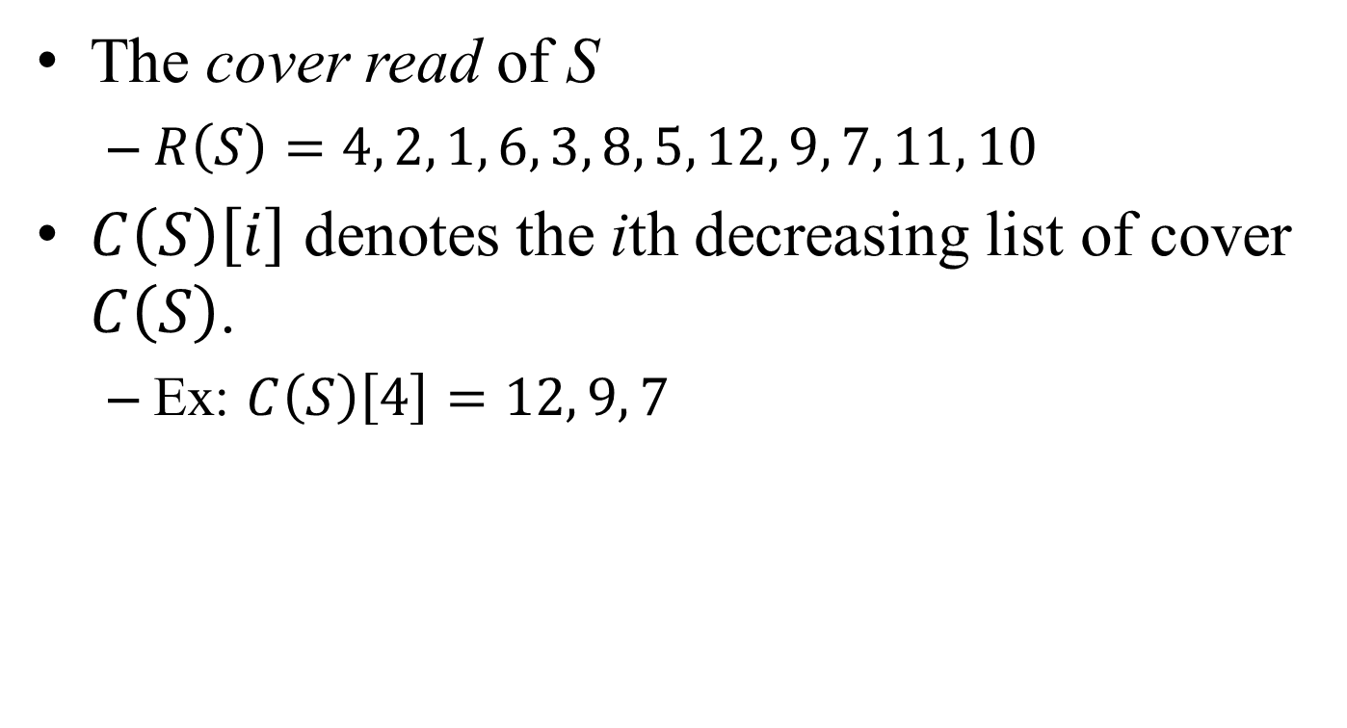
Greedy cover (cont.)
The cover read of S
$R\left(S\right)=4, 2, 1, 6, 3, 8, 5, 12, 9, 7, 11, 10$
$C\left(S\right)\left[i\right]$ denotes the ith decreasing list of cover $C\left(S\right)$.
Ex: $C\left(S\right)\left[4\right]=12, 9, 7$
Notes:
先講動機
1.
2. There are applications where the data items have a small amount of noise.

Slide 8

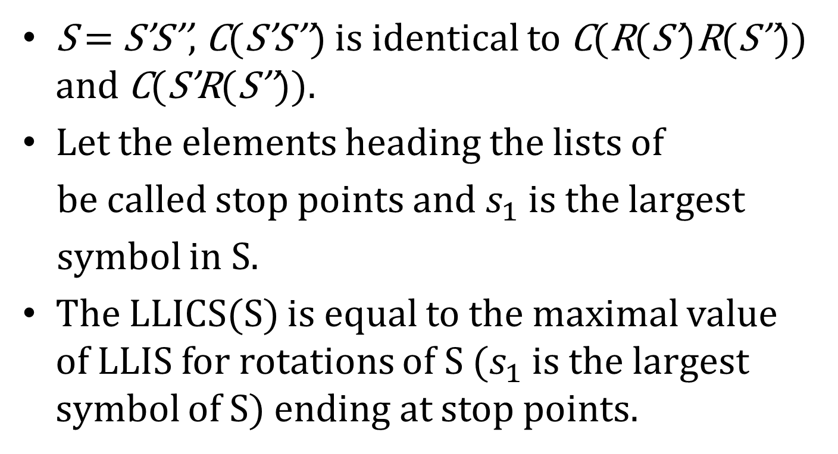
Lemmas and theorems
S = S’S’’, C(S’S’’) is identical to C(R(S’)R(S’’)) and C(S’R(S’’)).
Let the elements heading the lists of
be called stop points and $s_{1}$ is the largest
symbol in S.
The LLICS(S) is equal to the maximal value of LLIS for rotations of S ($s_{1}$ is the largest symbol of S) ending at stop points.
Notes:
先講動機
1.
2. There are applications where the data items have a small amount of noise.

Slide 9
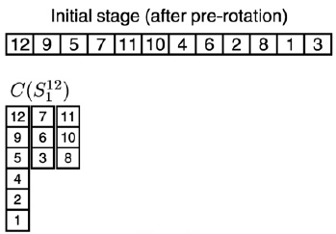
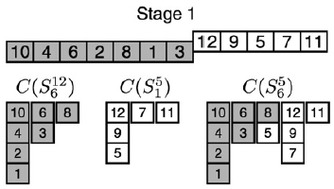
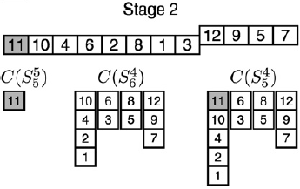
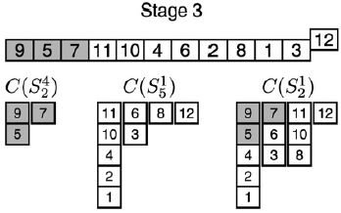
Stop pointers: 12, 7, 11
Notes:
先講動機
1.
2. There are applications where the data items have a small amount of noise.

Slide 10









Stop pointers: 12, 7, 11
Notes:
先講動機
1.
2. There are applications where the data items have a small amount of noise.

Slide 11



Stop pointers: 12, 7, 11
Notes:
先講動機
1.
2. There are applications where the data items have a small amount of noise.

Slide 12



Stop pointers: 12, 7, 11
Notes:
先講動機
1.
2. There are applications where the data items have a small amount of noise.

Slide 13

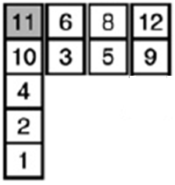


Stop pointers: 12, 7, 11
Notes:
先講動機
1.
2. There are applications where the data items have a small amount of noise.

Slide 14



Stop pointers: 12, 7, 11
Notes:
先講動機
1.
2. There are applications where the data items have a small amount of noise.

Slide 15



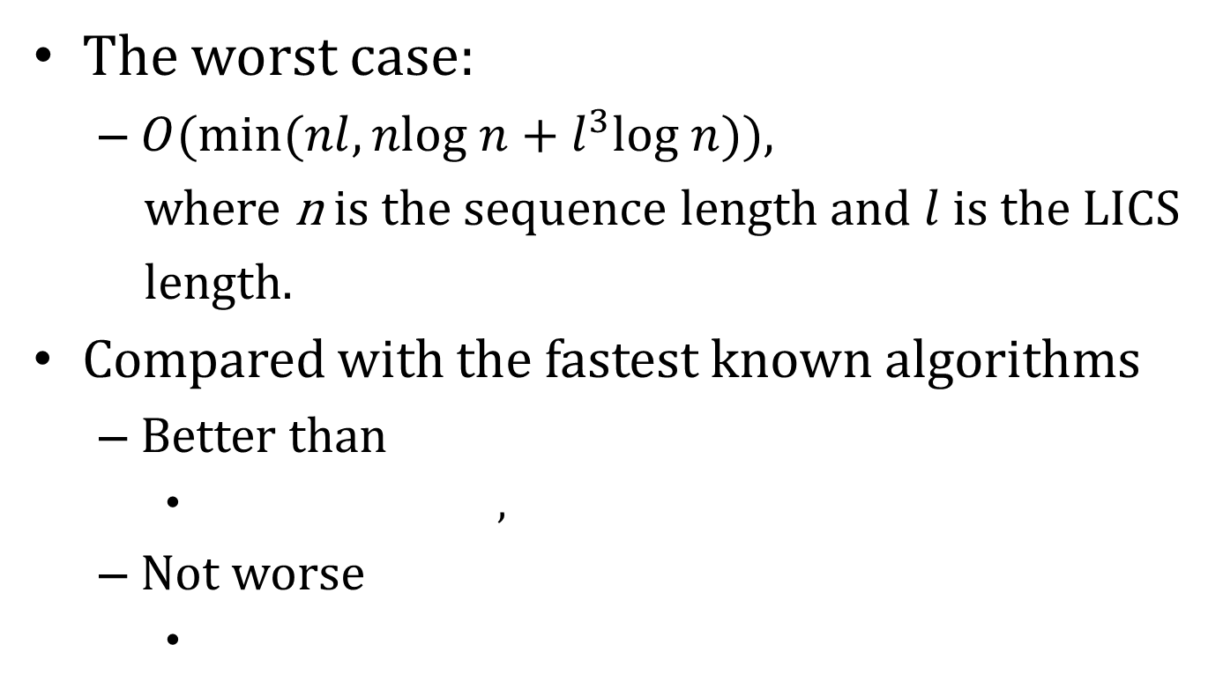
Conclusions
The worst case:
$O(min⁡(nl, nlog n+l^{3}log n))$,
where n is the sequence length and $l$ is the LICS
length.
Compared with the fastest known algorithms
Better than
,
Not worse
Notes:
先講動機
1.
2. There are applications where the data items have a small amount of noise.

