Slide 1
Highly-fair bakery algorithm using symmetric tokens Alex A. Aravind Information Processing Letters, Vol. 110, pp. 1155-1060, 2010
Presenter:Chen Yu shiun
Date:Nov. 23, 2010

Slide 2
Abstract
This note proposes a new version of the bakery algorithm that: (i) assures fair tie-breaking when two or more processes choose same token number; and (ii) bounds the token numbers within the range [−n,n]. The algorithm is simple and uses one additional shared bit.

Slide 3
Mutual Exclution
P1: i++
Global Variable i=1
i=?
P2: i++
Mutual exclusion algorithms are used in concurrent programming to avoid the simultaneous use of a common resource, such as a global variable, by pieces of computer code called critical sections.

Slide 4
Software Solution of Mutual Exclusion
P1
P2
Pn
……………………
Doorway
(Enter Section)
CS
(Critical Section)
Exit Section

Slide 5
Critical Section Design
Safety property
At any time, at most one process is allowed to access R.
Liveness property
When some processes are interested in accessing R, one of them eventually succeeds in accessing R.
Freedom from starvation property
Any process interested in accessing R will be able to do so in finite time.

Slide 6
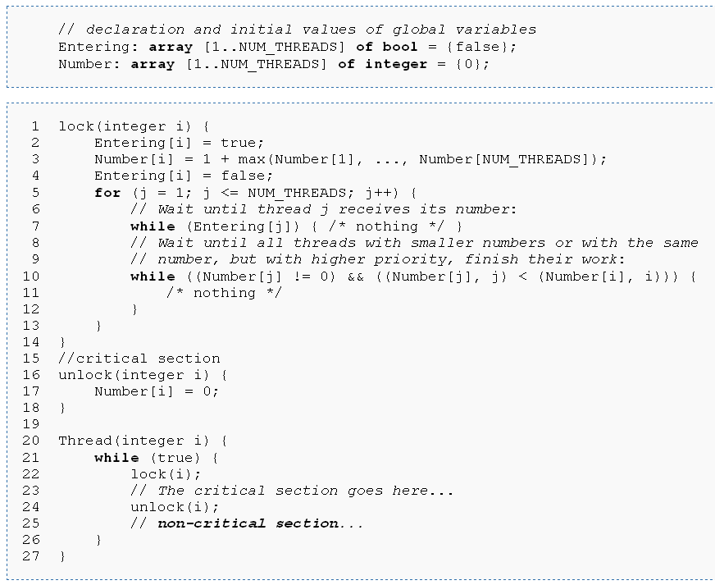
Bakery Algorithm
(Num[i],i) < (Num[j],j) means:
Num[i] < Num[j]
or
Num[i] = Num[j] and i<j

Slide 7
Disadvantages of original Bakery Algorithm
Lack of fairness
When a “tie” event occurs ,Bakery Algorithm are always in favor of smaller ids.
Overflow
The token n may overflow in 32bit system.

Slide 8
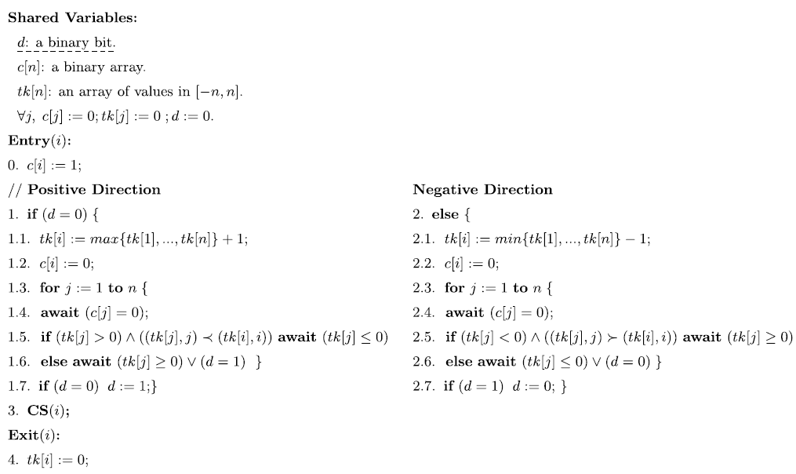
Symmetric Token Bakery Algorithm

Slide 9
SPIN Verification System
Target efficient software verification
Supports a high level language to specify systems descriptions
called PROMELA (a process META language)
Used to trace logical design errors in distributed systems design
such as operating systems, data communications protocols, switching systems, concurrent algorithms, railway signaling protocols, etc.
Checks the logical consistency of a specification
reports on deadlocks, unspecified receptions, flags incompleteness, race conditions
Provides direct support for the use of multi-core computers for model checking runs
supporting both safety and liveness verifications

Slide 10
Correctness Proofs
Theorem 3.1. Symmetric token bakery algorithm assures safety.
That is, i ∈ [1.7, 2.7, 3, 4] ∧ j ∈ [1.7, 2.7, 3, 4]⇒i = j.
Theorem 3.2. Symmetric token bakery algorithm assures liveness.
That is, when one or more processes interested in executing CS, one of them eventually succeeds in executing CS.
Theorem 3.3. Symmetric token bakery algorithm satisfies doorway based FIFO.
Theorem 3.4. Symmetric token bakery algorithm bounds the token numbers within the interval [−n,n].

Slide 11
Correctness Proofs
Theorem 3.1. Symmetric token bakery algorithm assures safety.
That is, i ∈ [1.7, 2.7, 3, 4] ∧ j ∈ [1.7, 2.7, 3, 4]⇒i = j.
Suppose d = 1. Let t be the latest time at which d was set to 1 (at line 1.7). This implies, process i must have computed tk[i], at line 1.1, before t and j must have computed tk[ j], at line 2.1, after t. In this case, process j must notice tk[i] > 0 and d = 1 at line 2.6 and therefore must be blocked there.

Slide 12
Correctness Proofs
Theorem 3.2. Symmetric token bakery algorithm assures liveness.
That is, when one or more processes interested in executing CS, one of them eventually succeeds in executing CS.
The process with the smallest token, say i, will not be blocked at line 1.5 by any other process with the same token type. If d = 1, then i will not be blocked by j, at line 1.7, and hence i will eventually access CS. If d = 0, then j will not be blocked by i, at line 2.7, and hence j will eventually access CS.

Slide 13
Correctness Proofs
Theorem 3.3. Symmetric token bakery algorithm satisfies doorway based FIFO.
We need to show that if a process i completes the execution of the doorway before another process j starts then i completes CS execution before j does.
Let t be the time at which the value has changed. By the safety property, this is possible only if no process had a negative token at time t. j must notice tk[i] > 0 and d = 1 at line 2.6 and therefore be blocked there until i completes its CS access.

Slide 14
Correctness Proofs
Theorem 3.4. Symmetric token bakery algorithm bounds the token numbers within the interval [−n,n].
Let t be the time of the most recent execution of the assignment statement d := 0. This assignment would be possible either by initialization or by a process with a negative token number. By the safety property, a process with a negative token number will set d := 0 only when no process with a positive token number is competing. That is, at time t, the token numbers of the processes in the system must be either 0 or negative. This implies that the first positive token number computed after t must be 1. Since n is the maximum number of processes in the system and each process can compute its token number as the current maximum plus 1, no process can compute a token number greater than n before d is set to 1 (by the process with the smallest positive token number). The process with the smallest positive token number will set d to 1 only when no process with a negative token number is competing. Now, the first negative token number computed must be −1. Since n is the maximum number of processes in the system and each process can compute its token number as the current minimum minus 1, no process can compute a token number less than −n before d is set to 0 (by the process with the largest negative token number). The pattern repeats keeping the token numbers within the range [−n,n].

Slide 15
Correctness Proofs
Theorem 3.5. Symmetric token bakery algorithm assures fair tie-breaking between any two competing processes.
The worst case will occur if ties in token numbers occur always with one type of tokens for all the processes. If all the ties occur always with positive token numbers in the symmetric token bakery algorithm, then they will be broken always in favor of smaller ids.

Slide 16
Conclusion
Space complexity
use 1 extra binary variable than bakery algorithm
Time complexity
Use 2 extra checks (on line 1 and 1.7/2.7)
Simplicity

Slide 17
Thank you!!!

