Slide 1
A Hybrid Algorithm for the Longest Common Transposition-Invariant Subsequence Problem
S. Deorowicz and S. Grabowski
Computing and Informatics, Vol. 28, No. 5, pp. 729-744, 2009
Presenter: Chiou-Ting Tseng
Date: Jan 18, 2011

Slide 2
Abstract
The longest common transposition-invariant subsequence (LCTS) problem is a music information retrieval oriented variation of the classic LCS problem. There are basically only two known efficient approaches to calculate the length of the LCTS, one based on sparse dynamic programming and the other on bit-parallelism. In this work, we propose a hybrid algorithm picking the better of the two algorithms for individual subproblems. Experiments on music (MIDI), with 32-bit and 64-bit implementations, show that the proposed algorithm outperforms the faster of the two component algorithms by a factor of 1.4-2.0, depending on sequence lengths.

Slide 3
Abstract
Similar, if not better, improvements can be observed for random data with Gaussian distribution. Also for uniformly random data, the hybrid algorithm is the winner if the alphabet is neither too small (at least 32 symbols) nor too large (up to 128 symbols). Part of the success of our scheme is attributed to a quite robust component selection heuristic.

Slide 4
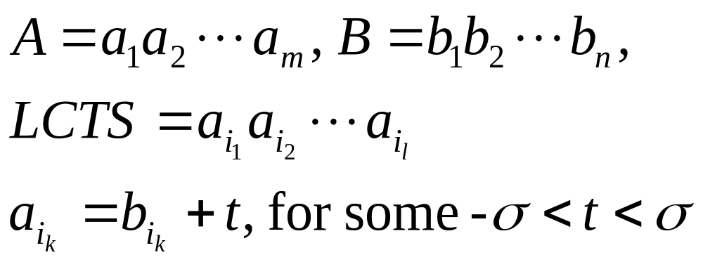
Longest Common Transposition -
Invariant Subsequence (LCTS)
Σ={0,…, σ-1}
A=13467, B=2468, LCS=46
LCTS=137, for t=-1
This corresponds to a music phrase (melody) shifted to another key, which is perceived by humans as the same melody.

Slide 5
Algorithms
Naïve: Run the dynamic programming algorithm independently for each transposition, which yields O(mnσ) time.
Almost all existing better solutions belong to one of the two categories: they are bit-parallel or based on sparse dynamic programming.

Slide 6
Sparse Dynamic Programming
A technique of visiting only selected cells of the DP matrix, namely those corresponding to matching pairs of characters of A and B.
For the LCS problem, this technique was first used in the seminal paper by Hunt and Szymanski, and to apply it for the LCTS it was basically enough to notice that each cell in the DP matrix corresponds to exactly one transposition.
O(mnlog log σ) time complexity.

Slide 7
Hunt-Szymanski LCS Algorithm
By extending the idea in RSK algorithm, the LCS problem can be solved in O(rlogn) time, where r denotes the number of matches.
This algorithm is faster than traditional dynamic programming if r is small.

Slide 8
The Pairs of Matching
Input sequences: TAGTCACG and AGACTGTC
Pairs of matching:
 | A | G | A | C | T | G | T | C
T
A
G
T
C
A
C
G
(1,5) | (1,7)
(2,1) | (2,3)
(3,2) | (3,6)
(4,5) | (4,7)
(5,4) | (5,8)
(6,1) | (6,3)
(7,4) | (7,8)
(8,2) | (8,6)

Slide 9
Example for Hunt-Szymanski Algorithm
The insertion order is row major and column backward.
 | (1,7) | (1,5) | (2,3) | (2,1) | (3,6) | (3,2) | (4,7) | (4,5) | (5,8) | (5,4)
1 | (1,7) | (1,5) | (2,3) | (2,1) | (2,1) | (2,1) | (2,1) | (2,1) | (2,1) | (2,1)
2 |  |  |  |  | (3,6) | (3,2) | (3,2) | (3,2) | (3,2) | (3,2)
3 |  |  |  |  |  |  | (4,7) | (4,5) | (4,5) | (5,4)
4 |  |  |  |  |  |  |  |  | (5,8) | (5,8)
L
Exercise: Please fill out the rest parts by yourself.
Time Complexity: O(rlogn), r: # of matches
Each match needs O(logn) time for binary search.

Slide 10
Main Idea
In this paper, we present a hybrid algorithm for LCTS making use of a simple observation: if the alphabet is small, the bit-parallel approach is a clear winner, but for large enough alphabets sparse dynamic programming algorithms starts to dominate.
Our idea is to use the bit -parallel technique for frequent transpositions and the Hunt –Szymanski algorithm for the rare ones.

Slide 11
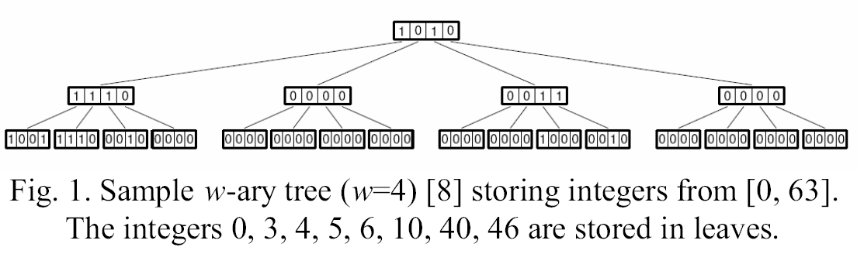
The Deorowicz Refinement
In Deorowicz’s LCTS algorithm, one w-ary tree is used for each transposition, each tree stores the values of the T array for the corresponding transposition.
O(mnlogσ/log w) worst-case time

Slide 12
The Deorowicz Refinement
To check if j is in the tree, it is enough to examine one particular bit in a certain leaf, which takes O(1) time.
Inserting or removing a value needs to set or reset the corresponding bit in the leaf and update the nodes upward the tree, with the overall complexity of O(log v / logw).
The successor operation for j requires looking for the next set bit in the leaf corresponding to value j (which can be done in constant time), and if there is no such set bit, moving upward the tree and following analogously until such a bit is found.
Because each node is handled in O(1) time, the overall time complexity is again O(log v / log w).

Slide 13
Bit-parallelism
Widely used technique in string matching, making use of the simple fact that any real CPU works on several bits in parallel (usually 32 or 64 nowadays).
For LCS, there are known algorithms of O(mn/w) worst case time complexity, where w is the machine word size (in bits).
Run the LCS routine for each of the 2σ – 1 transpositions separately, achieving O(mnσ/w) time complexity

Slide 14
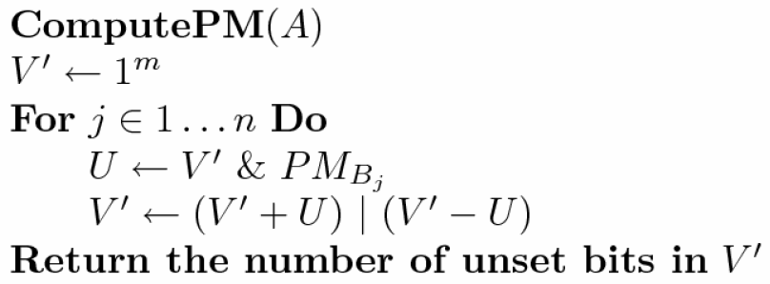
HyyrЦ Algorithm

Slide 15
Example
A =AGACTGTC, B=TAGTCACGT, m=8, n=9
A’=CTGTCAGA
A 00000101
G 00100010
C 10001000
T 01010000
O(σ⎡m/w⎤+m) time, O(σm) bits of space

Slide 16
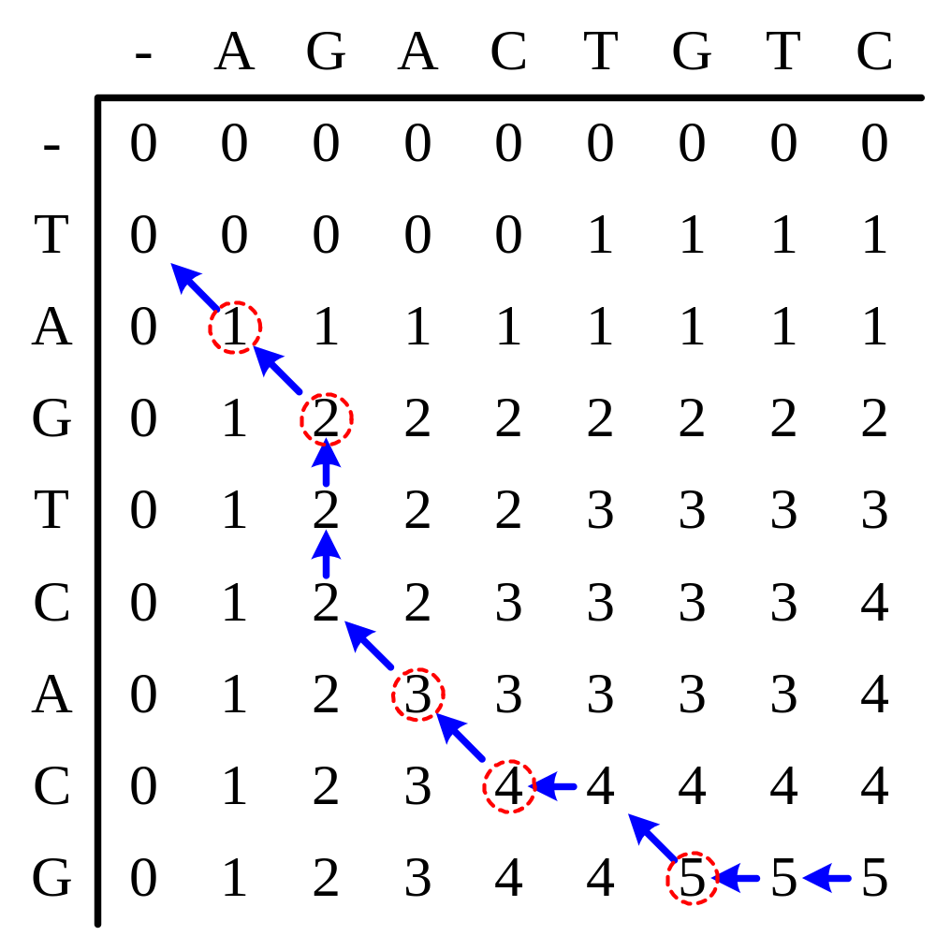
S₂
S₁
TAGTCACG
AGACTGTC
LCS:AGACG
After matrix A has been found, we can trace back to find the LCS.

Slide 17
Example-reverse
A =AGACTGTC, B=TAGTCACGT, m=8, n=9
V’ =11111111
j=1
PM =01010000
U =01010000
V’+U=01001111
V’-U=10101111
V’ =11101111

Slide 18
Example-reverse
A =AGACTGTC, B=TAGTCACGT, m=8, n=9
V’ =11101111
j=2
PM =00000101
U =00000101
V’+U=11110100
V’-U=11101010
V’ =11111110

Slide 19
Example-reverse
A =AGACTGTC, B=TAGTCACGT, m=8, n=9
V’ =11111110
j=3
PM =00100010
U =00100010
V’+U=00100000
V’-U=11011100
V’ =11111100

Slide 20
Example-reverse
A =AGACTGTC, B=TAGTCACGT, m=8, n=9
V’ =11111100
j=4
PM =01010000
U =01010000
V’+U=01001100
V’-U=10101100
V’ =11101100

Slide 21
Example-reverse
A =AGACTGTC, B=TAGTCACGT, m=8, n=9
V’ =11101100
j=5
PM =10001000
U =10001000
V’+U=01110100
V’-U=01100100
V’ =01110100

Slide 22
Example-reverse
A =AGACTGTC, B=TAGTCACGT, m=8, n=9
V’ =01110100
j=6
PM =01010000
U =01010000
V’+U=11000100
V’-U=00100100
V’ =11100100

Slide 23
Example-reverse
A =AGACTGTC, B=TAGTCACGT, m=8, n=9
V’ =11100100
j=7
PM =10001000
U =10000000
V’+U=01100100
V’-U=11100100
V’ =11100100

Slide 24
Example-reverse
A =AGACTGTC, B=TAGTCACGT, m=8, n=9
V’ =11100100
j=8
PM =01010000
U =01000000
V’+U=00100100
V’-U=10100100
V’ =10100100

Slide 25
Example-reverse
A =AGACTGTC, B=TAGTCACGT, m=8, n=9
V’ =10100100
j=9
PM =01010000
U =00000000
V’+U=10100100
V’-U=10100100
V’ =10100100

Slide 26
Experimental Results
Concatenation of 7543 music pieces, obtained by extracting the pitch values from MIDI files.
The total length is 1,828,089 bytes.
The pitch values are in the range 0...127, which corresponds to 255 possible transpositions.
This data is far from random: the six most frequent pitch values occur 915,082 times, which is approximately 50% of the whole text, and the total number of different pitch values is just 55.

Slide 27
Experimental Results
A set of 101 pairs of randomly extracted excerpts(片段) from the text was generated. We varied the lengths, n and m, of those sequences, but always set n = m.
Next slide demonstrates the relation between the (percentage) amount of most frequent transpositions and the amount of matches covered by them.
但是兩首歌之間不同的部份用不同的transposition好像怪怪的。

Slide 28
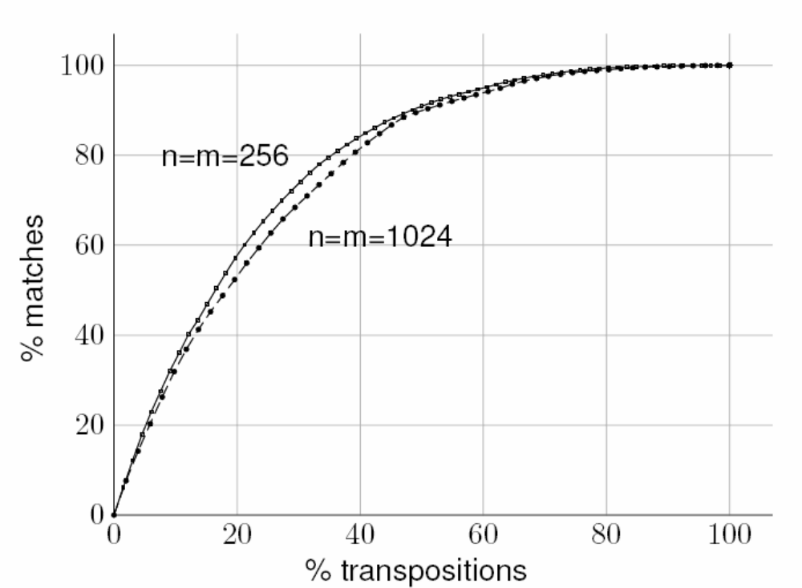
Experimental Results

Slide 29
Experimental Results
Figs 4–9 show the overall processing time of our hybrid in the function of the percentage of the matches handled by the bit-parallel component.

Slide 30
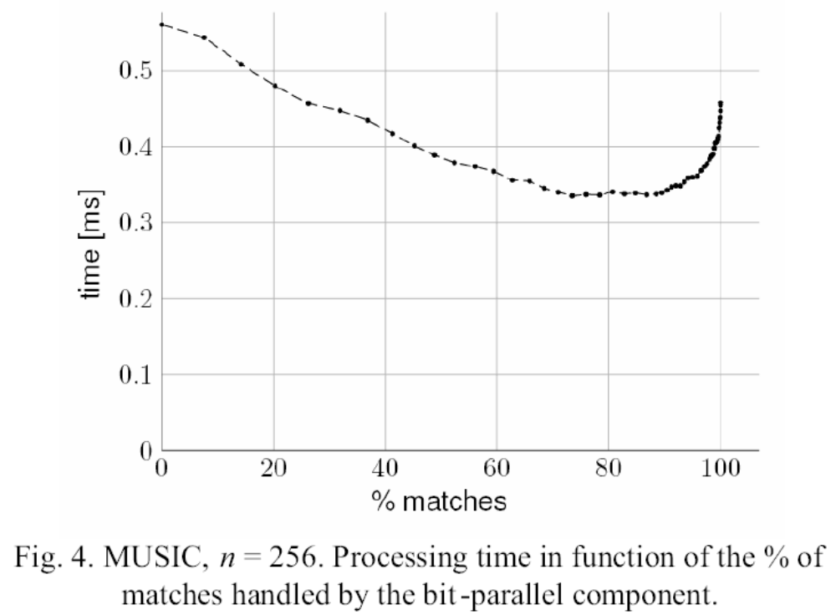
Experimental Results

Slide 31
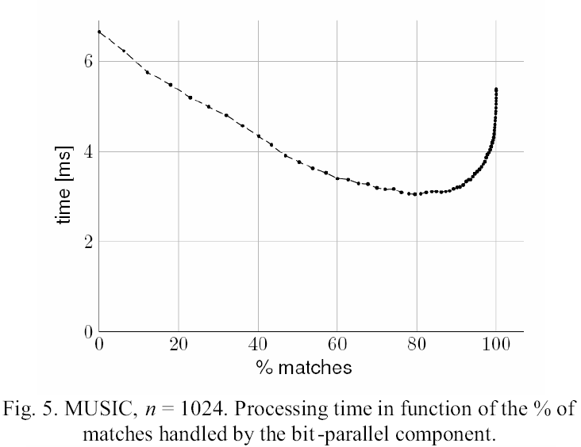
Experimental Results

Slide 32
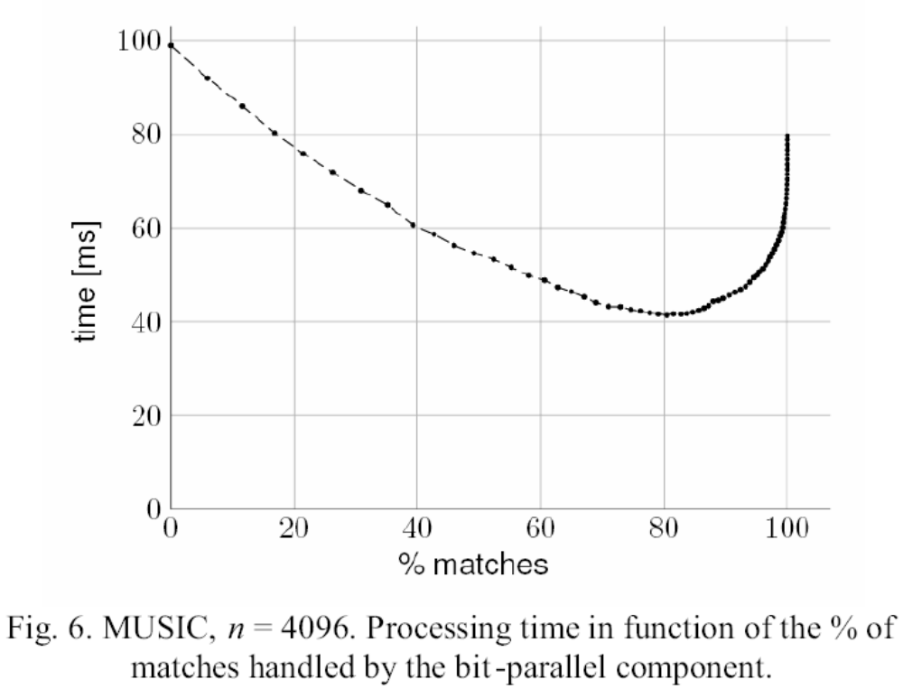
Experimental Results

Slide 33
Experimental Results
For the music data, the best split is to have about 80% matches (from the most frequent transpositions) handled by the BP algorithm, while the remaining 20% matches handled by the HS variant.
In other words, less than 40% of the most frequent transpositions should be processed by BP.

Slide 34
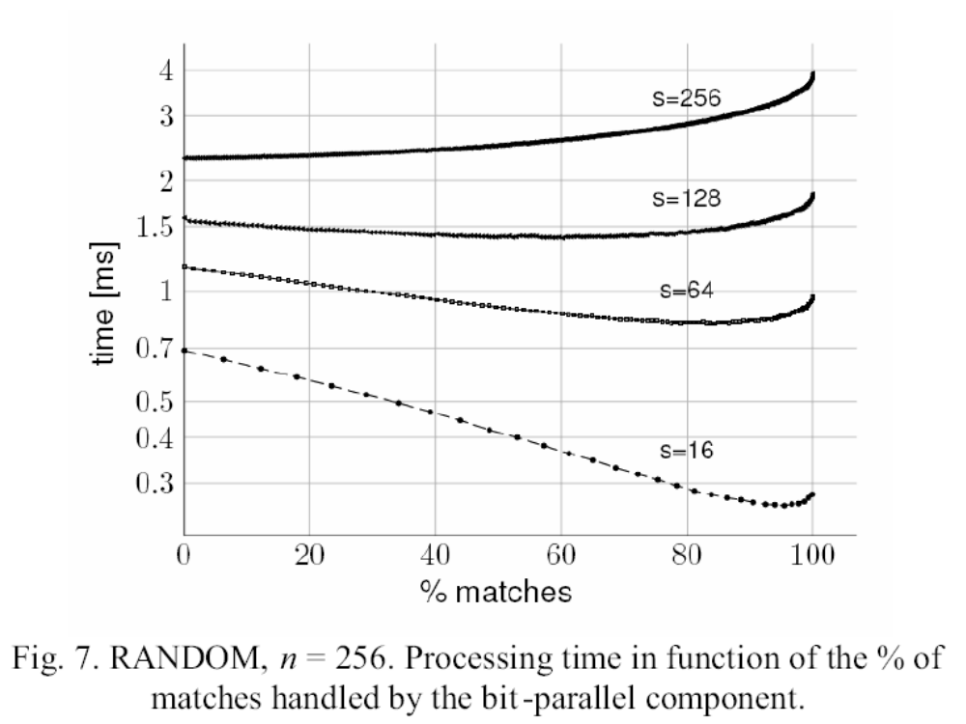
Experimental Results

Slide 35
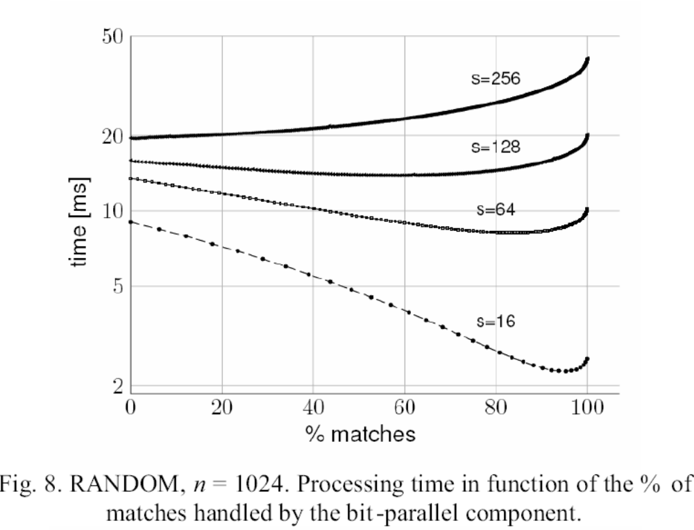
Experimental Results

Slide 36
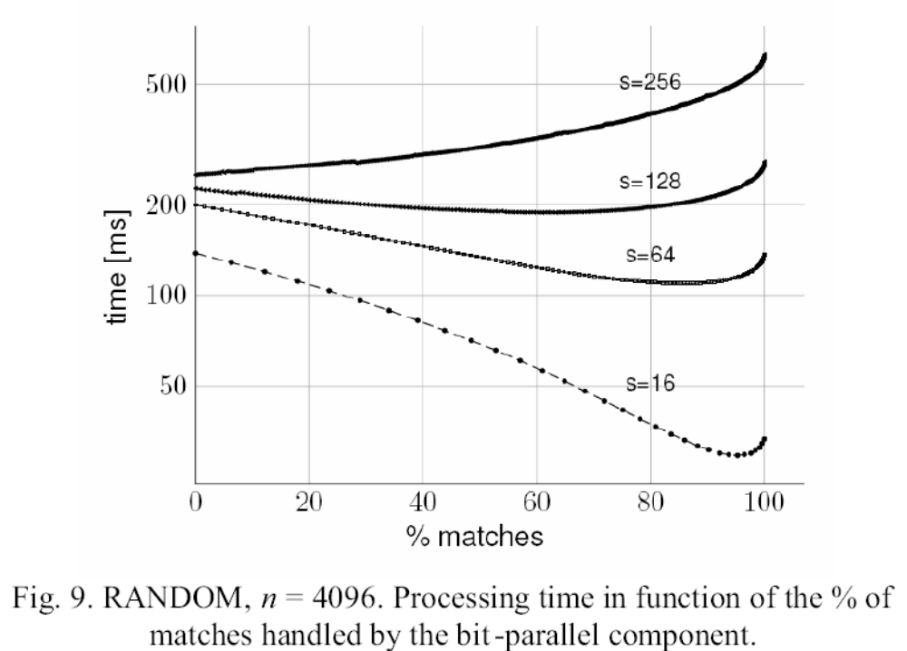
Experimental Results

Slide 37
Experimental Results
For small to moderate σ(up to 64) the bit-parallel algorithm is much faster than the HS one, but the picture changes for σ= 128 and σ= 256.

Slide 39
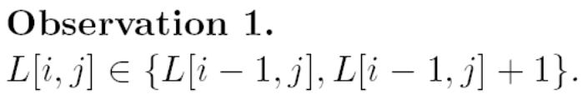
Background

Slide 40
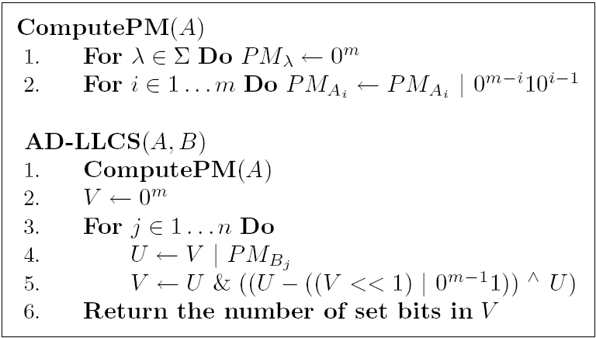
Allison-Dix

Slide 41
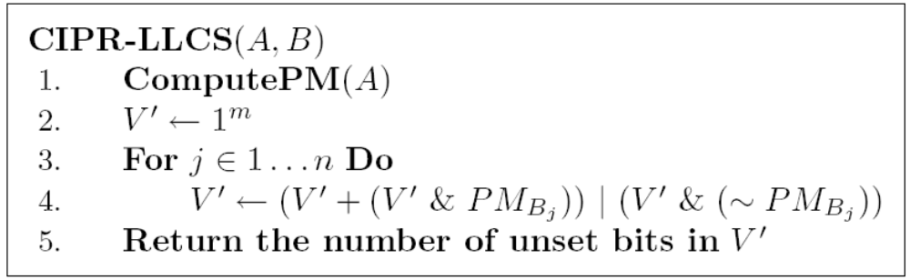
Crochemore

