Slide 1
MAGIIC-PRO: detecting functional signatures by efficient discovery of long patterns in protein sequences Chen-Ming Hsu, Chien-Yu Chen, and Baw-Jhiune Liu Nucleic Acids Research, Web Server issue, Vol. 34, pp. 356-361, 2006.
Presenter: Hong-Yu Chen
Date: May 31, 2011

Slide 2
Abstract (1/3)
This paper presents a web service named MAGIICPRO, which aims to discover functional signatures of a query protein by sequential pattern mining. Automatic discovery of patterns from unaligned biological sequences is an important problem in molecular biology. MAGIIC-PRO is different from several previously established methods performing similar tasks in two major ways.

Slide 3
Abstract (2/3)
The first remarkable feature of MAGIIC-PRO is its efficiency in delivering long patterns. With incorporating a new type of gap constraints and some of the state-of-the-art data mining techniques, MAGIIC-PRO usually identifies satisfied patterns within an acceptable response time. The efficiency of MAGIIC-PRO enables the users to quickly discover functional signatures of which the residues are not from only one region of the protein sequences or are only conserved in few members of a protein family.

Slide 4
Abstract (3/3)
The second remarkable feature of MAGIICPRO is its effort in refining the mining results. Considering large flexible gaps improves the completeness of the derived functional signatures. The users can be directly guided to the patterns with as many blocks as that are conserved simultaneously. In this paper, we show by experiments that MAGIIC-PRO is efficient and effective in identifying ligand-binding sites and hot regions in protein–protein interactions directly from sequences. The web service is available at http://biominer.bime.ntu.edu.tw/magiicpro.

Slide 5
MAGIIC-PRO
Web service
To discover functional signatures of a query protein by sequential pattern mining
Remarkable feature
efficiency in delivering long patterns
effort in refining the mining results
Considering large flexible gaps improves the completeness of the derived functional signatures

Slide 6
When compared with the approaches based on multiple sequence alignment in identifying functional regions, pattern mining algorithms have the advantage of automatically determining the subset of sequences involved in the final mining results.

Slide 7
Description models
Regular expressions (deterministic model)
Profiles (probabilistic model)
Hidden Markov models (probabilistic model)
Exact components in a pattern
Ex. N-R-x(5,19)-Y-x-G-x(3)-D
rigid gaps, a gap of fixed length
flexible gap, a gap of flexible length

Slide 8
Method
(Rigid) intra-block gaps
the gaps within a conserved region
in protein sequences that insertions and deletions are seldom present in highly conserved regions
inter-block gaps
the gaps in between two adjacent conserved regions
considering only rigid gaps within a block is useful in eliminating noisy patterns

Slide 9
Steps
MAGIIC-PRO first quickly identifies rigid gapped blocks by bounded-prefix growth technique of MAGIIC.
After that, the candidate blocks are concatenated into patterns with large irregular gaps by exploiting the antimonotone characteristic of this problem.

Slide 10
Input
A protein sequence
Prepare the training data for pattern mining
Collecting relative sequences of the query protein
Swiss-Prot annotations
PSI-BLAST

Slide 11
Parameters (1/4)
Minimum support constraint
A pattern with a high support usually highlight the most highly conserved residues regarding a functional region, while a large-size but low-support pattern in general provides a complete signature with respect to a function site.
Most patterns with the maximum support are related to a functional site of the query protein but do not serve as a complete signature of a functional site.

Slide 12
Parameters (2/4)
Pattern block
An exact pattern is composed of more than one pattern elements as a sequence, in which between each successive pair of pattern elements is a rigid or flexible gap.
Gap constraints
intra-block gaps, rigid gap, x(a)
inter-block gaps, flexible gap, x(a,b), a < b
{I-x-H-N-P-x-C-x(30,68)-E-x(2)-L-x-K-x-I}

Slide 13
Parameters (3/4) First group, specifies the gap constraints
The maximum length of an intra-block gap (default: 3)
The minimum length of an inter-block gap (default: the max. length of an intra-block gap + 1)
{I-x-H-N-P-x-C-x(30,68)-E-x(2)-L-x-K-x-I}
The maximum relative flexibility of an inter-block gap (default value = 30%)
Let l be the length of inter-block gap in the query protein which connects two successive pattern blocks.
Lower bound of the inter-block gap: (1 - fmax)*l
Upper bound of the inter-block gap: (1 + fmax)*l

Slide 14
Parameters (4/4) Second group, specifies the size constraints
The minimum size of a block (default value = 3)
The minimum number of blocks in a pattern (default value = 2)
We argue that a pattern should have at least two blocks to be meaningful, because an important region is seldom to be conserved singly either from structural or functional aspects.
{I-x-H-N-P-x-C-x(30,68)-E-x(2)-L-x-K-x-I}

Slide 15
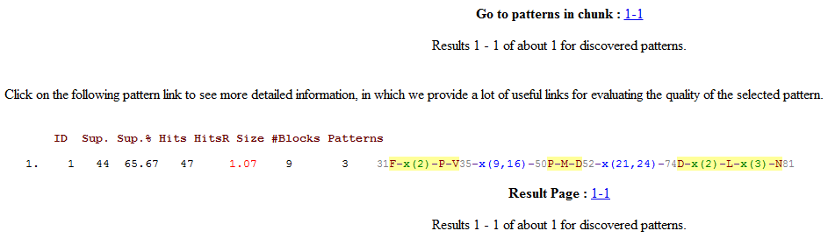
Output

Slide 16
the locations of the pattern in its supporting sequences
plotted with a protein structure if there are PDB entries available
fed to the ScanProsite web service to check its selectivity, the ability to reject false positive matches.
Perform a multiple sequence alignment on the segments of supporting sequences that are associated with the selected pattern.
aligns each excluded sequence with the segment of the query protein.

Slide 17
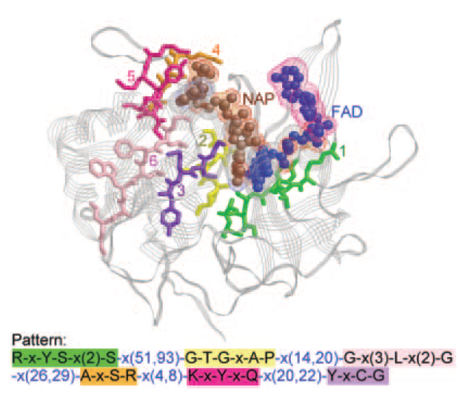

Slide 18
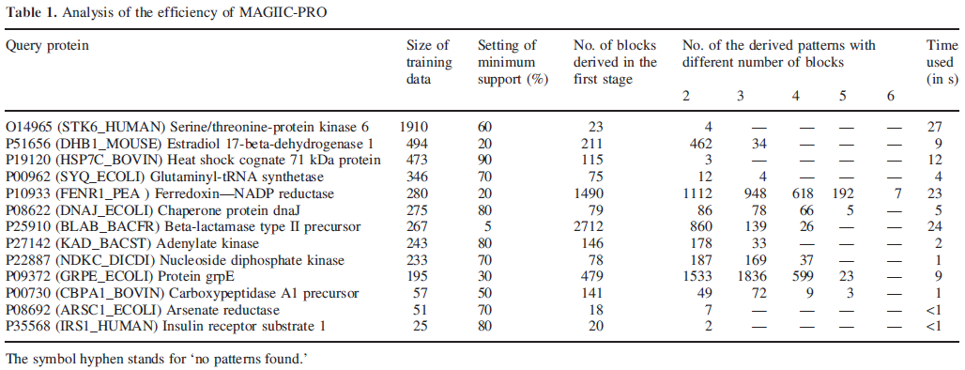

Slide 19
