Slide 1
On the Wiberg Algorithm for Matrix Factorization in the Presence of Missing Components
Takayuki Okatani (岡谷准) and Koichiro Deguchi (出口光一郎)
Graduate School of Information Sciences, Tohoku University (東北大學), Sendai, Japan
International Journal on Computer Vision, Vol. 72(3), pp. 329-337, 2007
Presenter: Hung-Hsin Chen (陳紘昕)
Date: July 19, 2011

Slide 2
Abstract (1/2)
This paper considers the problem of factorizing a matrix with missing components into a product of two smaller matrices, also known as principal component analysis with missing data (PCAMD). The Wiberg algorithm is a numerical algorithm developed for the problem in the community of applied mathematics. We argue that the algorithm has not been correctly understood in the computer vision community. Although there are many studies in our community, almost every one of which refers to the Wiberg study, as far as we know, there is no literature in which the performance of the Wiberg algorithm is investigated or the detail of the algorithm is presented. In this paper, we present derivation of the algorithm along with a problem in its implementation that needs to be carefully considered, and then examine its performance.

Slide 3
Abstract (2/2)
The experimental results demonstrate that the Wiberg algorithm shows a considerably good performance, which should contradict the conventional view in our community, namely that minimization-based algorithms tend to fail to converge to a global minimum relatively frequently. The performance of the Wiberg algorithm is such that even starting with random initial values, it converges in most cases to a correct solution, even when the matrix has many missing components and the data are contaminated with very strong noise. Our conclusion is that the Wiberg algorithm can also be used as a standard algorithm for the problems of computer vision.

Slide 4
Data representation
Partial iris flower data set:
Attributes (features) |  |  |  | Class
Sepal Length | Sepal Width | Petal Length | Petal Width | Species
5.1 | 3.5 | 1.4 | 0.2 | setosa
4.9 | 3 | 1.4 | 0.2 | setosa
4.7 | 3.2 | 1.3 | 0.2 | setosa
4.6 | 3.1 | 1.5 | 0.2 | setosa
5 | 3.6 | 1.4 | 0.2 | setosa
0 | 3.2 | 4.7 | 1.4 | versicolor
6.4 | 3.2 | 4.5 | 1.5 | versicolor
6.9 | 3.1 | 4.9 | 1.5 | versicolor
5.5 | 2.3 | 4 | 1.3 | versicolor
6.5 | 2.8 | 4.6 | 1.5 | versicolor
6.3 | 3.3 | 6 | 2.5 | virginica
5.8 | 2.7 | 5.1 | 1.9 | virginica
7.1 | 3 | 5.9 | 2.1 | virginica
6.3 | 2.9 | 5.6 | 1.8 | virginica
6.5 | 3 | 5.8 | 2.2 | virginica
One data is usually called a point or an instance
We can treat the attributes as a matrix.

Slide 5



Each image is also a matrix:

Slide 6
Matrix decomposition
Y: data set
μ: mean vector (row vector)
Do the matrices U and V exist?

Slide 7
Singular value decomposition (SVD)

Slide 9
Object function
Some components of Y are missing
U, V , μ are unknown (to be estimated)
.* component-wise product

Slide 10
將Y以row major方式轉換成vector y，U,V也改寫成vector u, v
在此u_{i,} r_{j}為row vector

Slide 11
U,V為我們所要估計的矩陣，假設U, V已知(正常應為未知狀態)，
改寫為vector form如下:

Slide 12
改成vector form之後，object function可改寫成:

Slide 13
If some components in Y are missing, then corresponding matrix F and G are also modified:

Slide 14
若Y拆解成U, V, μ 的形式:
改成vector form之後，object function可改寫成(F與前式相同, G, v改變):

Slide 15
Alternated least square (ALS) algorithm
Input: matrix Y (some components are missing)
Output: vector u and vector v which are the optimal solution of φ(u, v)
We want to minimize φ(u, v). i.e.

Slide 16
Randomly given u⁽⁰⁾, v⁽⁰⁾
使用u^{(n)}, v^{(n)}分別建出矩陣G, F
固定v^{(n)},計算u^{(n+1)}=(F^{T}F)⁻¹F^{T}y 直到u^{(n+1)}之值的變動量小於ε
固定u^{(n+1)}, 計算v^{(n+1)}=(G^{T}G)⁻¹G^{T}y 直到v^{(n+1)}之值的變動量小於ε
若object function收斂，則停止，否則回到step2
There is no guarantee to the speed of its convergence.
It tends to be quite slow, especially for “badly conditioned” data such as there are many missing components and strong noise.

Slide 17
ALS algorithm Python code
#orignal y=[4, 6, 8 ,12, 12 ,18], lack of 2 components (6, 12)
y = np.array([4, 8, 12, 18])
#randomly initialize u and v
u = np.random.rand(1, 6)
v = np.random.rand(1, 4)
print "u:%s\n v:%s"%(u, v)
print u.shape
print v.shape
#use vectors u, v to construct matrics F, G, respectively
'''
Y=[y11, y12, y21, y22, y31, y32].T, lack of y12 and y31
y=[y11, y21, y22, y32].T
u=[u11, u12, u21, u22, u31, u32].T
v=[v11, v12, v21, v22].T
F=[[v11, v12, 0, 0, 0, 0],
[ 0, 0, v11, v12, 0, 0],
[ 0, 0, v21, v22, 0, 0],
[ 0, 0, 0, 0, v21, v22]]
G=[[u11, u12, 0, 0],
[u21, u22, 0, 0],
[0, 0, u21, u22],
[0, 0, u31, u32]]
'''

Slide 18
for idx in xrange(1000):
u_converge, v_converge = False, False
u_cnt, v_cnt=0,0
while u_converge is False:
#fix v, update u to local optimal
F = np.zeros((4, 6))
F[0,0], F[0,1]= v[0,0], v[0,1]
F[1,2], F[1,3]= v[0,0], v[0,1]
F[2,2], F[2,3]= v[0,2], v[0,3]
F[3,4], F[3,5]= v[0,2], v[0,3]
F = np.asmatrix(F)
# print F
#use pseudo inverse to calculate (F.T*F)^(-1)
new_u = lg.pinv(F.T*F)*F.T*np.asmatrix(y).T
u_distance= lg.norm(new_u-u.T)
u_converge = True if u_distance < 1e-30 else False
u = new_u.T
u_cnt+=1
print "%d iters, cnt %d, u: %s"%(idx, u_cnt, u)
while v_converge is False:
#fix u, update v to local optimal
G = np.zeros((4, 4))
G[0,0], G[0,1]= u[0,0], u[0,1]
G[1,0], G[1,1]= u[0,2], u[0,3]
G[2,2], G[2,3]= u[0,2], u[0,3]
G[3,2], G[3,3]= u[0,4], u[0,5]
G = np.asmatrix(G)
# print G
new_v = lg.pinv(G.T*G)*G.T*np.asmatrix(y).T
v_distance= lg.norm(new_v-v.T)
v_converge = True if v_distance < 1e-30 else False
v = new_v.T
v_cnt+=1
print "%d iters,cnt %d, v: %s"%(idx, v_cnt, v)
obj_mtx = F*u.T-np.asmatrix(y).T
obj_value =(obj_mtx.T*obj_mtx)[0][0]
print "object fuction value: %s"%(obj_value)

Slide 19
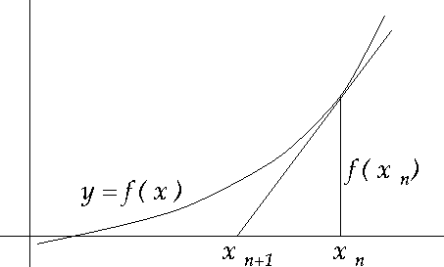
Newton method to find extreme values
Find the root of f(x) => f(x)=0
f(x^{(n)})/f’(x^{(n)})
To find extreme values of f(x) => f’(x)=0

Slide 20
Minimum of the sum of squares
Given m functions of n variables X=(x₁, x₂,…x_{n}), with m>=n
The algorithm finds the minimum of the sum of squares:
J_{r}: Jacobian matrix for function r

Slide 23
Gauss-Newton algorithm

Slide 24
Example (wikipedia):
i | 1 | 2 | 3 | 4 | 5 | 6 | 7
x | 0.038 | 0.194 | 0.425 | 0.626 | 1.253 | 2.500 | 3.740
y | 0.05 | 0.127 | 0.094 | 0.2122 | 0.2729 | 0.2665 | 0.3317
Find a curve model to fit the data:
The residual:
Object function:
ith row of theJacobian matrix:

Slide 25
Randomly give initial point:
To solve the normal equation to get ∆ :

Slide 26
The solution of ∆ :
Update the point:
After 5 iterations, we can optimal values:

Slide 27
Gauss-Newton algorithm Python code
X= np.array([0.038, 0.194, 0.425, 0.626, 1.253, 2.500, 3.740])
Y= np.array([0.050, 0.127, 0.094, 0.2122, 0.2729, 0.2665, 0.3317])
B1, B2= 0.9, 0.2
for i in range(6):
part = []
for el in X:
part.append([-el/(B2+el), B1*el/((B2+el)*(B2+el))])
Jr =np.matrix(part)
r = np.matrix(Y - B1*X/(B2+X))
db1, db2 = (Jr.T*Jr).I*Jr.T*r.T
B1 = float(B1 - db1)
B2 = float(B2 - db2)
print "%d iterations, %.4f RSS, (B1,B2)=(%.4f, %.4f)”%(i+1, r.sum(), B1, B2)
Results:
1 iterations, -2.9904 RSS, (B1,B2)=(0.3327, 0.2602)
2 iterations, -0.1593 RSS, (B1,B2)=(0.3428, 0.4261)
3 iterations, -0.0126 RSS, (B1,B2)=(0.3578, 0.5295)
4 iterations, 0.0211 RSS, (B1,B2)=(0.3614, 0.5537)
5 iterations, 0.0272 RSS, (B1,B2)=(0.3618, 0.5561)
6 iterations, 0.0277 RSS, (B1,B2)=(0.3618, 0.5563)

Slide 28
Wiberg algorithm
由ALS求解過程中，可知給定v，可計算出u的值，所以將u視為v的函數:
改寫object function:
If we use Gauss-Newton algorithm for solving vector v:

Slide 29
We want to calculate the value:

Slide 30
Q_{F} is a projector to the space orthogonal to the column space of F, then
Note: the minimization does not have a unique solution, since Q_{F}G is always singular

Slide 31
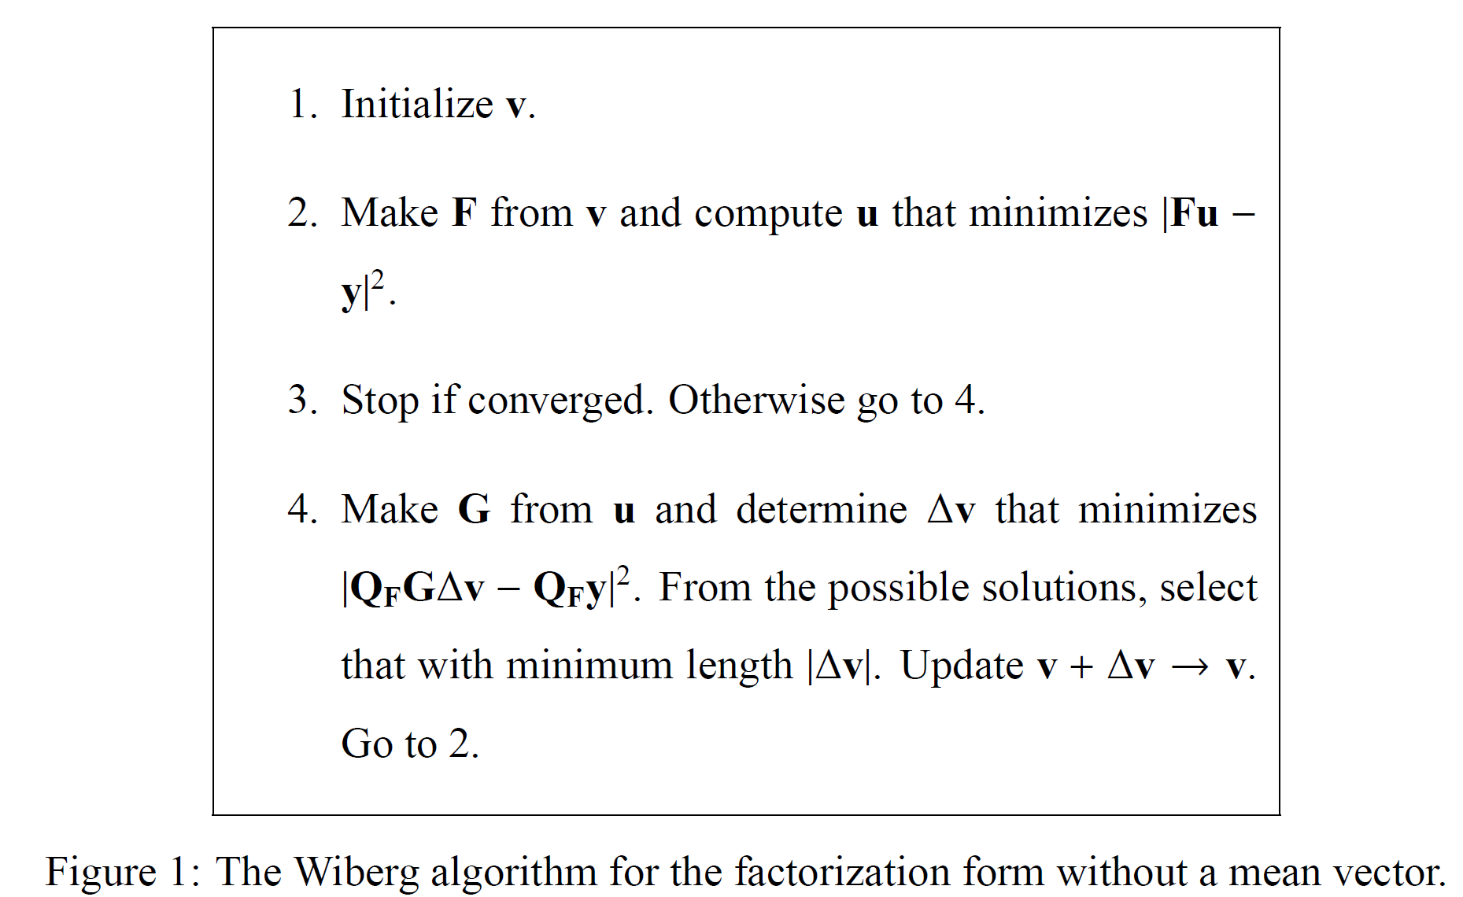
Step2: time complexity O(mnr²)
Step4: time complexity O(pn²r²) (larger than step2)

Slide 32
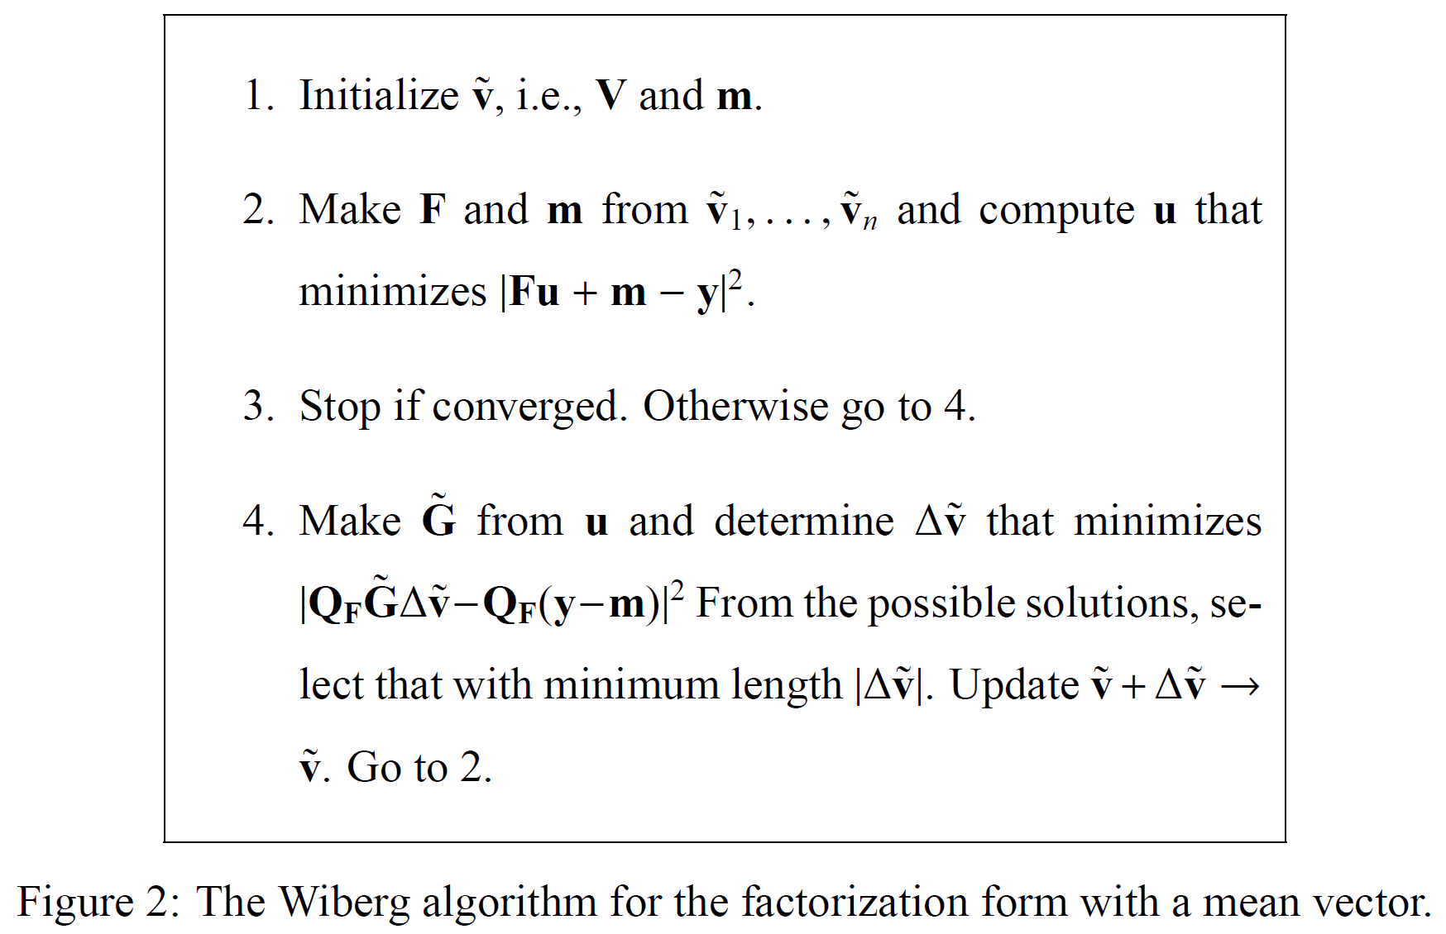

Slide 33
Experimental results-synthetic data
Matrics of 30*20 (m=30, n=20) with rank r= 3
Each component y_{ij} is randomly values
y_{ij}=u_{i}^{T}v_{j}+μ_{j}+ε_{ij}, where u_{i}, v_{j}, μ_{j}~N(0, 1)
ε_{ij} ~N(0, 0.05²) (5% noise)
Missing components are chosen randomly
500 trials
30% and 60% missing components

Slide 34
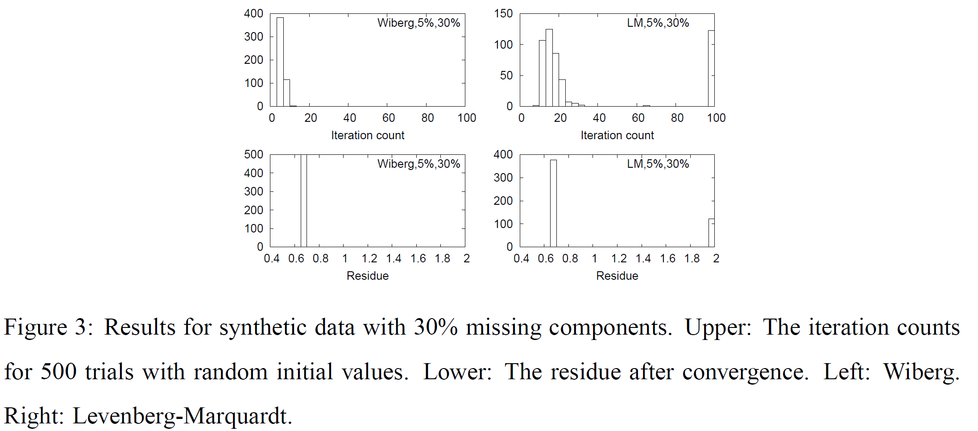
Wiberg algo在500次測試當中，都能很快收斂
Wiberg algo在500次測試當中，收斂性很穩定

Slide 35
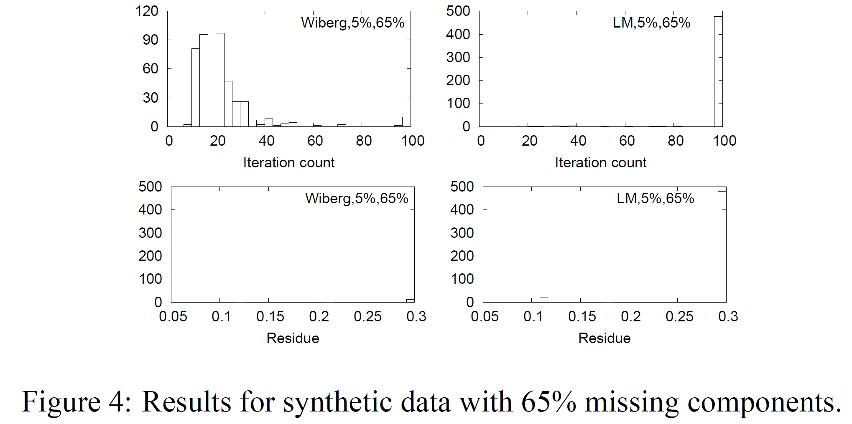

Slide 36
Experimental results-real data
A image sequence of a cube rotated through 360 degrees
177 images
Lucas-Kanade-Tomasi tracker for extracting trajectories (軌道) of feature points
A few erroneous trajectories are unremoved to test the algorithm
106 trajectories survive
Observed data: 5550
Missing components: 1-5550/(106-177)=70.4%
100 trials

Slide 37
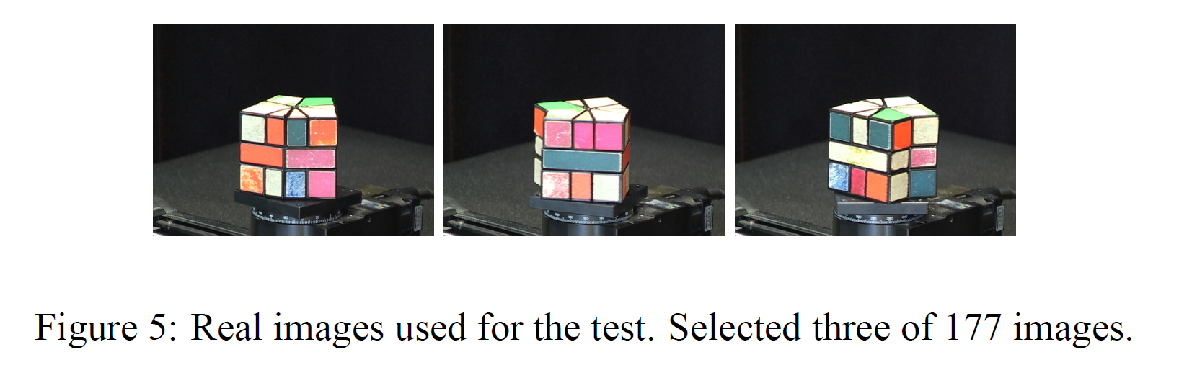
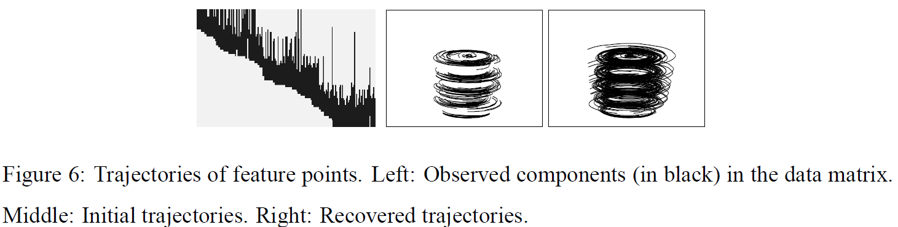

Slide 38
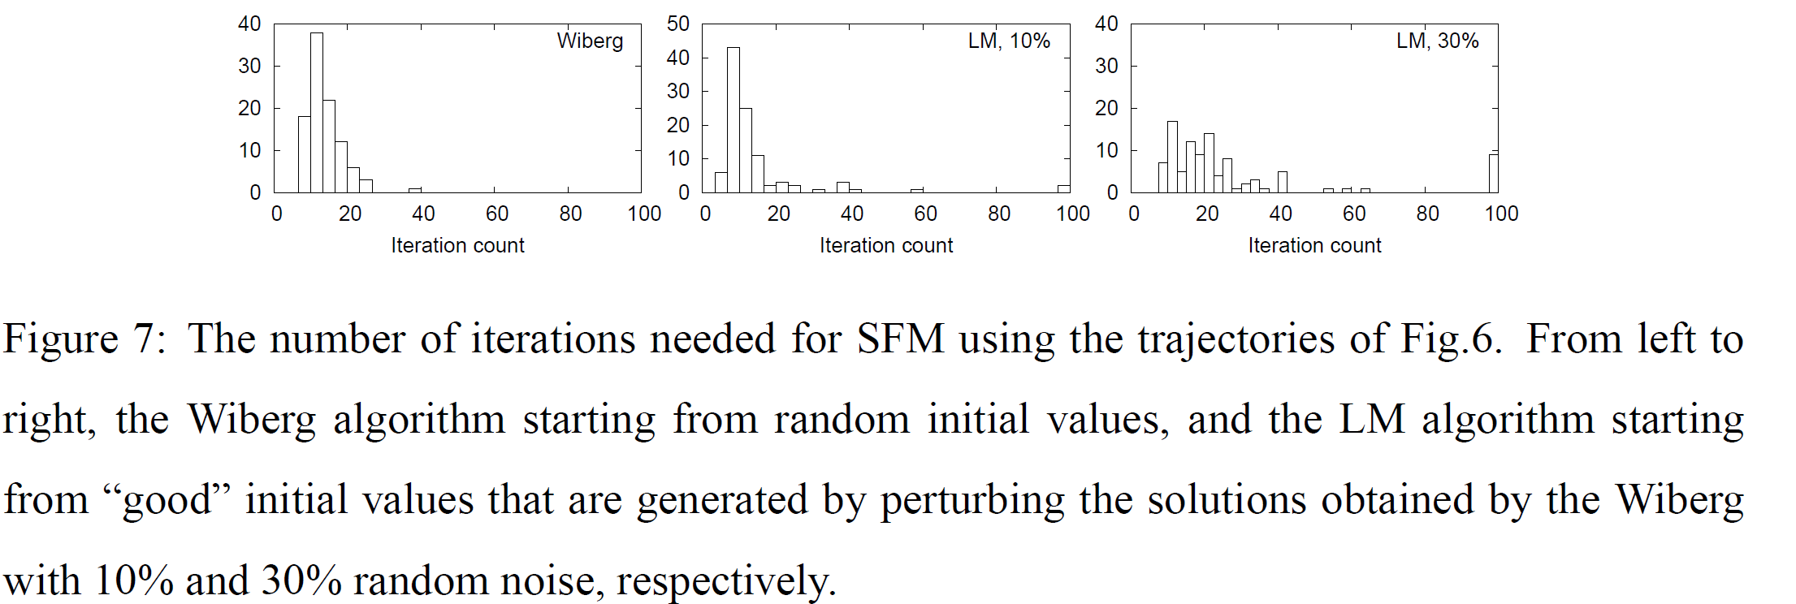
Note: the LM algorithm did not converge in any 100 of the trials without giving good initial values

Slide 39
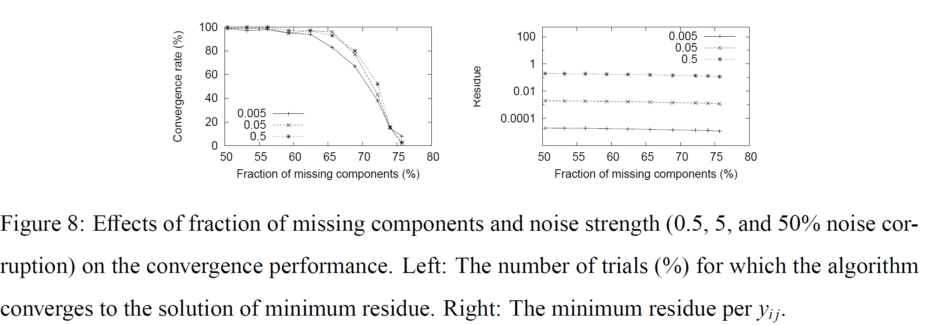
Convergence performance

Slide 40
Time complexity
Weiberg algorithm : O(pn²r²)
Gauss-Newton algorithm : O(p(m+n)²r²)
m,n, r :matrix length or width,
p: observed components
ALS algorithm: computational cost per iteration is less than Weiberg algorithm, but it needs many iterations to converge.

Slide 41
Website
The paper which published on the journal had some typos, here is the correct version:
http://www.fractal.is.tohoku.ac.jp/okatani/2007/06/29_155635.html
The Wiberg algorithm MATLAB code:
http://www.fractal.is.tohoku.ac.jp/okatani/code/Wiberg.zip

Slide 42
Wiberg algorithm MATLAB results
>> Y=[ 4 6; 8 12; 12 18]
>> H=[1 0;1 1;0 1]
>> [U,V]=wiberg_nomean(Y,H,1)
U =
5.8114
11.6228
17.4343
V =
0.6883
1.0324
>> U*V'
ans =
4.0000 6.0000
8.0000 12.0000
12.0000 18.0000
>> [U,V]=wiberg_nomean(Y,H,2)
U =
2.5903 0
-11.7481 -17.5259
0 -24.2489
V =
1.5442 -1.4916
0.0859 -0.7423
>> U*V'
ans =
4.0000 0.2226
8.0000 12.0000
36.1694 18.0000

Slide 43

Thank you!!

