Slide 1
Efficient Discovery of Structural Motifs from Protein Sequences with Combination of Flexible Intra- and Inter-block Gap Constraints Chen-Ming Hsu, Chien-Yu Chen, Ching-Chi Hsu, and Baw-Jhiune Liu Pacific Area Conference on Knowledge Discovery and Data Mining (PAKDD) 2006, LNAI 3918, pp. 530 – 539, 2006.
Presenter: Hong-Yu Chen
Date: July 19, 2011

Slide 2
Abstract (1/2)
Discovering protein structural signatures directly from their primary information is a challenging task, because the residues associated with a functional motif are not necessarily clustered in one region of the sequence. This work proposes an algorithm that aims to discover conserved sequential blocks interleaved by large irregular gaps from a set of unaligned biological sequences. Different from the previous works that employ only one type of constraint on gap flexibility, we propose using combination of intra- and inter-block gap constraints to discover longer patterns with larger irregular gaps.

Slide 3
Abstract (2/2)
The smaller flexible intra-block gap constraint is used to relax the restriction in local motif blocks but still keep them compact, and the larger flexible inter-block gap constraint is proposed to allow longer irregular gaps between compact motif blocks. Using two types of gap constraints for different purposes improves the efficiency of mining process while keeping high accuracy of mining results. The efficiency of the algorithm also helps to identify functional motifs that are conserved in only a small subset of the input sequences.

Slide 4
Introduction
For a set of proteins that share a common function or structure, it is often that only a few of common residues are conserved among them.
Limited insertions and deletions are admitted within a motif block, and large insertions and deletions may happen between motif blocks during evolution.
Exact components in a pattern
Ex. N-R-x(5,19)-Y-x-G-x(3)-D
Rigid gaps, a gap of fixed length
Flexible gap, a gap of flexible length

Slide 5
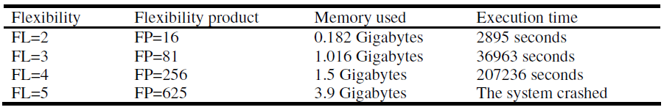
Current mining algorithms
Pratt v2.1
About 100 sequences, support constraint = 70%
Longer patterns cannot be discovered
Teiresias
Only fixed gaps are considered
Note: worse when lower support constraint is requested

Slide 6
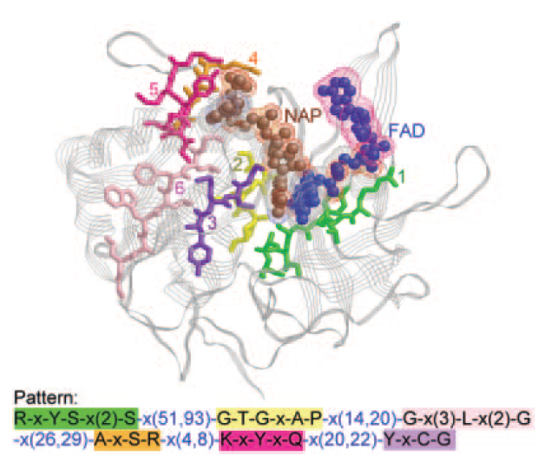
MAGIIC
Discover flexible long patterns from a set of unaligned biological sequences.
Using combination of intra- and inter-block gap constraints to find patterns with large irregular gaps.
Gap constraints
Intra-block gaps, rigid gap, x(a)
Inter-block gaps, flexible gap, x(a,b), a < b
Based on the PrefixSpan algorithm

Slide 7
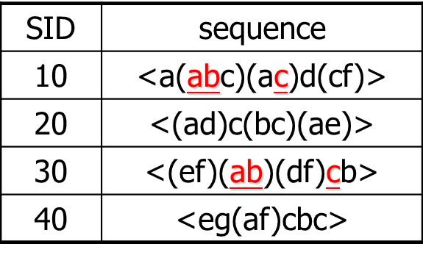
PrefixSpan
Sequential pattern mining: Finding time-related frequent patterns (frequent subsequences)
<e(ab)dc> is a subsequence of <(ef)(ab)(df)cb>
<(ab)c> is a sequential pattern, min_sup = 2
General idea: examine only the prefixes and project only their corresponding postfixes
Avoiding generating a large amount of pattern candidates
Pseudo projecting technique
Record only the sequence identifiers and the associated event identifiers

Slide 8
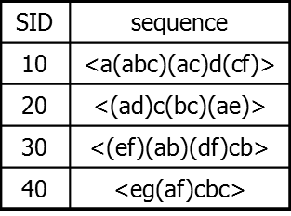
Completeness of PrefixSpan
SDB
Length-1 sequential patterns
<a>, <b>, <c>, <d>, <e>, <f>
Having prefix <a>
Having prefix <c>, …, <f>
Having prefix <b>
<a>-projected database
<(abc)(ac)d(cf)>
<(_d)c(bc)(ae)>
<(_b)(df)cb>
<(_f)cbc>
<b>-projected database
…
Length-2 sequential
patterns
<aa>, <ab>, <(ab)>,
<ac>, <ad>, <af>
… …
Having prefix <aa>
Having prefix <af>
<aa>-proj. db
…
<af>-proj. db
……………..
8

Slide 9
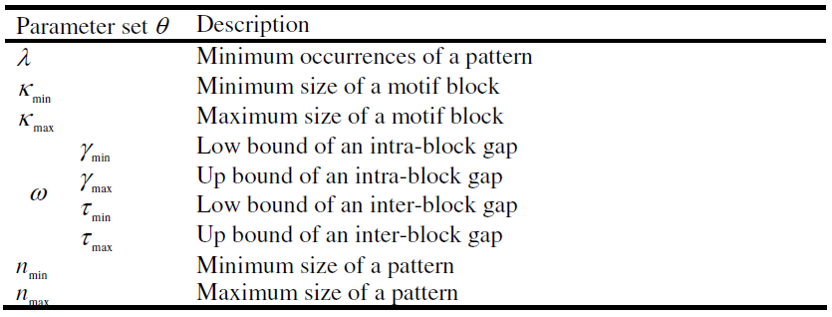
Patameters of MAGIIC
Ex. N-R-x(5,19)-Y-x-G-x(3)-D

Slide 10
MAGIIC method
Based on the PrefixSpan algorithm
Contribution of MAGIIC
Bounded-prefix-growth based on the prefix-growth procedure of the PrefixSpan algorithm.
Incorporates intra- and inter-block gap constraints
Complete projected database

Slide 11
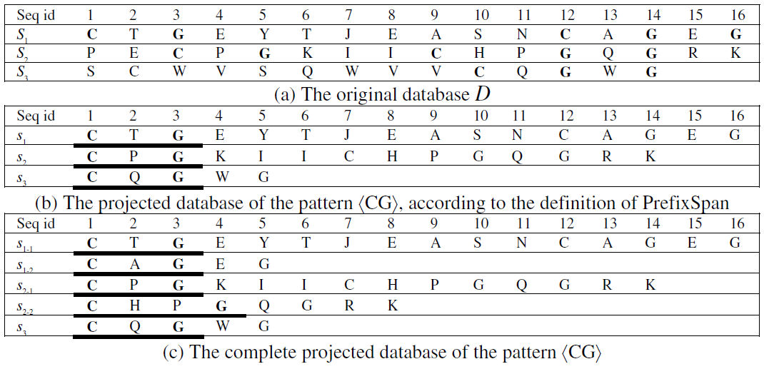
Complete projected database

Slide 12
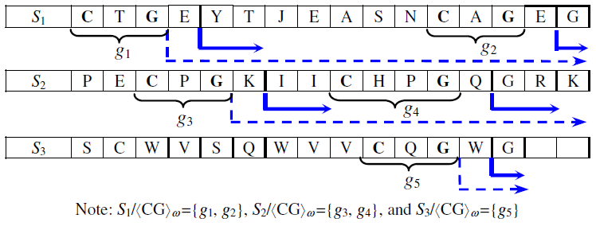
Bounded-prefix-growth
γ_{min} = 1, γ_{max} = 2
Only when the size of the currently growing block (the right most block) of the pattern satisfies the minimum block size constraint, larger scanning range with respect to the inter-block constraints will also be considered during the mining process.

Slide 13
Experiment - first data set
Support constraint = 70%
Size of a motif block
K_{max} = 100, K_{min} = 4
Size of a pattern
n_{max} = 100
Bound of an intra-block gap
γ_{min} = 0, γ_{max} = 2
Bound of an inter-block gap
τ_{min} = 3, τ_{max} = 100

Slide 14
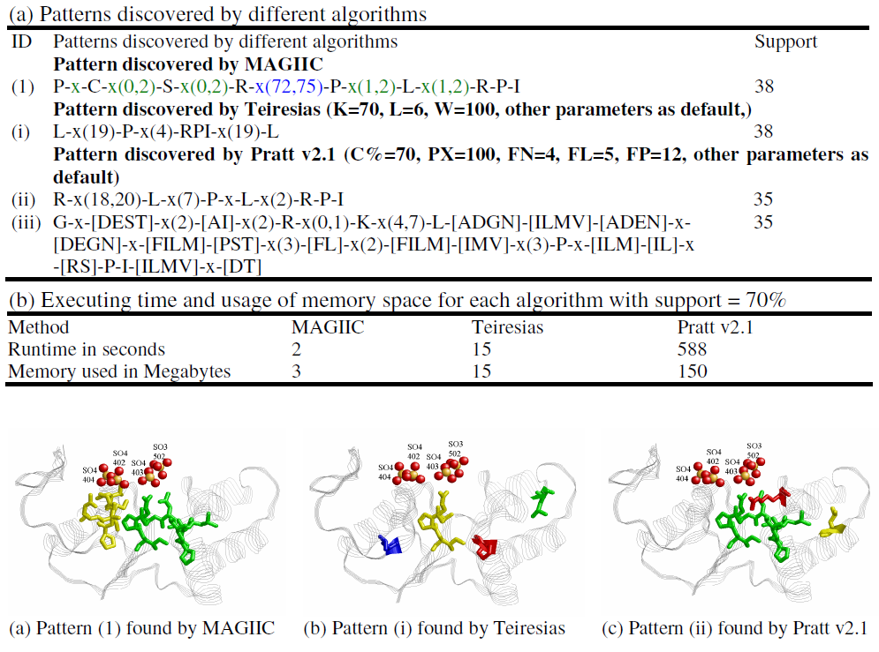
First data set (50 proteins, Arsenate reductase and related)

Slide 15
Experiment - second data set
Support constraint = 70%
Minimum size of a motif block = 4
Up bound of an inter-block gap constraint = 20

Slide 16
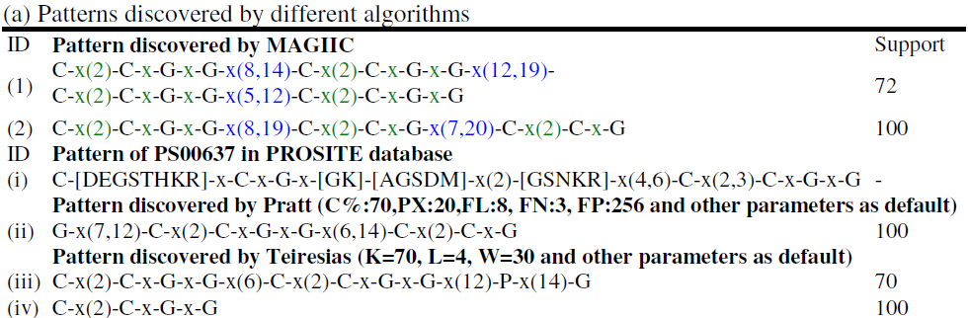
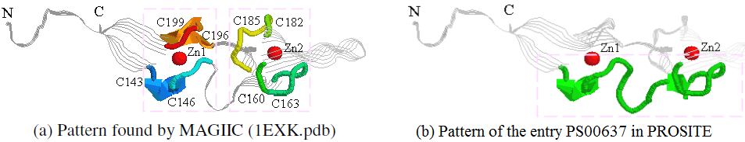
Second data set (100/272 proteins, CXXCXGXG domain signature of DnaJ)
DnaJ central cysteine-rich (CR) domain.
DnaJ CR domain consists of two zinc centers, each of which is composed of four conserved cysteines.

Slide 17
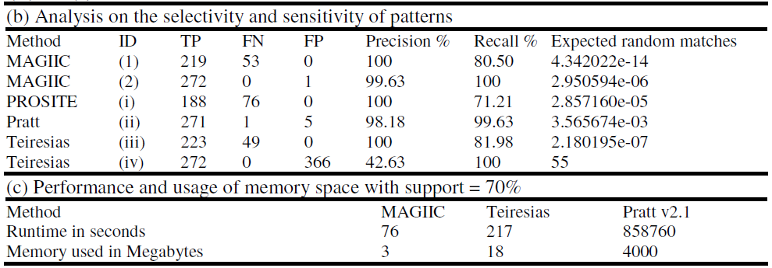
Second data set (100/272 proteins, CXXCXGXG domain signature of DnaJ)
Evaluated by employing the ScanProsite, Swiss-Prot database
Precision rate = TP / (TP + FP)
Recall rate = TP / (TP + FN)
 | Positives | Negatives
True | TP | TN
False | FP | FN

Slide 18
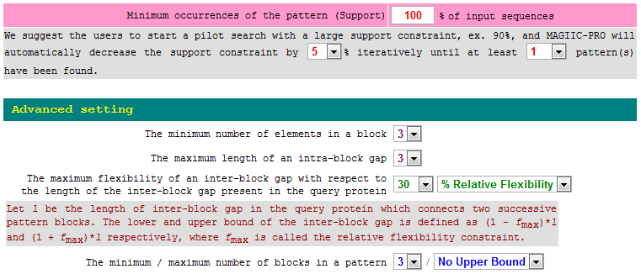
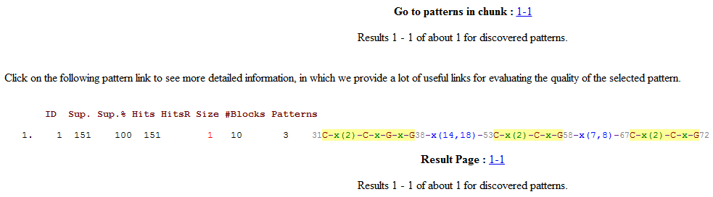
Example (1EXK.pdb)

Slide 19
Conclusion
Current mining technologies might individually find each motif block but fail to connect them with large irregular gaps.
MAGIIC employs intra- and inter-block gap constraints to discover clusters of conserved residues present in protein sequences.
The efficiency of MAGIIC remains even when the constraints are relaxed.
How to incorporate MAGIIC in the study of protein binding or protein-protein interaction deserves further study.

