Slide 1
Disulfide Connectivity Prediction with 70% Accuracy Using Two-Level Models Bo-Juen Chen, Chi-Hung Tsai, Chen-hsiung Chan, and Cheng-Yan Kao PROTEINS: Structure, Function, and Bioinformatics, Vol. 64, pp. 246–252, 2006
Presenter: Hong-Yu Chen
Date: Oct. 31, 2011

Slide 2
Abstract (1/2)
Disulfide bridges stabilize protein structures covalently and play an important role in protein folding. Predicting disulfide connectivity precisely helps towards the solution of protein structure prediction. Previous methods for disulfide connectivity prediction either infer the bonding potential of cysteine pairs or rank alternative disulfide bonding patterns. As a result, these methods encode data according to cysteine pairs (pair-wise) or disulfide bonding patterns (pattern-wise). However, using either encoding scheme alone cannot fully utilize the local and global information of proteins, so the accuracies of previous methods are limited.

Slide 3
Abstract (2/2)
In this work, we propose a novel two-level framework to predict disulfide connectivity. With this framework, both the pair-wise and pattern-wise encoding schemes are considered. Our models were validated on the datasets derived from SWISS-PROT 39 and 43, and the results demonstrate that our models can combine both local and global information. Compared to previous methods, significant improvements were obtained by our models. Our work may also provide insights to further improvements of disulfide connectivity prediction and increase its applicability in protein structure analysis and prediction.

Slide 4
Why do I choose this paper to study?
The method by Chen et al. [20] is based on a two-level strategy where all cysteine pairs are first classified by an SVM and all possible connectivity patterns are subsequently evaluated by second binary classifier that was trained with the correct connectivity patterns as positive examples. – A simplified approach to disulfide connectivity prediction from protein sequences, BMC Bioinformatics, Vol. 9, no. 20, 2008

Slide 5
Introduction
Bonding state prediction
Evolutionary information (i.e., profiles extracted from multiple sequence alignments)
Bonding pattern prediction
Pair-wise
Focus on the bonding potential between two cysteines.
A disulfide bridge is a long-range interaction between two sequentially distant cysteines, the performance of the pair-wise models built with only local information is restricted.
Pattern-wise
Rank connectivity patterns.
The local information of cysteine residues is difficult to be fully examined.
May suffer from the imbalance of data during the training phase
The accuracy of pattern-wise methods to around 50%

Slide 6
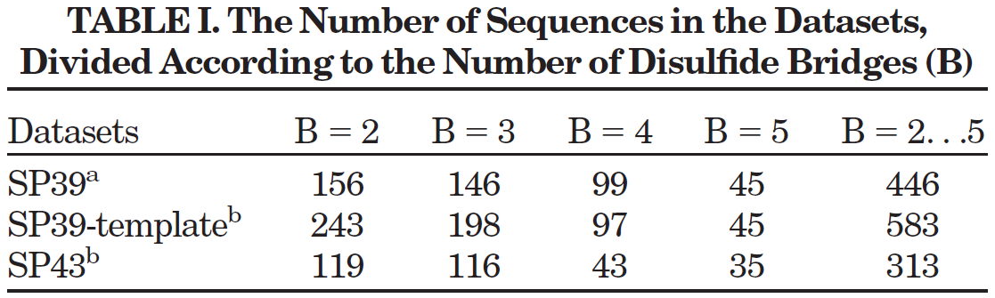

Dataset
SP39: 4-fold cross-validation, each two of them shared a sequence homology of $≤30\%.$
SP43: the sequences share less than 25% identity with each other.
SP39-template: same filter except for the PDB match, only sequences that share similarity <30% with SP43

Slide 7
Clarifying the concept
Identity
Exact matches.
The extent to which two sequences are invariant.
Similarity
The extent to which sequences are related. Similarity makes no statement about descent from a common ancestor.
A direct measurement and can be discussed in terms of percentages.
Homology
Sequence similarity that can be attributed to descent from a common ancestor.
A matter of opinion, not directly measurable or observable.

Slide 8
Method
The idea of the two-level framework is to extend the modeling from a local view (pair-wise) to a global perspective (pattern-wise).

Slide 9
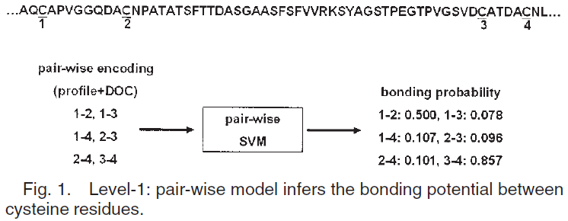
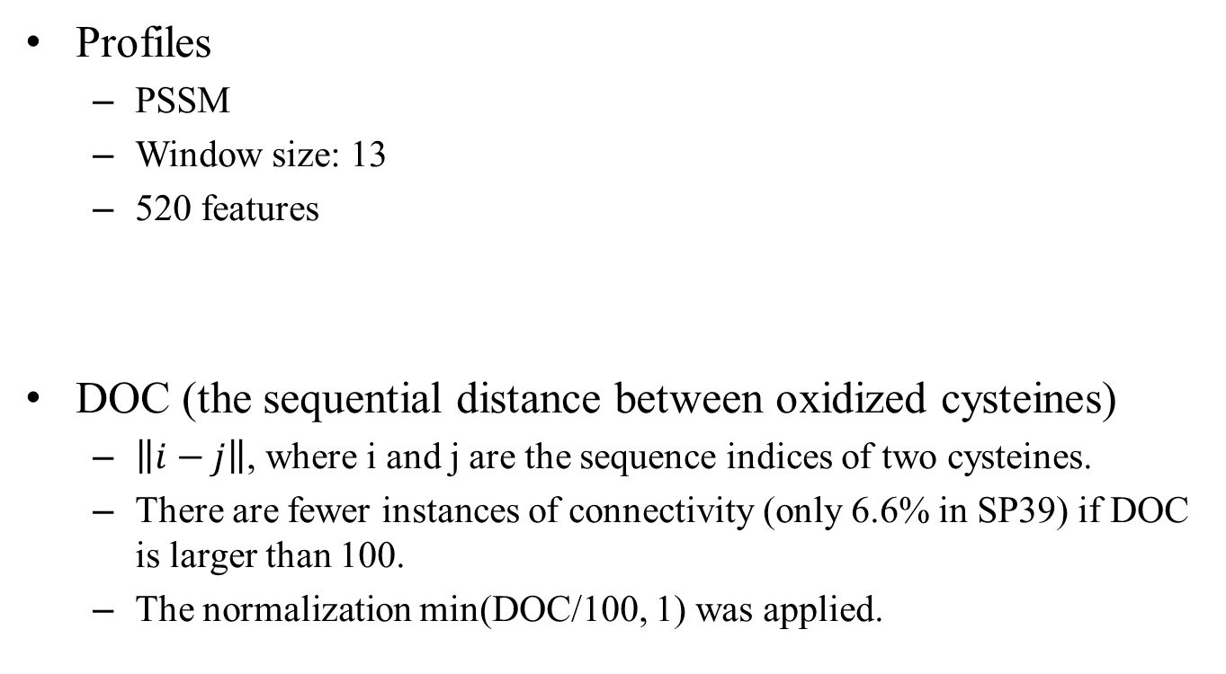
Level-1: Pair-wise
Profiles
PSSM
Window size: 13
520 features
DOC (the sequential distance between oxidized cysteines)
$\left\|i−j\right\|$, where i and j are the sequence indices of two cysteines.
There are fewer instances of connectivity (only 6.6% in SP39) if DOC is larger than 100.
The normalization min(DOC/100, 1) was applied.

Slide 10


Level-2: Pattern-wise
For each protein, all possible disulfide bonding patterns were generated for encoding.
Confidence scores from pair-wise SVM (denoted as S)
CSP search (denoted as C)
Based on the assumption that two proteins with similar cysteine separation share the same disulfide connectivity.
Global information (denoted as G)
Cysteine ordering
Protein length

Slide 11
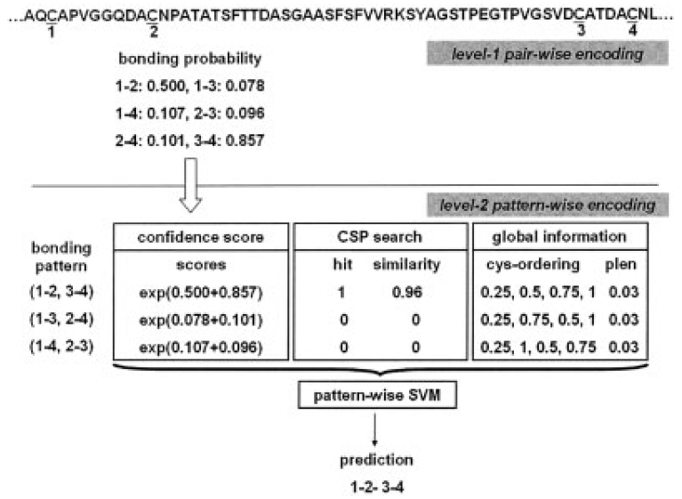
Level-2: Pattern-wise
SVM models were separately trained for proteins with different numbers of bonds.
Reduction for imbalance
Select the top k possible patterns as candidates by using the confidence scores.
k is set to 15.

Slide 12
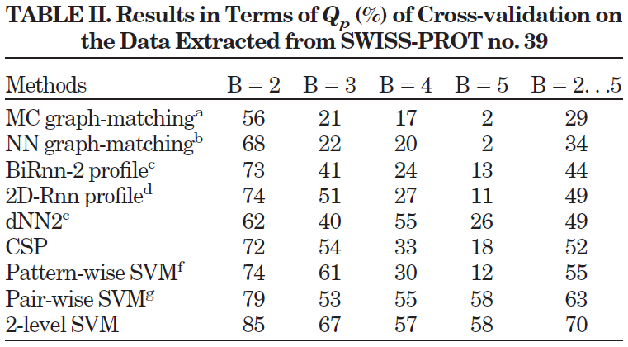
Result (SP39)

Slide 13
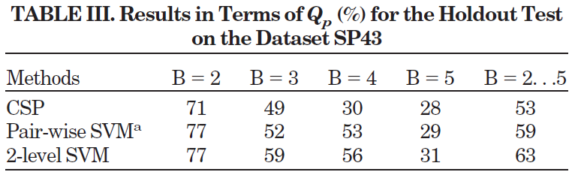
Result (SP43)
In the SP39-template, the sequences were not filtered by the PDB database, and therefore might contain incorrect disulfide annotation.
This kind of noisy information in the SP39-template might be the cause of the 7% difference in accuracy for SP39 and SP43.

Slide 14
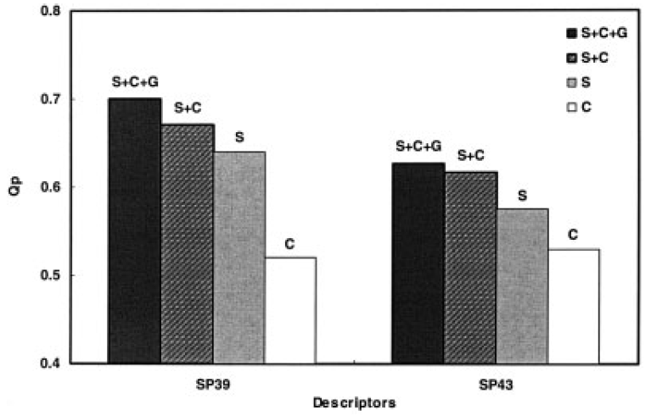
Discussion

Slide 15
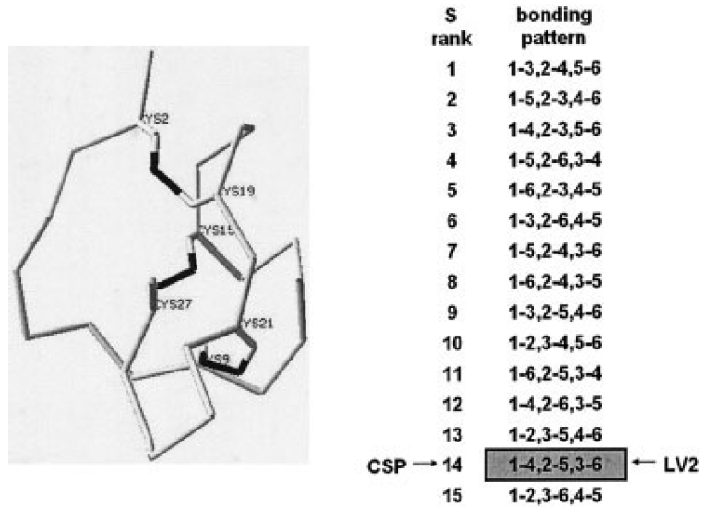
Example – CSP implication
For some sequences, their actual disulfide bonding patterns may not have high confidence scores from the pair-wise models.

Slide 16
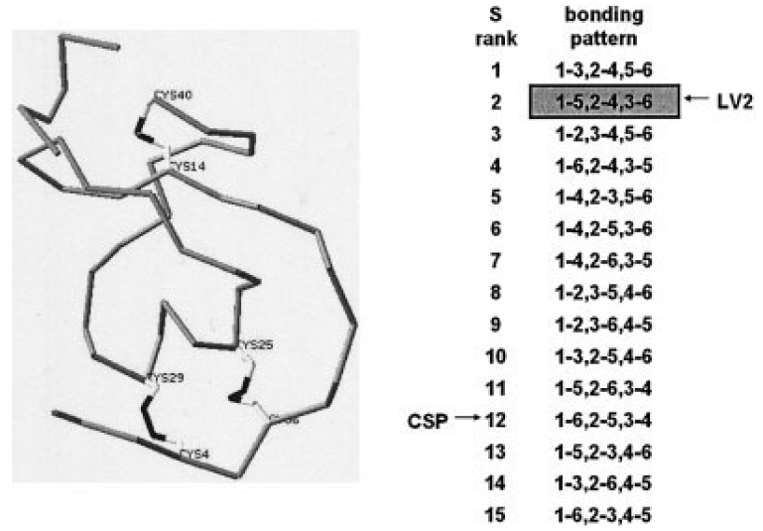
Example – Global information

Slide 17
Effect of candidate selection
SP39, there were 28 sequences with B = 4, whose actual bonding patterns were excluded from the candidate set when testing.
Speed up the model training.
Qp | SP39 | SP43
With candidate selection | 70% | 63%
Without candidate selection | 69% | 62%

Slide 18
Conclusion
Yet, the pattern-wise methods cannot fully explore the local environment of cysteine residues.
The pattern-wise methods may suffer from the imbalance of training data.
The two-level framework takes the advantages of both encoding schemes and attempts to avoid the limitation of both methods.
The proposed framework is flexible and extensible.

