Slide 1
Efficient Algorithms for the Longest Common Subsequence Problem with Sequential Substring Constraints
Chiou-Ting Tseng, Chang-Biau Yang
and Hsing-Yen Ann
National Sun Yat-sen University, Kaohsiung, Taiwan

Slide 2
Outline
Introduction
Problem definition
Conclusions

Slide 3
Longest Common Subsequence (LCS)
Given two strings A = a₁a₂a₃…a_{m} and B = b₁b₂b₃…b_{n}, find the longest common part of A and B by deleting zero or more characters from A and B.
For example, A = atcatatgag, B = atcatctagg, LCS(A, B) = atcattag

Slide 4
Constrained Longest Common Subsequence (CLCS)
Given two strings A and B and a constraint sequence C, find the LCS of A and B containing C as a subsequence.
For example, A = atcatatgag, B = atcatctagg, C = atg, CLCS(A, B, C) = atcatagg
O( |A ||B ||C |) dynamic programming algorithm was proposed at 2003 and some subsequence improvements was proposed later on.

Slide 5
Example for CLCS Algorithm
Input: S₁ = TAGTCACG, S₂ = AGACTGTC and C = AT
CLCS of S₁ and S₂ with constraint C: (X means -∞)
k = 0
k = 1 (constraint A)
k = 2 (constraint T)
 | - | A | G | A | C | T | G | T | C
- | 0 | 0 | 0 | 0 | 0 | 0 | 0 | 0 | 0
T | 0 | 0 | 0 | 0 | 0 | 1 | 1 | 1 | 1
A | 0 | 1 | 1 | 1 | 1 | 1 | 1 | 1 | 1
G | 0 | 1 | 2 | 2 | 2 | 2 | 2 | 2 | 2
T | 0 | 1 | 2 | 2 | 2 | 3 | 3 | 3 | 3
C | 0 | 1 | 2 | 2 | 3 | 3 | 3 | 3 | 4
A | 0 | 1 | 2 | 3 | 3 | 3 | 3 | 3 | 4
C | 0 | 1 | 2 | 3 | 4 | 4 | 4 | 4 | 4
G | 0 | 1 | 2 | 3 | 4 | 4 | 5 | 5 | 5
 | - | A | G | A | C | T | G | T | C
- | X | X | X | X | X | X | X | X | X
T | X | X | X | X | X | X | X | X | X
A | X | 1 | 1 | 1 | 1 | 1 | 1 | 1 | 1
G | X | 1 | 2 | 2 | 2 | 2 | 2 | 2 | 2
T | X | 1 | 2 | 2 | 2 | 3 | 3 | 3 | 3
C | X | 1 | 2 | 2 | 3 | 3 | 3 | 3 | 4
A | X | 1 | 2 | 3 | 3 | 3 | 3 | 3 | 4
C | X | 1 | 2 | 3 | 4 | 4 | 4 | 4 | 4
G | X | 1 | 2 | 3 | 4 | 4 | 5 | 5 | 5
 | - | A | G | A | C | T | G | T | C
- | X | X | X | X | X | X | X | X | X
T | X | X | X | X | X | X | X | X | X
A | X | X | X | X | X | X | X | X | X
G | X | X | X | X | X | X | X | X | X
T | X | X | X | X | X | 3 | 3 | 3 | 3
C | X | X | X | X | X | 3 | 3 | 3 | 4
A | X | X | X | X | X | 3 | 3 | 3 | 4
C | X | X | X | X | X | 3 | 3 | 3 | 4
G | X | X | X | X | X | 3 | 4 | 4 | 4
Following the link, we can obtain the CLCS AGTG

Slide 6
Generalized CLCS
In 2009, Chen and Chao extended the CLCS into four different variants
Sequence-inclusion CLCS
Sequence-exclusion CLCS
String-inclusion CLCS
String-exclusion CLCS
In 2010, Chen combines the Sequence-inclusion CLCS and the Sequence-exclusion CLCS.

Slide 7
Outline
Introduction
Problem definition
Conclusions

Slide 8
Sequential Substring Constrained Longest Common Subsequence (SSCLCS)
The Constraint C is composed of ordered strings (C ¹, C ², …, C ^{l} ) with total length r, we call them partitions of C.
We are to find the longest common subsequence D of A and B containing C ¹, C ², …, C ^{l} as substrings and the order of C’s are retained.
Ex: A = atcatatgag, B = atcatatagg, C=(acat, tag), SSCLCS(A, B, C) = acatatag

Slide 9
Sequential Substring Constrained Longest Common Subsequence (SSCLCS)
Generalization of String-inclusion CLCS and Sequence-inclusion CLCS
The sequence inclusion CLCS is a special case of SSCLCS when each partition is a single character.
The string inclusion CLCS is a special case of SSCLCS when there is only one partition.

Slide 10
Non-Overlapping vs. Overlapping
In the non-overlapping variant, the partitions cannot overlap in the SSCLCS obtained.
In the overlapping variant, the partitions may overlap in the resulting SSCLCS but the positions are monotonically increasing.
For example, when A = atcatatgag, B = atcatctagg and C = (acat, tag), acatagg is an SSCLCS of the second variant, but not the first one.

Slide 11
Theorem 1
Let T = are the largest indices such that and contains C as their subsequences.} The SSCLCS solution can be obtained by finding the maximum of
We proved that i ' and j ' can be obtained by greedily and reversely search for the nearest occurrence of the characters of C in A and B.

Slide 12
PreviousMatch Table
Modification of the NextMatch table proposed by Landau et al. at 2007.
Records the previous occurrence position of each symbol in every position.

Slide 13
PreviousMatch Table
A = atcatatgag
 | 1 | 2 | 3 | 4 | 5 | 6 | 7 | 8 | 9 | 10
 | a | t | c | a | t | a | t | g | a | g
a | -1 | 1 | 1 | 1 | 4 | 4 | 6 | 6 | 6 | 9
c | -1 | -1 | -1 | 3 | 3 | 3 | 3 | 3 | 3 | 3
g | -1 | -1 | -1 | -1 | -1 | -1 | -1 | -1 | 8 | 8
t | -1 | -1 | 2 | 2 | 2 | 5 | 5 | 7 | 7 | 7
O(|S||Σ|) time and space

Slide 14
ζ Table for Non-overlapping Variant
We call the index in Theorem 1 as the corresponding starting position to ending position .
We record the corresponding starting position to all ending position in the ζ Table.

Slide 15
ζ Table for Non-overlapping Variant
A=atcatatgag, C = acat
 | 1 | 2 | 3 | 4 | 5 | 6 | 7 | 8 | 9 | 10
 | a | t | c | a | t | a | t | g | a | g
a | -1 | 1 | 1 | 1 | 4 | 4 | 6 | 6 | 6 | 9
c | -1 | -1 | -1 | 3 | 3 | 3 | 3 | 3 | 3 | 3
g | -1 | -1 | -1 | -1 | -1 | -1 | -1 | -1 | 8 | 8
t | -1 | -1 | 2 | 2 | 2 | 5 | 5 | 7 | 7 | 7
ζ_{A} | -1 | -1 | -1 | -1 | 1 | -1 | 1 | -1 | -1 | -1
O((m+n)r) time

Slide 16
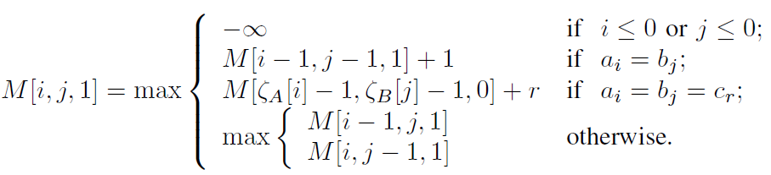
String Inclusion CLCS
M[i, j, 0] is calculated as the standard LCS DP formula
O((m+n)|Σ|) time for the PreviousMatch Tables
O((m+n)r) time for the ζ Tables
O(mn) time and space for the DP

Slide 17
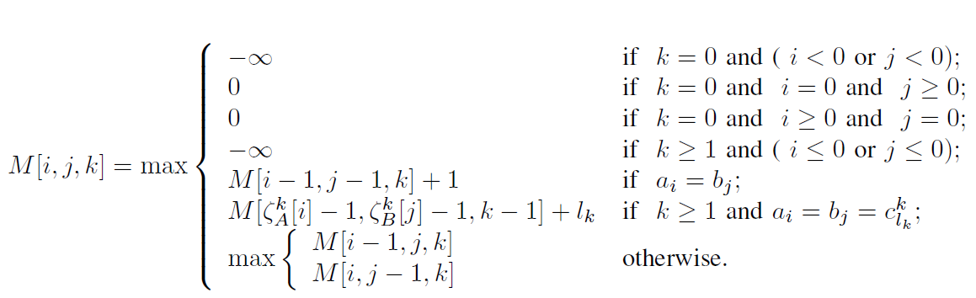
Dynamic Programming Formula for Non-overlapping SSCLCS
O((m+n)|Σ|) time for the PreviousMatch Tables
O((m+n)r) time for the ζ Tables
O(mnl) time and space for the DP

Slide 18
Difference in Overlapping Variant
Checks need to be performed on the overlapping part. So
We find the possible overlap length of neighboring partitions in advance.
The ζ Tables becomes 2-ary with the additional dimension being the overlapping length.

Slide 19
ζ Table for Overlapping Variant
A=atcatatgag, C = acat
 | 1 | 2 | 3 | 4 | 5 | 6 | 7 | 8 | 9 | 10
 | a | t | c | a | t | a | t | g | a | g
1(t) | -1 | 2 | -1 | -1 | 5 | -1 | 7 | -1 | -1 | -1
2(a) | -1 | 1 | -1 | -1 | 4 | -1 | 6 | -1 | -1 | -1
3(c) | -1 | -1 | -1 | -1 | 3 | -1 | 3 | -1 | -1 | -1
4(a) | -1 | -1 | -1 | -1 | 1 | -1 | 1 | -1 | -1 | -1
5(-) | -2 | -2 | -2 | -2 | 0 | -2 | 0 | -2 | -2 | -2

Slide 20
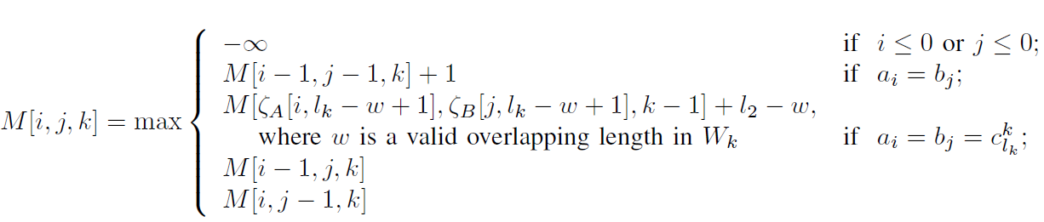
Dynamic Programming Formula for Overlapping SSCLCS
k = 0 or k = 1
k ≥ 2

Slide 21
Outline
Introduction
Problem definition
Conclusions

Slide 22
Conclusions (1/2)
We proposed a new variant of the CLCS called the Sequential Substring CLCS.
For the case when the partitions can not overlap, we proposed an O(mnl + (m+ n)(|Σ|+ r)) time algorithm.
For the case when the partitions can overlap, we proposed an O(mnr + (m+ n)(|Σ|+ r)) time algorithm.

Slide 23
Conclusions (2/2)
Our algorithm can be used to solve the string-inclusion CLCS with one or two constraint strings and our algorithms achieve an order improvement to the previous known algorithms by Chen and Chao at 2009.

Slide 24
BIBE參加心得

Slide 25
Conference Venue
這次來參加BIBE2011研討會學到的一個詞“Conference Venue”，這個詞的意思是研討會舉辦的地方
原本看到BIBE的網站想說那是合作的飯店，也沒有去查字典，仍然以為研討會在亞洲大學辦，結果當天早上花了一個半鐘頭從高鐵站台中站到亞洲大學，到的時候剛好九點，剛好是第一場keynote的開始時間。

Slide 26
Conference Venue
結果又花了一個小時找到怎麼到金典酒店，花了一個小時從亞洲大學到金典酒店。
中午吃飯的時候才發現同桌的四個學生有三個都跟我一樣跑到亞洲大學才又回到金典，其中一位同學說他要從亞洲大學回程的時候還碰到兩個住在金典的同學坐計程車到亞洲大學剛下車，問他研討會會場怎麼走。

Slide 27
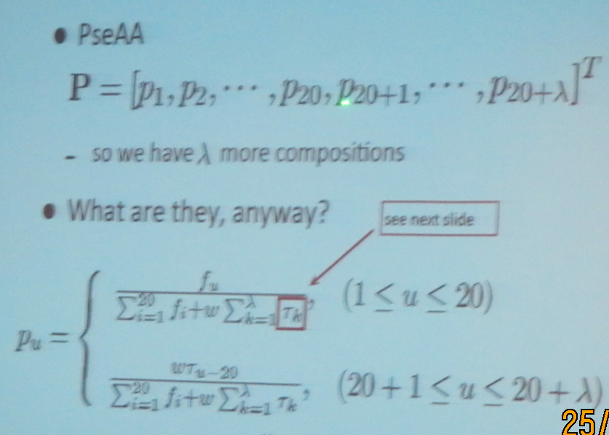
Pseudo Amino Acid Composition
http://en.wikipedia.org/wiki/Pseudo_amino_acid_composition

Slide 28

Relative Contribution to Variability Explained
where and stand for the R² value of the full model (which includes all of the analyzed genomic features) and in a reduced model, respectively. A reduced model was established by removing one genomic feature of interest.

Slide 29
Thank You for Listening

