Slide 1
The empirical mode decomposition and the Hilbert spectrum for nonlinear and non-stationary time series analysis
By Norden E. Huang(黃鍔)¹ , Zheng Shen², Steven R. Long³,
Manli C. Wu⁴ , Hsing H. Shih⁵, Quanan Zheng⁶, Nai-Chyuan Yen⁷,Chi Chao Tung⁸ and Henry H. Liu⁹
Laboratory for Hydrospheric Processes/Oceans and Ice Branch, NASA Goddard Space Flight Center, Greenbelt, MD 20771, USA
Department of Earth and Planetary Sciences, The John Hopkins University, Baltimore, USA
Laboratory for Hydrospheric Processes/Observational Science Branch, NASA Wallops Flight Facility, Wallops Island, USA
Laboratory for Atmospheres, NASA Goddard Space Flight Center, Greenbelt, USA
NOAA National Ocean Service, Silver Spring, USA
College of Marine Studies, University of Delaware, USA
Naval Research Laboratory, Washington, DC, USA
Department of Civil Engineering, North Carolina State University, Raleigh, USA
Naval Surface Warfare Center, Carderock Division, Bethesda, USA
Proceedings of the Royal Society London A, Vol. 454, pp. 903–995, 1998
Presenter: Hung-Hsin Chen (陳紘昕)
Date: Nov. 21, 2011

Slide 2
Abstract (1)
A new method for analyzing nonlinear and non-stationary data has been developed. The key part of the method is the ‘empirical mode decomposition’ method with which any complicated data set can be decomposed into a finite and often small number of ‘intrinsic mode functions’ that admit well-behaved Hilbert transforms. This decomposition method is adaptive, and, therefore, highly efficient. Since the decomposition is based on the local characteristic time scale of the data, it is applicable to nonlinear and non-stationary processes. With the Hilbert transform, the intrinsic mode functions yield instantaneous frequencies as functions of time that give sharp identifications of imbedded structures. The final presentation of the results is an energy-frequency-time distribution, designated as the Hilbert spectrum.

Slide 3
Abstract (2)
In this method, the main conceptual innovations are the introduction of ‘intrinsic mode functions’ based on local properties of the signal, which makes the instantaneous frequency meaningful; and the introduction of the instantaneous frequencies for complicated data sets, which eliminate the need for spurious harmonics to represent nonlinear and non-stationary signals. Examples from the numerical results of the classical nonlinear equation systems and data representing natural phenomena are given to demonstrate the power of this new method. Classical nonlinear system data are especially interesting, for they serve to illustrate the roles played by the nonlinear and non-stationary effects in the energy-frequency-time distribution.

Slide 4

黃鍔博士 (Norden E. Huang) 簡介
1960 年從臺灣大學土木系畢業
1962 年進入美國約翰．霍普金斯大學力學系
華盛頓大學海洋地理學系研究員
北卡羅來納州立大學海洋地理學系副教授
1975 年起進入美國太空總署(NASA)
1998發表本篇論文 Hilbert-Huang transform (HHT)聞名國際
2000 美國國家工程學院院士
2003 美國 NASA 發明獎
2004 中央研究院院士 (第二十五屆)
2002~2006 美國服務貢獻獎
2006~now 中央大學講座教授

Slide 5
Introduction
在訊號處理與頻譜分析的目的是要描述信號的頻譜含量在時間上變化，以便能在時間和頻譜上同時表示信號的能量或者強度。
傳統的方法不適合分析non-statationary data。

Slide 6
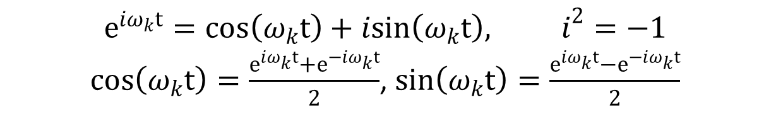
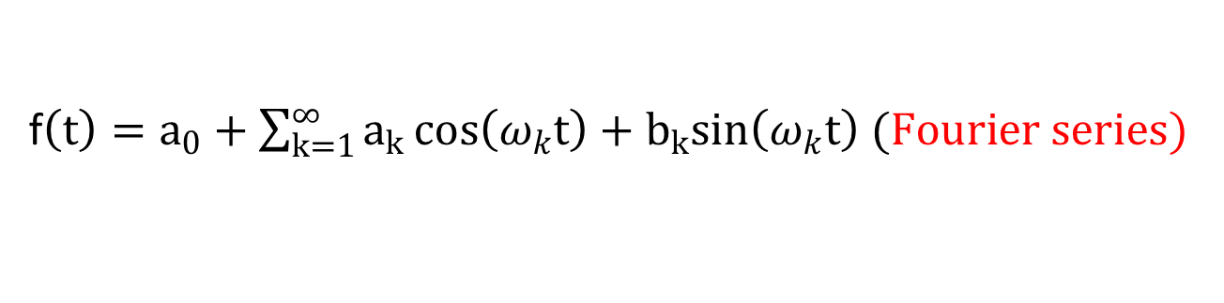
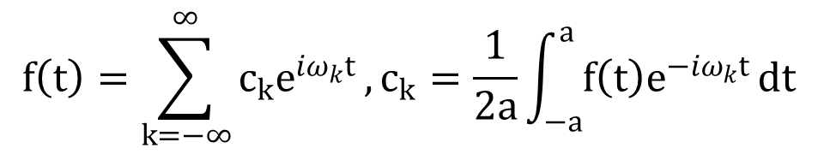
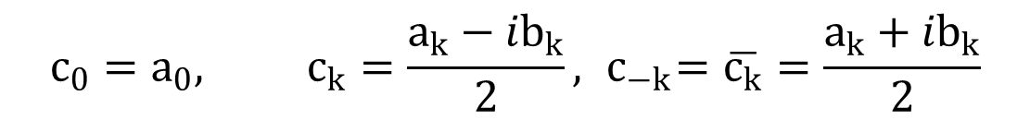
Fourier series
f$\left(t\right)=a_{0}+\sum_{k=1}^{∞}{a_{k}}\cos\left(ω_{k}t\right)+b_{k}sin\left(ω_{k}t\right) (Fourier series)$
$$e^{iω_{k}t}=\cos\left(ω_{k}t\right)+isin\left(ω_{k}t\right), i^{2}=−1$$
$\cos\left(ω_{k}t\right)=\frac{e^{iω_{k}t}+e^{−iω_{k}t}}{2}$, $\sin\left(ω_{k}t\right)=\frac{e^{iω_{k}t}−e^{−iω_{k}t}}{2}$
$$c_{0}=a_{0}, c_{k}=\frac{a_{k}−ib_{k}}{2}, { c}_{−k}=\overline{c_{k}}=\frac{a_{k}+ib_{k}}{2}$$
Complex form of Fourier series:
$$f\left(t\right)=\sum_{k=−∞}^{∞}{{c_{k}e}^{iω_{k}t}}, c_{k}=\frac{1}{2a}\int_{−a}^{a}{f\left(t\right)e^{−iω_{k}t}}dt$$

Slide 7
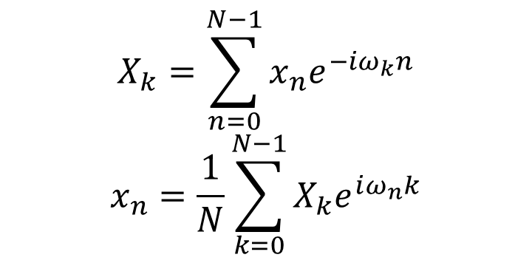
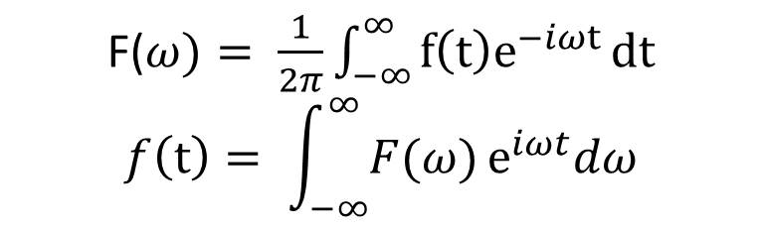
Fourier transform
F($ω)= \frac{1}{2π}\int_{−∞}^{∞}{f\left(t\right)e^{−iωt}}dt$
$$f\left(t\right)= \int_{−∞}^{∞}{F(ω)}e^{iωt}dω$$
continuous
$$X_{k}=\sum_{n=0}^{N−1}{x_{n}e^{−iω_{k}n}}$$
$$x_{n}=\frac{1}{N}\sum_{k=0}^{N−1}{X_{k}e^{iω_{n}k}}$$
discrete
x=[1,2,3,4,5,6,7, 8]
X= [36, -4+ 9.6569i, -4 + 4i, -4. + 1.6569i, -4, -4-1.6569i , -4 - 4i, -4 - 9.6569i]

Slide 8
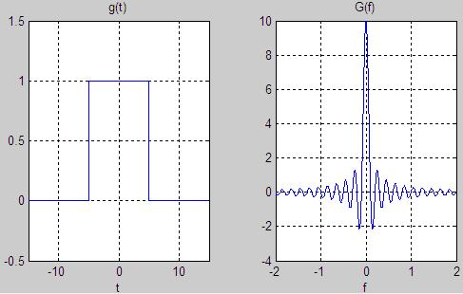

Slide 9
Example: x(t) = cos(π t) (0.5Hz) when t < 10,
x(t) = cos(3π t) (1.5 Hz) when 10 ≤ t < 20,
x(t) = cos(2π t) (1 Hz) when t ≥ 20
最大頻率超過 1.5Hz

Slide 10
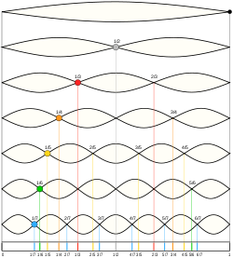
Disadvantages of Fourier transform
建構原始資料訊號的基本函數為固定頻率之諧和函數，FT僅適用於分析呈穩態分佈之時間序列(stationary time series)亦即資料分佈的各個統計值(譬如數據平均值與自我關聯函數等)不隨時間變化的序列。
分析非線性系統中常見之非諧和振盪訊號時，傅立葉頻譜會出現許多額外的峰值於諧和頻率(harmonic frequencies)處。此額外的頻率與原訊號之間並無直接對應的物理意義，純粹只是因為傅立葉展開過程中需疊加許多高頻之諧和函數來模擬被扭曲之波形。

Slide 11
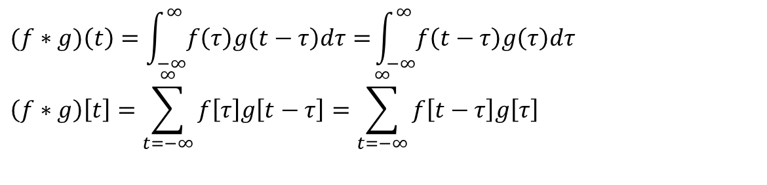
Convolution
$$(f∗g)\left(t\right)=\int_{−∞}^{∞}{f\left(τ\right)g\left(t−τ\right)dτ=}\int_{−∞}^{∞}{f\left(t−τ\right)g\left(τ\right)dτ}$$
$$\left(f∗g\right)\left[t\right]=\sum_{t=−∞}^{∞}{f\left[τ\right]g\left[t−τ\right]=\sum_{t=−∞}^{∞}{f\left[t−τ\right]g\left[τ\right]}}$$
http://en.wikipedia.org/wiki/Convolution

Slide 12
Time-frequency analysis
因為FT轉換後只有得到全部frequency的分佈，無法得知訊號在時間t的frequency的局部特性，所以有以下常見的方法來得到time-frequency的性質。
Short-time Fourier transform (STFT)
Wavelet transform
Wigner-ville distribution
上述三種方法有以下共同缺點，
在頻譜解析上皆是以固定頻率與振幅之函數作為基本模態函數，不適用於non-stationary data。
無法明確定義訊號之瞬時振盪頻率
都會受到Uncertainty principle的限制

Slide 13


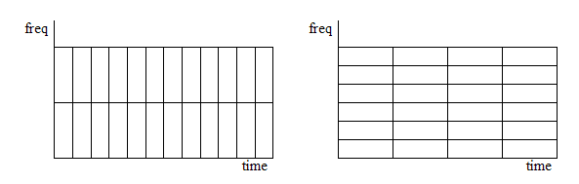
Short-time Fourier transform (STFT)
Small window has better time resolution
Large window has better frequency resolution
Fixed width of window size

Slide 14
Uncertainty principle
由Werner Heisenberg所提出，其說明了任何訊號不可能同時準確的觀察到時間與頻率的分佈。
簡單的說，如果人們觀察一個很短暫(時間域)的訊號(如音樂)，則很難以準確判定此訊號是屬於那些頻率，只能大概猜測其頻率範圍。反之，如果能夠長時間觀察到訊號，則能夠較準確判定訊號的頻率域。
當STFT的window為Gaussian function時，可達到Uncertainty princple的下限，此時又稱為Gabor transform.
http://en.wikipedia.org/wiki/Uncertainty_principle

Slide 15
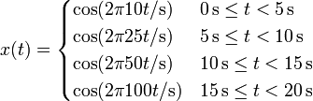
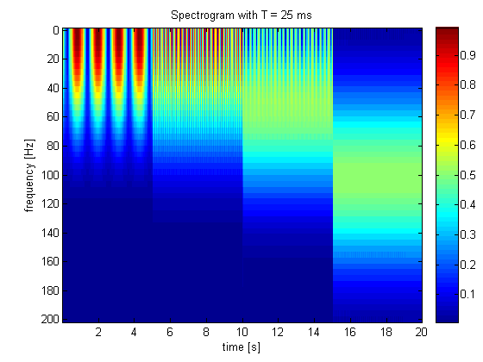
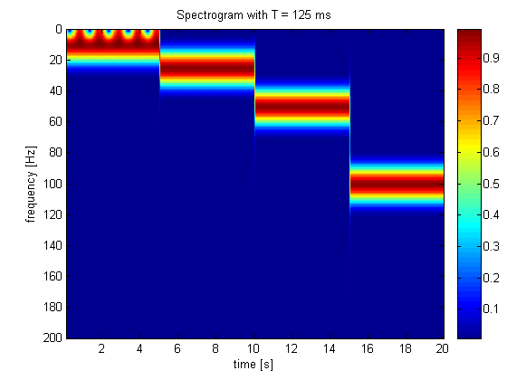
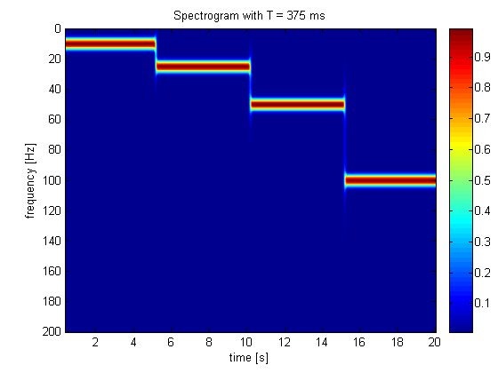
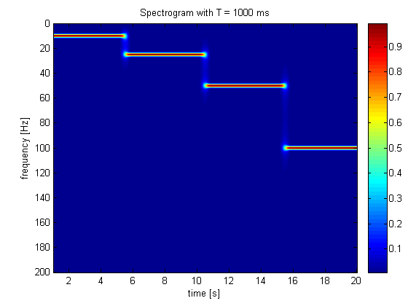

Slide 16
Wavelet transform
Continuous wavelet transform
ψ(t): mother wavelet, a: location, b: scaling (frequency)
Continuous inverse wavelet transform
ϕ_{a,b}(t) is dual orthogonal to ψ(t) (scaling function, father wave)

Slide 17
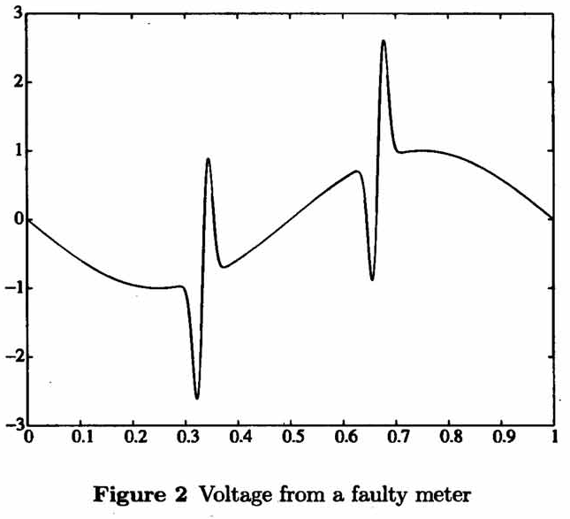
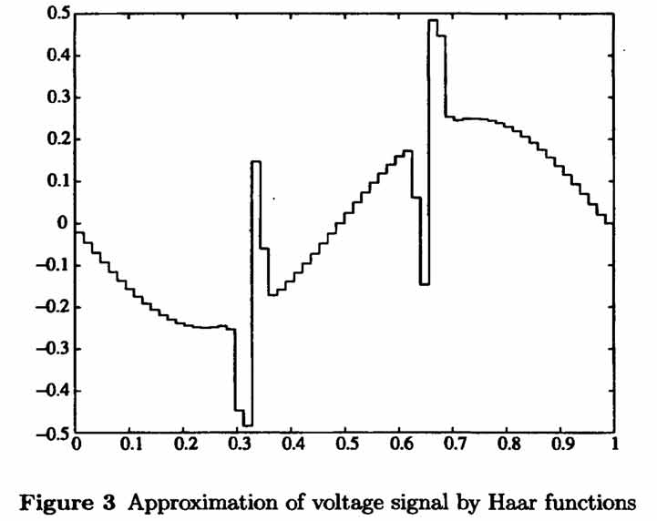
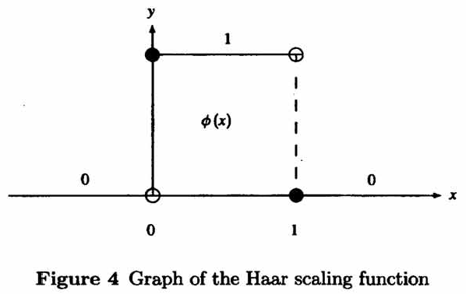
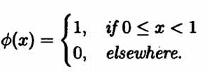

Haar scaling function
$$∅(2^{j}x)∈V_{j}$$

Slide 18
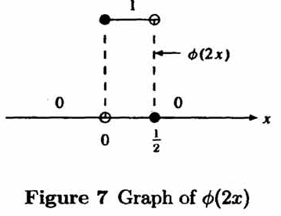
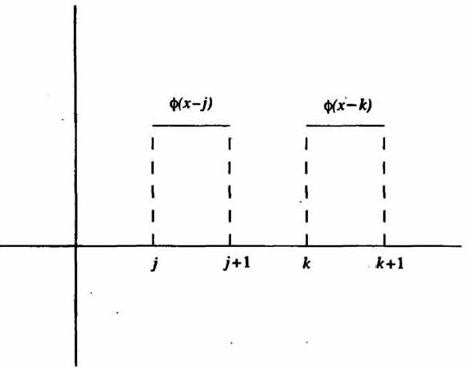

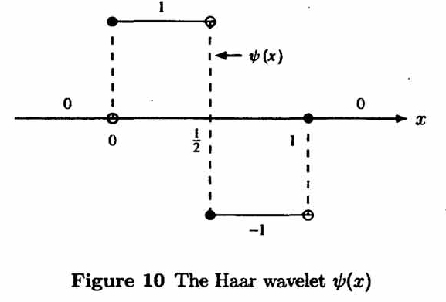
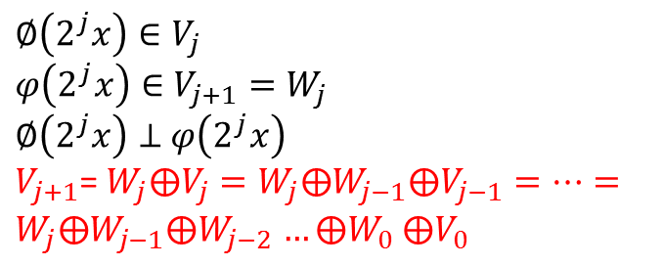
$$∅\left(2^{j}x\right)∈V_{j}$$
$$φ\left(2^{j}x\right)∈V_{j+1}=W_{j}$$
$∅\left(2^{j}x\right)⊥$ $φ\left(2^{j}x\right)$
$V_{j+1}$= $W_{j}⨁V_{j}=W_{j}⨁W_{j−1}⨁V_{j−1}=…=W_{j}⨁W_{j−1}⨁W_{j−2}$ $…⨁W_{0}$ $⨁V_{0}$

Slide 19
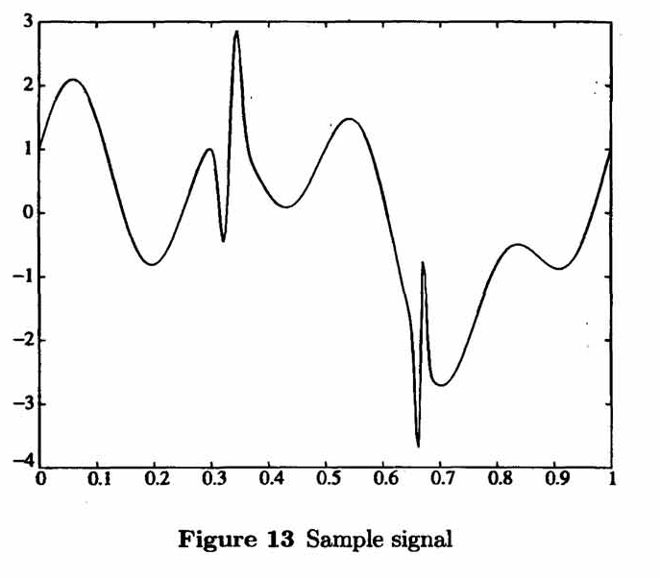
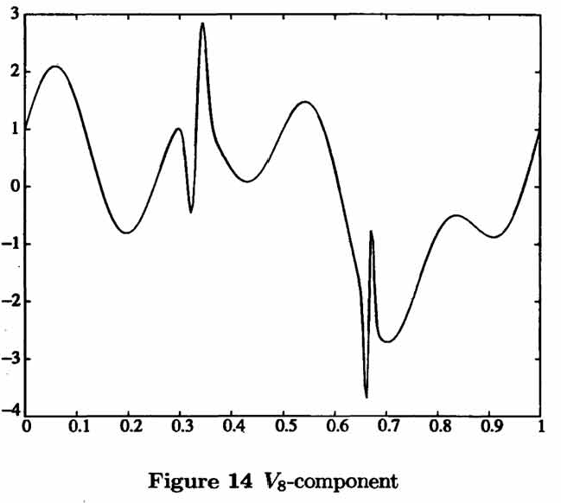
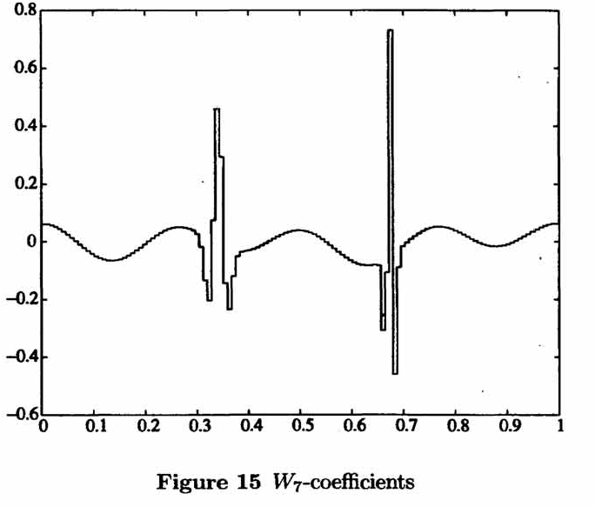
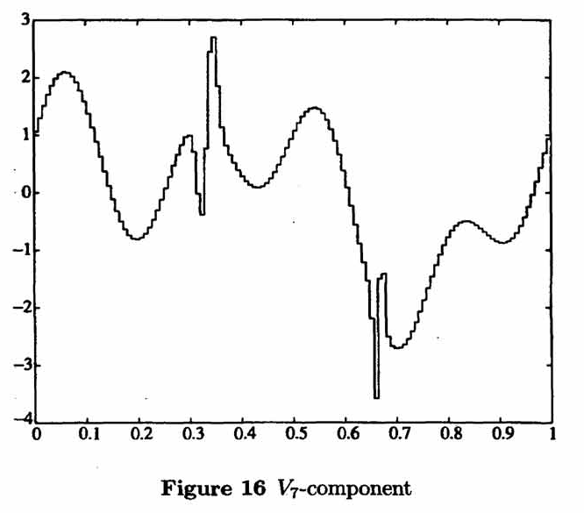

Slide 20
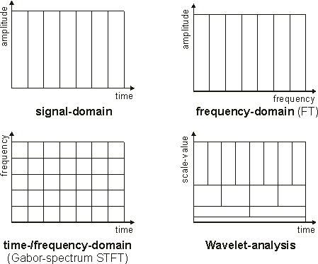
限制：
(1) when a₁ = a and b₁ = b,
otherwise
(2) ψ(t) has a finite time interval
Two parameters, a: 調整位置, b: 調整寬度
所以頻率較高的部份，可用較高的頻率b來分析資料。

Slide 21
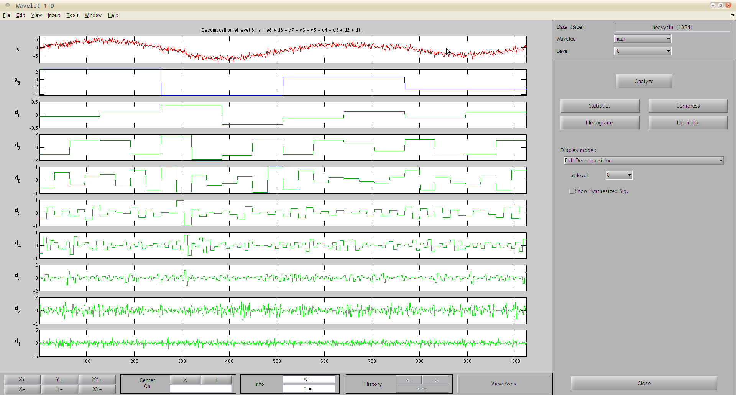

Slide 22
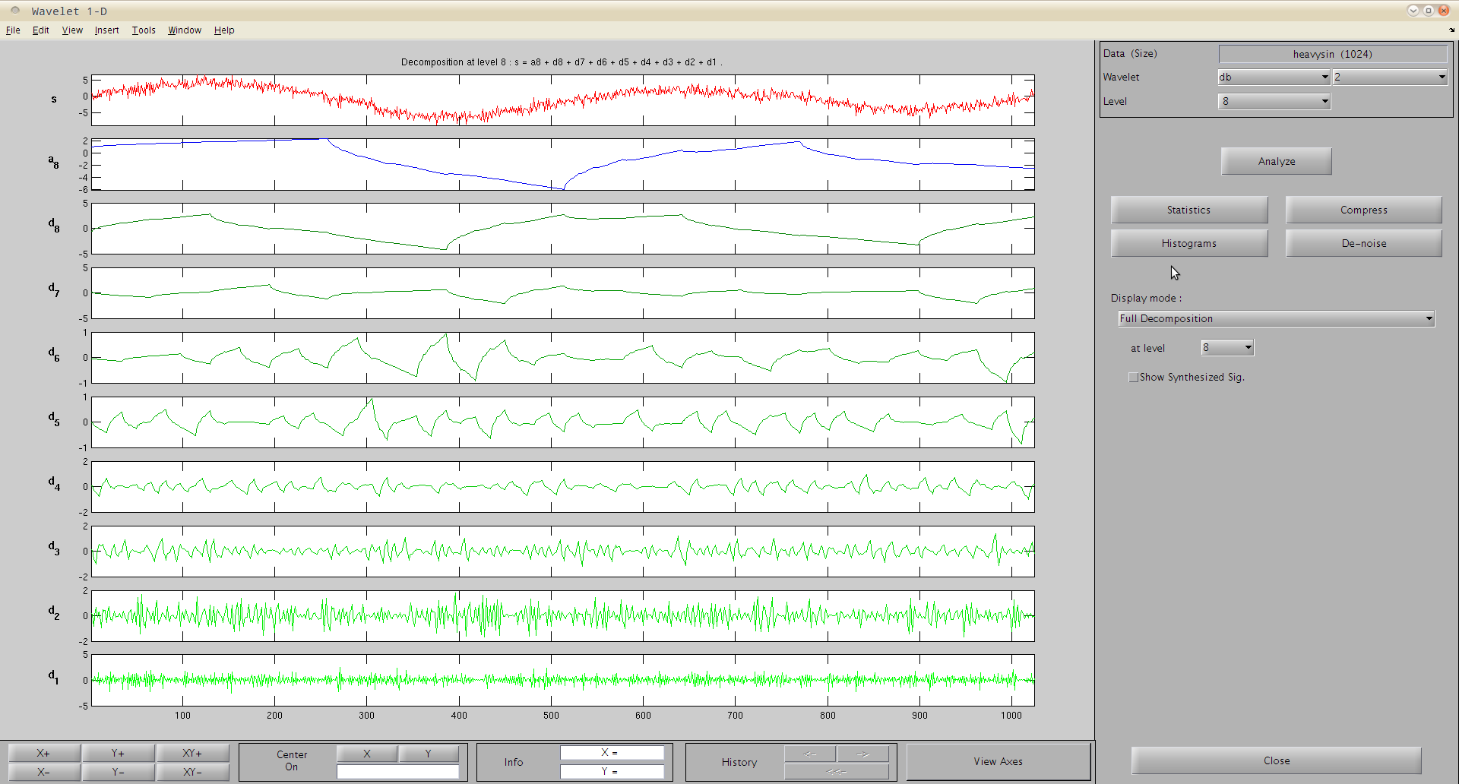

Slide 23
Wigner-ville distribution (Heisenberg wavelet)
Signal auto-correlation function, then Fourier transform
解析度比STFT好，但轉換後的頻率域有時會出現負能量， 難以解釋物理意義

Slide 24
x(t) = cos(2πt)
by WDF by Gabor transform
f-axis
f-axis
t-axis
t-axis

Slide 25
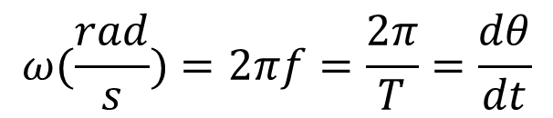
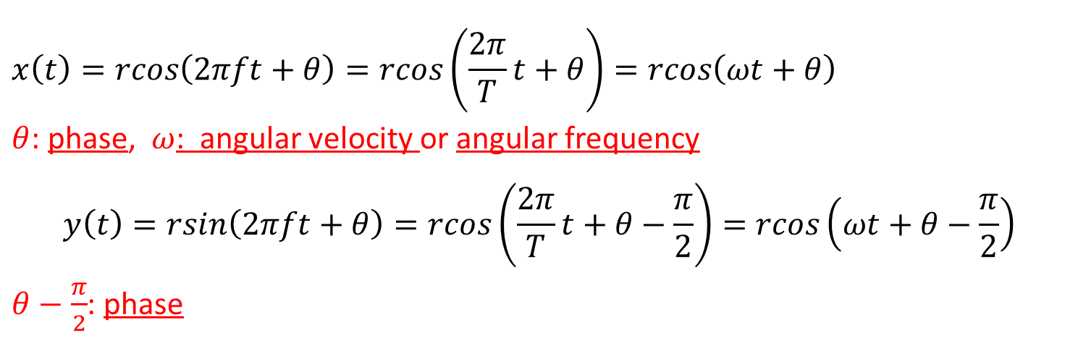

Phase (相位)
$$x\left(t\right)=rcos\left(2πft+θ\right)=rcos\left(\frac{2π}{T}t+θ\right)=rcos\left(ωt+θ\right)$$
$θ$: phase, $ω$: angular velocity or angular frequency
$$y\left(t\right)=rsin\left(2πft+θ\right)=rcos\left(\frac{2π}{T}t+θ−\frac{π}{2}\right)=rcos\left(ωt+θ−\frac{π}{2}\right)$$
$θ−\frac{π}{2}$: phase
$$ω(\frac{rad}{s})=2πf=\frac{2π}{T}=\frac{dθ}{dt}$$
每單位時間旋轉角度(角速度)
頻率(Hz)的$2π$倍 (角頻率)
http://en.wikipedia.org/wiki/Phase_(waves)

Slide 26
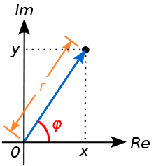
Instantaneous phase (瞬時相位)
If x(t) is a complex number:
X(t) = a + bi
Φ(t) = tan⁻¹(b/a)
If x(t) is a real number, it is determined from the signal's analytic representation x_{a}(t)=c+di
X(t) = c => x_{a}(t) = c+di
Φ(t) = tan⁻¹(d/c)
http://en.wikipedia.org/wiki/Instantaneous_phase

Slide 27
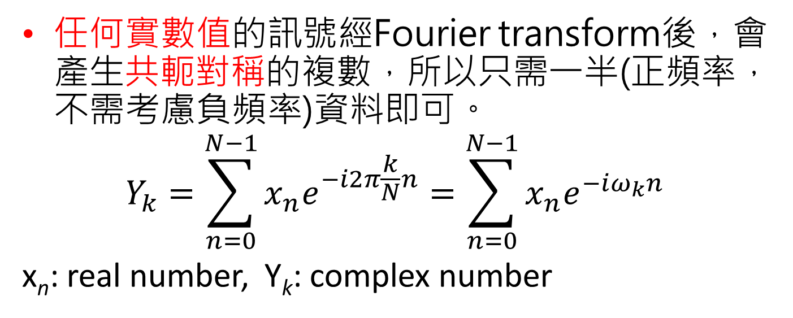
Analytic signal representation
任何實數值的訊號經Fourier transform後，會產生共軛對稱的複數，所以只需一半(正頻率，不需考慮負頻率)資料即可。
$$Y_{k}=\sum_{n=0}^{N−1}{x_{n}e^{−i2π\frac{k}{N}n}=\sum_{n=0}^{N−1}{x_{n}e^{−iω_{k}n}}}$$
x_{n}: real number, Y_{k}: complex number
$$re^{iθ}=rcosθ+irsinθ=rcos\left(−θ\right)−irsin\left(−θ\right)=\overline{rcos\left(−θ\right)+irsin\left(−θ\right)}=\overline{{re}^{i(−θ)}}$$
x=[1,2,3,4,5,6,7, 8]
Y= [36, -4+ 9.6569i, -4 + 4i, -4. + 1.6569i, -4, -4-1.6569i , -4 - 4i, -4 - 9.6569i]

Slide 28
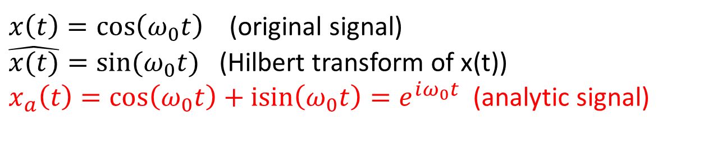
如果原始訊號經變換得到合成訊號，合成訊號經FT轉換後，不會產生負頻率(即在頻率域時，第二象限為0)，則將合成訊號頻率域轉換回合成訊號時間域時，實數值的部份即代表原始訊號，不需考慮複數值i的部份。稱這個合成訊號為analytic signal。
$x\left(t\right)=\cos\left(ω_{0}t\right)$ (original signal)
$\hat{x(t)}=sin⁡(ω_{0}t)$ (Hilbert transform of x(t))
$x_{a}\left(t\right)=\cos\left(ω_{0}t\right)+\operatorname{isin}\left(ω_{0}t\right)=e^{iω_{0}t}$ (analytic signal)
http://en.wikipedia.org/wiki/Analytic_signal

Slide 29
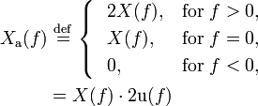
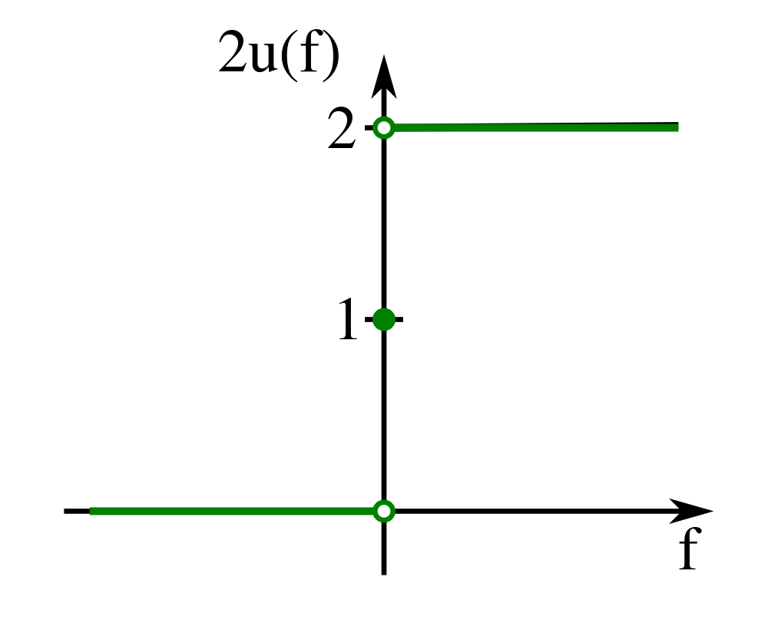

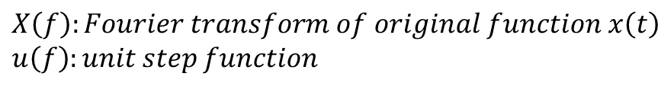
經過FT轉換後的解析信號頻率域， 負頻率部份為0
$$X\left(f\right):Fourier transform of original function x\left(t\right)$$
$$u\left(f\right):unit step function$$
可由解析訊號頻率域得到原始訊號的頻率域訊號

Slide 30
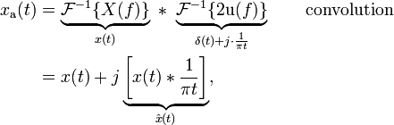
將解析信號頻率域做IFT轉換得到解析信號時間域
x(t)做Hilbert transform即x(t)與 1/($πt) convolution$
$$H\left(x\right)(t)=p.v.\int_{−∞}^{∞}{x\left(τ\right)h\left(t−τ\right)dτ= \frac{1}{π}p.v.\int_{−∞}^{∞}{\frac{x(τ)}{t−τ}dτ}}$$

Slide 31
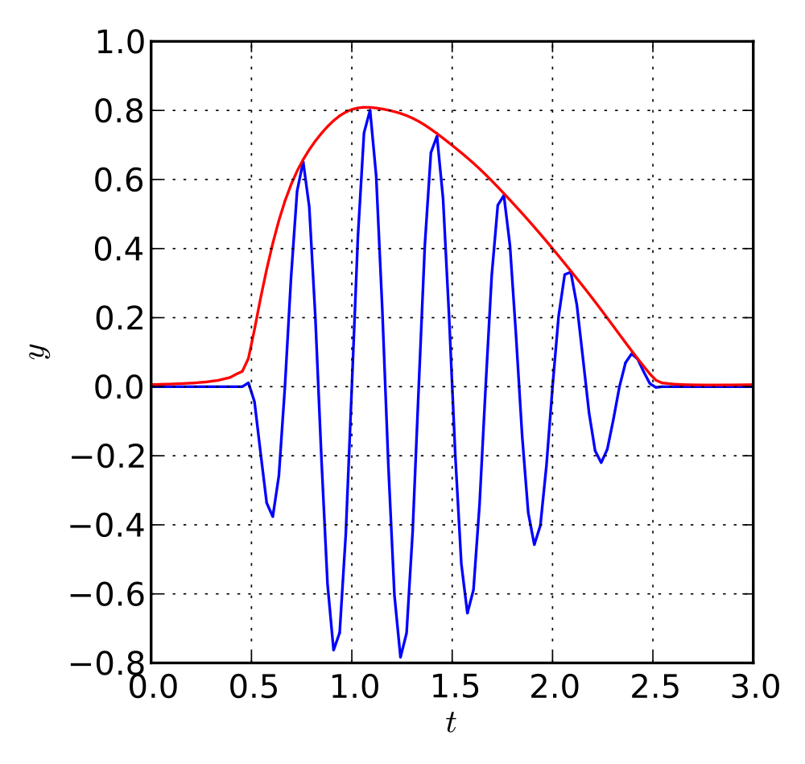
Blue: original signal
Red: magnitude of its analytic signal (envelope)

Slide 32
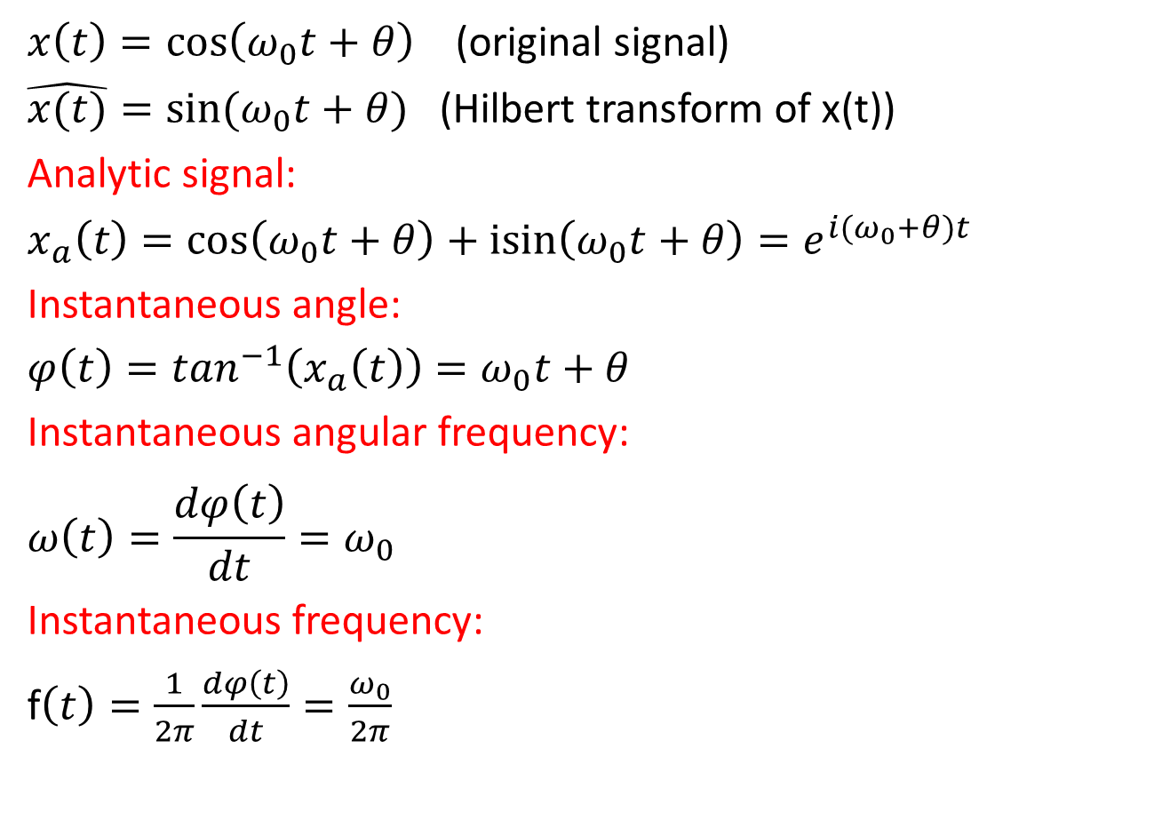
Instantaneous frequency (1)
$x\left(t\right)=\cos\left(ω_{0}t+θ\right)$ (original signal)
$\hat{x(t)}=sin⁡(ω_{0}t+θ)$ (Hilbert transform of x(t))
Analytic signal:
$$x_{a}\left(t\right)=\cos\left(ω_{0}t+θ\right)+\operatorname{isin}\left(ω_{0}t+θ\right)=e^{i{(ω}_{0}+θ)t}$$
Instantaneous angle:
$$φ\left(t\right)=\tan^{−1}\left(x_{a}\left(t\right)\right)=ω_{0}t+θ$$
Instantaneous angular frequency:
$$ω\left(t\right)=\frac{dφ\left(t\right)}{dt}=ω_{0}$$
Instantaneous frequency:
f$\left(t\right)=\frac{1}{2π}\frac{dφ\left(t\right)}{dt}=\frac{ω_{0}}{2π}$
三角函數為固定頻率， 所以瞬時頻率為常數

Slide 33
Instantaneous frequency (2)
以此種方式得出之瞬時頻率仍存有一些問題。
此方法得到的瞬時頻率為單值函數(single-valued function)；亦即在任一時刻僅定義了唯一的一個頻率值，此與一般複雜訊號是由多個不同振盪頻率所組成之概念不符。
第二個問題為倘若將原始訊號X(t)直接作Hilbert 轉換，所得到之瞬時頻率ω(t)在很多情況下不具任何物理意義。

Slide 34
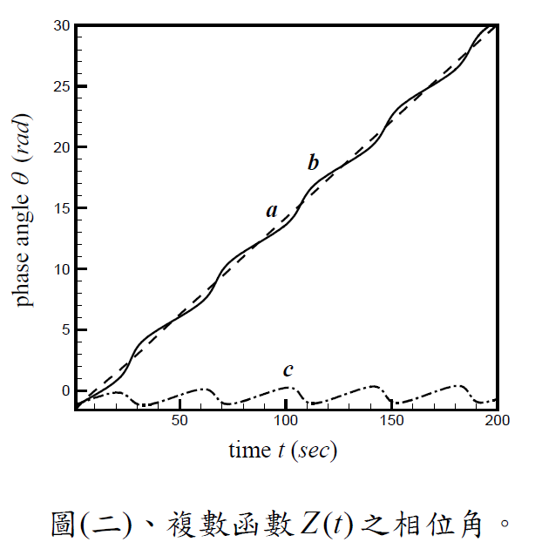
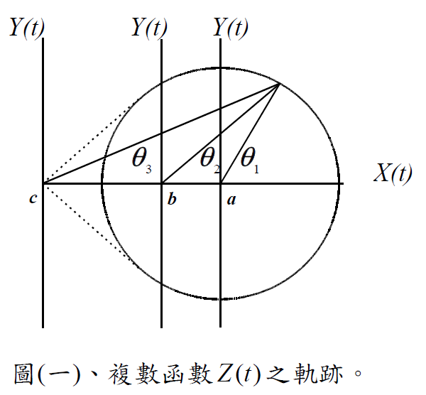
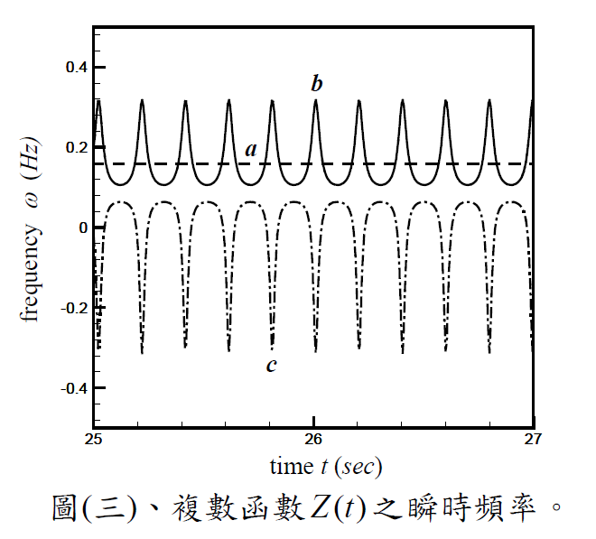
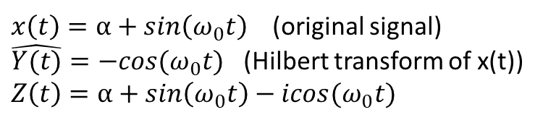
Instantaneous frequency (3)
$x\left(t\right)=α+sin\left(ω_{0}t\right)$ (original signal)
$\hat{Y(t)}=−cos⁡(ω_{0}t)$ (Hilbert transform of x(t))
$$Z\left(t\right)=α+sin\left(ω_{0}t\right)−icos⁡(ω_{0}t)$$
由此可知若訊號振盪平均值α不為0時，轉換不具物理意義，因此必須對x(t)做前處理
a: α=0, b: 0<α<1, c: α>1

Slide 35
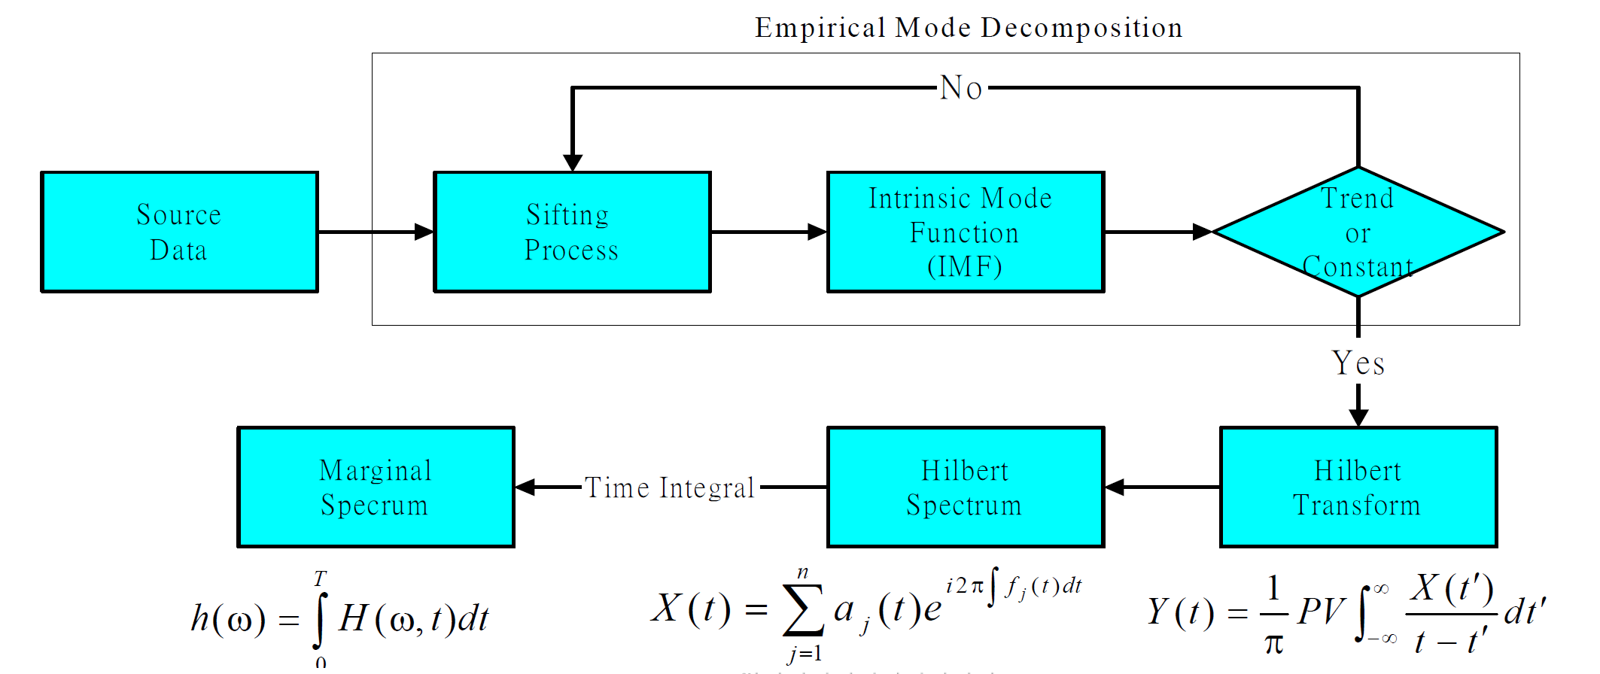
Hilbert-Huang transform (HHT)

Slide 36
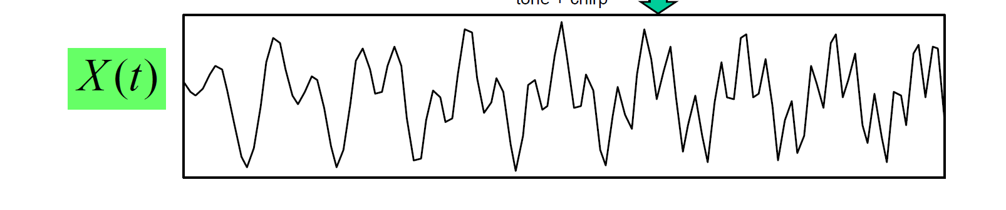
Empirical mode decomposition (EMD) (1)
Huang et al. 獲致一個結論。一個具備符合瞬時頻率物理意義的時間序列必須滿足兩個條件：
此時間序列於任兩相鄰局部極值(local extremes)之間必須通過一零點(zero point)；
此時間序列的局部平均值(local mean)必須為零。
使用EMD先將原始訊號分解成多個滿足上列條件的 Intrinsic Mode Function（IMF）

Slide 37
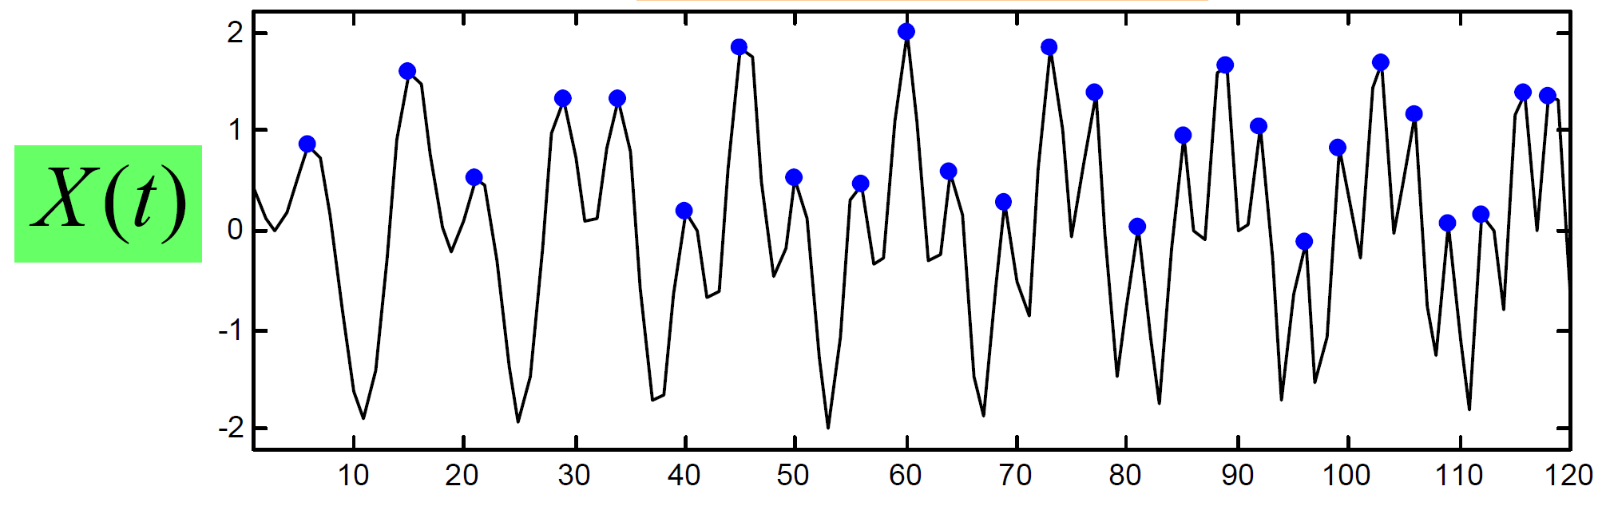
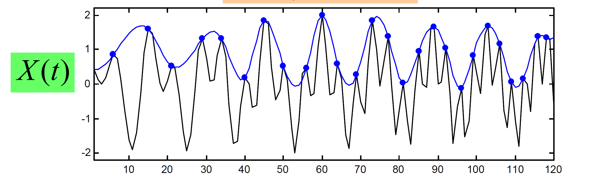
Empirical mode decomposition (EMD) (2)
IMF₁ iteration 0, step1: 找出 local maximum
IMF₁ iteration 0, step2: 找出 local maximum的 envelope (cubic function)

Slide 38
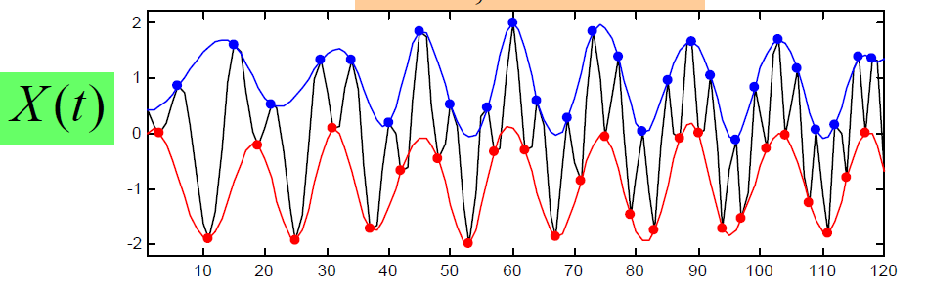

Empirical mode decomposition (EMD) (3)
IMF₁ iteration 0, step3, 4: 找出 local miniimum的 envelope (cubic function)
IMF₁ iteration 0, step 5: 找出upper & lower envelope的mean envelope m₁

Slide 39

Empirical mode decomposition (EMD) (4)
篩檢過程有兩個目的
1.可消除載波
2.使得波形更對稱

Slide 40


Empirical mode decomposition (EMD)(4)
IMF₁ iteration 1, 重複上述step得到h1的mean envelope m₁₁
h₁

Slide 41

Empirical mode decomposition (EMD)(5)
IMF₁ iteration k, 重複上述步驟直到h_{1k}與h_{1(k-1)}的SD之值小於0.1(自訂，建議為0.2~0.3)，得到原始訊號的IMF₁ c₁

Slide 42

Empirical mode decomposition (EMD)(6)
將x(t)-c₁之後，繼續上述的分解得到IMF₂ c₂

Slide 43

Empirical mode decomposition (EMD)(7)
將x(t)-c₁-c₂之後，繼續上述的分解得到IMF₃ c₃

Slide 44



Empirical mode decomposition (EMD)(8)
當訊號之極值數目小於2，或是訊號能量已經小於設定的門檻值（例如原始訊號1%），整個篩檢過程即停止。
$$X\left(t\right)=\sum_{i=1}^{6}{c_{i}+r_{n}}$$
即可由IMF訊號疊加後復原到原始訊號X(t)
IMF訊號之間接近正交!!
殘餘序列，非IMF

Slide 45

Reconstruction (1)
c₁
c₁+c₂
c₁+c₂+c₃
…
X(t)

Slide 46

Reconstruction (2)

Slide 47



Hilbert transform
由於 IMF₁~IMF_{n}會滿足瞬時頻率有物理意義的兩個條件，因此可以做轉換得Y(t)。
此時間序列於任兩相鄰局部極值之間必須通過一零點(zero point)；
此時間序列的局部平均值(local mean)必須為零。
Analytic signal Z(t):
$$Z\left(t\right)=\sum_{j=1}^{n}{a_{j}\left(t\right)e^{iθ_{j}(t)}}=\sum_{j=1}^{n}{a_{j}\left(t\right)e^{i\int{ω_{j}\left(t\right)dt}}}$$
$$X\left(t\right)=Re\left(\sum_{j=1}^{n}{a_{j}\left(t\right)e^{i\int{ω_{j}\left(t\right)dt}}}\right)$$
$ω\left(t\right)=\frac{dθ\left(t\right)}{dt}$ (rad/s) $$f\left(t\right)=\frac{ω\left(t\right)}{2π} (Hz)$$

Slide 48


Hilbert spectrum
$$Z\left(t\right)=\sum_{j=1}^{n}{a_{j}\left(t\right)e^{i\int{ω_{j}\left(t\right)dt}}}$$
$$令H\left(ω,t\right)為Z\left(t\right)中在時間t，角頻率為ω的能量強度$$
可由此關係式得下面的Hilbert spectrum $H\left(ω,t\right)$

Slide 49

Marginal Hilbert spectrum (1)
$$由H\left(ω,t\right)對時間t積分，可得到marginal spectrum h(ω)$$
對時間積分，則可表示每個頻率所對應到的振幅或能量的總和。

Slide 50

Marginal Hilbert spectrum (2)
Marginal Hilbert spectrum與Fourier spectrum意義不同

Slide 51
Comparison
 | Fourier | Fourier | HHT
Basis | a priori | a priori | adaptive
Frequency | convolution: global, uncertainty | convolution: regional, uncertainty | differentiation: local, certainty
Presentation | energy-frequency | energy-time-frequency | energy-time-frequency
Nonlinear | No | No | Yes
Non-stationary | No | Yes | Yes
Feature extraction | No | Discrete: No Continuous: Yes | yes
Theoretical base | theory complete | theory complete | empirical
http://www.scholarpedia.org/article/Hilbert-Huang_transform

Slide 52
Application- finance
蔡茹鈴 (96)，小波轉換與HHT轉換法在金融股價預測之應用碩士論文，應用數學所，逢甲大學
柯宏儒(97)， 以小波與HHT轉換為基礎利用二次自我迴歸模型預測金融股價， 碩士論文，應用數學所，逢甲大學
以HHT做為金融股價預測，其預測準確率小波轉換高，且較容易觀察股價訊息
3. Norden E. Huang, Man-Li Wu, Wendong Qu, Steven R. Long , Samuel S. P. Shen, ”Applications of Hilbert–Huang transform to non-stationary financial time series analysis, ” Applied Stochastic Models in Business and Industry, Vol. 19, Issue 3, pp. 245-268, 2003.
說明了HHT用於金融商品時間序列時的的特性
4. Lean Yua, Shouyang Wang, Kin Keung Lai, Fenghua Wen, “A multiscale neural network learning paradigm for financial crisis forecasting,” Neurocomputing, Vol. 73, Issue 4-6, pp. 716-725, 2010.

Slide 53
Application-Bioinformatics
Feng Shi , Qiu-Jian Chen & Na-na Li , “Hilbert Huang transform for predicting proteins subcellular location,” J. Biomedical Science and Engineering, Vol. 1, pp. 59-63, 2003.
Rong Jianga, Hong Yana, ”Studies of spectral properties of short genes using the wavelet subspace Hilbert–Huangtransform(WSHHT),” Physica A: Statistical Mechanics and its Applications, vol. 387, pp. 4223-4247, 2008.
Wei-Feng Zhang, Hong Yan, “Exon prediction using empirical mode decomposition and Fourier transform of structural profiles of DNA sequences ,” Pattern Recognition, vol. 45, pp.947-955, 2012.

Slide 54
Program
Matlab:
http://www.mathworks.com/matlabcentral/fileexchange/19681-hilbert-huang-transform
http://www.mathworks.com/matlabcentral/fileexchange/21409-empirical-mode-decomposition
數據分析方法研究中心 - 國立中央大學 http://rcada.ncu.edu.tw/research1.htm
Video lecture http://rcada.ncu.edu.tw/class2008.htm

Slide 55

Thank you!!

