Slide 1
P. P. Lab. 論文寫作提要

Slide 2
沒有閱讀過的人就不要畢業
實驗室網頁中的「實驗室必看」
  http://par.cse.nsysu.edu.tw/resource/lab_relative/ieresource.html
  平行處理實驗室組織章程
    第一章 總則
    第二章 成員
    第三章 成員之權利與義務
    第四章 組織架構
    第五章 附則
  投影片編輯範例
    編輯教學
    下載範本
  其它注意事項
    Unix vi 簡易使用手冊
    Latex簡易使用命令
    畢業論文寫作注意事項
    畢業論文流程
    經常使用期刊列表
    研究室同仁週報連結
    研究室電腦IP及使用者列表

Slide 3
論文寫作要點提示
一律使用Latex排版軟體
論文中的句子，不可抄自別的論文。但內容、意思可以相同，唯必須詳實列出論文出處。
論文印出之前，一定要做英文拼字及文法錯誤檢查（可利用M$ Word）。
所有章節、圖表、定義、定理、參考文獻均由Latex自動編排序號。
專有名詞及所使用之符號，在一篇文章中必須前後一致。
取自：畢業論文寫作注意事項

Slide 4
Begin & End
\begin{document}
%論文內容就在這裡面
\end{document}
% 在%後面的文字為註解
\begin{figure}
%圖要放在這裡面
\end{figure}
\begin{description}
%步驟或方法
\end{description}
\begin{table}
% 表格與數據資料
\end{table}
\begin{table*}
% 這個table可以跨欄
\end{table*}
\begin{center}
%想要把這一塊置中
\end{center}

Slide 5
Section (章節)
\begin{abstract}
% 好的摘要
\end{abstract}
\section{Introduction}
\label{sect:intro}
…In Section \ref{sect:pre}, we briefly introduce the fractal compression scheme and review some related algorithms.
\section{Previous Works} \label{sect:pre}
\section{The Intra-Block Variance Distribution Scheme} \label{sect:our}
1 Introduction
… In Section 2, we briefly introduce the fractal compression scheme and review some related algorithms.
2 Previous Works
3 The Intra-Block Variance Distribution Scheme
\subsection{The TKT Algorithm}

Slide 6
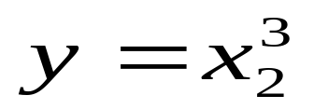

數學式與符號
\[ x_2 \] x₂
$x^{3}$ x³
\begin{displaymath}
y=x^{3}_{2}
\end{displaymath}
A = {a₁, a₂, …, a_{n}}
×$ A = \{a_{1}, a_{2}, ..., a_{n}\} $
√ $ A = \{a_{1}, a_{2}, \cdots, a_{n}\} $
\ldots, \cdots, \vdots, \ddots

Slide 7
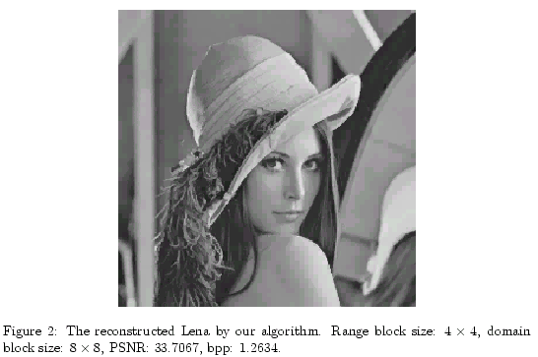
圖片
\begin{figure}
\centerline{\psfig{figure=lena_2.eps}}
\caption{The reconstructed Lena by our algorithm.
Range block size: $4 \times 4$, domain block size: $8 \times 8$, PSNR: 33.7067, bpp: 1.2634.}
\label{fig:lena}
\end{figure}
Figure \ref{fig:lena} shows the reconstructed Lena image…
\psfig[]{}
\graphicx[]{}

Slide 8
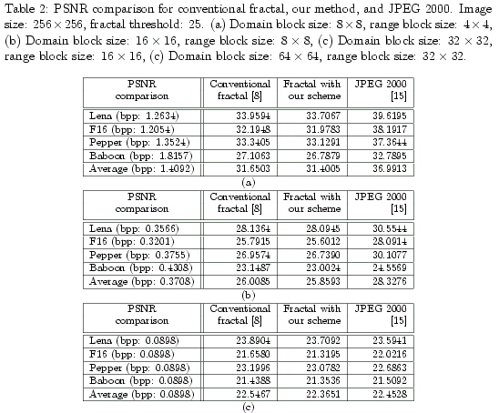
表格 (1)

Slide 9
表格 (2)
\begin{table*}
\caption[Performance of various fractal algorithms.]{Performance
of various fractal algorithms. The window size of local variance
fractal (LVF) is 3000. (a) Image: $256\times 256$,
threshold: 25, domain block size: $ 8 \times 8 $, range block
size: $ 4 \times 4 $. (b) Image: $256\times 256$, threshold: 25,
domain block size: $ 16 \times 16 $, range block size: $ 8 \times 8
$. }
\begin{center}
\hline \hline
& PSNR & 33.9594 & 34.0116 & 32.3305 & 32.0662 & 30.6072 & 33.6956 & 33.7067 \\
\cline{2-9} Lena & Time & 3355.4650 & 328.1510 & 233.4290 & 421.8470 & 64.2000 & 190.6750 & 45.3350 \\
\cline{2-9} & bpp & 1.2634 & 1.3272 & 1.2634 & 1.2634 & 1.2634 & 1.2634 & 1.2634 \\
\hline
& PSNR & 32.1948 & 32.3126 & 30.2904 & 29.8026 & 27.7408 & 32.0254 & 31.9783 \\
\cline{2-9} F16 & Time & 2491.4310 & 248.1550 & 178.7400 & 409.6000 & 30.4300 & 152.5150 & 46.5400 \\
\cline{2-9} & bpp & 1.2054 & 1.2638 & 1.2054 & 1.2054 & 1.2054 & 1.2054 & 1.2054 \\
\hline
& PSNR & 33.3405 & 33.3332 & 31.9643 & 29.9808 & 31.1345 & 33.1467 & 33.1291 \\
\cline{2-9} Pepper & Time & 3307.2260 & 326.7510 & 229.3550 & 273.3960 & 83.1660 & 227.7060 & 73.9350 \\
\cline{2-9} & bpp & 1.3524 & 1.4242 & 1.3524 & 1.3524 & 1.3524 & 1.3524 & 1.3524 \\
\hline
\hline
\multicolumn{9}{c} {(a)} \\
\end{tabular}

Slide 10
表格 (3)
\begin{table*} % Note: * 可讓這個table跨欄
\caption[Performance of various fractal algorithms.]{Performance of various fractal algorithms. The window size of local variance fractal (LVF) is 3000. (a) Image: $256\times 256$, threshold: 25, domain block size: $ 8 \times 8 $, range block size: $ 4 \times 4 $. (b) Image: $256\times 256$, threshold: 25, domain block size: $ 16 \times 16 $, range block size: $ 8 \times 8 $. }
\begin{center}
…
\end{center}
\label{tab:psnr}
\end{table*}
In Table \ref{tab:psnr}, it is interesting…

Slide 11
Reference
規則：(第一作者姓)4 + (年份) 2
In the fractal encoding scheme \cite{Tai98},
In the fractal encoding scheme [16],
The concept of classification can help us to reduce the encoding time in the fractal image compression \cite{Fish94, Pfef99, Huan97, Lin00}.
The concept of classification can help us to reduce the encoding time in the fractal image compression [5, 6, 13, 14].

Slide 12
Introduction to .bib (1)
@ARTICLE{Kim98,
AUTHOR="C. S. Kim and R. C. Kim and S. U. Lee",
TITLE="A fractal vector quantization for image coding",
JOURNAL=ieeetip,
MONTH=nov,
YEAR="1998",
VOLUME="7",
NUMBER="11",
PAGES="1598-1602"
}

Slide 13
Introduction to .bib (2)
@ARTICLE{Lloy82,
AUTHOR="S. P. Lloyd",
TITLE="Least squares quantization in {PCM}",
JOURNAL=ieeetit,
MONTH=mar,
YEAR="1982",
VOLUME="IT-28",
PAGES="129-137"
}

Slide 14
Introduction to .bib (3)
@STRING{jan="Jan."}
@STRING{ieeetip="IEEE Transactions on Image Processing"}
@STRING{ieeetit="IEEE Transactions on Information Theory"}
@STRING{ieeetpds="IEEE Transactions on Parallel and Distributed Systems"}

Slide 15
Introduction to .bib (4)
@BOOK{Barn93,
author = {M. F. Barnsley},
title = {Fractals everywhere},
year = 1993,
address = "San Diego, USA",
publisher = {Academic Press, Inc.},
edition = {Second}
}

Slide 16
Introduction to .bib (5)
@CONFERENCE{Pfe99,
AUTHOR="J. D. Pfefferman, P. E. Cingolani, and B. Cernuschi-Frias",
TITLE="A improved search algorithm for fractal image compression",
BOOKTITLE="In Proc. of ICECS '99",
YEAR="1999"
VOLUME="2",
PAGES="693~696"
}
試試看：把錯誤找出來，答案在下一頁

Slide 17
Introduction to .bib (6)
@CONFERENCE{Pfe99,
AUTHOR="J. D. Pfefferman, P. E. Cingolani, and B. Cernuschi-Frias",
TITLE="An improved search algorithm for fractal image compression",
BOOKTITLE="In Proc. of ICECS '99",
YEAR="1999",
VOLUME="2",
PAGES="693~696"
}
J. D. P. P. E. Cingolani and B. Cernuschi-Frias ?

Slide 18
Correctness of Your .bib
嚴謹（這不只是你自己的東西）
出處
  到資料庫或圖書館取得論文
  到作者網頁上找這篇
  到 citeseer 或google上找有參考這篇的別篇論文
確認
  編輯時確認
  列印前確認
  印出後確認
沒有讀過的資料可不可以拿來 reference ?

Slide 19
Bibliography
⇓ style file
\bibliographystyle{nie3tr}
%\nocite{*} %include all the references in bbl file
\bibliography{fractal}
⇑ bib file: fractal.bib

Slide 20
LaTeX Compiler
Input files: "file.tex" and "file.bib"
latex file[.tex]
bibtex file[.bib]
latex file[.tex]
latex file[.tex]

