Slide 1
Learn++: An Incremental Learning Algorithm for Supervised Neural Networks
Robi Polikar, Lalita Udpa, Satish S. Udpa,and Vasant Honavar
IEEE TRANSACTIONS ON SYSTEMS, MAN, AND CYBERNETICS,
VOL. 31, NO. 4, NOVEMBER 2001, pp. 497-508
Reporter: Hor, Chiou-yi
Date: Sept. 3, 2008

Slide 2
Abstract
We introduce Learn++, an algorithm for incremental training of neural network (NN) pattern classifiers. The proposed algorithm enables supervised NN paradigms, such as the multilayer perceptron (MLP), to accommodate new data, including examples that correspond to previously unseen classes.

Slide 3
Abstract
Furthermore, the algorithm does not require access to previously used data during subsequent incremental learning sessions, yet at the same time, it does not forget previously acquired knowledge. Learn++ utilizes ensemble (兩個或更多的聲樂家或演奏家共同演出的作品) of classifiers by generating multiple hypotheses using training data sampled according to carefully tailored distributions.

Slide 4
Abstract
The outputs of the resulting classifiers are combined using a weighted majority voting (加權多數決) procedure. We present simulation results on several benchmark datasets as well as a real-world classification task. Initial results indicate that the proposed algorithm works rather well in practice. A theoretical upper bound on the error of the classifiers constructed by Learn++ is also provided.

Slide 5
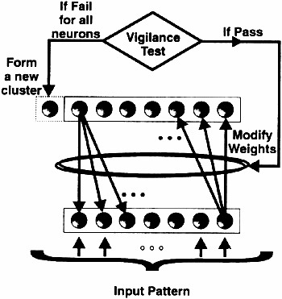
ART (Adaptive resonance theory)

Slide 6
ART
Based on the idea of adaptive resonant feedback between two layers of nodes
Developed by Carpenter & Goldberg
ART1: binary input clustering
ART2: analogy input clustering
ART3: refined scheme
Unsupervised vector classifiers

Slide 7
ART
Classifying according to the stored pattern they most resemble
The vigilance test:
  adaptively create a new neuron corresponding to an input pattern if it is determined to be “sufficiently” different from existing clusters

Slide 8
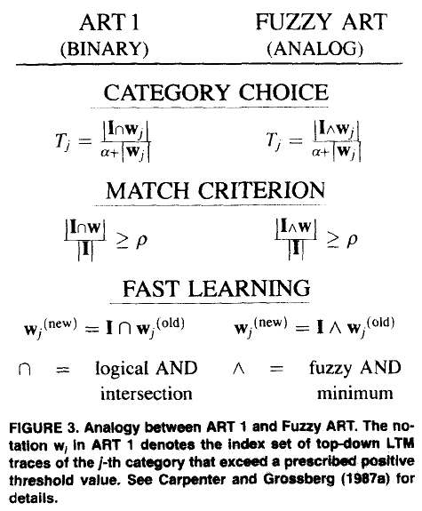
ART Comparison

Slide 9
Fuzzy ARTMAP (FAM)
A supervised network which is composed of two Fuzzy ARTs: ARTa and ARTb.
ARTa
  Consists of fully connected input layer F1 & output layer F2 (nodes # => prototypes #)
  It learns by placing hyper-boxes in the 2*M, where M is the size of layer F1.
  Each prototype is defined by a box. The first M positions represent one corner of the box and the other M positions represent the opposite one.

Slide 10
Fuzzy ARTMAP (FAM)
ARTa
  Using the conventional ATR mechanism to decide whether a new F2 node should be created
  A vigilance criterion checks whether a vigilance parameter is satisfied.
ARTb
  Comparing the mapped class of the input with the actual input's label. (Supervised)
  If the labels are different, ARTa creates a new prototype and connects it to the input's label.

Slide 11
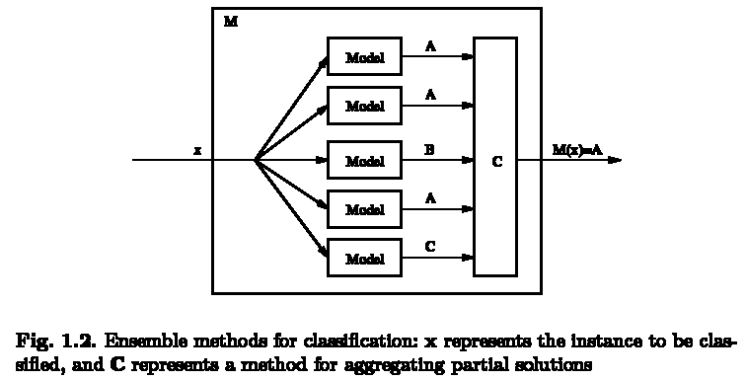
Ensemble classifiers

Slide 12
Ensemble classifiers
Assume we have three independent but weak (better than randomly guessing) classifiers, each achieves a classification rate of 60%. The final output is obtained by a majority voting scheme.
The probability to make mistakes is:
  0.6*0.4*0.4 = 9.6%
  0.4*0.6*0.4 = 9.6%
  0.4*0.4*0.6 = 9.6%
  0.4*0.4*0.4 = 6.4%
The overall classification rate is: 1-3*9.6%-6.4% = 64.8%. [稱此辨識率提升為boosting]

Slide 13
Adaboost
Train classifier1
classified
test
unclassified
data
越後面分類器負責學習前面分類器認為困難的資料
分類時所有分類器以加權投票方式決定類別
Train classifier2
…

Slide 14
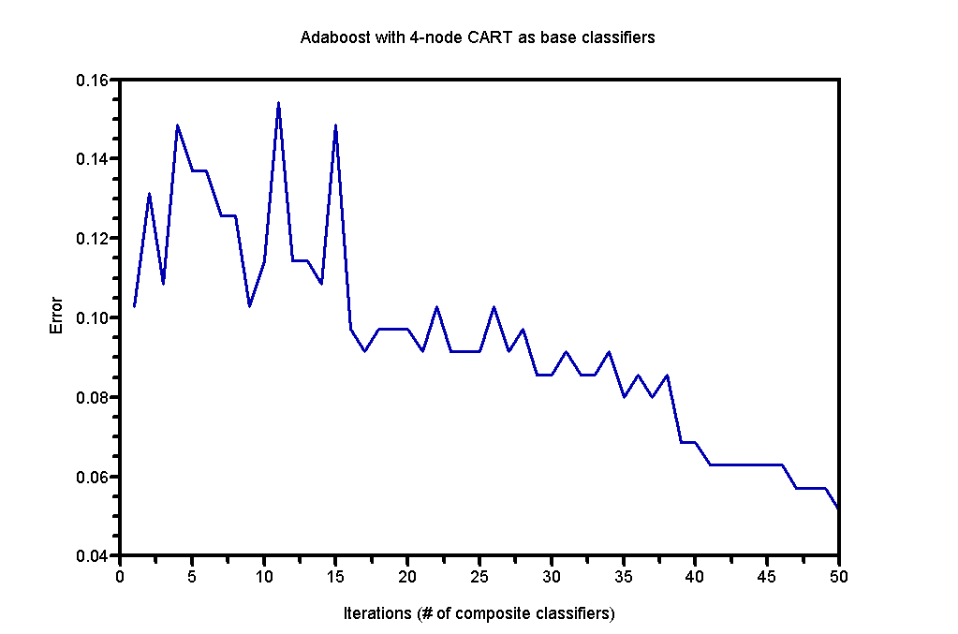
Adaboost
Data: Ionosphere (2-classes, 32-features) from UCI Repository of machine learning databases
50 CART classifiers are built.
Codes are GML AdaBoost Matlab Toolbox 0.3.

Slide 15
Limitations of ensemble classifiers
Use of strong learners, on the other hand, are not recommended in algorithms using the ensemble of classifiers approach, since there is little to be gained from their combination, and/or they may lead to over fitting of the data.

Slide 16
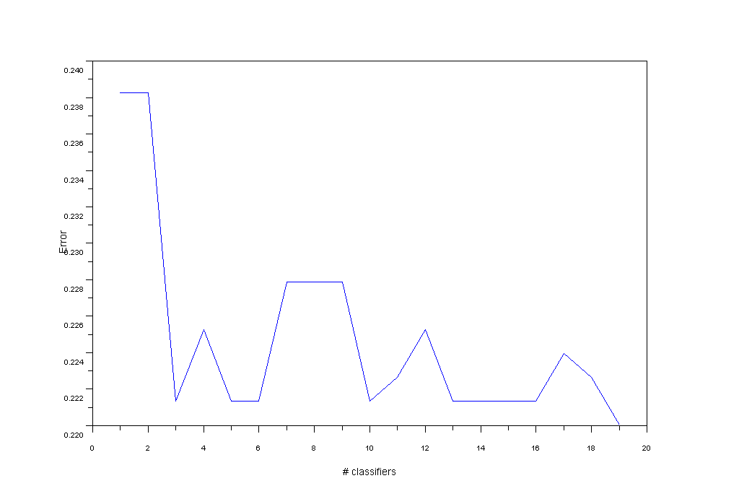
Limitations of ensemble classifiers

Slide 17
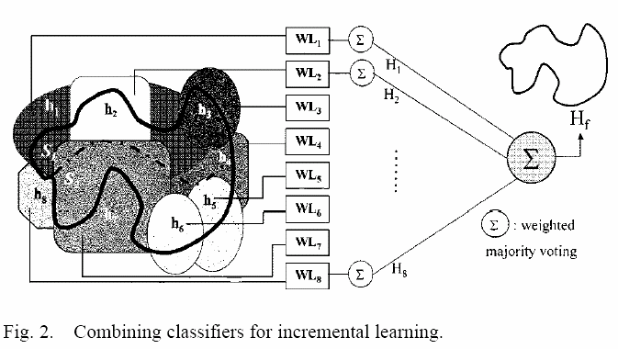
Learn++ architecture

Slide 18

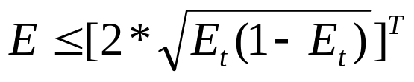
Performance
Given total T composite hypotheses (or weak classifiers) and Et the t'th composite hypothesis Ht
The error bound is (its proof is in the paper)
If Et<0.5, then (Et(1-Et))^{½}<0.5 and 2*(Et(1-Et))^{½}<1. When T→∞, E→0.

Slide 19
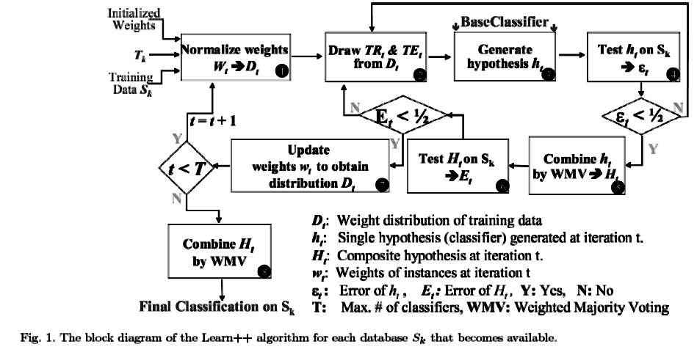
Learn++ algorithm

Slide 20
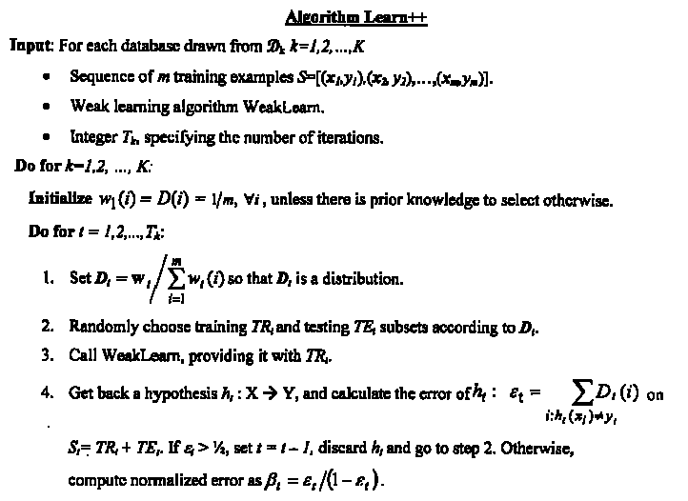
Learn++ algorithm
x為sample，y為類別
共計K個composite classifiers學習K個資料庫
初始化每一sample權重
每個composite classifier計Tk個weak classifiers
正規化每一sample權重，並根據sample權重決定被納入訓練之機率
3.訓練weak classifiers，如果其分類正確率小於50%則捨棄

Slide 21
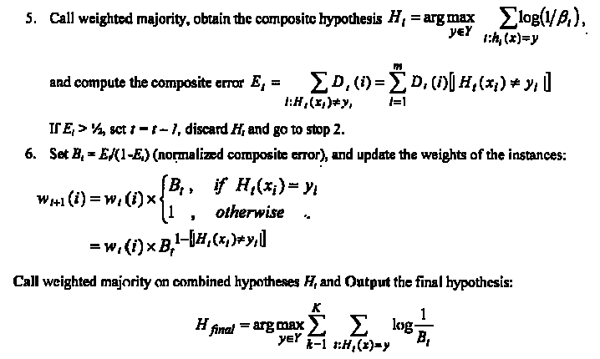
Learn++ algorithm
如果composite classifiers分類正確率小於50%則捨棄
更新每一sample的權重，如果在此iteration被分錯，則權重增加，反之則減少。權重越高到下一iteration被再拿來訓練機會越高
在面對未知sample時，各composite classifiers每一票權重係由訓練時分類正確率高低決定(上式應為log(1/β_{t}))

Slide 22
Step 3-4: Decide weights of weak classifiers
Call WeakLearn to train a weak classifier.
  Can be any training algorithm such as neural networks or decision trees.
Calculate the error rate ε_{t} of each t'th weak classifier. Discard classifier with ε_{t}>0.5.
Compute normalized error for t‘th weak classifier β_{t}=ε_{t}/(1-ε_{t}). Assign its weighted majority as log(1/β_{t}) = log((1-ε_{t})/ε_{t}) = log(correct/wrong). [正確率越高，投票時權重越大]

Slide 23
Step 5 : Decide weights of composite classifiers
Calculate the error rate E_{t} of each t'th composite classifier. Discard classifier with E_{t}>0.5.
Compute normalized error for t‘th composite classifier B_{t}=E_{t}/(1-E_{t}). Assign its weighted majority as log(1/B_{t}) = log((1-E_{t})/E_{t}) = log(correct/wrong). [正確率越高，投票時權重越大]

Slide 24

Step 6 : Decide weights of training samples
Compute the weight for i‘th samplein the next (t+1) iteration. [錯誤率越高，下次被納入訓練機會越大] (∵B_{t} < 1,若此輪分類正確(H_{t}(x_{i})=y_{i})，即，composite分類器輸出H_{t}(x_{i})和類別y_{i}一樣，w_{t}(i)*B_{t}到下一輪時變小)

Slide 25
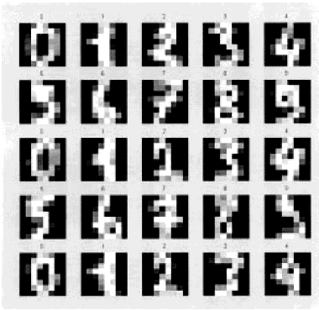
Experiment 1
UCI 0-9 digital numerals, 1200 samples for training and 4420 ones for validation, 10 classes, and 64 attributes.
1200 training samples are divided into 6 datasets. Each dataset contains 200 samples.
Train 6 composite classifiers, each contain 30 weak classifiers (Multi-layer perceptron with 30 hidden units and target MSE 0.1).
The ensemble classifier is compared with 100 hidden units and target MSE 0.001.

Slide 26
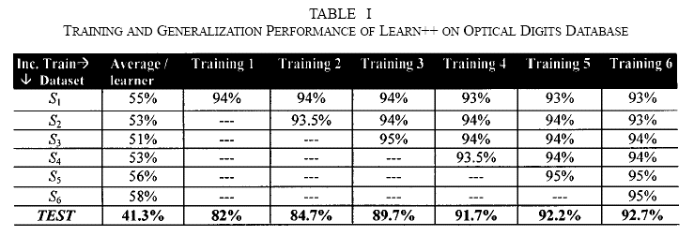
Experiment 1
The ensemble classifier’s generalization performance is comparable with the strong classifier with 100 hidden units and target MSE 0.001 (with 95% classification rate)

Slide 27
Experiment 2
UCI Vehicle Silhouette[輪廓;側影] Database: vehicle classification, 630 samples for training and 216 ones for validation, 4 classes, and 64 attributes.
630 training samples are divided into 3 datasets. Each dataset contains 210 samples.
Train 3 composite classifiers, each contain 30 NN weak classifiers (with 30 hidden units and target MSE 0.1).
The ensemble classifier is compared with other training algorithms such as boosting or constructive NNs.

Slide 28
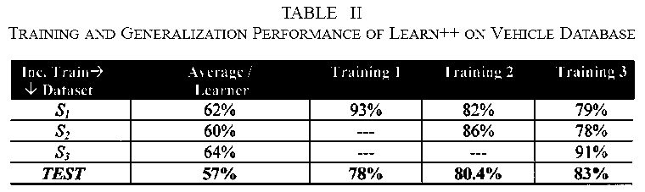
Experiment 2
The ensemble classifier’s generalization performance is better than the other strong classifiers (typically 65-80% classification rate)

Slide 29
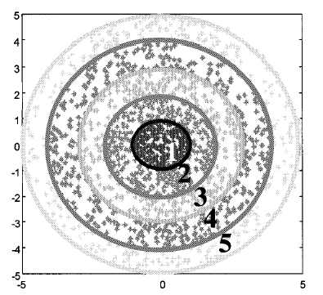
Experiment 3
Synthetic Concentric Circles Database: 300 samples for training and 500 ones for validation, 5 classes, and 2 attributes.
300 training samples are divided into 6 datasets. Each dataset contains 50 samples.
Train 6 composite classifiers.
The ensemble classifier is compared with 50 hidden units and target MSE 0.005.
Class 1-5
Class 1-4
Class 1-3

Slide 30
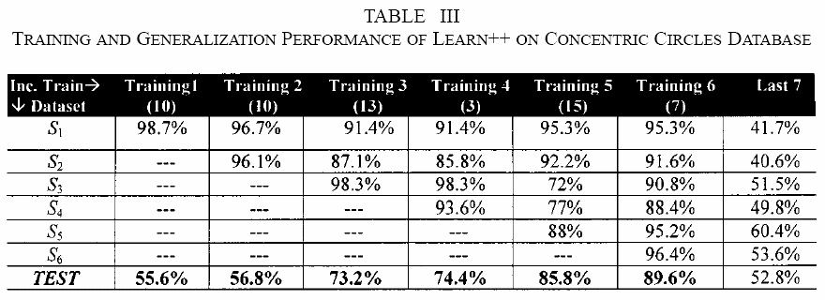
Experiment 3
The ensemble classifier’s generalization performance is better than the other strong classifiers (typically 95% classification rate).
The last column titled “Last 7” indicates the Learn++ performance on the last seven hypotheses. [表示第六次訓練包含新的知識，但無法含蓋前五次知識]

Slide 31
Experiment 4
Gas Sensing Dataset: 180 samples for training and 204 ones for validation, 5 classes, and 6 attributes.
180 training samples are divided into 3 datasets. Each dataset contains 80, 40 and 60 samples.
Train 3 composite classifiers.
The ensemble classifier is compared with 2-hidden –layer MLP with target MSE 0.001 and fuzzy ARTMAP.

Slide 32
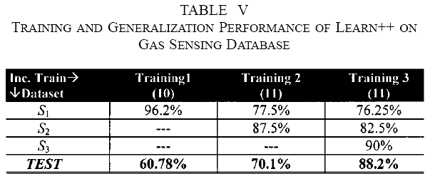
Experiment 4
The 2-hidden–layer MLP achieves 90% classification rate.

Slide 33
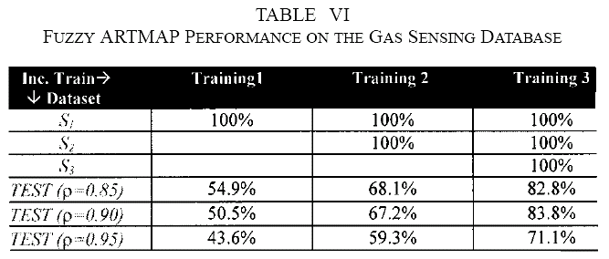
Experiment 4

Slide 34
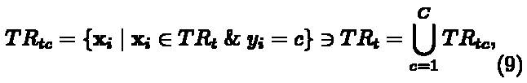
Dynamically Updating Voting Weights
Class-specific Mahalanobis distance is introduced as a modification to the original Learn++ voting weights. 意思就是說，分類器權重的調整可以根據未知樣本與每一類別中心的遠近決定，而非僅由訓練時每一分類器的表現決定
TR_{tc} includes only those instances of TR_{t} that belong to class c.

Slide 35


Dynamically Updating Voting Weights
Class 1
Class 3
m_{t1}
m_{t3}
M_{t1}
M_{t3}
The weight is
Unknown sample
M_{t2}
m_{t2}
Class 2
C_{tc} is covariance matrix.

Slide 36


Estimating the Confidence
For any given instance x, the final classification is class c, if the total vote class c receives:
The confidence is:

Slide 37
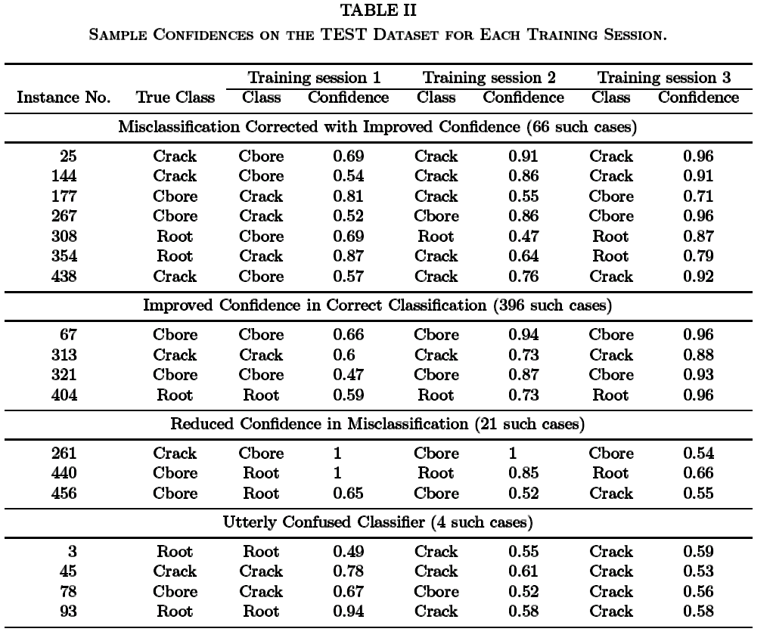
Experiments
原先被分錯，但之後被分對，且正確率越來越高
原先訓練時就被分對，且之後正確率越來越高

