Slide 1
Hierarchical Learning Architecture With
Automatic Feature Selection for Multi-class
Protein Fold Classification
Chuen-Der Huang, Chin-Teng Lin,,and Nikhil Ranjan Pal
IEEE TRANSACTIONS ON NANOBIOSCIENCE, VOL. 2, NO. 4, DECEMBER 2003
Reporter: Hor, Chiou-yi
Date: Oct. 28, 2008

Slide 2
Abstract
The structure classification of proteins plays a very important role in bioinformatics, since the relationships and characteristics among those known proteins can be exploited to predict the structure of new proteins. The success of a classification system depends heavily on two things: the tools being used and the features considered. For the bioinformatics applications, the role of appropriate features has not been paid adequate importance. In this investigation we use three novel ideas for multiclass protein fold classification.

Slide 3
Abstract
First, we use the gating neural network, where each input node is associated with a gate. This network can select important features in an online manner when the learning goes on. At the beginning of the training, all gates are almost closed, i.e., no feature is allowed to enter the network. Through the training, gates corresponding to good features are completely opened while gates corresponding to bad features are closed more tightly, and some gates may be partially open.

Slide 4
Abstract
The second novel idea is to use a hierarchical learning architecture (HLA). The classifier in the first level of HLA classifies the protein features into four major classes: all alpha, all beta, alpha + beta, and alpha/beta. And in the next level we have another set of classifiers, which further classifies the protein features into 27 folds. The third novel idea is to induce the indirect coding features from the amino-acid composition sequence of proteins based on the N-gram concept. This provides us with more representative and discriminative new local features of protein sequences for multiclass protein fold classification.

Slide 5
Abstract
The proposed HLA with new indirect coding features increases the protein fold classification accuracy by about 12%. Moreover, the gating neural network is found to reduce the number of features drastically. Using only half of the original features selected by the gating neural network can reach comparable test accuracy as that using all the original features. The gating mechanism also helps us to get a better insight into the folding process of proteins. For example, tracking the evolution of different gates we can find which characteristics (features) of the data are more important for the folding process. And, of course, it also reduces the computation time.

Slide 6
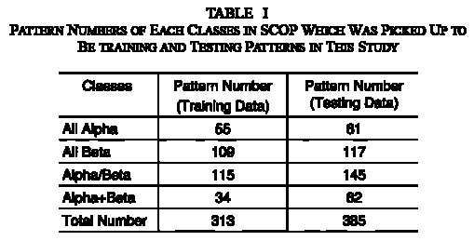
Original Datasets
4 protein classes & 27 foldings to be classified
Training datasets: 313 samples with identity less than 35%
Test datasets: 385 samples with identity less than 40%
4種proteins

Slide 7
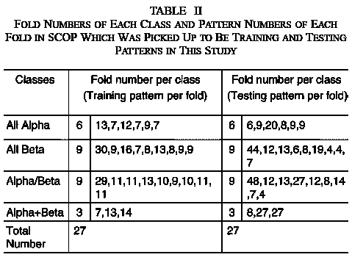
Original Datasets
4種proteins
27種foldings
每種folding樣本數

Slide 8
Features
Global features#: 20+21+21+21+21+21
  Contained in the original datasets
Local features#: 441 + 441
  Proposed by the author

Slide 9
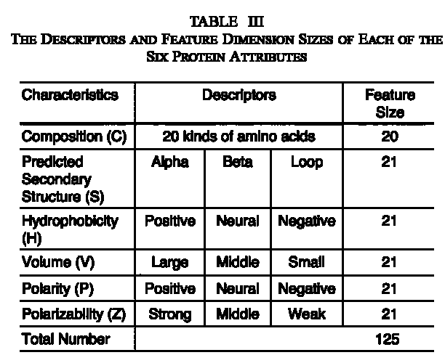
Global Features
The six kinds of protein sequence information (PSI) are extracted from the provided open protein database.
(http://ranger.uta.edu/~chqding/protein)

Slide 10
Local Features: N-grams Coding
假設 PIVDGPI序列由PIVDG五種元素組合，Bi-gram定義為序列中相鄰兩種元素(可以重複)出現次數
在原amio acids序列中，除了20個常見amio acids外，其餘的均以第21個alphabet表示，因此共有21*21種組合
 | P | I | V | D | G
P | PP | PI | PV | PD | PG
I | IP | II | IV | ID | IG
V | VP | VI | VV | VD | VG
D | DP | DI | DV | DD | DG
G | GP | GI | GV | GD | GG
 | P | I | V | D | G
P |  | 2
I |  |  | 1
V |  |  |  | 1
D |  |  |  |  | 1
G | 1

Slide 11
Local Features: N-grams codings
假設 PIVDGPI序列由PIVDG五種元素組合，Spaced Bi-gram定義為序列中間隔一個元素之兩種元素(可以重複)出現次數，同樣有21*21種組合
 | P | I | V | D | G
P | P?P | P?I | P?V | P?D | P?G
I | I?P | I?I | I?V | I?D | I?G
V | V?P | V?I | V?V | V?D | V?G
D | D?P | D?I | D?V | D?D | D?G
G | G?P | G?I | G?V | G?D | G?G
 | P | I | V | D | G
P |  |  | 1
I |  |  |  | 1
V |  |  |  |  | 1
D | 1
G |  | 1

Slide 12
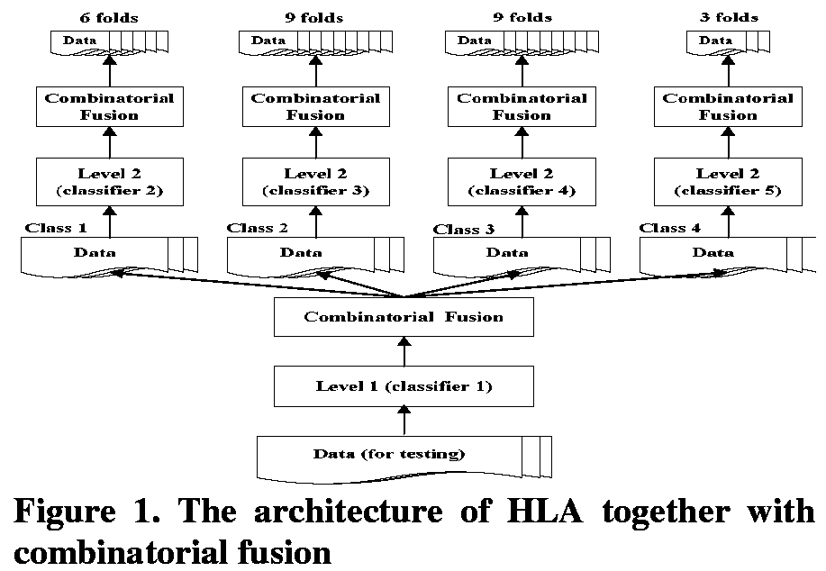
Hierarchical Learning Architecture (HLA)

Slide 13
Hierarchical Learning Architecture (HLA)
A two-level procedure
  1st level: 4 protein classes (α, β, α/β, α+β)
  2nd level: 6, 9, 9 and 3 folding classes respectively for classes in level 1 (舉例來說， α-protein內包括6種folding， α+ β -protein內則包括3種folding)
優點：
  Reducing the numbers of classifiers
  Avoiding the voting scheme
  Increasing the accuracy of protein fold recognition
缺點：
  If the Level 1 classifier makes any mistake, then Level 2 classifiers cannot recover the same.

Slide 14
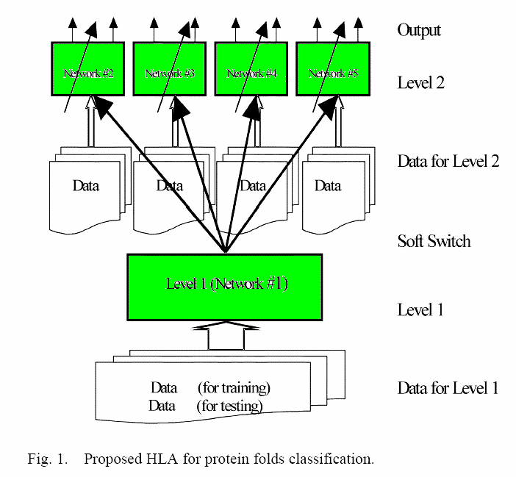
Hierarchical Learning Architecture (HLA)
Basic building blocks
  Radial basis function neural network
    Being a three-layer network which can grow its hidden nodes automatically
  Support vector machines
    RBF kernels are adopted.

Slide 15
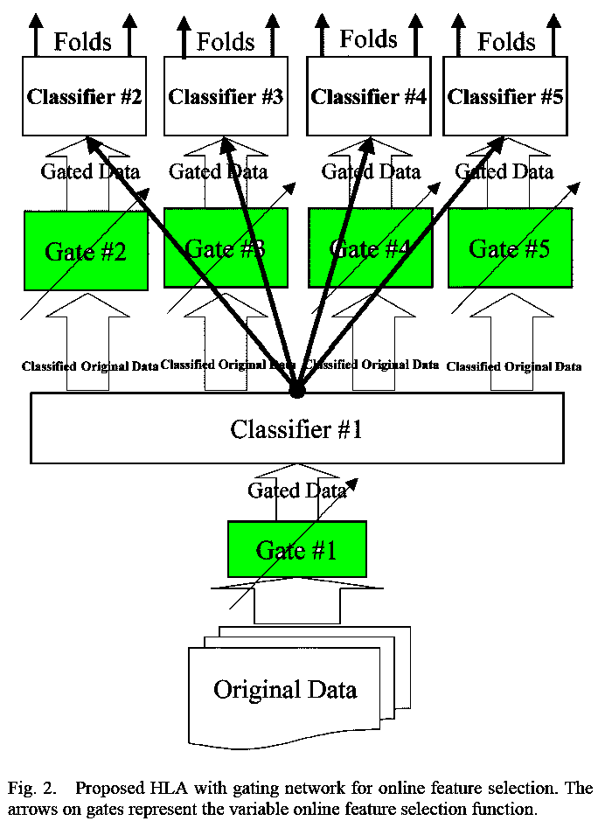

Feature Selection through Gating
真正輸入Classifier的為：
x‘=(x₁(F(w₁), x₂(F(w₂),…,x_{k}(F(w_{k}))
F=(F(w₁),F(w₂),…,F(w_{k}))
x=(x₁,x₂,…, x_{k})

Slide 16
Feature Selection through Gating
Before a set of training data are sent into a classifier in the HLA for training, they are passed into the feature selection mechanism.
A gate so that “partially useful” features be identified and attenuated according to their relative usefulness.
The gate for each feature is modeled with an attenuation[散佈、擴散、稀釋] function such that for a good feature the function produces a value of one or nearly one; while for a bad feature, it should be nearly zero.

Slide 17
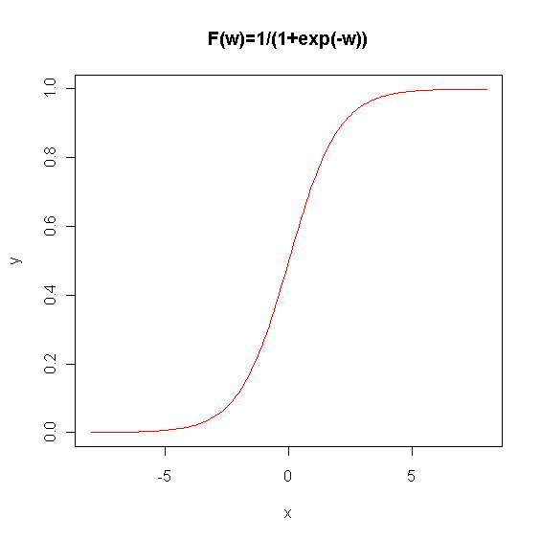
Feature Selection through Gating
Sigmoid Attenuation function

Slide 18
Feature Selection through Gating
Making use of MLP (Multi-Layer Perceptron[感知機])
  wi: the attenuation parameter
  F(wi): the attenuation function associated with the ith input feature xi
  F’(wi): the derivative of the attenuation function at wi
  u,v: the learning rate
  w⁰_{ij}: the weight connecting the jth node of the first hidden layer to the ith node of the input layer
  δ^{i}_{j}: the error term for the jth node of the first hidden layer

Slide 19
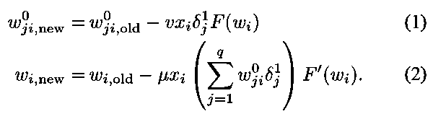
Feature Selection through Gating
Update of the attenuation parameter wi & weight w⁰_{ij}

Slide 20
Classification Accuracy
ni: # of ith test fold, i=1~27
ci: # of ith test fold that are correctly classified
N=Σni=385
C=Σci
Accuracy Q = C/N

Slide 21
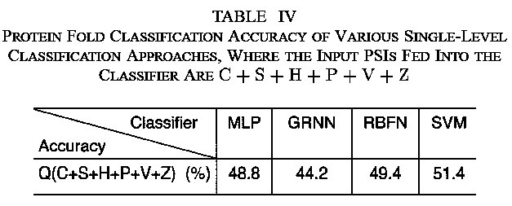
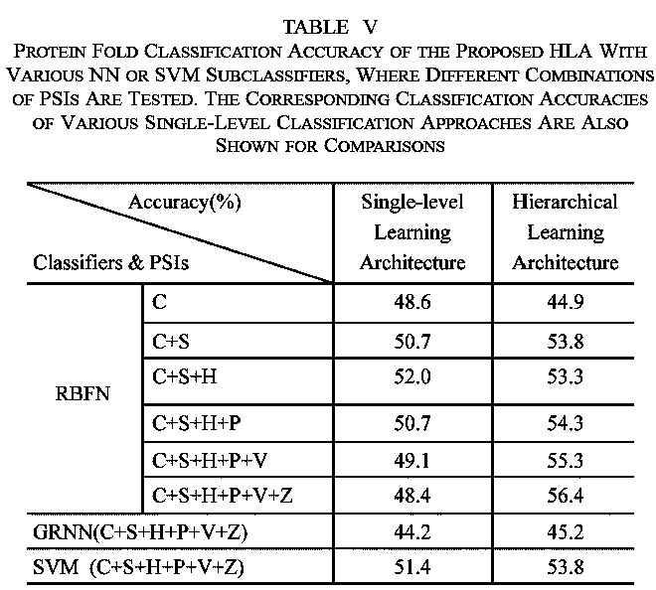
Effect of HLA
Note: General Regression Neural Network (GRNN)
The HLA can increase the classification accuracy.

Slide 22
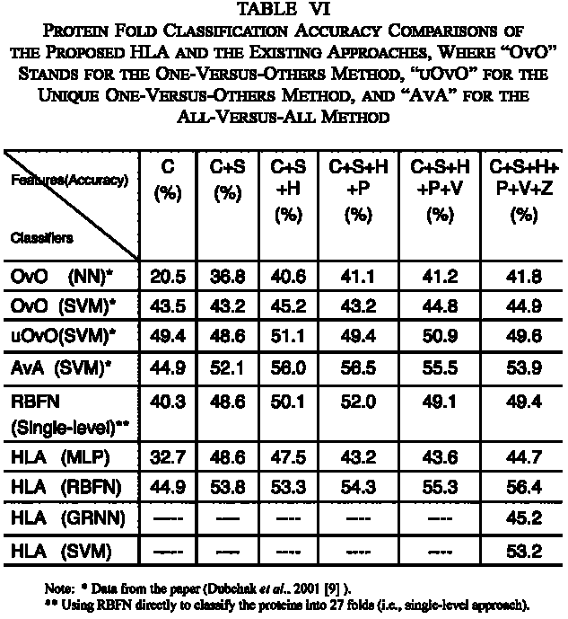
Effect of HLA
Accuracy↑

Slide 23
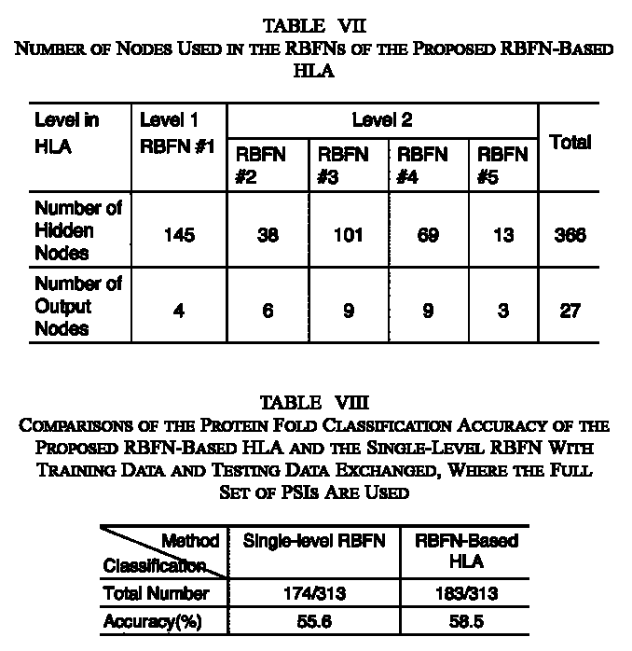
Effect of HLA
Accuracy↑

Slide 24
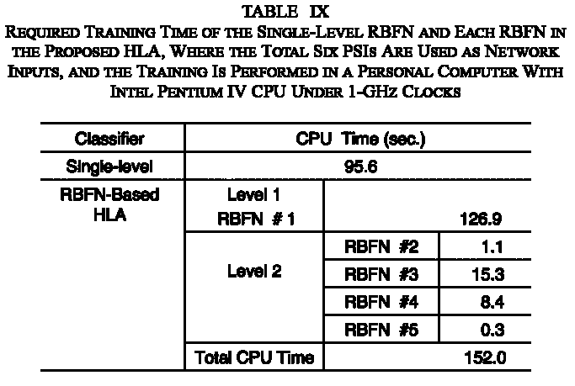
Effect of HLA
Although Level 1 RBFN in the HLA consumed longer training time, the training of each Level 2 RBFN converged very quickly.

Slide 25
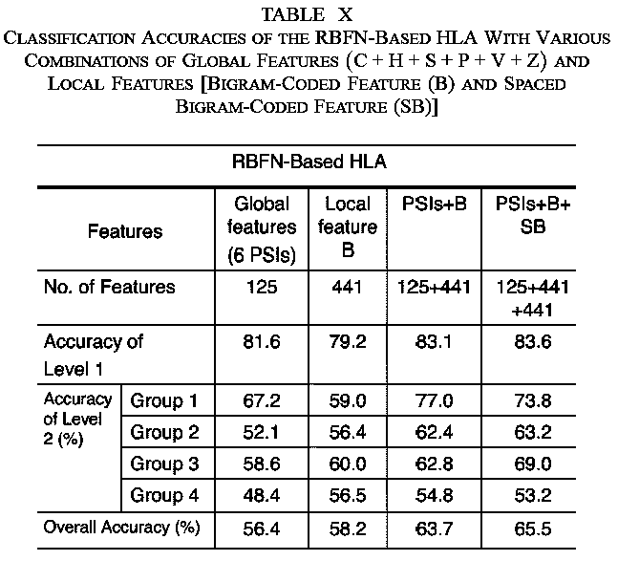
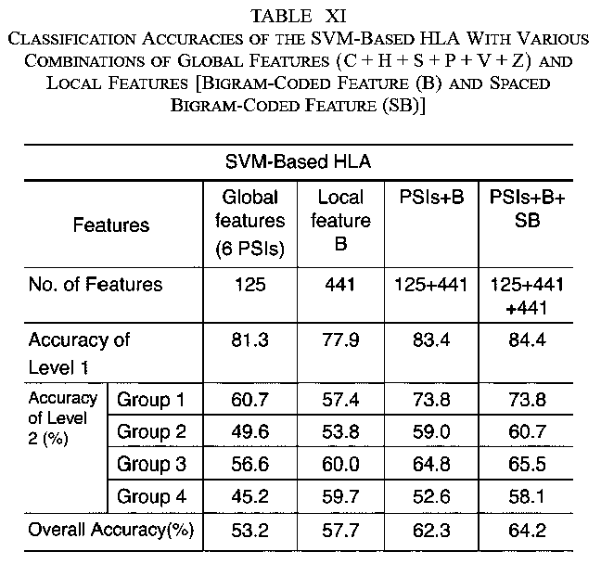
Effect of New Features
More features, Accuracy↑

Slide 26
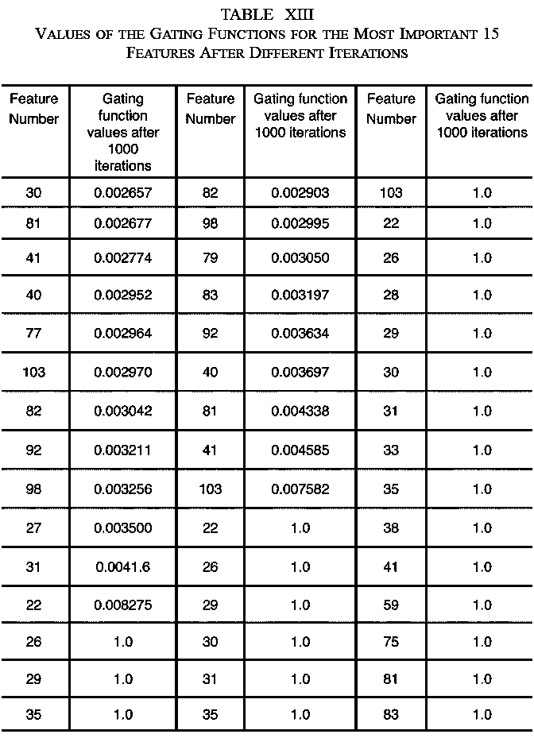
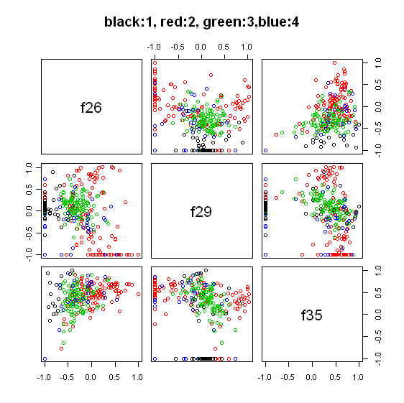
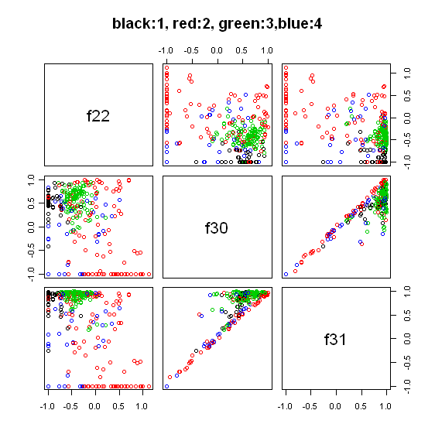
Feature Selection

Slide 27
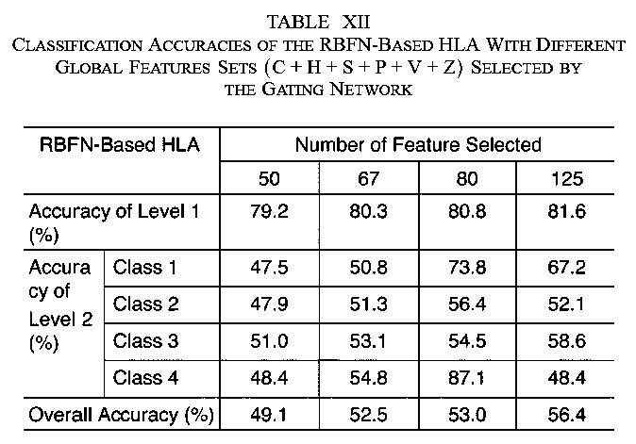
Effect of Feature Selection

Slide 28
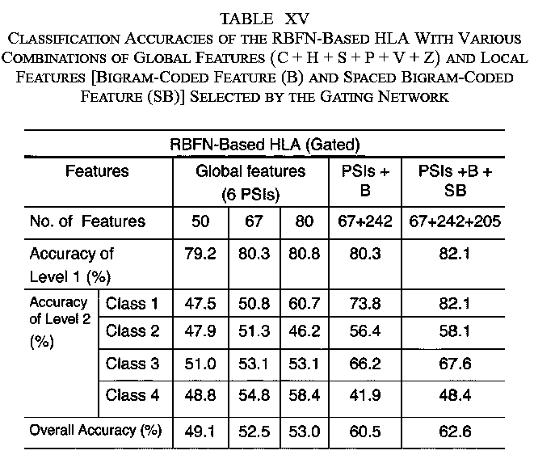
Effect of Feature Selection

