Slide 1
Protein Backbone Angle Prediction with Machine Learning Approaches
Rui Kuang, Christina S. Leslie, and An-Suei Yang
Department of Computer Science, Department of Pharmacology, Columbia Genome Center and Center for Computational Biology and Bioinformatics, Columbia University, West 168th Street, PH 7 W Room 318, New York, NY 10032, USA
BIOINFORMATICS Vol. 20 10 2004, pages 1612-1621
Presenter: Hsin-Wei Yen
Date: Dec. 3 , 2008

Slide 2
Abstract
Motivation: Protein backbone torsion angle prediction provides useful local structural information that goes beyond conventional three-state (α, β, and coil) secondary structure predictions. Accurate prediction of protein backbone torsion angles will substantially improve modeling procedures for local structures of protein sequence segments, especially in modeling loop conformations that do not form regular structures as in α-helices or β-strands.

Slide 3
Abstract (cont’)
Results: We have devised two novel automated methods in protein backbone conformational state prediction. One method is based on support vector machines (SVMs); the other method combines a standard feed-forward back-propagation artificial neural network (NN) with a local structure-based sequence profile database (LSBSP1). Extensive benchmark experiments demonstrate that both methods have improved the prediction accuracy rate over the previously published methods for conformation state prediction when using an alphabet of three or four states.

Slide 4
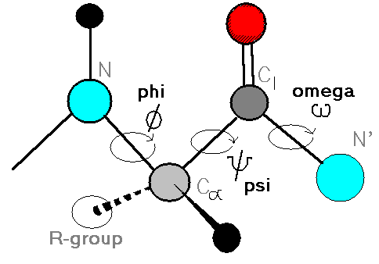
Introduction
Alpha:
Φ=-60, Ψ=-40
Beta:
Φ=-120, Ψ=120

Slide 5
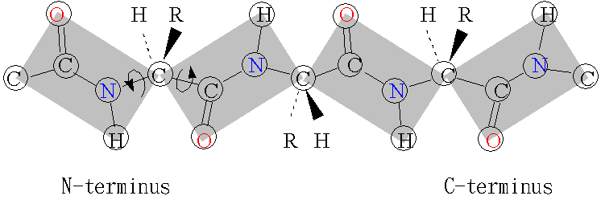
Φ and Ψ
Φ
Ψ

Slide 6
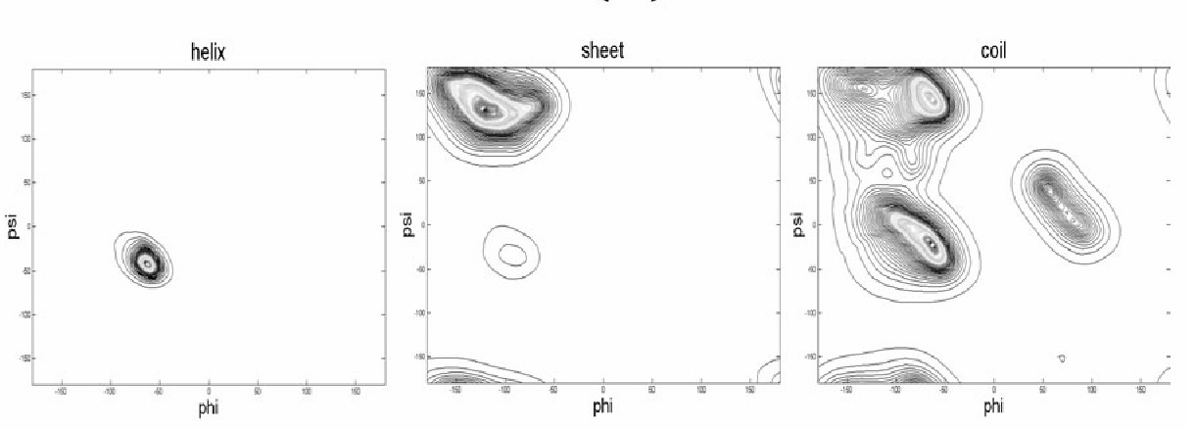
Density Plot

Slide 7
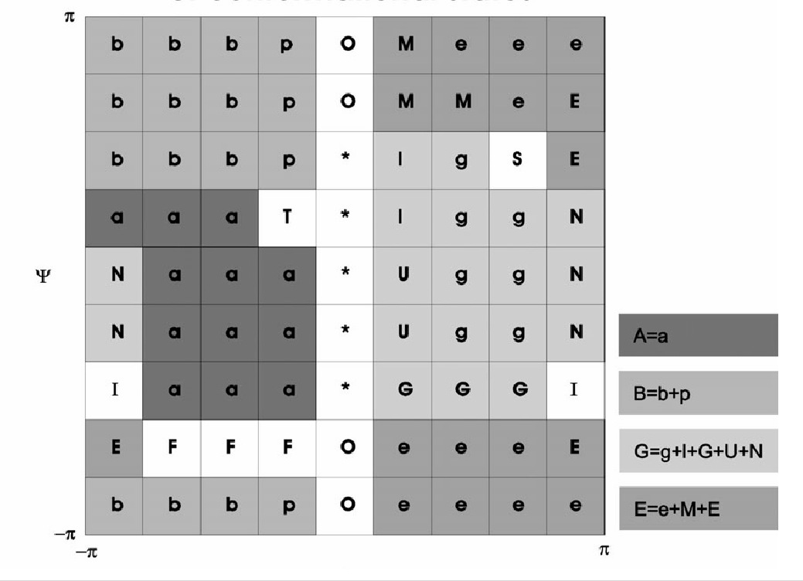
Ramachandran Plot

Slide 8
LSBSP1 Database
Local structure-based sequence profile databse
LSBSP1 database contains a total of 138,604 PSSMs.
Each PSSM has dimensions of 9x20
Segments in LSBSP1 are 9 consecutive residue sequence segments from PDB_SELECT_25

Slide 9
Method1 : LSBSP1+NN
The input layer has 216 input units, representing a window of 9 consecutive residues
The hidden layer has 50 units
The output layer has 3 units, representing A, B or G/E backbone conformational state

Slide 10
Method1 : LSBSP1+NN (cont’)
The 216 input units are divided into 9 group
  1~20 : the type of amino acid type
  21: set to 1 for residue positions outside the N- or C-terminus
  22~24: values summarized from the backbone torsion angle predictions with the LSBSP1 database

Slide 11
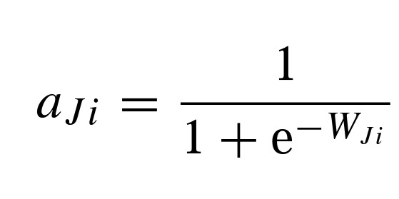
22 ~ 24
i = 1, 2, 3
W_{Ji} is a log-odds ratio for the backbone conformational state predictions at position J

Slide 12
Method2: SVM and PSI-PRED
Predict the backbone conformation of the middle amino acid in a nine-residue sequence segment
Classify four types of conformational states (A, B, E and G) or combine the two smallest states into a single class (E/G)

Slide 13
Encoding Feature Map 1: Ф_{binary}
Each amino acid is represented as 21-dimensional vector
A special null character is used to fill in the blank positions before the beginning or after the end of a sequence
A length 9-segment is mapped to a 189 (9x21)-dimension vector by the feature map Ф_{binary}

Slide 14
Encoding Feature Map 2: Ф_{profile}
PSSM is constructed for all protein sequences with the PSI-BLAST
PSSMs are cut along with the sequence into 9x20 matrices
For the blank positions at the beginning and the end of a protein sequence 20 zeros are filled

Slide 15
Encoding Feature Map 3: Ф_{sec}
The secondary structure of training sequences is derived from the DSSP
For testing sequences, secondary structures are predicted with the PSI-PRED program
Each position has a 4-dimensional vector (three kinds of secondary structures plus the blank position)

Slide 16
Datasets
Two datasets are used for evaluation
First we used proteins in the LSBSP1 database (PDB_SELECT_25 version Feb/2001) as the training set and test on PDB_SELECT_25 (version Dec/2002)
Version Dec/2002 are not related to any proteins in the training set
The second dataset is also performed 10-fold cross validation experiment

Slide 17
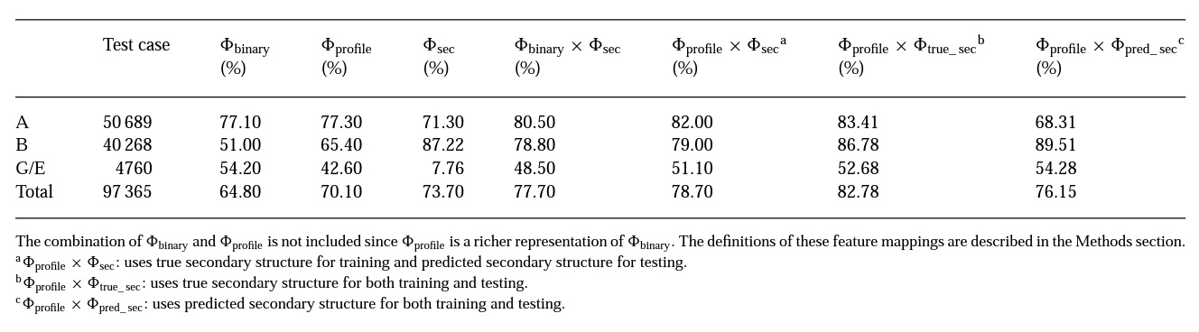
Results (1/4)

Slide 18
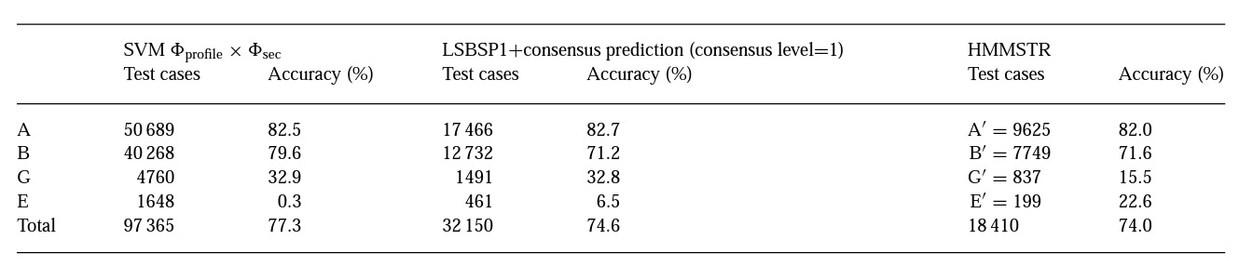
Results (2/4)

Slide 19
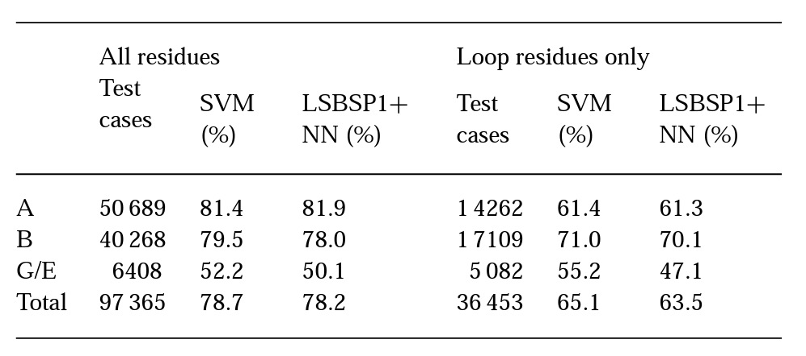
Results (3/4)

Slide 20
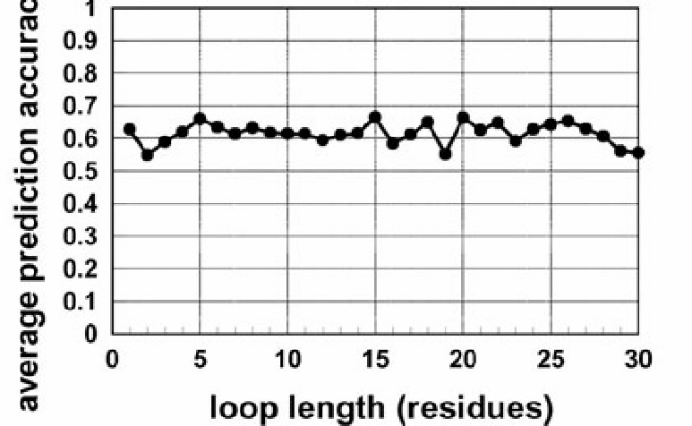
Results (4/4)

