Slide 1
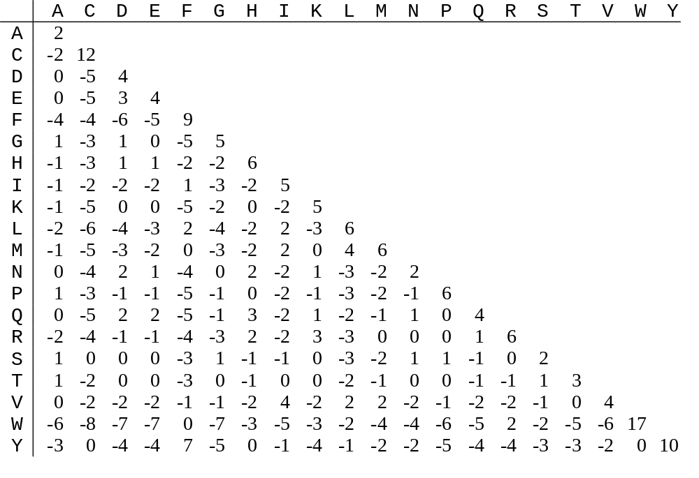
PAM250 Score Matrix

Slide 2
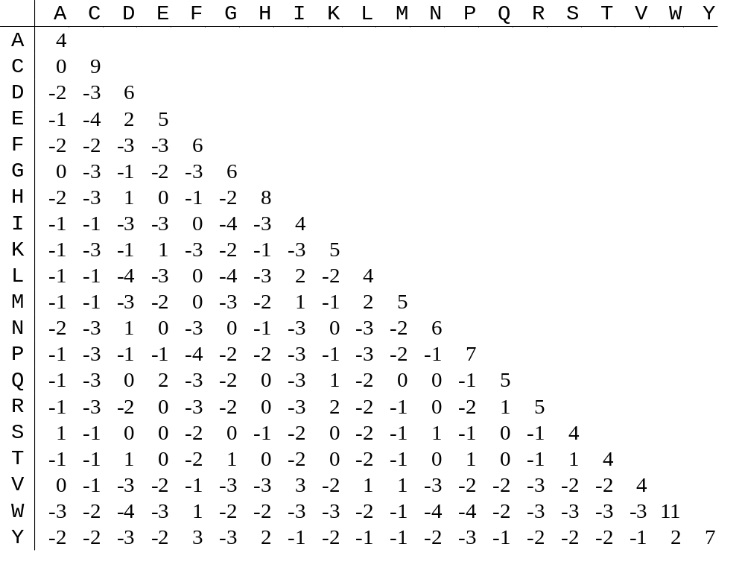
Blosum62 Score Matrix

Slide 3
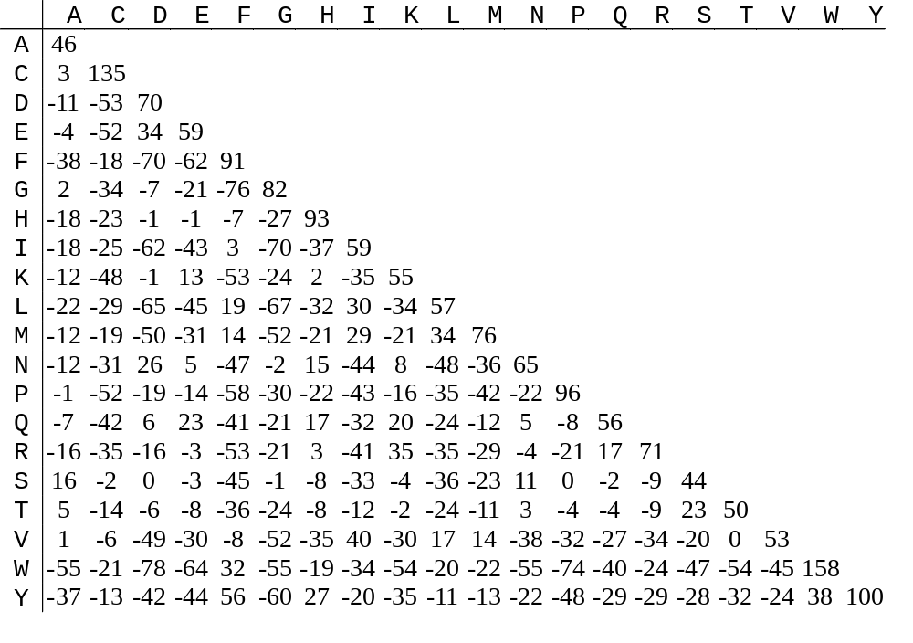
Gonnet160 Score Matrix

