Slide 1
Dynamic Programming Algorithms for The Mosaic Longest Common Subsequence Problem
Kuo-Si Huang, Chang-Biau Yang, Kuo-Tsung Tseng,
Yung-Hsing Peng, Hsing-Yen Ann
Information Processing Letters
Volume 102,Issue 2-3,April 2007 pp 99–103
Presenter: Chien-Ting Lee
Date: Nov. 15, 2022

Slide 2
Abstract(1/2)
The longest common subsequence (LCS) problem can be used to measure the relationship between sequences. In general, the inputs of the LCS problem are two sequences. For finding the relationship between one sequence and a set of sequences, we cannot apply the traditional LCS algorithms immediately. In this paper, we define the mosaic LCS (MLCS) problem of finding a mosaic sequence C, composed of repeatable k sequences in source sequence set S, such that the LCS of C and the target sequence T is maximal.

Slide 3
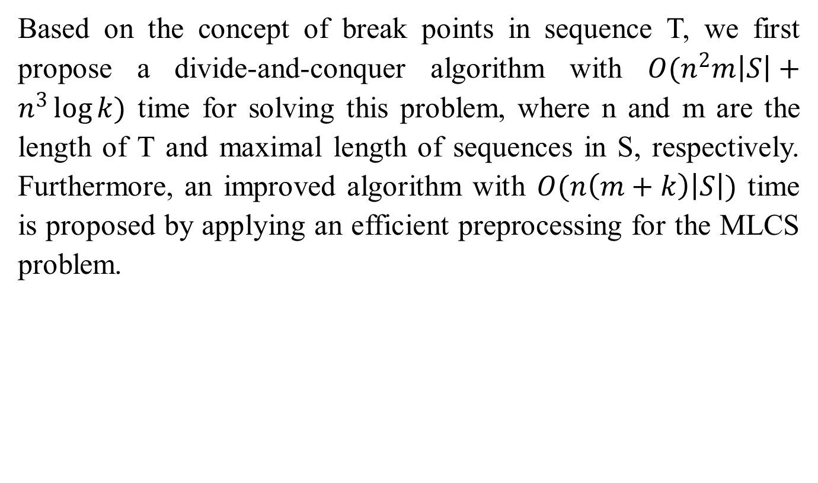
Abstract(2/2)
Based on the concept of break points in sequence T, we first propose a divide-and-conquer algorithm with $O(n^{2}m\left|S\right|+n^{3}\log{k})$ time for solving this problem, where n and m are the length of T and maximal length of sequences in S, respectively. Furthermore, an improved algorithm with $O(n\left(m+k\right)\left|S\right|)$ time is proposed by applying an efficient preprocessing for the MLCS problem.
Notes:
Squared
cubed

Slide 4
LCS Problem
Sequence S1: agaca
Sequence S2: tagtc
Common Subsequence : ag, ac, agc…
Longest Common Subsequence :agc

Slide 5
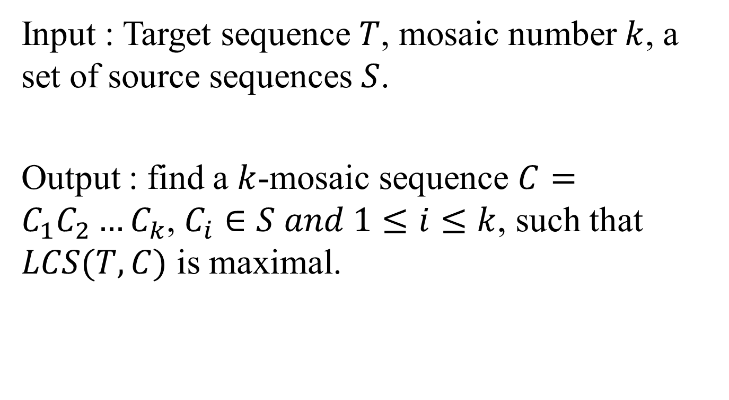
Mosaic Longest Common Subsequence (MLCS) Problem
Input : Target sequence $T$, mosaic number $k$, a set of source sequences $S$.
Output : find a $k$-mosaic sequence $C=C_{1}C_{2}…C_{k}$, $C_{i}∈S and 1≤i≤k$, such that $LCS(T,C)$ is maximal.

Slide 6
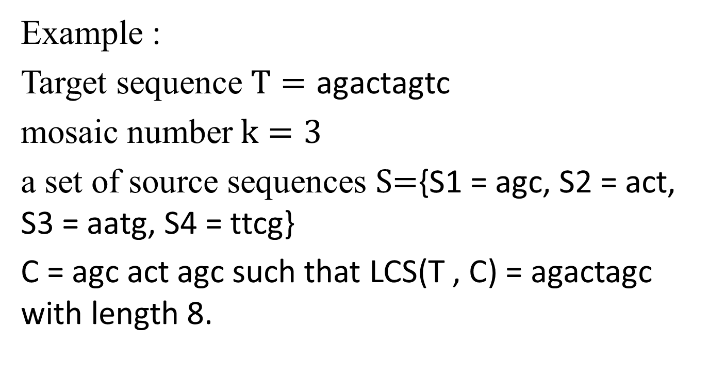
Mosaic Longest Common Subsequence (MLCS) Problem
Example :
Target sequence $T=\text{agactagtc}$
mosaic number $k=3$
a set of source sequences $S\text{=}\text{\{}\text{S}\text{1 = }\text{agc}\text{, }\text{S}\text{2 = }\text{act}\text{, }\text{S}\text{3 = }\text{aatg}\text{, }\text{S}\text{4 = }\text{ttcg}\text{\}}$
C = agc act agc such that LCS(T , C) = agactagc with length 8.

Slide 7
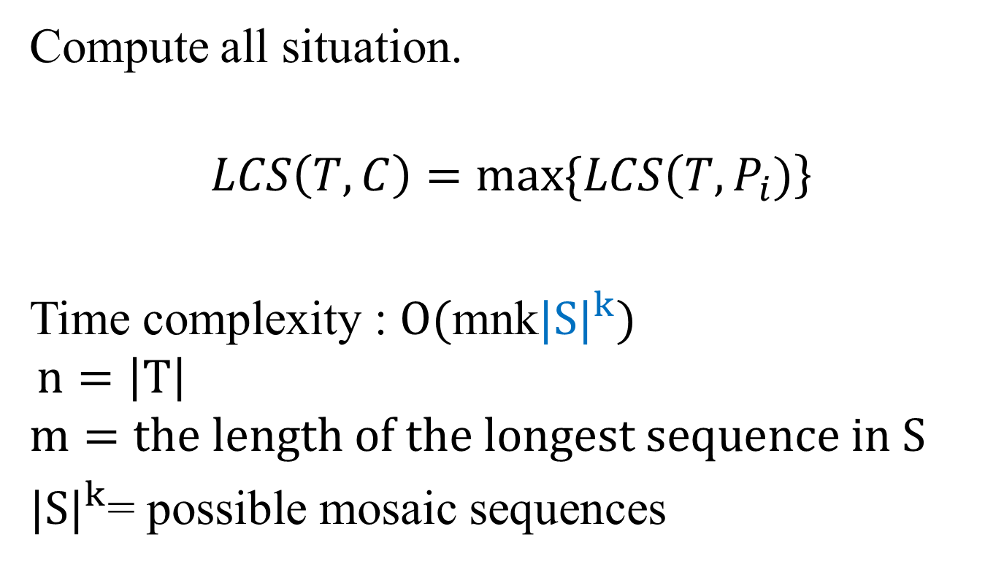
Method 1 : Brute Force
Compute all situation.
$$LCS\left(T,C\right)=max⁡\{LCS\left(T,P_{i})\right\}$$
Time complexity : $O(\text{mnk}{|S|}^{k})$
$$n=\left|T\right|$$
$$m=the length of the longest sequence in S$$
${|S|}^{k}$= possible mosaic sequences

Slide 8


Method 2 : Divide-and-Conquer
k=2
T
C
r
n
$$C_{1}$$
$$C_{2}$$
$$LCS\left(T[1,n],C\right)=LCS\left(T\left[1,r\right],C_{1}\right)+LCS(T\left[r+1,n\right],C_{2})$$

Slide 9
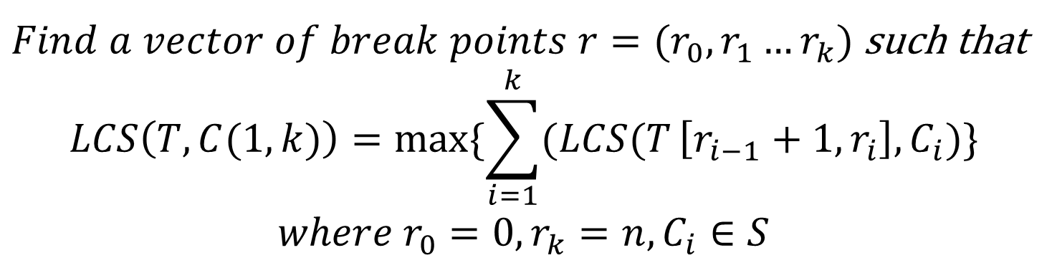
Method 2 : Divide-and-Conquer
k≥2
T
C
$Find a vector of break points r=(r_{0},r_{1}…r_{k})$ such that
$$LCS\left(T,C(1,k)\right)=max⁡\{\sum_{i=1}^{k}{(LCS(T}\left[r_{i−1}+1,r_{i}\right],C_{i})\}$$
$$where r_{0}=0,r_{k}=n,C_{i}∈S$$

Slide 10
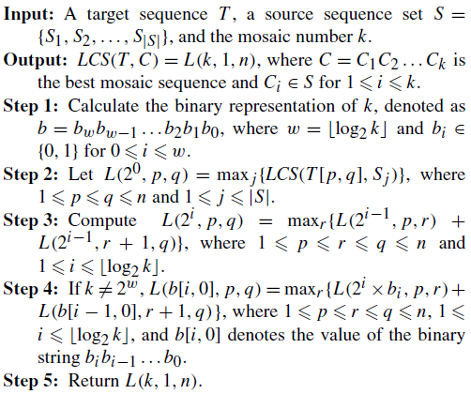




Method 2 : Divide-and-Conquer
$$O(\log_{2}{k})$$
$$O(n^{2}m|S|)$$
$$O(n^{3}\log{k})$$
$$O(n^{3}\log{k})$$
$$Time complexity:O(n^{2}m\left|S\right|+n^{3}\log{k})$$

Slide 11

Method 3 : S-table
S1:TACA S2:TCA
i/l | 1 | 2 | 3
0 | 1 | 2 | 4
1 | 2 | 4
2 | 3 | 4
3 | 4
$$O(mn)$$
Notes:
S1拿掉前面0個字元
S1拿掉前面1個字元
S1拿掉前面2個字元
S1拿掉前面3個字元

Slide 12
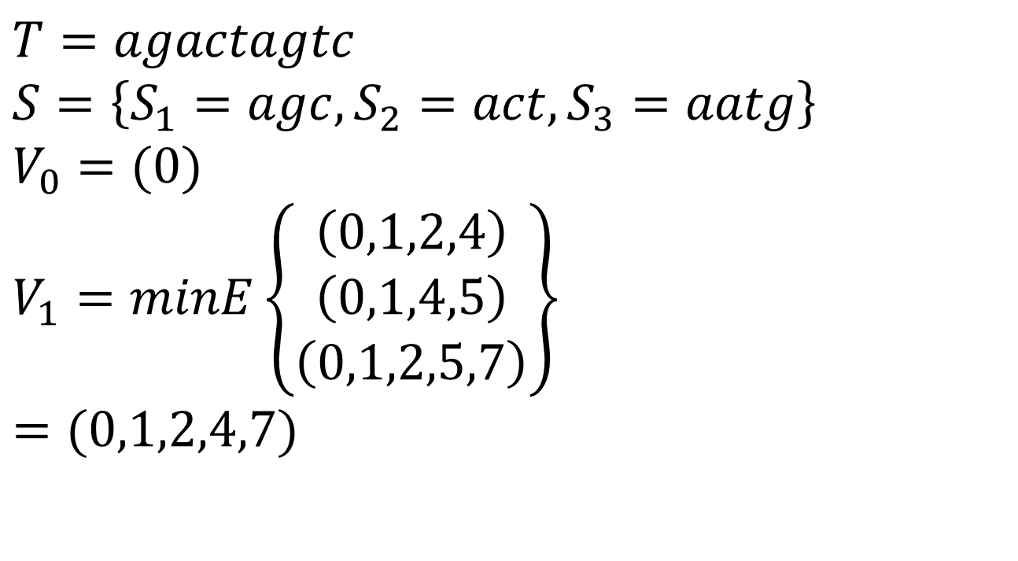
Method 3
$$T=agactagtc$$
$$S=\left\{S_{1}=agc,S_{2}=act,S_{3}=aatg\right\}$$
$$V_{0}=(0)$$
$$V_{1}=minE\left\{\begin{aligned}\left(0,1,2,4\right) \\ \begin{aligned}\left(0,1,4,5\right) \\ \left(0,1,2,5,7\right)\end{aligned}\end{aligned}\right\}$$
$$=(0,1,2,4,7)$$
 | 1 | 2 | 3 | 1 | 2 | 3 | 1 | 2 | 3 | 4
0 | 1 | 2 | 4 | 1 | 4 | 5 | 1 | 2 | 5 | 7
1 | 2 | 4 | 9 | 3 | 4 | 5 | 2 | 5 | 7
2 | 3 | 4 | 9 | 3 | 4 | 5 | 3 | 5 | 7
3 | 4 | 7 | 9 | 4 | 5 |  | 5 | 7
4 | 6 | 7 | 9 | 5 | 8 |  | 5 | 7
5 | 6 | 7 | 9 | 6 | 8 |  | 6 | 7
6 | 7 | 9 |  | 8 |  |  | 7
7 | 9 |  |  | 8 |  |  | 8
8 | 9 |  |  | 9

Slide 13
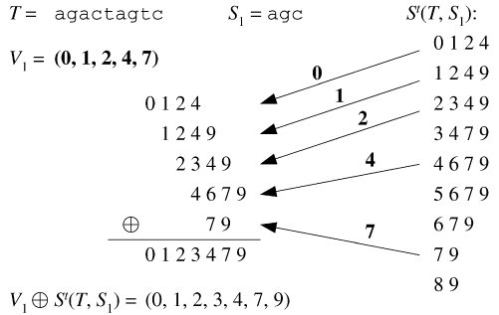

Method 3
$$T=agactagtc$$
$$S=\{S_{1}=agc,S_{2}=act,S_{3}=aatg\}$$
(0, 1, 2, 3, 4)
(0 1 2 3 4 5 6)
Notes:
枚舉後面接s1,s2,s3

Slide 14
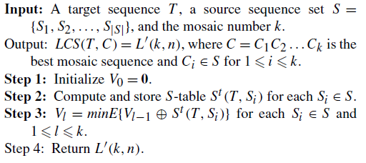


Method 3
$$O(nm|S|)$$
$$O(nk|S|)$$
$$Time complexity:O(n(m+k)\left|S\right|)$$

