Slide 1
Parallel Local Alignment Algorithm for Multiple Sequences on Heterogeneous Cluster Systems
Xin Cui,Cheng Zhong,Xiang-Yan Lu
3rd International Symposium on Parallel Architectures, Algorithms and Programming, December 2010, Liaoning, China
Presenter: Yu-Chen Lin
Date: Nov. 15, 2022
Notes:
心揆 陳松 尚言盧

Slide 2
Abstract
By taking into account communication startup overhead and the assigned processor distribution order and by applying hashing technique, a novel sequence distribution strategy is presented and the parallel local alignment algorithm for multiple sequences is designed on the heterogeneous cluster system that the computing nodes have different computing speeds and communication capabilities based on divisible load principle.
The experimental results on the cluster system with heterogeneous personal computers show that, compared with the parallel algorithm with the average sequence distribution approach, the parallel local alignment algorithm for multiple sequences with the presented sequence distribution strategy can decrease the execution time of 13%~35%, and it can obtain good speedup and scalability.
Notes:
Fu gi tive

Slide 3
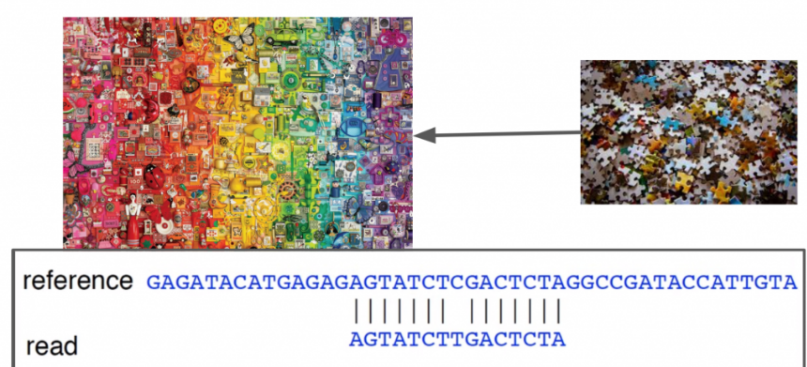
Basic concept of Bioinformatics
In bioinformatics, when we find a new sequence looking for its possible function, we usually compare the sequence with the sequence in the database first, then compare the results according to the sequence similarity.
Therefore we can determine whether this unknown sequence has homology with the existing sequence, and then predict the possible function of the unknown sequence based on the characteristics of the known sequence.

Slide 4
BLAST(1)
In bioinformatics, BLAST (basic local alignment search tool) is an algorithm and program for comparing primary biological sequence information, such as the amino-acid sequences of proteins or the nucleotides of DNA and/or RNA sequences.
Using a scoring function to measure the similarity among the sequences. This score is calculated by using Karlin-Altschul algorithm. The obtained Poisson probability shows the possibility of the random similarity among the sequences.

Slide 5
BLAST(2)
Step 1:
length W of a string is predetermined and each word of length W in the sequence is listed.
Step 2:
For every word wi of length W in the query sequence of length n, where 1≤ i ≤n –W+1 , all the possible alignments are scored by a scoring matrix and the words whose score is larger than a given value of T are kept.
Step 3:
The algorithm searches the fields matching with some words in the word list for each sequence in the database.

Slide 6
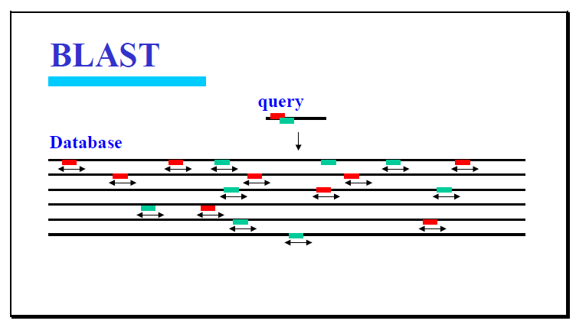
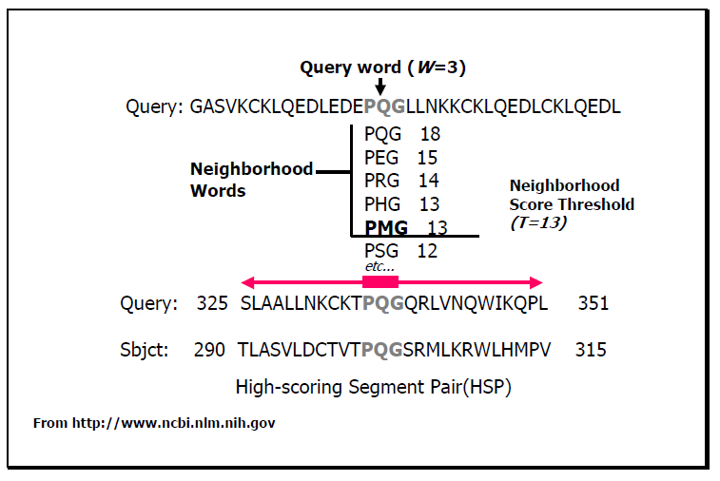
BLAST(3)
Step 4:
The matched fields are extended to the left and right sides, and the corresponding nucleotides are compared until the score is lower than the given value of S.
Step 5:
A probability of random generation with high scoring pair is determined. It represents the statistical significance of the score.

Slide 7
Sequences Distribution Strategy
Determine the number of the sequences which is distributed to each salve processor with different computing, communication and storage capability on the heterogeneous cluster system by computing the number of the segments in the sequences.
The required processing time is makes of three parts:
1. The master processor sends the given query sequence and sequence database to each slave processor.
2. Each salve processor computes local alignment for multiple sequences.
3. Each salve processor returns its local results to the master processor and the master processor generates the optimal local alignment results.

Slide 8
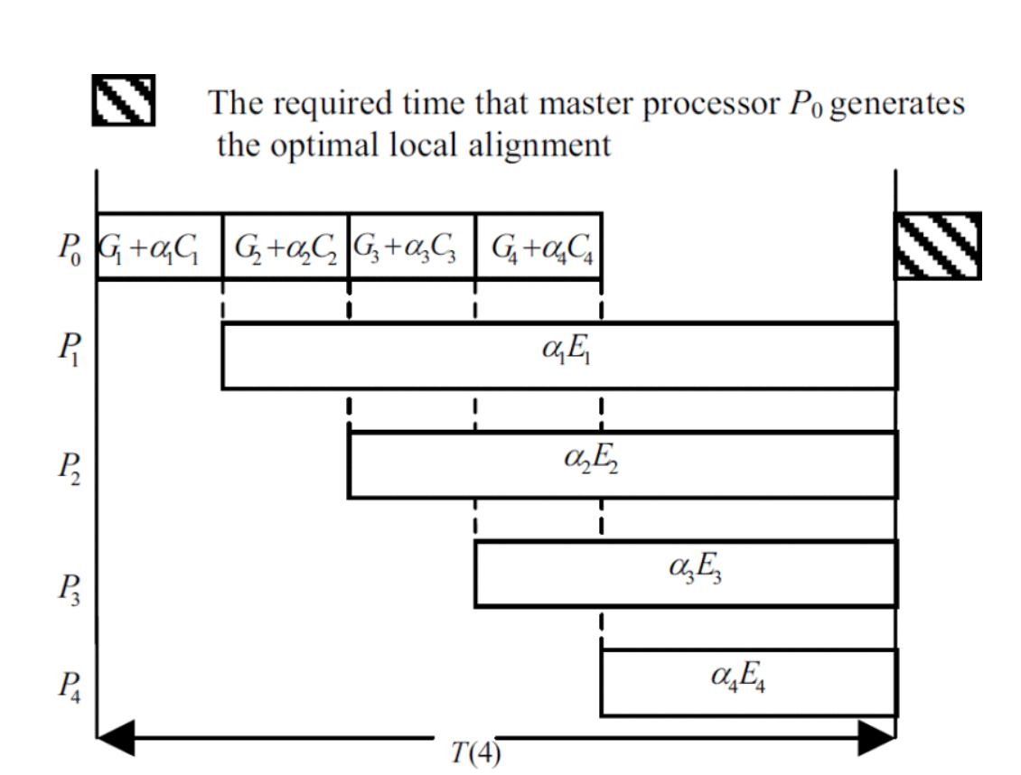
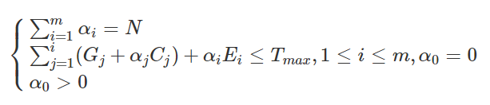
αi:The amount of the segments allocated to slave processor Pi
Gi:Start time for the communication
Ci:Required time that P0 sends a segment to Pi in link
Ei:Required time that Pi computes one segment

Slide 9
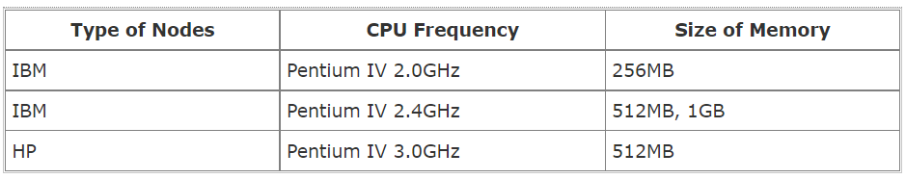
Experiments
The experimental platform is a cluster system with heterogeneous personal computers connected via 100Mbps Ethernet, which each computing node runs Red Hat Linux 9.0 operating system.

Slide 10
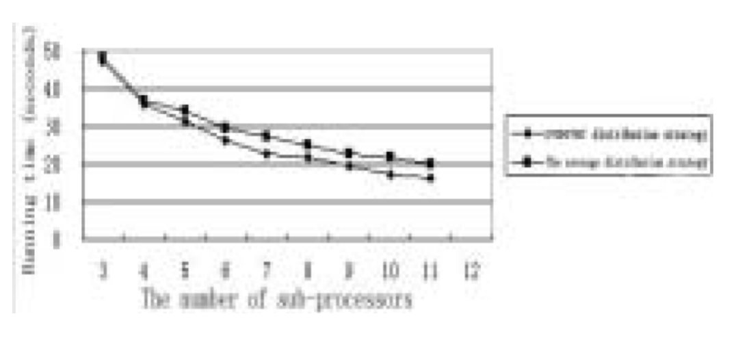
The result is evaluating the required execution time of the presented parallel local alignment using the optimal sequence distribution strategy and the required execution time of the parallel multi-sequence local alignment algorithm using the average distribution approach respectively.
The presented parallel local alignment algorithm using the presented sequence distribution strategy is faster than the one with the average sequence distribution approach.
#upper line is average distribution approach

Slide 11
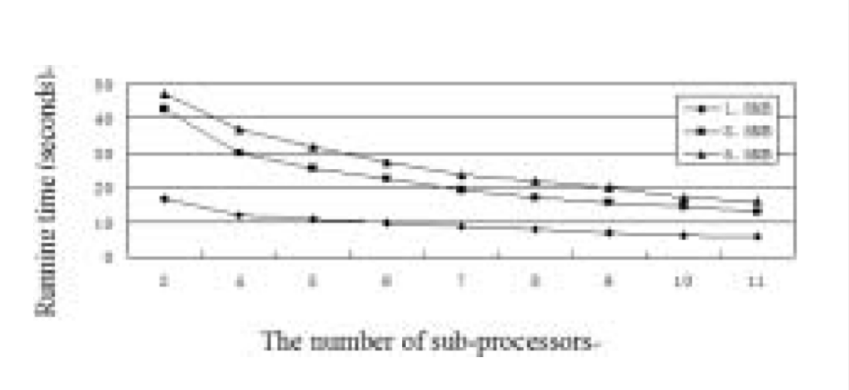
The result is the required execution time of presented parallel local alignment when the size of the sequence database is 1.5MB, 3.5MB and 5.5MB respectively.
For fixed query sequence and different size of sequence database, the required execution time of the presented parallel local alignment is significantly reduced when the number of used nodes is increased.
#from top to down is 5.5MB,3.5MB,1.5MB

Slide 12
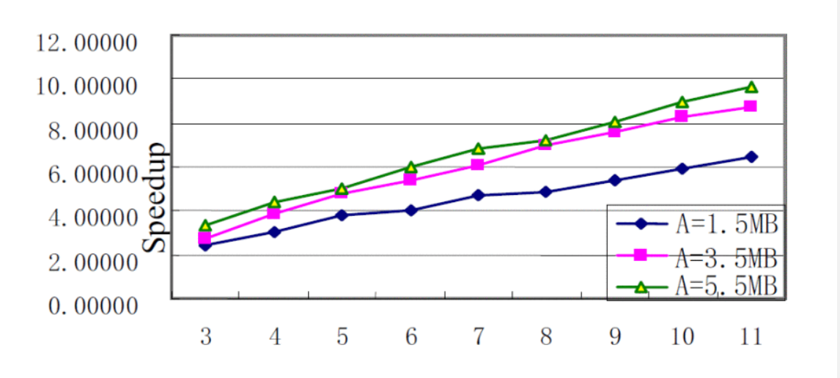
The result is the speedup of presented parallel local alignment with the increase of used computing nodes when the size of the sequence database is 1.5MB, 3.5MB and 5.5MB respectively.
For fixed query sequence and different size of sequence database, the speedup of the presented parallel algorithm is getting higher when the used computing nodes are increasing.
The larger the size of sequence database is, the higher speedup meaning that the parallel local alignment algorithm using the presented sequence distribution strategy can be efficiently applied to the largescale applications.

Slide 13
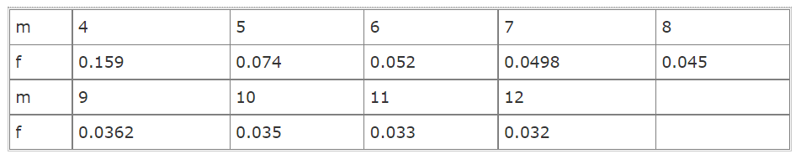
The scalability of parallel algorithms is one of the important issues in parallel computing discipline.
f denote the proportion of the sequential execution time
m denote the number of processor
With increase of amount m of computing nodes, the value of ratio f is decreasing. Therefore, the presented parallel local alignment algorithm for multiple sequences on the heterogeneous cluster achieves good scalability.

Slide 14
Conclusion
The analysis and experimental results show that the presented parallel local alignment algorithm for multiple sequences obtains good speedup and scalability, and it can be efficiently applied to the large-scale applications.

