Slide 1
Computing the Longest Common Almost-Increasing Subsequence
Mohammad Tawhidul Hasan Bhuiyan,
Muhammad Rashed Alam, M. Sohel Rahman
Theoretical Computer Science, 2022
Volume 930 , pp. 157-178
Presenter: Tsung-Lin Lu
Date: Nov. 15, 2022

Slide 2
Abstract
In this paper, we revisit the problem of computing longest common almost increasing subsequence (LCAIS) where, given two input sequences, the goal is to compute a common subsequence that is ‘almost’ increasing. Here the concept of an almost increasing subsequence offers an interesting relaxation over the increasing condition. This problem has been studied in the literature albeit with some constraints. Here, we present a number of a number of algorithmic approaches to solve the problem more generally and efficiently.

Slide 3
Outline
LCaIS
Aproach1: Tracking The Maximum
Algorithm1
Aproach2: Tracking The Last Element
Algorithm2
Algorithm3: Reducing The Search Space
Algorithm4: Deferred Computation
Algorithm5: Using a priority search tree
Aproach3: Tracking The Index of Lengths
Algorithm6

Slide 4











LCaIS
9 *
8
7 *
6
5
4 *
3
2
1 *
v\A 1 4 7 9
LCIS (4): <1, 4, 7, 9>
X: 1 4 7 3 9 3 5 7 5 4
Y: 3 1 4 3 7 9 5 5 4 7
LCaIS(6): <1, 4, 3, 5, 5, 4>
X: 1 4 7 3 9 3 5 7 5 4
Y: 3 1 4 3 7 9 5 5 4 7
c: 3
5 * *
4 * *
3 *
2
1 *
v\A 1 4 3 5 5 4

Slide 5
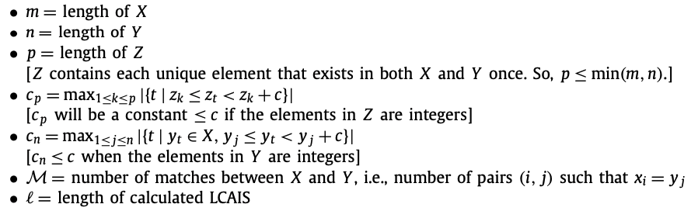
Complexity
Algo. | Time | Space
1 | O(mnp) | O(mnp) | Max
2 | O(mnp) | O(np) | Last
3 | O(mnc_{p}) | O(nc_{p}) | Reduce
Algo. | Time | Space
4 | O(m(n + c_{n}c_{p})) | O(nc_{p}) | Deferred
5 | O(mn + Mc_{p}logl) | O(np) | Tree
6 | O(mn + M(p + l)) | O(pl) | Index
X(m=5): 4, 5, 3, 2, 1
Y(n=6): 3, 2, 6, 4, 5, 7
Z(p=4): 2, 3, 4, 5

Slide 6
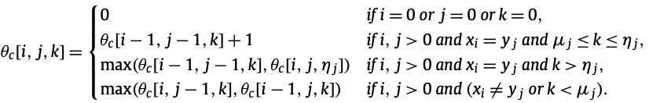
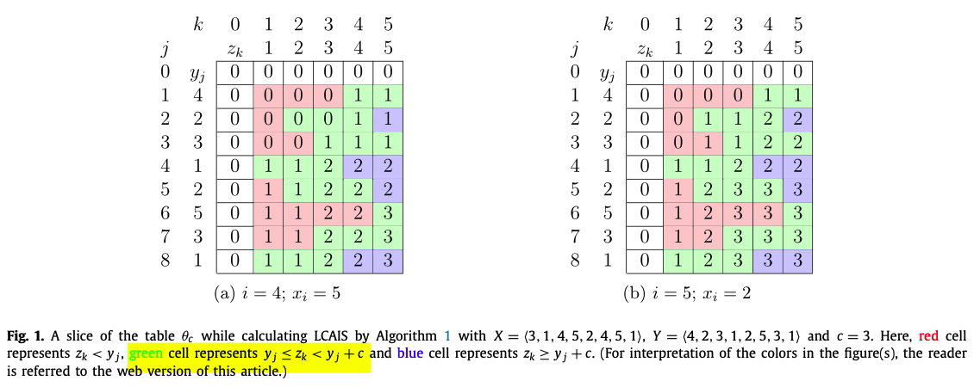
Algo.1
Time: O(mnp)
Space: O(mnp)
θ_{c}[i,j,k] is the length of an LCaIS of the sequences X_{i} and Y_{j} that has maximum element less than or equal to Z_{k}.
Green
Blue
Red

Slide 7
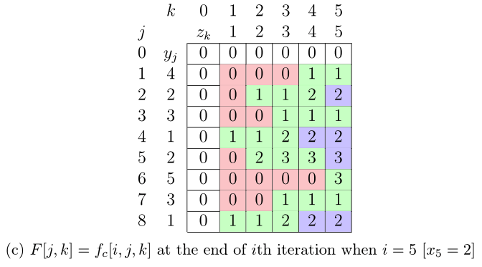
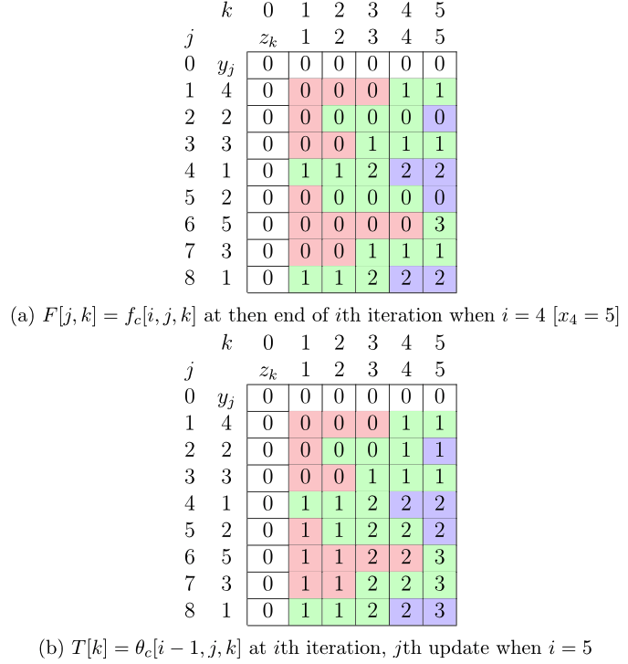
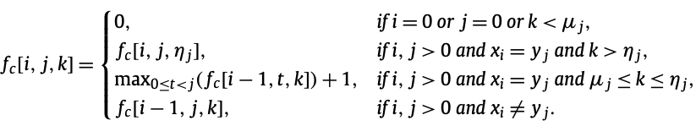

Algo.2
Time: O(mnp)
Space: O(np)
f_{c}[i,j,k] is the length of an LCaIS of the sequences X_{i} and Y_{j} that ends on y_{j} and has maximum element less than or equal to Z_{k}.
Red
Blue
Green

Slide 8
Algo.2
Time: O(mnp)
Space: O(np)
f_{c}[i,j,k] is the length of an LCaIS of the sequences X_{i} and Y_{j} that ends on y_{j} and has maximum element less than or equal to Z_{k}.
Red
Blue
Green

Slide 9
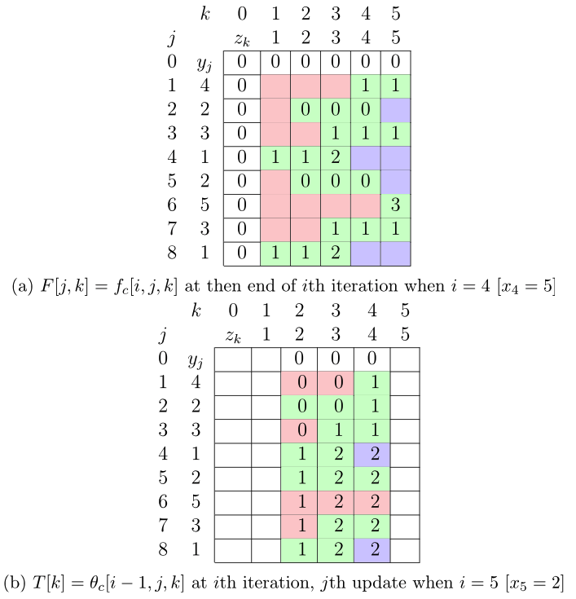
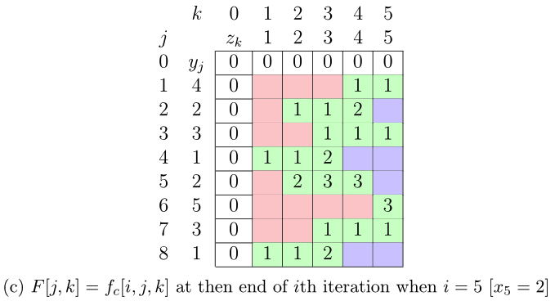
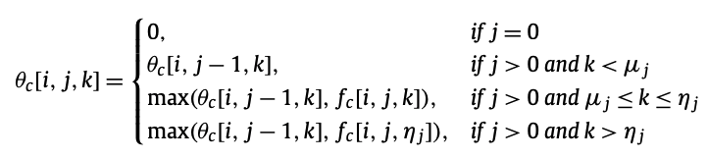

Algo.3: Reducing The Search Space
Time: O(mnc_{p})
Space: O(nc_{p})
Red
Green
Blue

Slide 10
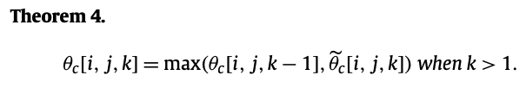
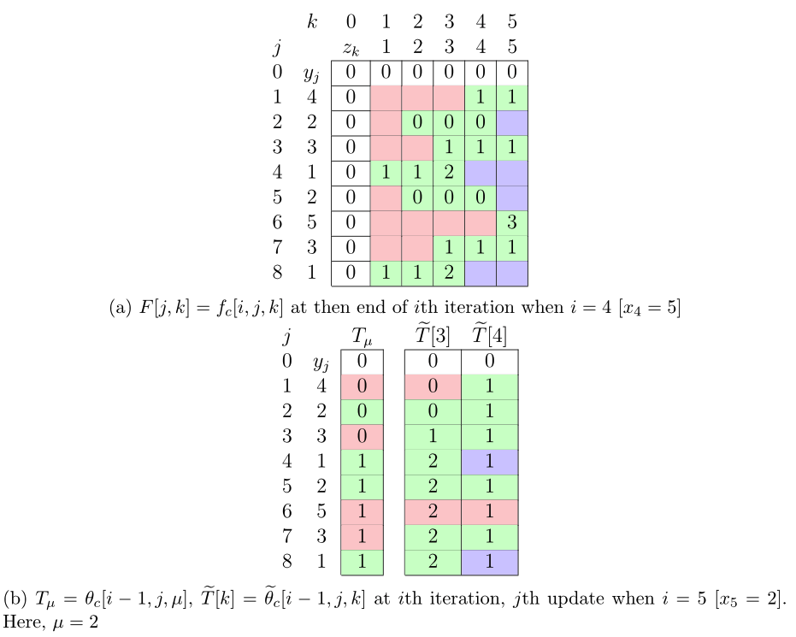
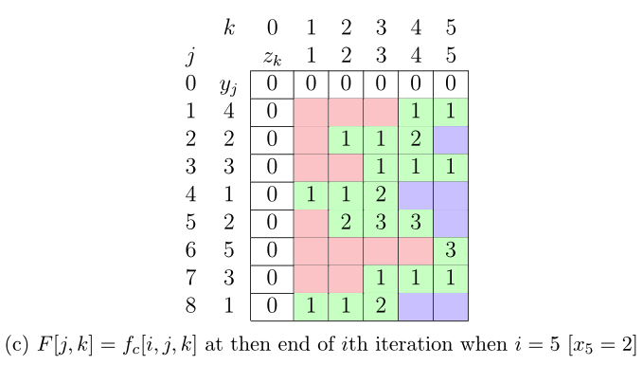
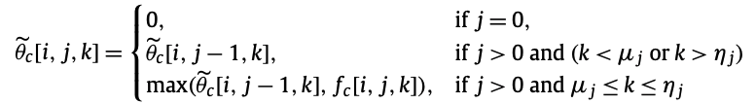
Algo.4: Deferred Computation
Time: O(m(n + c_{n}c_{p}))
Space: O(nc_{p})
We will defer the computation of θ_{c} until we get x_{i} = y_{j}.
Red Blue
Red Blue
Green
Green

Slide 11

Algo.4: Deferred Computation
Time: O(m(n + c_{n}c_{p}))
Space: O(nc_{p})
We will defer the computation of θ_{c} until we get x_{i} = y_{j}.

Slide 12
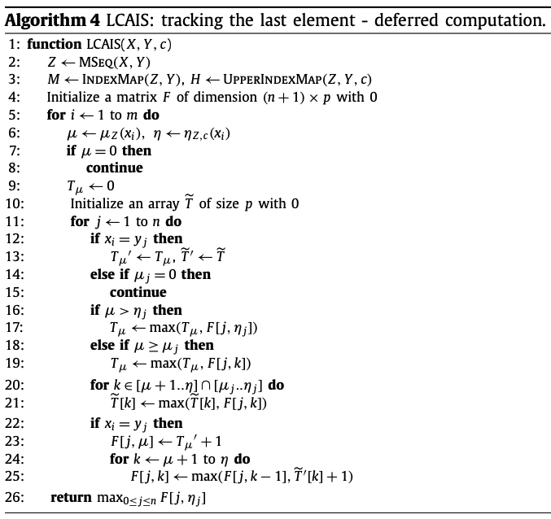
Time: O(m(n + c_{n}c_{p}))
Space: O(nc_{p})
Skip dummy element in Y
O(mn)
O(mc_{n}c_{p}) ???
O(mc_{n}) > O(M) ???
O(Mc_{p})
Total: O(mn + mc_{n}c_{p})

Slide 13
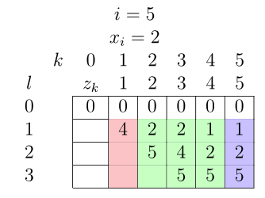
Algo.6
Time: O(mn + M(p + l))
Space: O(pl)

Slide 14
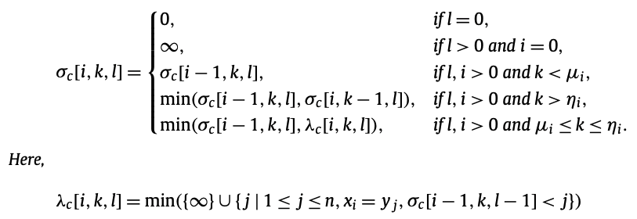
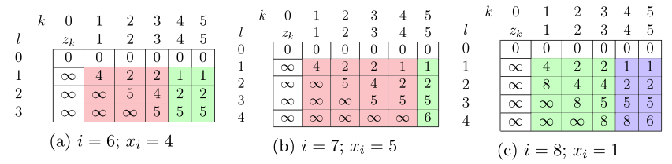
Algo.6
Time: O(mn + M(p + l))
Space: O(pl)
Red
Blue
Green

Slide 15
Thank you for listening

