Slide 1
Distributed Grey Wolf Optimizer for Scheduling of Workflow Applications in Cloud Environments
Bilal H.Abed- alguni and Noor Aldeen Alawad
Applied Soft Computing Volume 102, April 2021
Presenter: Chih-Hsuan Chien​
Date: Nov. 22, 2022

Slide 2
Abstract (1/2)
Optimal scheduling of workflows in cloud computing environments is an essential element to maximize the utilization of Virtual Machines (VMs). In practice, scheduling of dependent tasks in a workflow requires distributing the tasks to the available VMs on the cloud. This paper introduces a discrete variation of the Distributed Grey Wolf Optimizer (DGWO) for scheduling dependent tasks to VMs. The scheduling process in DGWO is modeled as a minimization problem for two objectives: computation and data transmission costs.

Slide 3
Abstract (2/2)
DGWO uses the largest order value (LOV) method to convert the continuous candidate solutions produced by DGWO to discrete candidate solutions. DGWO was experimentally tested and compared to well-known optimization-based scheduling algorithms (Particle Swarm Optimization (PSO), Grey Wolf Optimizer). The experimental results suggest that DGWO distributes tasks to VMs faster than the other tested algorithms. Besides, DGWO was compared to PSO and Binary PSO (BPSO) using WorkflowSim and scientific workflows of different sizes. The obtained simulation results suggest that DGWO provides the best makespan compared to the other algorithms.

Slide 4
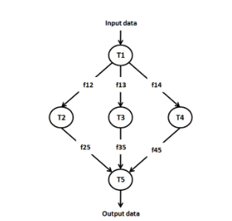
Workflow

Slide 5

Encode

Slide 6
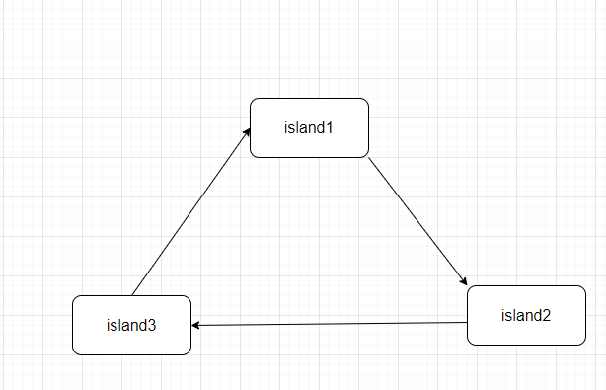
Island model

Slide 7
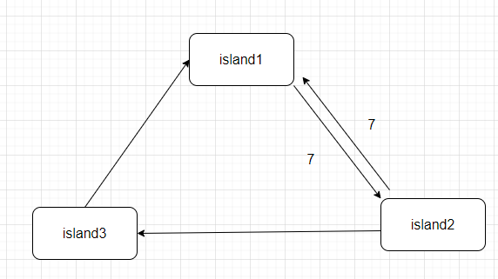
Best– worst migration policy
M=35%
n=200
s=10
35%*(200/10)=7

Slide 8
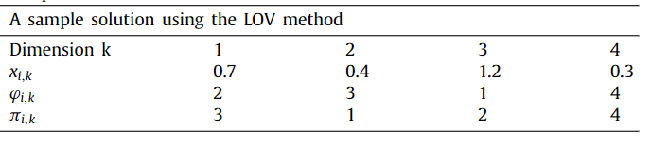

Largest order value (LOV) method

Slide 9
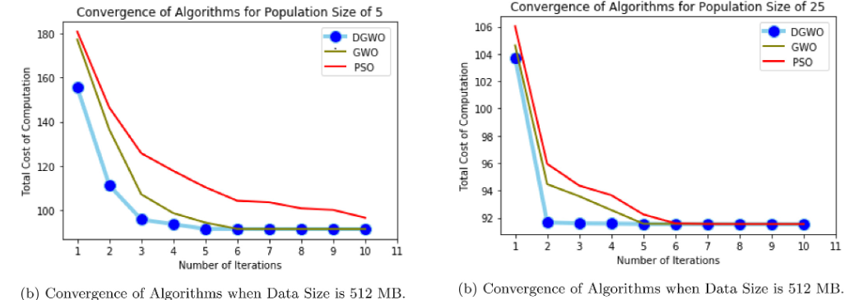
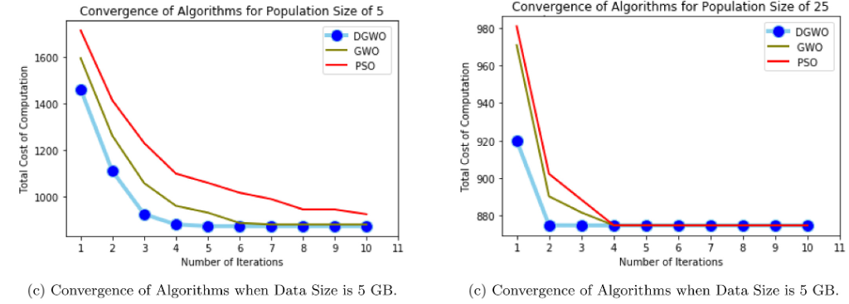
Experimental
Notes:
Convergence rate
Differnece when population

Slide 10
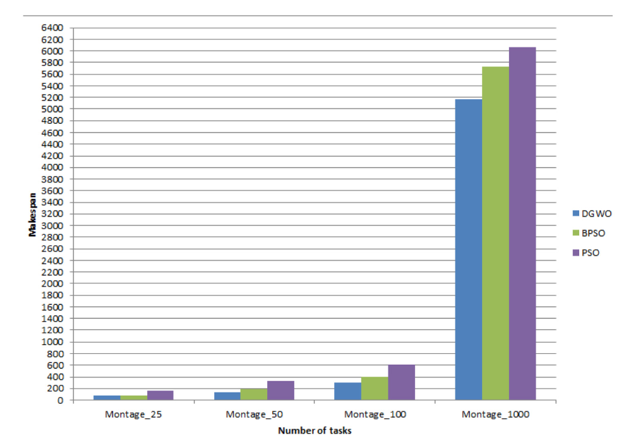
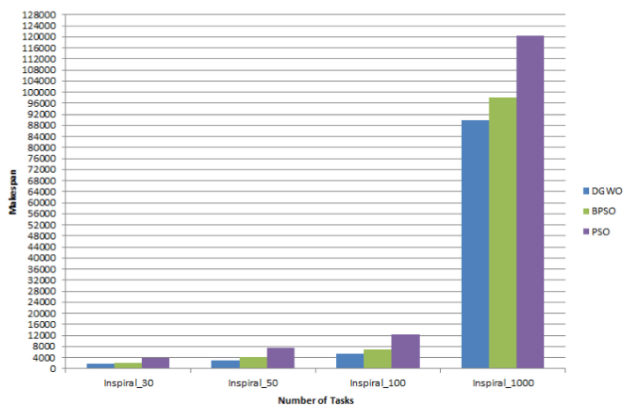
Experimental

