Slide 1
Automatic Bridge Bidding Using Deep Reinforcement Learning
Chih-Kuan Yeh, Cheng-Yu Hsieh, and Hsuan-Tien Lin
IEEE Transactions on Games, vol. 10, no. 4, Dec. 2018
Presenter: Yu-Yen Chu
Date: Nov. 22, 2022

Slide 2
Abstract
Bridge is among the zero-sum games for which artificial intelligence has not yet outperformed expert human players. The main difficulty lies in the bidding phase of bridge, which requires cooperative decision making with partial information. Existing artificial intelligence systems for bridge bidding rely on, and are thus restricted by, human-designed bidding systems or features. In this work, we propose a flexible and pioneering bridge-bidding system, which can learn either with or without the aid of human domain knowledge. The system is based on a novel deep reinforcement learning model, which extracts sophisticated features and learns to bid automatically based on raw card data.

Slide 3
Abstract (Cont.)
The model includes an upper-confidence-bound algorithm and additional techniques to achieve a balance between exploration and exploitation. We further study how different pieces of human knowledge can be exploited to assist the model. Our experiments demonstrate the promising performance of our proposed model. In particular, the model can advance from having no knowledge on bidding to achieving a superior performance compared with a champion-winning computer bridge program that implements a human-designed bidding system. In addition, further synergies can be extracted by incorporating expert knowledge into the proposed model.

Slide 4
Problem Setup
A bidding system without competitive bidding
Information at some state:
player’s own hand (North or South)
history bidding sequence
Double Dummy Analysis
Compute each contract’s highest score.
Calculate the average score by 5 different East-West hands.
cost = highest score over all contracts – average score

Slide 5
Methods
Bandit algorithm (Exploration & Exploitation)
ε-Greedy
UCB (upper-confidence-bound)
Reinforcement learning
Q-learning
Bellman equation
Penetrative Bellman equation

Slide 6
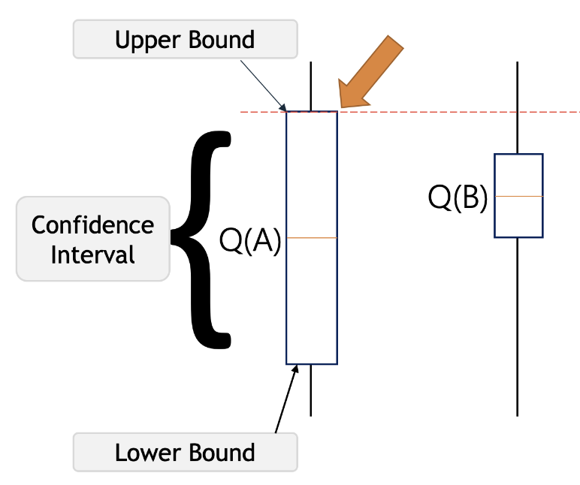
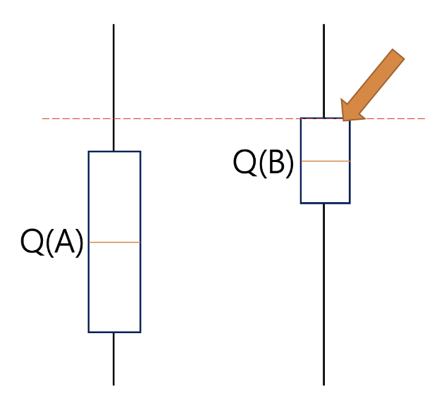
Bandit Algorithm
image credit: geeksforfgeeks
Trade-off between Exploration and Exploitation
Multiple slot machines, no information which one has highest profit.
Exploration: try other slot machines to find a better one.
Exploitation: play slot machine whose profit is highest based on experience.
ε-Greedy
Do Exploration with probability ε; do Exploitation with probability (1 - ε).
Choose any actions with equal probability during Exploration.
UCB (upper confidence bound)
Find all choices’ confidence intervals based on their reward’s distribution.
Use upper confidence bound to determine which choice should select during Exploration (select the one with highest potential reward).
mean(Exploitation) + α * standard deviation(Exploration), α is exploration rate.

Slide 7
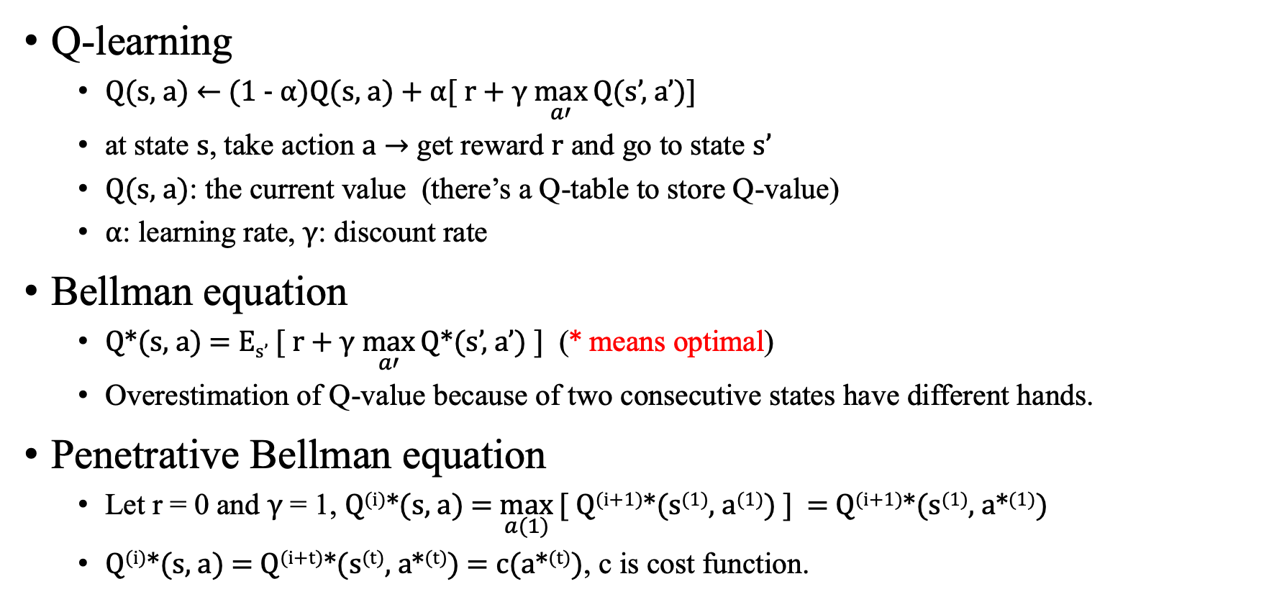
Reinforcement Learning
Q-learning
Q(s, a) ← (1 - α)Q(s, a) + α[ r + γ $\max_{a′}{\text{Q}\text{(}\text{s}’\text{, }\text{a}’\text{)}}$]
at state s, take action a $→$ get reward r and go to state s’
Q(s, a): the current value (there’s a Q-table to store Q-value)
α: learning rate, γ: discount rate
Bellman equation
Q*(s, a) = E_{s’} [ r + γ $\max_{a′}{\text{Q}\text{*(}\text{s}’\text{, }\text{a}’\text{)}}$ ] (* means optimal)
Overestimation of Q-value because of two consecutive states have different hands.
Penetrative Bellman equation
Let r = 0 and γ = 1, Q^{(i)}*(s, a) = $\max_{a(1)}{\text{[ }\text{Q}\text{(}\text{i}\text{+1)*(}\text{s}\text{(}\text{1}\text{)}\text{, }\text{a}\text{(}\text{1}\text{)}\text{)}\text{ ]} }$ = Q^{(i+1)}*(s⁽¹⁾, a*⁽¹⁾)
Q^{(i)}*(s, a) = Q^{(i+t)}*(s^{(t)}, a*^{(t)}) = c(a*^{(t)}), c is cost function.

Slide 8
Experiment
Dataset: 140,000 North-South hands.
training: 100,000
validation: 20,000
testing: 20,000
average cost = average of “(IMP of optimal contract – IMP of a contract)”

Slide 9
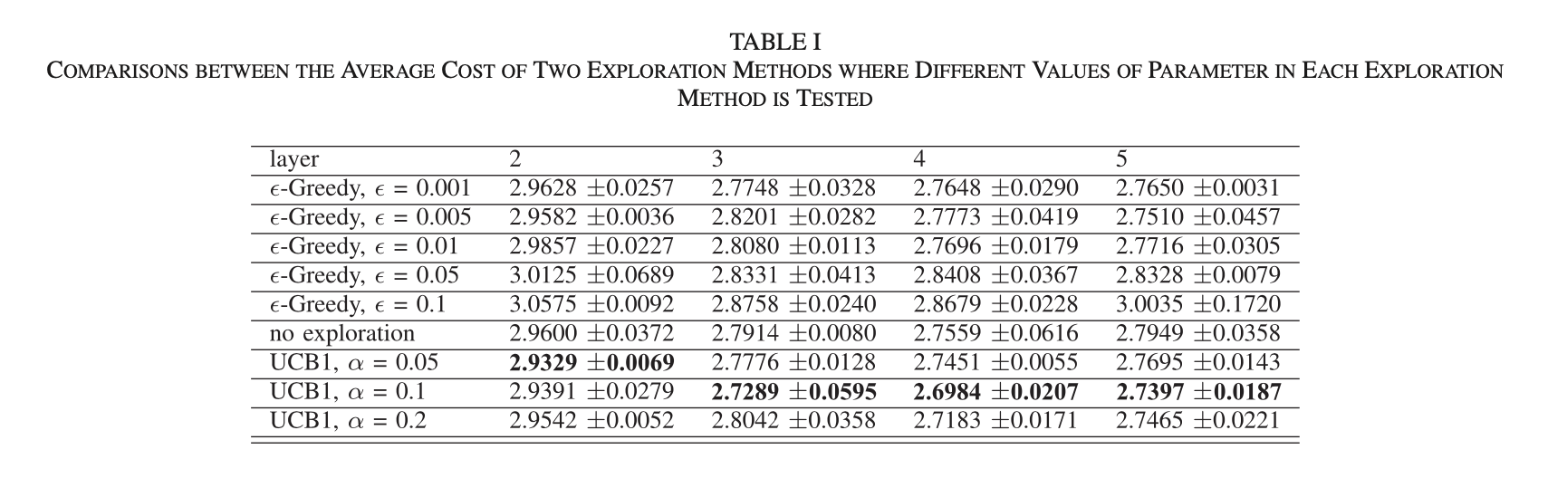

Result
UCB1
a^{(t)} = $\max_{a(t)}{\text{[ }\text{Q}\text{(}\text{s}\text{(}\text{t}\text{)}\text{, }\text{a}\text{(}\text{t}\text{)}\text{)}\text{ + }\text{α}\sqrt{\frac{2ln⁡(T)}{Ta}}\text{]} }$
T is # of total moves; T_{a} is # of moves selected action a.

Slide 10
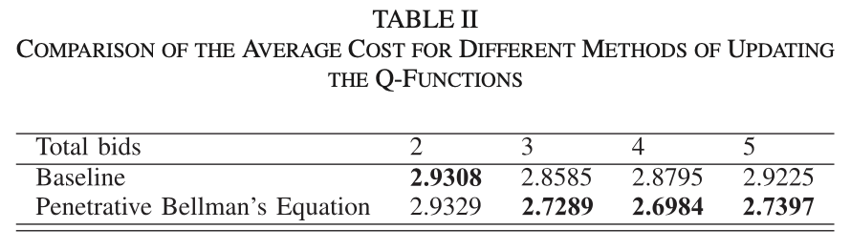
Result

Slide 11
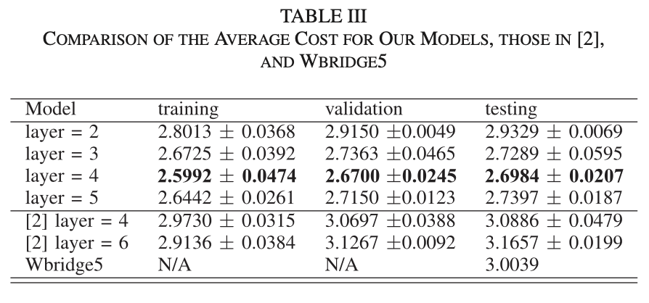
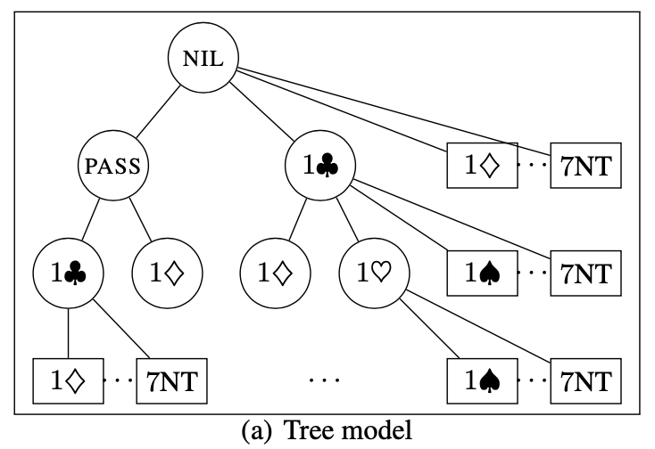
Result
[2]: Contract Bridge Bidding by Learning, Ho and Lin, 2015
tree model with UCB1

Slide 12
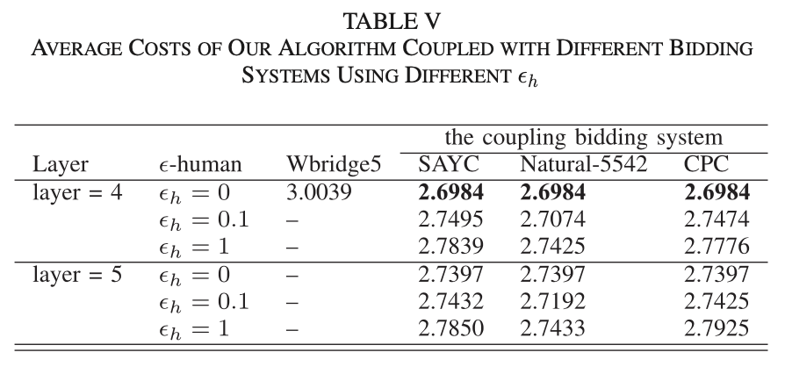
Result
ε-human: the probability uses human bidding system to bid opening bid
UCB1 with α = 0.1

Slide 13
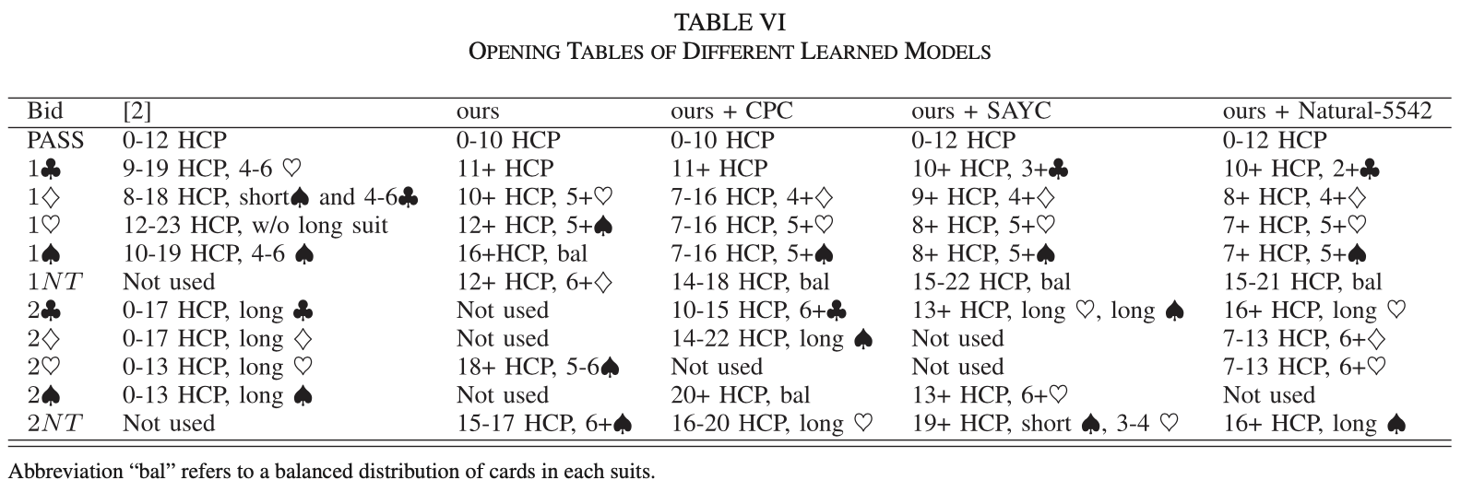
Result

Slide 14
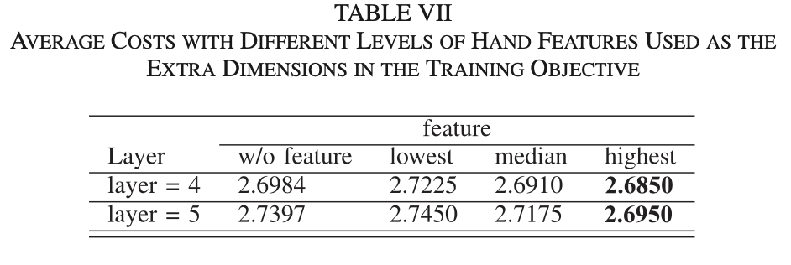
Result
lowest
the length of each suit and the presence of honors(AKQJ) in each suit
median
the length of each suit and HCP system (A=4, K=3, Q=2, J=1)
highest
features of median and the strength of each suit

