Slide 1
N-queens Problem by Efficient Non-backtracking Algorithm Using Local Search, Heuristics and Tabu Search Elements
Marian Kovac
The 10th International Conference on Digital Technologies 2014
Presenter: Guan-Jie Chen
Date: Dec. 27, 2022

Slide 2
Abstract
This paper presents an efficient algorithm using Local search, various heuristics and Tabu search elements, which is capable to find solution for huge instances of the n-queens (hundreds of millions n). The algorithm returns random solutions in short time even on an ordinary personal computer. There is no other faster algorithm in n-Queens bibliography as our presented algorithm so far.

Slide 3
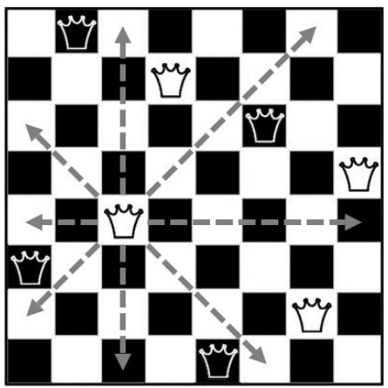
N-queens Problem
Rules
．1: no two queens can share a same row
．2: no two queens can share a same column
．3: no two queens can share a same diagonal

Slide 4
Constraints (1 / 3)
．Elements of Q are always a permutation of the set {1, 2, . . . , n}
．Value on k-th position of Q represents column number in which
the queen is placed in k-th row

Slide 5
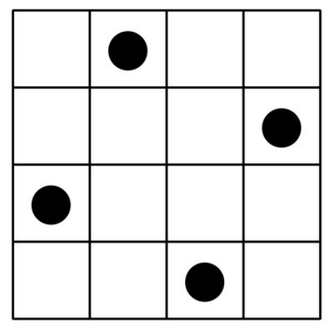
Constraints (2 / 3)
Q = (2, 4, 1, 3)

Slide 6
Constraints (3 / 3)
．The representation guarantees that no more than one queen will
be in every row and every column

Slide 7
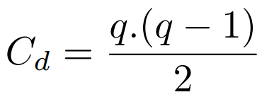
Conflicts on diagonal d
q is amount of queens on diagonal d

Slide 8
Algorithm
．Pre-shaking
．Shaking

Slide 9
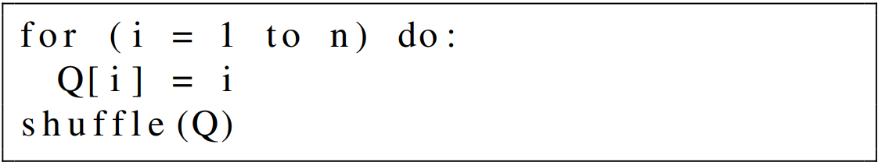
Pre-shaking (1 / 4)
Step1.
the average number of conflicts among the queens is
⅔ n approximately
Notes:
對Q做permutation

Slide 10
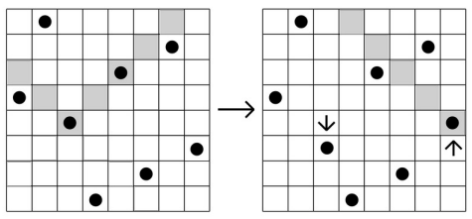
Pre-shaking (2 / 4)
Step2.
Notes:
check 1 to (i - 1)

Slide 11
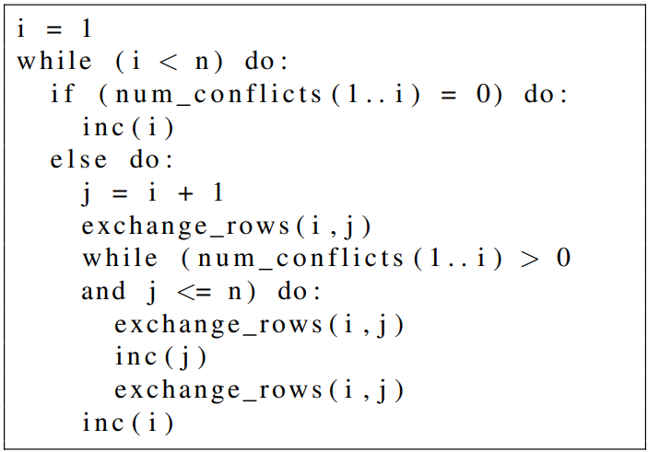
Pre-shaking (3 / 4)
Step2.

Slide 12
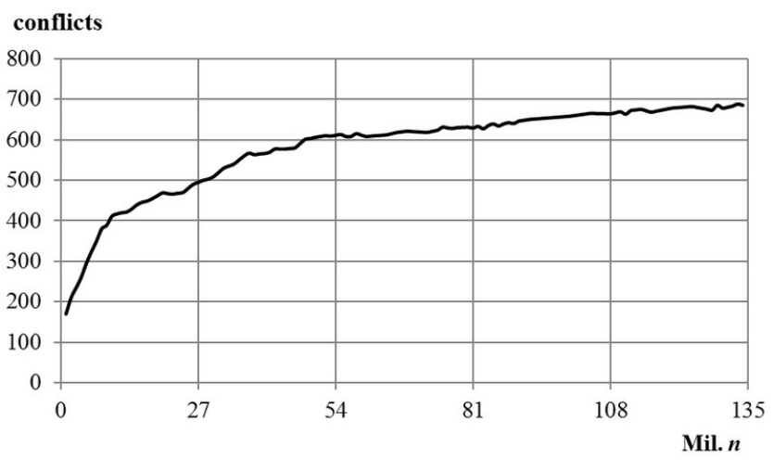
Pre-shaking (4 / 4)
Notes:
rotations and flips通常產生更多conflicts
conflicts are almost reduced to a constant

Slide 13
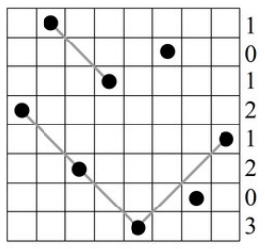
Shaking (1 / 7)
Step1.
Assign the value equal to number of conflicts which causes
the queen in the given row

Slide 14
Shaking (2 / 7)
Step2.
case1: Gradually walk through row max and search for such
row for which the exchange with row max ensures migration
of queens to the diagonals with no other queens

Slide 15
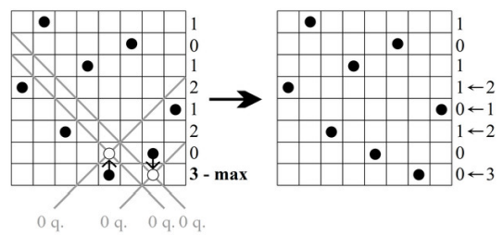
Shaking (3 / 7)
Step2.
case1:

Slide 16
Shaking (4 / 7)
Step2.
case2: If diagonals with no other queens were not found, try to
exchange the actual row (max) with several other rows.
If overall number of conflicts after the exchange decreases,
perform the exchange, otherwise continue without changes.
Notes:
這是 case1 的保護機制，在 n < 1500 的情況下，empty diagonals 會不夠多
exchange 次數由 variable “tries” 決定

Slide 17
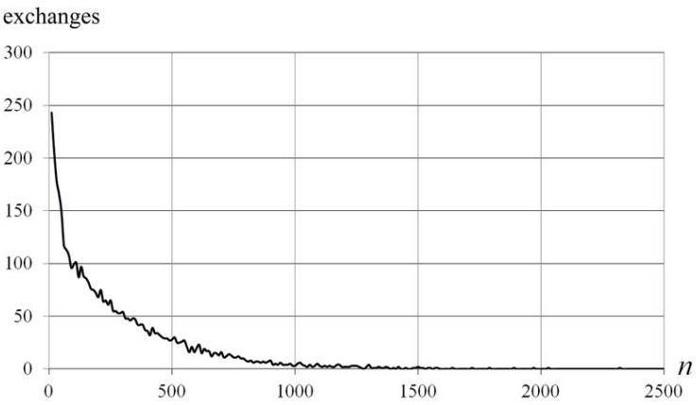
Shaking (5 / 7)
Step2.
case2:
Notes:
圖為 case2 的exchange次數

Slide 18
Shaking (6 / 7)
Step2.
case3: If case1 and case2 don’t work, we stuck in local extrema
We accept such exchange of already performed exchanges,
which ensures the lowest increase of total conflicts.
Notes:
局部死局
最差就回到原本，不會更差

Slide 19
Shaking (7 / 7)
Step3.
Continue with step1, until total conflicts = 0

Slide 20
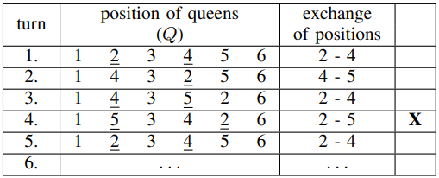
Tabu List
used to avoid loop

Slide 21
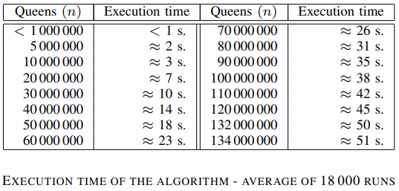
Results

Slide 22
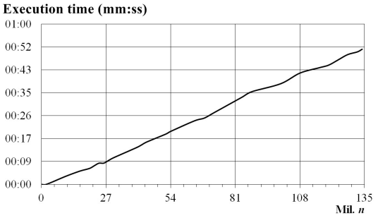
Results

Slide 23
Thanks for your patience

