Slide 1
Hand Strength Evaluation in Bridge Games with the Evolutionary Algorithms
Jing-Ping Jan
Master’s Thesis Department of Computer Science and Engineering,
National Sun Yat-Sen University, 2022
Presenter: Yun-An Chen
Date: Dec. 27, 2022

Slide 2
Abstract
In the contract bridge game, the evaluation of hand strength could significantly affect the decision of bids, and even the final contract. The commonly used methods by human players involve the combination of the high card point (HCP), extra strength in a long suit and a short suit method. However, the parameters (such as A=4, K=3, Q=2 and J=1) in the commonly used methods may not be optimal. The goal of this thesis is to design a better hand strength evaluation method. To achieve our goal, we examine many previously used formulas, and generalize them to become more flexible by adding some parameters to these formulas. These formulas may be linear or non-linear. Then, we train the parameters of these formulas by the genetic algorithm (GA).

Slide 3
Abstract
The fitness is measured by the correlation coefficient between the hand strength and the number of win tricks, obtained by the double-dummy solver. After getting better combined formulas, we further adjust the parameters manually so that the point resolution is 0.5. With this resolution, human players can really apply our evaluation formula in a real bridge game. The experimental datasets come from the Vugraph project in which the boards were really played in bridge games in the world. In the trump contract, the correlation coefficient is improved from 0.859 made the Goren point count to 0.923 made by our formula.

Slide 4
Training Process
Design the various formulas of hand strength evaluation methods
Honor cards in the long suit
Opponent’s bid
Build datasets with different sizes for different stage of training
Find better formula combinations and the hyperparameters of GA
Select the best combination from the 25 better formula combinations
Make the formula more easily to memorize and calculate

Slide 5
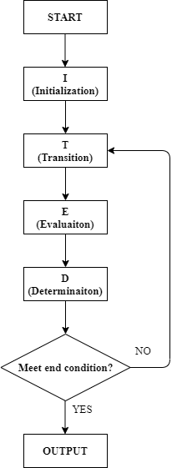
Genetic Algorithm
Crossover
Mutation
A | 1 | 2 | 3 | 4 | 5
B | 6 | 7 | 8 | 9 | 10
A | 1 | 2 | 3 | 9 | 10
B | 6 | 7 | 8 | 4 | 5
A | 1 | 2 | 3 | 4 | 5
A | 2 | 2 | 4 | 4 | 4

Slide 6
Strength of the Hand
Evaluation method | A | K | Q | J | 10
Goren | 4 | 3 | 2 | 1 | 0
Bamberger | 7 | 5 | 3 | 1 | 0
Collet | 4 | 3 | 2 | 0.5 | 0.5
Four Aces | 3 | 2 | 1 | 0.5 | 0
Polish | 7 | 4 | 3 | 0 | 0
Reith | 6 | 4 | 3 | 2 | 1
Robertson | 7 | 5 | 3 | 2 | 1
Vernes | 4 | 3.1 | 1.9 | 0.9 | 0
AKQ | 4 | 3 | 2 | 0 | 0

Slide 7
Strength of the Hand
 |  | S 42 H AT74 D 853 C QJ95
S 853 H K832 D 9 C 87642 | N W E S |  | S JT7 H J D AKJ7642 C AT
 |  | S AKQ96 H Q965 D QT C K3
Goren(HCP)
Long suit method
Short suit method
Void = 3
Singleton = 2
Doubleton = 1
Pavlicek Point Count
Short + HCP =17
Pavlicek = 16

Slide 8
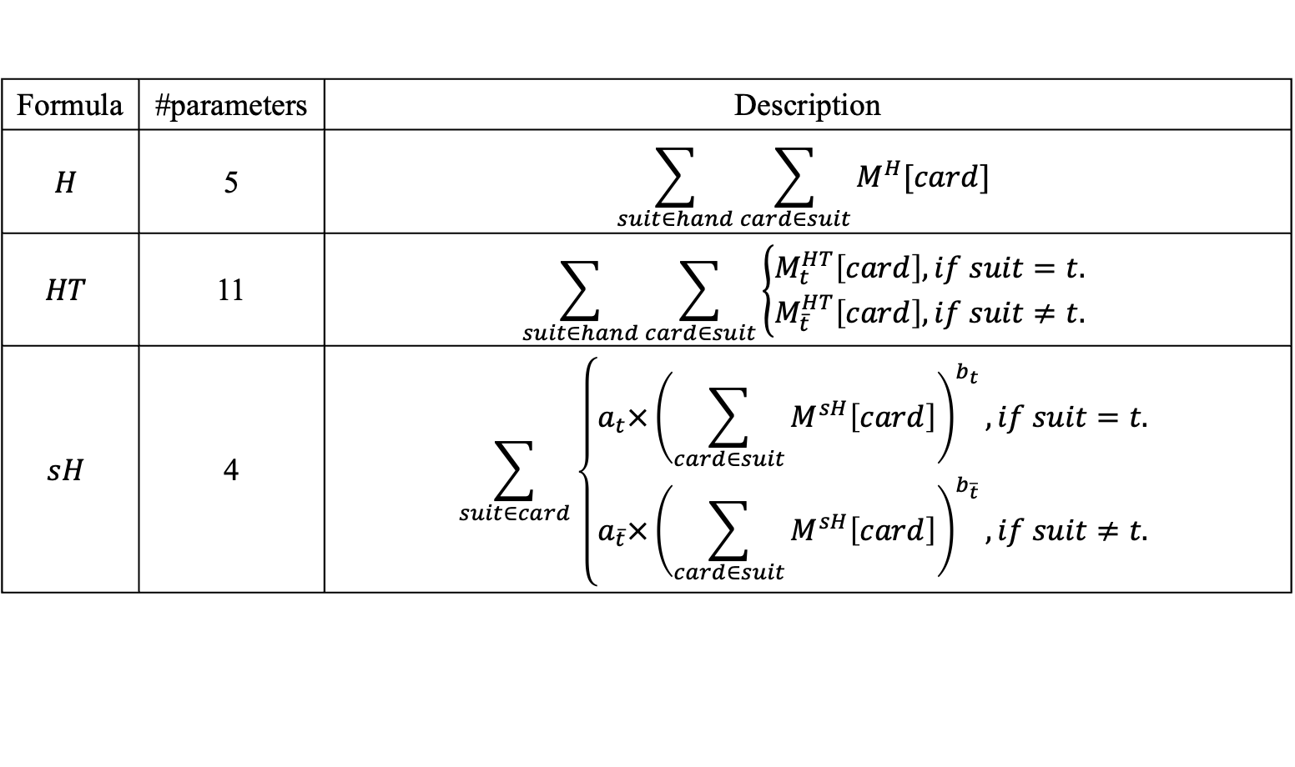
Individual Card Strength Formula
Formula | #parameters | Description
$$H$$ | 5 | $$\sum_{suit∈hand}{\sum_{card∈suit}{M^{H}[card]}}$$
$$HT$$ | 11 | $$\sum_{suit∈hand}{\sum_{card∈suit}{\left\{\begin{aligned}M_{t}^{HT}\left[card\right], if suit=t. \\ M_{\overline{t}}^{HT}\left[card\right], if suit≠t.\end{aligned}\right.}}$$
$$sH$$ | 4 | $$\sum_{suit∈card}{\left\{\begin{aligned}a_{t}×{\left(\sum_{card∈suit}{M^{sH}\left[card\right]}\right)}^{b_{t}}, if suit=t. \\ a_{\overline{t}}×{\left(\sum_{card∈suit}{M^{sH}\left[card\right]}\right)}^{b_{\overline{t}}}, if suit≠t.\end{aligned}\right.}$$

Slide 9
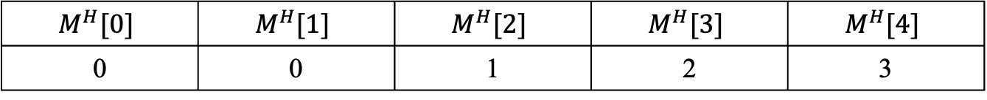
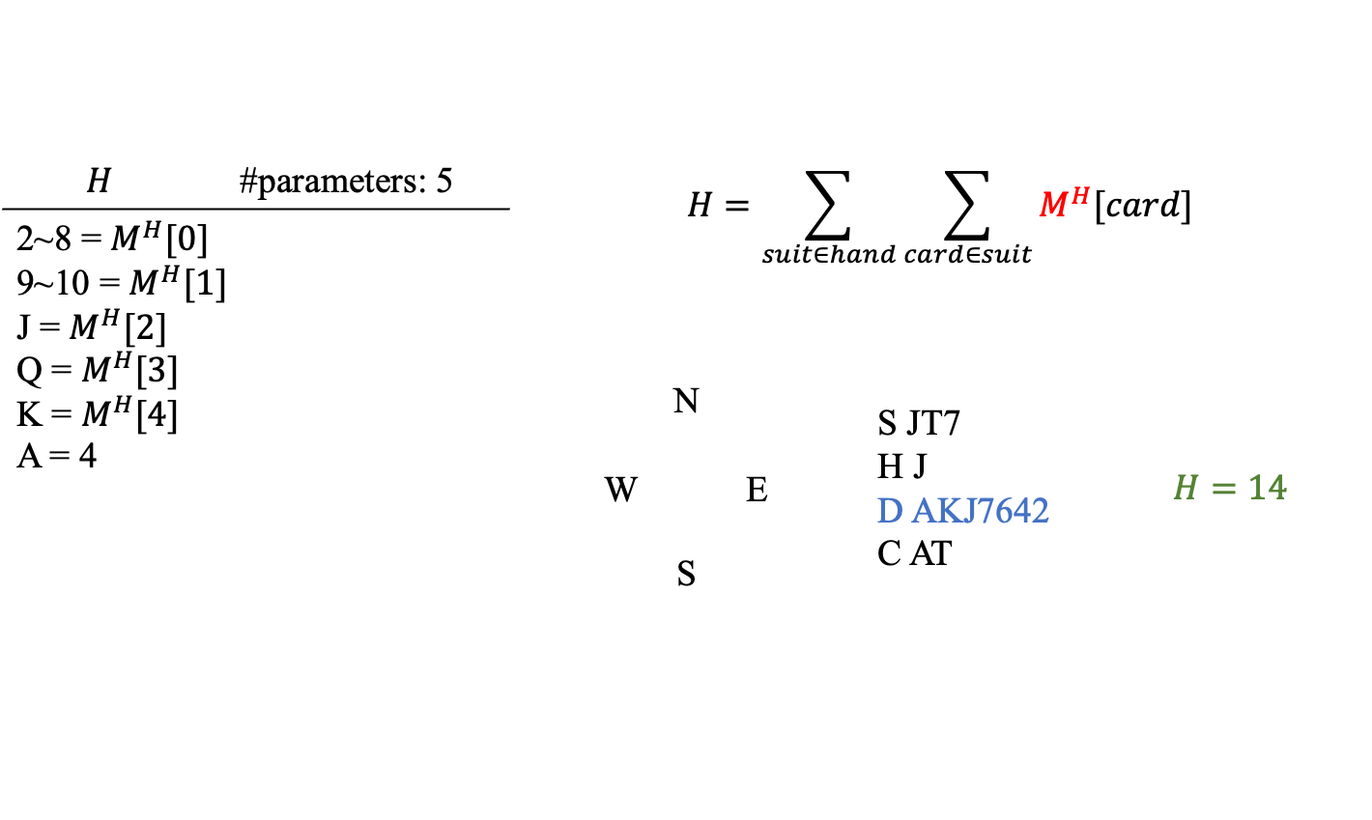
Individual Card Strength Formula
$$H$$ | #parameters: 5 | $$H=\sum_{suit∈hand}{\sum_{card∈suit}{M^{H}[card]}}$$
2~8 = $M^{H}[0]$ 9~10 = $M^{H}[1]$ J = $M^{H}[2]$ Q = $M^{H}[3]$ K = $M^{H}[4]$ A = 4
 |  | N W E S | S JT7 H J D AKJ7642 C AT |  | $$H=14$$
$$M^{H}[0]$$ | $$M^{H}[1]$$ | $$M^{H}[2]$$ | $$M^{H}[3]$$ | $$M^{H}[4]$$
0 | 0 | 1 | 2 | 3

Slide 10
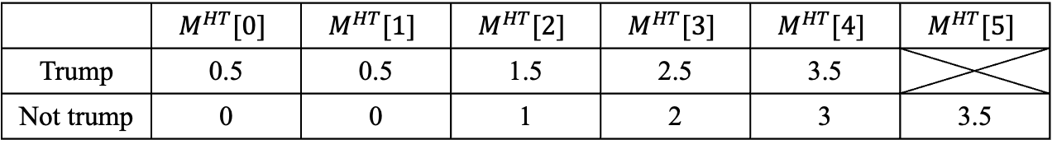
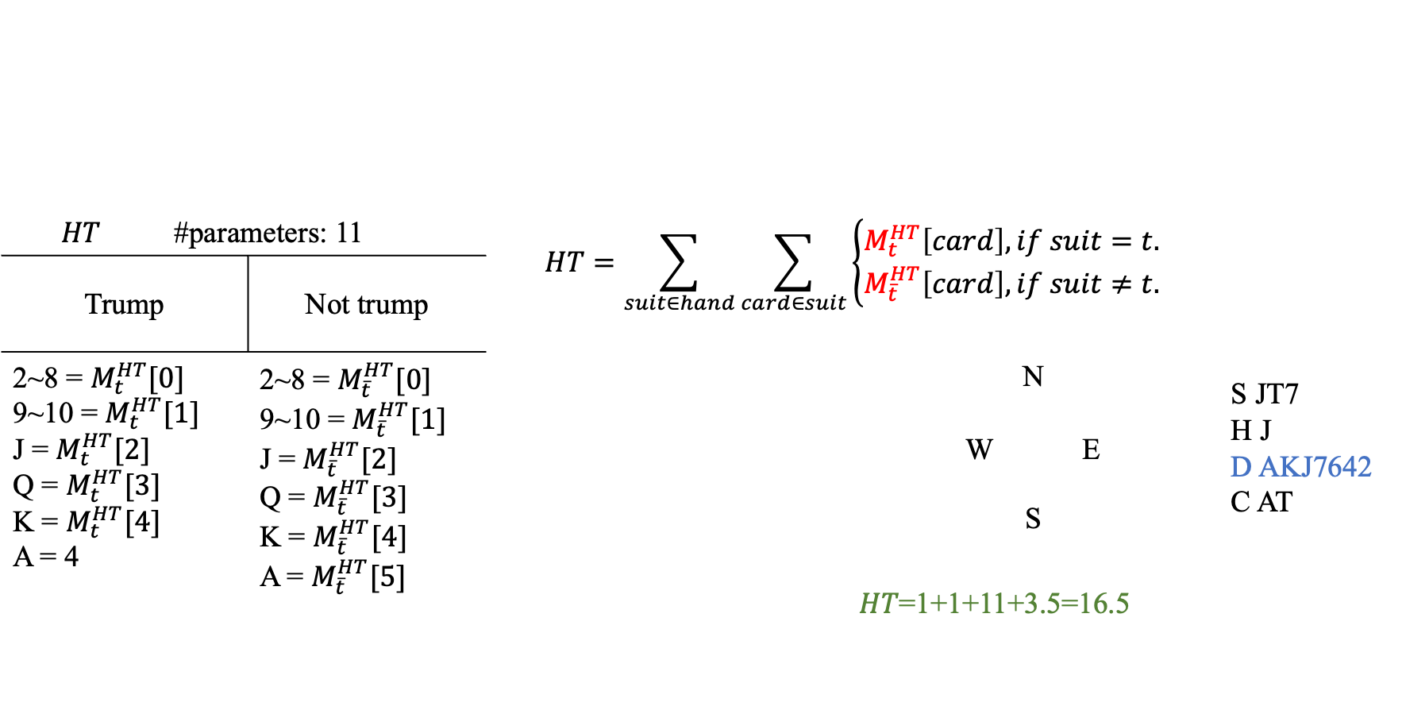
Individual Card Strength Formula
$$HT$$ | #parameters: 11 |  | $$HT=\sum_{suit∈hand}{\sum_{card∈suit}{\left\{\begin{aligned}M_{t}^{HT}\left[card\right], if suit=t. \\ M_{\overline{t}}^{HT}\left[card\right], if suit≠t.\end{aligned}\right.}}$$
Trump |  | Not trump
2~8 = $M_{t}^{HT}[0]$ 9~10 = $M_{t}^{HT}[1]$ J = $M_{t}^{HT}[2]$ Q = $M_{t}^{HT}[3]$ K = $M_{t}^{HT}[4]$ A = 4 |  | 2~8 = $M_{\overline{t}}^{HT}[0]$ 9~10 = $M_{\overline{t}}^{HT}[1]$ J = $M_{\overline{t}}^{HT}[2]$ Q = $M_{\overline{t}}^{HT}[3]$ K = $M_{\overline{t}}^{HT}[4]$ A = $M_{\overline{t}}^{HT}[5]$ |  |  | N W E S | S JT7 H J D AKJ7642 C AT
 |  |  |  |  | 𝐻𝑇=1+1+11+3.5=16.5
 | $$M^{HT}[0]$$ | $$M^{HT}[1]$$ | $$M^{HT}[2]$$ | $$M^{HT}[3]$$ | $$M^{HT}[4]$$ | $$M^{HT}[5]$$
Trump | 0.5 | 0.5 | 1.5 | 2.5 | 3.5
Not trump | 0 | 0 | 1 | 2 | 3 | 3.5

Slide 11
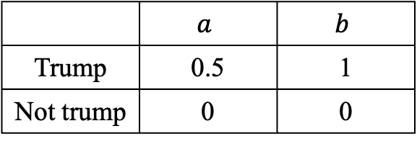
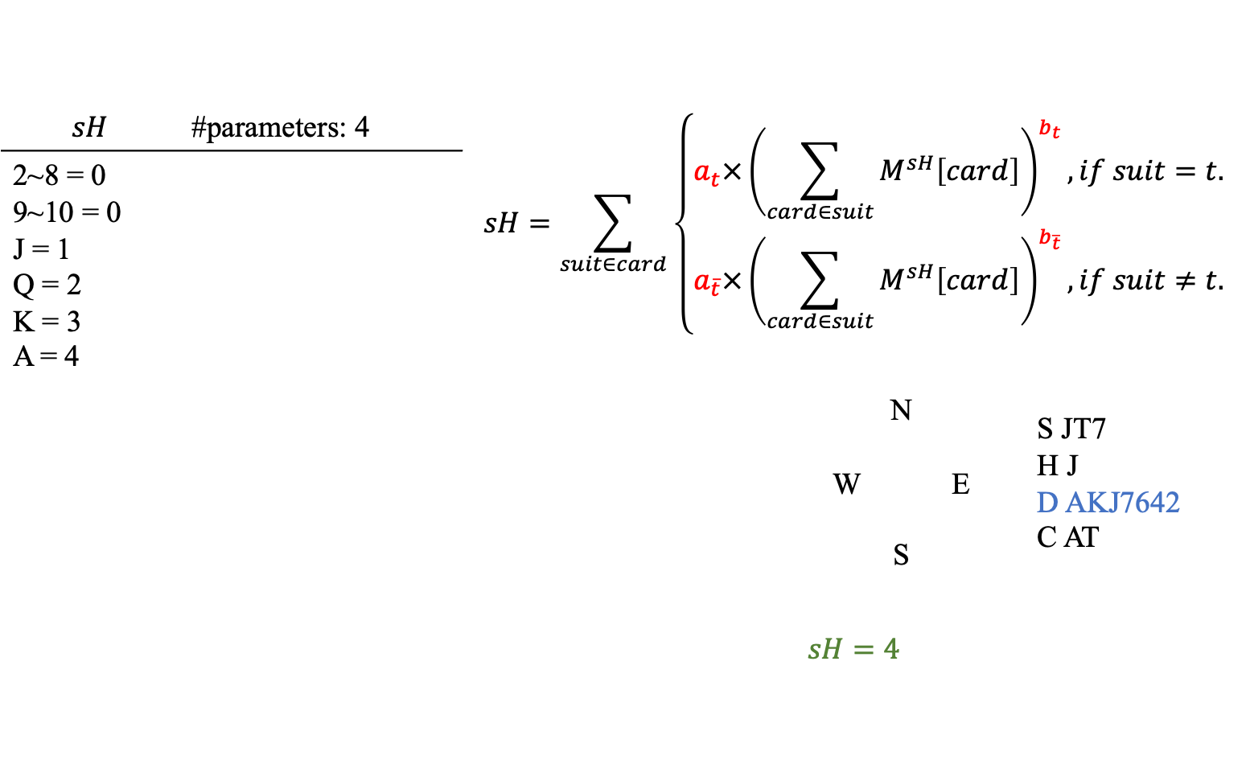
Individual Card Strength Formula
$$sH$$ | #parameters: 4 | $$sH=\sum_{suit∈card}{\left\{\begin{aligned}a_{t}×{\left(\sum_{card∈suit}{M^{sH}\left[card\right]}\right)}^{b_{t}}, if suit=t. \\ a_{\overline{t}}×{\left(\sum_{card∈suit}{M^{sH}\left[card\right]}\right)}^{b_{\overline{t}}}, if suit≠t.\end{aligned}\right.}$$
2~8 = 0 9~10 = 0 J = 1 Q = 2 K = 3 A = 4
 |  |  | N W E S | S JT7 H J D AKJ7642 C AT
 |  | $$sH=4$$
 | $$a$$ | $$b$$
Trump | 0.5 | 1
Not trump | 0 | 0

Slide 12
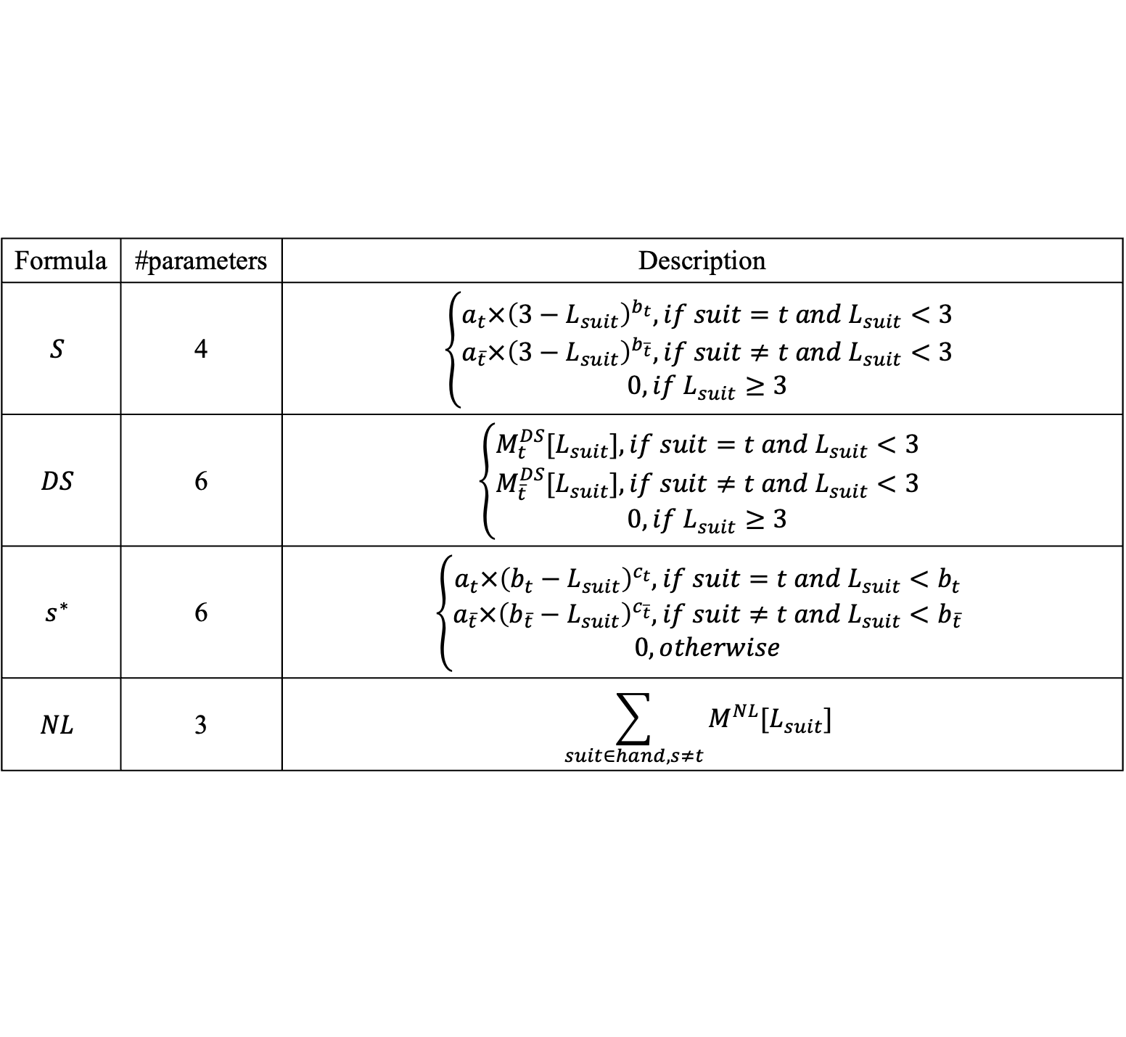
Short suit formula
Formula | #parameters | Description
$$S$$ | 4 | $$\left\{\begin{aligned}a_{t}×{\left(3−L_{suit}\right)}^{b_{t}}, if suit=t &and L_{suit}<3 \\ a_{\overline{t}}×{\left(3−L_{suit}\right)}^{b_{\overline{t}}}, if suit≠t &and L_{suit}<3 \\ 0, if L_{suit}≥3\end{aligned}\right.$$
$$DS$$ | 6 | $$\left\{\begin{aligned}M_{t}^{DS}[L_{suit}], if suit=t &and L_{suit}<3 \\ M_{\overline{t}}^{DS}[L_{suit}], if suit≠t &and L_{suit}<3 \\ 0, if L_{suit}≥3\end{aligned}\right.$$
$$s^{∗}$$ | 6 | $$\left\{\begin{aligned}a_{t}×{\left(b_{t}−L_{suit}\right)}^{c_{t}}, if suit=t &and L_{suit}<b_{t} \\ a_{\overline{t}}×{\left(b_{\overline{t}}−L_{suit}\right)}^{c_{\overline{t}}}, if suit≠t &and L_{suit}<b_{\overline{t}} \\ 0, otherwise\end{aligned}\right.$$
$$NL$$ | 3 | $$\sum_{suit∈hand, s≠t}{M^{NL}[L_{suit}]}$$

Slide 13
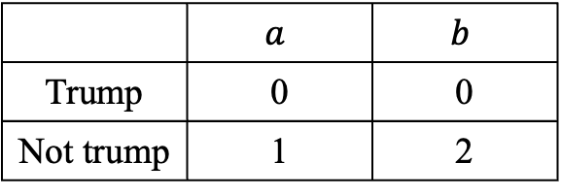
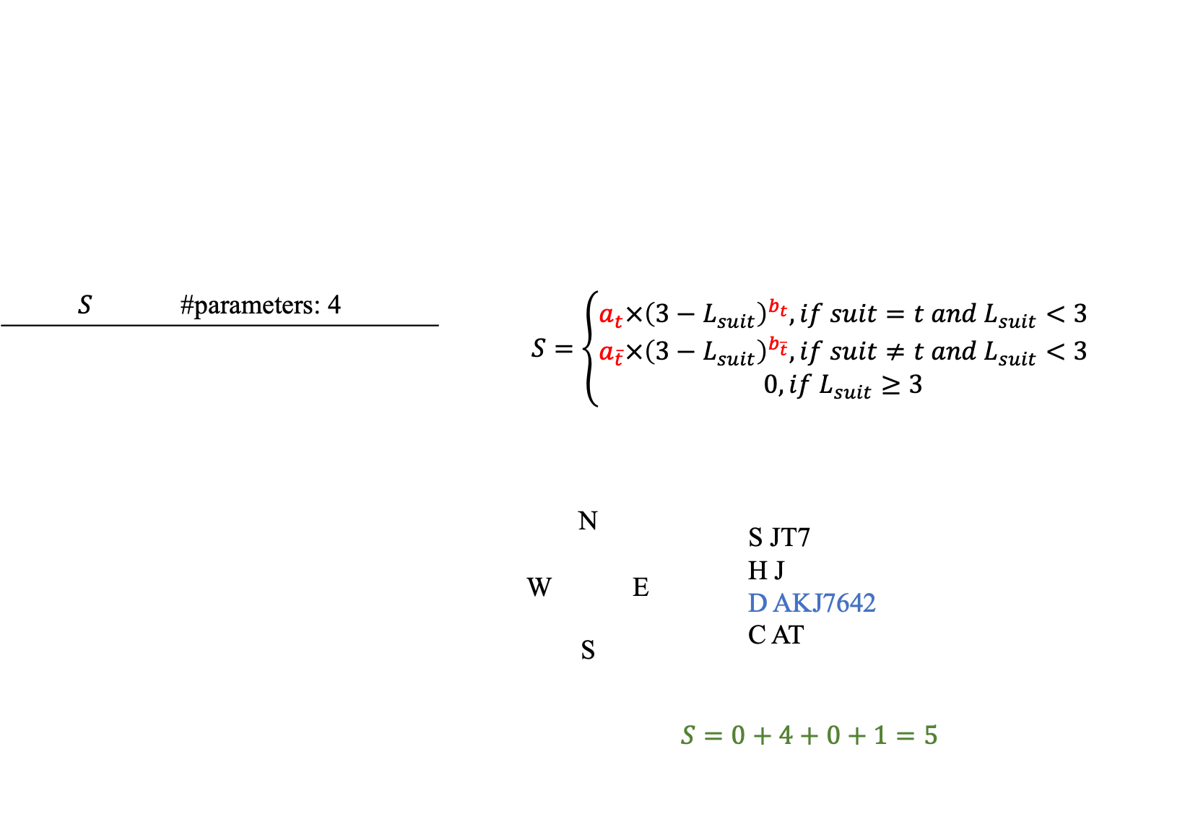
Short suit formula
$$S$$ | #parameters: 4 | $$S=\left\{\begin{aligned}a_{t}×{\left(3−L_{suit}\right)}^{b_{t}}, if suit=t &and L_{suit}<3 \\ a_{\overline{t}}×{\left(3−L_{suit}\right)}^{b_{\overline{t}}}, if suit≠t &and L_{suit}<3 \\ 0, if L_{suit}≥3\end{aligned}\right.$$
 |  | N W E S | S JT7 H J D AKJ7642 C AT
 |  | $$S=0+4+0+1=5$$
 | $$a$$ | $$b$$
Trump | 0 | 0
Not trump | 1 | 2

Slide 14
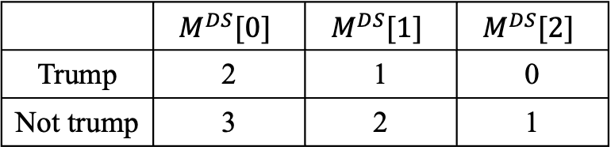
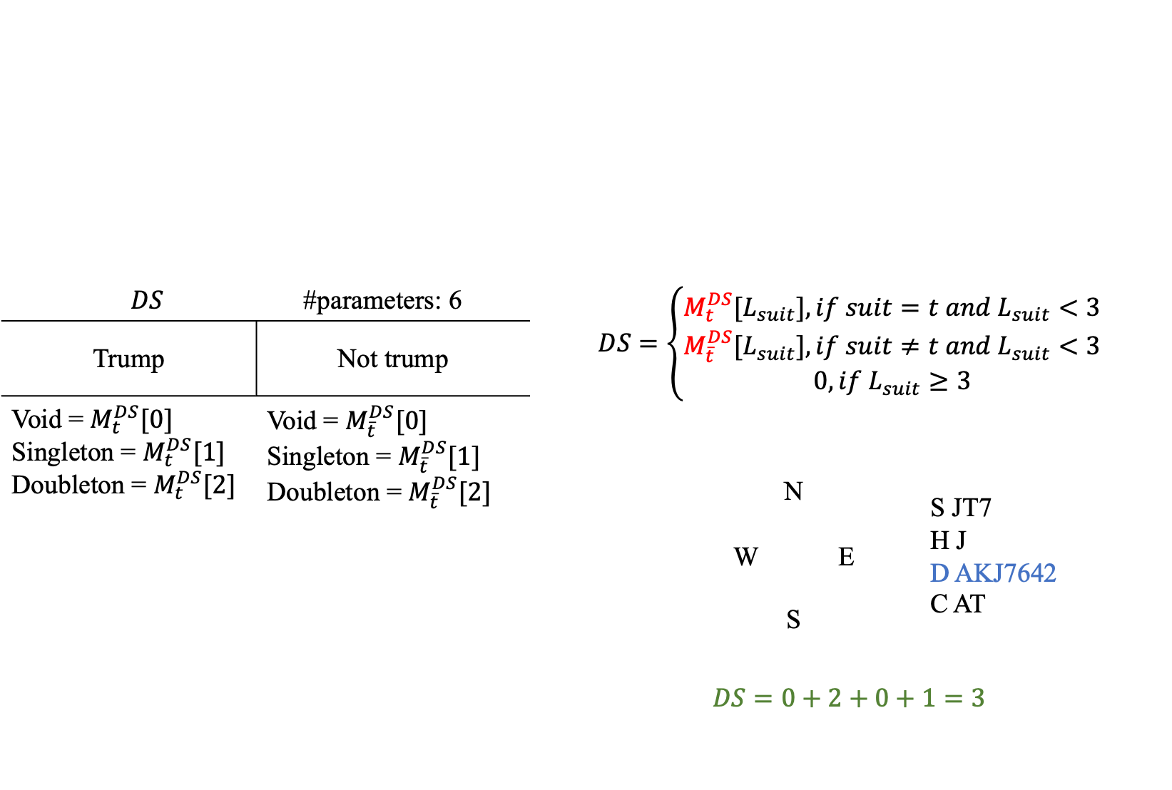
Short suit formula
$$DS$$ |  | #parameters: 6 | $$DS=\left\{\begin{aligned}M_{t}^{DS}[L_{suit}], if suit=t &and L_{suit}<3 \\ M_{\overline{t}}^{DS}[L_{suit}], if suit≠t &and L_{suit}<3 \\ 0, if L_{suit}≥3\end{aligned}\right.$$
Trump | Not trump
Void = $M_{t}^{DS}[0]$ Singleton = $M_{t}^{DS}[1]$ Doubleton = $M_{t}^{DS}[2]$ | Void = $M_{\overline{t}}^{DS}[0]$ Singleton = $M_{\overline{t}}^{DS}[1]$ Doubleton = $M_{\overline{t}}^{DS}[2]$
 |  |  |  | N W E S | S JT7 H J D AKJ7642 C AT
 |  |  | $$DS=0+2+0+1=3$$
 | $$M^{DS}[0]$$ | $$M^{DS}[1]$$ | $$M^{DS}[2]$$
Trump | 2 | 1 | 0
Not trump | 3 | 2 | 1

Slide 15
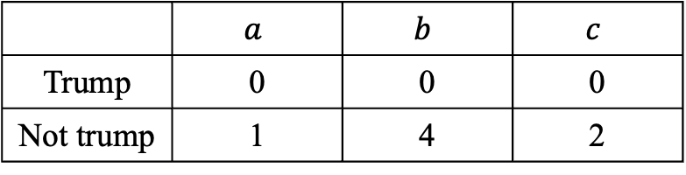
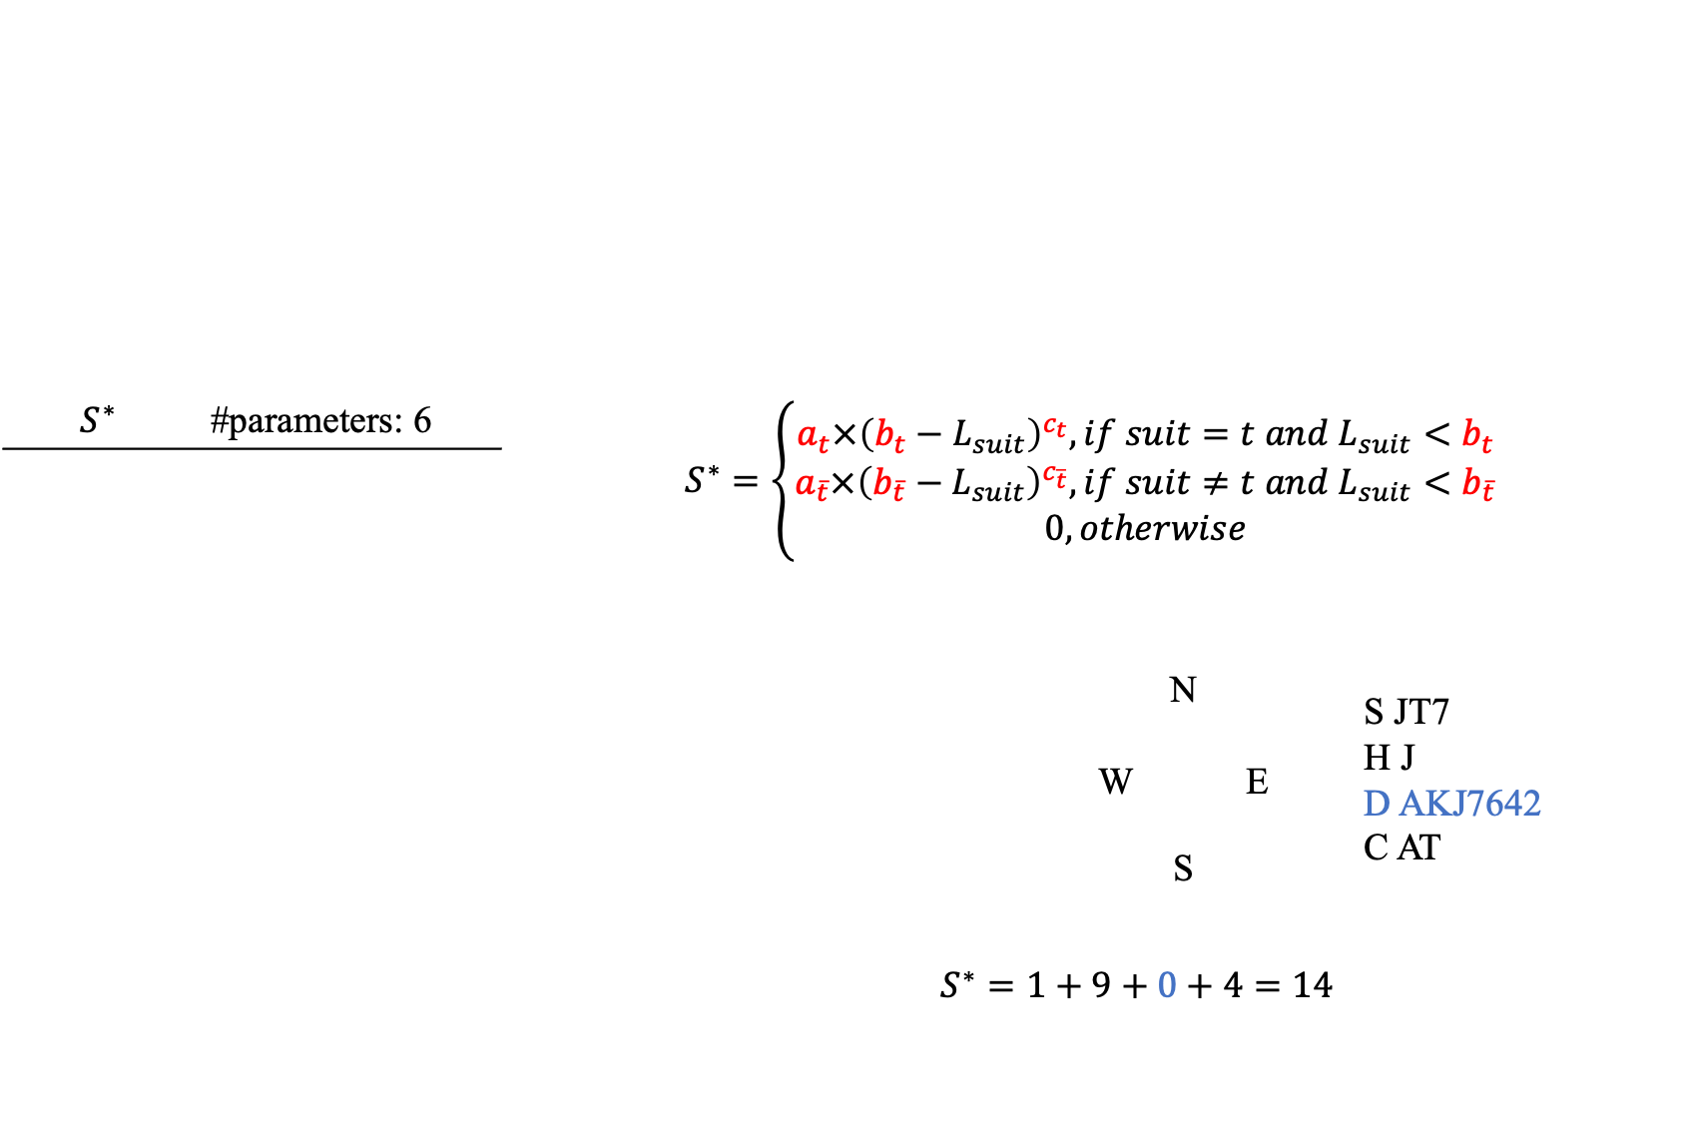
Short suit formula
$$S^{∗}$$ | #parameters: 6 | $$S^{∗}=\left\{\begin{aligned}a_{t}×{\left(b_{t}−L_{suit}\right)}^{c_{t}}, if suit=t &and L_{suit}<b_{t} \\ a_{\overline{t}}×{\left(b_{\overline{t}}−L_{suit}\right)}^{c_{\overline{t}}}, if suit≠t &and L_{suit}<b_{\overline{t}} \\ 0, otherwise\end{aligned}\right.$$
 |  |  |  | N W E S | S JT7 H J D AKJ7642 C AT
 |  | $$S^{∗}=1+9+0+4=14$$
 | $$a$$ | $$b$$ | $$c$$
Trump | 0 | 0 | 0
Not trump | 1 | 4 | 2

Slide 16
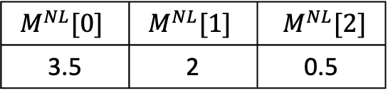
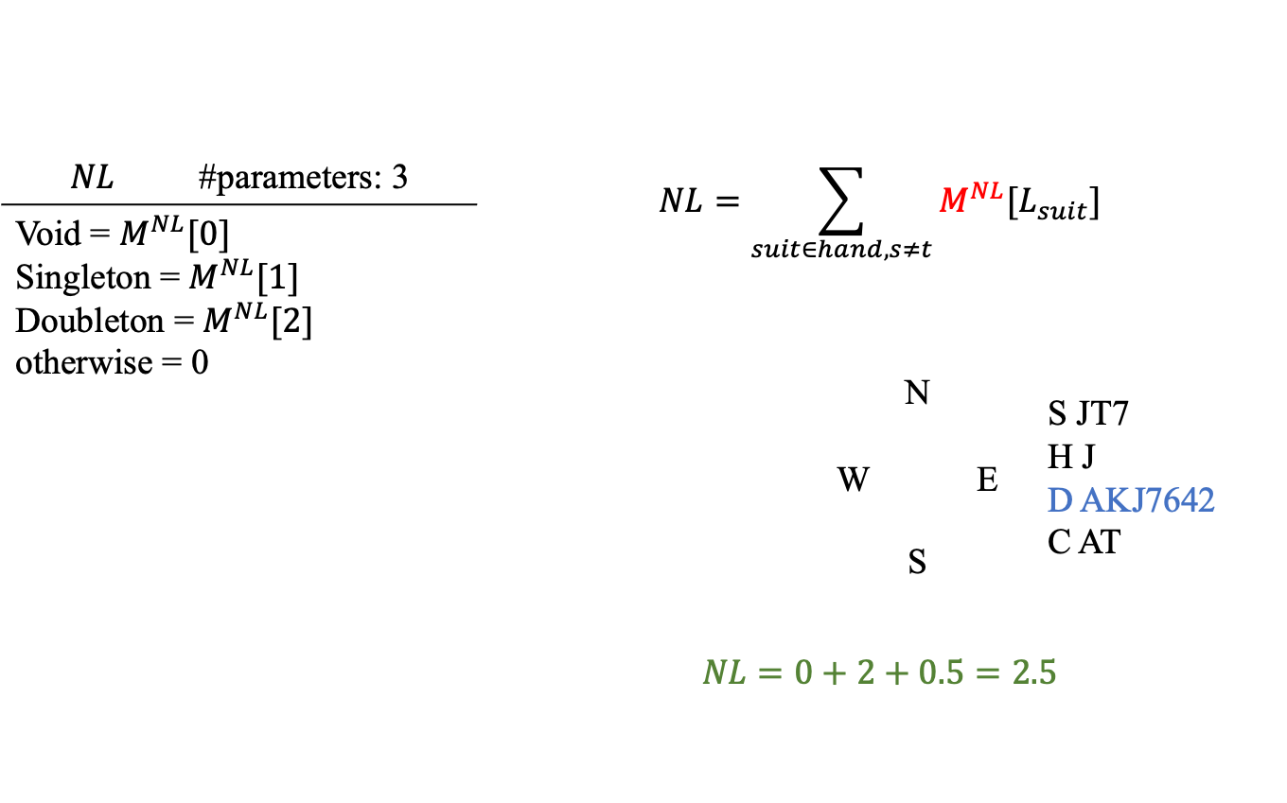
Short suit formula
$$NL$$ | #parameters: 3 | $$NL=\sum_{suit∈hand, s≠t}{M^{NL}[L_{suit}]}$$
Void = $M^{NL}[0]$ Singleton = $M^{NL}[1]$ Doubleton = $M^{NL}[2]$ otherwise = 0
 |  |  | N W E S | S JT7 H J D AKJ7642 C AT
 |  | $$NL=0+2+0.5=2.5$$
$$M^{NL}[0]$$ | $$M^{NL}[1]$$ | $M^{NL}[2]$
3.5 | 2 | 0.5

Slide 17
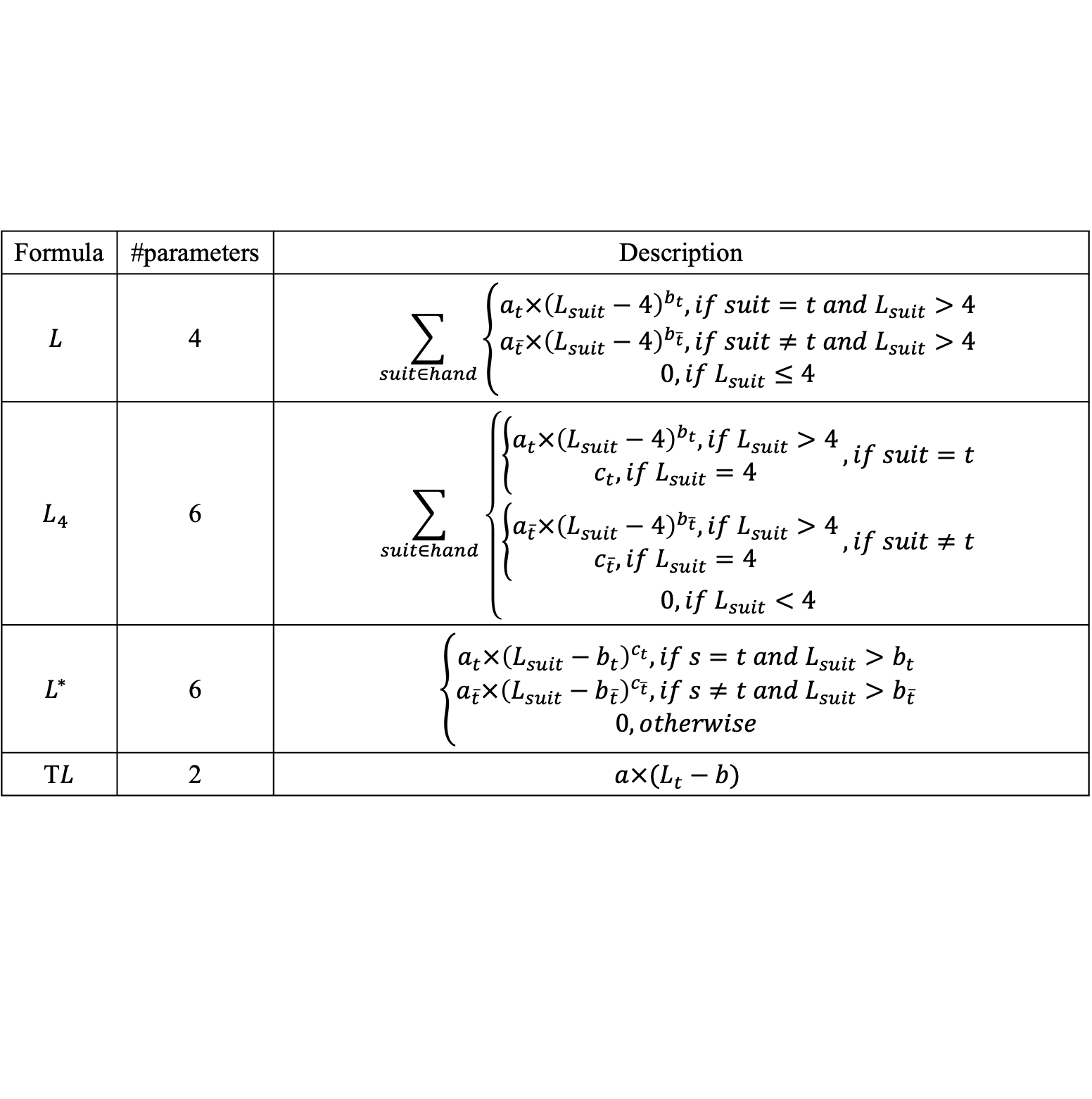
Long suit formula
Formula | #parameters | Description
$$L$$ | 4 | $$\sum_{suit∈hand}{\left\{\begin{aligned}a_{t}×{\left(L_{suit}−4\right)}^{b_{t}}, if suit=t &and L_{suit}>4 \\ a_{\overline{t}}×{\left(L_{suit}−4\right)}^{b_{\overline{t}}}, if suit≠t &and L_{suit}>4 \\ 0, if L_{suit}≤4\end{aligned}\right.}$$
$$L_{4}$$ | 6 | $$\sum_{suit∈hand}{\left\{\begin{aligned}\left\{\begin{aligned}a_{t}×{\left(L_{suit}−4\right)}^{b_{t}}, if L_{suit}>4 \\ c_{t}, if L_{suit}=4\end{aligned}\right., if suit=t \\ \left\{\begin{aligned}a_{\overline{t}}×{\left(L_{suit}−4\right)}^{b_{\overline{t}}}, if L_{suit}>4 \\ c_{\overline{t}}, if L_{suit}=4\end{aligned}\right., if suit≠t \\ 0, if L_{suit}<4\end{aligned}\right.}$$
$$L^{∗}$$ | 6 | $$\left\{\begin{aligned}a_{t}×{\left(L_{suit}−b_{t}\right)}^{c_{t}}, if s=t &and L_{suit}>b_{t} \\ a_{\overline{t}}×{\left(L_{suit}−b_{\overline{t}}\right)}^{c_{\overline{t}}}, if s≠t &and L_{suit}>b_{\overline{t}} \\ 0, otherwise\end{aligned}\right.$$
T$L$ | 2 | $$a×(L_{t}−b)$$

Slide 18
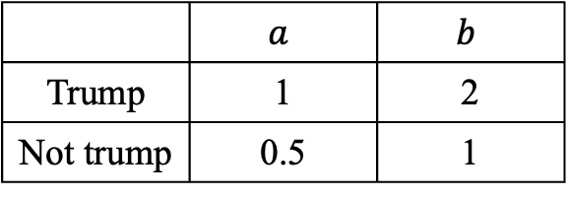
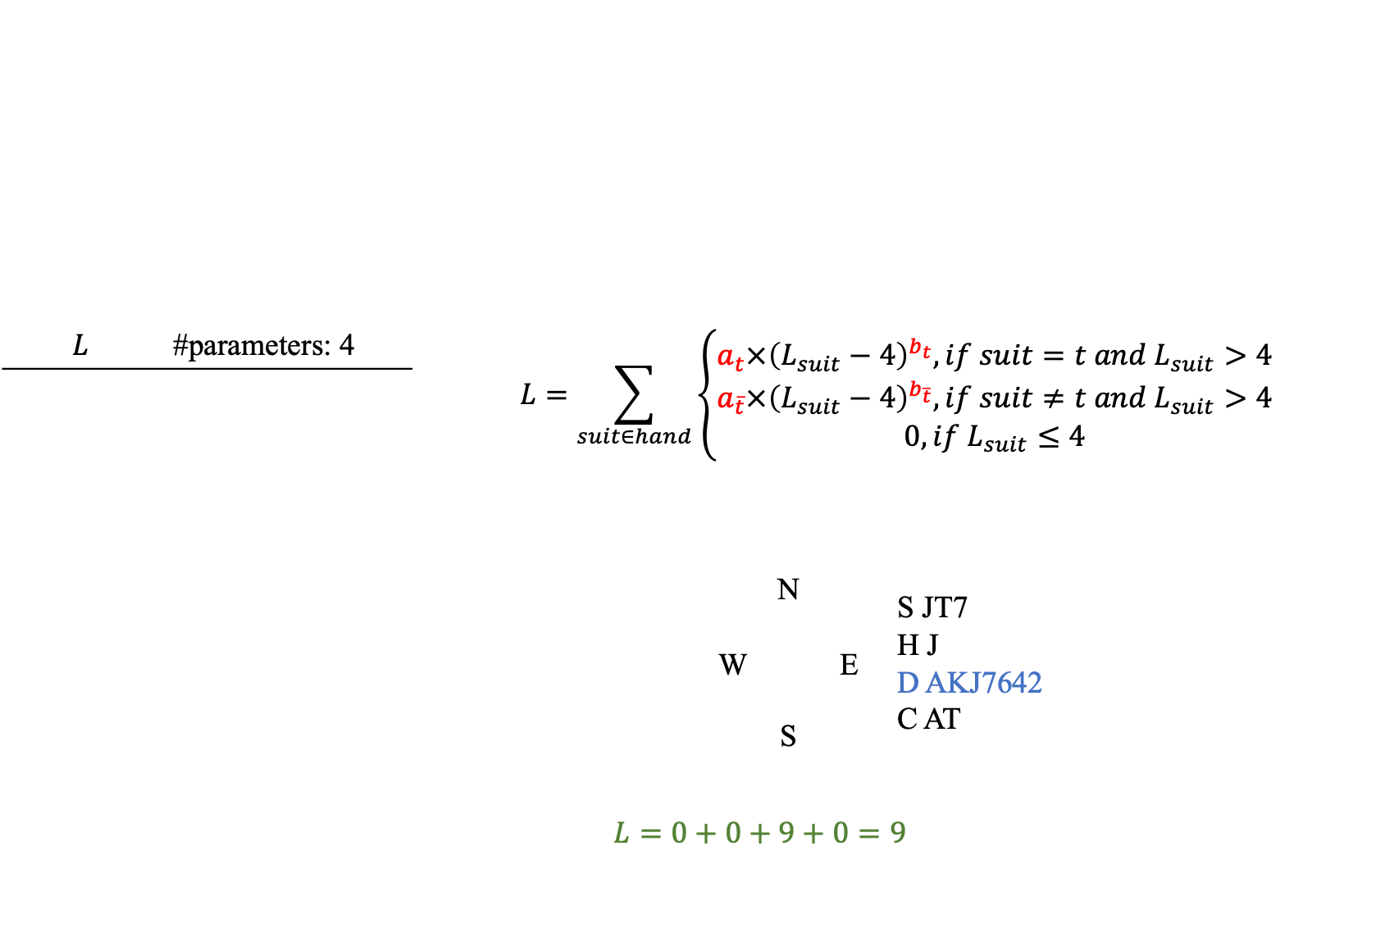
Long suit formula
$$L$$ | #parameters: 4 | $$L=\sum_{suit∈hand}{\left\{\begin{aligned}a_{t}×{\left(L_{suit}−4\right)}^{b_{t}}, if suit=t &and L_{suit}>4 \\ a_{\overline{t}}×{\left(L_{suit}−4\right)}^{b_{\overline{t}}}, if suit≠t &and L_{suit}>4 \\ 0, if L_{suit}≤4\end{aligned}\right.}$$
 |  |  | N W E S | S JT7 H J D AKJ7642 C AT
 |  | $$L=0+0+9+0=9$$
 | $$a$$ | $$b$$
Trump | 1 | 2
Not trump | 0.5 | 1

Slide 19
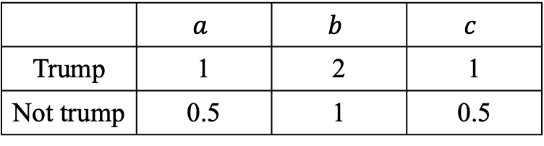
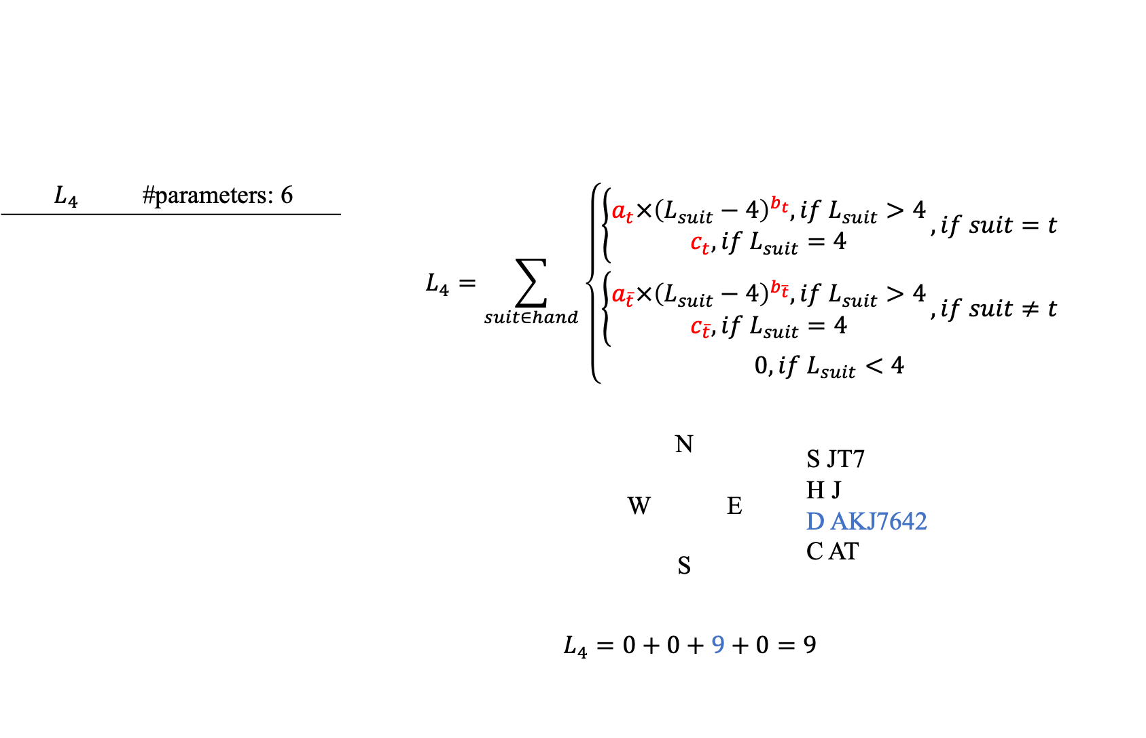
Long suit formula
$$L_{4}$$ | #parameters: 6 | $$L_{4}=\sum_{suit∈hand}{\left\{\begin{aligned}\left\{\begin{aligned}a_{t}×{\left(L_{suit}−4\right)}^{b_{t}}, if L_{suit}>4 \\ c_{t}, if L_{suit}=4\end{aligned}\right., if suit=t \\ \left\{\begin{aligned}a_{\overline{t}}×{\left(L_{suit}−4\right)}^{b_{\overline{t}}}, if L_{suit}>4 \\ c_{\overline{t}}, if L_{suit}=4\end{aligned}\right., if suit≠t \\ 0, if L_{suit}<4\end{aligned}\right.}$$
 |  |  | N W E S | S JT7 H J D AKJ7642 C AT
 |  | $$L_{4}=0+0+9+0=9$$
 | $$a$$ | $$b$$ | $$c$$
Trump | 1 | 2 | 1
Not trump | 0.5 | 1 | 0.5

Slide 20
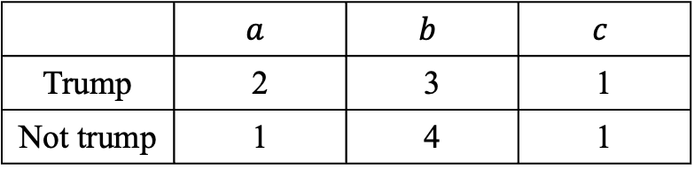
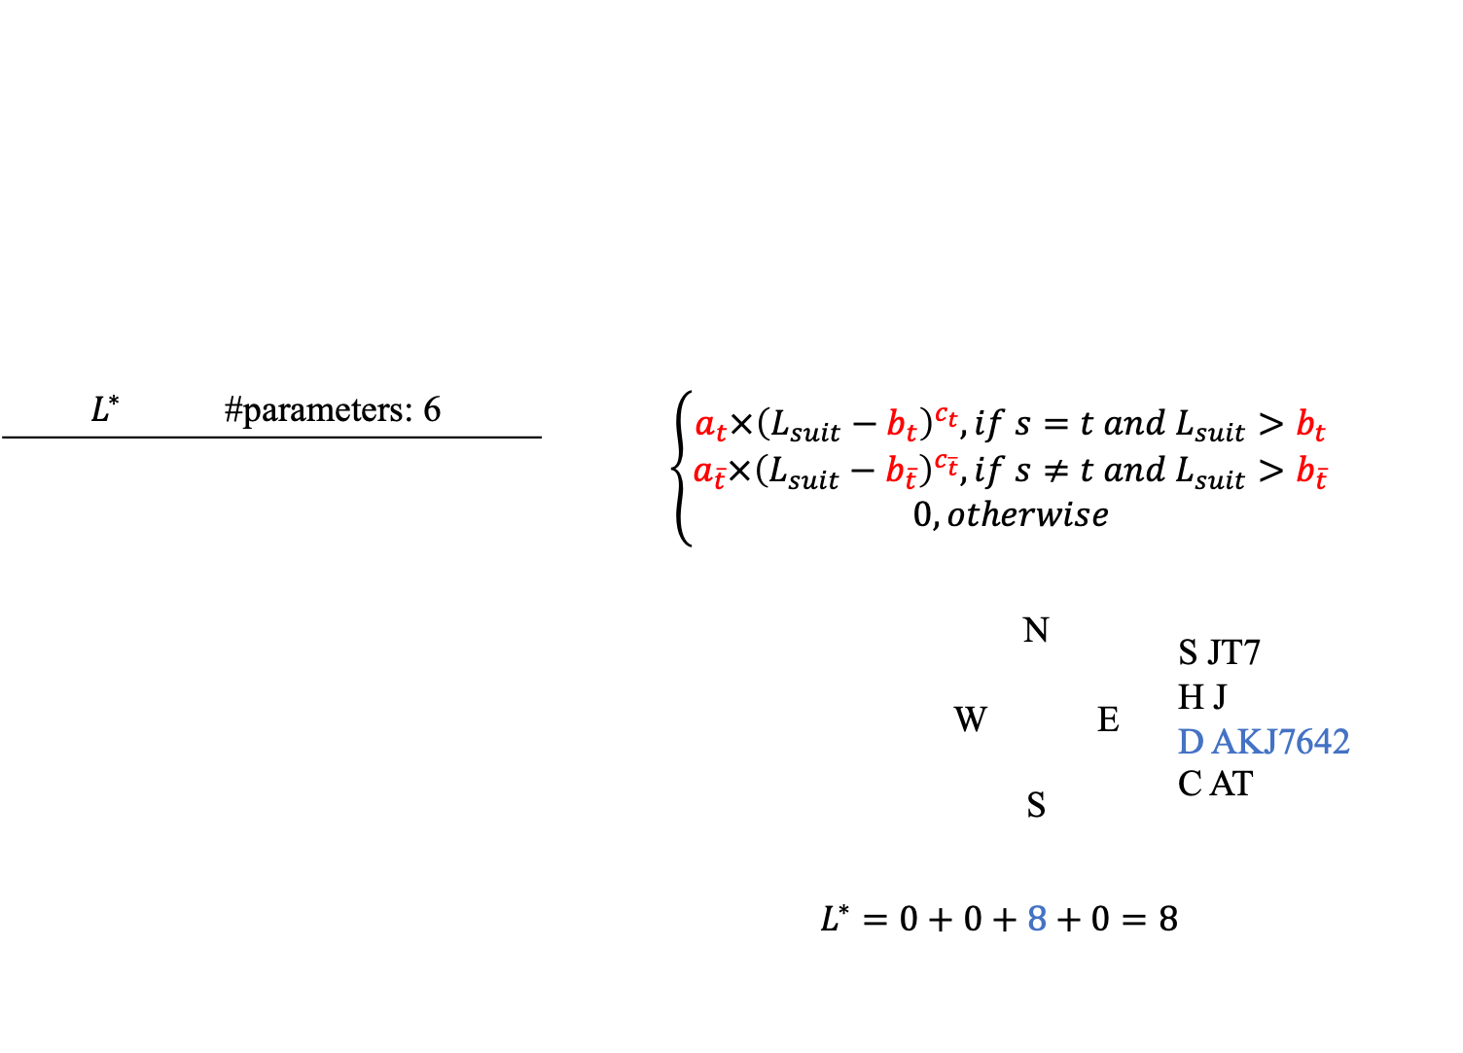
Long suit formula
$$L^{∗}$$ | #parameters: 6 | $$\left\{\begin{aligned}a_{t}×{\left(L_{suit}−b_{t}\right)}^{c_{t}}, if s=t &and L_{suit}>b_{t} \\ a_{\overline{t}}×{\left(L_{suit}−b_{\overline{t}}\right)}^{c_{\overline{t}}}, if s≠t &and L_{suit}>b_{\overline{t}} \\ 0, otherwise\end{aligned}\right.$$
 |  |  | N W E S | S JT7 H J D AKJ7642 C AT
 |  | $$L^{∗}=0+0+8+0=8$$
 | $$a$$ | $$b$$ | $$c$$
Trump | 2 | 3 | 1
Not trump | 1 | 4 | 1

Slide 21
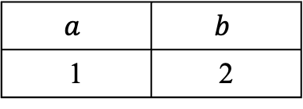
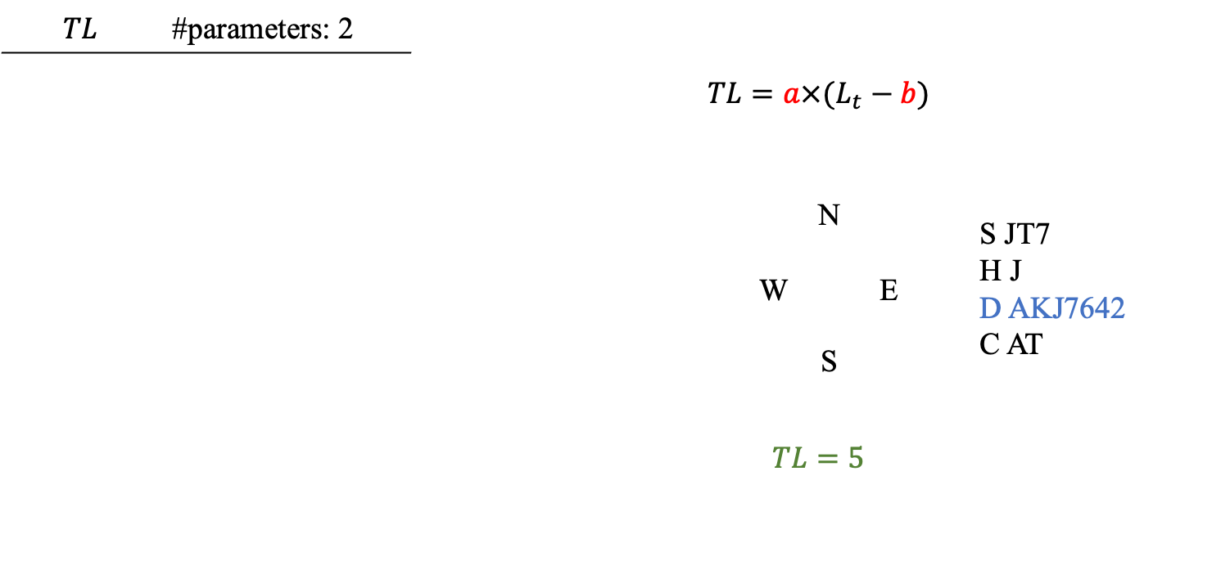
Long suit formula
$$TL$$ | #parameters: 2 | $$TL=a×(L_{t}−b)$$
 |  |  | N W E S | S JT7 H J D AKJ7642 C AT
 |  | $$TL=5$$
$$a$$ | $$b$$
1 | 2

Slide 22
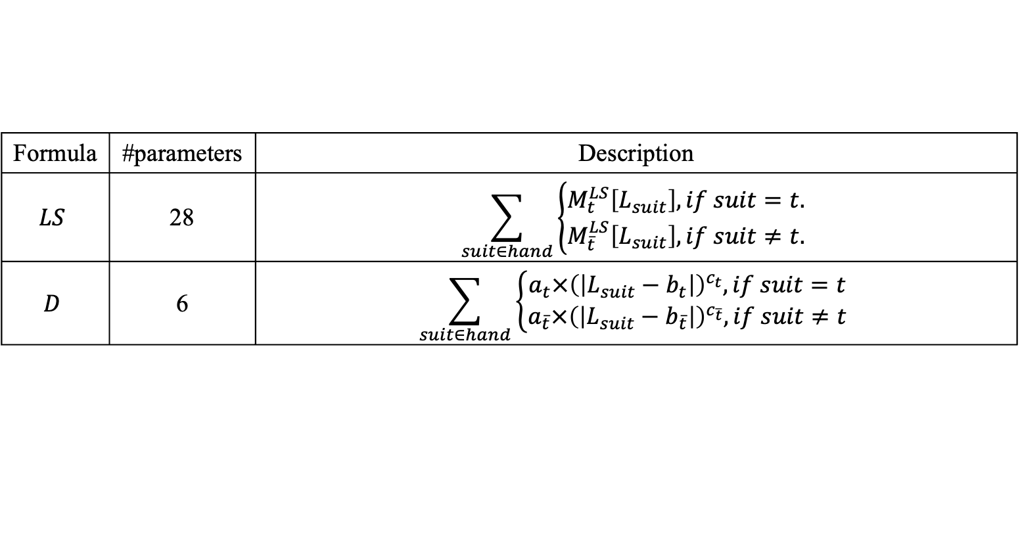
Length formula
Formula | #parameters | Description
$$LS$$ | 28 | $$\sum_{suit∈hand}{\left\{\begin{aligned}M_{t}^{LS}\left[L_{suit}\right], if suit=t. \\ M_{\overline{t}}^{LS}\left[L_{suit}\right], if suit≠t.\end{aligned}\right.}$$
$$D$$ | 6 | $$\sum_{suit∈hand}{\left\{\begin{aligned}a_{t}×{\left(\left|L_{suit}−b_{t}\right|\right)}^{c_{t}}, if suit=t \\ a_{\overline{t}}×{\left(\left|L_{suit}−b_{\overline{t}}\right|\right)}^{c_{\overline{t}}}, if suit≠t\end{aligned}\right.}$$

Slide 23
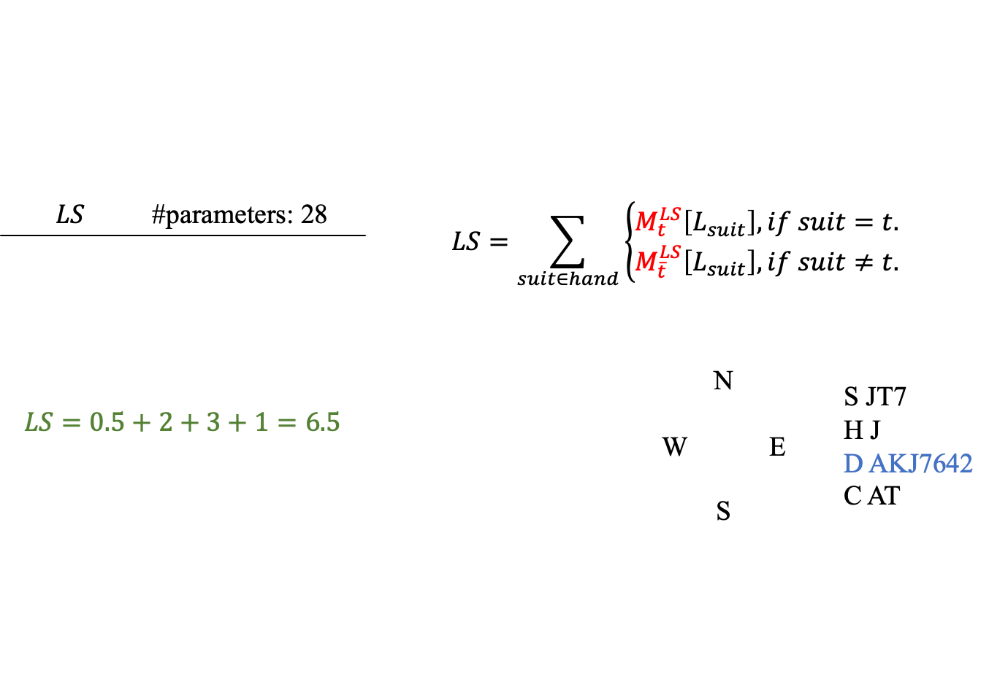
Length formula
$$LS$$ | #parameters: 28 | $$LS=\sum_{suit∈hand}{\left\{\begin{aligned}M_{t}^{LS}\left[L_{suit}\right], if suit=t. \\ M_{\overline{t}}^{LS}\left[L_{suit}\right], if suit≠t.\end{aligned}\right.}$$
$$LS=0.5+2+3+1=6.5$$
 |  |  | N W E S | S JT7 H J D AKJ7642 C AT
 | $$M^{LS}[0]$$ | $$M^{LS}[1]$$ | $$M^{LS}[2]$$ | $$M^{LS}[3]$$ | $$M^{LS}[4]$$ | $$M^{LS}[5]$$ | $$M^{LS}[6]$$ | $$M^{LS}[7]$$ | $$M^{LS}[8]$$ | $$M^{LS}[9]$$ | $$M^{LS}[10]$$ | $$M^{LS}[11]$$ | $$M^{LS}[12]$$ | $$M^{LS}[13]$$
Trump | 0 | 0 | 0 | 0 | 0.5 | 1 | 2 | 3 | 4 | 5 | 6 | 7 | 8 | 9
Not trump | 3 | 2 | 1 | 0.5 | 0 | 0 | 0 | 0 | 0 | 0 | 0 | 0 | 0 | 0

Slide 24
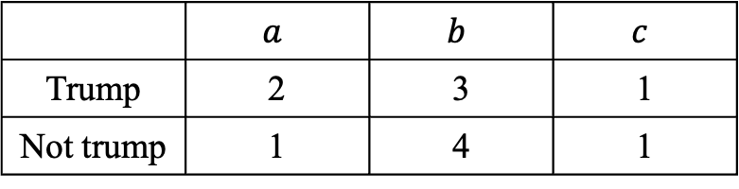
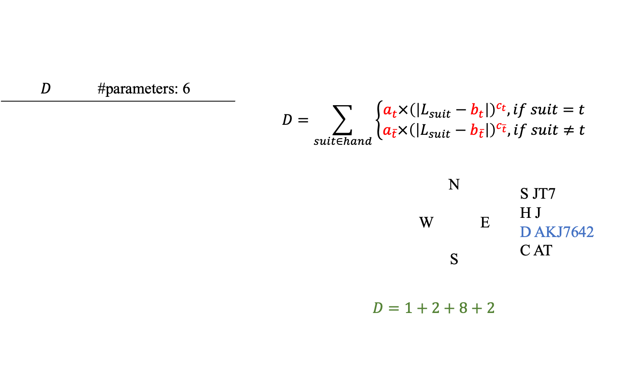
Length formula
$$D$$ | #parameters: 6 | $$D=\sum_{suit∈hand}{\left\{\begin{aligned}a_{t}×{\left(\left|L_{suit}−b_{t}\right|\right)}^{c_{t}}, if suit=t \\ a_{\overline{t}}×{\left(\left|L_{suit}−b_{\overline{t}}\right|\right)}^{c_{\overline{t}}}, if suit≠t\end{aligned}\right.}$$
 |  |  | N W E S | S JT7 H J D AKJ7642 C AT
 |  | $$D=1+2+8+2$$
 | $$a$$ | $$b$$ | $$c$$
Trump | 2 | 3 | 1
Not trump | 1 | 4 | 1

Slide 25
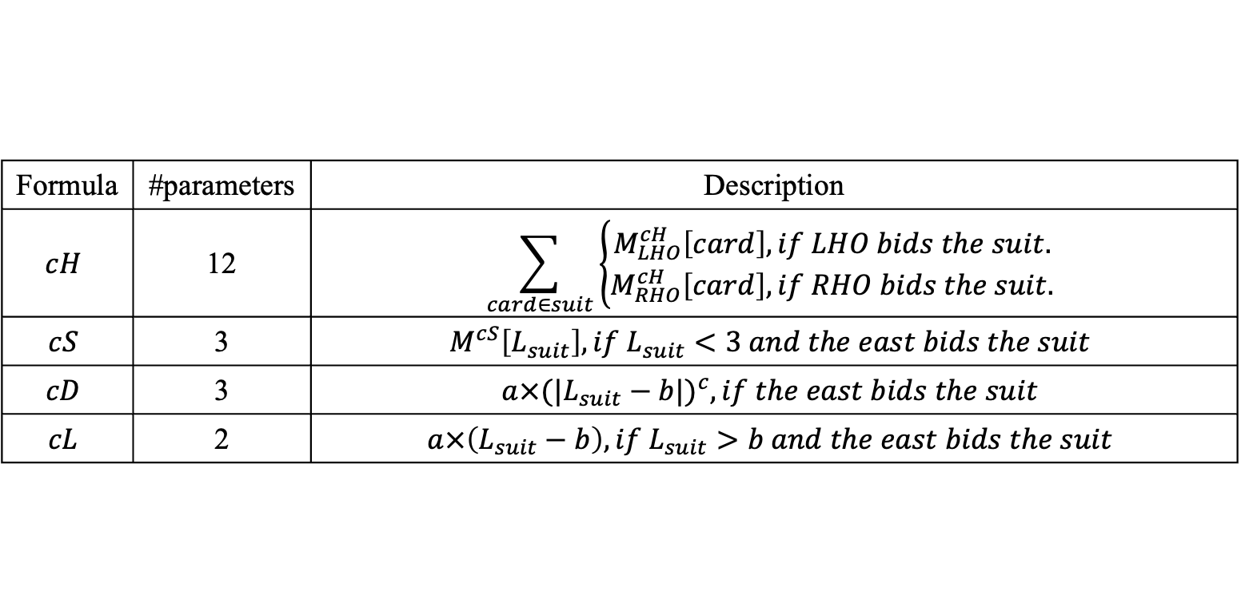
Fine-Tune if the East Bids
Formula | #parameters | Description
$$cH$$ | 12 | $$\sum_{card∈suit}{\left\{\begin{aligned}M_{LHO}^{cH}\left[card\right], if LHO bids the suit. \\ M_{RHO}^{cH}\left[card\right], if RHO bids the suit.\end{aligned}\right.}$$
$$cS$$ | 3 | $$M^{cS}\left[L_{suit}\right], if L_{suit}<3 and the east bids the suit$$
$$cD$$ | 3 | $$a×{(|L_{suit}−b|)}^{c}, if the east bids the suit$$
$$cL$$ | 2 | $$a×\left(L_{suit}−b\right), if L_{suit}>b and the east bids the suit$$

Slide 26
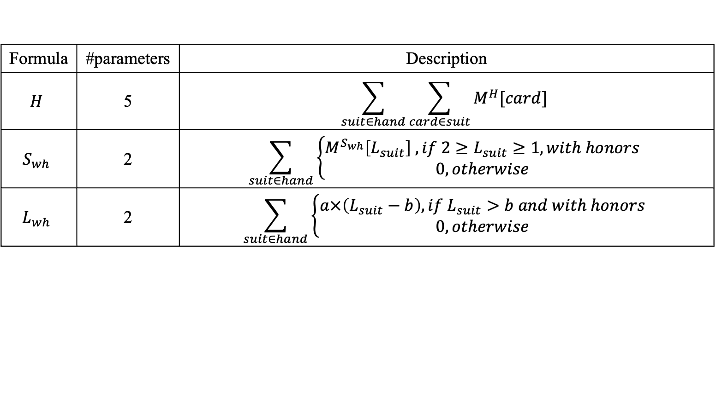
No Trump Contract
Formula | #parameters | Description
$$H$$ | 5 | $$\sum_{suit∈hand}{\sum_{card∈suit}{M^{H}[card]}}$$
$$S_{wh}$$ | 2 | $$\sum_{suit∈hand}{\left\{\begin{aligned}M^{S_{wh}}\left[L_{suit}\right] , if 2≥L_{suit}≥1, with honors \\ 0, otherwise\end{aligned}\right.}$$
$$L_{wh}$$ | 2 | $$\sum_{suit∈hand}{\left\{\begin{aligned}a×\left(L_{suit}−b\right), if L_{suit}>b and with honors \\ 0, otherwise\end{aligned}\right.}$$

Slide 27
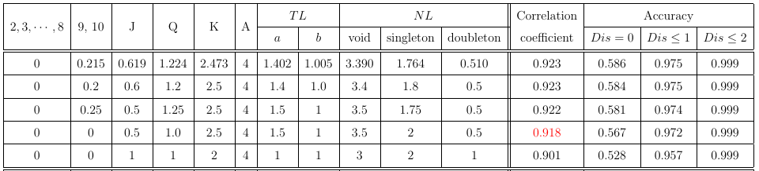

Results
$$H+TL+NL$$

Slide 28
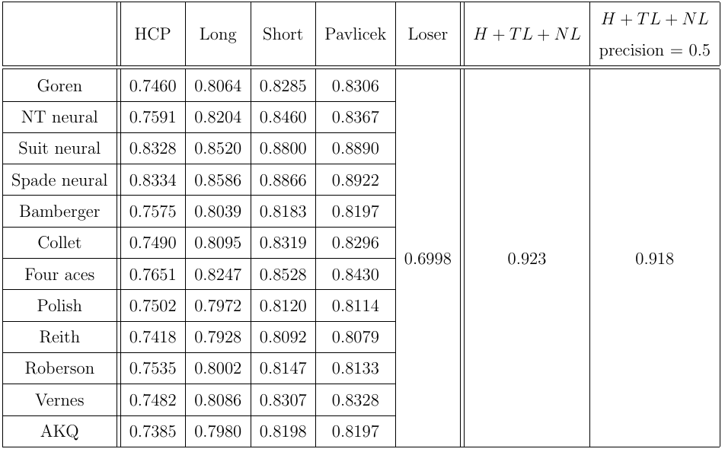
Results
resolution

Slide 29
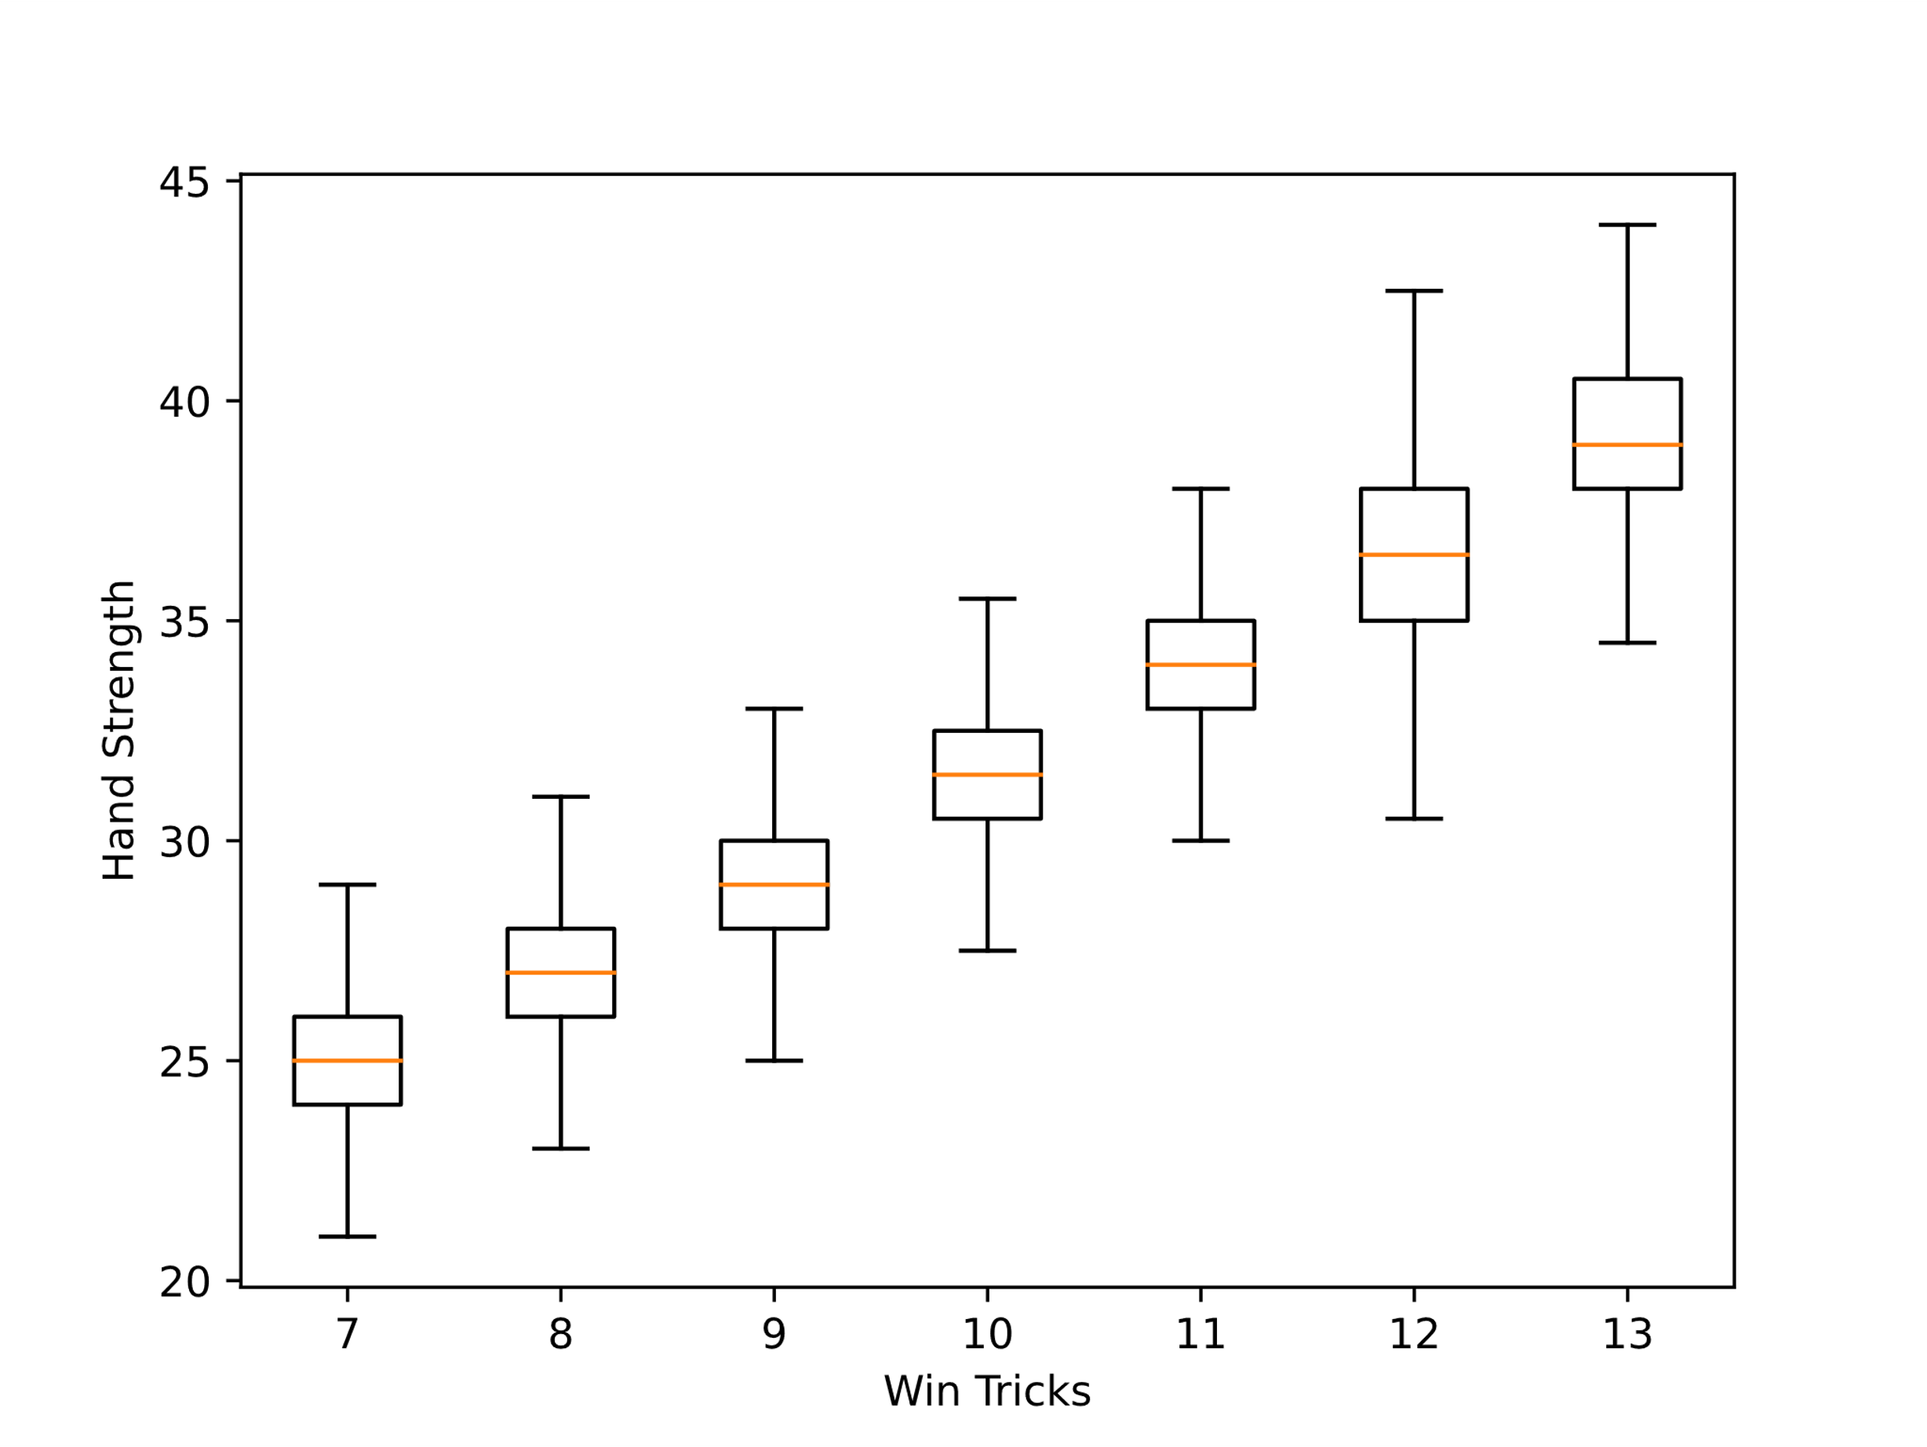
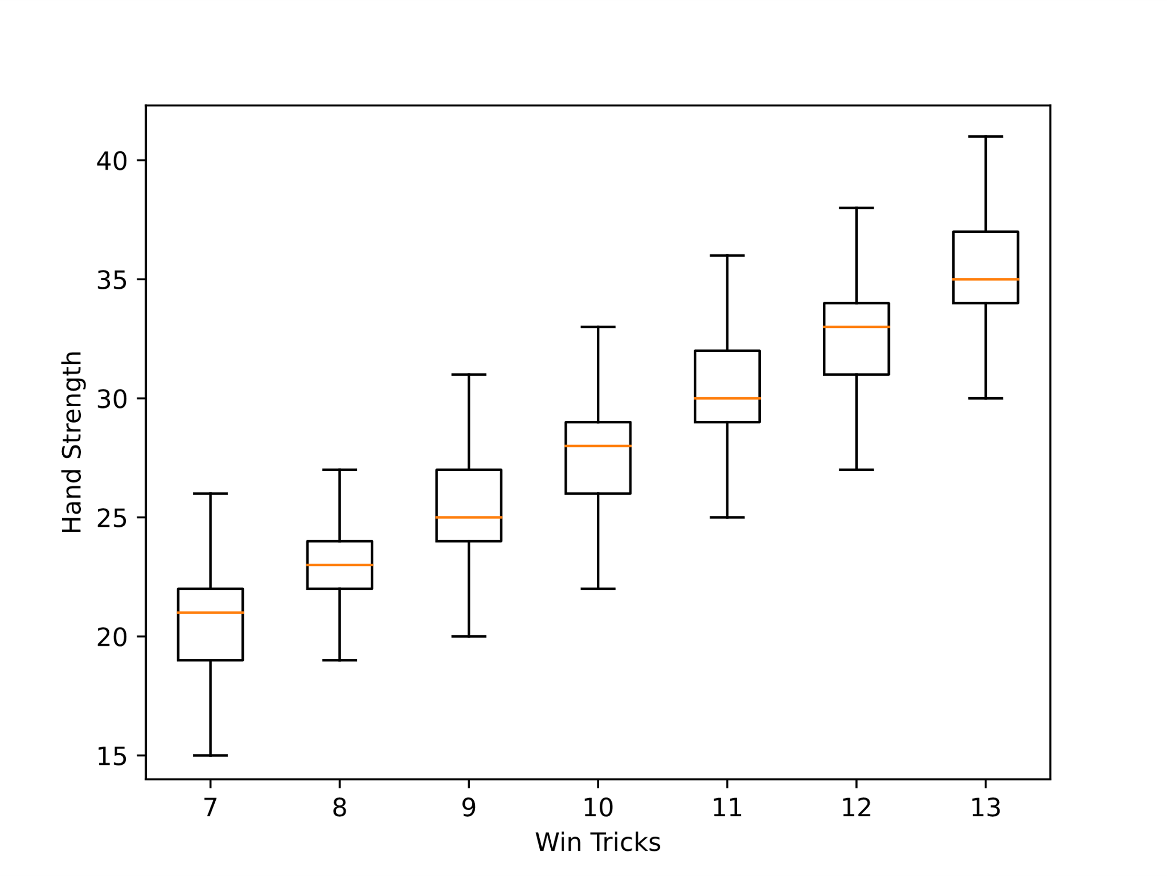
Results
fine-tune H + TL + NL with resolution=0.5
Goren point count + short method(void=5, singleton=3, doubleton=1)

Slide 30

Conclusion
$H+TL+NL$
Increase the correlation coefficient from 0.859 to 0.918.

