Slide 1
Bit-Parallel Algorithm for the Block Variant of the Merged Longest Common Subsequence Problem
Agnieszka Danek, Sebastian Deorowicz
Man-Machine Interactions 3
Advances in Intelligent Systems and Computing Volume 242, 2014, pp 173-181
Presenter:De-Sheng Jhan
2014/11/11

Slide 2
Abstract
The problem of comparison of genomic sequences is of great importance. There are various measures of similarity of sequences. One of the most popular is
the length of the longest common subsequence (LCS). We propose the first bit-parallel algorithm for the variant of the LCS problem, block merged LCS, which
was recently formulated in the studies on the whole genome duplication hypothesis. Practical experiments show that our proposal is from 10 to over 100 times faster than existing algorithms.

Slide 3
BMLCS
T = t₁t_{2…}t_{r} = ADB
A = a₁a₂…a_{n} = X₁X₂ = BA#CD, E_{A}{0, 2, 4}
B = b₁b₂…b_{m} = Y₁Y₂ = AD#CC, E_{B}{0, 2, 4}
C₁ = X₁Y₁X₂Y₂ = BA AD CD CC LCS(T , C₁) = 2 (AD)
C₂ = Y₁Y₂X₁X₂ = AD CC BA CD LCS(T , C₂) = 3 (ADB)
C₃ = X₁X₂Y₁Y₂ = BA CD AD CC LCS(T , C₃) = 2 (AD)
BMLCS(T, A, B) = LCS(T , C₂) = 3

Slide 4
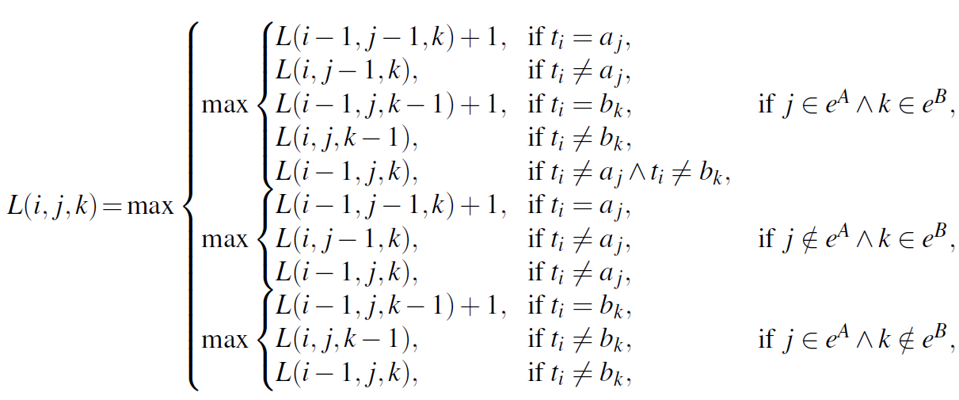
BMLCS
Huang, K.S., Yang, C.B., Tseng, K.T., Ann, H.Y., Peng, Y.H.: Efficient algorithms
for finding interleaving relationship between sequences. Information Processing Letters
105(5), 188–193 (2008)

Slide 5
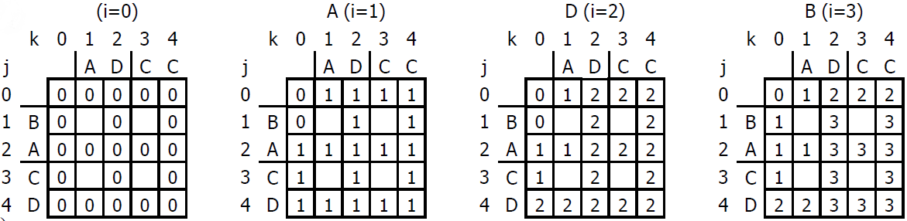
BMLCS
T = ADB, A = X₁X₂ = BA#CD, B = Y₁Y₂ = AD#CC
BMLCS(T, A, B) = 3

Slide 6
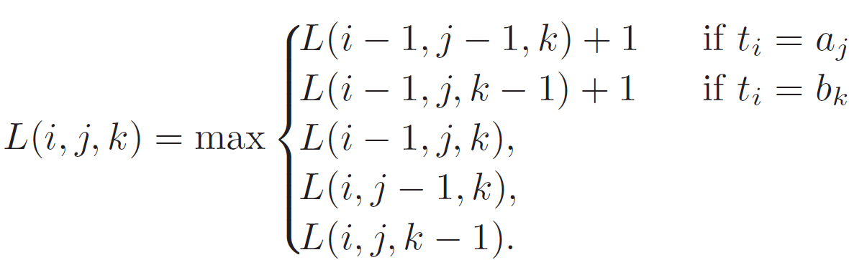
Bit-Parallel Algorithm
MLCS
BMLCS

Slide 7
Bit-Parallel Algorithm
M(4, 4) = {1, 2, 3}, M(4, 1) = {1, 2}, M(2, 1) = {1}

Slide 8
Bit-Parallel Algorithm
M(4, 4) = {1, 2, 3} M(4, 1) = {1, 2}
W(4, 4) = W(2, 3) =
index | value
0 | 1
1 | 0
2 | 0
3 | 0
index | value
0 | 1
1 | 0
2 | 0
3 | 1
In a similar way W ’( j, k), W’’( j, k) can be computed.

Slide 9
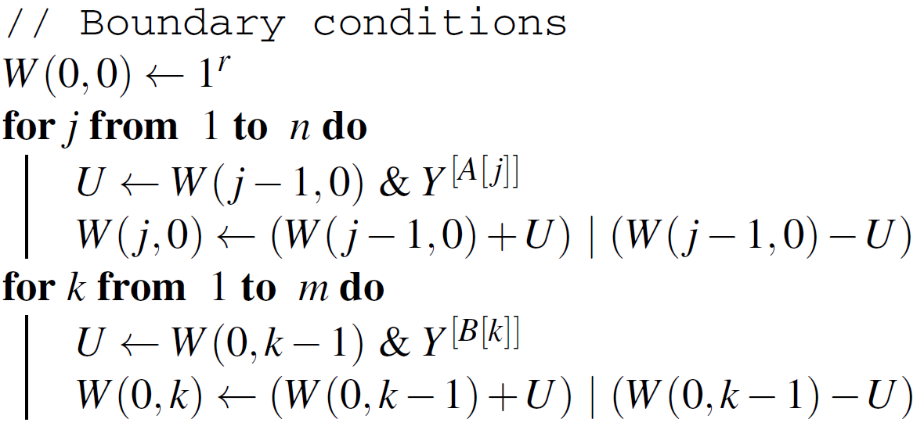
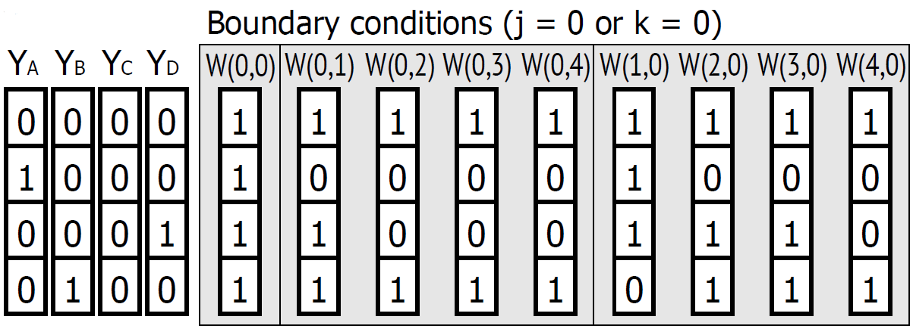
LCS(T, A)
LCS(T, B)

Slide 10
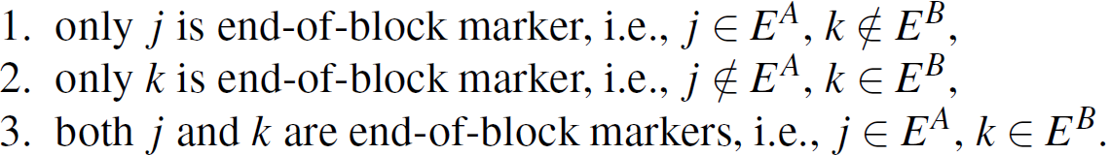
Case3
Case2:W(j, k) = W’(j-1,k)
Case1:W(j, k) = W’’(j,k-1)

Slide 11
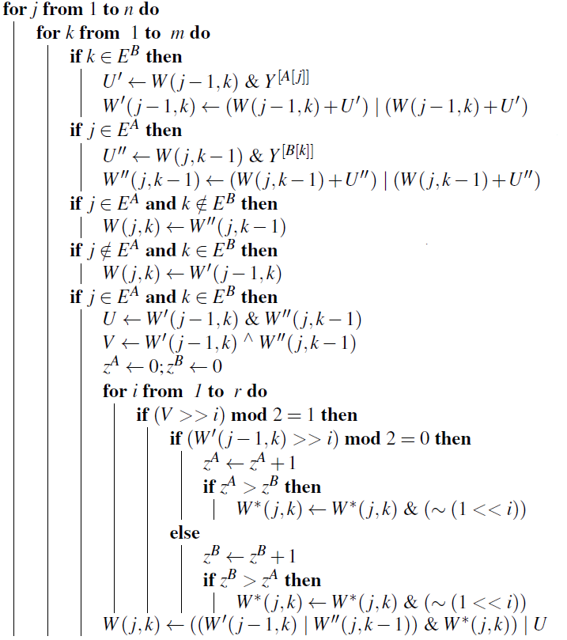
W’(j-1,k)
W’’(j,k-1)
Case1:W(j, k) = W’’(j,k-1)
Case2:W(j, k) = W’(j-1,k)
Case3

Slide 12
Bit-Parallel Algorithm
Case3:
M ’(7, 8) ={1, 3, 4, 5, 6}
M ’’(8, 7) ={1, 2, 3, 5, 7}
M (8, 8) ={1, 2, 3, 5, 6}
ex: M(8, 8)

Slide 13
Bit-Parallel Algorithm
M ’(7, 8) = {1, 3, 4, 5, 6}
M ’’(8, 7) ={1, 2, 3, 5, 7}
M (8, 8) ={1, 2, 3, 5, 6}
ex: M(8, 8)
M ’ (7, 8) = {1, 3, 4, 5, 6}
M ’’(8, 7) ={1, 2, 3, 5, 7}
1, 3, 5∈ M (8, 8)
M ’ (7, 8) = {4, 6}
M ’’(8, 7) = {2, 7}
2, 4, 6, 7 ∈ M (8, 8)
∴ 1, 2, 3, 5, 6 ∈ M (8, 8)

Slide 14
8 | 7 | 6 | 5 | 4 | 3 | 2 | 1 | 0
1 | 1 | 0 | 0 | 0 | 0 | 1 | 0 | 1
1 | 0 | 1 | 0 | 1 | 0 | 0 | 0 | 1
1 | 1 | 0 | 0 | 1 | 0 | 0 | 0 | 1
M ’(7, 8) = {1, 3, 4, 5, 6}=>W’(7, 8) =
M ’’(8, 7) ={1, 2, 3, 5, 7}=>W’’(8,7) =
M (8, 8) ={1, 2, 3, 5, 6}=> W(8, 8) =
V = W’(7, 8) ^ W’’(8, 7) = 011010100 (7, 6, 4, 2 )
W*(8, 8) = 111111111
Z^{A} = 0, Z^{B} = 0
V = 011010101
Z^{B} = 1
W*(8, 8) = 111111011
M ’ (7, 8) = {}
M ’’(8, 7) = {2}

Slide 15
8 | 7 | 6 | 5 | 4 | 3 | 2 | 1 | 0
1 | 1 | 0 | 0 | 0 | 0 | 1 | 0 | 1
1 | 0 | 1 | 0 | 1 | 0 | 0 | 0 | 1
1 | 1 | 0 | 0 | 1 | 0 | 0 | 0 | 1
M ’(7, 8) = {1, 3, 4, 5, 6}=>W’(7, 8) =
M ’’(8, 7) ={1, 2, 3, 5, 7}=>W’’(8,7) =
M (8, 8) ={1, 2, 3, 5, 6}=> W(8, 8) =
V = W’(7, 8) ^ W’’(8, 7) = 011010100 (7, 6, 4, 2 )
W*(8, 8) = 111111011
Z^{A} = 0, Z^{B} = 1
V = 011010100
Z^{A} = 1, Z^{A} = Z^{B}
W*(8, 8) = 111111011
M ’ (7, 8) = {4}
M ’’(8, 7) = {2}

Slide 16
8 | 7 | 6 | 5 | 4 | 3 | 2 | 1 | 0
1 | 1 | 0 | 0 | 0 | 0 | 1 | 0 | 1
1 | 0 | 1 | 0 | 1 | 0 | 0 | 0 | 1
1 | 1 | 0 | 0 | 1 | 0 | 0 | 0 | 1
M ’(7, 8) = {1, 3, 4, 5, 6}=>W’(7, 8) =
M ’’(8, 7) ={1, 2, 3, 5, 7}=>W’’(8,7) =
M (8, 8) ={1, 2, 3, 5, 6}=> W(8, 8) =
V = W’(7, 8) ^ W’’(8, 7) = 011010100 (7, 6, 4, 2 )
W*(8, 8) = 110111011
W(8, 8) = ((W’(7, 8) | W’’(8, 7))&W*(8, 8))
= 111010101 &
110111011
= 110010001
2, 4, 6, 7 ∈ M (8, 8)

Slide 17
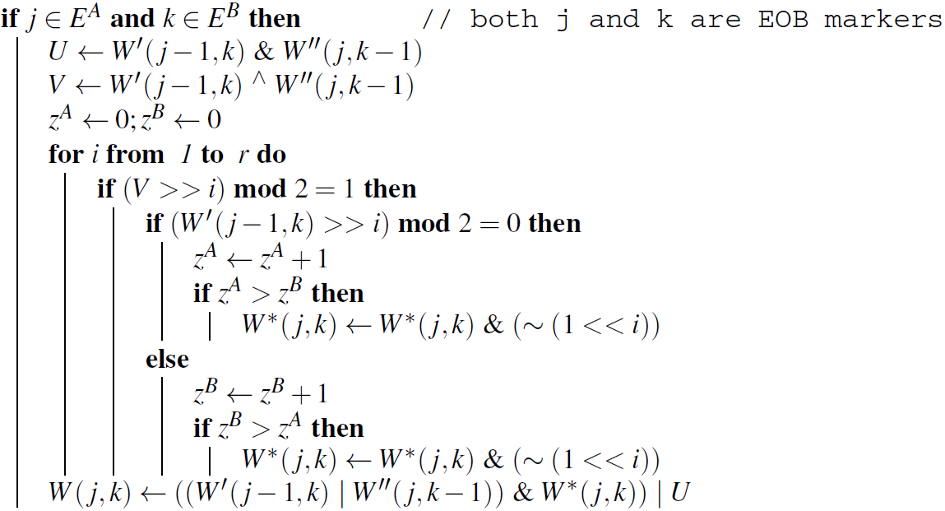

Slide 18
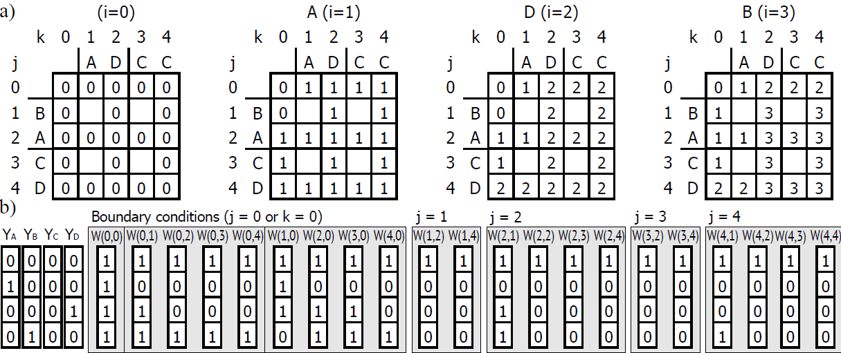

Slide 19
Lookup Table(LUT)
Word size w’ = 64
W(j-1 ,k) 2^{w’}
W(j ,k-1) 2^{w’}
Range of (Z^{A} – Z^{B}) 2w’+1
There are 2^{w’} × 2^{w’} ×(2w’+1)
possible inputs.
W*(j, k)

Slide 20
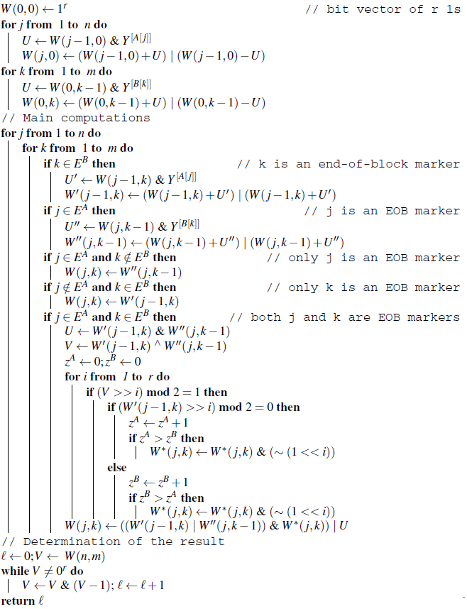
O((mn’ + m’n)⌈r/w⌉)+m’n’⌈r/w’⌉)

Slide 21
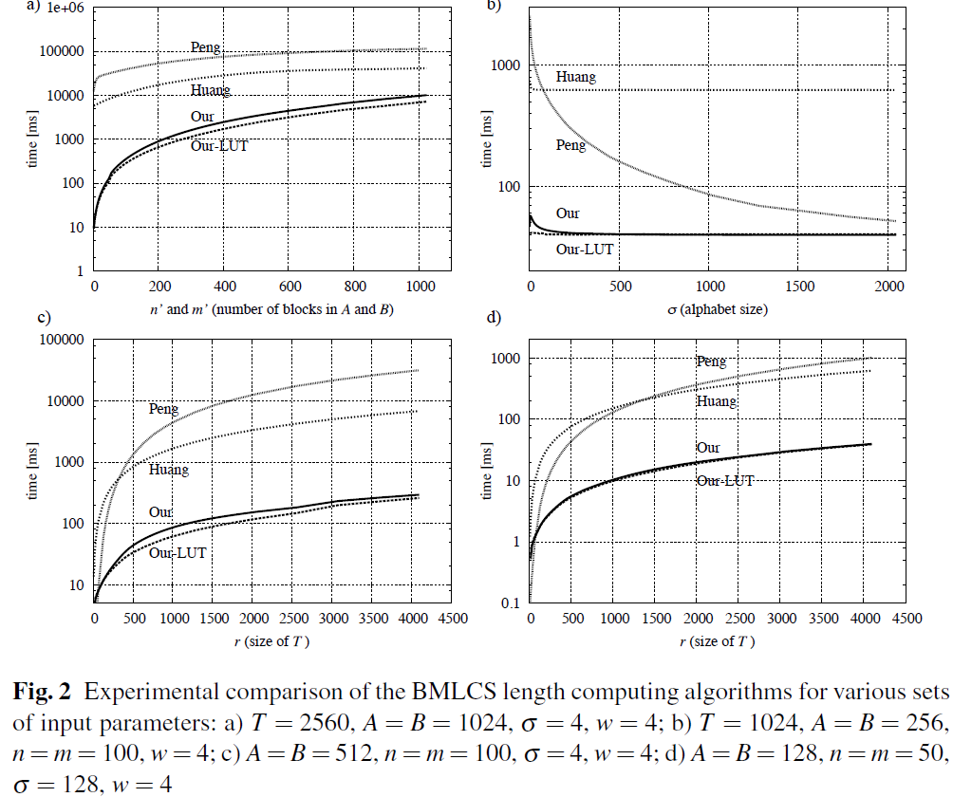
Experimental Results

Slide 22
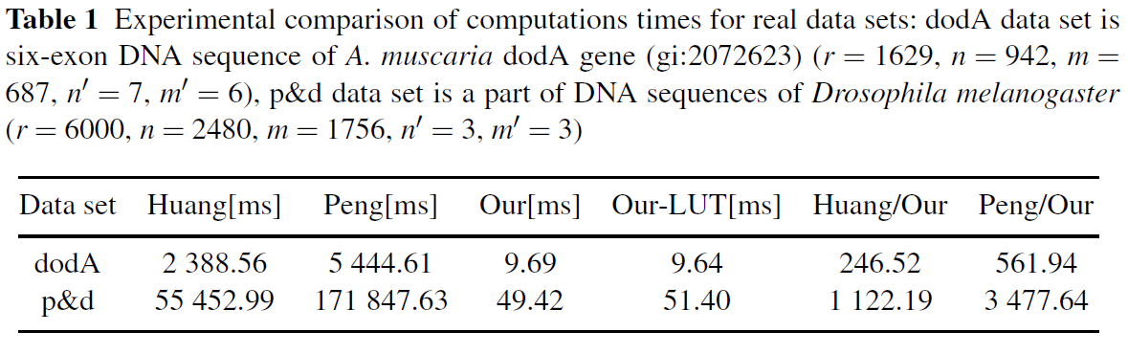

Slide 23
Thanks for listening

