Slide 1
Sparse LCS Common Substring Alignment
Gad M. Landau, Baruch Schieber, Michal Ziv-Ukelson
Combinatorial Pattern Matching,
Lecture Notes in Computer Science Volume 2676, 2003, pp. 225-236 (2003)
Presenter: Tzu-Chiang Hsu (徐子強)
2014/11/11

Slide 2
Abstract (1/3)
The “Common Substring Alignment” problem is defined as follows. The input consists of a set of strings S₁, S₂ ... S_{c}, with a common substring appearing at least once in each of them, and a target string T. The goal is to compute similarity of all strings S_{i} with T, without computing the part of the common substring over and over again.

Slide 3
Abstract (2/3)
In this paper we consider the Common Substring Alignment problem for the LCS (Longest Common Subsequence) similarity metric. Our algorithm gains its efficiency by exploiting the sparsity inherent to the LCS problem. Let Y be the common substring, n be the size of the compared sequences, L_{y} be the length of the LCS of T and Y, denoted |LCS[T, Y]|, and L be max{|LCS[T, S_{i}]|}.

Slide 4
Abstract (3/3)
Our algorithm consists of an O(nL_{y}) time encoding stage that is executed once per common substring, and an O(L) time alignment stage that is executed once for each appearance of the common substring in each source string. The additional running time depends only on the length of the parts of the strings that are not in any common substring.

Slide 5
the Common Substring Alignment problem
 |  |  | B | C | B | A | D | B | D | C | D
A | E | B
E | B | C
B | C | B
C | B | C
B | D | B
D | D | D
B | B | C
D | C
D | B
 | D
[ target string ]

Slide 6
 |  | B | C | B | A | D | B | D | C | D
B
C | 0 | 1 | 2 | 2 | 2 | 2 | 2 | 2 | 2 | 2
B
C
B
D | 0 | 1 | 2 | 3 | 3 | 4 | 4 | 5 | 5 | 5
C
S
0 1 2 3 5 -
1 2 3 5 - -
2 3 5 7 - -
3 5 7 9 - -
4 5 7 9 - -
5 6 7 9 - -
6 7 9 - - -
7 8 9 - - -
8 9 - - - -
9 - - - - -

Slide 7
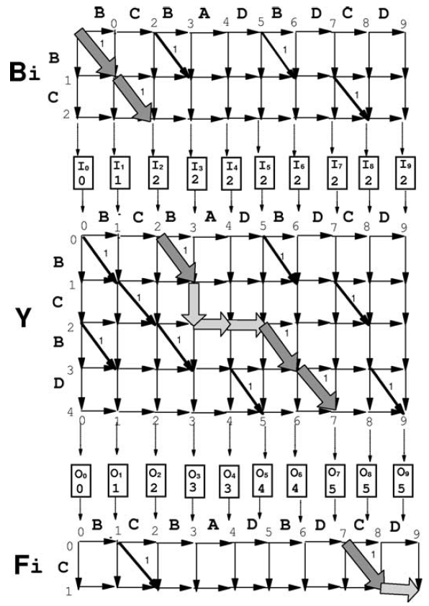

Slide 8
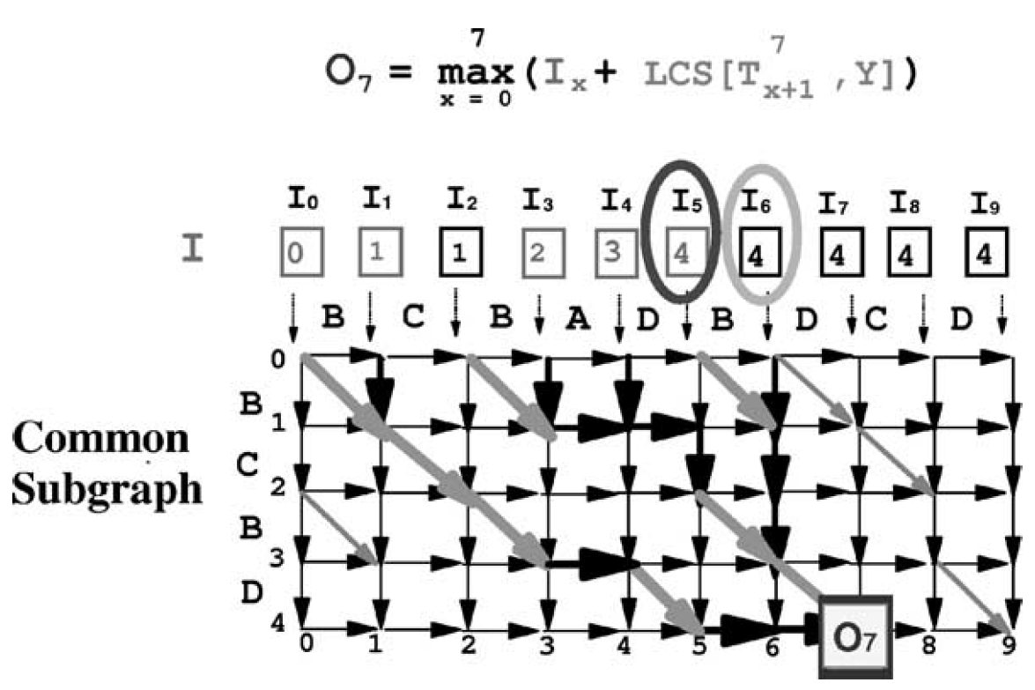

Slide 9
4

Slide 10
6

Slide 11
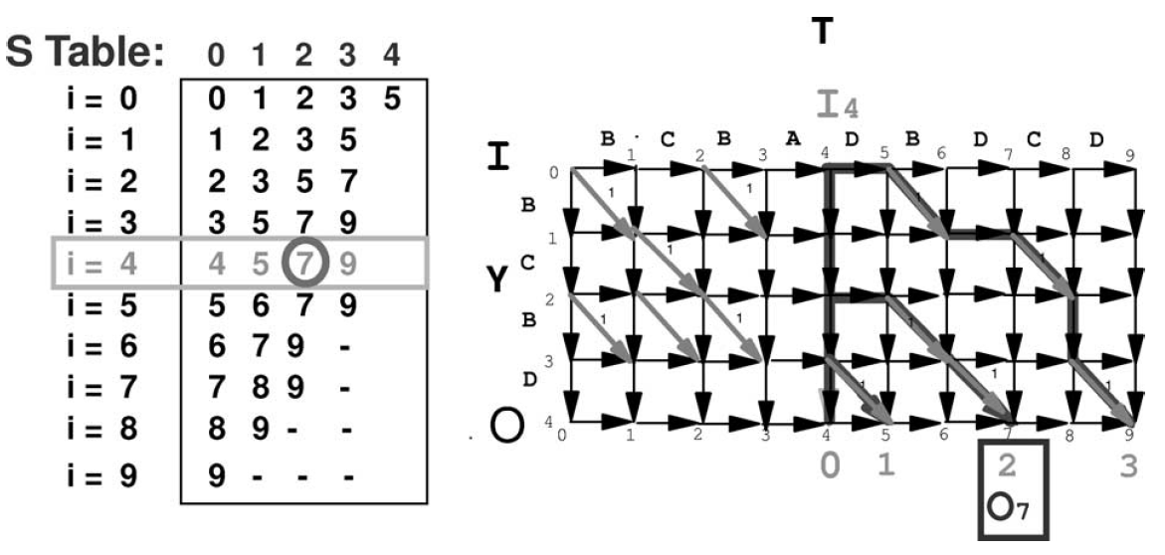

Slide 16
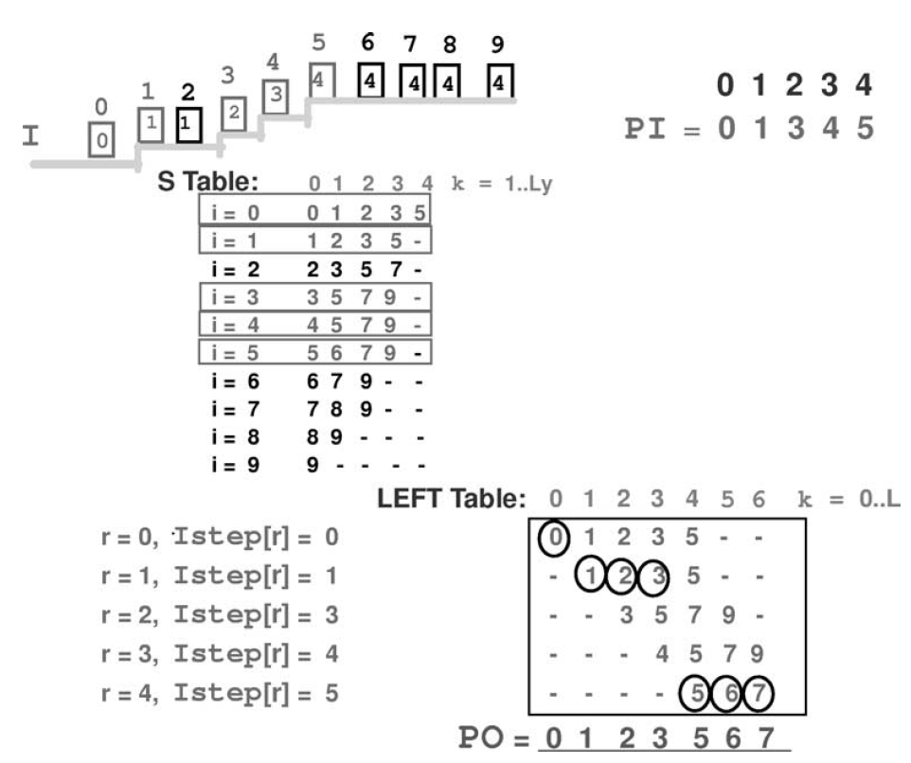

Slide 19
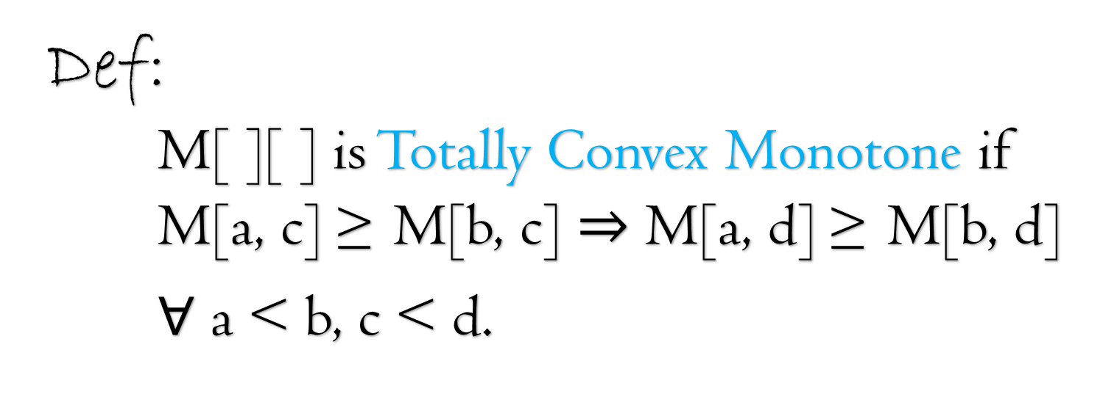
Def:
M[ ][ ] is Totally Convex Monotone if
M[a, c] ≥ M[b, c] M[a, d] ≥ M[b, d]
$∀$ a < b, c < d.

Slide 20
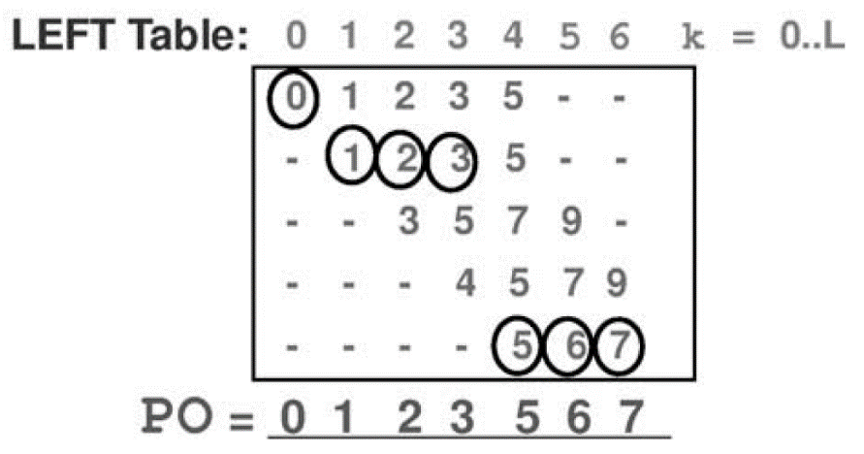
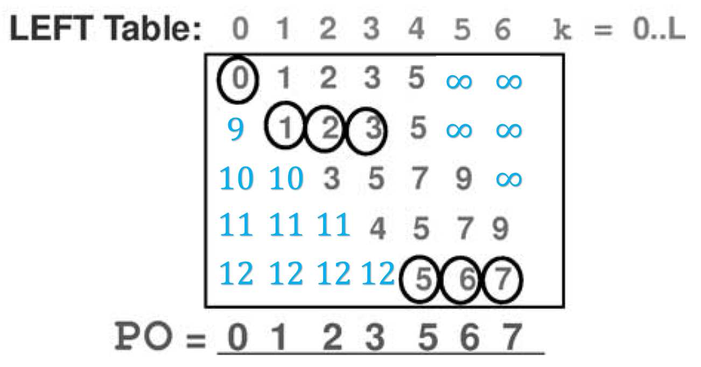
→

Slide 21
if ○ ≥ *,
then ○ ≥ *
○
○
*
*

Slide 22
if ○ ≥ *,
then ○ ≥ *
○
○
*
*

Slide 23
if ○ ≥ *,
then ○ ≥ *
○
○
*
*

Slide 24


Slide 25
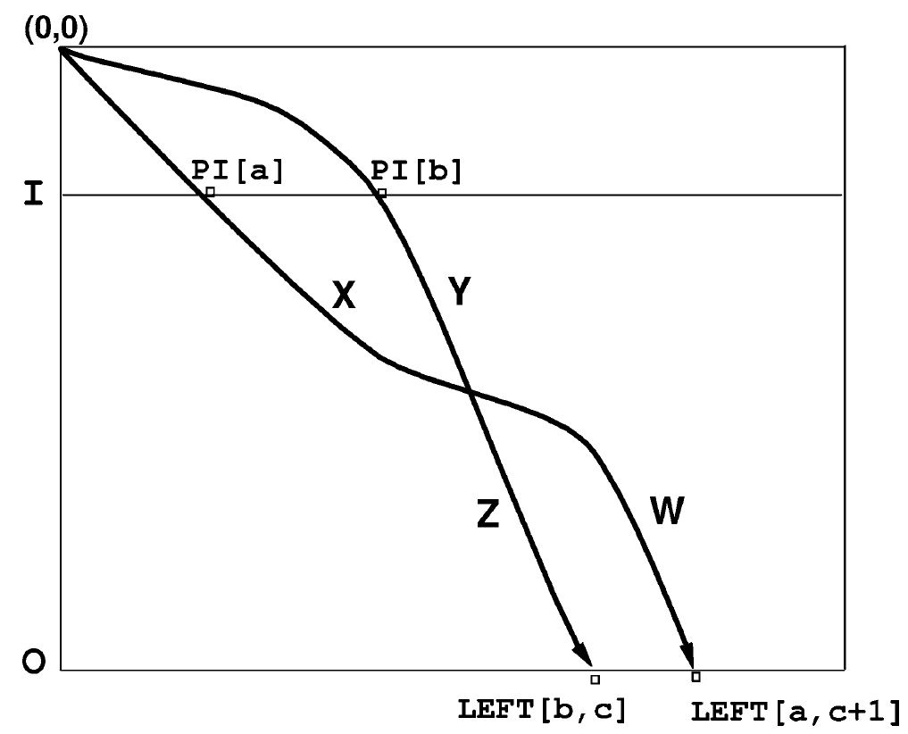
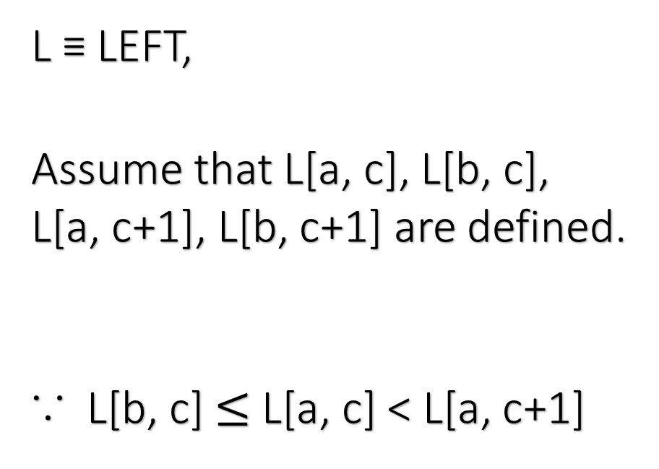
L ≡ LEFT,
Assume that L[a, c], L[b, c],
L[a, c+1], L[b, c+1] are defined.
∵ L[b, c] $≤$ L[a, c] < L[a, c+1]

Slide 26
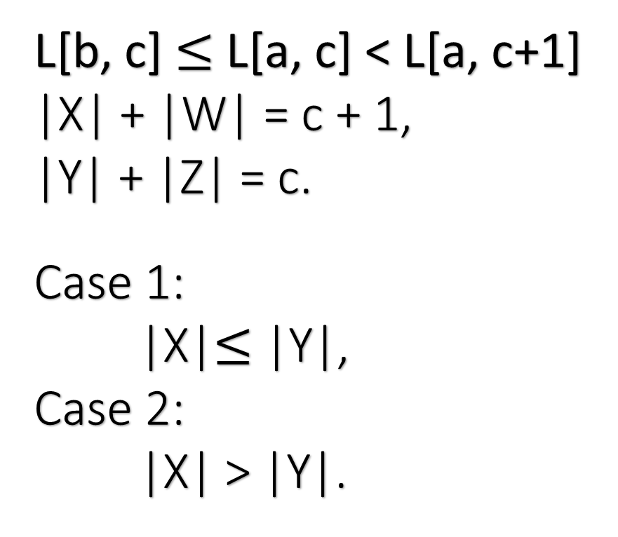
L[b, c] $≤$ L[a, c] < L[a, c+1]
|X| + |W| = c + 1,
|Y| + |Z| = c.
Case 1:
|X|$≤$|Y|,
Case 2:
|X| > |Y|.

Slide 27
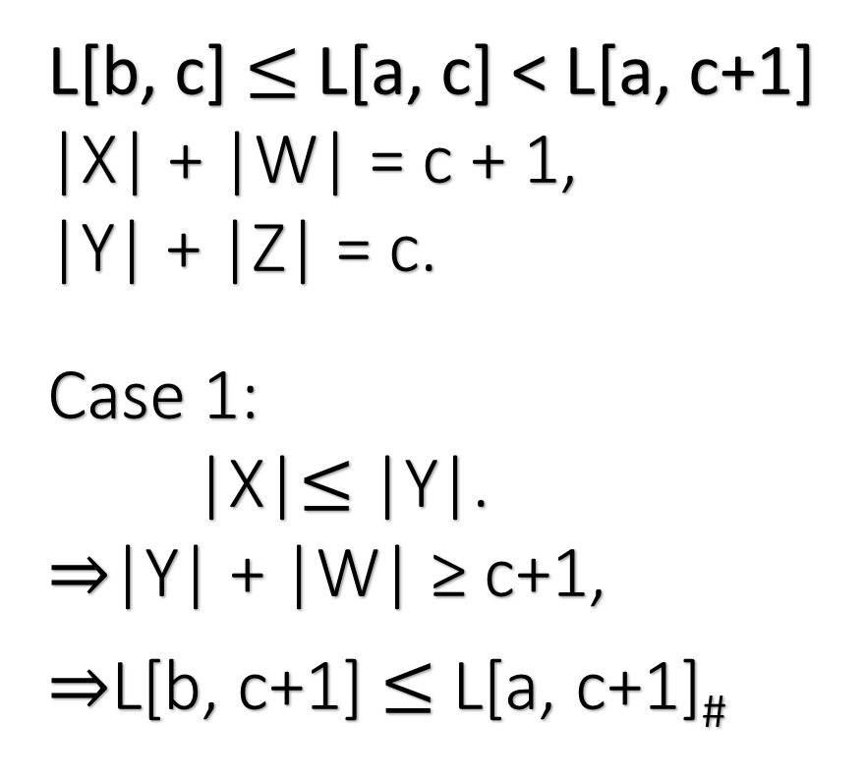
L[b, c] $≤$ L[a, c] < L[a, c+1]
|X| + |W| = c + 1,
|Y| + |Z| = c.
Case 1:
|X|$≤$|Y|.
|Y| + |W| ≥ c+1,
L[b, c+1] $≤$ L[a, c+1]#

Slide 28
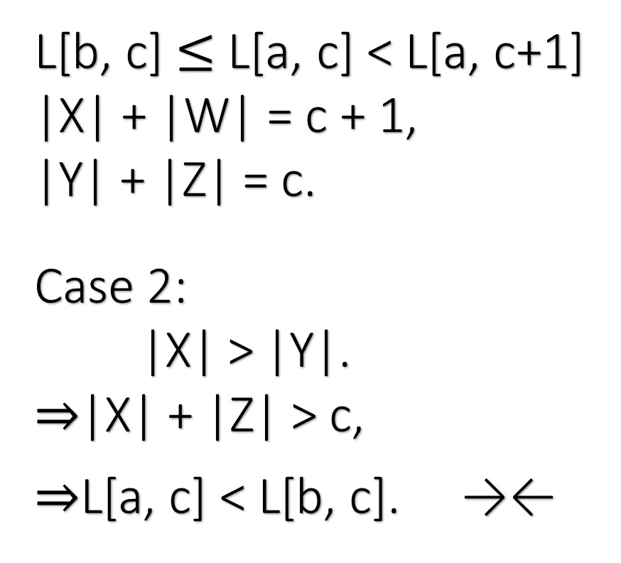
L[b, c] $≤$ L[a, c] < L[a, c+1]
|X| + |W| = c + 1,
|Y| + |Z| = c.
Case 2:
|X| > |Y|.
|X| + |Z| > c,
L[a, c] < L[b, c]. →←

Slide 29















$$∞$$
$$∞$$
$$9$$
$$∞$$
$$∞$$
$$10$$
$$10$$
$$∞$$
$$11$$
$$11$$
$$11$$
$$12$$
$$12$$
$$12$$
$$12$$
LEFT[r, k] = S[PI[r], k − r]

Slide 30
 |  | B | C | B | A | D | B | D | C | D
B
C | 0 | 1 | 2 | 2 | 2 | 2 | 2 | 2 | 2 | 2
B
C
B
D | 0 | 1 | 2 | 3 | 3 | 4 | 4 | 5 | 5 | 5
C
S
0 1 2 3 5 -
1 2 3 5 - -
2 3 5 7 - -
3 5 7 9 - -
4 5 7 9 - -
5 6 7 9 - -
6 7 9 - - -
7 8 9 - - -
8 9 - - - -
9 - - - - -

Slide 31
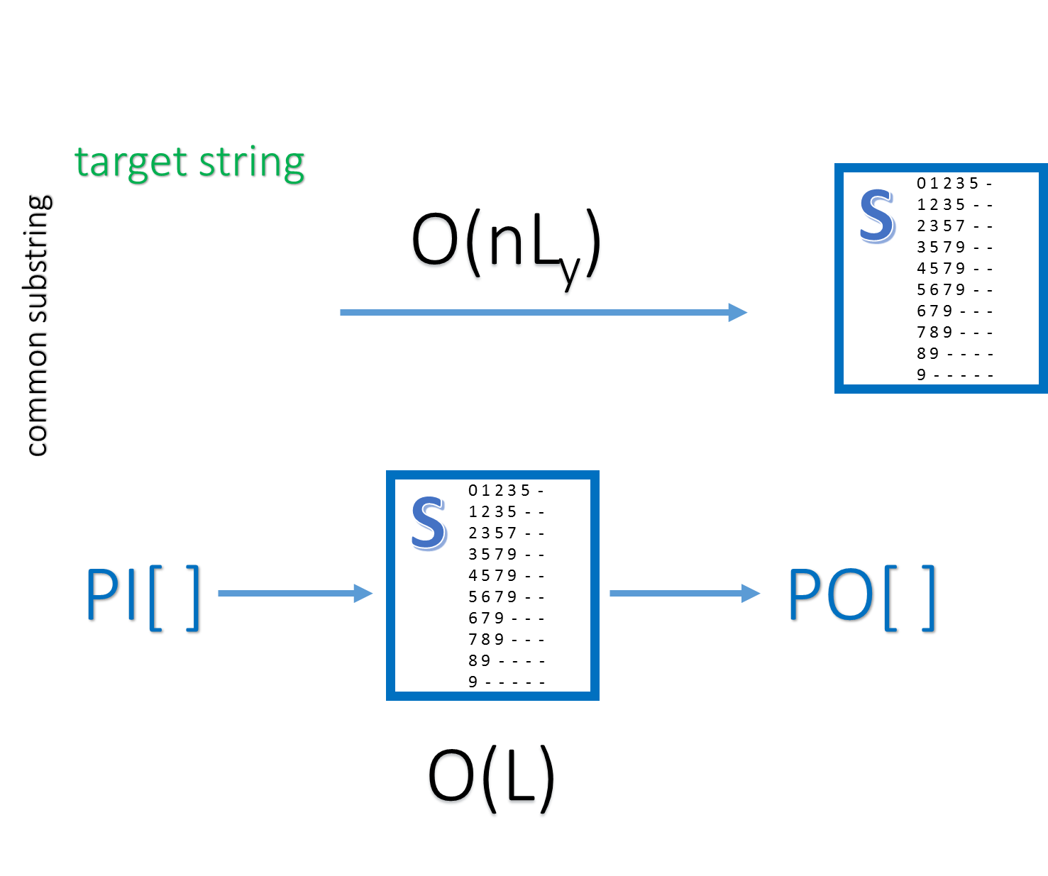
L_{y} : |LCS[T, Y]|,
L : max{|LCS[T, S_{i}]|}.

