Slide 1
A hybrid approach of support vector regression with genetic algorithm optimization for aquaculture water quality prediction
Shuangyin Liu, Haijiang Tai , Qisheng Ding ,Daoliang Li, Longqin Xu, Yaoguang Wei
Mathematical and Computer Modelling 58 (2013) 458–465
Presenter: Ding-Yao Huang
Date:2014/11/

Slide 2
A b s t r a c t
Water quality prediction plays an important role in modern intensive river crab aquaculture management. Due to the nonlinearity and non-stationarity of water quality indicator series, the accuracy of the commonly used conventional methods, including regression analyses and neural networks, has been limited.
A prediction model based on support vector regression (SVR) is proposed in this paper to solve the aquaculture water quality prediction problem. To build an effective SVR model, the SVR parameters must be set carefully.
This study presents a hybrid approach, known as real-value genetic algorithm support vector regression (RGA–SVR), which searches for the optimal SVR parameters using real-value genetic algorithms, and then adopts the optimal parameters to construct the SVR models.
The approach is applied to predict the aquaculture water quality data collected from the aquatic factories of YiXing, in China.
The experimental results demonstrate that RGA–SVR outperforms the traditional SVR and back-propagation (BP) neural network models based on the root mean square error (RMSE) and mean absolute percentage error (MAPE). This RGA–SVR model is proven to be an effective approach to predict aquaculture water quality.

Slide 3
Introduction (Genetic Algorithms)
Choose a randomly generated population
Calculate the fitness of each chromosome in the population
selection
Judge the stopping criteria
crossover
mutation
Get the answer

Slide 4
Introduction (Genetic Algorithms)
Step1: Choose a randomly generated population
1. Binary encoding
2. Real value encoding
3. symbol encoding
Step2: Calculate the fitness of each chromosome in the population
1. f(x) = x+1 適合度越好、競爭力越強
Step3:
1. selection
2. crossover
3. mutation
0 | 1 | 1 | 0 | 1 | 1 | 1 | 0 | 1 | 0 | 0 | 1 | 1 | 1 | 0 | 0 | 1 | 0
85.3 | 115 | 10.8 | 121 | 1.9 | 68.5
A | B | C | D | E | F

Slide 5
Genetic Algorithms (selection)
Step3-1: selection
1.roulette wheel selection
依照適應函數分割輪盤位置，
適合度函數值越大的話，
則在輪盤上佔有的面積比例就越大
2.tournament selection
每一代的演化過程中首先隨機地選取兩個或更多的染色體個體(字串）
具有最大適合度函數值的物種即被選中送至交配池中
適合度函數值越高的個體就越容易被選中

Slide 6
Genetic Algorithms (Crossover)
Step3-2. Crossover
依據交配方式的不同，又可分為單點、兩點以及均勻
85.3 | 115 | 10.8 | 121 | 1.9 | 68.5
兩點間
85.3 | 115 | 12.8 | 121 | 1.9 | 68.5

Slide 7
Genetic Algorithms (mutation)
Step3-3. mutation
利用隨機改變基因，以創造出父母代所未具備的新特徵。過程是將交配後產生的子代
0 | 1 | 1 | 0 | 1 | 1 | 1 | 0 | 1 | 0 | 0 | 1 | 1 | 1 | 0 | 0 | 1 | 0
0 | 1 | 1 | 0 | 1 | 1 | 0 | 0 | 1 | 0 | 0 | 1 | 1 | 1 | 0 | 0 | 1 | 0
1 | 1 | 1 | 0 | 1 | 0 | 1 | 0 | 1 | 0 | 0 | 1 | 1 | 0 | 0 | 0 | 1 | 1
1 | 1 | 1 | 0 | 1 | 0 | 1 | 0 | 1 | 0 | 0 | 1 | 1 | 1 | 0 | 0 | 1 | 1

Slide 8
Introduction (Genetic Algorithms)
Choose a randomly generated population
Calculate the fitness of each chromosome in the population
selection
Judge the stopping criteria
crossover
mutation
Get the answer

Slide 9
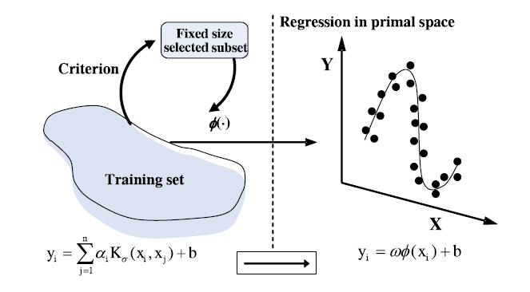

Introduction (Support Vector Regression)
ω越小表示模型越不複雜

Slide 10
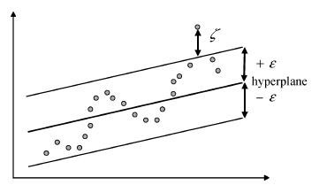
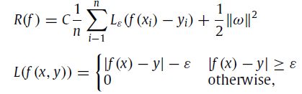

Introduction (Support Vector Regression)
x_{i} 是輸入向量，y_{i} 是實際目標值
是經驗誤差風險(empirical error risk)

Slide 11
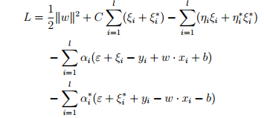
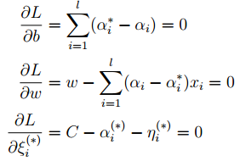

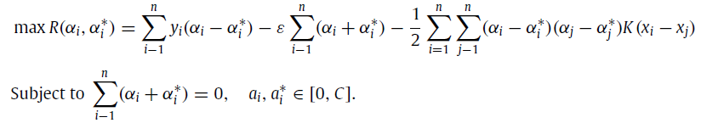
Introduction (Support Vector Regression)

Slide 12


Support Vector Regression (kernel function)
Support Vector (α_{i} − α_{i}∗ 不為零的 instances) 的個數有關
kernel function
linear: u'*v
polynomial: (gamma*u'*v + coef0)^degree
radial basis function: exp(-gamma*|u-v|^2)
sigmoid: tanh(gamma*u'*v + coef0)

Slide 13
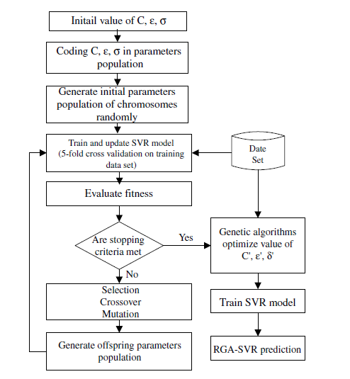
RGA-based optimization of the SVR model
C ,ε ,σ 隨機產生

Slide 14

RGA-based optimization of the SVR model

Slide 15
RGA-based optimization of the SVR model
訓練，得解

Slide 16

Data collection and pre-processing of water quality in aquaculture river crab
Data acquisition
pH, dissolved oxygen (DO), electrical conductivity (EC), water temperature (WT), solar radiation(SR), air temperature (AT), and wind speed (WS)
The data used in this paper spanned 15 days, from 5 July 2010 to 20 July 2010. The sampling interval is 10 min
The water quality data for aquaculture water quality prediction were split into two parts: the first 600 sets of water quality data were used for RGA–SVR modeling training and the last 120 sets of data as testing data to analyze the prediction performance of RGA–SVR
Data pre-processing
The design of an aquaculture water quality forecasting model based on RGA–SVR

Slide 17
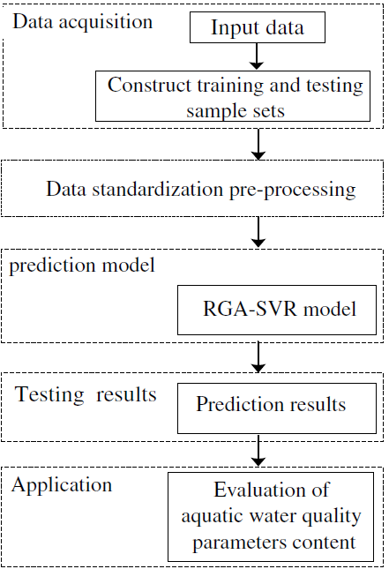
The design of an aquaculture water quality forecasting model based on RGA–SVR

Slide 18

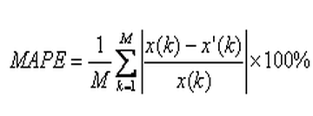
判斷依據
RMSE
MAPE
用以作為預測模式好壞之評估指標。主因為 MAPE 為相對數值，不受測量值與預估值單位與大小之影響，能夠客觀得獲得估計值與評估值間之差異程度
MAPE 值若越接近 0 表示估計效果越佳
實際值
估計值

Slide 19
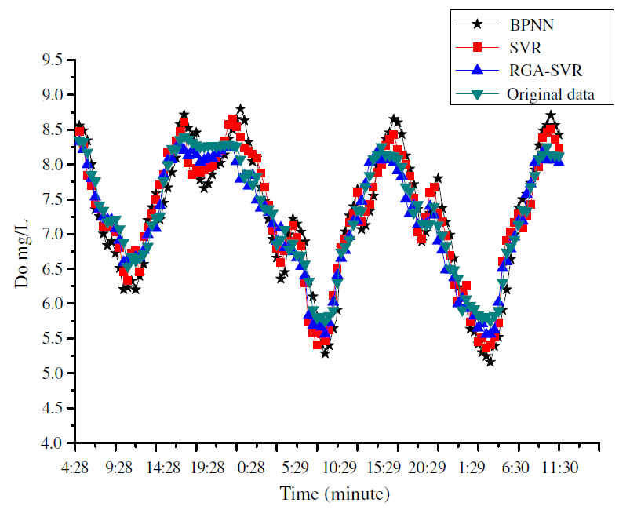
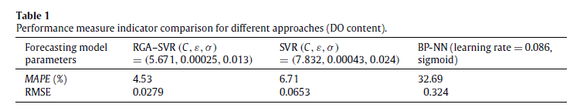
Experimental results and discussion

Slide 20
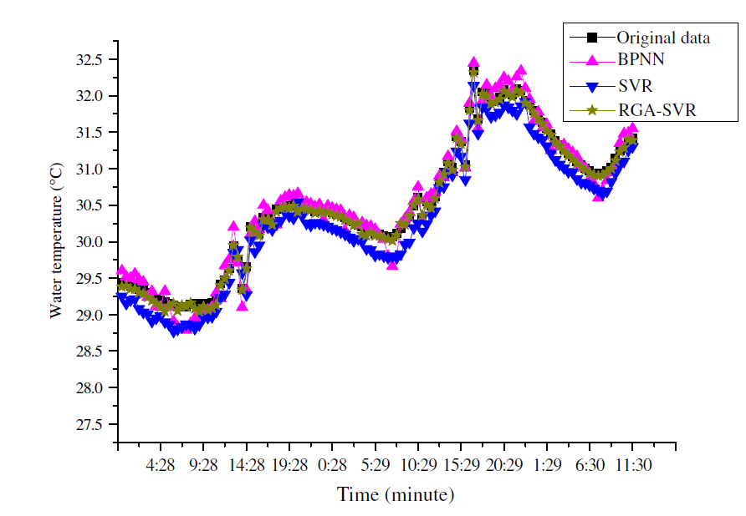
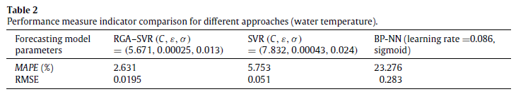
Experimental results and discussion

Slide 21
Conclusion
Water quality prediction is very important for intensive aquaculture. It can help provide early warnings of the change of water quality and reduce the loss of aquaculture.
The method introduced here employs a hybrid RGA–SVR approach for the forecasting of aquaculture water quality, in which a real-value genetic algorithm is used to select suitable parameters for SVR.
The genetic algorithm consists in maintaining a population of chromosomes, which represent potential solutions to the problem to be solved. From actual experiments using monitored aquaculture water quality data from aquatic factories of YiXing in China, the hybrid approach of support vector regression with genetic algorithm optimization is able to provide reliable data on the water quality prediction of large-scale intensive aquaculture.
The experimental results also suggest that the application of an artificial intelligence technique is perfectly suitable for the forecasting operation of nonlinear time series problems.
The RGA–SVR forecasting method can help avoid economic losses caused by water quality problems to a certain extent. However, in the training process of the RGA–SVR model, operation of the genetic algorithm is difficult: different types and rates of crossover and mutation need to be set for different problems. So, how to use advanced techniques to update the appropriate features and parameters of the proposed model will be an important direction for future development.

