Slide 1
Mitigation of Rotational Constraints in Image Based Plagiarism Detection Using Perceptual Hash Sushila Aghav, Ankit Kumar, Ganesh Gadakar, Aditya Mehta, Amey Mhaisane, International Journal of Computer Science Trends and Technology (IJCST), Volume 2 Issue 1, pp. 28-32, Mar-Apr 2014.

Slide 2
abstract
Image plagiarism can be detected using similarity between the two images. This paper proposes a new modification to perceptual hashing (pHash) based approach for Image Retrieval. By the simplified use of a distance function two perceptual hash values can be compared and, it can be understood whether the images being compared are perceptually different or not. Existing Image Plagiarism detection techniques are not sensitive to image rotation. We propose an algorithm that compares the various degrees of rotation of the source image to the perceived similar image in an efficient way. Perceptual image hash functions along with the rotation check can be used for the identification of plagiarised images, authentication or integrity verification of images.

Slide 3
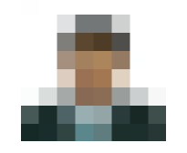
Perceptual hashing
Reduce size-Shrink the image to 8x8 so that there are 64 total pixels. The aspect ratio need not be maintained.

Slide 4
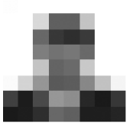
Perceptual hashing
Reduce color-The 8x8 picture is converted to a grayscale. This changes the hash from 64 pixels (64 red, 64 green, and 64 blue) to 64 total colors
Grayscale-
Gray = R*0.299 + G*0.587 + B*0.114

Slide 5

Perceptual hashing
Construct the Hash
Average the colors
Compute the bits
Generated hash value

Slide 6

Perceptual hashing
Construct the Hash
Average the colors
Compute the bits
Generated hash value

Slide 7
Perceptual hashing
Construct the Hash
Average the colors
Compute the bits
Generated hash value

Slide 8
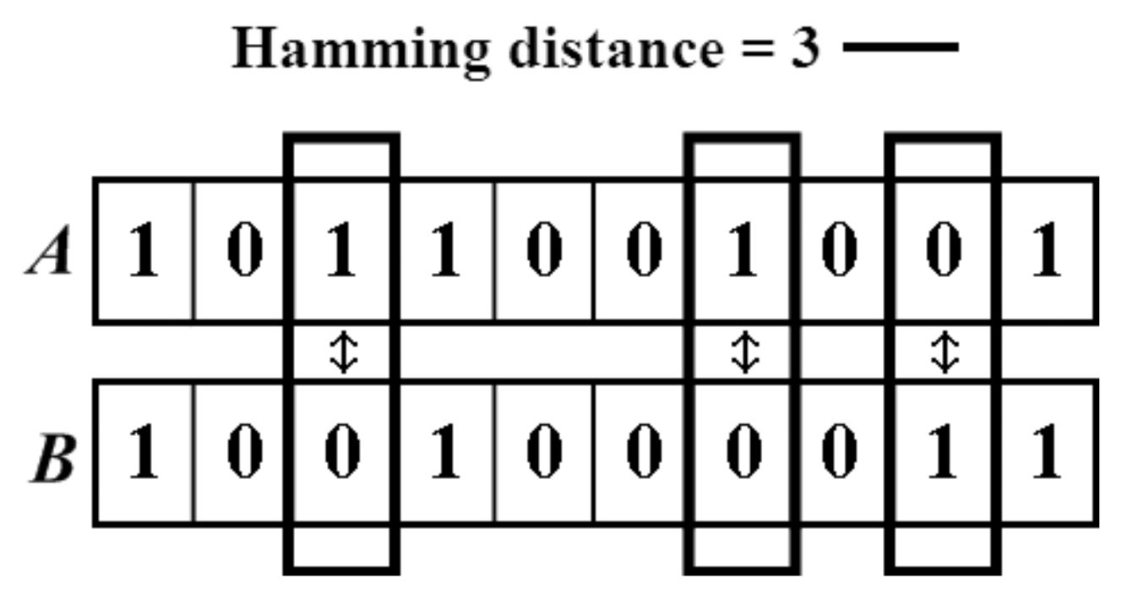
Perceptual hashing
Calculate hamming distance

Slide 9
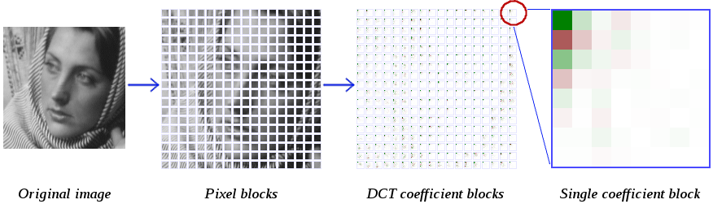
Other hashing
Compute DCT

Slide 10


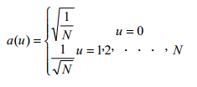
Other hashing
FDCT
IDCT

Slide 11
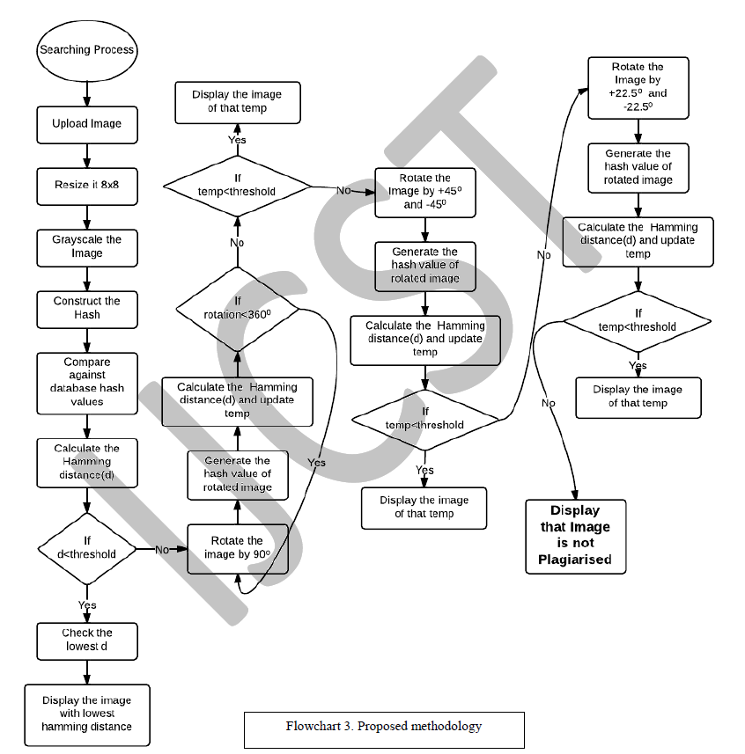

Slide 13
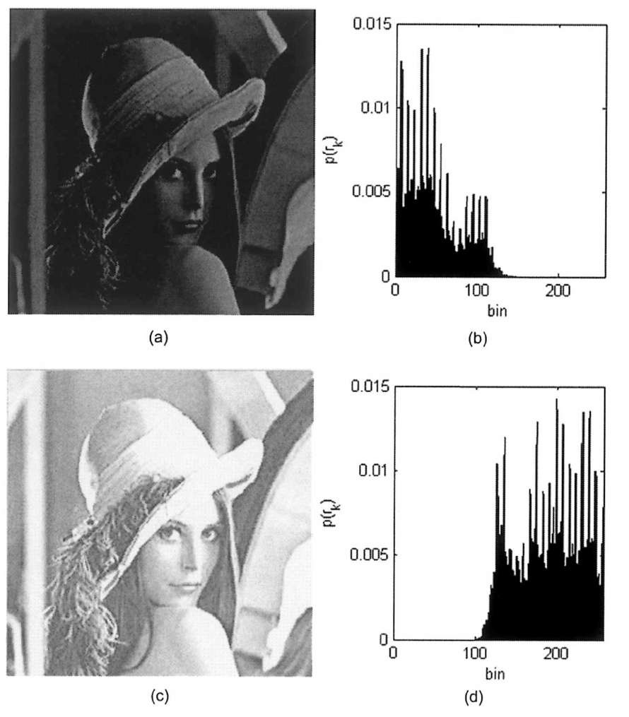
Histogram

Slide 14
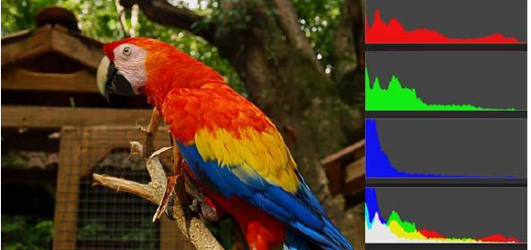
Histogram

Slide 15
Histogram
Each Color have 256 pixel value(0~255)
Divided into four groups(0~63, 64~127, 128~191, 192~255)
4(r)*4(g)*4(b)=64 combinations
64 combinations converted to 64bits
Make a fingerprint

