Slide 1
A Survey of Longest Common Subsequence Algorithms
L. Bergroth, H. Hakonen, T. Raita
String Processing and Information Retrieval, 2000. SPIRE 2000. Proceedings. Seventh International Symposium on Pages 39-48
Presenter: Huang-Ting Chan
Date:2014/11/25

Slide 2
Abstract
The aim of this paper is to give a comprehensive comparison of well-known longest common subsequence algorithms (for two input strings) and study their behaviour in various application environments.
The performance of the methods depends heavily on the properties of the problem instance as well as the supporting data structures used in the implementation.

Slide 3
We want to make also a clear distinction between methods that determine the actual lcs and those calculating only its length, since the execution time and more importantly, the space demand depends crucially on the type of the task.
To our knowledge, this is the first time this kind of survey has been done. Due to the page limits, we can give here only a coarse overview of the performance of the algorithms; more detailed studies are reported elsewhere.

Slide 4
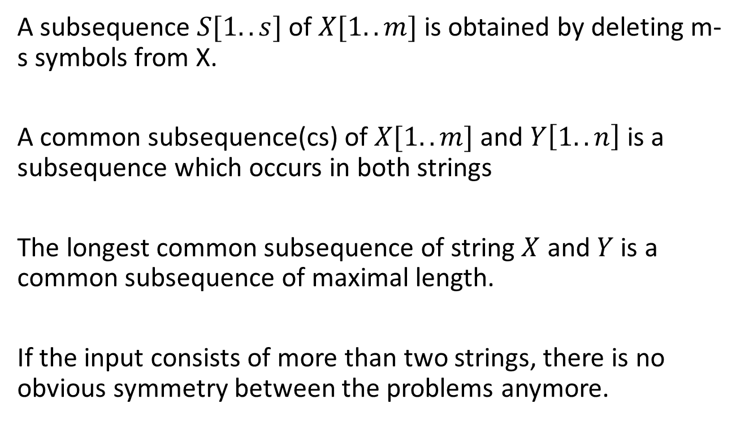
Introduction
A subsequence $S[1..s]$of $X[1..m]$ is obtained by deleting m-s symbols from X.
A common subsequence(cs) of $X[1..m]$ and $Y\left[1..n\right]$ is a subsequence which occurs in both strings
The longest common subsequence of string $X$ and $Y$ is a common subsequence of maximal length.
If the input consists of more than two strings, there is no obvious symmetry between the problems anymore.

Slide 5
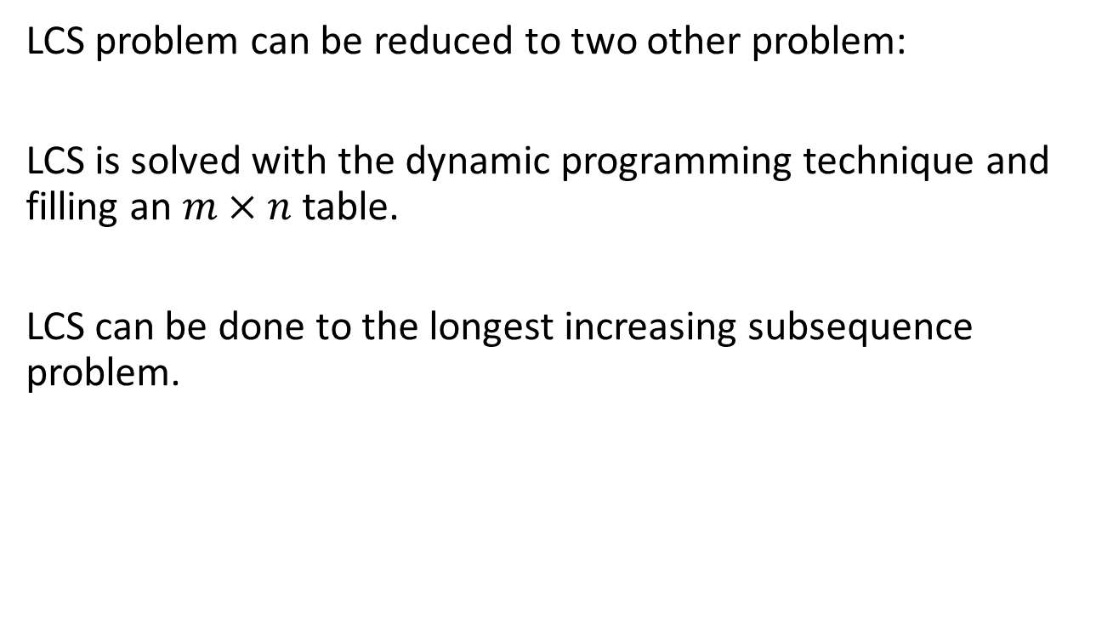
LCS problem can be reduced to two other problem:
LCS is solved with the dynamic programming technique and filling an $m×n$table.
LCS can be done to the longest increasing subsequence problem.

Slide 6
Longest increasing subsequence problem
Example
S :1 3 5 2 9 8 10 4
LIS of S is 1 3 5 9 10

Slide 7
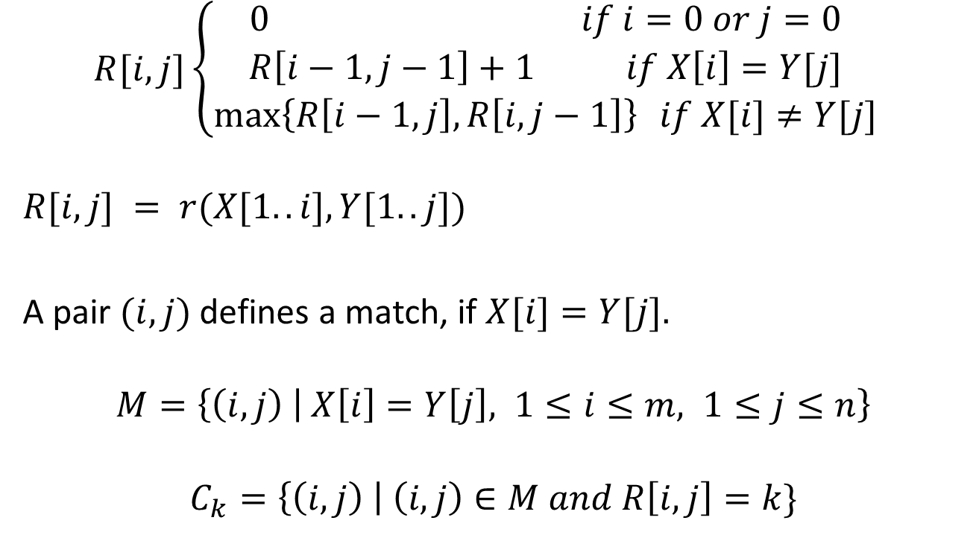
Basic Concepts
$$R[i,j]\left\{\begin{aligned}0 if i=0 or j=0 \\ R\left[i−1,j−1\right]+1 if X\left[i\right]=Y[j] \\ \max\left\{R\left[i−1,j\right],R\left[i,j−1\right]\right\} if X[i]≠Y[j]\end{aligned} \right.$$
$$R[i,j] = r(X[1..i],Y[1..j])$$
A pair $(i,j)$defines a match, if $X[i]=Y[j].$
$$M=\left\{\left(i,j\right) | X\left[i\right]=Y\left[j\right], 1≤i≤m, 1≤j≤n\right\}$$
$$C_{k}=\left\{\left(i,j\right) \right| \left(i,j\right)∈M and R\left[i,j\right]=k\}$$

Slide 8
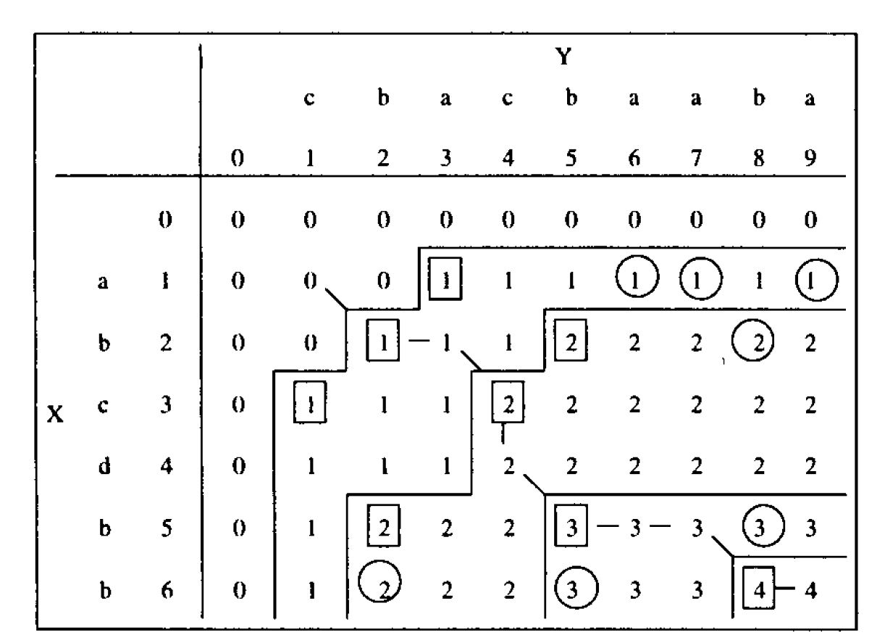

$D_{k}$denote the set of all dominant $k$-matches
$$D_{k}=\left(i_{1},j_{1}\right),\left(i_{2},j_{2}\right),…\left(i_{l},j_{l}\right) i_{1}<i_{2}<..i_{l} and j_{1}<j_{2}<j_{3}$$

Slide 9
Three approaches to solve the problem
Processing the Table Row by Row
Advancing from Contour to Contour
Filling the Table Diagonalwise

Slide 10
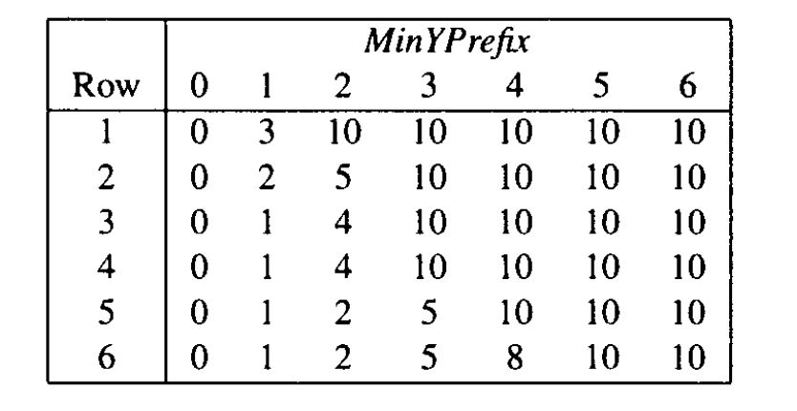

Processing the Table Row by Row
Example $X = abcdbb$and $Y = cbacbaaba$

Slide 11

Update rule
$$MinYPrefix\left[i−1\right]<j<MinYPrefix[i]$$
then update $MinYPrefix[i]=j$

Slide 12
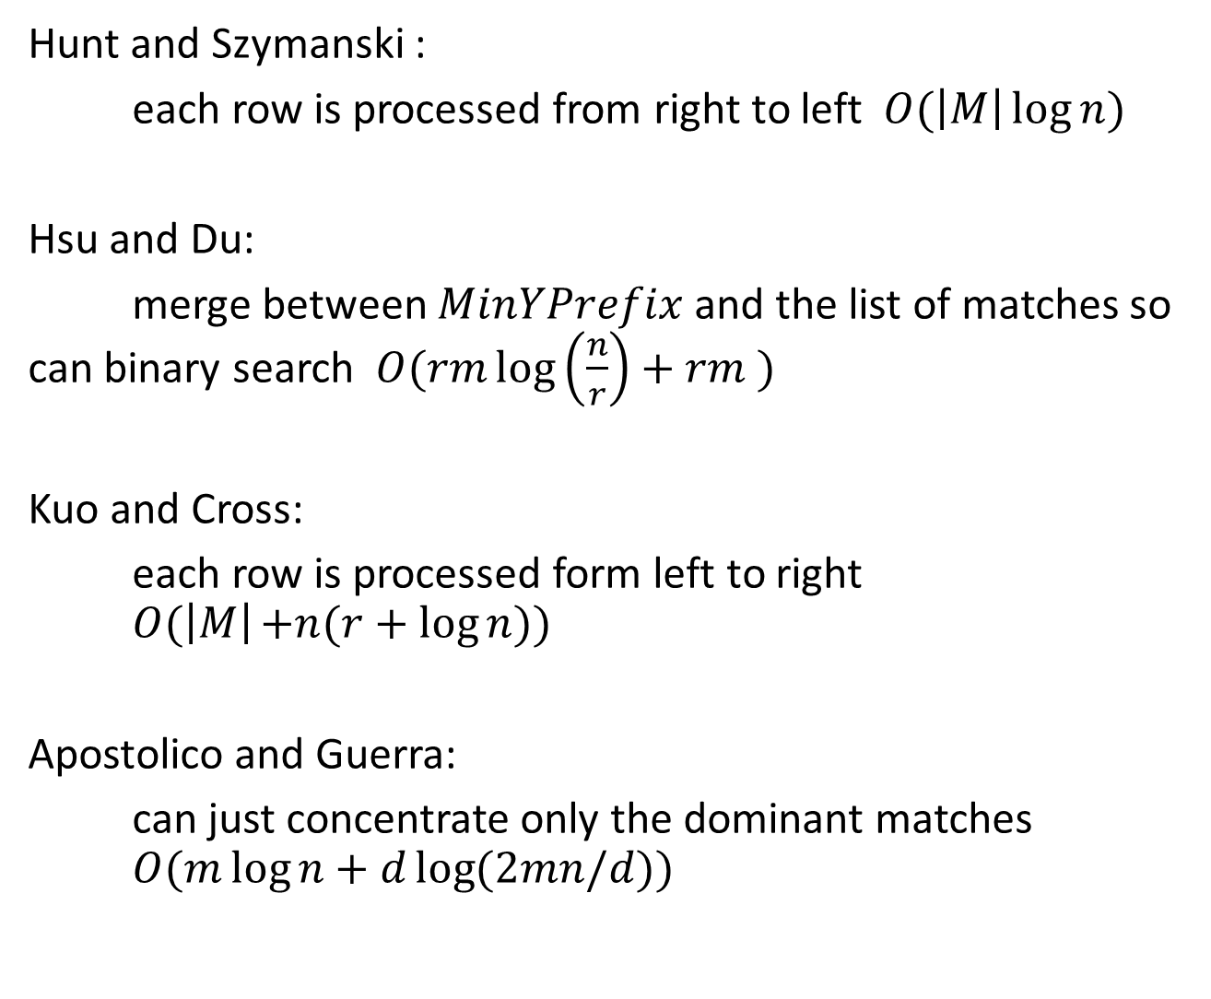
Hunt and Szymanski :
each row is processed from right to left$O(\left|M\right|\log{n})$
Hsu and Du:
merge between $MinYPrefix$ and the list of matches so can binary search $O(rm\log\left(\frac{n}{r}\right)+rm )$
Kuo and Cross:
each row is processed form left to right $O(\left|M\right|+n(r+log{n)})$
Apostolico and Guerra:
can just concentrate only the dominant matches $O(m\log{n+d\log{(2mn/d)}})$

Slide 13
 |  | 1 | 2 | 3 | 4 | 5 | 6 | 7 | 8 | 9
 |  | c | b | a | c | b | a | a | b | a
1 | a |  |  |  |  |  |  |  |  | 1
2 | b
3 | c
4 | d
5 | b
6 | b
g=1,2,….6
0
Thresh[0]
Thresh[g]

Slide 14
 |  | 1 | 2 | 3 | 4 | 5 | 6 | 7 | 8 | 9
 |  | c | b | a | c | b | a | a | b | a
1 | a |  |  |  |  |  |  |  |  | 1
2 | b
3 | c
4 | d
5 | b
6 | b
g=1,2,….6
0
Thresh[0]
Thresh[g]

Slide 15
 |  | 1 | 2 | 3 | 4 | 5 | 6 | 7 | 8 | 9
 |  | c | b | a | c | b | a | a | b | a
1 | a |  |  |  |  |  |  | 1 |  | 1
2 | b
3 | c
4 | d
5 | b
6 | b
g=2,3,….6
0
Thresh[0]
Thresh[g]
Thresh[1]

Slide 16
 |  | 1 | 2 | 3 | 4 | 5 | 6 | 7 | 8 | 9
 |  | c | b | a | c | b | a | a | b | a
1 | a |  |  |  |  |  | 1 | 1 |  | 1
2 | b
3 | c
4 | d
5 | b
6 | b
g=2,3,….6
0
Thresh[0]
Thresh[g]
Thresh[1]

Slide 17
 |  | 1 | 2 | 3 | 4 | 5 | 6 | 7 | 8 | 9
 |  | c | b | a | c | b | a | a | b | a
1 | a |  |  | 1 |  |  | 1 | 1 |  | 1
2 | b
3 | c
4 | d
5 | b
6 | b
g=2,3,….6
0
Thresh[0]
Thresh[g]
Thresh[1]

Slide 18
 |  | 1 | 2 | 3 | 4 | 5 | 6 | 7 | 8 | 9
 |  | c | b | a | c | b | a | a | b | a
1 | a |  |  | 1 |  |  | 1 | 1 |  | 1
2 | b |  |  |  |  |  |  |  | 2
3 | c
4 | d
5 | b
6 | b
g=2,3,….6
0
Thresh[0]
Thresh[g]
Thresh[1]

Slide 19
 |  | 1 | 2 | 3 | 4 | 5 | 6 | 7 | 8 | 9
 |  | c | b | a | c | b | a | a | b | a
1 | a |  |  | 1 |  |  | 1 | 1 |  | 1
2 | b |  |  |  |  | 2 |  |  | 2
3 | c
4 | d
5 | b
6 | b
g=3,4,5,6
0
Thresh[0]
Thresh[g]
Thresh[1]
Thresh[2]

Slide 20
 |  | 1 | 2 | 3 | 4 | 5 | 6 | 7 | 8 | 9
 |  | c | b | a | c | b | a | a | b | a
1 | a |  |  | 1 |  |  | 1 | 1 |  | 1
2 | b |  | 1 |  |  | 2 |  |  | 2
3 | c
4 | d
5 | b
6 | b
g=3,4,5,6
0
Thresh[0]
Thresh[g]
Thresh[1]
Thresh[2]

Slide 21
 |  | 1 | 2 | 3 | 4 | 5 | 6 | 7 | 8 | 9
 |  | c | b | a | c | b | a | a | b | a
1 | a |  |  | 1 |  |  | 1 | 1 |  | 1
2 | b |  | 1 |  |  | 2 |  |  | 2
3 | c |  |  |  | 2
4 | d
5 | b
6 | b
g=3,4,5,6
0
Thresh[0]
Thresh[g]
Thresh[1]
Thresh[2]

Slide 22
 |  | 1 | 2 | 3 | 4 | 5 | 6 | 7 | 8 | 9
 |  | c | b | a | c | b | a | a | b | a
1 | a |  |  | 1 |  |  | 1 | 1 |  | 1
2 | b |  | 1 |  |  | 2 |  |  | 2
3 | c | 1 |  |  | 2
4 | d
5 | b
6 | b
g=3,4,5,6
0
Thresh[0]
Thresh[g]
Thresh[1]
Thresh[2]

Slide 23
 |  | 1 | 2 | 3 | 4 | 5 | 6 | 7 | 8 | 9
 |  | c | b | a | c | b | a | a | b | a
1 | a |  |  | 1 |  |  | 1 | 1 |  | 1
2 | b |  | 1 |  |  | 2 |  |  | 2
3 | c | 1 |  |  | 2
4 | d
5 | b |  |  |  |  |  |  |  | 3
6 | b
g=3,4,5,6
0
Thresh[0]
Thresh[g]
Thresh[1]
Thresh[2]

Slide 24
 |  | 1 | 2 | 3 | 4 | 5 | 6 | 7 | 8 | 9
 |  | c | b | a | c | b | a | a | b | a
1 | a |  |  | 1 |  |  | 1 | 1 |  | 1
2 | b |  | 1 |  |  | 2 |  |  | 2
3 | c | 1 |  |  | 2
4 | d
5 | b |  |  |  |  | 3 |  |  | 3
6 | b
g=4,5,6
0
Thresh[g]
T[0]
T[1]
T[2]
T[3]

Slide 25
 |  | 1 | 2 | 3 | 4 | 5 | 6 | 7 | 8 | 9
 |  | c | b | a | c | b | a | a | b | a
1 | a |  |  | 1 |  |  | 1 | 1 |  | 1
2 | b |  | 1 |  |  | 2 |  |  | 2
3 | c | 1 |  |  | 2
4 | d
5 | b |  | 2 |  |  | 3 |  |  | 3
6 | b
g=4,5,6
0
Thresh[g]
T[0]
T[1]
T[2]
T[3]

Slide 26
 |  | 1 | 2 | 3 | 4 | 5 | 6 | 7 | 8 | 9
 |  | c | b | a | c | b | a | a | b | a
1 | a |  |  | 1 |  |  | 1 | 1 |  | 1
2 | b |  | 1 |  |  | 2 |  |  | 2
3 | c | 1 |  |  | 2
4 | d
5 | b |  | 2 |  |  | 3 |  |  | 3
6 | b |  |  |  |  |  |  |  | 4
g=4,5,6
0
Thresh[g]
T[0]
T[1]
T[2]
T[3]

Slide 27
 |  | 1 | 2 | 3 | 4 | 5 | 6 | 7 | 8 | 9
 |  | c | b | a | c | b | a | a | b | a
1 | a |  |  | 1 |  |  | 1 | 1 |  | 1
2 | b |  | 1 |  |  | 2 |  |  | 2
3 | c | 1 |  |  | 2
4 | d
5 | b |  | 2 |  |  | 3 |  |  | 3
6 | b |  |  |  |  | 3 |  |  | 4
g=4,5,6
0
Thresh[g]
T[0]
T[1]
T[2]
T[3]

Slide 28
 |  | 1 | 2 | 3 | 4 | 5 | 6 | 7 | 8 | 9
 |  | c | b | a | c | b | a | a | b | a
1 | a |  |  | 1 |  |  | 1 | 1 |  | 1
2 | b |  | 1 |  |  | 2 |  |  | 2
3 | c | 1 |  |  | 2
4 | d
5 | b |  | 2 |  |  | 3 |  |  | 3
6 | b |  | 2 |  |  | 3 |  |  | 4
g=5,6
0
Thresh[g]
T[0]
T[1]
T[2]
T[3]
T[4]

Slide 29
 |  | 1 | 2 | 3 | 4 | 5 | 6 | 7 | 8 | 9
 |  | c | b | a | c | b | a | a | b | a
1 | a |  |  | 1 |  |  | 1 | 1 |  | 1
2 | b |  | 1 |  |  | 2 |  |  | 2
3 | c | 1 |  |  | 2
4 | d
5 | b |  | 2 |  |  | 3 |  |  | 3
6 | b |  | 2 |  |  | 3 |  |  | 4
0

Slide 30
Thresh={}
 |  | 1 | 2 | 3 | 4 | 5 | 6 | 7 | 8 | 9 | 10
 |  | c | b | a | c | b | a | a | b | a | $
1 | a
2 | b
3 | c
4 | d
5 | b
6 | b
0

Slide 31
Thresh={}
 |  | 1 | 2 | 3 | 4 | 5 | 6 | 7 | 8 | 9 | 10
 |  | c | b | a | c | b | a | a | b | a | $
1 | a |  |  | 1
2 | b
3 | c
4 | d
5 | b
6 | b
0

Slide 32
Thresh={3}
 |  | 1 | 2 | 3 | 4 | 5 | 6 | 7 | 8 | 9 | 10
 |  | c | b | a | c | b | a | a | b | a | $
1 | a |  |  | 1
2 | b
3 | c
4 | d
5 | b
6 | b
0

Slide 33
Thresh={3}
 |  | 1 | 2 | 3 | 4 | 5 | 6 | 7 | 8 | 9 | 10
 |  | c | b | a | c | b | a | a | b | a | $
1 | a |  |  | 1
2 | b |  | 1
3 | c
4 | d
5 | b
6 | b
0

Slide 34
Thresh={3}
 |  | 1 | 2 | 3 | 4 | 5 | 6 | 7 | 8 | 9 | 10
 |  | c | b | a | c | b | a | a | b | a | $
1 | a |  |  | 1
2 | b |  | 1 |  |  | 2
3 | c
4 | d
5 | b
6 | b
0

Slide 35
Thresh={2}
 |  | 1 | 2 | 3 | 4 | 5 | 6 | 7 | 8 | 9 | 10
 |  | c | b | a | c | b | a | a | b | a | $
1 | a |  |  | 1
2 | b |  | 1 |  |  | 2
3 | c
4 | d
5 | b
6 | b
0

Slide 36
Thresh={2, 5}
 |  | 1 | 2 | 3 | 4 | 5 | 6 | 7 | 8 | 9 | 10
 |  | c | b | a | c | b | a | a | b | a | $
1 | a |  |  | 1
2 | b |  | 1 |  |  | 2
3 | c
4 | d
5 | b
6 | b
0

Slide 37
Thresh={2, 5}
 |  | 1 | 2 | 3 | 4 | 5 | 6 | 7 | 8 | 9 | 10
 |  | c | b | a | c | b | a | a | b | a | $
1 | a |  |  | 1
2 | b |  | 1 |  |  | 2
3 | c | 1
4 | d
5 | b
6 | b
0

Slide 38
Thresh={2, 5}
 |  | 1 | 2 | 3 | 4 | 5 | 6 | 7 | 8 | 9 | 10
 |  | c | b | a | c | b | a | a | b | a | $
1 | a |  |  | 1
2 | b |  | 1 |  |  | 2
3 | c | 1 |  |  | 2
4 | d
5 | b
6 | b
0

Slide 39
Thresh={2, 5}
 |  | 1 | 2 | 3 | 4 | 5 | 6 | 7 | 8 | 9 | 10
 |  | c | b | a | c | b | a | a | b | a | $
1 | a |  |  | 1
2 | b |  | 1 |  |  | 2
3 | c | 1 |  |  | 2
4 | d
5 | b
6 | b
0
delete(2, Thresh); insert(1, Thresh);

Slide 40
Thresh={1, 5}
 |  | 1 | 2 | 3 | 4 | 5 | 6 | 7 | 8 | 9 | 10
 |  | c | b | a | c | b | a | a | b | a | $
1 | a |  |  | 1
2 | b |  | 1 |  |  | 2
3 | c | 1 |  |  | 2
4 | d
5 | b
6 | b
0

Slide 41
Thresh={1, 5}
 |  | 1 | 2 | 3 | 4 | 5 | 6 | 7 | 8 | 9 | 10
 |  | c | b | a | c | b | a | a | b | a | $
1 | a |  |  | 1
2 | b |  | 1 |  |  | 2
3 | c | 1 |  |  | 2 |  |  |  |  |  | 3
4 | d
5 | b
6 | b
0

Slide 42
Thresh={1, 4}
 |  | 1 | 2 | 3 | 4 | 5 | 6 | 7 | 8 | 9 | 10
 |  | c | b | a | c | b | a | a | b | a | $
1 | a |  |  | 1
2 | b |  | 1 |  |  | 2
3 | c | 1 |  |  | 2 |  |  |  |  |  | 3
4 | d
5 | b
6 | b
0

Slide 43
Thresh={1, 4}
 |  | 1 | 2 | 3 | 4 | 5 | 6 | 7 | 8 | 9 | 10
 |  | c | b | a | c | b | a | a | b | a | $
1 | a |  |  | 1
2 | b |  | 1 |  |  | 2
3 | c | 1 |  |  | 2 |  |  |  |  |  | 3
4 | d |  |  |  |  |  |  |  |  |  | 3
5 | b
6 | b
0

Slide 44
Thresh={1, 4}
 |  | 1 | 2 | 3 | 4 | 5 | 6 | 7 | 8 | 9 | 10
 |  | c | b | a | c | b | a | a | b | a | $
1 | a |  |  | 1
2 | b |  | 1 |  |  | 2
3 | c | 1 |  |  | 2 |  |  |  |  |  | 3
4 | d |  |  |  |  |  |  |  |  |  | 3
5 | b |  | 2
6 | b
0

Slide 45
Thresh={1, 4}
 |  | 1 | 2 | 3 | 4 | 5 | 6 | 7 | 8 | 9 | 10
 |  | c | b | a | c | b | a | a | b | a | $
1 | a |  |  | 1
2 | b |  | 1 |  |  | 2
3 | c | 1 |  |  | 2 |  |  |  |  |  | 3
4 | d |  |  |  |  |  |  |  |  |  | 3
5 | b |  | 2 |  |  | 3
6 | b
0

Slide 46
Thresh={1, 2}
 |  | 1 | 2 | 3 | 4 | 5 | 6 | 7 | 8 | 9 | 10
 |  | c | b | a | c | b | a | a | b | a | $
1 | a |  |  | 1
2 | b |  | 1 |  |  | 2
3 | c | 1 |  |  | 2 |  |  |  |  |  | 3
4 | d |  |  |  |  |  |  |  |  |  | 3
5 | b |  | 2 |  |  | 3
6 | b
0

Slide 47
Thresh={1, 2, 5}
 |  | 1 | 2 | 3 | 4 | 5 | 6 | 7 | 8 | 9 | 10
 |  | c | b | a | c | b | a | a | b | a | $
1 | a |  |  | 1
2 | b |  | 1 |  |  | 2
3 | c | 1 |  |  | 2 |  |  |  |  |  | 3
4 | d |  |  |  |  |  |  |  |  |  | 3
5 | b |  | 2 |  |  | 3
6 | b
0

Slide 48
Thresh={1, 2, 5}
 |  | 1 | 2 | 3 | 4 | 5 | 6 | 7 | 8 | 9 | 10
 |  | c | b | a | c | b | a | a | b | a | $
1 | a |  |  | 1
2 | b |  | 1 |  |  | 2
3 | c | 1 |  |  | 2 |  |  |  |  |  | 3
4 | d |  |  |  |  |  |  |  |  |  | 3
5 | b |  | 2 |  |  | 3
6 | b |  |  |  |  |  |  |  | 4
0

Slide 49
Thresh={1, 2, 5, 8}
 |  | 1 | 2 | 3 | 4 | 5 | 6 | 7 | 8 | 9 | 10
 |  | c | b | a | c | b | a | a | b | a | $
1 | a |  |  | 1
2 | b |  | 1 |  |  | 2
3 | c | 1 |  |  | 2 |  |  |  |  |  | 3
4 | d |  |  |  |  |  |  |  |  |  | 3
5 | b |  | 2 |  |  | 3
6 | b |  |  |  |  |  |  |  | 4
0

Slide 50
 |  | 1 | 2 | 3 | 4 | 5 | 6 | 7 | 8 | 9 | 10
 |  | c | b | a | c | b | a | a | b | a | $
1 | a |  |  | 1
2 | b |  | 1 |  |  | 2
3 | c | 1 |  |  | 2 |  |  |  |  |  | 3
4 | d |  |  |  |  |  |  |  |  |  | 3
5 | b |  | 2 |  |  | 3
6 | b |  |  |  |  |  |  |  | 4
0

Slide 51
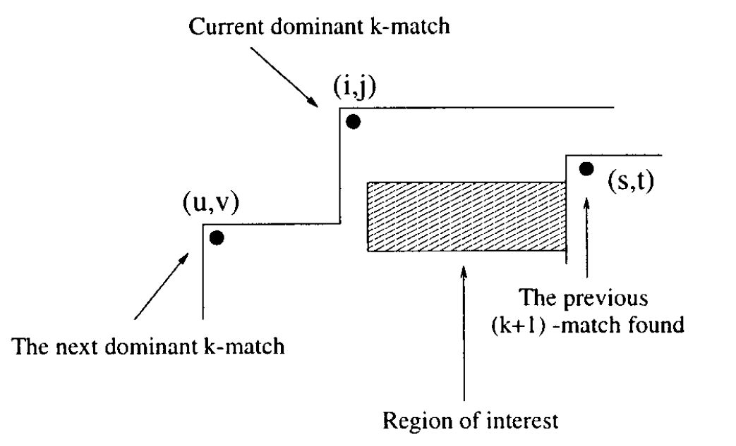
Advancing from Contour to Contour

Slide 52
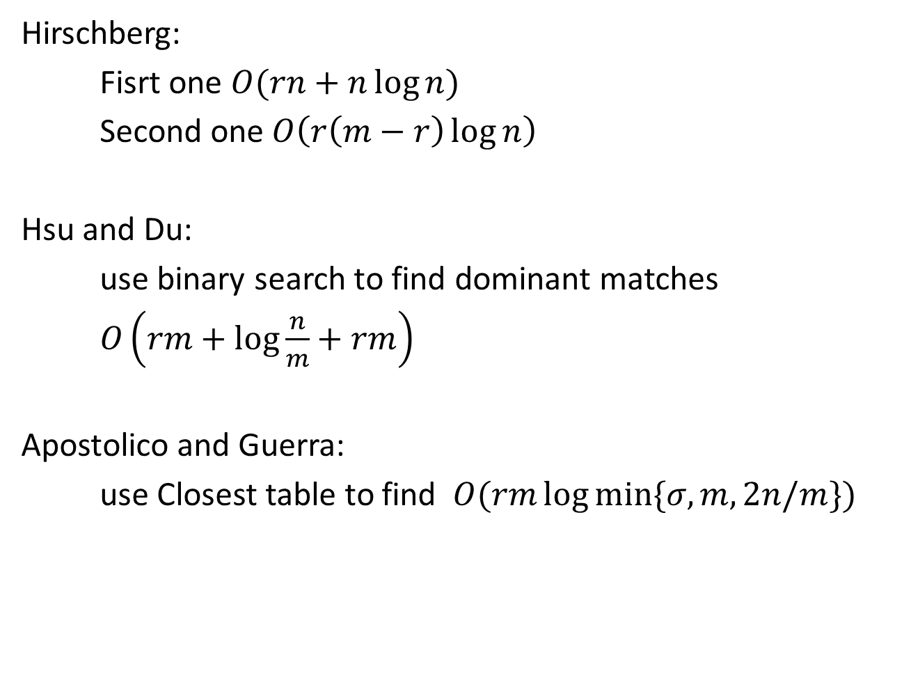
Hirschberg:
Fisrt one $O(rn+n\log{n})$
Second one $O\left(r\left(m−r\right)\log{n}\right)$
Hsu and Du:
use binary search to find dominant matches
$O\left(rm+\log{\frac{n}{m}}+rm\right)$
Apostolico and Guerra:
use Closest table to find $O(rm\log{min⁡\{σ,m,2n/m\}})$

Slide 53
 |  | 1 | 2 | 3 | 4 | 5 | 6 | 7 | 8 | 9
 |  | c | b | a | c | b | a | a | b | a
1 | a |  |  | 1
2 | b
3 | c
4 | d
5 | b
6 | b

Slide 54
 |  | 1 | 2 | 3 | 4 | 5 | 6 | 7 | 8 | 9
 |  | c | b | a | c | b | a | a | b | a
1 | a |  |  | 1
2 | b |  | 1
3 | c
4 | d
5 | b
6 | b

Slide 55
 |  | 1 | 2 | 3 | 4 | 5 | 6 | 7 | 8 | 9
 |  | c | b | a | c | b | a | a | b | a
1 | a |  |  | 1
2 | b |  | 1
3 | c | 1
4 | d
5 | b
6 | b

Slide 56
 |  | 1 | 2 | 3 | 4 | 5 | 6 | 7 | 8 | 9
 |  | c | b | a | c | b | a | a | b | a
1 | a |  |  | 1
2 | b |  | 1
3 | c | 1
4 | d
5 | b
6 | b

Slide 57
 |  | 1 | 2 | 3 | 4 | 5 | 6 | 7 | 8 | 9
 |  | c | b | a | c | b | a | a | b | a
1 | a |  |  | 1
2 | b |  | 1 |  |  | 2
3 | c | 1
4 | d
5 | b
6 | b

Slide 58
 |  | 1 | 2 | 3 | 4 | 5 | 6 | 7 | 8 | 9
 |  | c | b | a | c | b | a | a | b | a
1 | a |  |  | 1
2 | b |  | 1 |  |  | 2
3 | c | 1 |  |  | 2
4 | d
5 | b
6 | b

Slide 59
 |  | 1 | 2 | 3 | 4 | 5 | 6 | 7 | 8 | 9
 |  | c | b | a | c | b | a | a | b | a
1 | a |  |  | 1
2 | b |  | 1 |  |  | 2
3 | c | 1 |  |  | 2
4 | d
5 | b
6 | b

Slide 60
 |  | 1 | 2 | 3 | 4 | 5 | 6 | 7 | 8 | 9
 |  | c | b | a | c | b | a | a | b | a
1 | a |  |  | 1
2 | b |  | 1 |  |  | 2
3 | c | 1 |  |  | 2
4 | d
5 | b |  | 2
6 | b

Slide 61
 |  | 1 | 2 | 3 | 4 | 5 | 6 | 7 | 8 | 9
 |  | c | b | a | c | b | a | a | b | a
1 | a |  |  | 1
2 | b |  | 1 |  |  | 2
3 | c | 1 |  |  | 2
4 | d
5 | b |  | 2
6 | b

Slide 62
 |  | 1 | 2 | 3 | 4 | 5 | 6 | 7 | 8 | 9
 |  | c | b | a | c | b | a | a | b | a
1 | a |  |  | 1
2 | b |  | 1 |  |  | 2
3 | c | 1 |  |  | 2
4 | d
5 | b |  | 2
6 | b

Slide 63
 |  | 1 | 2 | 3 | 4 | 5 | 6 | 7 | 8 | 9
 |  | c | b | a | c | b | a | a | b | a
1 | a |  |  | 1
2 | b |  | 1 |  |  | 2
3 | c | 1 |  |  | 2
4 | d
5 | b |  | 2
6 | b

Slide 64
 |  | 1 | 2 | 3 | 4 | 5 | 6 | 7 | 8 | 9
 |  | c | b | a | c | b | a | a | b | a
1 | a |  |  | 1
2 | b |  | 1 |  |  | 2
3 | c | 1 |  |  | 2
4 | d
5 | b |  | 2 |  |  | 3
6 | b

Slide 65
 |  | 1 | 2 | 3 | 4 | 5 | 6 | 7 | 8 | 9
 |  | c | b | a | c | b | a | a | b | a
1 | a |  |  | 1
2 | b |  | 1 |  |  | 2
3 | c | 1 |  |  | 2
4 | d
5 | b |  | 2 |  |  | 3
6 | b |  | 3

Slide 66
 |  | 1 | 2 | 3 | 4 | 5 | 6 | 7 | 8 | 9
 |  | c | b | a | c | b | a | a | b | a
1 | a |  |  | 1
2 | b |  | 1 |  |  | 2
3 | c | 1 |  |  | 2
4 | d
5 | b |  | 2 |  |  | 3
6 | b |  | 3 |  |  |  |  |  | 4

Slide 67
 |  | 1 | 2 | 3 | 4 | 5 | 6 | 7 | 8 | 9
 |  | c | b | a | c | b | a | a | b | a
1 | a |  |  | 1
2 | b |  | 1 |  |  | 2
3 | c | 1 |  |  | 2
4 | d
5 | b |  | 2 |  |  | 3
6 | b |  | 3 |  |  |  |  |  | 4

Slide 68
 |  | 1 | 2 | 3 | 4 | 5 | 6 | 7 | 8 | 9 | 10
 |  | c | b | a | c | b | a | a | b | a | $
1 | a |  |  | 1
2 | b
3 | c
4 | d
5 | b
6 | b

Slide 69
 |  | 1 | 2 | 3 | 4 | 5 | 6 | 7 | 8 | 9 | 10
 |  | c | b | a | c | b | a | a | b | a | $
1 | a |  |  | 1
2 | b
3 | c
4 | d
5 | b
6 | b

Slide 70
 |  | 1 | 2 | 3 | 4 | 5 | 6 | 7 | 8 | 9 | 10
 |  | c | b | a | c | b | a | a | b | a | $
1 | a |  |  | 1
2 | b |  | 1
3 | c
4 | d
5 | b
6 | b

Slide 71
 |  | 1 | 2 | 3 | 4 | 5 | 6 | 7 | 8 | 9 | 10
 |  | c | b | a | c | b | a | a | b | a | $
1 | a |  |  | 1
2 | b |  | 1
3 | c
4 | d
5 | b
6 | b

Slide 72
 |  | 1 | 2 | 3 | 4 | 5 | 6 | 7 | 8 | 9 | 10
 |  | c | b | a | c | b | a | a | b | a | $
1 | a |  |  | 1
2 | b |  | 1
3 | c | 1
4 | d
5 | b
6 | b

Slide 73
 |  | 1 | 2 | 3 | 4 | 5 | 6 | 7 | 8 | 9 | 10
 |  | c | b | a | c | b | a | a | b | a | $
1 | a |  |  | 1
2 | b |  | 1
3 | c | 1
4 | d
5 | b
6 | b

Slide 74
 |  | 1 | 2 | 3 | 4 | 5 | 6 | 7 | 8 | 9 | 10
 |  | c | b | a | c | b | a | a | b | a | $
1 | a |  |  | 1
2 | b |  | 1 |  |  | 2
3 | c | 1
4 | d
5 | b
6 | b

Slide 75
 |  | 1 | 2 | 3 | 4 | 5 | 6 | 7 | 8 | 9 | 10
 |  | c | b | a | c | b | a | a | b | a | $
1 | a |  |  | 1
2 | b |  | 1 |  |  | 2
3 | c | 1
4 | d
5 | b
6 | b

Slide 76
 |  | 1 | 2 | 3 | 4 | 5 | 6 | 7 | 8 | 9 | 10
 |  | c | b | a | c | b | a | a | b | a | $
1 | a |  |  | 1
2 | b |  | 1 |  |  | 2
3 | c | 1 |  |  | 2
4 | d
5 | b
6 | b

Slide 77
 |  | 1 | 2 | 3 | 4 | 5 | 6 | 7 | 8 | 9 | 10
 |  | c | b | a | c | b | a | a | b | a | $
1 | a |  |  | 1
2 | b |  | 1 |  |  | 2
3 | c | 1 |  |  | 2
4 | d
5 | b
6 | b

Slide 78
 |  | 1 | 2 | 3 | 4 | 5 | 6 | 7 | 8 | 9 | 10
 |  | c | b | a | c | b | a | a | b | a | $
1 | a |  |  | 1
2 | b |  | 1 |  |  | 2
3 | c | 1 |  |  | 2
4 | d
5 | b |  | 2
6 | b

Slide 79
 |  | 1 | 2 | 3 | 4 | 5 | 6 | 7 | 8 | 9 | 10
 |  | c | b | a | c | b | a | a | b | a | $
1 | a |  |  | 1
2 | b |  | 1 |  |  | 2
3 | c | 1 |  |  | 2
4 | d
5 | b |  | 2
6 | b

Slide 80
 |  | 1 | 2 | 3 | 4 | 5 | 6 | 7 | 8 | 9 | 10
 |  | c | b | a | c | b | a | a | b | a | $
1 | a |  |  | 1
2 | b |  | 1 |  |  | 2
3 | c | 1 |  |  | 2
4 | d
5 | b |  | 2
6 | b

Slide 81
 |  | 1 | 2 | 3 | 4 | 5 | 6 | 7 | 8 | 9 | 10
 |  | c | b | a | c | b | a | a | b | a | $
1 | a |  |  | 1
2 | b |  | 1 |  |  | 2
3 | c | 1 |  |  | 2
4 | d
5 | b |  | 2 |  |  | 3
6 | b

Slide 82
 |  | 1 | 2 | 3 | 4 | 5 | 6 | 7 | 8 | 9 | 10
 |  | c | b | a | c | b | a | a | b | a | $
1 | a |  |  | 1
2 | b |  | 1 |  |  | 2
3 | c | 1 |  |  | 2
4 | d
5 | b |  | 2 |  |  | 3
6 | b

Slide 83
 |  | 1 | 2 | 3 | 4 | 5 | 6 | 7 | 8 | 9 | 10
 |  | c | b | a | c | b | a | a | b | a | $
1 | a |  |  | 1
2 | b |  | 1 |  |  | 2
3 | c | 1 |  |  | 2
4 | d
5 | b |  | 2 |  |  | 3
6 | b

Slide 84
 |  | 1 | 2 | 3 | 4 | 5 | 6 | 7 | 8 | 9 | 10
 |  | c | b | a | c | b | a | a | b | a | $
1 | a |  |  | 1
2 | b |  | 1 |  |  | 2
3 | c | 1 |  |  | 2
4 | d
5 | b |  | 2 |  |  | 3
6 | b |  |  |  |  |  |  |  | 4

Slide 85
 |  | 1 | 2 | 3 | 4 | 5 | 6 | 7 | 8 | 9 | 10
 |  | c | b | a | c | b | a | a | b | a | $
1 | a |  |  | 1
2 | b |  | 1 |  |  | 2
3 | c | 1 |  |  | 2
4 | d
5 | b |  | 2 |  |  | 3
6 | b |  |  |  |  |  |  |  | 4

Slide 86
 |  | 1 | 2 | 3 | 4 | 5 | 6 | 7 | 8 | 9 | 10
 |  | c | b | a | c | b | a | a | b | a | $
1 | a |  |  | 1
2 | b |  | 1 |  |  | 2
3 | c | 1 |  |  | 2
4 | d
5 | b |  | 2 |  |  | 3
6 | b |  |  |  |  |  |  |  | 4

Slide 87
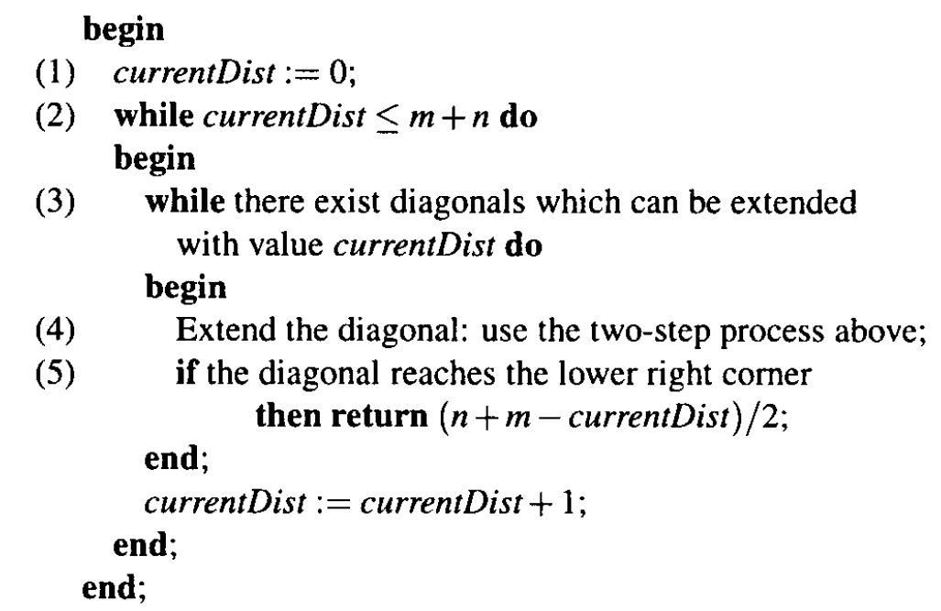
Filling the Table Diagonalwise
That method which fill the dynamic programming table greedily, trying to reach the goal entry R[m,n] as fast as possible.
Most of these algorithms are based on the calculation of the edit distance between the input strings.

Slide 88
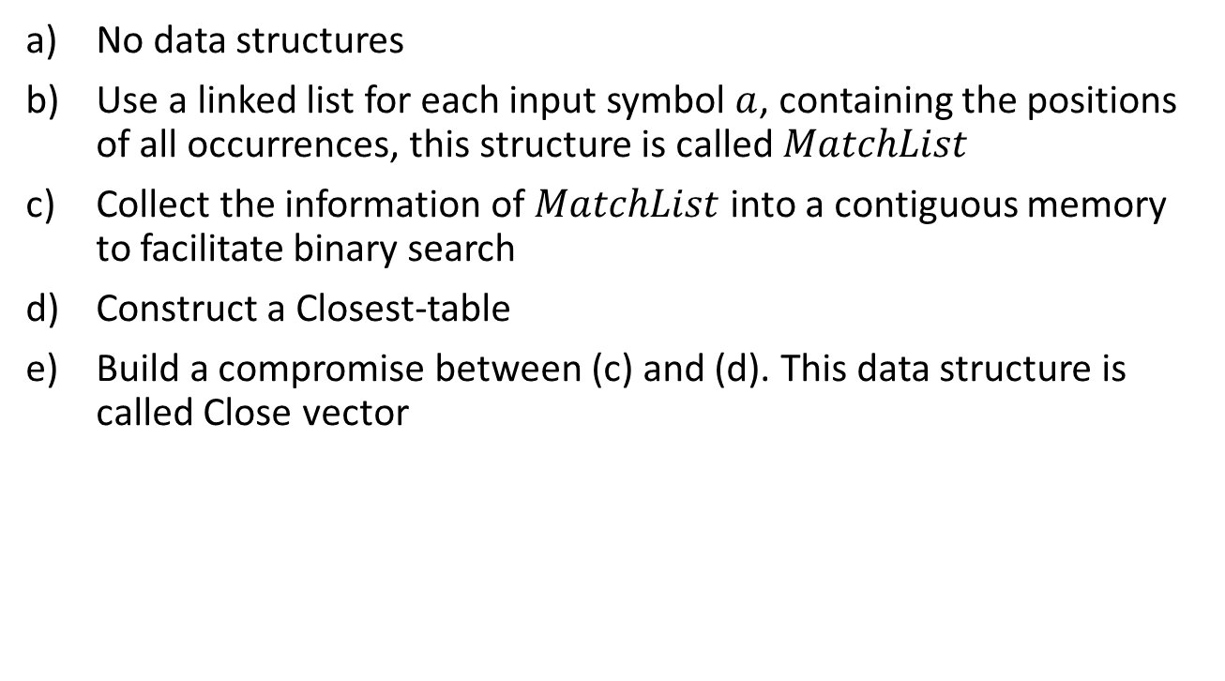
No data structures
Use a linked list for each input symbol $a$, containing the positions of all occurrences, this structure is called $MatchList$
Collect the information of $MatchList$ into a contiguous memory to facilitate binary search
Construct a Closest-table
Build a compromise between (c) and (d). This data structure is called Close vector

Slide 89
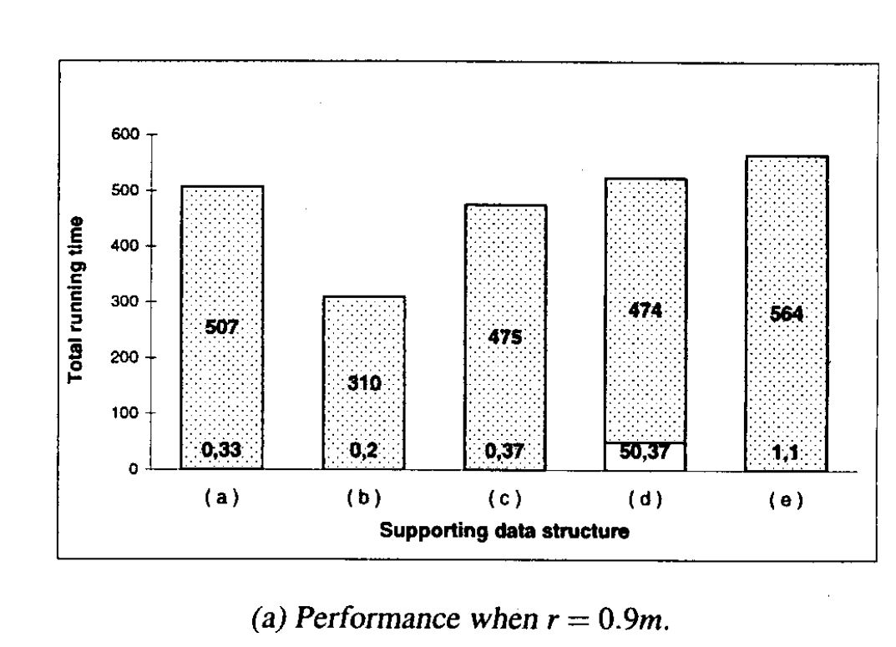
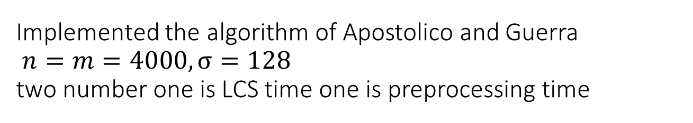
Implemented the algorithm of Apostolico and Guerra $n=m=4000, σ=128$ two number one is LCS time one is preprocessing time

Slide 90
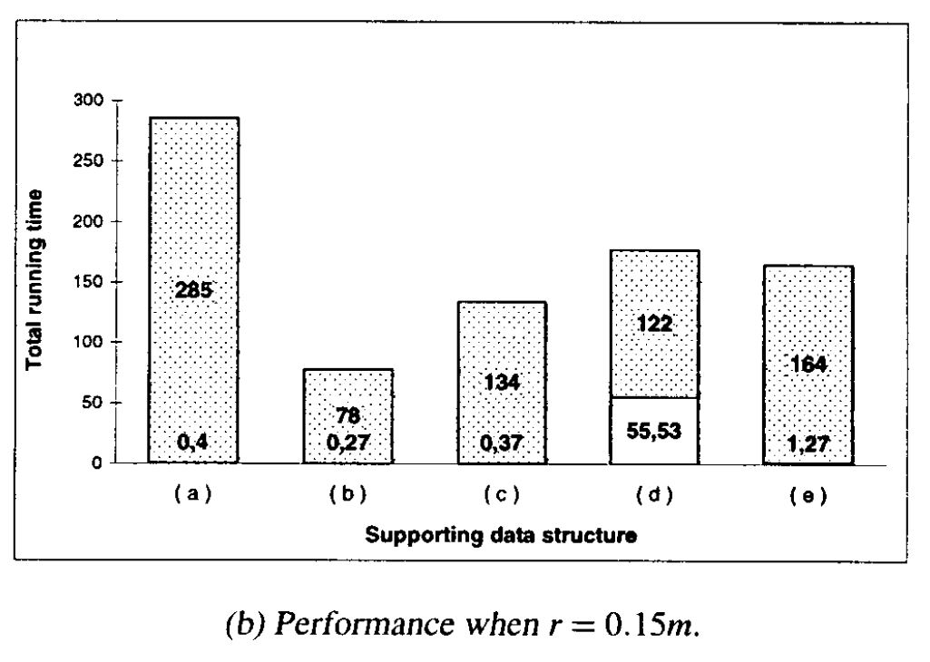

Slide 91
