Slide 1
Matching for Run-Length Encoded Strings
Apostolico, A., Landau, G.M. and Skiena, S. Compression and Complexity of Sequences 1997. Proceedings page 348 - 356

Slide 2
Abstract
Measuring the similarity between two strings, through such standard measures as Hamming distance, edit distance, and longest common subsequence, is one of the fundamental problems in pattern matching. We consider the problem of finding the longest common subsequence of two strings. A well-known dynamic programming algorithm computes the longest common subsequence of strings X and Y in O(|X|·|Y|) time. We develop significantly faster algorithms for a special class of strings which emerge frequently in pattern matching problems.

Slide 3
Introduction
Run-length string X = aaabbbbbbcaaaa → a³b⁶c¹a⁴ Y = aaaaaabbbaaaaaaaabbb → a⁶b³a⁸b³
X = X₁…X_{i}, Y = Y₁…Y_{j}
TOP^{j}(α)：Y在第j元素時，α的出現次數
LEFT^{i}(α)：X在第i元素時，α的出現次數

Slide 4
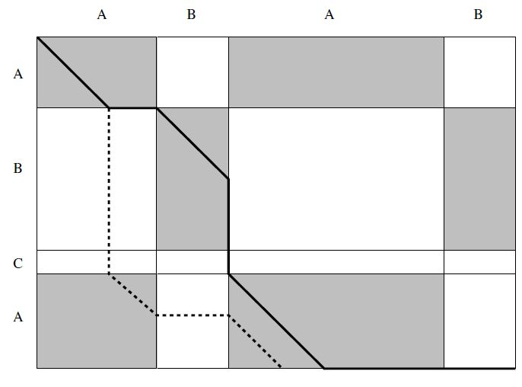
Forced Path and Corner Path
Forced path: 不是從block的 右下角離開的path。
Corner path: 從block的 右下角離開的path。
虛線為forced path， 實線為corner path。

Slide 5
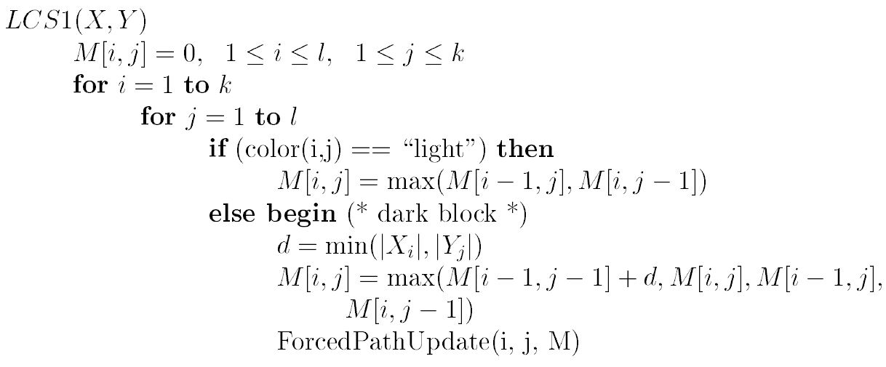
Dynamic Programming
O(k+l)
Total Time Complexity: O(kl(k+l))

Slide 6
RANK
使用balanced binary tree紀錄forced path，其中的資訊包含：RANK，起始LCS value，起始點。
RANK(α; i, j) = TOP^{j-1}(α) - LEFT ^{i-1}(α)
Initial LCS value = M[i-1, j-1]
事先建立每個符號的TOP與LEFT表格，利用其對應關係得到RANK
每個符號建立兩個tree C與R，其中的node用RANK作為key，分別處理橫向與縱向的forced path。

Slide 7
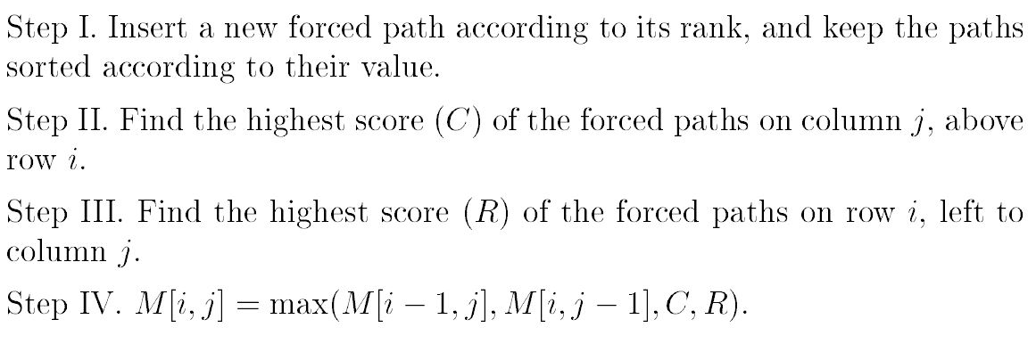
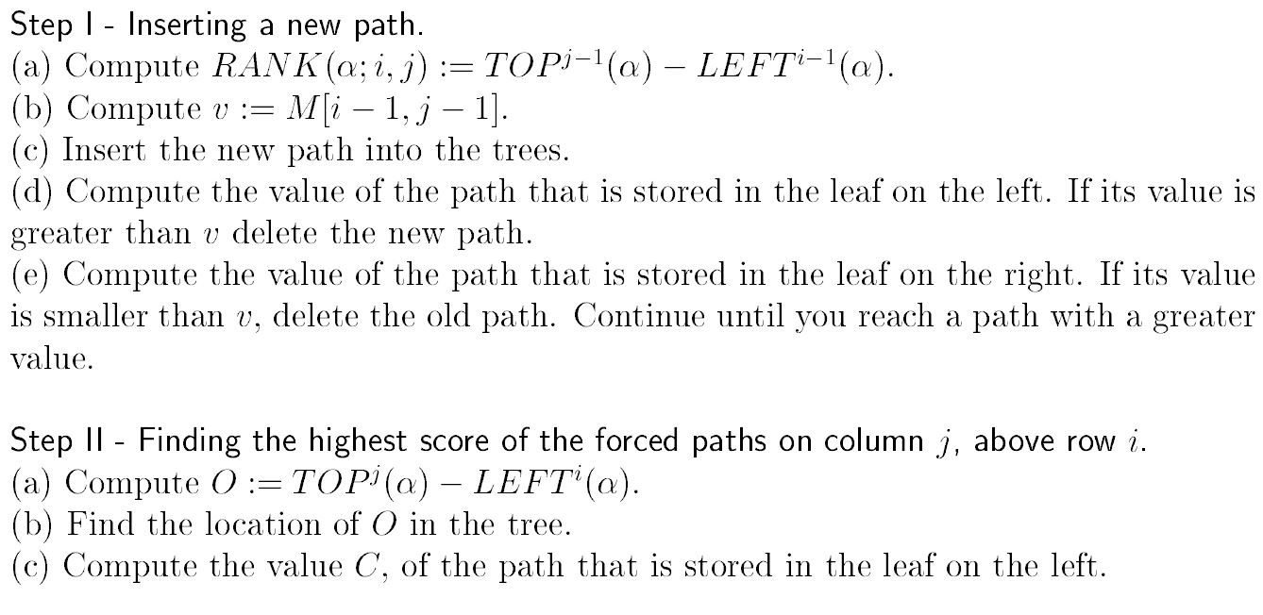
Forced Path Tree

Slide 8
 | a6 | b3 | a8 | b3
a3
b6
c
a4
a
TOP | 0 | 6 | 6 | 14 | 14
LEFT | 0 | 3 | 3 | 3 | 7
b
TOP | 0 | 0 | 3 | 3 | 6
LEFT | 0 | 0 | 6 | 6 | 6
c
TOP | 0 | 0 | 0 | 0 | 0
LEFT | 0 | 0 | 0 | 3 | 3
O_{c} = TOP₁(a) – LEFT₁(a) = 3
(i, j) = (1, 1)
RANK(a, 1, 1) = TOP₀(a) – LEFT₀(a) = 0
v = M[0, 0] = 0
C | (0, 0) | (3, 0)
Value of path starts from (1, 1) = 0 + 3
O_{r} = LEFT₁(a) – TOP₁(a) = -3
C | (0, 0)
R | (0, 0)
R | (-3, 0) | (0, 0)
Forced path tree of a
M[1, 1] = max(0, 0, 3, 0) = 3

Slide 9
 | a6 | b3 | a8 | b3
a3 | 3 | 3
b6
c
a4
a
TOP | 0 | 6 | 6 | 14 | 14
LEFT | 0 | 3 | 3 | 3 | 7
b
TOP | 0 | 0 | 3 | 3 | 6
LEFT | 0 | 0 | 6 | 6 | 6
c
TOP | 0 | 0 | 0 | 0 | 0
LEFT | 0 | 0 | 0 | 3 | 3
O_{c} = TOP₃(a) – LEFT₁(a) = 11
(i, j) = (1, 3)
RANK(a, 1, 3) = TOP₂(a) – LEFT₀(a) = 14
v = M[0, 2] = 0
C | (0, 0) | (11, 0) | (14, 0)
Value of path starts from (1, 1) = 0 + 3
O_{r} = LEFT₁(a) – TOP₃(a) = -11
C | (0, 0) | (14, 0)
R | (0, 0) | (14, 0)
R | (-11, 0) | (0, 0) | (14, 0)
Forced path tree of a
M[1, 1] = max(0, 3, 3, 0) = 3

Slide 10
 | a6 | b3 | a8 | b3
a3 | 3 | 3 | 3 | 3
b6 | 3
c
a4
a
TOP | 0 | 6 | 6 | 14 | 14
LEFT | 0 | 3 | 3 | 3 | 7
b
TOP | 0 | 0 | 3 | 3 | 6
LEFT | 0 | 0 | 6 | 6 | 6
c
TOP | 0 | 0 | 0 | 0 | 0
LEFT | 0 | 0 | 0 | 3 | 3
O_{c} = TOP₂(b) – LEFT₂(b) = -3
(i, j) = (2, 2)
RANK(b, 2, 2) = TOP₁(b) – LEFT₁(b) = 0
v = M[1, 1] = 3
C | (-3, 0) | (0, 3)
O_{r} = LEFT₂(b) – TOP₂(b) = 3
C | (0, 3)
R | (0, 3)
R | (0, 3) | (3, 0)
Forced path tree of b
Value of path starts from (2, 2) = 3 + 3 = 6
M[2, 2] = max(3, 3, 0, 6) = 6

Slide 11
 | a6 | b3 | a8 | b3
a3 | 3 | 3 | 3 | 3
b6 | 3 | 6 | 6
c
a4
a
TOP | 0 | 6 | 6 | 14 | 14
LEFT | 0 | 3 | 3 | 3 | 7
b
TOP | 0 | 0 | 3 | 3 | 6
LEFT | 0 | 0 | 6 | 6 | 6
c
TOP | 0 | 0 | 0 | 0 | 0
LEFT | 0 | 0 | 0 | 3 | 3
O_{c} = TOP₄(b) – LEFT₂(b) = 0
(i, j) = (2, 4)
RANK(b, 2, 4) = TOP₃(b) – LEFT₁(b) = 3
v = M[1, 3] = 3
C | (0, 3) | (0, 0) | (3, 3)
Value of path starts from (2, 2) = 3 + 6 = 9
O_{r} = LEFT₂(b) – TOP₄(b) = 0
C | (0, 3) | (3, 3)
R | (0, 3) | (3, 3)
R | (0, 3) | (0, 0) | (3, 3)
Forced path tree of b
Value of path starts from (2, 2) = 3 + 6 = 9
M[2, 4] = max(3, 6, 9, 9) = 9

Slide 12
 | a6 | b3 | a8 | b3
a3 | 3 | 3 | 3 | 3
b6 | 3 | 6 | 6 | 9
c | 3 | 6 | 6 | 9
a4
a
TOP | 0 | 6 | 6 | 14 | 14
LEFT | 0 | 3 | 3 | 3 | 7
b
TOP | 0 | 0 | 3 | 3 | 6
LEFT | 0 | 0 | 6 | 6 | 6
c
TOP | 0 | 0 | 0 | 0 | 0
LEFT | 0 | 0 | 0 | 3 | 3
6
4
O_{c} = TOP₁(a) – LEFT₄(a) = -1
(i, j) = (4, 1)
RANK(a, 4, 1) = TOP₀(a) – LEFT₃(a) = -3
v = M[3, 0] = 0
C | (-3, 0) | (-1, 0) | (0, 0) | (14, 0)
Value of path starts from (4, 1) = 0 + 4 = 4
O_{r} = LEFT₄(b) – TOP₁(b) = 1
C | (-3, 0) | (0, 0) | (14, 0)
R | (-3, 0) | (0, 0) | (14, 0)
R | (-3, 0) | (0, 0) | (1, 0) | (14, 0)
Forced path tree of a
Value of path starts from (1, 1) = 0 + 6 = 6
M[4, 1] = max(3, 0, 4, 6) = 6

Slide 13
 | a6 | b3 | a8 | b3
a3 | 3 | 3 | 3 | 3
b6 | 3 | 6 | 6 | 9
c | 3 | 6 | 6 | 9
a4 | 6 | 6
a
TOP | 0 | 6 | 6 | 14 | 14
LEFT | 0 | 3 | 3 | 3 | 7
b
TOP | 0 | 0 | 3 | 3 | 6
LEFT | 0 | 0 | 6 | 6 | 6
c
TOP | 0 | 0 | 0 | 0 | 0
LEFT | 0 | 0 | 0 | 3 | 3
10
7
7
O_{c} = TOP₃(a) – LEFT₄(a) = 7
(i, j) = (4, 3)
RANK(a, 4, 3) = TOP₂(a) – LEFT₃(a) = 3
v = M[3, 2] = 6
C | (-3, 0) | (0, 0) | (3, 6) | (7, 0)
Value of path starts from (4, 3) = 6 + 4 = 10
O_{r} = LEFT₄(b) – TOP₃(b) = -7
C | (-3, 0) | (0, 0) | (3, 6) | (14, 0)
R | (-3, 0) | (0, 0) | (3, 6) | (14, 0)
R | (-7, 0) | (-3, 0) | (0, 0) | (3, 6)
Forced path tree of a
M[4, 3] = max(6, 6, 10, 0) = 10

Slide 14
 | a6 | b3 | a8 | b3
a3 | 3 | 3 | 3 | 3
b6 | 3 | 6 | 6 | 9
c | 3 | 6 | 6 | 9
a4 | 6 | 6 | 10 | 10
a
TOP | 0 | 6 | 6 | 14 | 14
LEFT | 0 | 3 | 3 | 3 | 7
b
TOP | 0 | 0 | 3 | 3 | 6
LEFT | 0 | 0 | 6 | 6 | 6
c
TOP | 0 | 0 | 0 | 0 | 0
LEFT | 0 | 0 | 0 | 3 | 3
O_{c} = TOP₃(a) – LEFT₄(a) = 7
(i, j) = (4, 3)
RANK(a, 4, 3) = TOP₂(a) – LEFT₃(a) = 3
v = M[3, 2] = 6
C | (-3, 0) | (0, 0) | (3, 6) | (7, 0)
Value of path starts from (4, 3) = 6 + 4 = 10
O_{r} = LEFT₄(b) – TOP₃(b) = -7
C | (-3, 0) | (0, 0) | (3, 6) | (14, 0)
R | (-3, 0) | (0, 0) | (3, 6) | (14, 0)
R | (-7, 0) | (-3, 0) | (0, 0) | (3, 6)
Forced path tree of a
M[4, 3] = max(6, 6, 10, 0) = 10

Slide 15
Time Complexity
使用balance binary searching tree處理forced path，O(log(k+l))
總時間複雜度O(kl * log(k+l))

