Slide 1
Fast Time Series Classification Using Numerosity Reduction
Xiaopeng Xi, Eamonn Keogh, Christian Shelton, Li Wei and Chotirat Ann Ratanamahatana
Proceeding ICML '06 Proceedings of the 23rd international conference on Machine learning
Pages 1033-1040 (2006)
Presenter：Guan-Cheng Guo Date：2014/11/25

Slide 2
Abstract
Many algorithms have been proposed for the problem of time series classification. However, it is clear that one-nearest-neighbor with Dynamic Time Warping (DTW) distance is exceptionally difficult to beat. This approach has one weakness, however; it is computationally too demanding for many real-time applications. One way to mitigate this problem is to speed up the DTW calculations. Nonetheless, there is a limit to how much this can help. In this work, we propose an additional technique, numerosity reduction, to speed up one-nearest-neighbor DTW. While the idea of numerosity reduction for nearest-neighbor classifiers has a long history, we show here that we can leverage off an original observation about the relationship between dataset size and DTW constraints to produce an extremely compact dataset with little or no loss in accuracy. We test our ideas with a comprehensive set of experiments, and show that it can efficiently produce extremely fast accurate classifiers.

Slide 3
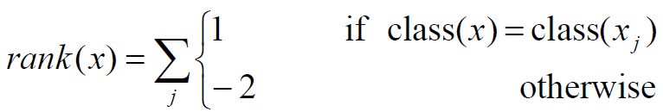
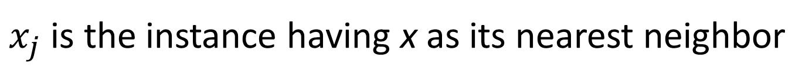
Naïve Rank Reduction
The Naïve Rank Reduction algorithm works in two steps, ranking and thresholding.
Ranking step:
$x_{j}$ is the instance having x as its nearest neighbor

Slide 4
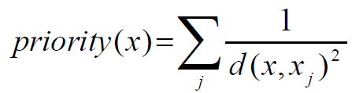
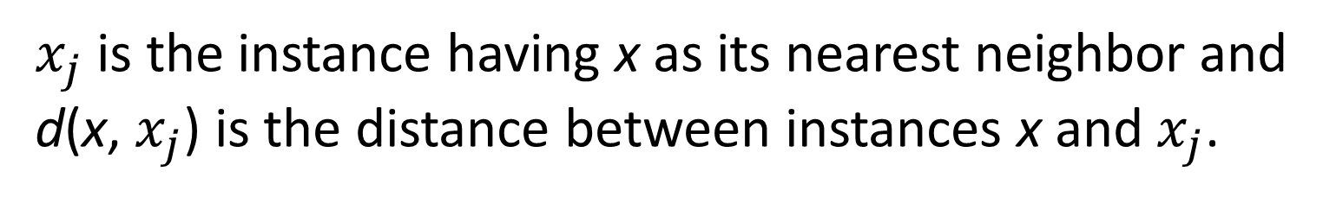
Naïve Rank Reduction
If two instances have the same rank, we break the tie by assigning different priorities to them.
Ranking step:
$x_{j}$ is the instance having x as its nearest neighbor and
d(x, $x_{j}$) is the distance between instances x and $x_{j}$.

Slide 5
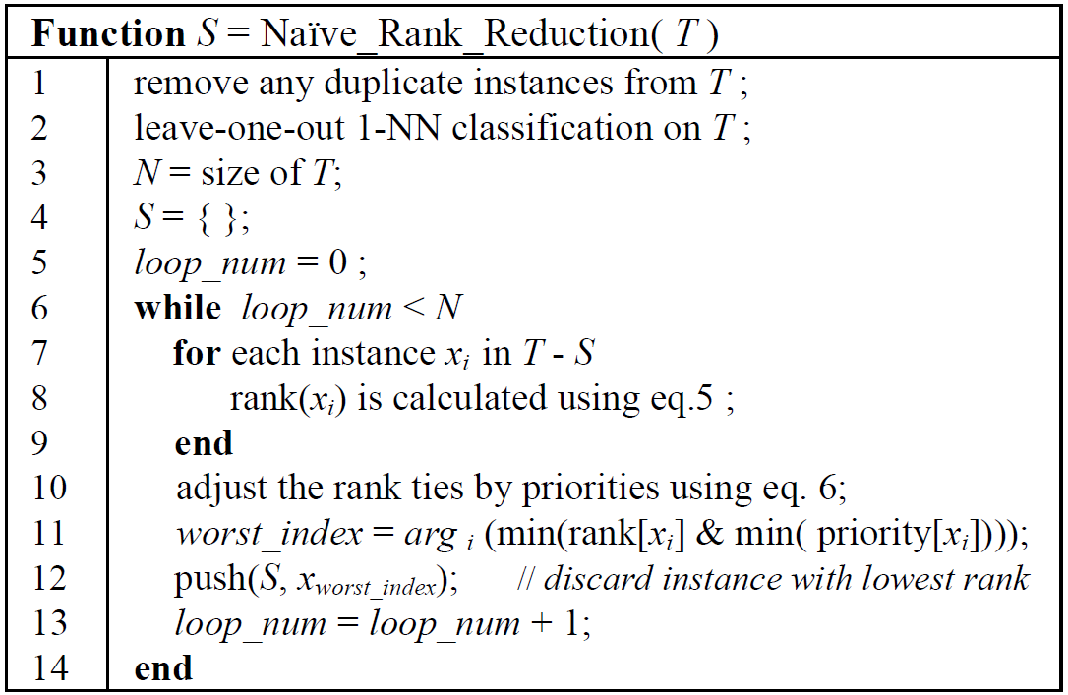
Naïve Rank Reduction
Ranking step:

Slide 6
Naïve Rank Reduction
Thresholding step:
keep the n highest ranking instances in S as the training set for future classification, where n is the threshold given by the user.

Slide 7
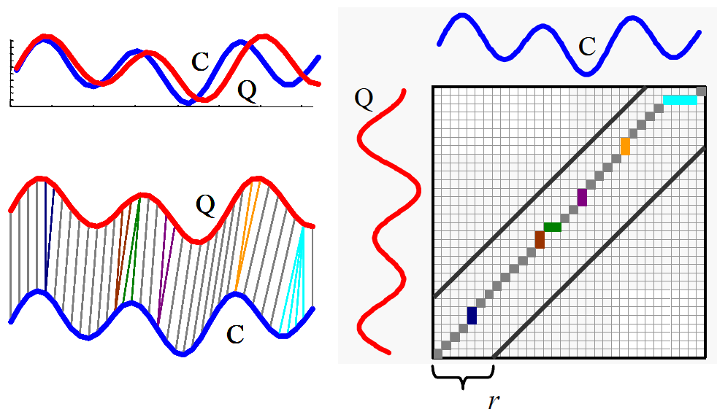
Numerosity Reduction with Adaptive Warping Window
Warping window constraints:

Slide 8
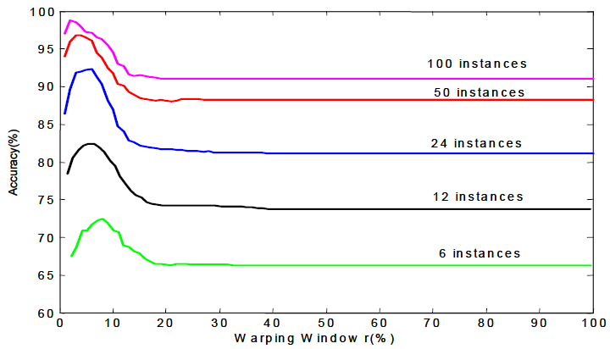
Numerosity Reduction with Adaptive Warping Window
Warping window constraints: A larger warping window constraint is not always good for accuracy.
Gun-Point Dataset using one-nearest-neighbor DTW. Each time, half of the
instances are randomly removed from the dataset.

Slide 9
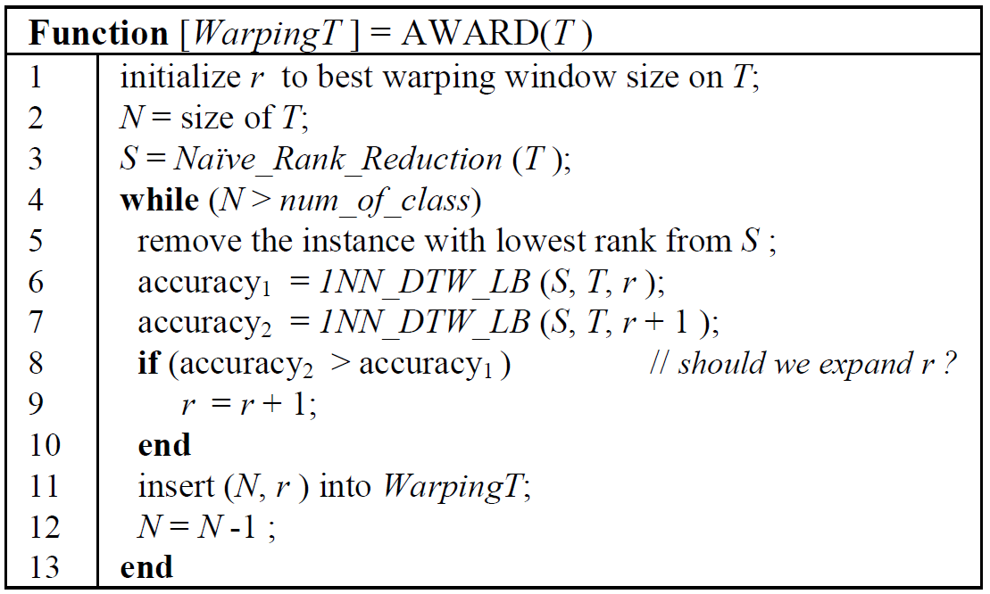
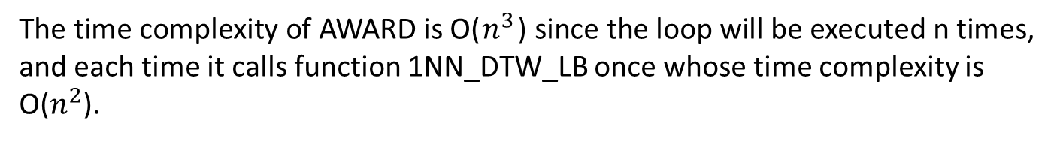
AWARD algorithm
The time complexity of AWARD is O($n^{3}$) since the loop will be executed n times, and each time it calls function 1NN_DTW_LB once whose time complexity is O($n^{2}$).

Slide 10
AWARD algorithm
1NN_DTW_LB uses dataset S to classify
dataset T with one-nearest-neighbor approach, and the distance measure used is DTW with warping window size r.
To accelerate classification, it adopts the widely used LB_Keogh lower bounding technique proposed in Keogh (2002) to locate the nearest neighbor.

Slide 11
Experimental Results
Two Patterns Dataset It contains 5,000 instances, each of length 128. There are four classes, denoting the presence of two patterns in a definite order, namely, down-down, up-down, down-up, and up-up.
We randomly choose 1,000 instances as training set, and use the remaining 4,000 instances as test set.

Slide 12
Experimental Results
RankFix, fixed window with naïve rank reduction
RandomFix, fixed window with random reduction
RandomEu, random reduction using Euclidean distance.

Slide 13
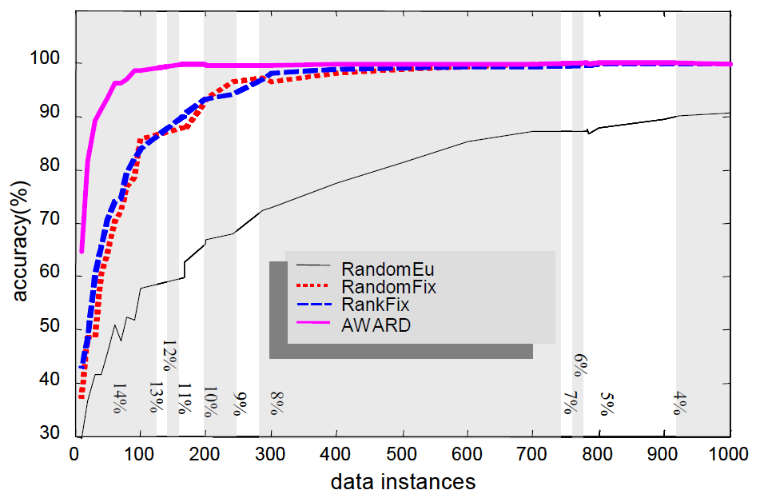
Experimental Results
RankFix and RandomFix always use warping window size of 4%.

Slide 14
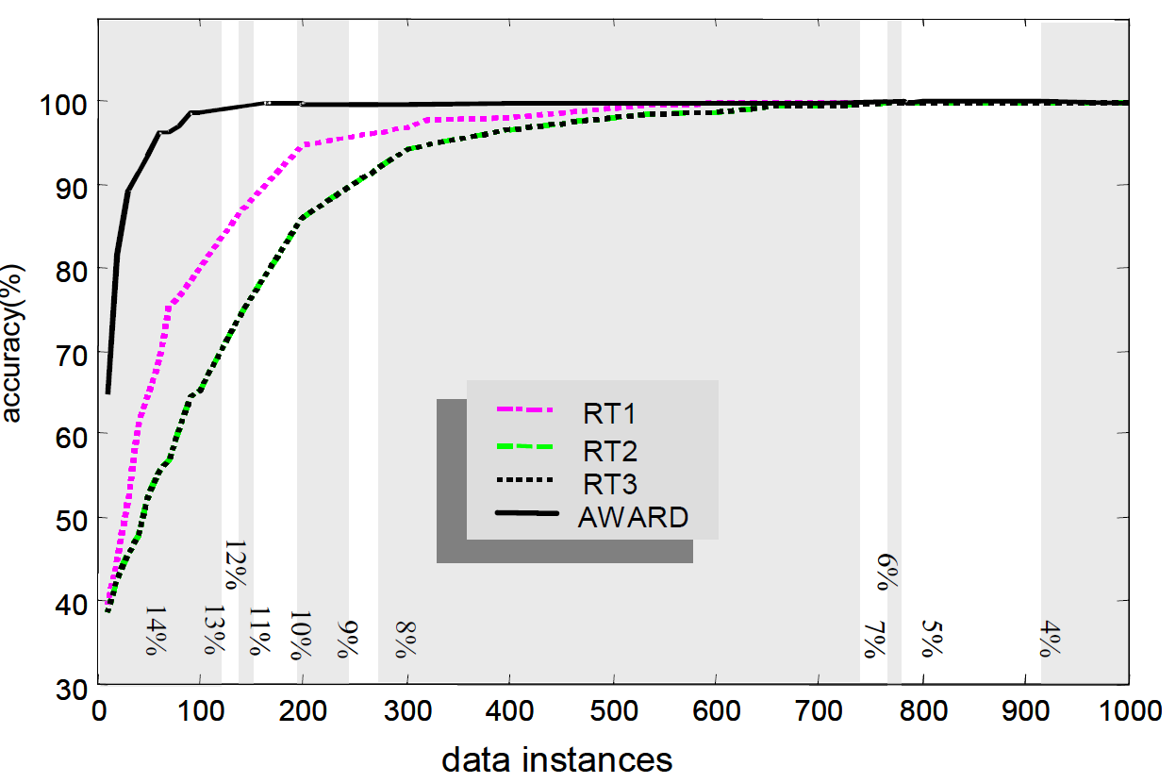
Experimental Results
Compare AWARD approach to the most referenced approaches in the numerosity reduction literature, namely RT1, RT2, and RT3 (Wilson & Martinez, 1997).

