Slide 1
Fast algorithm for constrained longest common subsequence problem
Theoretical and Applied Informatics
Vol. 19 (2007), no. 2 pp. 91–102
SEBASTIAN DEOROWICZ ª
Presenter:De-Sheng Jhan
2014/12/02

Slide 2
Abstract
The problem of finding the constrained longest common subsequence (CLCS) for the sequences A and B with respect to the sequence P was introduced recently. Its goal is to find the longest subsequence of A and B such that P is a subsequence of it. The best known algorithms for its solving require time of order of a product of the sequence lengths. We introduce a novel approach in which time and space complexities depend also on the number of matches between A, B, and P. The time complexity is better for typical parameter settings and never worse.

Slide 3
LCS
A = a₁a₂…a_{n} = ABAADACBAABC , n = 12
B = b₁b₂…b_{m} = CBCBDAADCDBA, m = 12
C = LCS(A, B) = B A A D C B A , |C| = 7

Slide 4
CLCS
A = a₁a₂…a_{n} = ABAADACBAABC , n = 12
B = b₁b₂…b_{m} = CBCBDAADCDBA, m = 12
C = LCS(A, B) = B A A D C B A, | C | = 7
P = p₁p₂…p_{r} = CBB, r = 3
P is not a subsequence of C

Slide 5
CLCS
A = a₁a₂…a_{n} = ABAADACBAABC , n = 12
B = b₁b₂…b_{m} = CBCBDAADCDBA, m = 12
P = CBB
C = CLCS(A, B) = B C B A A B, | C | = 6

Slide 6
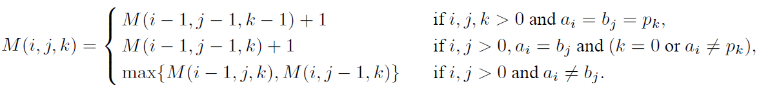
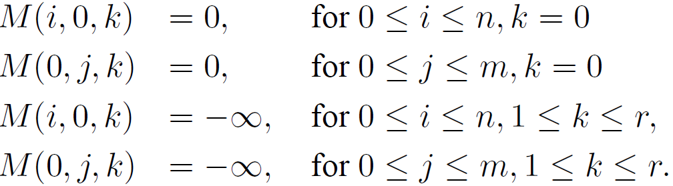
Chin et al. [2004]
O( rmn )
A_{i} = b_{j} = p_{k} : strong match

Slide 7
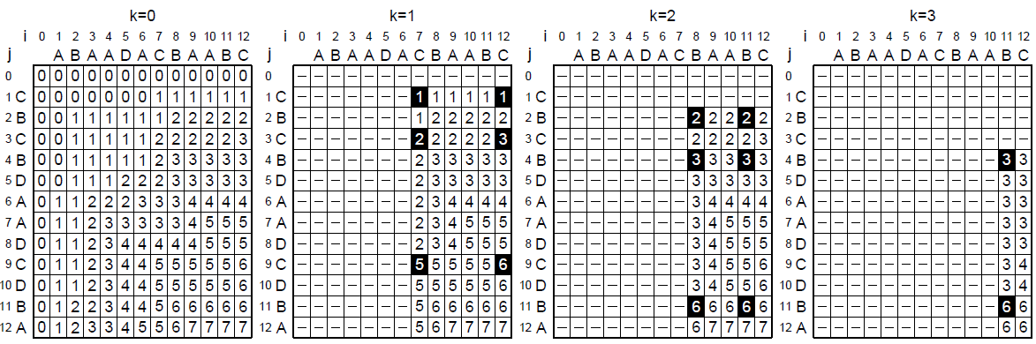
A = ABAADACBAABC
B = CBCBDAADCDBA
P = CBB

Slide 8
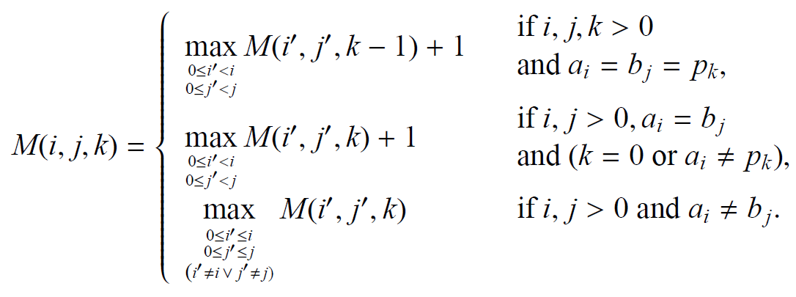
Our Algorithm

Slide 9
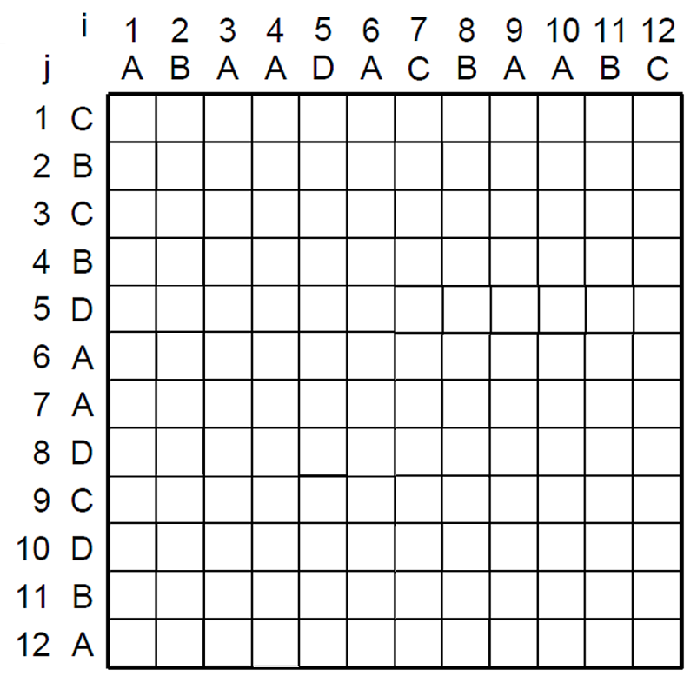
case1
case2
case3
K-1
K
Case1:

Slide 10
case1
case2
case3
Case2:
Case3:

Slide 11
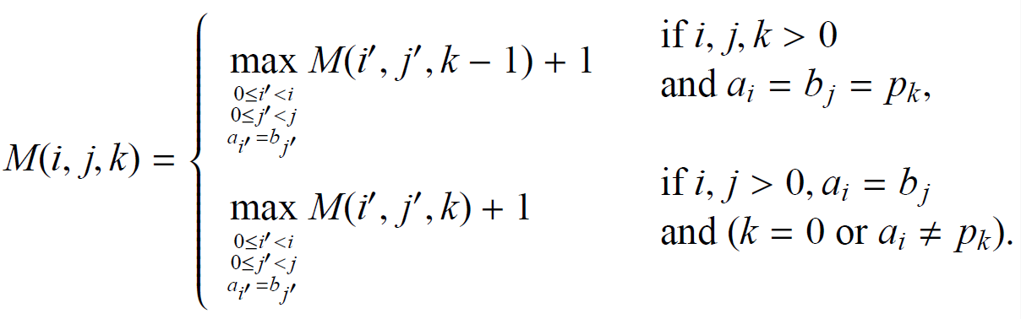

Slide 12
case1
case2
K-1
K
Case1:

Slide 13
case1
case2
Case2:

Slide 14
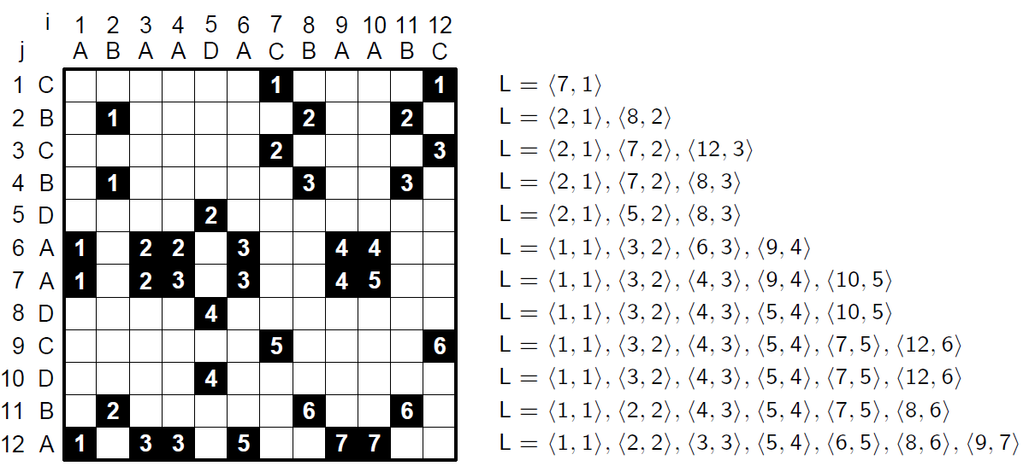
Variant of the Hunt-Szymanski

Slide 15
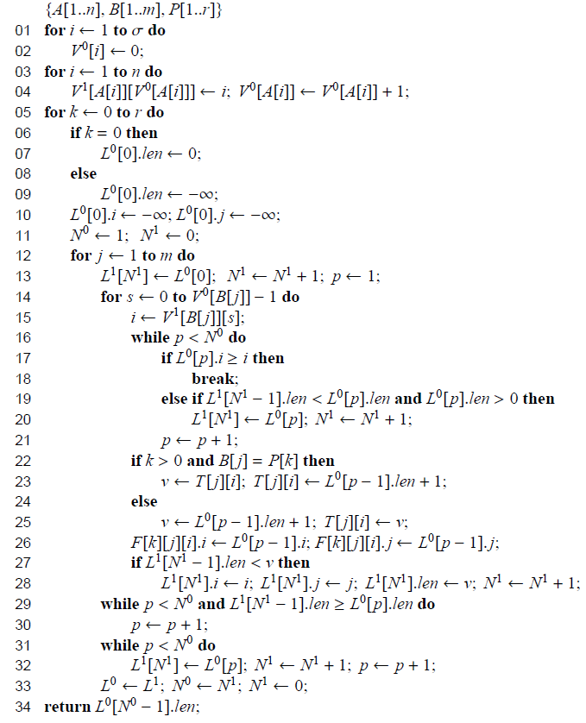
Algorithm computing the length of the CLCS

Slide 16
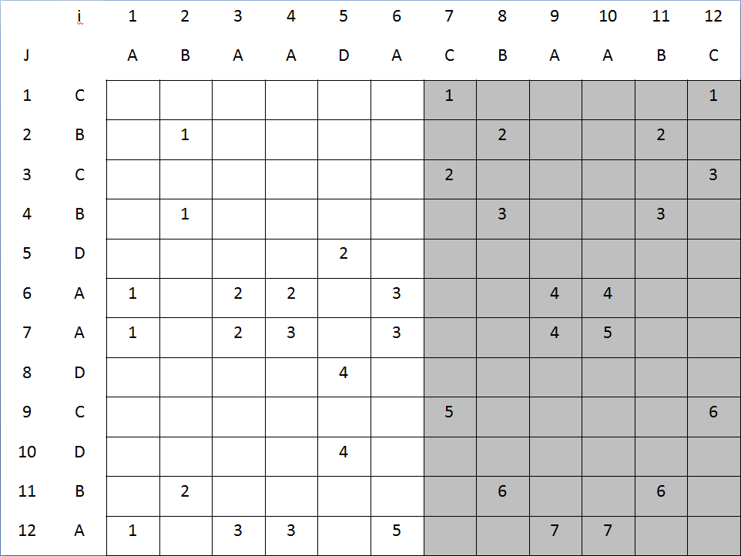
<7,1>
<7,1>,<8,2>
<7,2>,<12,3>
<7,2>,<8,3>
<7,2>,<8,3>
<7,2>,<8,3>,<9,4>
<7,2>,<8,3>,<9,4>,<10,5>
<7,2>,<8,3>,<9,4>,<10,5>
<7,5>,<12,6>,<9,4>,<10,5>
<7,5>,<12,6>,<9,4>,<10,5>
<7,5>,<8,6>,<9,4>,<10,5>
<7,5>,<8,6>,<9,7>,<10,5>
<i, M-value>

Slide 17
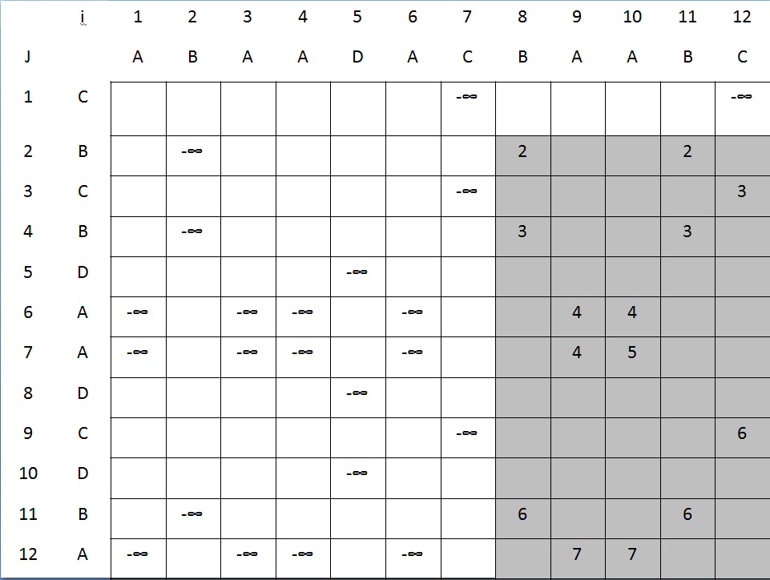
<8,2>
<8,2>,<12,3>
<8,3>,<12,3>
<8,3>,<12,3>
<8,3>,<9,4>
<8,3>,<9,4>,<10,5>
<8,3>,<9,4>,<10,5>
<8,3>,<9,4>,<10,5><12,6>
<8,3>,<9,4>,<10,5><12,6>
<8,6>,<9,4>,<10,5><12,6>
<8,6>,<9,7>,<10,5><12,6>

Slide 18
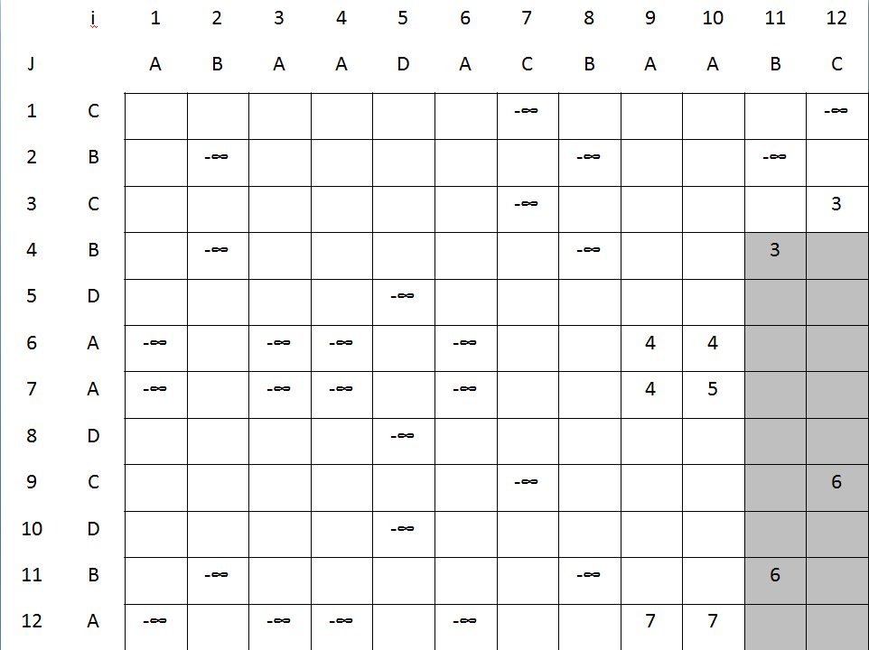
<11,3>
<11,3>
<11,3>
<11,3>
<11,3>
<11,3>,<12,6>
<11,3>,<12,6>
<11,6>,<12,6>
<11,6>,<12,6>

Slide 19
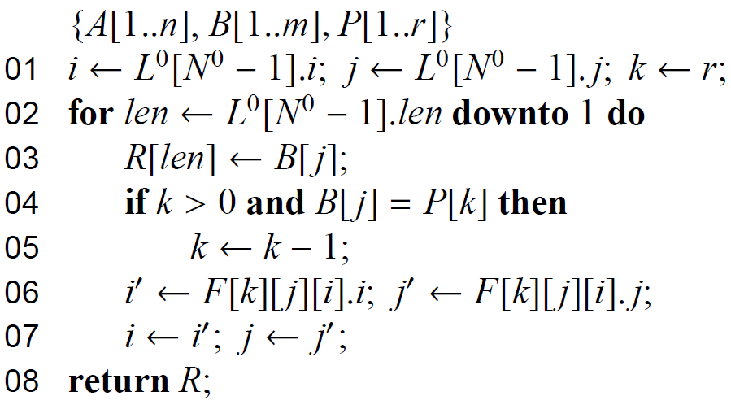
Algorithm computing the CLCS

Slide 20
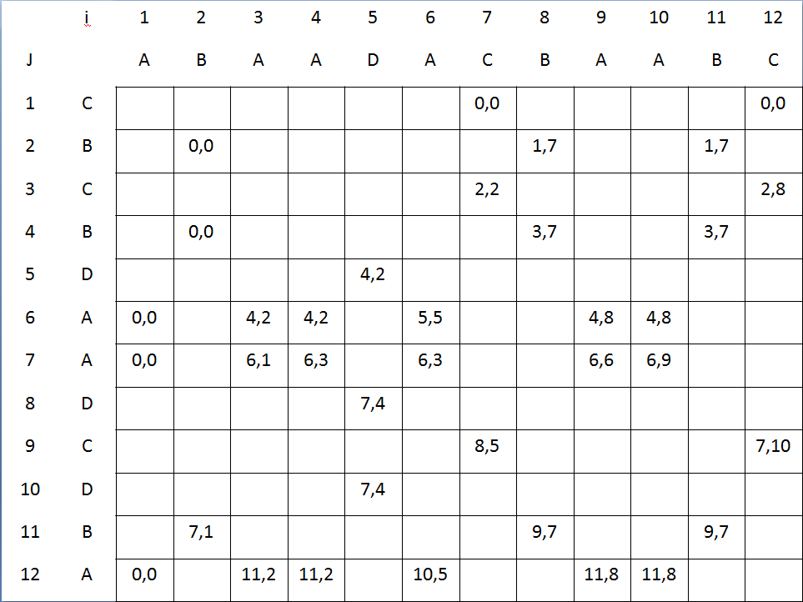
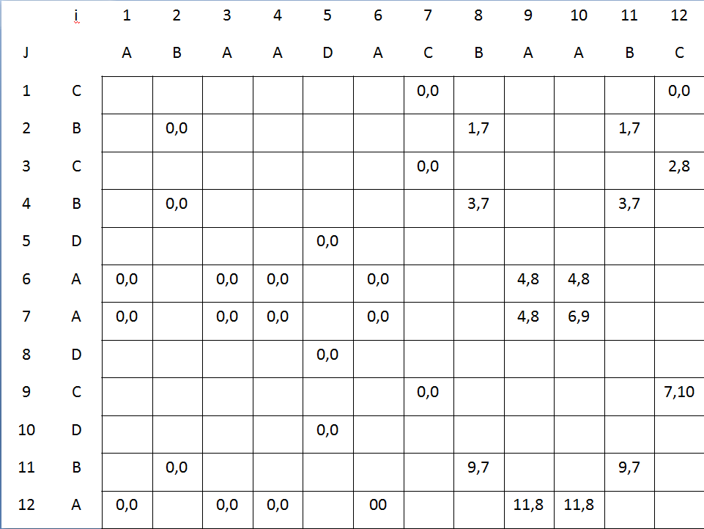
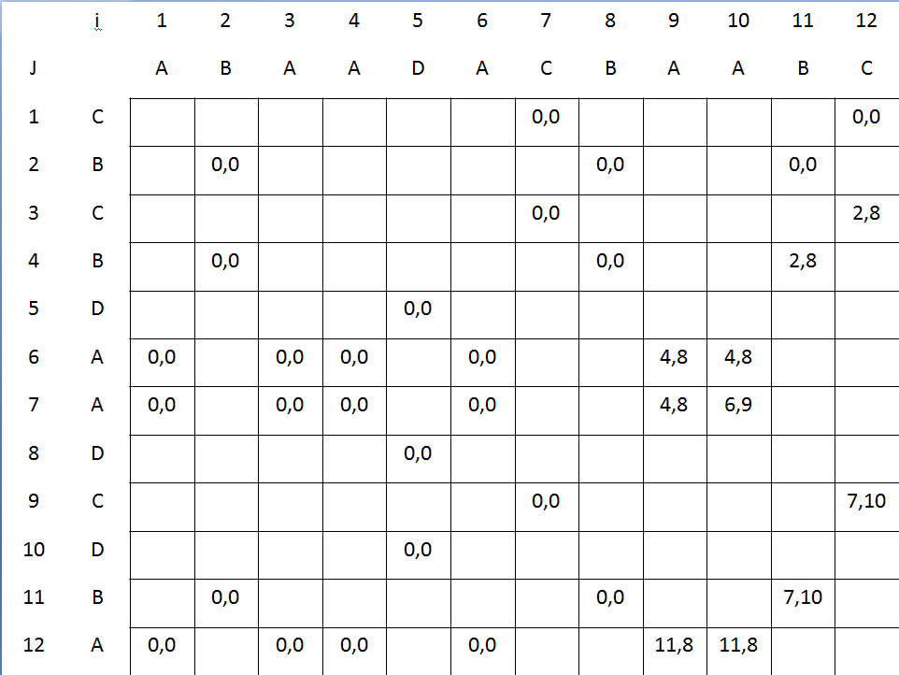
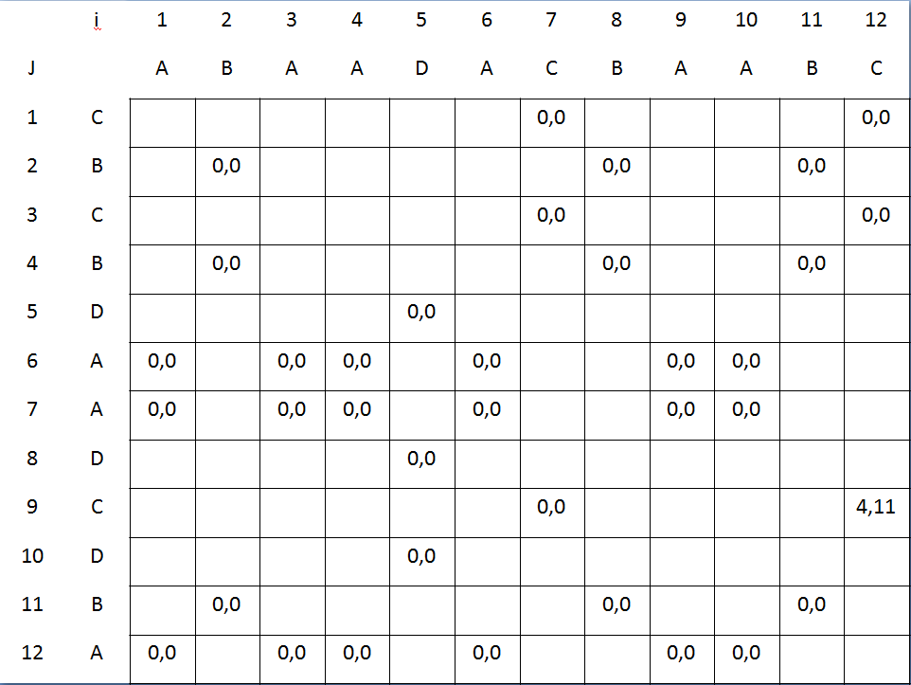
K=1
K=0
B
C
K=2
K=3
B
A
B
A

Slide 21
Experimental results(1/3)
We implemented both algorithms in C++, compiled using Microsoft Visual C++ 2005 compiler2, and run on a computer equipped with AMD Athlon 64 X2 5000+ processor (real 2600 MHz CPU clock) and 2GB RAM. Each time is a median of 51 executions.

Slide 22
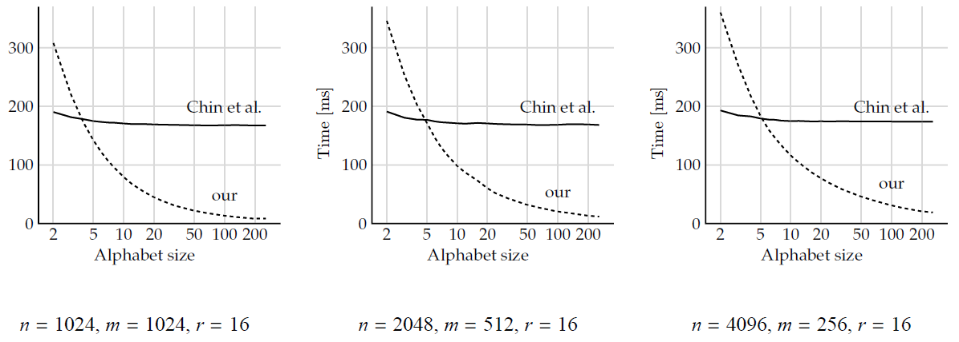
Experimental results(2/3)

Slide 23
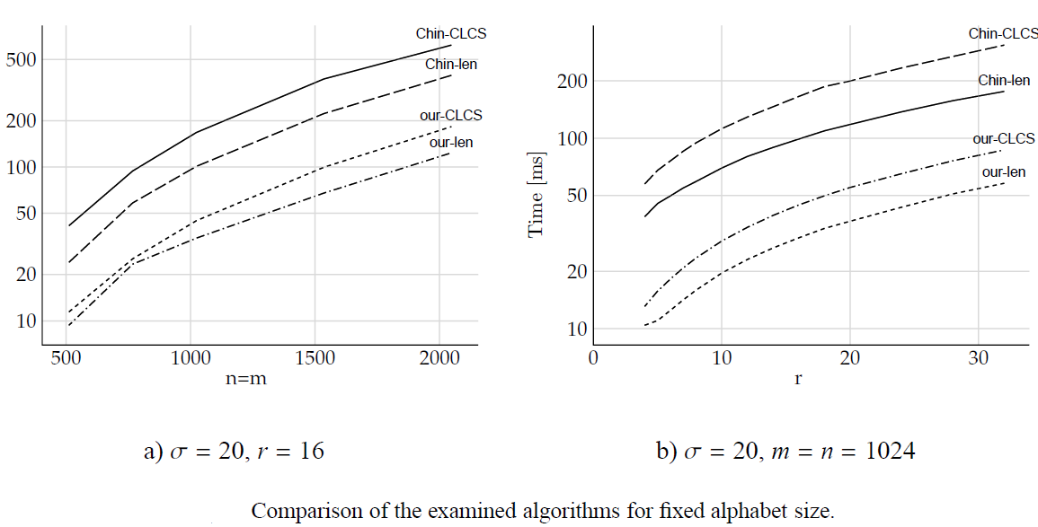
Experimental results(1/3)

Slide 24
Conclusions
The time complexity of the method is
O(r(ml + d) + n), where l is the LCS length for A and B and d is the number of matches between A and B.
The memory requirements of our algorithm is O(dr +max(n, σ)), where σ is the alphabet size.

Slide 25
Thanks for listening

