Slide 1
Proposal to sliding window-based support vector regression
Yuya Suzukia, Hirofumi Ibayashia, Yukimasa Kanedab, Hiroshi Minenoa*
Procedia Computer Science 35 ( 2014 ) 1615 – 1624
Presenter:Ding-Yao,Hunag
Date: 2014/12/15

Slide 2
Abstract
This paper proposes a new methodology, Sliding Window-based Support Vector Regression (SW-SVR), for micrometeorological data prediction. SVR is derived from a statistical learning theory and can be used to predict a quantity forward in time based on training that uses past data.
Although SVR is superior to traditional learning algorithms such as Artificial Neural Network (ANN),it is difficult to choose the suitable amount of training data to build an optimum SVR model for micrometeorological data prediction.

Slide 3
Abstract
This paper revealed the periodic characteristics of micrometeorological data and evaluated SW-SVR can adapt the appropriate amount of training data to build an optimum SVR model automatically using parallel distributed processing. The future prediction experiment was conducted on air temperature of Sapporo, Tokyo, Hamamatsu, and Naha.
As a result, SW-SVR has improved prediction accuracy in Sapporo, and Tokyo. In addition, it has reduced calculation time by more than 96 % in all regions.

Slide 4

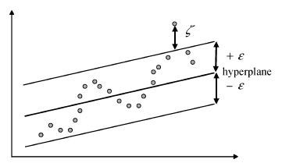
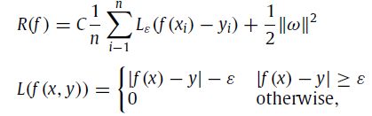

Introduction (Support Vector Regression)
x_{i} 是輸入向量，y_{i} 是實際目標值
是經驗誤差風險(empirical error risk)

Slide 5
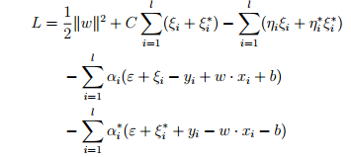
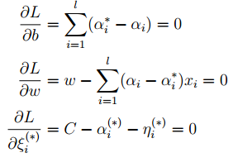

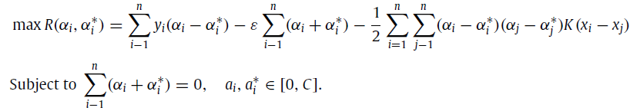
Introduction (Support Vector Regression)

Slide 6


Support Vector Regression (kernel function)
Support Vector (α_{i} − α_{i}∗ 不為零的 instances) 的個數有關
kernel function
linear: u'*v
polynomial: (gamma*u'*v + coef0)^degree
radial basis function: exp(-gamma*|u-v|^2)
sigmoid: tanh(gamma*u'*v + coef0)

Slide 7
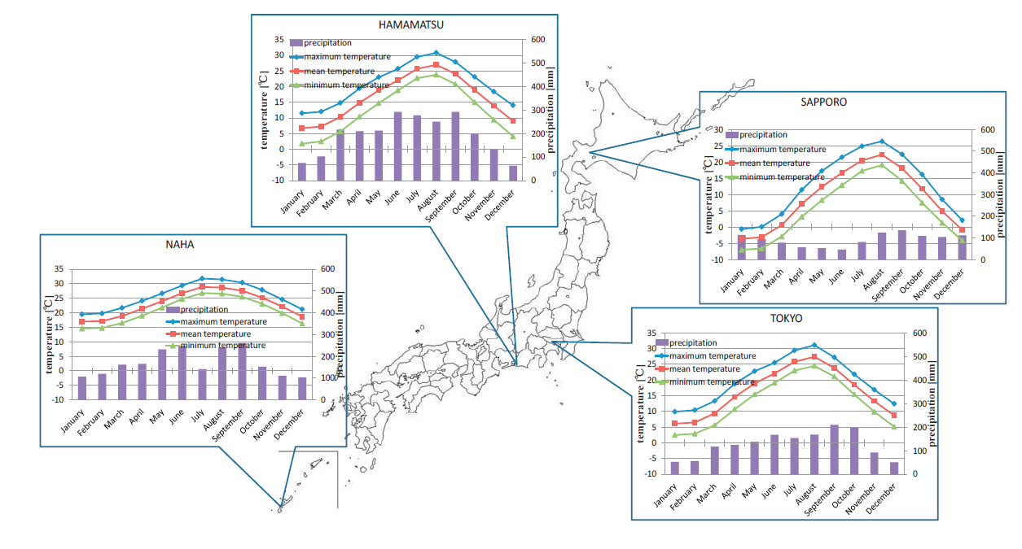
Sliding Windows-SVR
Notes:
那霸市-沖繩 最南邊
Hamamatsu濱松—中間
Sapporo札晃---最北方

Slide 8
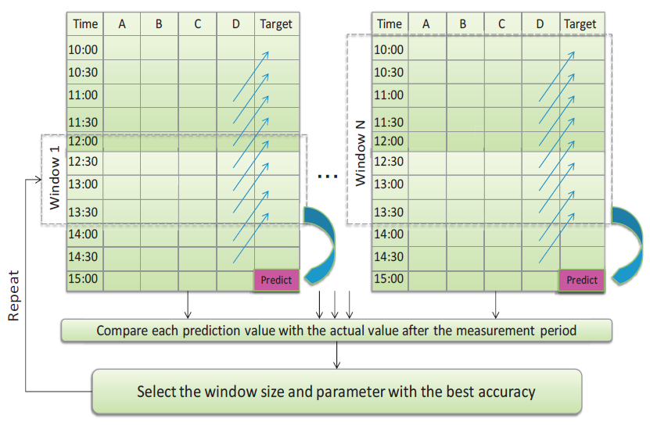
Sliding Windows-SVR

Slide 9
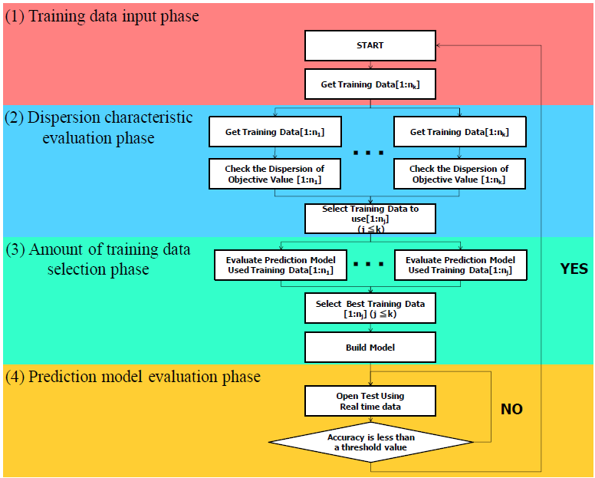
Sliding Windows-SVR
Notes:
第一階段將資料分成n等份,N要怎麼切是使用者自己決定

Slide 10
Sliding Windows-SVR
將過去3年
2011/1/1~2014/1/1
Notes:
第一階段將資料分成n等份,N要怎麼切是使用者自己決定

Slide 11
Sliding Windows-SVR
Notes:
選擇周期

Slide 12
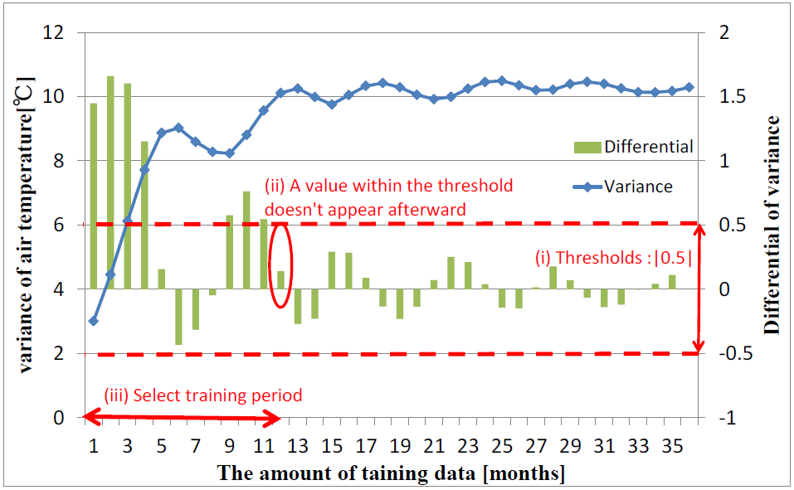
Sliding Windows-SVR
Notes:
預測的變異量 之後都沒有超過這個threshold
找到並定義這個收斂值

Slide 13
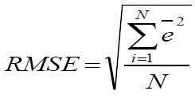
Sliding Windows-SVR

Slide 14
Sliding Windows-SVR
Notes:
不是的話 換下一個WINDOW

Slide 15
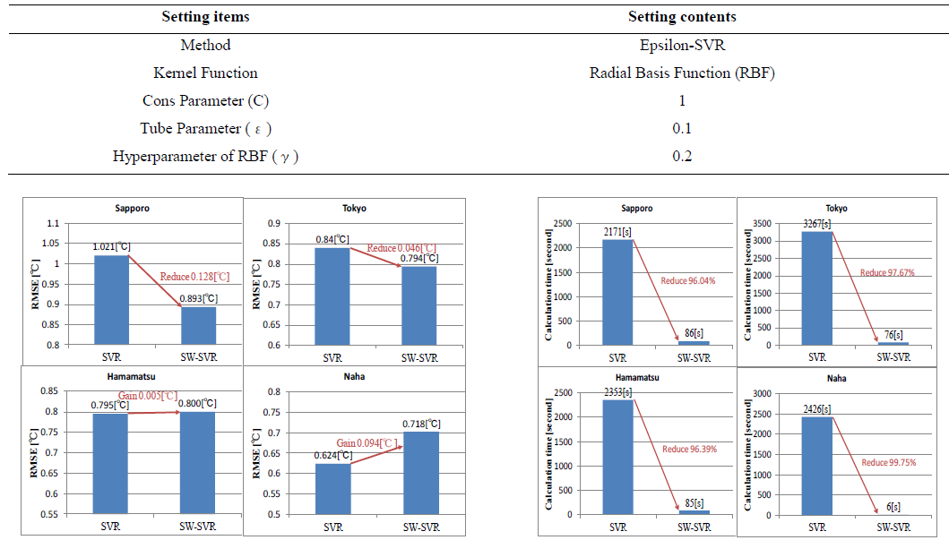
Result and discussion

Slide 16
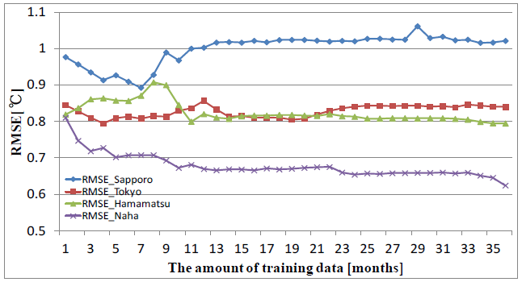
Result and discussion

Slide 17
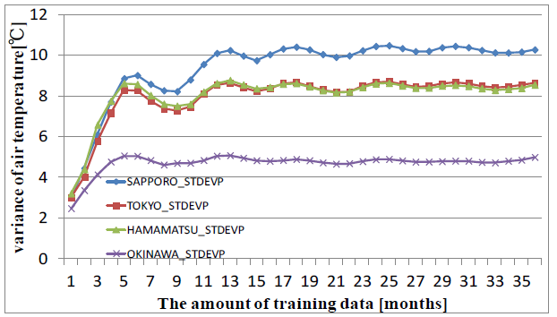
Result and discussion

Slide 18
Conclusion and future work
In this paper, SW-SVR that is a new methodology for micrometeorological data prediction was proposed. In time series air-prediction, since the meteorological data characteristics change according to the time elapsed, past data work as a noise data. Thus, it is necessary to determine the suitable amount of training data for building prediction model.
SW-SVR can determine the appropriate amount of training data to build more optimum SVR model automatically using parallel distributed processing. The experiments show that the proposed was successfully to determine the suitable amount of training data in the meteorological data of the year to January1, 2014 from January1, 2011 in Sapporo, Tokyo, Hamamatsu, and Naha provided by AMeDAS.
SW-SVR could improve RMSE in Sapporo, and Tokyo. In addition, it could reduce calculation time in all area. The remaining issues are evaluating more various situations to show SW-SVR works useful. In this paper, SW-SVR was evaluated using only air temperature.

