Slide 1
Marios A. Gavrielides, Elena ˇSikudová, and Ioannis Pitas IEEE TRANSACTIONS ON MULTIMEDIA, VOL. 8, NO. 4, pp. 740-748, AUGUST, 2006.
Color-Based Descriptors for Image Fingerprinting

Slide 2
Abstract(1/2)
Typically, content-based image retrieval (CBIR)systems receive an image or an image description as input and retrieve images from a database that are similar to the query image in regard to properties such as color, texture, shape, or layout. A kind of system that did not receive much attention compared to CBIR systems, is one that searches for images that are not similar but exact copies of the same image that have undergone some transformation. In this paper, we present such a system referred to as an image fingerprinting system, since it aims to extract unique and robust image descriptors (in analogy to human fingerprints).We examine the use of color-based descriptors and provide comparisons for different quantization methods, histograms calculated using color-only and/or spatial-color information with different similarity measures.

Slide 3
Abstract(2/2)
The system was evaluated with receiver operating characteristic (ROC) analysis on a large database of 919 original images consisting of randomly drawn art images and similar images from specific categories, along with 30 transformed images for each original, totaling 27570 images. The transformed images were produced with attacks that typically occur during digital image distribution, including different degrees of scaling, rotation, cropping, smoothing, additive noise and compression, as well as illumination contrast changes. Results showed a sensitivity of 96% at the small false positive fraction of 4% and a reduced sensitivity of 88% when 13% of all transformations involved changing the illuminance of the images. The overall performance of the system is encouraging for the use of color, and particularly spatial chromatic descriptors for image fingerprinting.

Slide 4
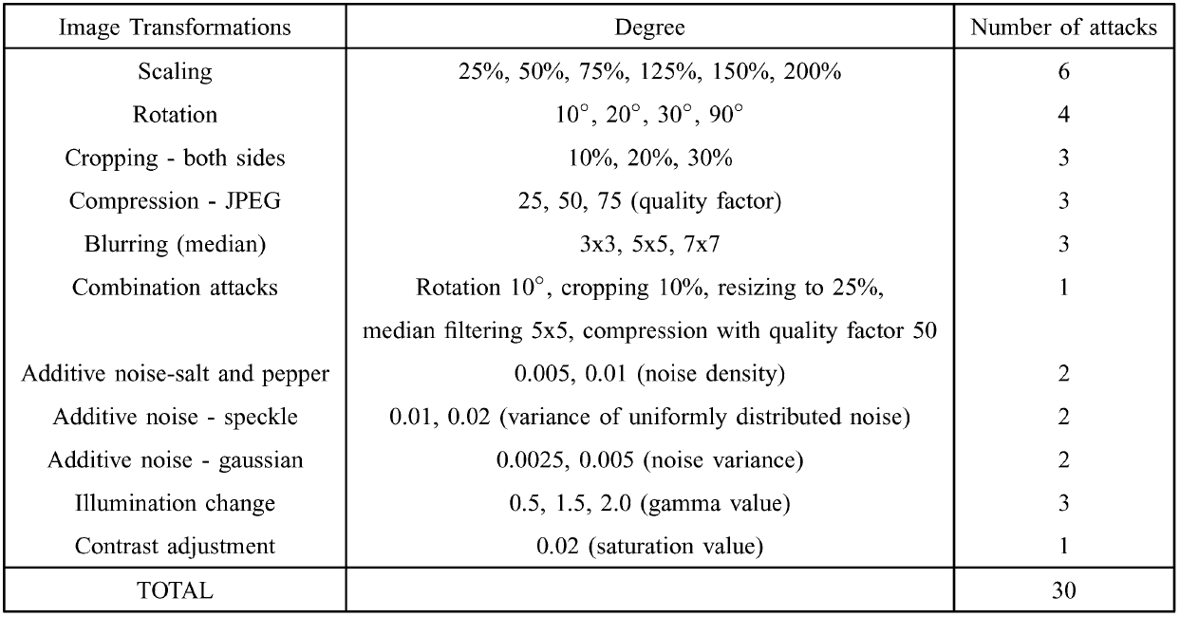
TRANSFORMATIONS APPLIED TO ORIGINAL IMAGES

Slide 5
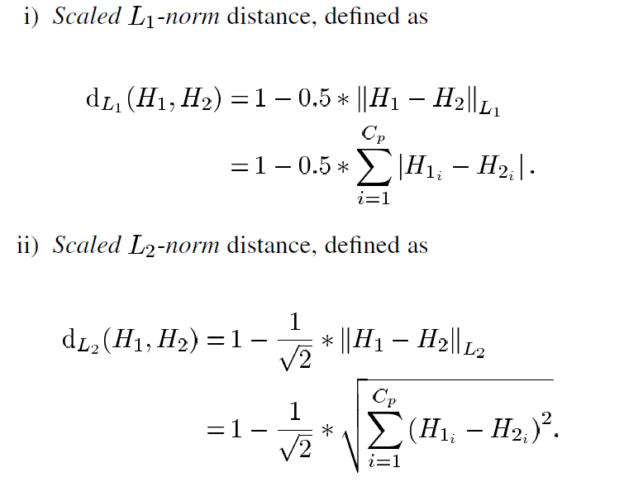



COLOR-BASED FINGERPRINT MATCHING
Normalized

Slide 6
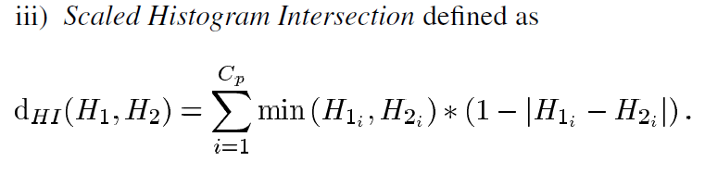
COLOR-BASED FINGERPRINT MATCHING

Slide 7
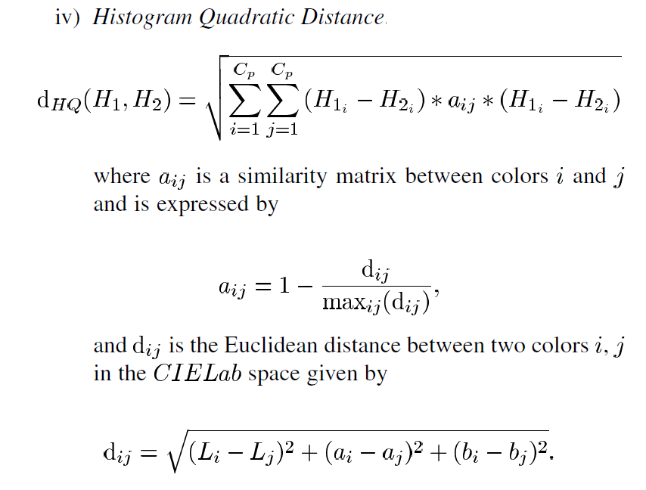
COLOR-BASED FINGERPRINT MATCHING

Slide 8
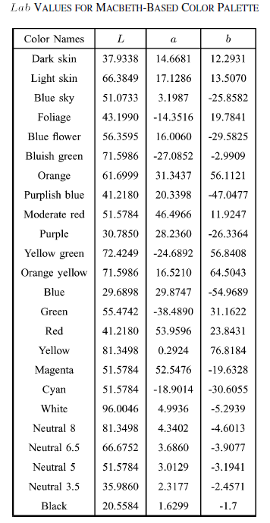
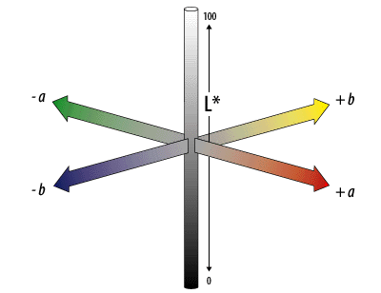
CIELab

Slide 9

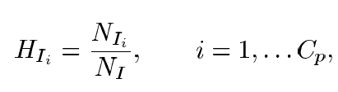

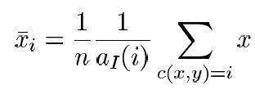
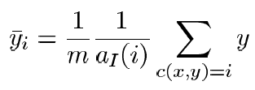

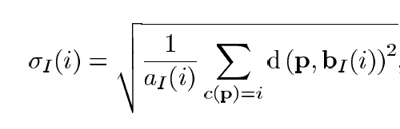


COLOR-BASED FINGERPRINT MATCHING
:

Slide 10
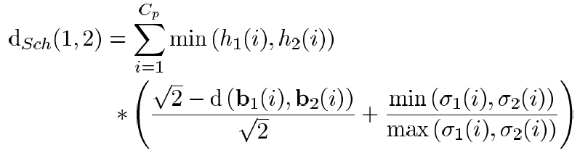
COLOR-BASED FINGERPRINT MATCHING

