Slide 1
Edit Distance with Move Operations
Dana Shapira and James A. Storer
Brandeis University, Waltham, MA
Journal of Discrete Algorithms
Volume 5 Issue 2, June, 2007
Pages 380-392

Slide 2
Abstract(1/3)
The traditional edit-distance problem is to find the minimum number of insert-character and delete-character (and sometimes change character) operations required to transform one string into another. Here we consider the more general problem of a string represented by a singly linked list (one character per node) and being able to apply these operations to the pointer associated with a vertex as well as the character associated with the vertex.

Slide 3
Abstract(2/3)
That is, in O(1) time, not only can characters be inserted or deleted, but substrings can be moved or deleted. We limit our attention to the ability to move substrings and leave substring deletions for future research. Note that O(1) time substring move operation implies O(1) substring exchange operation as well, a form of transformation that has been of interest in molecular biology. We show that this problem is NP-complete, and that a “recursive” sequence of moves can be simulated with at most a constant factor increase by a non-recursive sequence.

Slide 4
Abstract(3/3)
Although a greedy algorithm is known to have poor (a polynomial factor) worst case performance, we present a polynomial time greedy algorithm for non-recursive moves which on a sub class of instances of a problem of size n achieves an approximation factor to optimal of at most O(log n). The development of this greedy algorithm shows how to reduce moves of substrings to moves of characters, and how to convert moves of characters to only inserts and deletes of characters.

Slide 5
Edit distance(1/3)
Quantifying how dissimilar two strings
Edit distance ed(S, T) is the minimum-weight series of edit operations that transforms S into T.
3 operations
  Insertion : S = ac, insert b, S’ = abc
  Deleteion : S = abc, delete b, S’ = ac
  Substitution : S = abc, change b to e, S’ = aec

Slide 6
Edit distance(2/3)
Example : S = abcde T = adbce
 |  | a | b | c | d | e
 | 0 | 1 | 2 | 3 | 4 | 5
a | 1 | 0 | 1 | 2 | 3 | 4
d | 2 | 1 | 1 | 2 | 2 | 3
b | 3 | 2 | 1 | 2 | 3 | 3
c | 4 | 3 | 2 | 1 | 2 | 3
e | 5 | 4 | 3 | 2 | 2 | 2

Slide 7
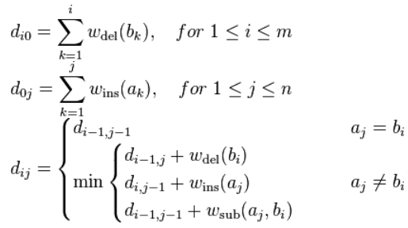
Edit distance(3/3)
Result:
Phase1. Delete d, abcde → abce
Phase2. Insert d, abce → adbce

Slide 8
Definition
Definition :
1. move(l, p1, p2) moves the string at position p2 of length l to position p1. Where 1 ≤ p1 < p2 ≤ n and a length 1 ≤ l ≤ n − p1 + 1(n is the length of sequence)
2. move(str, p1, p2) where str specifies the string which is moved, rather than its length. Move str from p1 to p2
Example :
S = abcdef T = adebcf
Our goal is transfer S to T
1. Move string bc from position 2 to position 4
2. Move string de from position 4 to position 2

Slide 9
Recursive moves(1/4)
Definition : A sequence of move operations applied to a string is recursive if it contains a move operation which moves a substring whose characters do not occur consecutively in the original string, or moves a substring in between characters which have already been moved.
Example :
Assume S = abcde
Move b to obtain T = acdbe
Move substring dbe is recursive move
Move substring ac is recursive move

Slide 10
Recursive moves(2/4)
Q : What’s different between recursive and non-recursive moves?
Example :
S = xababycdcdz T = xcddcyabbaz
Without recursive move:
Phase 1. Move(cd, 7, 2) => xcdababycdz
Phase 2. Move(d, 10, 4) => xcddababycz
Phase 3. Move(c, 10, 5) => xcddcababyz
Phase 4. Move(y, 10, 6) => xcddcyababz
Phase 5. Move(b, 10, 9) =>xcddcyabbaz

Slide 11
Recursive moves(3/4)
2. With recursive moves :
S = xababycdcdz T = xcddcyabbaz
Phase 1. Move(b, 5, 4) => xabbaycdcdz
Phase 2. Move(d, 10, 9) => xabbaycddcz
Phase 3. Move(cddc, 7 , 2) => xcddcabbayz
Phase 4. Move(y, 10, 6) => xcddcyabbaz
Conclusion:
With recursive moves we can reduce the cose to 4 operations.

Slide 12
Recursive moves(4/4)
1. Assume S = S1…Sn. After one move operation
move(l, p1, p2), S becomes as below
2. Every other move create a.t most 3 more blocks. If we have n recursive moves, then the number of blocks is bounded by 3n+1
3. If there are n recursive moves converts S to T, then there is a non-recursive of no more than 3n moves that converts S to T.
S1…S(p1-1) | S(p2)…S(p2+l+1) | S(p1)…S(p2-1) | S(p2+l)…Sn
Block1 | Block2 | Block3 | Block4

Slide 13
NP-Completeness
Given two strings S and T and an integer m ∈ N, using only the three unit-cost operations insert character , delete character , and move substring, it is NP-complete to determine if S can be converted to T with cost ≤ m using the above operations.

Slide 14
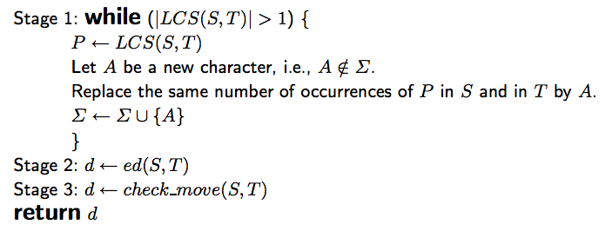
The greedy algorithm(1/4)
Definitions:
Stage1 :
Phase1. LCS(cdeab, abcde) = 3
New character A
Replace cdeab to Aab and abcde to abA
Phase2. LCS(Aab, abA) = 2
New character B
Replace Aab to AB and abA to BA
Then we have S = AB and T = BA

Slide 15
The greedy algorithm(2/4)
Definitions:
Stage2 : ed(S, T) is perform traditional edit distance on S and T
1. d >= 2
2. A -> delete(1)
3. insert(A, 2)
 |  | A | B
 | 0 | 1 | 2
B | 1 | 1 | 1
A | 2 | 1 | 2

Slide 16
The greedy algorithm(3/4)
Definitions:
Stage3 : check_move(S,T) check whether we can reduce the edit-distance by using move operations.
We find out that by performing move(1, 2, 1) can convert S to T, therefore d = 1.
1. AB -> move(A, 1, 2) -> BA
2. Move cde to the end of S
3. Reduce d to 1

Slide 17
The greedy algorithm(4/4)
The greedy denote that replaces the largest number of (non-overlapping) occurrences of LCS(S, T) in S and T by a new character.
The algorithm dose not perform any recursive move.
However we have shown that by not allowing recursive moves we do not increase the number of move operations by more than a constant factor.
Time complexity is O(n * m)

Slide 18

About move operations(1/2)
Combine delete and insert operation to one move operation.
Is that combine operations always better?
P = a way to convert a string S into T
= the number of insertions/deletions of the character σ ∈ Σ which were made when converting S into T using the path P
1.

Slide 19
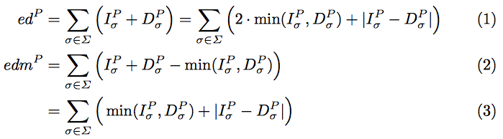


About move operations(2/2)
2.
3. If two path edP < edP’ ->
<

Slide 20
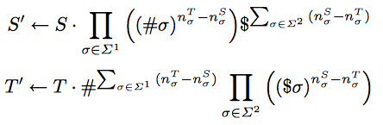
Only move operation
Given two strings S and T, we preprocess these strings and construct two new strings S’ and T’
3.
Example:
S = abcab T = abcdc
S’ = abcab#d#c$$ T’ = abcdc##$a$b
Greedy algorithm: S’ = Aab#d#c$$ T’ = Adc##$a$bs

Slide 21
Optimal & Greedy
Suppose
S = abaxxxababaxxxxab T = baxxxxababaxxxaba
Greedy:
S’ = BAxab T’ = baxAB
Edit distance = 4
Optimal:
Only two blocks require only one move operation.

