Slide 1
Longest Common Subsequence Problem and Its Approximation Algorithms
Kuo-Si Huang (黃國璽)

Slide 2
Substring and Subsequence
String vs. Substring
  A string v is a substring of a string s if s = s₁vs₂ for some prefix s₁ and suffix s₂
s = TAGTCACG
v₁ = TAGT v₂ = AGTCAC
v₃ = TAGTCACG …
Sequence vs. Subsequence
  A subsequence of a string s is a string obtained by deleting 0 or more characters from s.
s = TAGTCACG
s₁ = TTCCG s₂ = AGCACG
s₃ = TAGTCACG … ↑(No T)

Slide 3
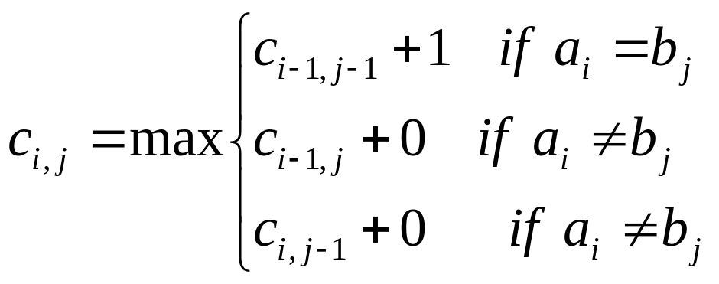
Longest Common Subsequence (1)
2-sequence version:
  To find a longest common subsequence between two sequences.
string1: TAGTCACG
string2: AGACTGTC
⇒ LCS : AGACG
  Dynamic programming:

Slide 4
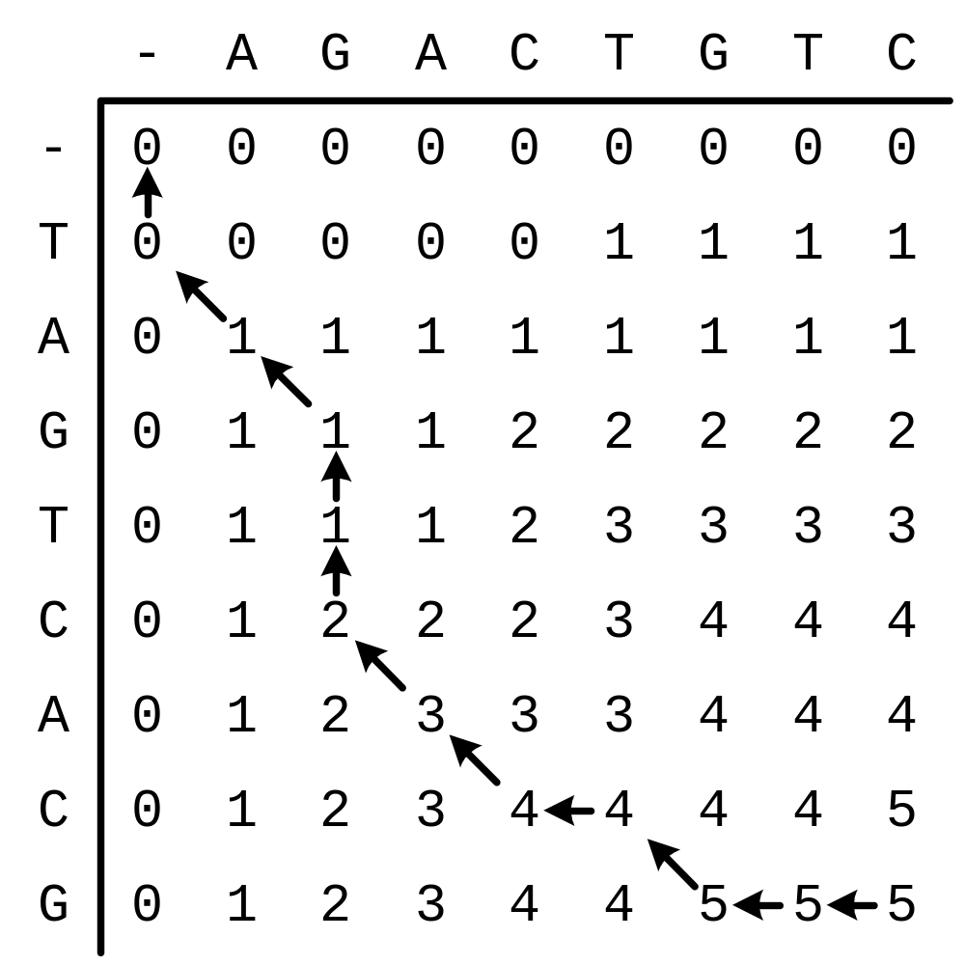
Longest Common Subsequence (2)
TAGTCACG
AGACTGTC
LCS:AGACG

Slide 5
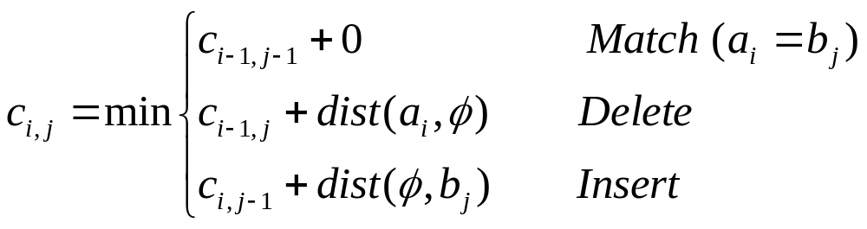
Edit Distance
To find a smallest edit process between two strings.
TAGTCAC G
AG ACTGTC
Operation: DMMDDMMIMII

Slide 6
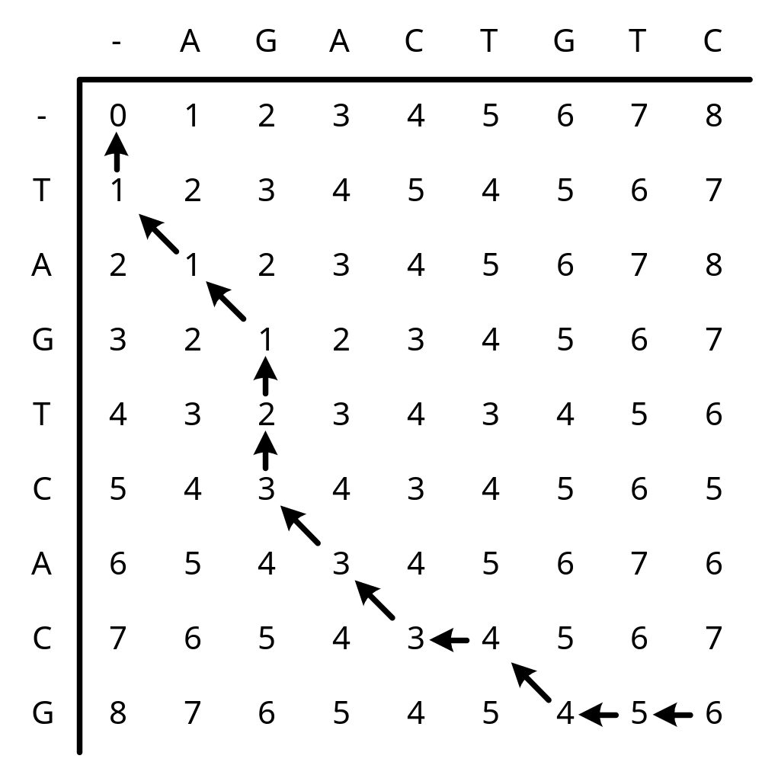
2-LCS and Sequence Alignment
AGACTGTC
TAGTCACG
⇓
-AG--ACTGTC
TAGTCAC-G--
1974 Wagner-Fischer, edit distance, O(m n) using dynamic programming

Slide 7
Algorithms Time Space
------------------------------------------------------------------------------------------
1974 Wagner-Fischer O(m n) O(m n)
1975 Hirschberg O(m n) O(n)
1977 Hunt-Szymanski O((n+R)log n) O(R+n)
1977 Hirschberg O(Ln + n log n) O(Ln)
1977 Hirschberg O(L(m− L)log n) O((m− L)²+n)
1980 Masek-Paterson O(n max{1, m/log n}) O(n²/log n)
1982 Nakatsu et al. O(n(m− L)) O(m²)
1984 Hsu-Du O(Lm log(n/L) + Lm) O(Lm)
1985 Ukkonen O(Em) O(E min{m, E})
1986 Apostolico O(n+m log n + D log(mn/D)) O(R+m)
1987 Kumar-Rangan O(n(m −L)) O(n)
1987 Apostolico-Guerra O(Lm + n) O(D+n)
1990 Chin-Poon O(n+min{D, Lm}) O(D+n)
1992 Apostolico et al. O(Lm) O(n)
1992 Eppstein et al. O(n+D log log min{D, mn/D}) O(D+m)
Time and space complexity of algorithms computing L(u, v). Here m = |u|, n = |v|, m≤n, R = number of matches, L = length of a longest common subsequence, E = m+n −2L = edit distance, D = number of dominant matches. (M. S. Paterson and V. Dancik(1994))

Slide 8
Global Alignment vs. Local Alignment
Global alignment:
Local alignment:
Pairwise alignment

Slide 9
Multiple Sequence Alignment
The multiple sequence alignment problem is to simultaneously align more than two sequences.
For k sequences of length n: O(n^{k})
NP-Complete
  L. Wang and T. Jiang. On the complexity of multiple sequence alignment. Journal of Computational Biology, 1:337-348, 1994.
The exact multiple alignment algorithms for many sequences are not feasible.
Some approximation algorithms are given.
(e.g., 2 – l/k for any fixed l by Bafna et al.)

Slide 10
Counterexample for Progressive MSA
S1 = taacc
S2 = aatgg
S3 = ccggt
LCS(S1, S2) = LCS(taacc, aatgg) = aa
LCS((S1, S2), S3) = LCS(aa, ccggt) = 0
LCS(S2, S3) = LCS(aatgg, ccggt) = gg
LCS((S2, S3), S1) = LCS(gg, taacc) = 0
LCS(S1, S3) = LCS(taacc, ccggt) = cc
LCS((S1, S3), S2) = LCS(cc, aagtt) = 0
LCS(S1, S2, S3) = LCS(taacc, aatgg, ccggt) = t

Slide 11
Progressive Alignment
s₁ = AAAAAGGG AAAAAGGG-----
s₂ = GGGAAAAA -----GGGAAAAA
s₃ = CCCCCGGG CCCCCGGG-----
s₄ = GGGCCCCC -----GGGCCCCC
---AAAAAGGG--------
GGGAAAAA-----------
-----------CCCCCGGG
--------GGGCCCCC---
What to optimize?

Slide 12
k-LCS
  Given k (k ≥ 2) strings S = {s₁, s₂, …, s_{k}} over a finite alphabet Σ, the problem is to find a longest sequence t = a₁a₂…a_{p}, which is a subsequence to each s_{i} for all i ∈ {1, 2, …, k}.
  s₁ = GCCGAGTTGGCT
  s₂ = AGCTACAGTGCT
  s₃ = AGACATGTACGA
  s₄ = ACGCAAGTGAGC
  t = GCAGTC
  Easy?
  NP-Complete problem
    D. Maier. The complexity of some problems on subsequences and supersequences. Journal of the ACM, 25:322–336, 1978.

Slide 13
Optimal k-LCS Method
Dynamic programming: O(n^{k})
Koji Hakata and Hiroshi Imai (1992)
O(nσ k+Dσ k(log^{k−3}n+log^{k−2}σ))
  for k sequences of sequence length n on alphabet of size σ, and D is the number of dominant matches.
R.W. Irving and C.B. Fraser (1992)
Algorithm 1: O(kn(n – l)^{k-1})
Algorithm 2: O(kl(n – l)^{k-1} + kσ n)
  for k sequences with length n, where l is the length of an LCS, and σ is the alphabet size.

Slide 14
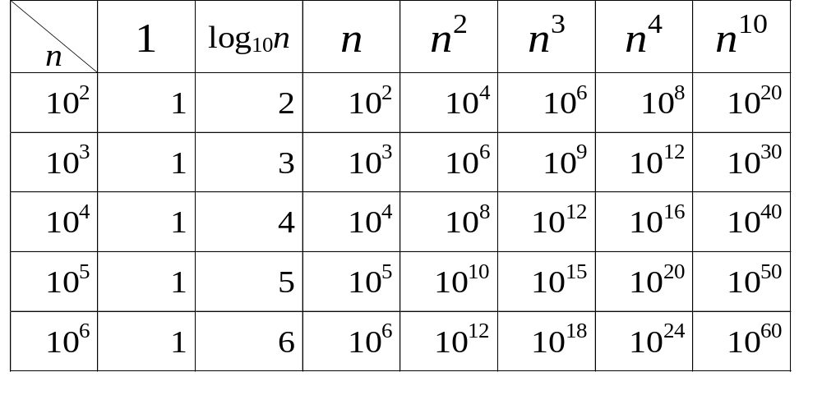
Time Complexity
1GHz = 10⁹Hz, 1 year ≅ 3×10⁷ seconds
⇒ 10¹⁷ units of time ≅ 3years,
10²⁰ units of time ≅ 3000 years

Slide 15
Approximate k-LCS Algorithm
Input: k sequences with length n over a finite alphabet Σ.
Output: A near longest common subsequence of above k sequences.
Long Run: O(kn)
Expansion Algorithm: O(kn⁴log n)
Paola Bonizzoni, Gianluca Della Vedova, Giancarlo Mauri,
“Experimenting an Approximation Algorithm for the LCS.”
Discrete Applied Mathematics, 110(1):13-24, 2001.

Slide 16
Long Run Algorithm
  s₁ = GCCGAGTTGGCT (1A 5G 3C 3T)
  s₂ = AGCTACAGTGCT (3A 3G 3C 3T)
  s₃ = AGACATGTACGA (5A 3G 2C 2T)
  s₄ = ACGCAAGTGAGC (4A 4G 3C 1T)
  (1A 3G 2C 1T)
  t′ = GGG
  Recall: t = GCAGTC
¼-approximation algorithm over Σ = {A,G,C,T}

Slide 17
Expansion Algorithm
S = {a⁴b³a⁴b²a, a³b⁴a⁴b³}
Sream: abab
Sequences of the expansions:
abab, a²bab, a²b²ab, a²b²a²b, a²b²a²b², a²b²a⁴b², a³b²a⁴b², a³b³a⁴b²
Return: a³b³a⁴b²
¼-approximation algorithm over Σ = {A,G,C,T}
Time complexity: O(kn⁴log n)

Slide 18
Semimanufacture
Old version
n = 20
s₁ = AGAGCGAAGGTACGTATACT
s₂ = CTTAAGACGCATCGTACTAG
t = AAGAGACGAT (10)
lcs = AGAGCATCGTATA (13)

Slide 19
Semimanufacture
Recent version
s₁ = AGAGCGAAGGTACGTATACT
s₂ = CTTAAGACGCATCGTACTAG
t = AGACGACGTACT (12)
lcs = GACGCCCCCGCG (13)

Slide 20
Semimanufacture
S1= AGAGCGAAGGTACGTATACT
s2= CTTAAGACGCATCGTACTAG
Conanical sequence:
c1= ATAGACGGACGTATACT

Slide 21
Semimanufacture
2.
s1= AGAGCGAAGGTACGTATACT
s2= CTTAAGACGCATCGTACTAG
c1= ATAGACGGACGTATACT
Conanical sequence:
c2= A(T)AGACGGACGTATACT

Slide 22
Semimanufacture
3.
s1= AGAGCGAAGGTACGTATACT
s2= CTTAAGACGCATCGTACTAG
c2’=AAGACGGACGTATACT
Conanical sequence:
c2’=AAGACGGACGTATACT

Slide 23
Semimanufacture
4.
s1= AGAGCGAAGGTACGTATACT
c2’= AAGACGGACGTATACT
LCS:
cs1= AGACGAGCGTATACT
-----------------------------
s2= CTTAAGACGCATCGTACTAG
c2’= AAGACGAGCGTATACT
LCS:
cs2= AAGACGACGTACT

Slide 24
Semimanufacture
5.
cs1=AAGACGACGTACT
cs2=AGACGAGCGTATACT
LCS:
cs= AGACGACGTACT

Slide 25
Our Time Complexity
O(k σ² n²)
  where k: # of sequence, σ : # of symbols, n: length of sequence
1GHz = 10⁹Hz, 1 year ≅ 3×10⁷ seconds
⇒ 10¹⁷ units of time ≅ 3years,
10²⁰ units of time ≅ 3000 years

Slide 26
Possible Contribution
A faster method to evaluate (guess) the similarity of a set of sequences.
A faster method to find the common subsequence (consensus) of several sequences.
A faster method to generate a common subsequence which can be adopted by other local improvement methods.

Slide 27
Conclusion
If we complete the mission with good result,
  we can obtain the MSA based on the k-LCS.
  compared with other MSA methods, it is a faster tool to view an MSA result.
  we shall study the relation between the k-LCS and MSA for getting better MSA.
  we can apply the k-LCS to construct evolutionary trees (cf. pairwise and progressive).

