Slide 1
Motif Finding in Transcription Factor Binding Sites
Jian-Bien Chen (陳建儐)

Slide 2
Outline
Background
Method
Improvement
Discussion

Slide 3
Background (1)
Transcription factor:
(1)general transcription factors.
(2)gene-specific transcription factors.
(gene activator)
Gene-specific factors:
(1)讓轉錄的速度增加，或是抑制轉錄發生。
(2)用來控制轉錄，藉由與enhancer的結合，來調節、
控制轉錄。

Slide 4
Background (2)
Why detecting regulatory site is a difficult problem?
In eukaryotes, the consensus sequences recognized by transcription factors are generally much shouter than in prokaryotes, they can quite variable, and can be dispersed over large distances. They can generally active in both orientations.

Slide 5
Definition
Input: Several DNA sequences with length = 1000bp.
Output: Several motifs with highly conserve (threshold > d).

Slide 6
Method (1)
Local alignment (Waterman,1984)
-an essential prerequisite of these methods is that the regulatory elements have to share a conserved position relative to a common reference (eg. the transcription start).
-This method well adapted to analysis of prokaryote promoters, but would be inappropriate for eukaryotes.

Slide 7
Method (2)
Consensus (Stormo & Hartzell, 1989)
-one drawback is that Consensus isolates a single element from each family.
-another drawback is two parameter: matrix length and expected number of marches (set to 35)
-slow (several minutes for each family)

Slide 8
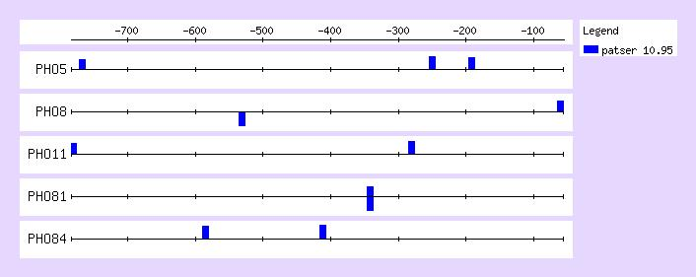

Slide 9
Method (3)
The Gibbs sampler method (Lawrence, 1993)
-can detect shared motifs in either proteic or nucleic acid sequences, with or without gap.
-Gibbs sampler is thus more sensitive than oligonucleotide analysis.
-slow (20 minutes per family).

Slide 10
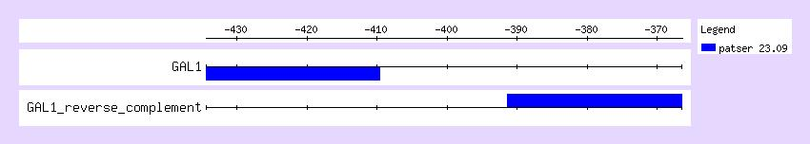

Slide 11
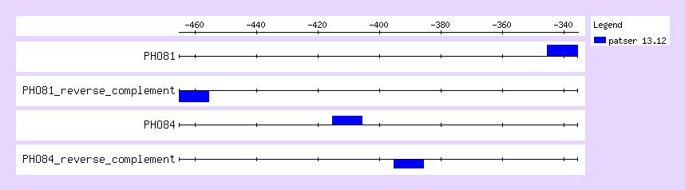

Slide 12
Improvement
Not only consider exact match.
The motifs should include ‘spacers’, which precludes algorithm from finding such well known binding sites as Gal4p, whose consensus is CGGNNNNNNNNNNNCCG.
In statistical model, assume occurrences of a motif at distinct sequence position are probabilistically independent, whereas in reality overlapping occurrences (in both orientations) have rather complex dependencies (Nicodeme, 1999).

Slide 13
Discussion
利用Gibbs Sampler 的方法，不外加任何條件的限制，所找到的 motif 現實生活中的 motif 是有一段差距的。
改進：
考慮 motif 出現的 frequency 及 positional information 。
用ambiguous的方法作motif時，score function的取法為何？
或是尋找其他motif的方法。

