Slide 1
Prediction of Protein Subcellular Locations by
Incorporating Quasi-Sequence-Order Effect
Biochemical and Biophysical Research Communications 278, 477–483 (2000)
報告者:李崑豪

Slide 2
Introduction
The function of a protein is closely correlated with its subcellular location.
The protein cellular location plays a important role in molecular biology, cell biology, pharmacology, and medical science.
Although there are many experiments to prediction protein location, but it is time consuming and costly to acquire the knowledge solely based on experimental.
There are many methods to develop to predict protein subcellular location.

Slide 3
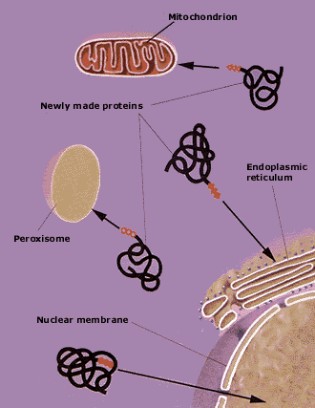
http://www.nobel.se/medicine/educational/poster/1999/signal.html

Slide 4
All these prediction methods are based on the amino-acid composition alone.
For a protein of only 50 residues, the number of different sequence order combinations would be 20⁵⁰≒1.1259 × 10⁶⁵.
The prediction of protein subcellular location could be based on the amino-acid composition.

Slide 5
The prediction quality will be certainly improved if the sequence order information can also be incorporated into the prediction algorithm.
To make the sequence order effect formulation to fit the statistical prediction algorithms.

Slide 6
The Quasi-Sequence-Order Approach
Suppose a protein chain of L amino acid residues
        R₁R₂R₃R₄R₅R₆R₇ · · · R_{L}
The sequence order effect can be approximately
reflected through a set of sequence-order-coupling
numbers

Slide 7
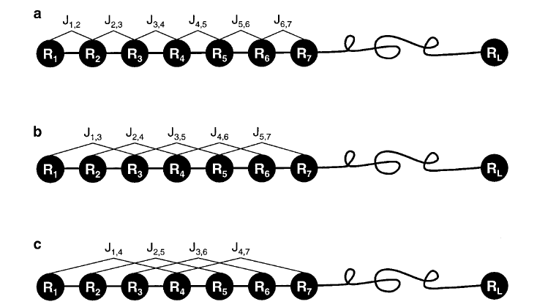
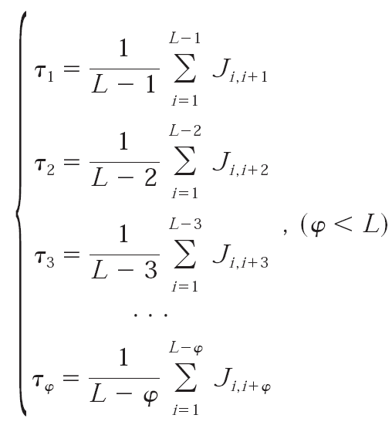

τ₁: 1st-rank sequence-order-coupling number that reflects the coupling mode between all the most contiguous residues
L: amino acid residues
J _{i, j} : amino acids R_{i} and R_{j}
D (R_{i}, R_{j}): physicochemical distance from amino acid R_{i} to amino acid R_{j}

Slide 8
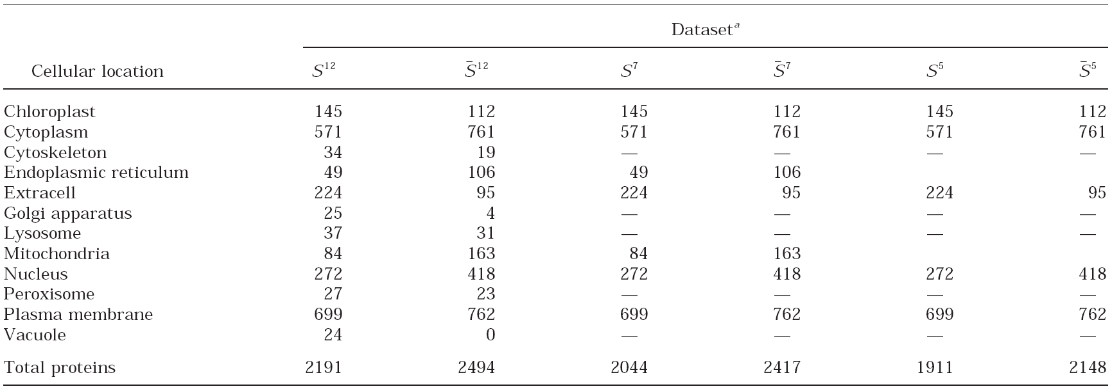
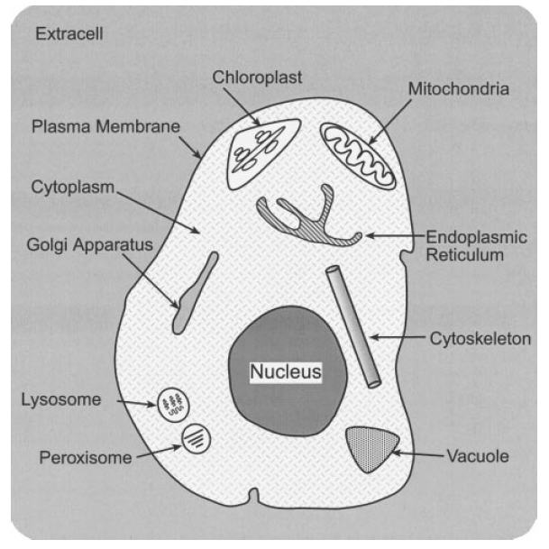
The Datasets Used in This Study

Slide 9
The Augmented Covariant Discriminant Algorithm
To make sequence order effect formulation to be
incorporated into any algorithms formulated for predicting
protein subcellular location based on the amino-acid-
composition.
Covariant discriminant algorithm formulation deduce
  Suppose there are N proteins forming a set S, which is the
  union of m subsets
        S = S₁ U S₂ U S₃ U S₄ U· · · U S_{m}
      The size of each subset is given by n_{ξ}(ξ=1, 2, 3, …..m)

Slide 10
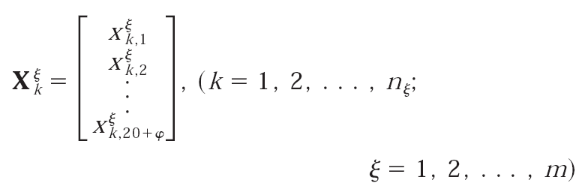
m
N= Σ n_{ξ}
ξ=1
For example, for the dataset in S¹² , m=12, n₁=145, n₂=571, n₃=34…..n₁₂=24 and N=2191
The kth protein in the subset S_{ξ} should now be described:

Slide 11
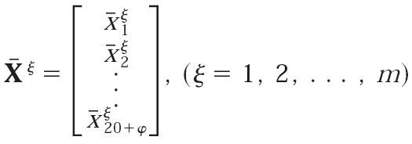
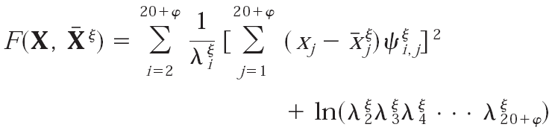
The standard vector for the subset S_{ξ} is defined:
The similarity between the standard vector X_{ξ} and the query protein X is characterized by the covariant discriminant function given:
VS.

Slide 12
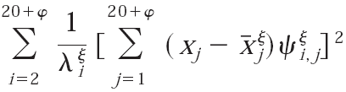

≒
Mahalanobis distance
Mahalanobis distance:
  A very useful way of determining the "similarity" of a set of values from an "unknown" sample to a set of values measured from a collection of "known" samples.

Slide 13
The covariant discriminant values computed according to:
The prediction protein subcellular location according to:

Slide 14
Results
The prediction correct rates was examined by three test methods:
  Self-consistency test
    Using the rules derived from the same datacet
  Jackknife test
    Each protein in the training dataset was singled out in turn as a ‘test protein’
  Independent-dataset test
    Using the independent dataset

Slide 15
The prediction methods was examined by three algorithms:
  Incorporation the quasi-sequence-order effect
    With φ=13 as the optimal rank number
  Covariant discriminant algorithm
    Based on the amino-acid composition alone
  The ProtLock algorithm

Slide 16
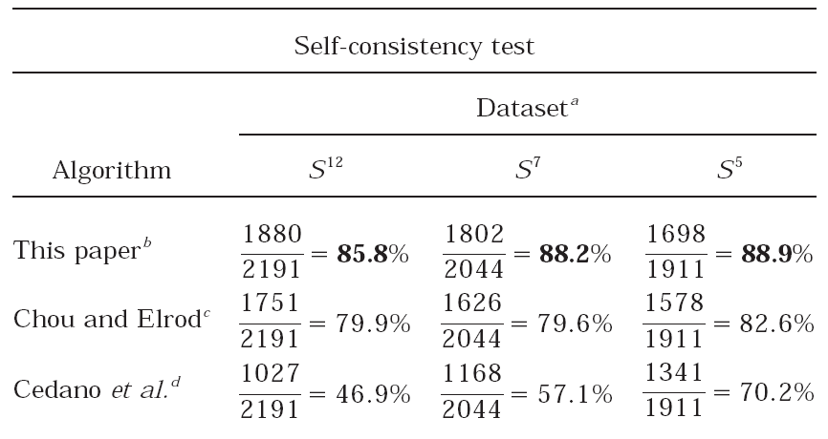
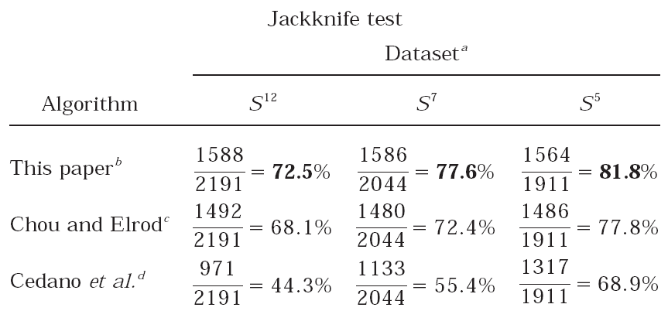

Slide 17
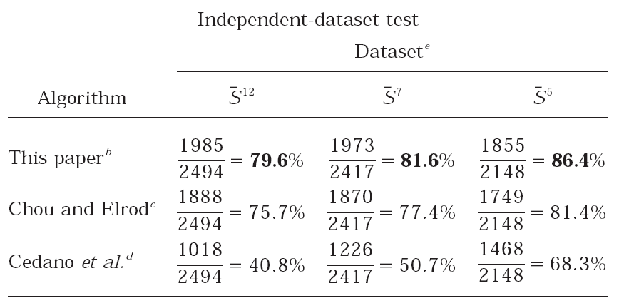
Chou and Elrod: Covariant discriminant algorithm
Cedano et al.: The ProtLock algorithm

Slide 18
Discussion
The prediction quality can be remarkably improved after taking into account the quasi-sequence-order effect.
The prediction quality can be further improved if :
  Narrow down the scope of subcellular location for a query protein
To further improve the prediction quality, one of the logical procedures is to incorporate the protein sequence order effect.

Slide 19
The prediction quality could be further improved if the prediction algorithm can be mainly based on the signal peptide of a protein.

Slide 20
Thank you
for your attention

