Slide 1
Construction of Phylogenetic Trees of SARS Virus
Kuo-Si Huang (黃國璽)

Slide 2
SARS
Severe Acute Respiratory Syndrome
嚴重急性呼吸道症候群
Total cases: 8422
Number of cases currently hospitalised: 64
Number of cases recovered: 7442
Number of deaths: 916
WHO -- Summary table of SARS cases by country, 1 November 2002 –
7 August 2003
http://www.who.int/entity/csr/sars/country/en/country2003_08_15.pdf

Slide 3
SARS
Country Total Recovering Recovered Death
China 5327 29 4949 349
(Hong Kong) 1755 7 1448 300
Taiwan 665 10 475 180
Canada 251 10 200 41
Singapore 238 0 205 33
WHO -- Summary table of SARS cases by country, 1 November 2002 –
7 August 2003
http://www.who.int/entity/csr/sars/country/en/country2003_08_15.pdf

Slide 4
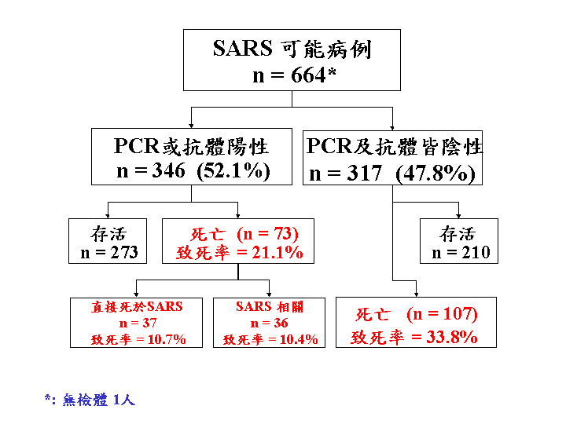
SARS in Taiwan from CDC.TW
http://www.cdc.gov.tw/sars/4國內SARS相關資訊/台灣SARS疫情現況.htm

Slide 5
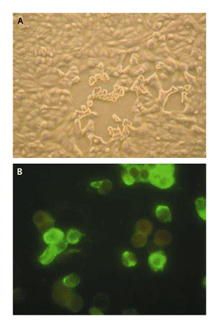
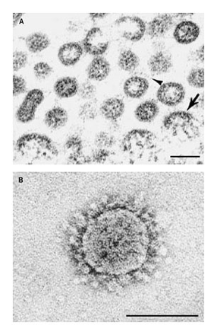
Some Figures about SARS
Vero E6 cells Inoculated with Oropharyngeal Specimens from Patients with SARS.
Ultrastructural Characteristics of SARS-Associated Coronavirus Grown in Vero E6 Cells.
T. G. Ksiazek, D. Erdman, C. S. Goldsmith, S. R. Zaki, et al., "A novel coronavirus associated with severe acute respiratory syndrome", The New England Journal of Medicine, Vol. 348, pp.1953-1966, May, 2003.

Slide 6
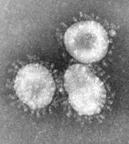
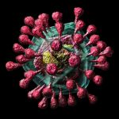
Coronavirus 冠狀病毒

Slide 7
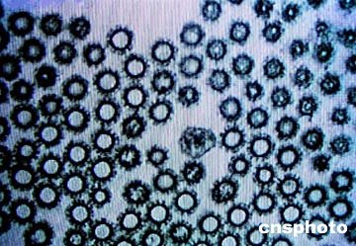

Coronavirus 冠狀病毒
SARS-CoV
    COronaVirus

Slide 8
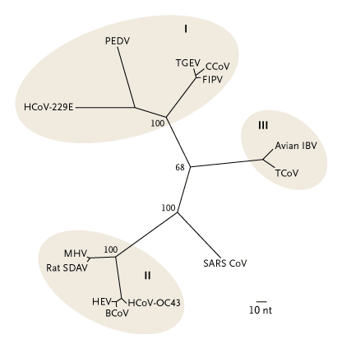
SARS – A New Coronavirus
Estimated Maximum-Parsimony Tree Based on the Sequence Alignment of 405 Nucleotides of the Coronavirus Polymerase Gene Open Reading Frame 1b (Nucleotide Numbers 15173 to 15578 Based on Bovine Coronavirus Complete Genome Accession Number NC_003045) Comparing SARS Coronavirus with Other Human and Animal Coronaviruses.

Slide 9
A Novel Coronavirus Associated with Svere Acute Respiratory Syndrome
This article is dedicated to the memory of Carlo Urbani.
T. G. Ksiazek, D. Erdman, C. S. Goldsmith, S. R. Zaki, …(Carlo Urbani, M.D. ) … et al., "A novel coronavirus associated with severe acute respiratory syndrome", The New England Journal of Medicine, Vol. 348, pp.1953-1966, May, 2003.

Slide 10
Phylogeny
Phylogeny
  Phylogenetic tree
  Evolutionary tree
Clarifying the coronaviruses relationships
Clinical relationships of SARS patients
Three major groups
  Distance, character and likelihood

Slide 11
Phylogeny
Distance-based phylogeny
  Fitch-Margolias method
  Neighbor-joining (NJ) method
  Unweighted pair group method with arithmetic mean (UPGMA)
These methods are fast and easy to implement.
The neighbor-joining methods may often get good estimate tree but UPGMA may lead to a misguided tree.

Slide 12
Phylogeny
Character-based phylogeny
  Parsimony tree
  Fitch's algorithm and Sankoff's algorithm
Likelihood-based phylogeny
  Maximum likelihood tree
Which tree is the optimal solution?
NP-complete

Slide 13
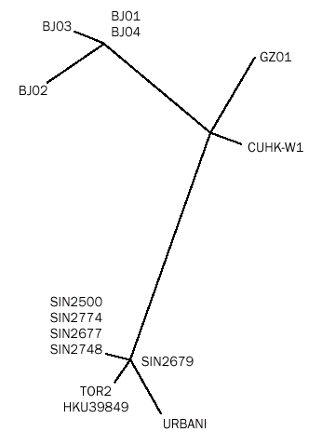
SARS Phylogeny
Singapore
Y. J. Ruan, C. L. Wei, L. A. Ee, V. B. Vega, et al., "Comparative full-length genome sequence analysis of 14 SARS coronavirus isolates and common mutations associated with putative origins of infection", The Lancet, Vol. 361, pp. 1779-1785, May, 2003.

Slide 14
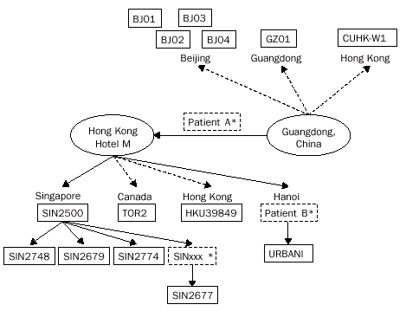
The Clinical Relations between the 14 SARS-CoV Isolates

Slide 15
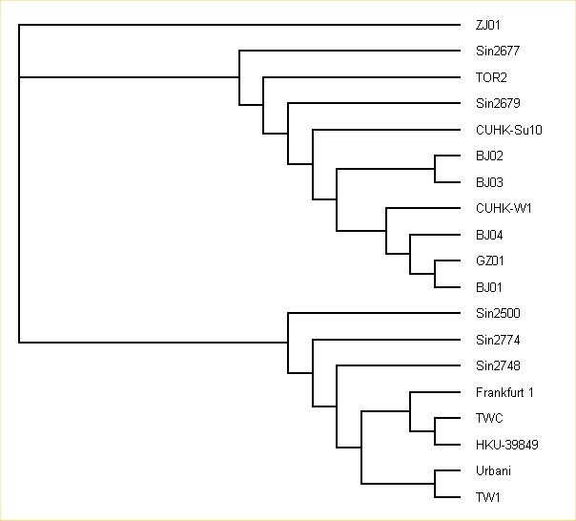
The Phylogeny from EBI
EBI -- European Bioinformatics Institute
http://www.ebi.ac.uk/2can/disease/SARSPHYLO.html
accessed at Oct. 10, 2003

Slide 16
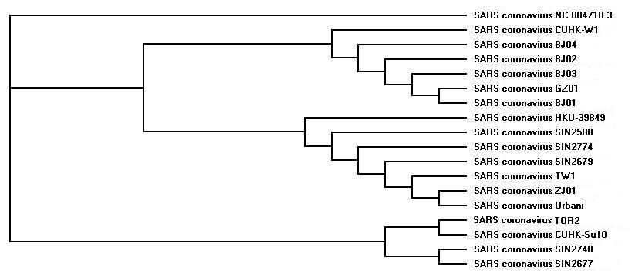
Another SARS Phylogeny

Slide 17
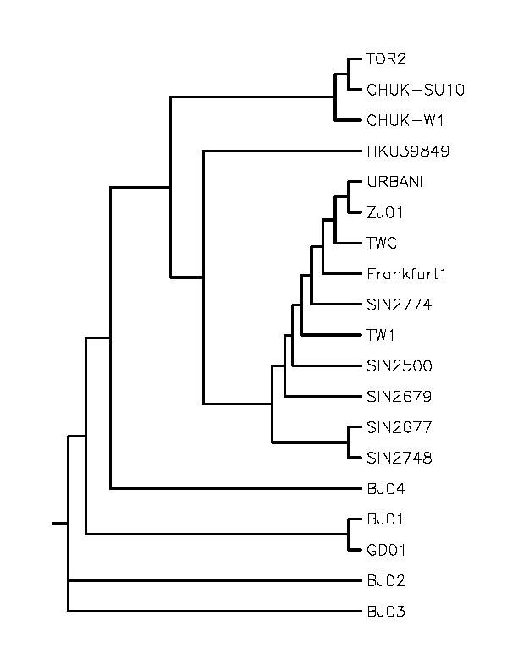
SARS Phylogeny
Clustal W (Version 1.83)
Guide tree
19 SARS-CoV sequences

Slide 18
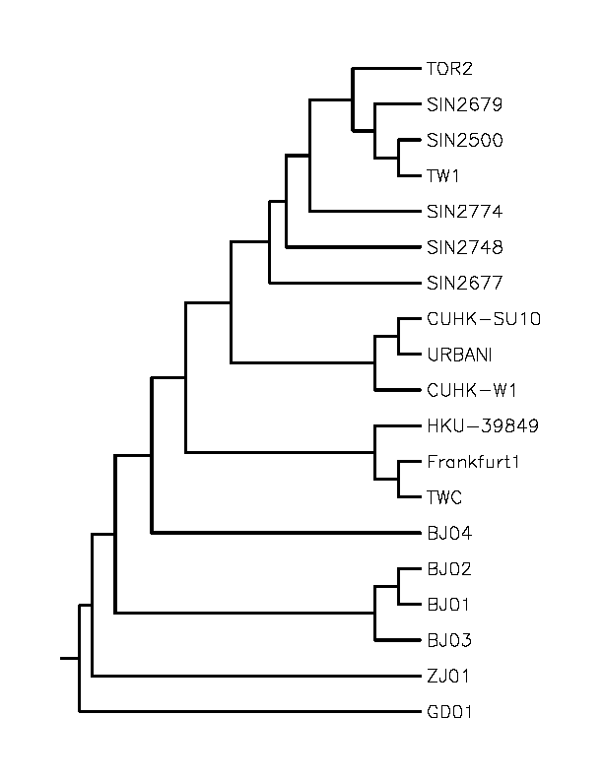
Our Working Phylogeny
Based on LDF method.
Cladogram

Slide 19
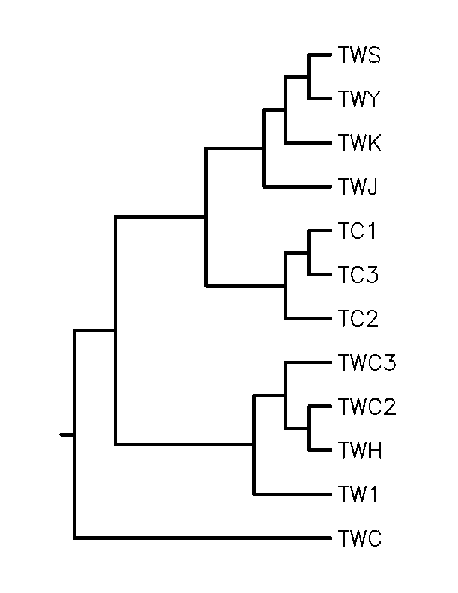
SARS Phylogeny of Taiwan
The phylogenetic tree
for 12 SARS sequences
of Taiwan.
Cladogram

