Slide 1
Prediction of Human Protein Function According to _x000b_Gene Ontology Categories
L. J. Jensen, R. Gupta, H. –H. Stærfeldt and S. Brunak
Bioinformatics, Vol. 19, No. 5, p.p. 635-642, 2003

Slide 2
Outline
Introduction
System and Methods
Discussion
Conclusion

Slide 3
Introduction
For most of the whole genome sequencing projects, the function of a large fraction of proteins remain unknown
This paper expands the ProtFun prediction method predicted the cellular role categories as well as enzymatic function to also cover a number of GO categories
  More specific description of the function

Slide 4
System and Methods
The Neural Networks Approach
  Data set
  Data set partitioning
  Choosing the classes to predict
  Sequence derived protein features
  Neural network training and feature selection
  Making predictions with the neural networks

Slide 5
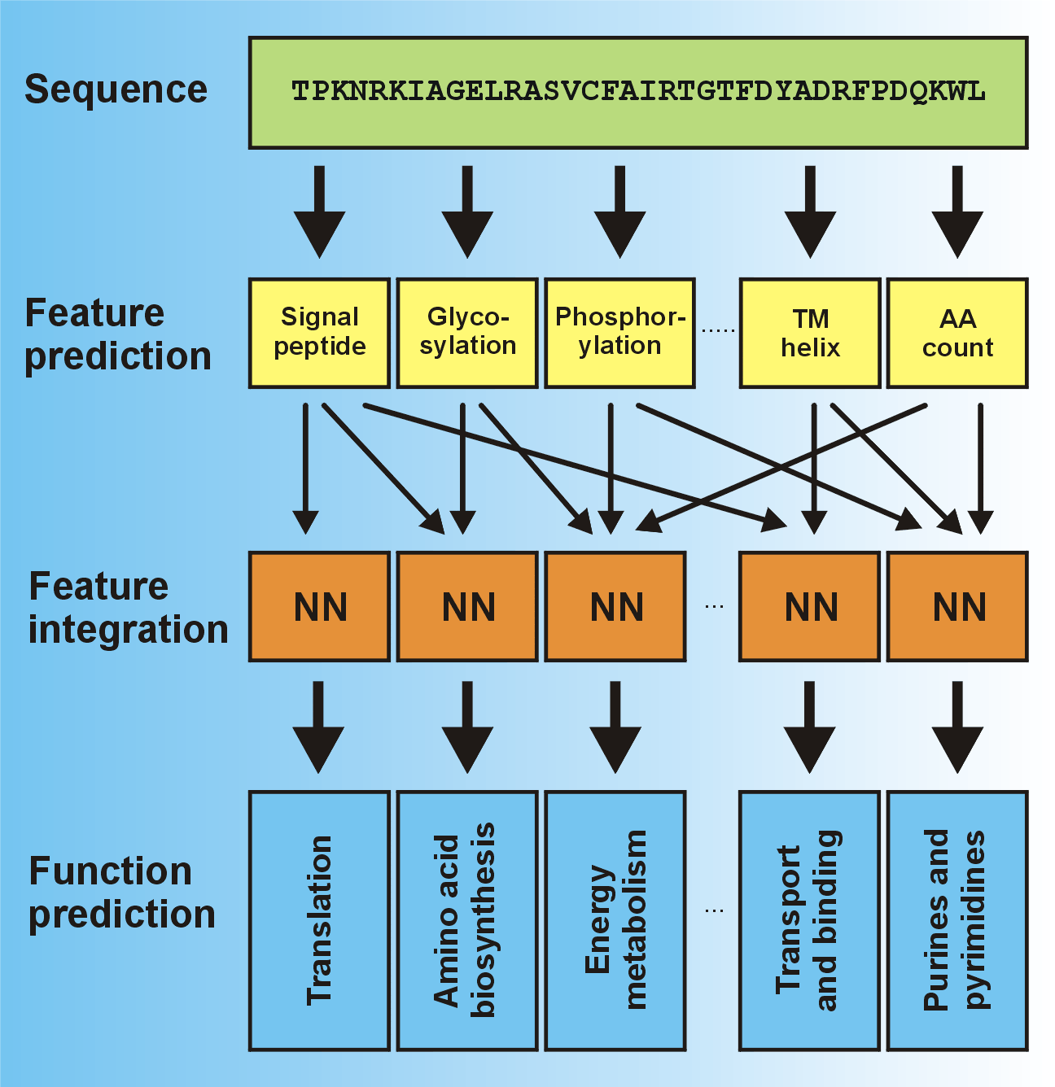
The Neural Networks

Slide 6
Data Set
Generation of a Labeled Data Set
  Making use of the InterPro database in which protein families have been assigned with GO numbers
  Linking this with a list InterPro domain matches to SWISS-PROT and TrEMBL
  A set of 21,401 human sequences with annotated GO numbers

Slide 7
Data Set Partitioning
Cross Validation - Heuristic
  Divide the data set into five sets of equal size with minimal sequence similarity overlap between the sets
Unfortunately, it turned out to either be impossible to split the set into five unrelated subsets or the heuristic at least failed to find a sufficiently good solution

Slide 8
Data Set Partitioning (cont.)
Reducing each of the five subsets to 2500 sequences
  By removing the sequences with the highest connectivity
A five fold cross validation set of 12,500 sequences with no significant similarity between sequences in the different subsets

Slide 9
Choosing the Classes to Predict
GO Categories as of June 10th 2001
  1532 of 7949 different classes were represented in the data set described above
  Leaving 347 categories which were annotated to at least 20 different InterPro families

Slide 10
Sequence Derived Protein Features
Features Used
  Aliphatic (脂肪族化合物) index
  Extinction (吸光度) coefficient
  Hydrophobicity (厭水)
  Instability (不穩定度) index
  Number of atoms
  Number of negative residues
  Number of positive residues
  Isoelectric (等電點) point
  Secondary structure
  Transmembrane (橫跨膜的) helices
  Low complexity regions
  Propeptides
  Signal peptides
  Protein targeting
  Protein sorting
  N-glycosylation (糖基化的)
  S/T-phosphorylation (磷酸化)

Slide 11
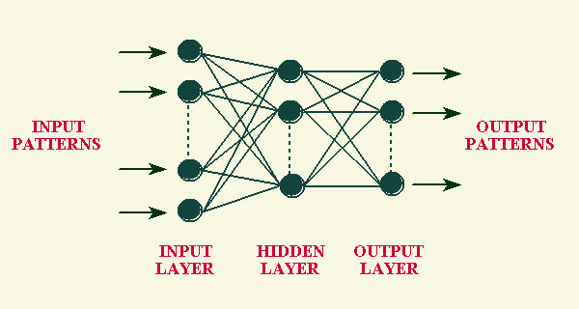
Training
For each GO class, standard feed-forward neural networks with a single layer of hidden neurons were used for predicting which example belong to a given class
For each feature combination the input vector for the neural networks consists of a concatenation of the respective feature vectors while the target output is a single value (1 or 0)

Slide 12
Training (cont.)
Only 26 GO classes remained after reducing those not strongly correlated to any of the predicted features
For each, the optimal feature combination was searched for using a greedy search heuristic
The final set of predictors consists of cross validation ensembles of five neural networks for each of 14 GO classes

Slide 13
Making Predictions
Use the neural networks to predict the function of novel sequences
  Sequence derived features and encoded
  For each GO class, the average output is calculated and converted to a probability using a calibration curve

Slide 14
Discussion
Why so relatively few GO classes can be predicted?
  Lack of data: for 90% of the GO classes we cannot assign a single positive example among human SWISS-PROT and TrEMBL entries
  Many of the categories are reduced for some reasons

Slide 15
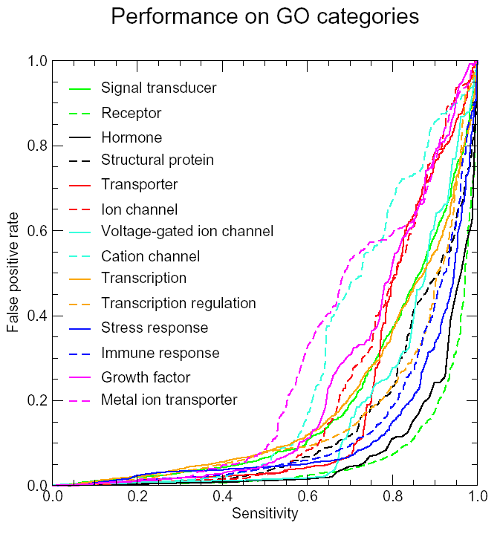

Slide 16
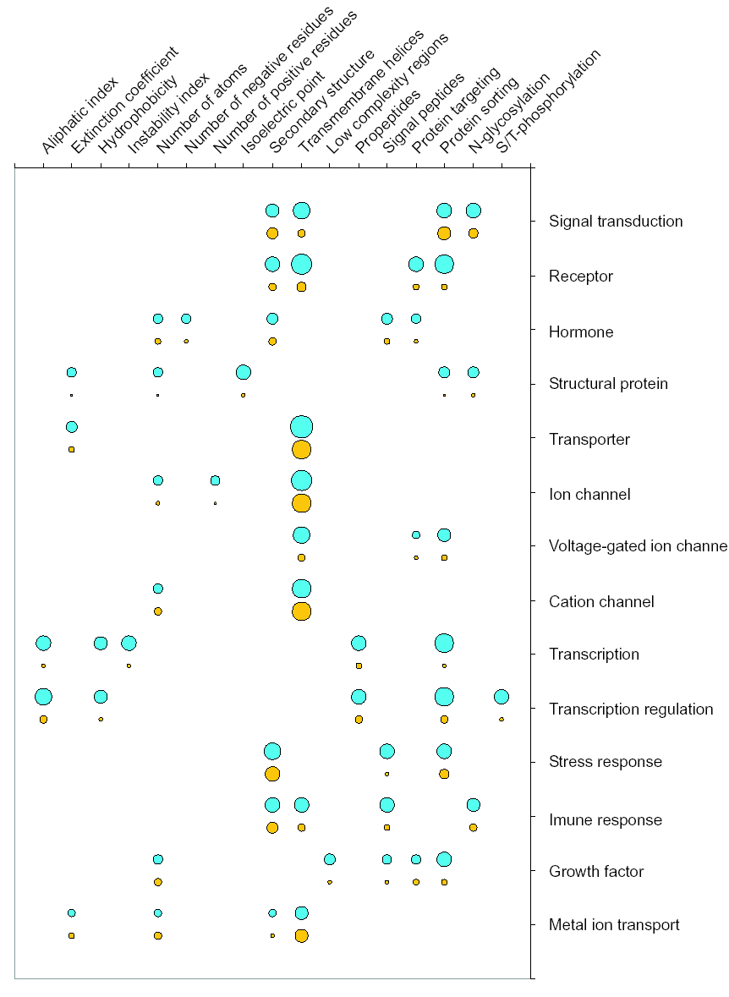

Slide 17
Discussion (cont.)
The method appears to be better at predicting biological process than molecular function
Novel putative receptors
Chromosomal clustering of protein with similar function

Slide 18
Conclusions
We have succeeded in making a sequence based function prediction method for a subset of the GO
The method is well suited for computational screening of the human genome for novel drug targets

Slide 19
Thank you!
Yi-Yao Huang(黃奕堯)
huangyy@par.cse.nsysu.edu.tw

Slide 20
What Is GO (Gene Ontology) ?
The Gene Ontology (GO) project is a collaborative effort to address the need for consistent descriptions of gene products in different databases
Three structured, controlled vocabularies (ontologies) that describe gene products in terms of their associated biological processes, cellular components and molecular functions in a species-independent manner
DAG (directed acyclic gragh)

Slide 21
名詞解釋
Protein sorting and protein targeting
  Proteins are sorted (delivered to their destination within the cell) in accordance with sorting signals
Propeptides, signal peptides and glycosylation
  欲使轉殖的基因產物在特定的胞器中表現或停留，通常需要在啟動子的後面加上一段可將基因帶到特定位置或胞器的 signal peptide 或 propeptide。Signal peptide 通常將基因帶到 ER (內質網)，受到 glycosylation，最後走向 secretory pathway，而分泌到細胞外。

