Slide 1
Design of oligonucleotides for microarrays and perspectives for design of multi-transcriptome arrays
Henrik Bjorn Nielsen, Rasmus Wernersson and Steen Knudsen
Nucleic Acids Research, 2003, Vol. 31, No. 13
3491–3496
Speaker: Chui-Wei Wong
Advisor:薛 佑 玲, PhD
Institute of Biomedical Science

Slide 2
Outlines
Introduction
Method
Designing Oligonucleotides
Result
Discussion

Slide 3
Introduction
Center for Biological Sequence Analysis --CBS
Technical University of Denmark
1993
Conducts basic research in the field of bioinformatics and systems biology
research groups
  molecular biologists
  biochemists
  medical doctors
  physicists
  computer scientists

Slide 4
Introduction
Oligonucleotides of 20–70 bp
OligoWiz
Evaluate and graphical
Input sequences according to collection of parameter
Can detect transcripts from multiple organisms

Slide 5
Introduction
OligoWiz is implemented as a client–server solution
Server is responsible for the calculation of the scores
Freely available
OligoWiz web page: http://www.cbs.dtu.dk/services/OligoWiz/

Slide 6
Method
Written in Java 1.3.1
MacOS X, Linux and Window
Server
  developed on SGI Unix system
  written in Per15
Utilizes the BLAST program for homology database
Pallelized using the Perl module ChildManager

Slide 7
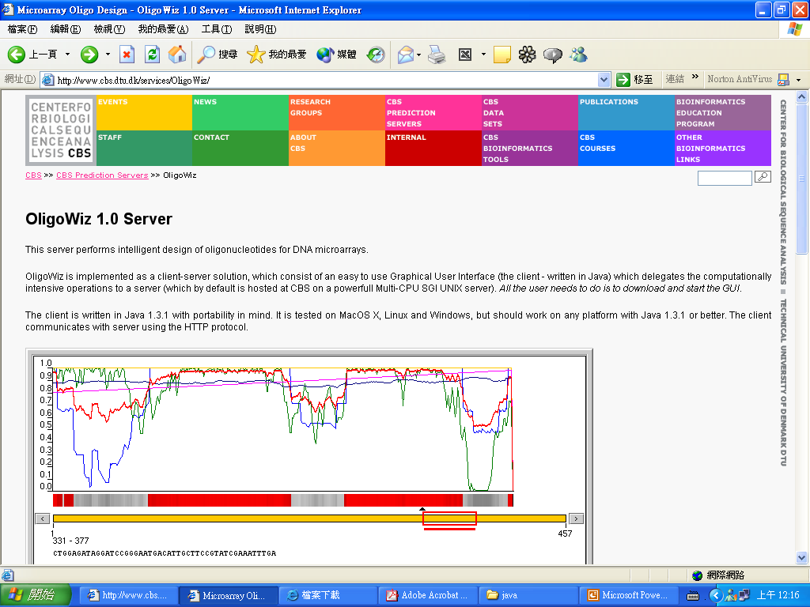

Slide 8
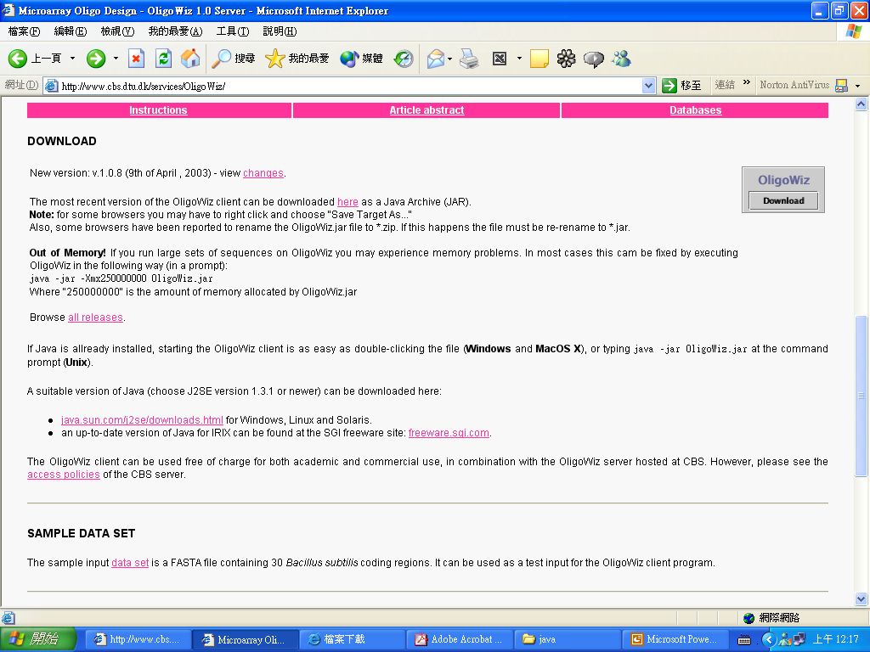
Download Java

Slide 9
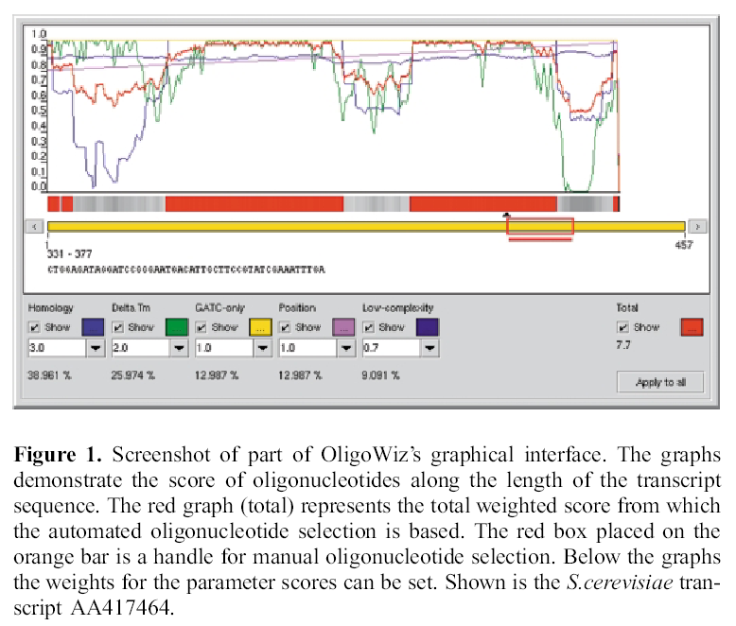

Slide 10
Designing Oligonucleotides
Cross-hybridization
△Tm
Position within transcript
Low-complexity filtering
GATC-only score

Slide 11
Cross-hybridization
To avoid cross-hybridization
Affinity difference between the intended target and all other targets should ideally be maximized
Experimental evidence suggests that a significantly false signal can be detected
  if a 50 bp oligonucleotide has >75–80% of the bases complementary
  if continuous stretches of >15 bp are complementary to a false target

Slide 12

homology score
m be the number of BLAST hits considered in position i of the oligonucleotide
h{h_{1i}, . . . , h_{mi}} be the BLAST hits in position i
L is the length of the oligonucleotide
BLAST hit along the full length of the oligonucleotide will get a
  score of 0 = 100% identity
  score of 1 = 0% identity (no homology)

Slide 13
△Tm
Oligonucleotides to discriminate between the targets, the hybridization and washing conditions need to be optimal
Oligonucleotides perform well under similar hybridization conditions
Melting temperature of the DNA:
DNA duplex (Tm) is a good description of an
oligonucleotide hybridization property
Minimal difference between the Tm of the oligonucleotides

Slide 14

△Tm
OligoWiz uses a nearest-neighbor model for Tm estimation:
△ H is the enthalpy
△ S is the entropy change of the nucleation reaction
A is a constant correcting for helix initiation (-10.8)
R is the universal gas constant (1.99 calK⁻¹ mol⁻¹)
Ct is the total molar concentration of strands
Since the total molar concentration of strands is
unknown for most microarray experiments, OligoWiz
uses a constant of 2.5x10-¹⁰ M

Slide 15

△Tm
Based on the Tm estimation a △ Tm score is calculated
O_{Tm} by default is the mean Tm of all oligonucleotides in all input sequences of aim length (user specified) or a specific user specified optimal Tm
For each 50 position along the input sequence the oligonucleotide length (extending toward the 3’ end) with the best △ Tm score is chosen
Therefore the △ Tm score is the first calculation the OligoWiz server performs

Slide 16
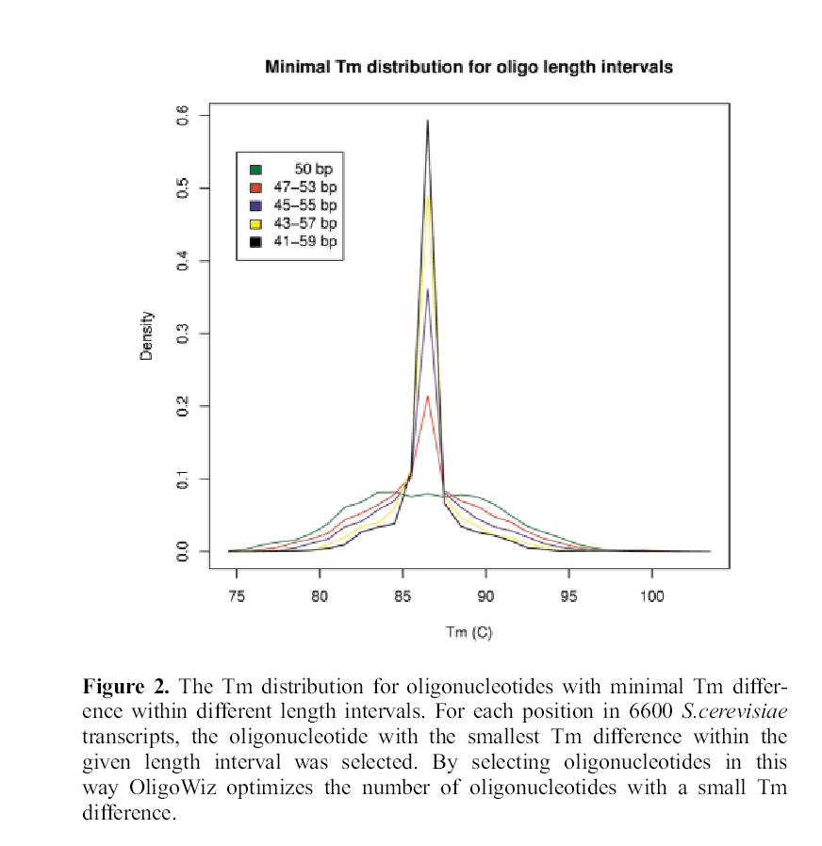
△Tm
Minimal Tm

Slide 17
Position within transcript
Position within the target transcript can be of
importance
The reverse transcriptase will fall off the
transcript with a certain probability
Further away from the starting point the less
signal will be generated

Slide 18
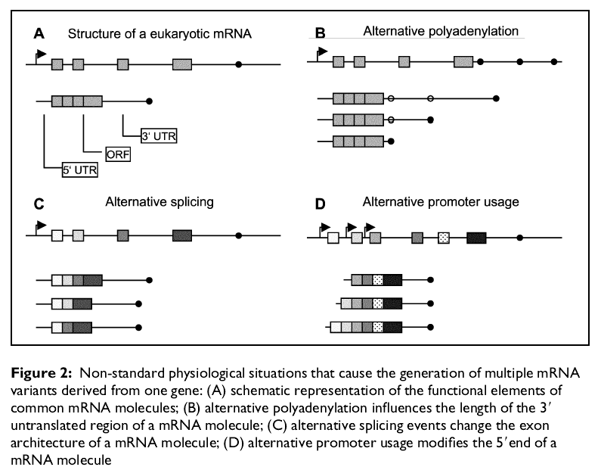
Briefing in bioinformatics. Vol 2. No.4. 329-340. Dec 2001

Slide 19

Position within transcript
If the labeling commences from the 3’ end (poly A tail) the following score is used:
  dp is the probability that the reverse transcriptase will fall off its template at any given base
  △ 3’end is the oligonucleotide distance to the 3’ end of the input sequence

Slide 20

Position within transcript
In cases where the labeling is done with random primers, as would be the case under prokaryote mRNA labeling, the chance of having an oligonucleotide upstream of a given position should be accounted for:
c is a constant indicating the probability that a random primer will bind at any given position

Slide 21
Low-complexity filtering
To avoid oligonucleotides composed of very common sequence fragments in probe design a low-complexity score was implemented
Different sequences are common in different species
  to estimate a low-complexity measure for an oligonucleotide a list of sequence subfragments
  the information content is generated specifically for each species

Slide 22

Low-complexity filtering
The information content can be calculated by the
following equation :
n(w) is the number of occurrences of a pattern
in the transcriptome
l(w) the pattern length
nt is the total number of patterns found of
a given length

Slide 23

Low-complexity filtering
OligoWiz uses this list to calculate a low-complexity score for each oligonucleotide:
L is the length of the oligonucleotide
wi is the pattern in position i
norm is a function that normalizes the summed information to a value between 1 and 0

Slide 24
Low-complexity filtering
A low-complexity score :
  0 : an oligonucleotide with very low complexity
  Between 1 and 0.8 : majority of oligonucleotides have a low-complexity

Slide 25
GATC-only score
To allow for filtering out sequence containing ambiguity annotation OligoWiz has a score called ‘GATC-only’
Oligonucleotides containing
  R, Y, M, K, X, S, W, H, B, V, D, N or anything else will be given a score of 0
  G, A, T and C will be assigned a score of 1

Slide 26
GATC-only score
Beside A, C, T, G
M = AC
R = AG
W = AT
S = CG
Y = CT
K = GT
V = ACG
H = ACT
D = AGT
B = CGT
X = AGCT

Slide 27
Result
6600 genes annotated in the Saccharomyces cerevisiae genome
Oligonucleotides : length interval 45–55 bp
The homology search and complexity score was based on whole genome databases
Mean Tm of the oligonucleotides was 75.7℃
calculations done in just 20 min

Slide 28
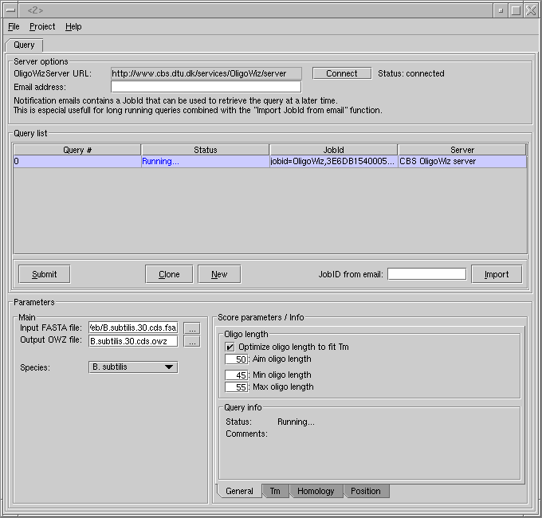

Slide 29
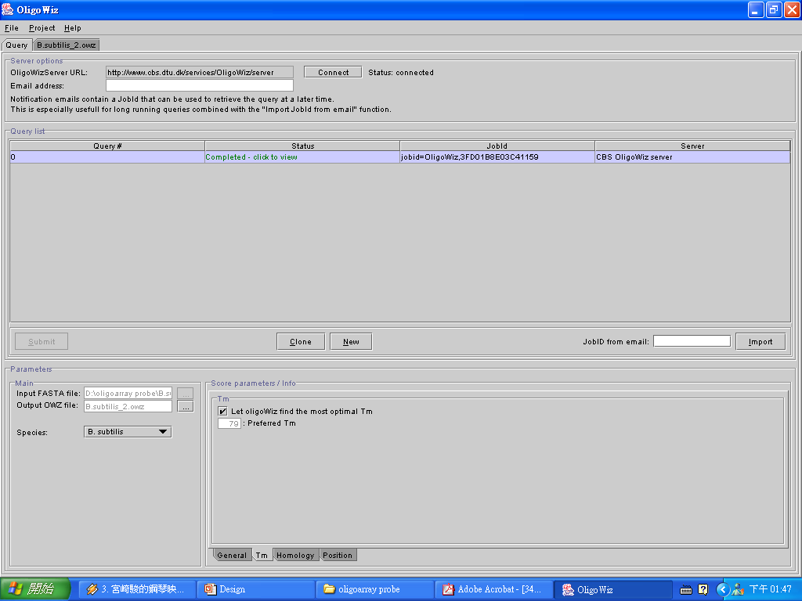
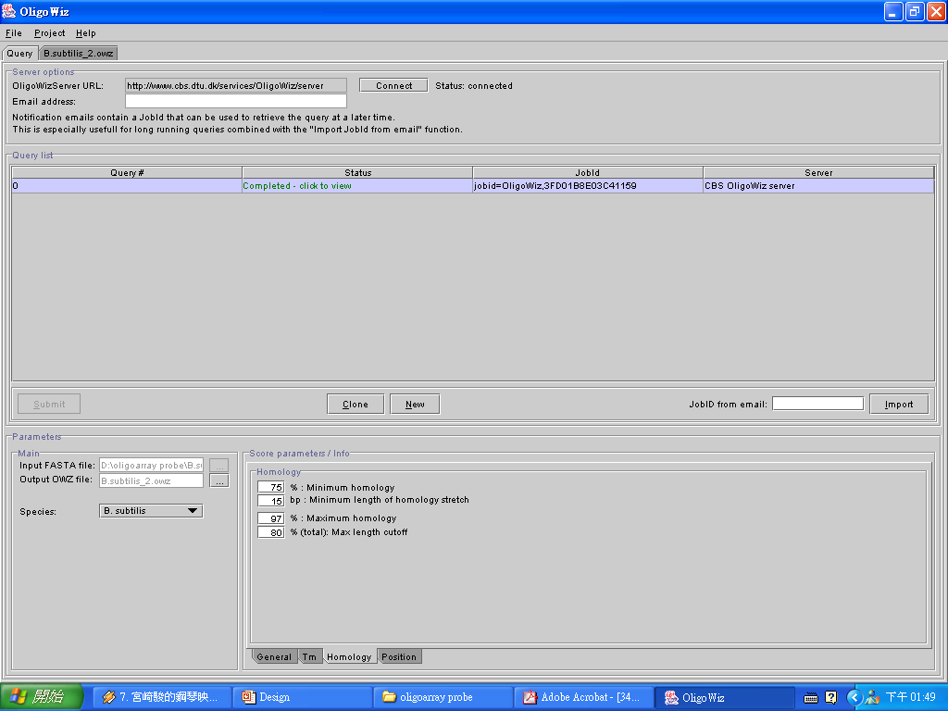
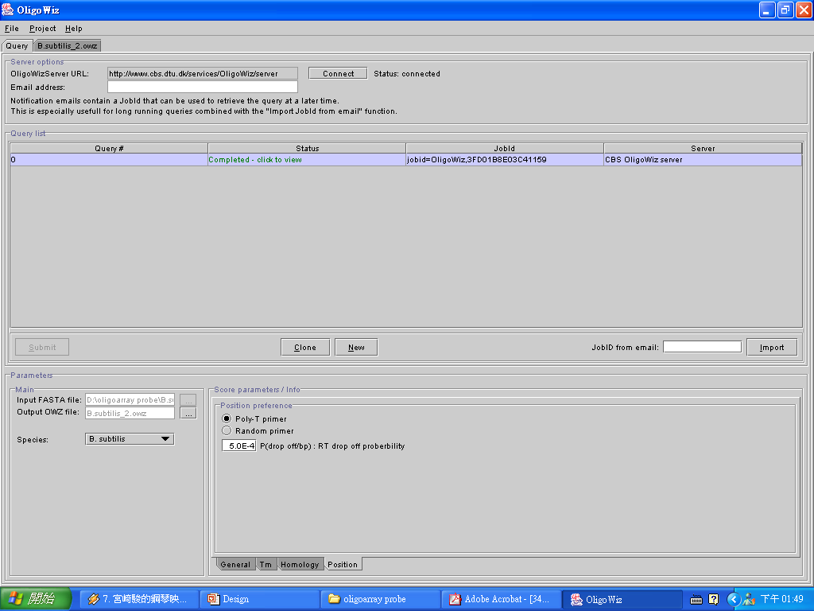
Score parameter/info

Slide 30
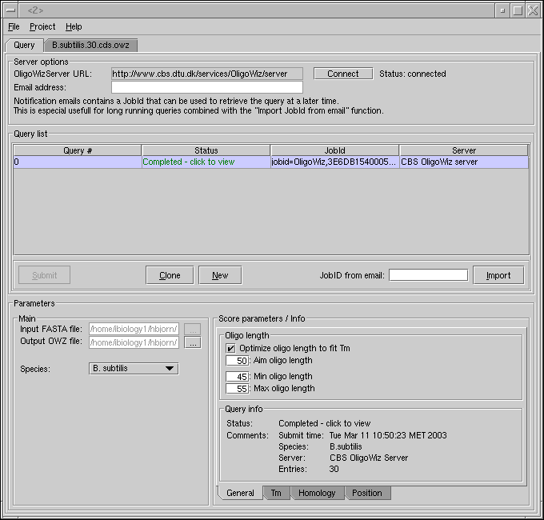

Slide 31
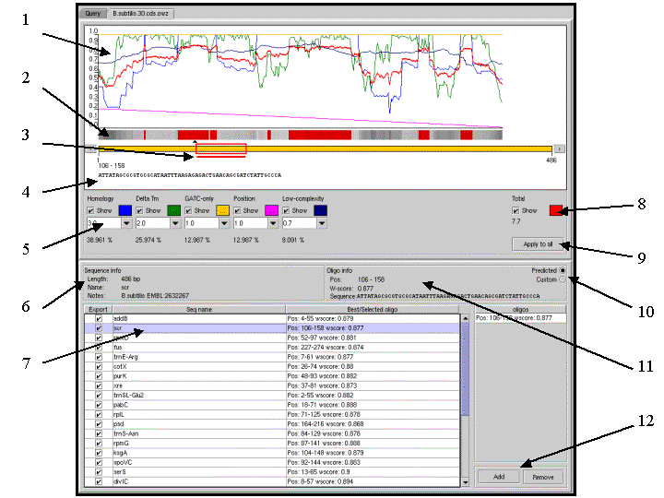
1. Graphs represent scores (y-axis) along the input sequence (x-axis).
2. Total (weighted) score
3. Oligonucleotide selected/predicted
8. Total score function manipulation interface
4. Sequence of the oligonucleotide selected
5. Score function manipulation interface
9. Applies score weights of the selected entry to all the entries
6. Sequence info field
10. Predicted/custom bottom
7. Iinput sequence table
11. W-score is the total weighted score for the selected oligonucleotide
12. “Oligos" per entry field

Slide 32
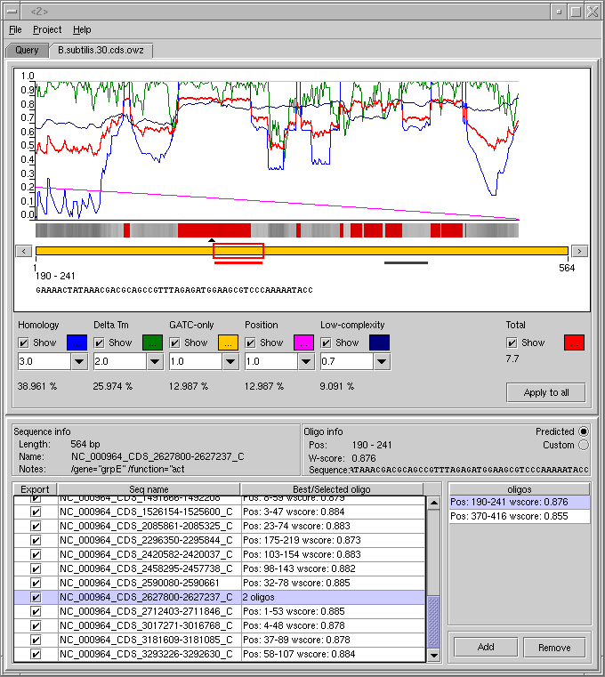

Slide 33
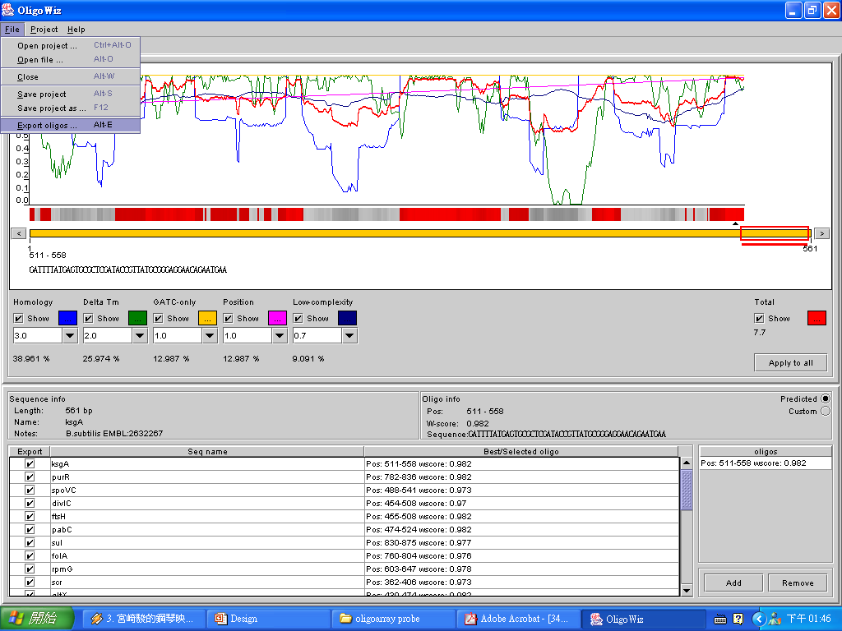

Slide 34

Thanks You!!!

