Slide 1
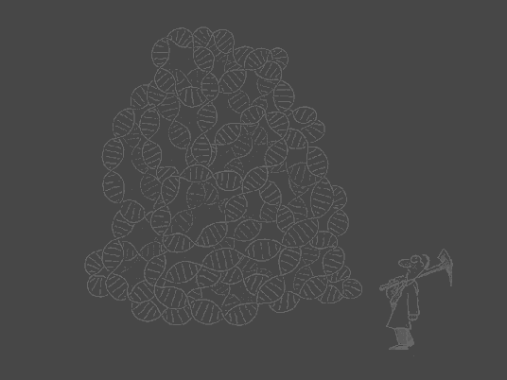
SNP Haplotype Block Partition and tagSNP Finding
Speaker:孫嘉璘
Adviser:楊昌彪

Slide 2
Outline
Introduction to SNP
Combinatorial problems arising from SNP
Haplotype block forming
Characteristics of blocks
tagSNP finding and block partition strategies
Conclusion

Slide 3
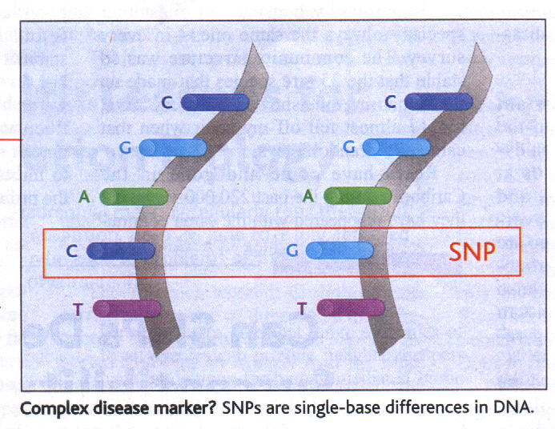
SNP
(Single Nucleotide Polymorphism)
Point mutation
Occurs about every 800bps, it’s relatively stable than other markers

Slide 4
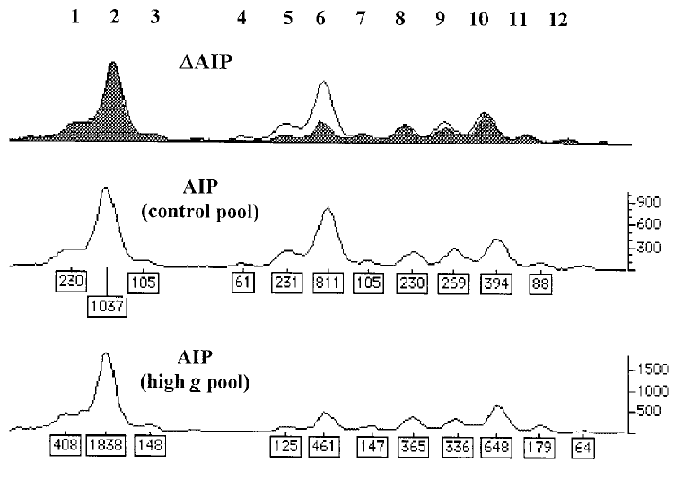
Measurement of the Variance within DNA Sequences
DNA pooling method under case control:
ΔAIP(Allele Image Pattern)
ΔAIP = Diff./(Diff.+Comm.)

Slide 5
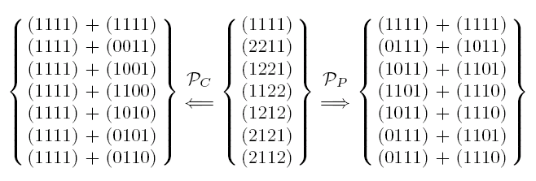
Combinatorial Problems Arising in SNP and Haplotype
Haplotype Phasing Problem: using a set of genotypes to infer haplotypes
Haplotype Block Detection: using a set of haplotype data to detect haplotype blocks
Finding tagSNP: using minimum number of SNP sites to identify all haplotypes

Slide 6
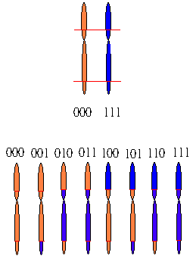
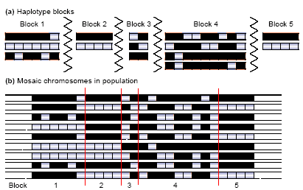
Haplotype Block Forming

Slide 7
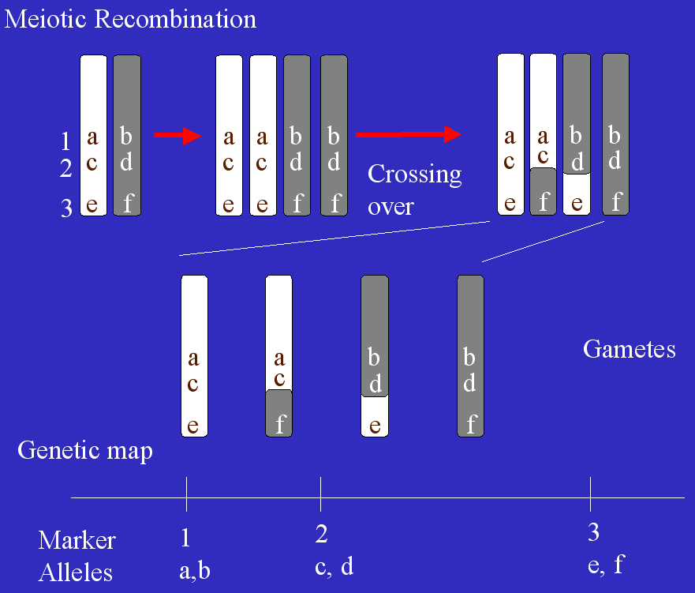
Recombination

Slide 8
Characteristics of Blocks
Haplotype: the pattern of alleles along a single chromosome
In every block, 2~5 haplotypes can capture 75~90% haplotypes
Block length is highly related to LD extent
Etc.

Slide 9
Cont.
Regions with low levels of LD would require a denser SNP map to detect association than regions where LD is conserved over large physical distances.

Slide 10
Hardness of Finding tagSNP
We concerned with the problem of how many tagSNPs are required to tag a given number of haplotypes
This question can be reduced to MINIMUM TEST COLLECTION problem, it shows the problem is NP-complete[2]

Slide 11
tagSNP Finding and Block Partition Strategies
The Best Enumeration of SNP Tags (BEST) algorithm uses the concept of derivation[3]
Zhang et al., dynamic programming method for block partition is based on coverage concept[4]
We are going to use entropy concept to work on this problem

Slide 12
BEST
Apply the Boolean dependency to initial H₁
Run the process recursively to draw out max c_{i} to H₁, and form
1. H_{2i} = H₁∪ c_{i}
2. C_{2i} = S \ (H_{2i} ∪ D_{2i})
Until set C is empty

Slide 13
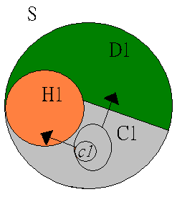
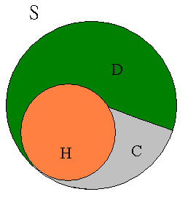
Cont.

Slide 14
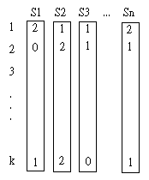
Zhang’s Dynamic Programming Method
k haplotypes with its length n (SNP sites)
ri(k) = 0,1 or 2 (i=1…n):
represents the ith SNP
in the kth haplotype
• block(ri, …, rj) = 1 if at least x% unambiguous haplotype occur at least once
• f(ri, …,rj) represents min tagSNP number required for
ri … rj within a block to distinguish x% unambiguous
haplotypes

Slide 15
Cont.
Sj : the minimum tagSNP require for j SNPs
Sj = min{ Si-1 + f(ri …rj) if 1≦ i≦ j and block(ri,…,rj) =1 }
Cj : the minimum number of blocks requires for Sj tagSNPs represents first j SNPs
Cj = min{Ci-1 + 1, if 1 ≦ i≦ j and block(ri,…,rj) =1 and Sj = Si-1 + f(ri,…,rj) }

Slide 16
Drawbacks in Recent Methods
BEST : Minimum tagSNPs coverage → O
Block structure → X
DP : Minimum tagSNPs coverage → O
Block structure → O
DP block definition does not meet the real
biology phenomenon ( 2~5 common
haplotypes per block)

Slide 17

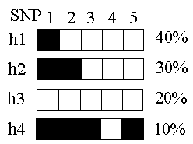
Entropy Concept
Entropy concept : entropy can represent the degree of difference in data
Formula : E(si) =
E(s1)=(-0.8)(log₂0.8)+(-0.2)(log₂0.2)=0.2173
E(s2)=(-0.4)(log₂0.4)+(-0.6)(log₂0.6)=0.2923
E(s3)=(-0.1)(log₂0.1)+(-0.9)(log₂0.9)=0.141
E(s4)=(-1.0)(log₂1.0) =0
E(s5)=(-0.1)(log₂0.1)+(-0.9)(log₂0.9)=0.141

Slide 18
Entropy Concept Method
Joint entropy : E(s1,s2,s3,s4,s5) = E(s1)+E(s2|s1)+E(s3|s2,s1)+E(s4|s3,s2,s1)+E(s5|s4,s3,s2,s1)
Within biological block definition criteria (2~5 common haplotypes),choosing the one has max entropy
Entropy stands for the number of tagSNPs needed in a block (still under progress)

Slide 19
Reference
[1]Bjarni V. Halldorsson et al., Combinatorial problems arising in SNP and haplotype analysis, Proc., DMTCS Conference (2003)
[2]Carsten Wiuf et al., Some notes on the combinatorial properties of haplotype tagging, Math. Bio. Vol.185 (2003)
[3]Paola Sebastiani et al., Minimal haplotype tagging, PNAS, Vol. 100 (2003) no. 17
[4]Zhang et al., A dynamic programming algorithm for block partitioning, PNAS, Vol.99 No.11 (2002)

Slide 20
Thank You

