Slide 1
Bridge Bidding with Imperfect Information
Lori L. Delooze , James Downey
2007 IEEE Symposium on Computational Intelligence and Games,
Honolulu, HI, USA P368~P373
Presenter: Jing-Ping Jan
Date: March 24, 2021

Slide 2
Abstract
Multiplayer games with imperfect information, such as Bridge, are especially challenging for game theory researchers. Although several algorithmic techniques have been successfully applied to the card play phase of the game, bidding requires a much different approach. We have shown that a special form of a neural network, called a self-organizing map (SOM), can be used to effectively bid no trump hands. The characteristic boundary that forms between resulting neighboring nodes in a SOM is an ideal mechanism for modeling the imprecise and ambiguous nature of the game.

Slide 3
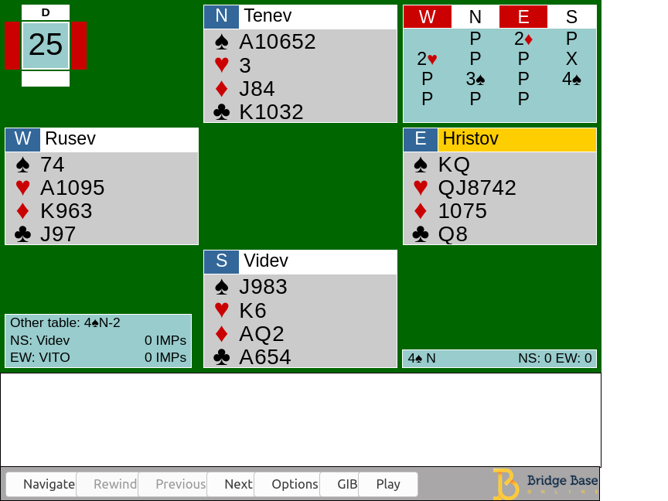
Introduction
Bidding stage Find the most profitable contract for the playing stage
Playing stage 13 rounds of a card-strength competition

Slide 4
Bidding stage
Asserting By making this bid, I assert that my hand has these properties
Denying By making this bid, I deny that my hand has these properties
Asking and Answering Questions If your hand is of type 1, make bid 1; if it is of type 2, make bid 2, etc.
Interrupting The primary purpose of this bid is to stop the opponents communicating

Slide 5
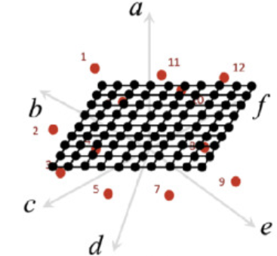
Self-Organizing Maps (SOM)
Initialize each node's weights.
Choose a vector at random from the set of training data and present it to the lattice.
Examine every node and determine which one‘s weights are most like the input vector. The winning node is commonly known as the Best Matching Unit (BMU).
Calculate the radius of the neighborhood of the BMU. This is a value that starts large, typically set to the ‘radius’ of the lattice, but diminishes each time-step. Any nodes found within this radius are deemed to be inside the BMU's neighborhood.
Adjust the weights of each neighboring node to make them more like the input vector. The closer a node is to the BMU, the more its weights get altered.
Repeat step 2 for N iterations.

Slide 6
Self-Organizing Maps (SOM)
Initialize each node's weights.
Choose a vector at random from the set of training data and present it to the lattice.
Examine every node and determine which one‘s weights are most like the input vector. The winning node is commonly known as the Best Matching Unit (BMU).
Calculate the radius of the neighborhood of the BMU. This is a value that starts large, typically set to the ‘radius’ of the lattice, but diminishes each time-step. Any nodes found within this radius are deemed to be inside the BMU's neighborhood.
Adjust the weights of each neighboring node to make them more like the input vector. The closer a node is to the BMU, the more its weights get altered.
Repeat step 2 for N iterations.

Slide 7
Self-Organizing Maps (SOM)
Initialize each node's weights.
Choose a vector at random from the set of training data and present it to the lattice.
Examine every node and determine which one‘s weights are most like the input vector. The winning node is commonly known as the Best Matching Unit (BMU).
Calculate the radius of the neighborhood of the BMU. This is a value that starts large, typically set to the ‘radius’ of the lattice, but diminishes each time-step. Any nodes found within this radius are deemed to be inside the BMU's neighborhood.
Adjust the weights of each neighboring node to make them more like the input vector. The closer a node is to the BMU, the more its weights get altered.
Repeat step 2 for N iterations.

Slide 8
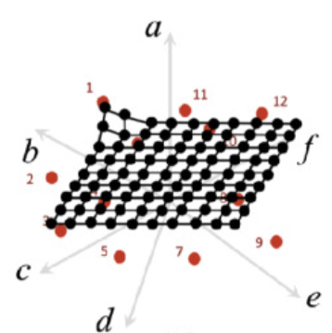
Self-Organizing Maps (SOM)
Initialize each node's weights.
Choose a vector at random from the set of training data and present it to the lattice.
Examine every node and determine which one‘s weights are most like the input vector. The winning node is commonly known as the Best Matching Unit (BMU).
Calculate the radius of the neighborhood of the BMU. This is a value that starts large, typically set to the ‘radius’ of the lattice, but diminishes each time-step. Any nodes found within this radius are deemed to be inside the BMU's neighborhood.
Adjust the weights of each neighboring node to make them more like the input vector. The closer a node is to the BMU, the more its weights get altered.
Repeat step 2 for N iterations.

Slide 9
Self-Organizing Maps (SOM)
Initialize each node's weights.
Choose a vector at random from the set of training data and present it to the lattice.
Examine every node and determine which one‘s weights are most like the input vector. The winning node is commonly known as the Best Matching Unit (BMU).
Calculate the radius of the neighborhood of the BMU. This is a value that starts large, typically set to the ‘radius’ of the lattice, but diminishes each time-step. Any nodes found within this radius are deemed to be inside the BMU's neighborhood.
Adjust the weights of each neighboring node to make them more like the input vector. The closer a node is to the BMU, the more its weights get altered.
Repeat step 2 for N iterations.

Slide 10
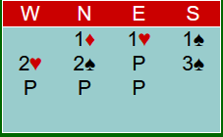
6 SOM
Opening bids
No trump responses
Primary responses
Overcalls
Re-bids by opener
Re-bids by responder

Slide 11
Experimental
Training data: American Contract Bridge League
Feature: The number of cards in each suit, the high card points and the bidding history
Jack: 2001~2004, 2006, 2009, 2010, 2012, 2013, 2015 world computer bridge champion

Slide 12
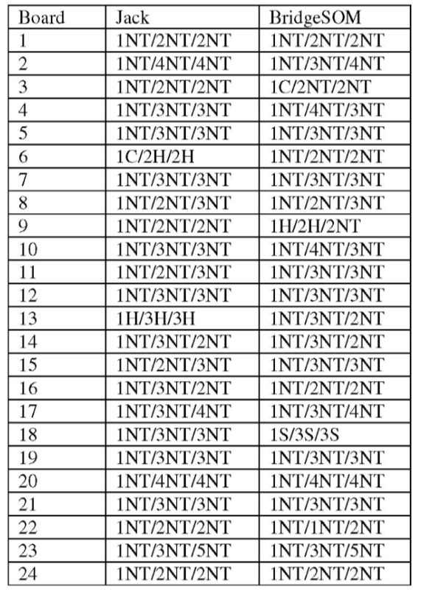
Experimental Result

Slide 13
Experimental Result
Initial bid

Slide 14
Experimental Result
Final contract

Slide 15
Experimental Result
Final result

Slide 16
Experimental Result

Slide 17
Experimental Result

