Slide 1
Detecting Road Intersections from GPS Traces Using Longest Common Subsequence Algorithm
Xingzhe Xie, Wenzhi Liao, Hamid Aghajan, Peter Veelaert and Wilfried Philips
International Journal of Geo-Information Vol.6 No.1 2017
Presenter: En-An Sung
Date: March 24, 2021

Slide 2
Abstract(1/2)
Intersections are important components of road networks, which are critical to both route planning and path optimization. Most existing methods define the intersections as locations where the road users change their moving directions and identify the intersections from GPS traces through analyzing the road users’ turning behaviors. However, these methods suffer from finding an appropriate threshold for the moving direction change, leading to true intersections being undetected or spurious intersections being falsely detected. In this paper, the intersections are defined as locations that connect three or more road segments in different directions.

Slide 3
Abstract(2/2)
We propose to detect the intersections under this definition by finding the common sub-tracks of the GPS traces. We first detect the Longest Common Subsequences (LCSS) between each pair of GPS traces using the dynamic programming approach. Second, we partition the longest nonconsecutive subsequences into consecutive sub-tracks. The starting and ending points of the common sub-tracks are collected as connecting points. At last, intersections are detected from the connecting points through Kernel Density Estimation (KDE). Experimental results show that our proposed method outperforms the turning point-based methods in terms of the F-score.

Slide 4
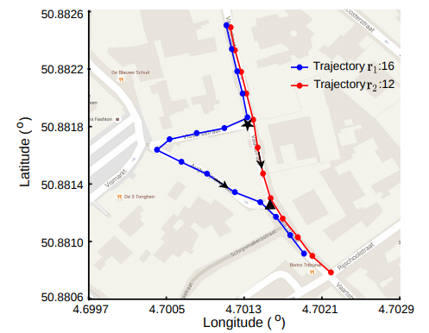
Detecting Road Intersections

Slide 5
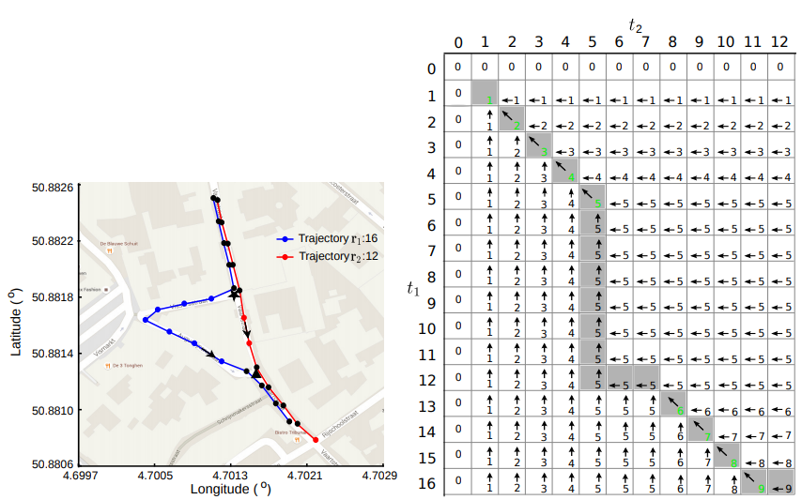
Detecting Road Intersections

Slide 6
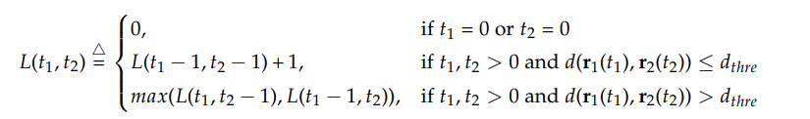
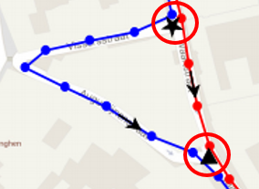
Detecting Road Intersections
≤ Distance threshold
Distance threshold
GPS pattern
Road width
≤ Distance threshold

Slide 7
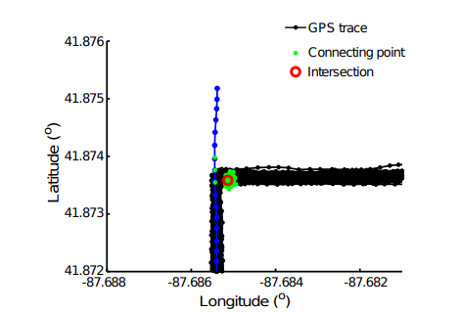
False Positive Intersection
removed, sould be confirmed by more traces
A false positive intersection. One intersection candidate in the red circle is detected from the connecting points in green dots. It is a false positive because all of the connecting points are produced from 152 traces interconnecting with one single trace.

Slide 8
Another method
Moving speed
Moving directions
Conflict point, two or more (GPS) trace across
困難點：Threshold的設定

Slide 9
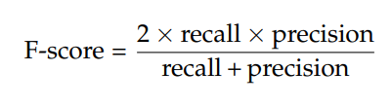
Accuracy measure
recall = I_{c}/(I_{m} + I_{c}), m : missing(false negative), c : correct(true positive)
precision = I_{c}/(I_{s} + I_{c}), s : spurious(false positive)

Slide 10
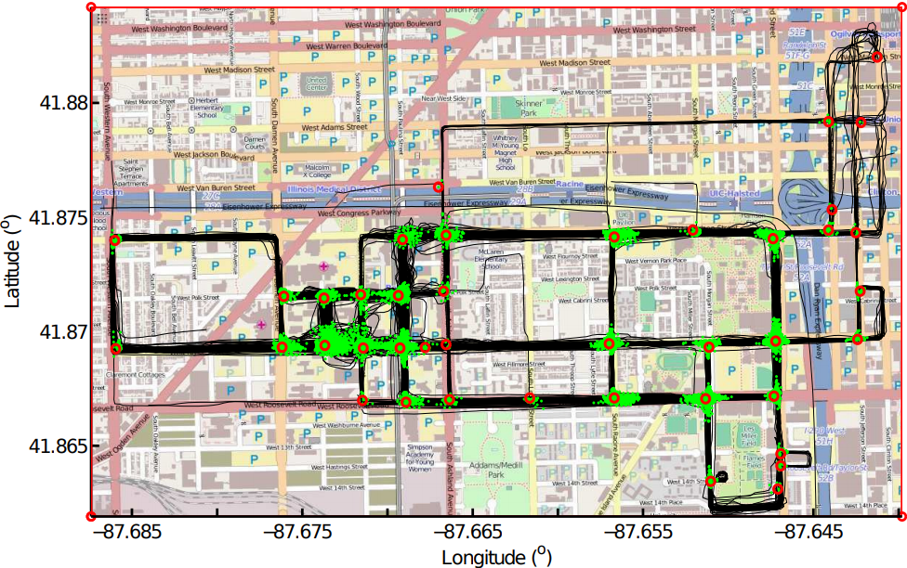
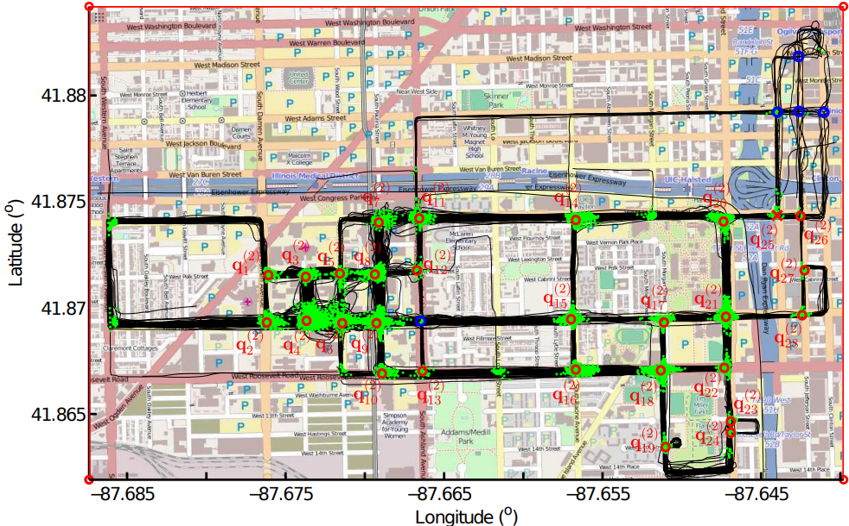
Experiment

Slide 11
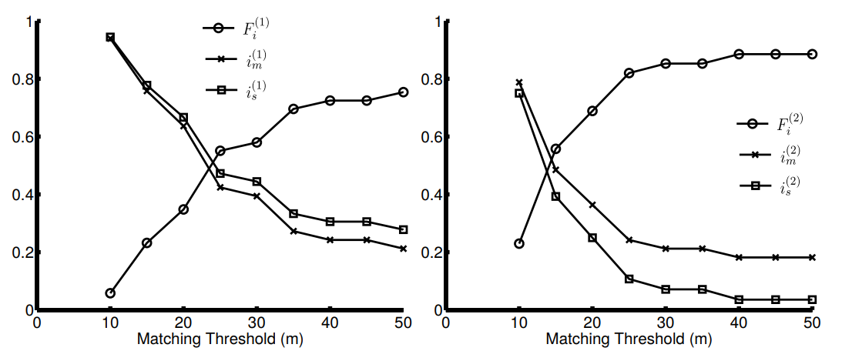
Experiment
Turning points
direction detection
speed detection
This method of this paper

Slide 12
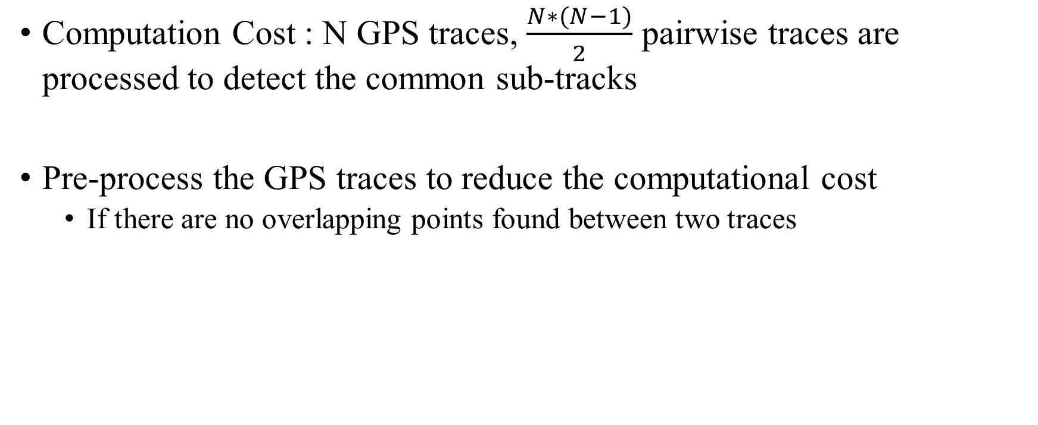
Conclusion
Computation Cost : N GPS traces, $\frac{N∗(N−1)}{2}$ pairwise traces are processed to detect the common sub-tracks
Pre-process the GPS traces to reduce the computational cost
If there are no overlapping points found between two traces

